Slide 1
BCHM463 GSS Regulation and Hormones
David Zhao | Dr. Tseng | 11/02/2022 (Wednesday)

Slide 2

Please sign in!
https://umdsurvey.umd.edu/jfe/form/SV_8pESxFL6Ce4uYho

Slide 3
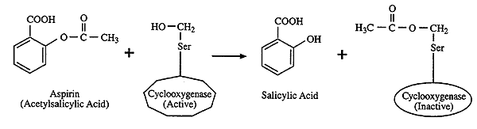
Warm Up Question (Part I)
COX-2 is an inducible enzyme which catalyzes the conversion of arachidonic acid to prostaglandin H2, an important precursor molecule involved in the inflammatory response.
Acetylsalicylic acid, also known as aspirin, acts to inhibit COX-2 activity by covalently attaching itself to a Serine-530 in the active site of the enzyme^{[1]}. This attachment of aspirin to COX-2 is irreversible.
Though this is not a natural type of enzyme regulation (aspirin is a drug), what type of enzyme regulation is this? Be specific.
^{[1]} Cebrián-Prats, A.; González-Lafont, À.; Lluch, J. M. Understanding the Molecular Details of the Mechanism That Governs the Oxidation of Arachidonic Acid Catalyzed by Aspirin-Acetylated Cyclooxygenase-2. ACS Catalysis 2019, 10 (1), 138–153. https://doi.org/10.1021/acscatal.9b04223.
‌

Slide 4
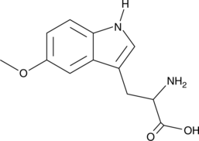
Warm Up Question (Part II)
COX-2 is an inducible enzyme which catalyzes the conversion of arachidonic acid to prostaglandin H2, an important precursor molecule involved in the inflammatory response.
Recently researchers have identified a novel metabolite, 5-methoxytryptophan (5-MTP, shown below) hypothesized to control COX-2 activity via an unknown ligand-receptor interaction on inflammatory cells such as macrophages and monocytes.
The binding of 5-MTP to the receptor results in a downstream signaling cascade which reduces COX-2 enzyme expression^{[2][3]}.
What type of enzyme regulation is this? Be specific.
[2] Cheng, H.-H.; Kuo, C.-C.; Yan, J.-L.; Chen, H.-L.; Lin, W.-C.; Wang, K.-H.; Tsai, K. K.-C. .; Guvén, H.; Flaberg, E.; Szekely, L.; Klein, G.; Wu, K. K. Control of Cyclooxygenase-2 Expression and Tumorigenesis by Endogenous 5-Methoxytryptophan. Proceedings of the National Academy of Sciences 2012, 109 (33), 13231–13236. https://doi.org/10.1073/pnas.1209919109.
‌
[3] Wang, Y.-F.; Hsu, Y.-J.; Wu, H.-F.; Lee, G.-L.; Yang, Y.-S.; Wu, J.-Y.; Yet, S.-F.; Wu, K. K.; Kuo, C.-C. Endothelium-Derived 5-Methoxytryptophan Is a Circulating Anti-Inflammatory Molecule That Blocks Systemic Inflammation. Circulation Research 2016, 119 (2), 222–236. https://doi.org/10.1161/circresaha.116.308559.
‌

Slide 5
Today’s Agenda
01
02
Regulation
Hormones
You can describe the topic of the section here
You can describe the topic of the section here

Slide 6
01
Regulation

Slide 7
Overview of Regulatory Mechanisms Discussed in Class
Enzyme Regulation
Substrate Availability
Product Availability
Control of Gene Expression
Enzyme Availability
Enzyme Catalytic Activity
Non-Covalent modifications
Covalent modifications
Inducible Enzymes –
Increase in [metabolite] → increase of enzyme production.
Activation – (e.g., Zymogens)
Constitutive Enzymes –
Synthesized at a constant level without regard to physiological demand
Reversible
Irreversible
Activators
Inhibition
Control of Proteolysis
Phosphorylation by Kinases and Phosphatases
Inhibitors
Allosteric Control
Repressible Enzymes – Increase in [metabolite] → decrease of enzyme production.
Enzyme degradation
Inhibition
Activation
Hormonal Control

Slide 8
Overview of Regulatory Mechanisms Discussed in Class
Enzyme Regulation
Substrate Availability
Product Availability
Control of Gene Expression
Enzyme Availability
Enzyme Catalytic Activity
Non-Covalent modifications
Covalent modifications
Inducible Enzymes –
Increase in [metabolite] → increase of enzyme production.
Activation – (e.g., Zymogens)
Constitutive Enzymes –
Synthesized at a constant level without regard to physiological demand
Reversible
Irreversible
Activators
Inhibition
Control of Proteolysis
Phosphorylation by Kinases and Phosphatases
Inhibitors
Allosteric Control
Repressible Enzymes – Increase in [metabolite] → decrease of enzyme production.
Enzyme degradation
Inhibition
Activation
Hormonal Control

Slide 9
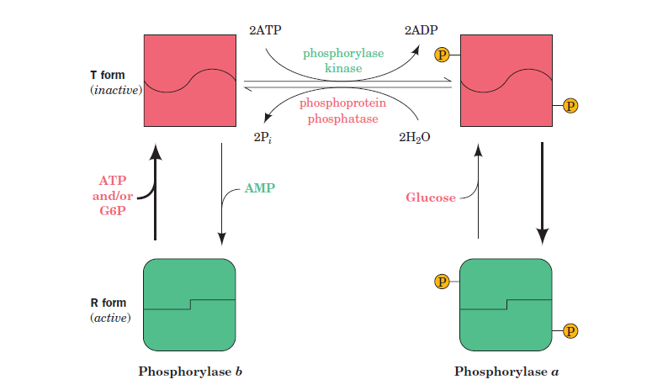
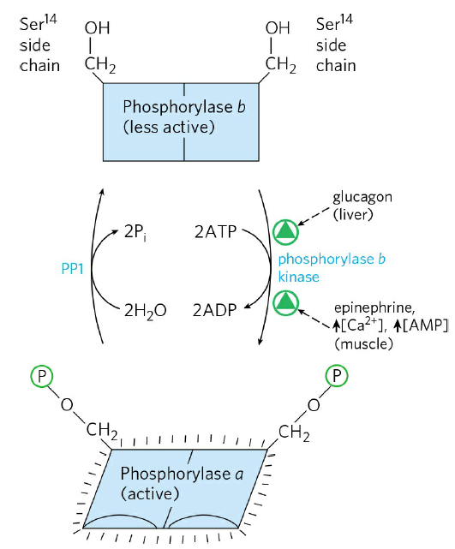
Glycogen Phosphorylase
Isozymes exist in both Liver and Skeletal Muscle tissue
Phosphorylase-α is the more active form, whereas phosphorylase-β is less active.
May be regulated allosterically or hormonally.

Slide 10
Glycogen Phosphorylase
Allosteric Regulatory Factors
Activating | Deactivating
AMP | ATP
 | Glucose
 | G6P
Which form of the Enzyme (R or T states) does the allosteric effector preferentially bind to?
Do you notice a pattern?

Slide 11
02
Hormones

Slide 12
Glycogen Phosphorylase
Hormonal Regulatory Factors
Activating | Deactivating
Glucagon (Liver) | Insulin (Liver and Muscle)
Epinephrine (Muscle)
A rabbit is being chased by a fox in the woods. During this time, would glycogen phosphorylase in the rabbit’s hind leg muscles be more present in the α-state or the β-state? Why?
Suppose you ate a big meal and remained sedentary for an extended period after. During this time, would glycogen phosphorylase in the liver be present more in the α-state or the β-state? Why?

Slide 13
Hormone Signaling: GPCRs
= Activates
Receptor Tyrosine Kinases (RTKs)
= Inhibits
Hormone Signaling
Stimulatory - G_{sα}
Adenylate Cyclase
G-Protein Coupled Receptors (GPCRs)
Inhibitory - G_{iα}
ATP
cAMP
Protein
Stimulatory - G_{qα}
PP_{i}
H₂O
Protein Kinase C (PKC)
Protein Kinase A (PKA)
Phospholipases
Protein-P_{i}
Cellular Response
cAMP Phosphodiesterase
Protein
Protein-P_{i}
PIP2
DAG
Calmodulin binding protein kinase
AMP
IP3
Cellular Response
Cytosolic Ca⁺²
IP3 – Gated Calcium Transport Channel
Calmodulin
Ca⁺² in ER Lumen

Slide 14
Hormone Signaling: GPCRs
Cholera Toxin
= Activates
Receptor Tyrosine Kinases (RTKs)
= Inhibits
Hormone Signaling
Stimulatory - G_{sα}
Adenylate Cyclase
G-Protein Coupled Receptors (GPCRs)
Inhibitory - G_{iα}
ATP
cAMP
Protein
Pertussis Toxin
Stimulatory - G_{qα}
PP_{i}
H₂O
Protein Kinase C (PKC)
Protein Kinase A (PKA)
Phospholipases
Protein-P_{i}
Cellular Response
cAMP Phosphodiesterase
Protein
Protein-P_{i}
PIP2
DAG
Calmodulin binding protein kinase
AMP
IP3
Cellular Response
Cytosolic Ca⁺²
IP3 – Gated Calcium Transport Channel
Calmodulin
Ca⁺² in ER Lumen

Slide 15
Hormone Signaling: GPCRs
= Activates
Receptor Tyrosine Kinases (RTKs)
= Inhibits
Hormone Signaling
Stimulatory - G_{sα}
Adenylate Cyclase
G-Protein Coupled Receptors (GPCRs)
Caffeine
(Specifically, G_{iα} receptors
Inhibitory - G_{iα}
ATP
cAMP
Protein
Stimulatory - G_{qα}
PP_{i}
H₂O
Protein Kinase C (PKC)
Protein Kinase A (PKA)
Phospholipases
Protein-P_{i}
Cellular Response
cAMP Phosphodiesterase
Protein
Protein-P_{i}
PIP2
DAG
Calmodulin binding protein kinase
AMP
IP3
Caffeine
and Theobromine
Cellular Response
Cytosolic Ca⁺²
IP3 – Gated Calcium Transport Channel
Calmodulin
Ca⁺² in ER Lumen

Slide 16
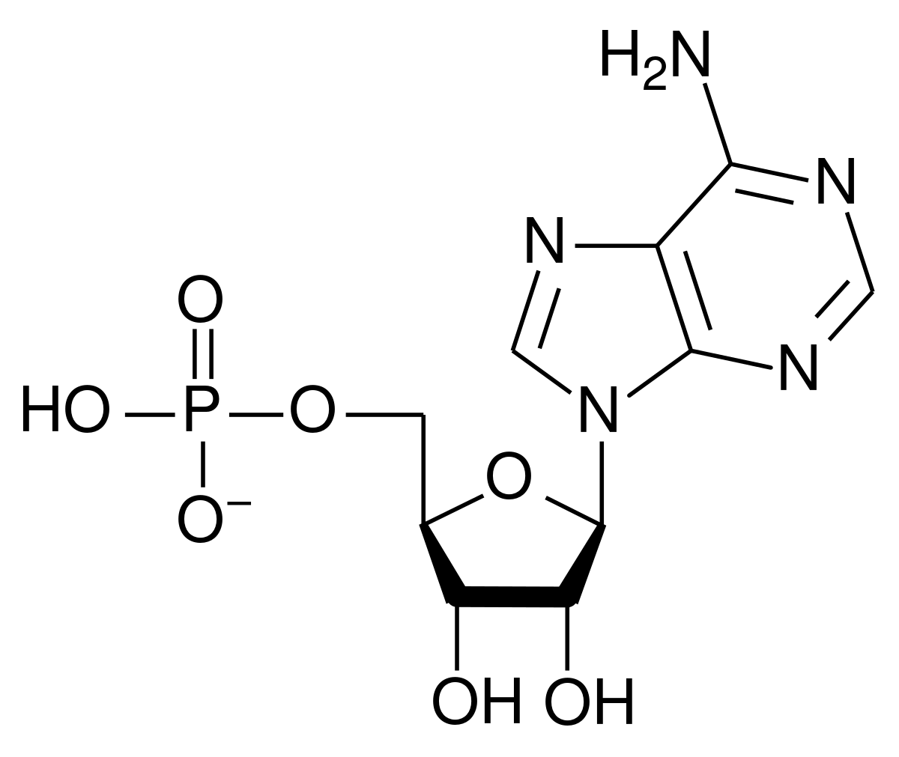
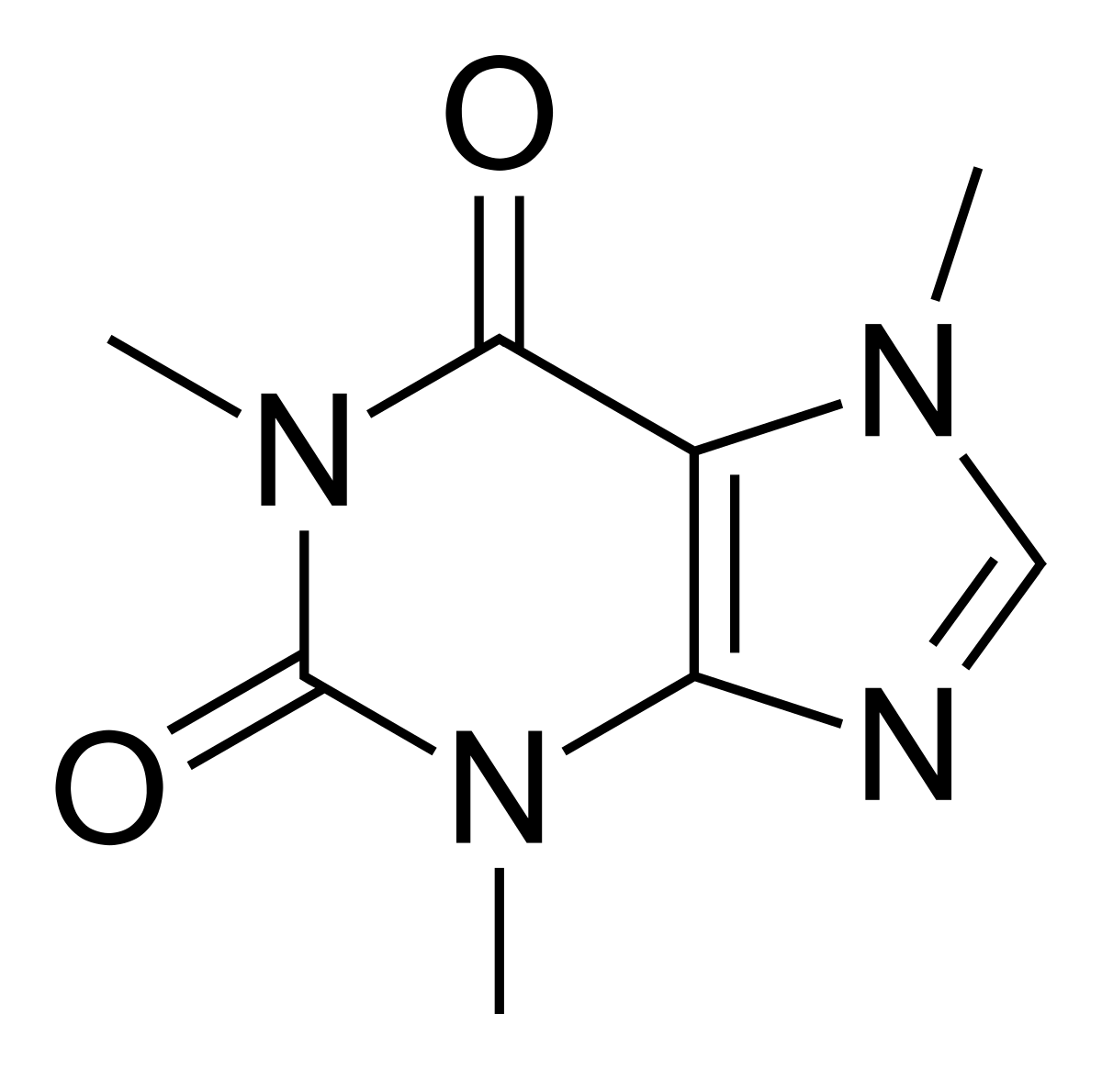
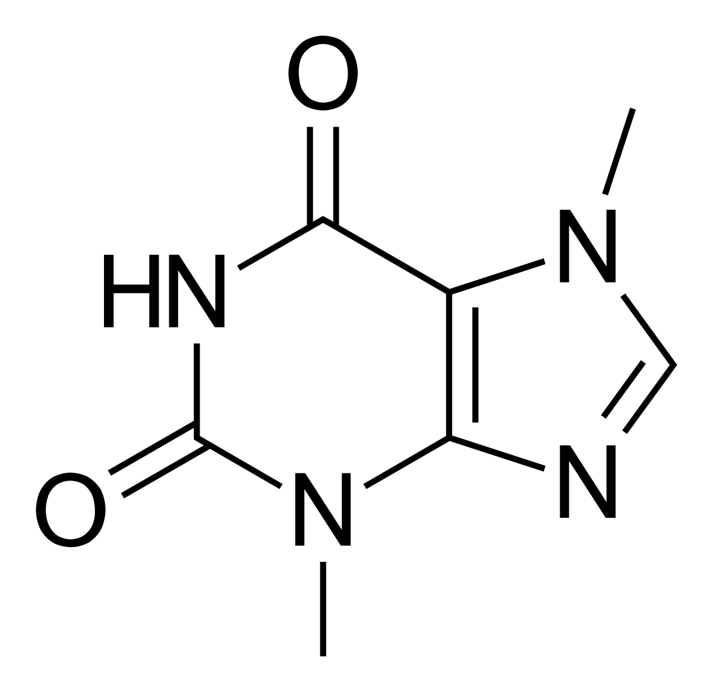
Theobromine, Caffeine, and AMP
Caffeine
Theobromine
Adenosine Monophosphate (AMP)

Slide 17
Theobromine, Caffeine, and AMP
Caffeine
Theobromine
Adenosine Monophosphate (AMP)

Slide 18
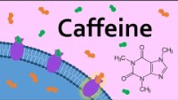
Theobromine, Caffeine, and AMP
https://www.youtube.com/watch?v=jOfquPE1cnU
Interesting video explaining this effect (watch on your own time)

Slide 19
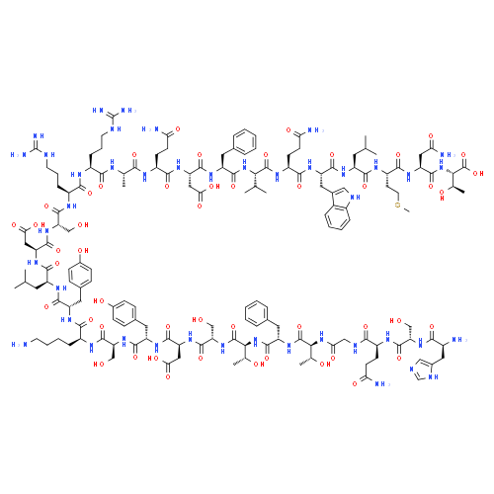
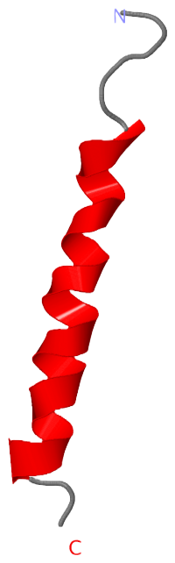
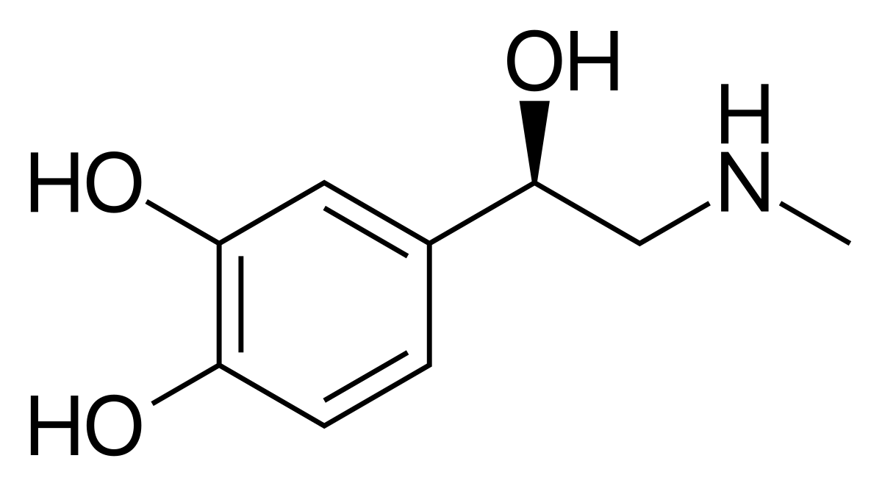
Epinephrine and Glucagon
Epinephrine acts through GPCRs
Beta-adrenergic receptors
Beta-blockers
Glucagon acts through GPCRs
Glucagon receptors

Slide 20
Hormone Signaling: GPCRs
= Activates
Receptor Tyrosine Kinases (RTKs)
= Inhibits
Hormone Signaling
Stimulatory - G_{sα}
Adenylate Cyclase
G-Protein Coupled Receptors (GPCRs)
Inhibitory - G_{iα}
ATP
cAMP
Protein
Stimulatory - G_{qα}
PP_{i}
H₂O
Protein Kinase C (PKC)
Protein Kinase A (PKA)
Phospholipases
Protein-P_{i}
Cellular Response
cAMP Phosphodiesterase
Protein
Protein-P_{i}
PIP2
DAG
Calmodulin binding protein kinase
AMP
IP3
Cellular Response
Cytosolic Ca⁺²
IP3 – Gated Calcium Transport Channel
Calmodulin
Ca⁺² in ER Lumen

Slide 21
Hormone Signaling: GPCRs
= Activates
Receptor Tyrosine Kinases (RTKs)
= Inhibits
Hormone Signaling
Stimulatory - G_{sα}
Adenylate Cyclase
G-Protein Coupled Receptors (GPCRs)
Inhibitory - G_{iα}
ATP
cAMP
Protein
Stimulatory - G_{qα}
PP_{i}
H₂O
Protein Kinase C (PKC)
Protein Kinase A (PKA)
Phospholipases
Protein-P_{i}
Cellular Response
cAMP Phosphodiesterase
Protein
Protein-P_{i}
PIP2
DAG
Calmodulin binding protein kinase
AMP
IP3
Cellular Response
Cytosolic Ca⁺²
IP3 – Gated Calcium Transport Channel
Calmodulin
Ca⁺² in ER Lumen

Slide 22
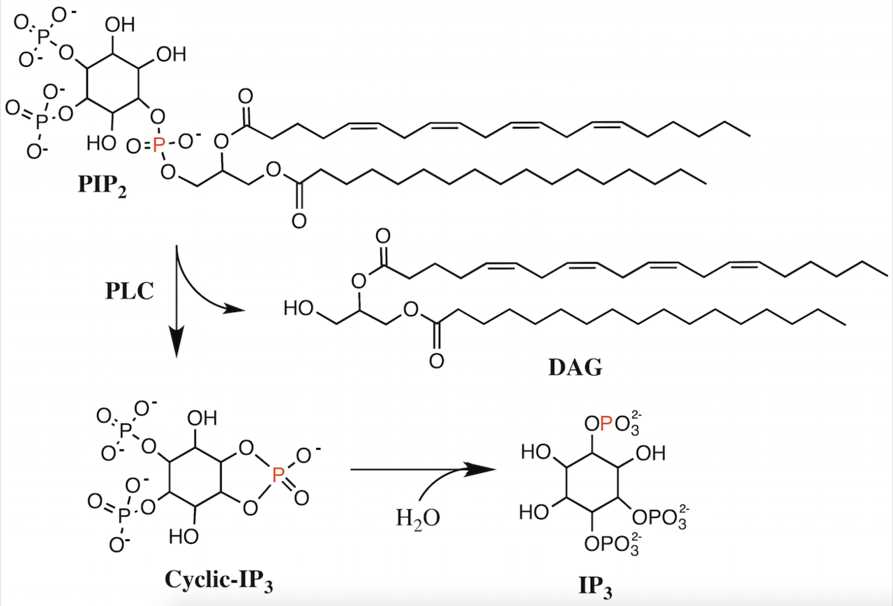
The G_{qa} Pathway
Reaction catalyzed by PLC

Slide 23
The G_{qa} Pathway
What kind of molecule is this?
Describe its physical properties.
Reaction catalyzed by PLC

Slide 24
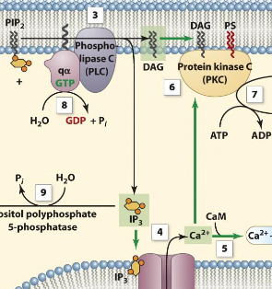
The G_{qa} Pathway

