Slide 1

BCHM 463 GSS – Exam III Review
David Zhao | Dr. Tseng | 11/12/2022

Slide 2

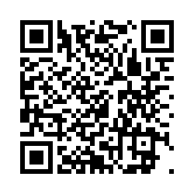
Please sign in!
https://umdsurvey.umd.edu/jfe/form/SV_8pESxFL6Ce4uYho

Slide 3

Agenda
Practice Exam Review
Metabolism and Regulation
Glycolysis
Gluconeogenesis
01
02
03
04

Slide 4

01
Practice Exam Review

Slide 5
Questions?

Slide 6
02
Metabolism and Regulation

Slide 7
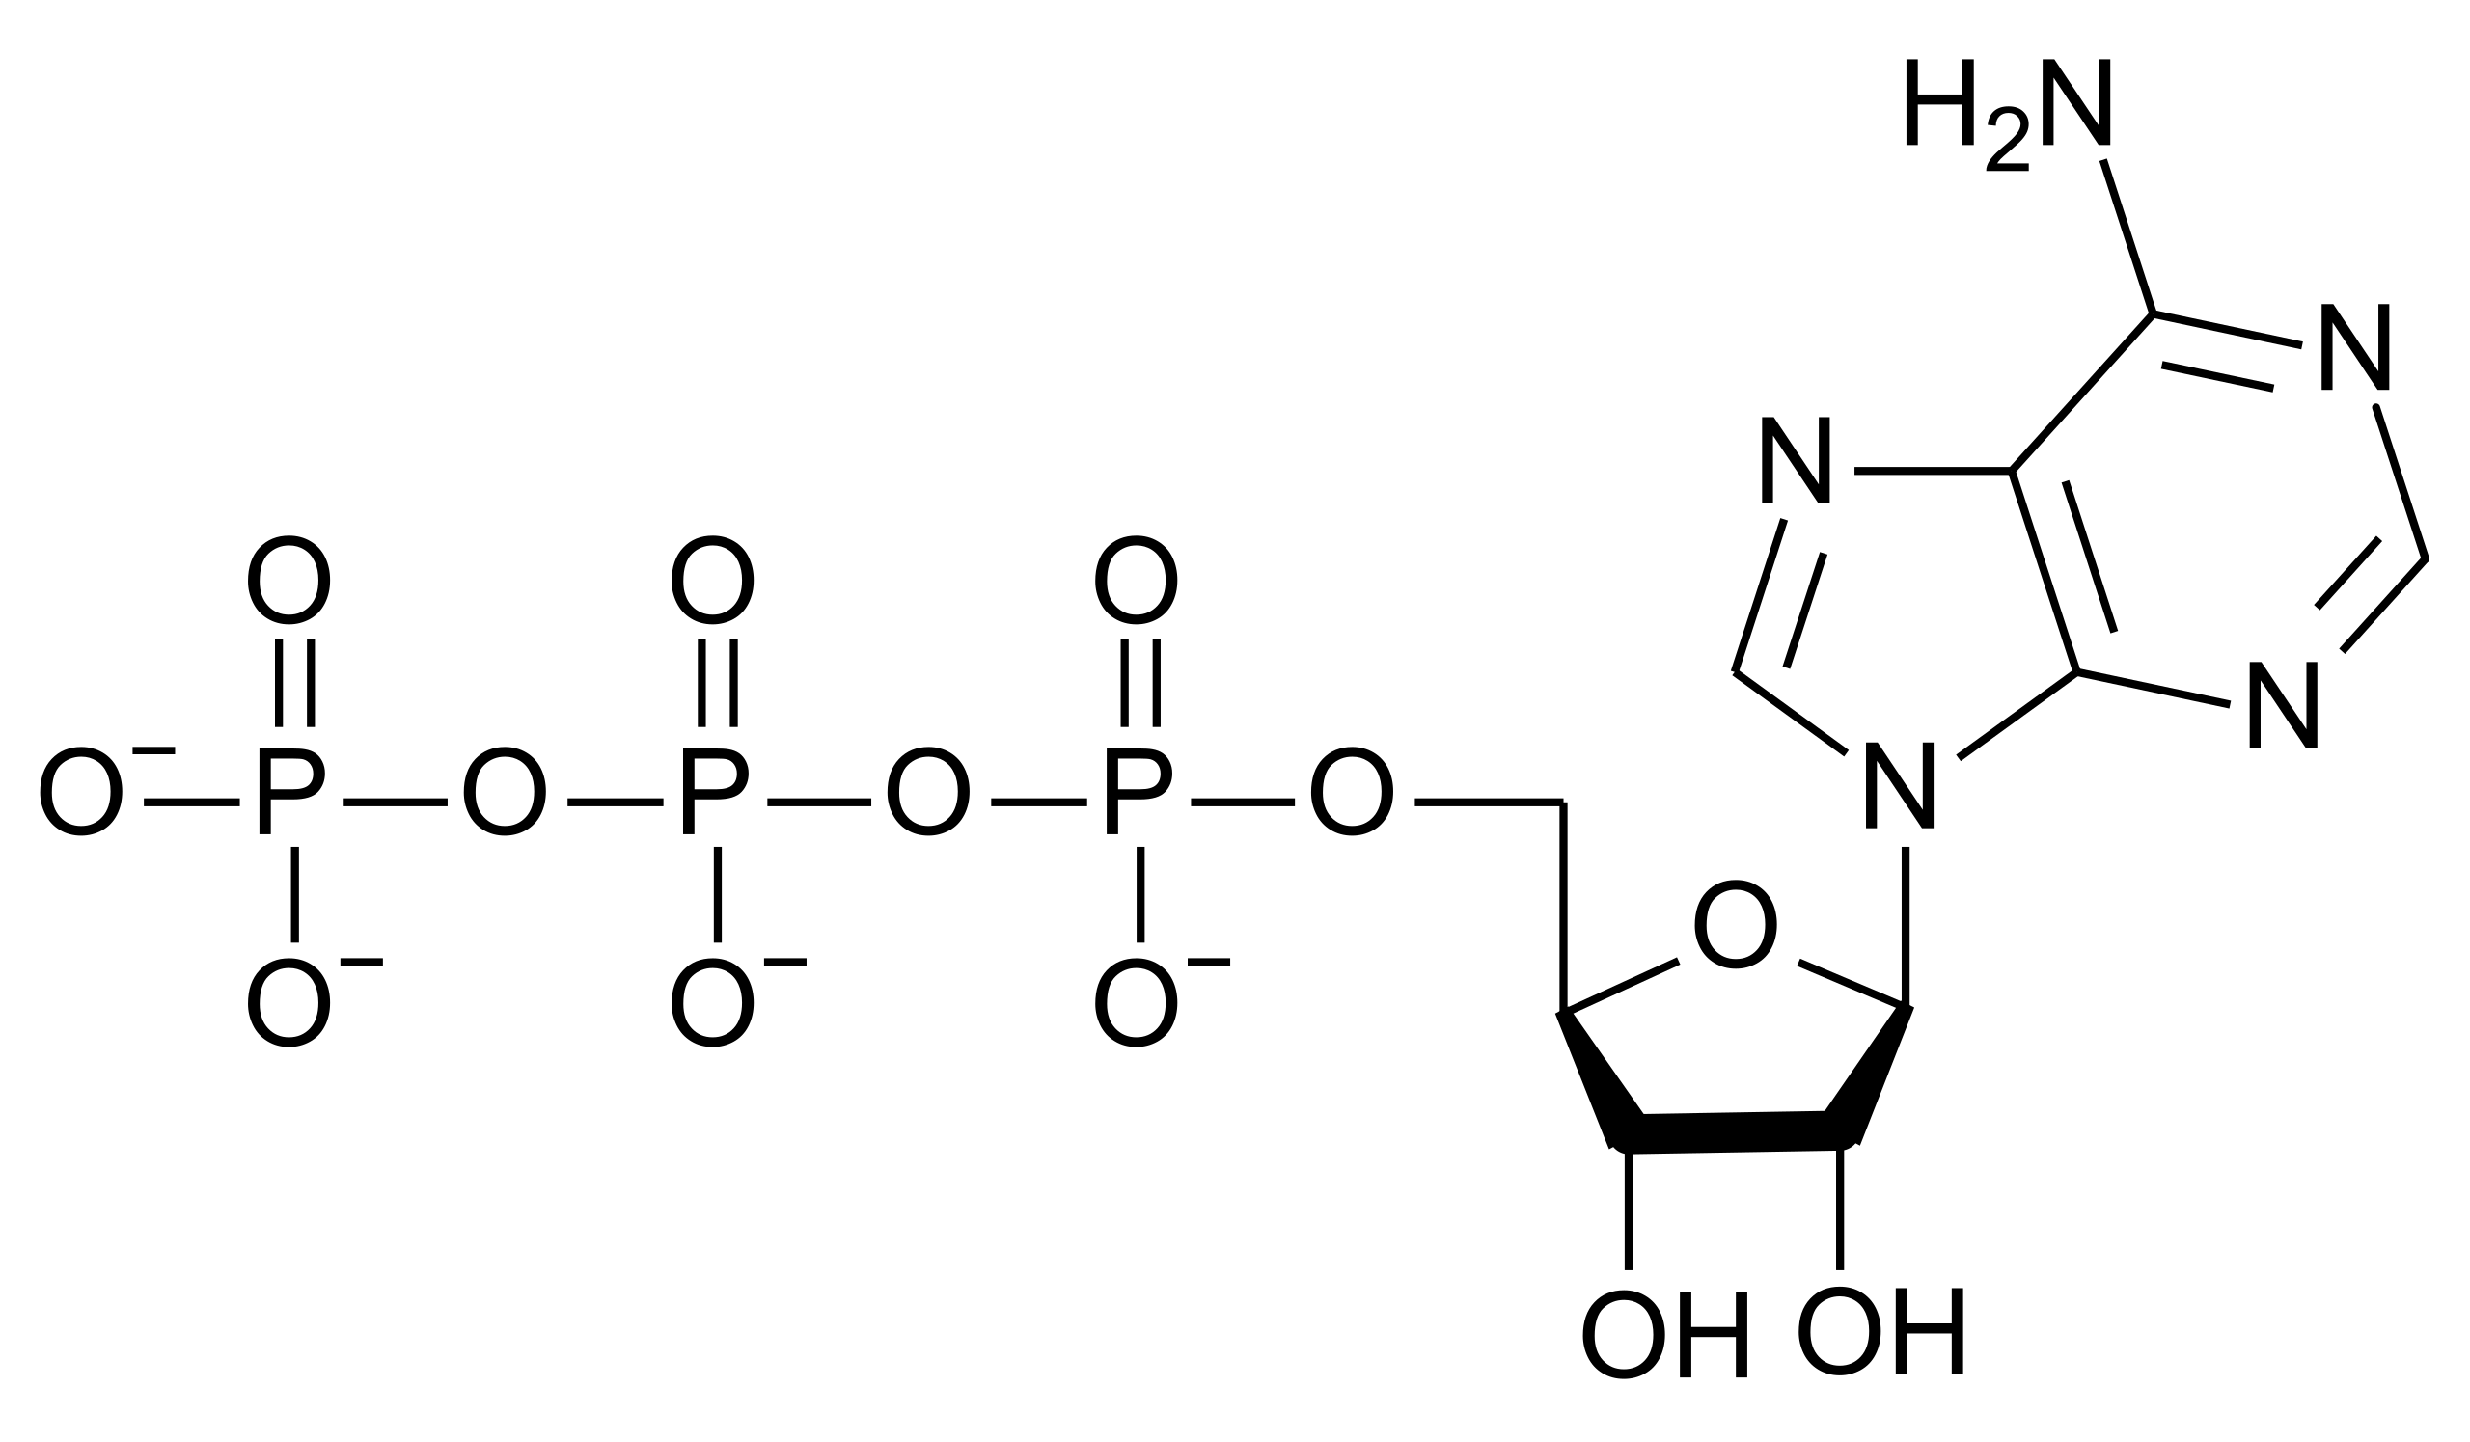
ATP – A “High Energy” Molecule
ATP is widely used in metabolism to catalyze reactions which are otherwise unfavorable under standard state conditions. Describe three reasons why ATP is considered a “high energy” molecule.

Slide 8
“High Energy” Bonds
How many high energy bonds did we discuss in class? Name them and draw an example for each.

Slide 9
Regulatory Mechanisms
We discussed two main methods by which enzymes may be regulated. Given the subclasses of those regulatory methods, what describes the methods of regulation given before?
Note: Check online session for 11/02/2022 for a more detailed diagram!
?
?
Control of Gene Expression
Control of Proteolysis
Covalent Modification
Non-covalent Modification

Slide 10
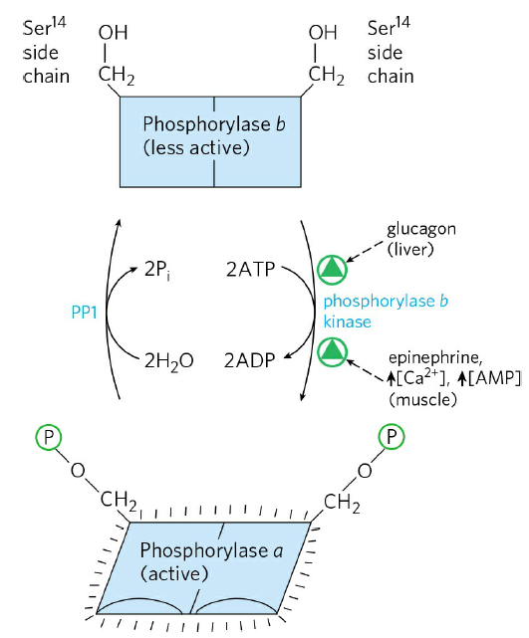
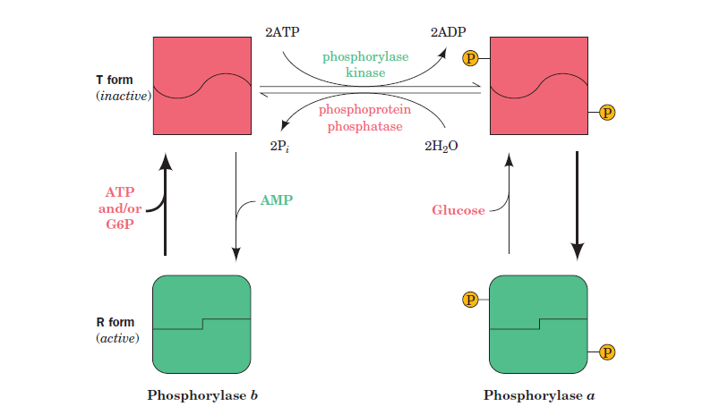
Glycogen Phosphorylase
Is glycogen phosphorylase regulated allosterically or hormonally?

Slide 11
03
Glycolysis

Slide 12
Glycolysis
Four steps in glycolysis involve either the formation or use of ATP.
Name each enzyme which catalyzes these steps.
Draw the intermediates involved, making sure to specify how many of each species is reacting given one mole of glucose.

Slide 13
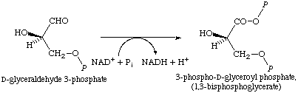
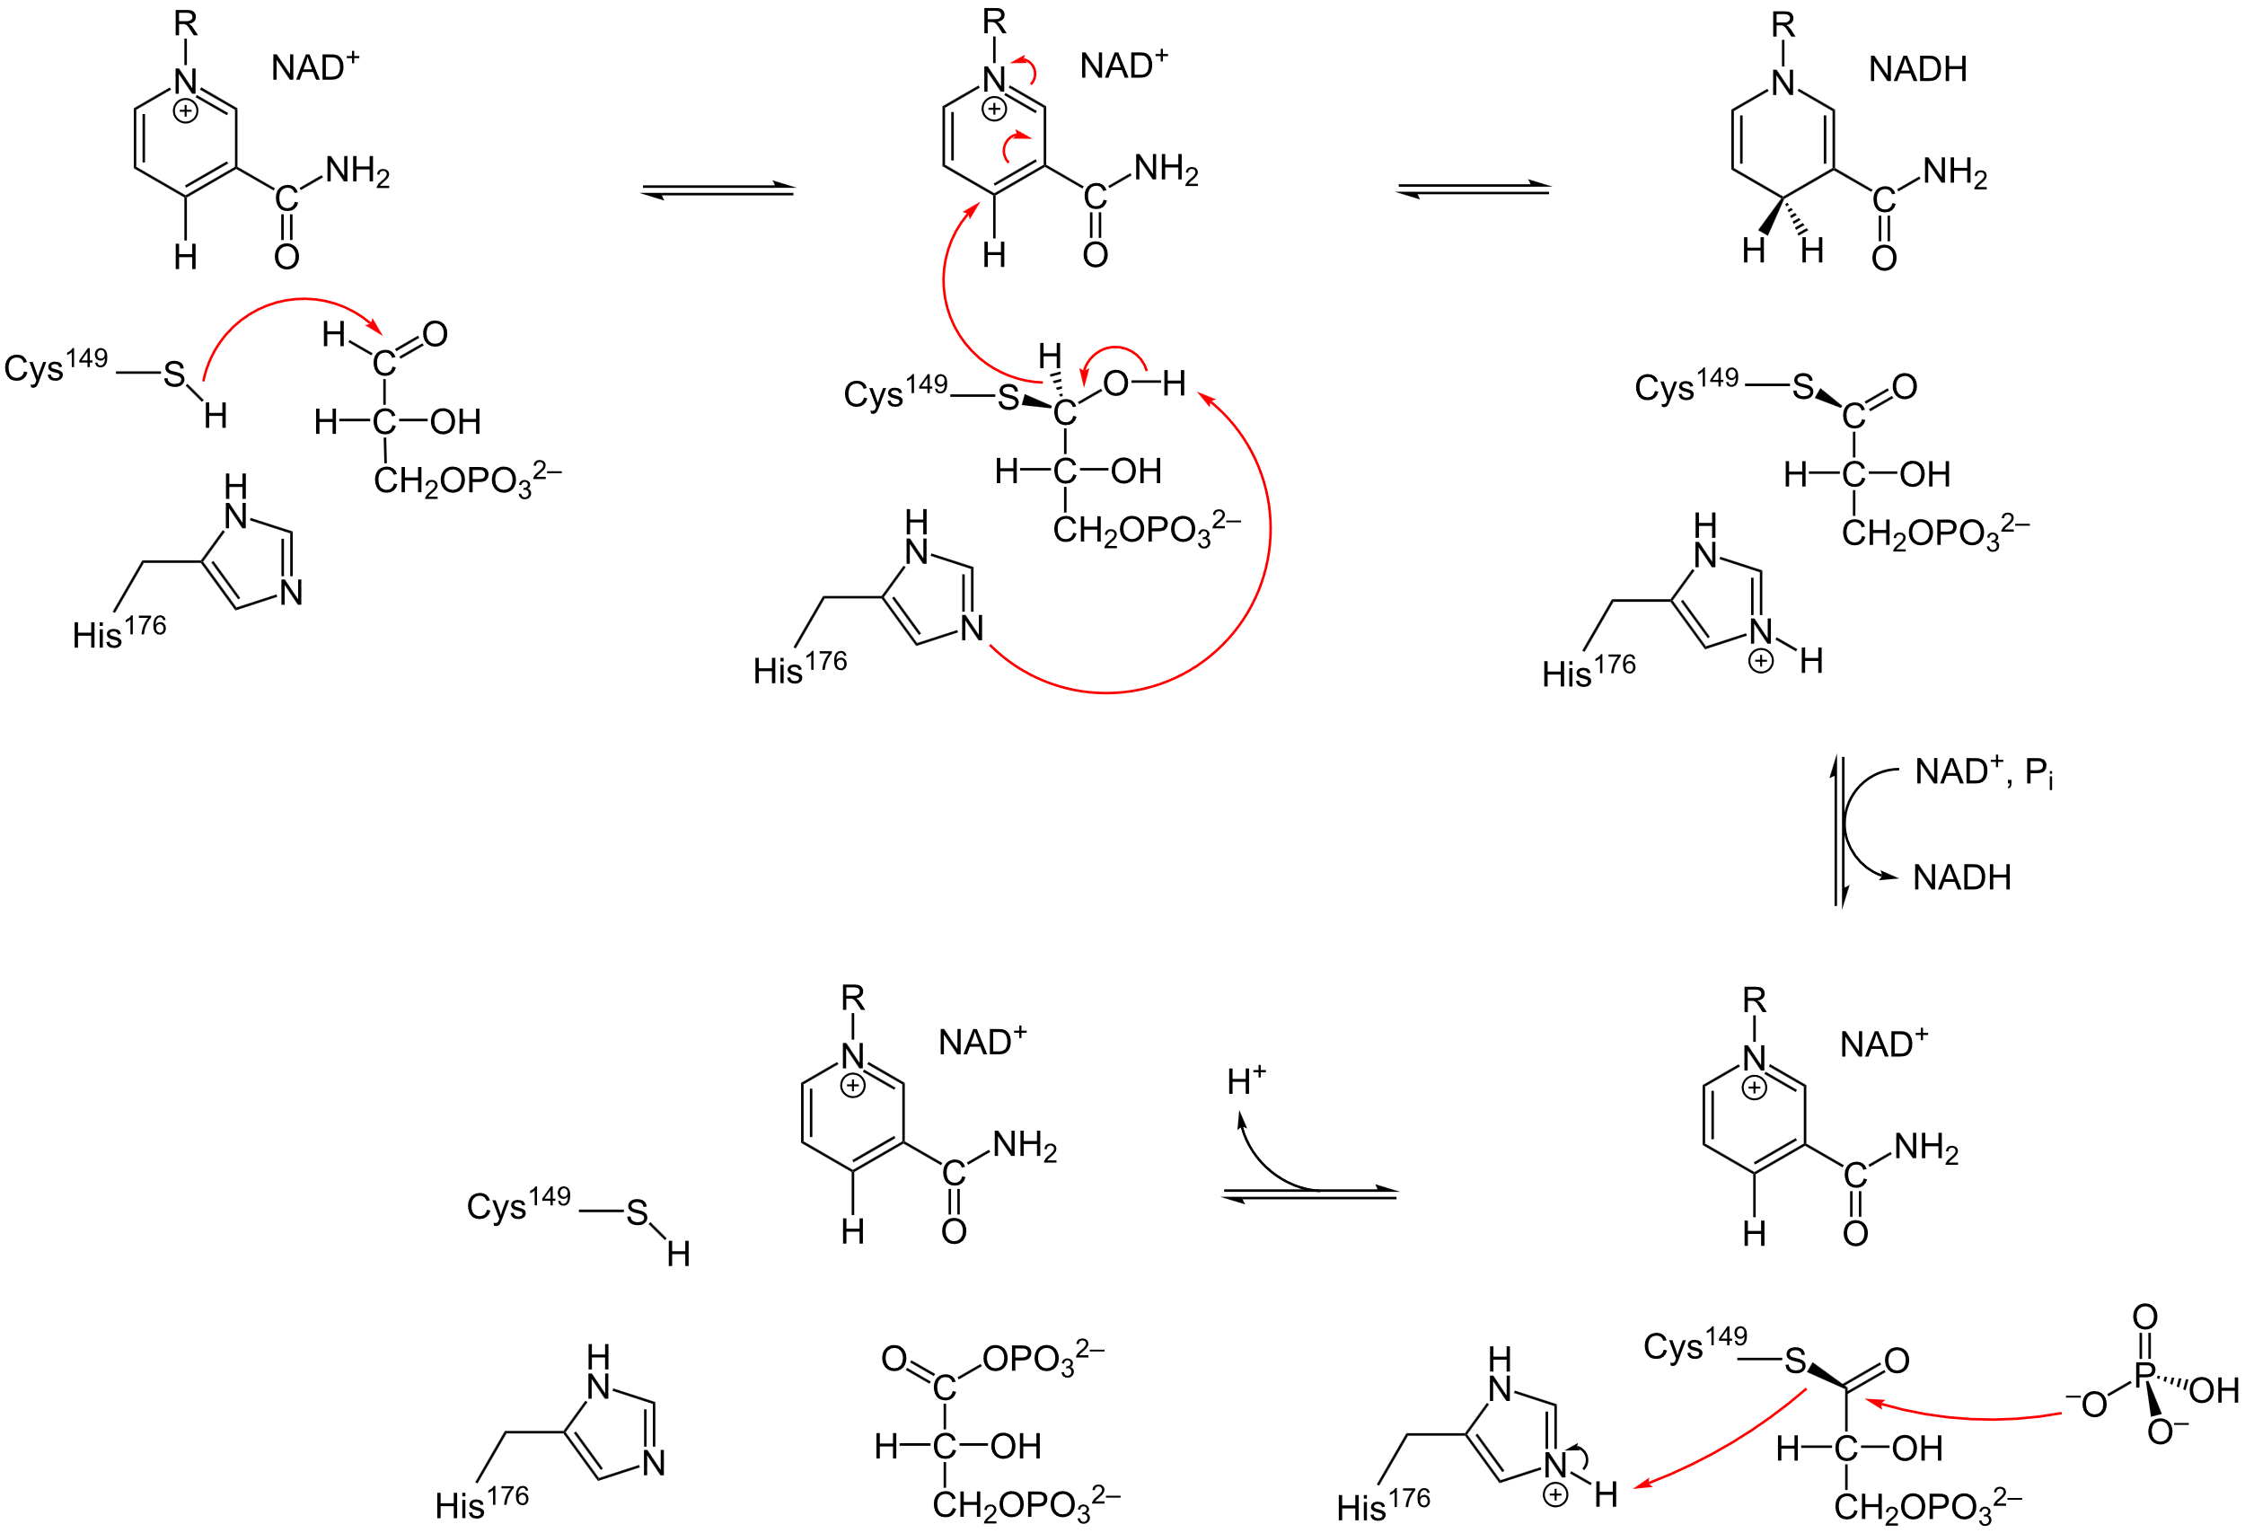
Glycolysis
Normally the addition of a phosphate to a molecule is highly thermodynamically favorable. So why is it that we can do it with GAPDH? The mechanism for GAPDH is given on the right for reference.

Slide 14
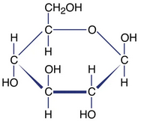

Glycolysis
Suppose carbon 1 and carbon 6 of glucose is isotopically labeled with a 13C tracer. Which carbon atom(s) of the resultant pyruvate molecule would be labeled?
*
A.) Carbon 1
B.) Carbon 2
C.) Carbon 3
*

Slide 15
04
Gluconeogenesis

Slide 16
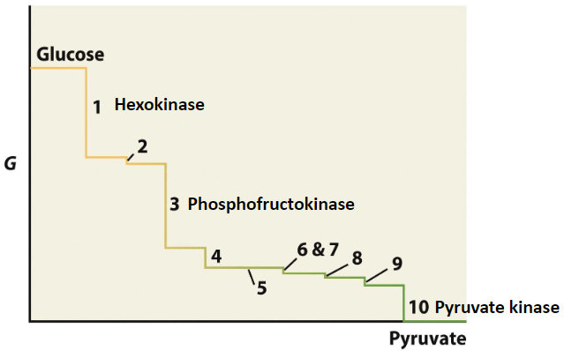
Bypass Reactions of Gluconeogenesis
There are four enzymes which help to catalyze reverse reactions of highly thermodynamically favorable steps in glycolysis. Name these four enzymes and describe some features of each.

Slide 17
Bypass Reactions of Gluconeogenesis
Glucose-6-phosphatase
Pyruvate Carboxylase / PEP Carboxykinase
FBPase
Expressed exclusively in the liver.
Allow for G6P dephosphorylation, which facilitates transport into bloodstream.
When [Glucose] is low, FBPase is highly active.
For pyruvate carboxylase:
Biotin dependent mechanism
For PEP Carboxykinase
GDP – dependent
Produces CO2

Slide 18
Bypass Reactions of Gluconeogenesis
How does exclusive G6Pase expression help with the physiological functions of the liver?

Slide 19
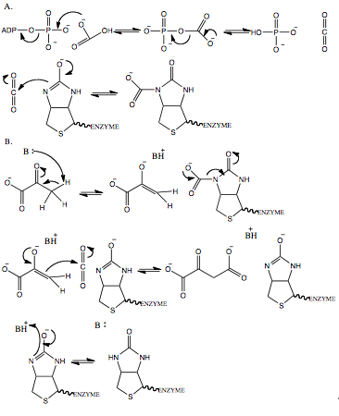
Pyruvate Carboxylase Mechanism
Converts phosphoenolpyruvate to oxaloacetate, with the help of biotin:
Do we see any high energy intermediates in this reaction mechanism?

Slide 20
Sources for Pyruvate and Oxaloacetate
Name three other sources for pyruvate when there is low [Glucose]. Hint: think cycles!

Slide 21
Good luck!

