Slide 1


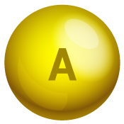
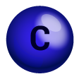
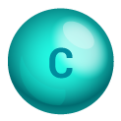






BCHM 463 GSS Ligand Binding and Hemoglobin
David Zhao

Slide 2







Attendance! https://umdsurvey.umd.edu/jfe/form/SV_8pESxFL6Ce4uYho

Slide 3
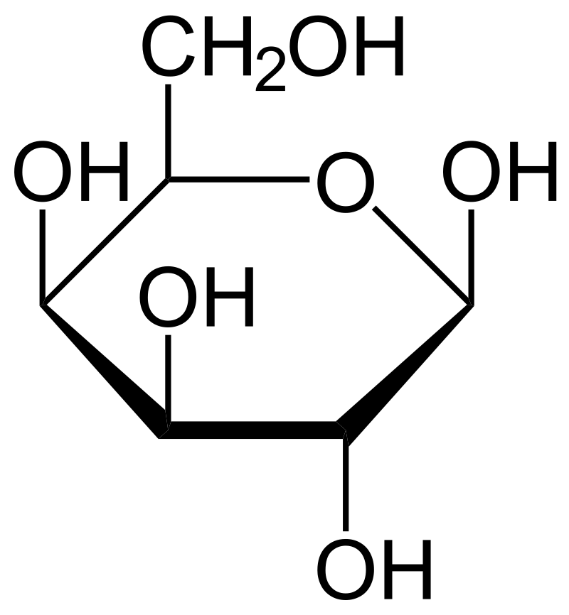
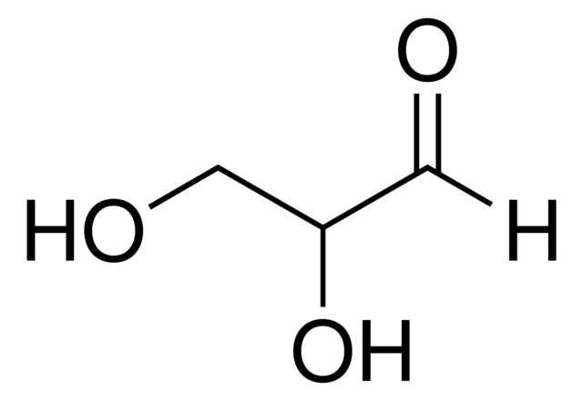
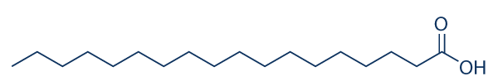


Opening Question
Identify these compounds.

Slide 4
AGENDA
Ligand Binding
01
Application to Hemoglobin
02

Slide 5
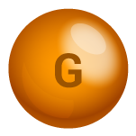
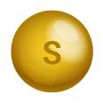

01
Ligand Binding

Slide 6

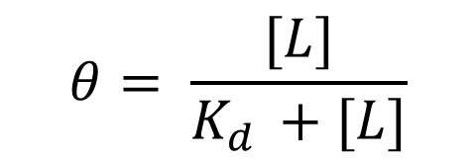
Ligand Binding – Fractional Saturation Calculation
Suppose a ligand receptor pair follows the scheme:
L + P ⇌ LP K_{d} = 20 μM
At what concentration of ligand would the proteins be 30% saturated with ATP?
$$θ= \frac{[PL]}{[PL]+[P]}$$
$$θ= \frac{[L]}{K_{d }+[L]}$$

Slide 7
Ligand Binding – Binding Affinity
Of the three proteins below, which binds most tightly to its ligand?
1
Fractional Saturation
0.5
0
10
20
30
40
50
60
70
80
Concentration of Ligand (mM)

Slide 8
Ligand Binding – Connection with Mutagenesis
Below is the ligand binding curve for a novel protein you isolate in a lab:
In the active site of the protein, three residues, namely, S147, T213, and N203 interact strongly with the ligand to cause a conformational change in the protein.
1.) Is the ligand most likely a polar or a nonpolar substance?
2.) How would the mutation T213S impact the function of the protein, if at all? How would the binding curve change, if at all?
3.) How would the mutation N203A impact the function of the protein, if at all? How would the binding curve change, if at all?
1
Fractional Saturation
0.5
0
10
20
30
40
50
60
70
80
[L] (mM)

Slide 9
02
Application to Hemoglobin

Slide 10
Myoglobin and Hemoglobin
Observe the affinity of myoglobin (blue) and hemoglobin (red) at a pO₂ of 12 kPa (the pO₂ typically found in lung alveoli) then at a concentration of 4 kPa (the pO₂ typically found in capillaries).
Why might this difference in affinity be important for a biological system?
1
Fractional Saturation
0.5
0
2
4
6
8
10
12
pO₂ (kPa)

Slide 11
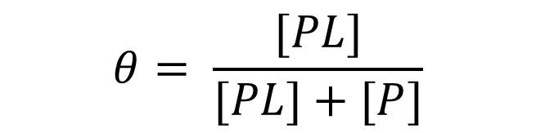
Hemoglobin – Sickle Cell Anemia
Sickle cell anemia is caused by a single nucleotide polymorphism (SNP) genetic defect. At amino acid 6 in the beta-subunit of hemoglobin, GAG (Glutamate) → GTG (Valine). This mutation is normally benign, with no apparent effects on protein folding or oxygen binding capabilities of the mutated protein. However, at low oxygen concentrations, the mutated protein starts to expose hydrophobic residues, causing hemoglobin proteins to aggregate together and become nonfunctional.
How might the binding pattern of normal hemoglobin (depicted below) be affected in patients with sickle cell anemia? Hint: think about the meaning of fractional saturation and focus on the effect of less functional hemoglobin in the blood. How would the amount of oxygen an individual with sickle cell be changed?
1
Fractional Saturation
$$θ= \frac{[PL]}{[PL]+[P]}$$
0.5
0
2
4
6
8
10
12
pO₂ (kPa)

Slide 12
Exit Ticket
Why do people get altitude sickness? Explain using the curve of hemoglobin binding:
1
Fractional Saturation
0.5
0
2
4
6
8
10
12
pO₂ (kPa)

