Slide 1
GSS REVIEW SESSION: EXAM 1 David Zhao
BCHM 463
Content from Acid Base Chemistry to Ion Exchange Chromatography

Slide 2

Please Sign in for Attendance!
https://umdsurvey.umd.edu/jfe/form/SV_8pESxFL6Ce4uYho

Slide 3
Agenda
01
02
Practice Exam Review
Acid Base Chemistry, Buffers, pI Calculation
03
04
Protein Structure, Protein Folding
Ligands, Hemoglobin and Myoglobin

Slide 4
01
Practice Exam Review

Slide 5
Questions?

Slide 6
02
Acid Base Chemistry and Buffers, pI Calculation

Slide 7
Practice Problem 1
Acetic acid (CH₃COOH) is a monoprotic acid with a pKa of 4.76. If you add 0.25 moles of sodium acetate (CH₃COONa) into 1 L of water, what is the concentration of the acid and conjugate base species after you adjust
To a pH of 2 ?
To a pH of 4.5?
To a pH of 7 ?

Slide 8
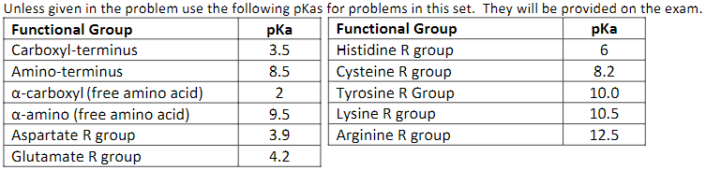
Practice Problem 2
Find the pI of Arginine:

Slide 9
Practice Problem 3
Calculate the pI of the following peptide sequence:

Slide 10
03
Protein Structure, Protein Folding

Slide 11
Practice Problem 1
What is the primary stabilizing force (intermolecular interaction) in an alpha helix? Draw this interaction and be sure to specify the periodicity of these interactions.

Slide 12
Practice Problem 2
There are two types of hydrogen bonding patterns in beta sheets. Diagram both, making sure to specify which end is the C terminus and which is the N-terminus.
In what pattern do the R groups face in a beta sheet?

Slide 13
Practice Problem 3
Describe some characteristics of each level of protein structure:
Primary | Secondary | Tertiary | Quaternary

Slide 14
04
Ligands, Hemoglobin and Myoglobin

Slide 15
Practice Problem 1
You want to study the kinetics of Enolase, a key enzyme in glycolysis which catalyzes the conversion of 2-phosphoglyceric acid (2-PG) to phosphoenolpyruvate (PEP). The active site of this enzyme contains 2 key amino acid residues: Lys-345 and Glu-211, which stabilize the reaction.
A mutagenesis study is proposed with the following mutants:
K345R
E211P
K345D
Which of these mutants would most likely cause the greatest change in function?

Slide 16
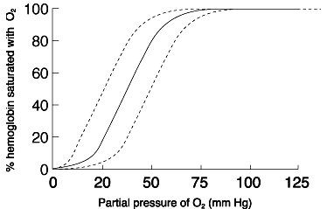
Practice Problem 2
Given that B is the base binding curve for hemoglobin, answer the following:
Which way would this curve shift to accommodate an influx of 2,3-BPG?
People unaccustomed to high altitude breathing can often face symptoms of altitude sickness. In this case, which way would the curve shift?
How would an increase in CO₂ shift the binding curve of hemoglobin?
A
B
C

Slide 17
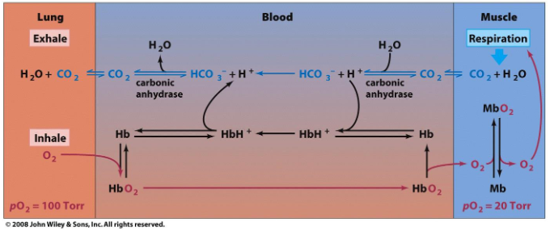
Practice Problem 3
Diabetic patients with chronic uncontrolled hyperglycemia may enter ketoacidosis, in which the blood becomes acidic. In severe cases, the hyperglycemia becomes life threatening as symptomatic features such as Kussmaul breathing appear, in which the patient enters a deep labored breathing pattern.
Interpreting the diagram above and using what you understand about how pH impacts hemoglobin affinity, describe how this symptom might arise.
Would the CO₂ concentrations in the blood of these patients be high, low, or the same?
Would the bicarbonate (HCO₃⁻) levels in the blood of these patients be high, low or the same?

Slide 18
Reflection of Exam Content
Take some time to rank the topics you might need the most time to review tonight, and topics you might know well enough to teach others.

Slide 19
—Paul Nurse
“I was never very good at exams, having a poor memory and finding the examination process rather artificial, and there never seemed to be enough time to follow up things that really interested me.”

