Slide 1
BCHM 463 Virtual GSS
Week 1
Amino Acids and Acid/Base Chemistry

Slide 2

Attendance
https://umdsurvey.umd.edu/jfe/form/SV_8pESxFL6Ce4uYho

Slide 3
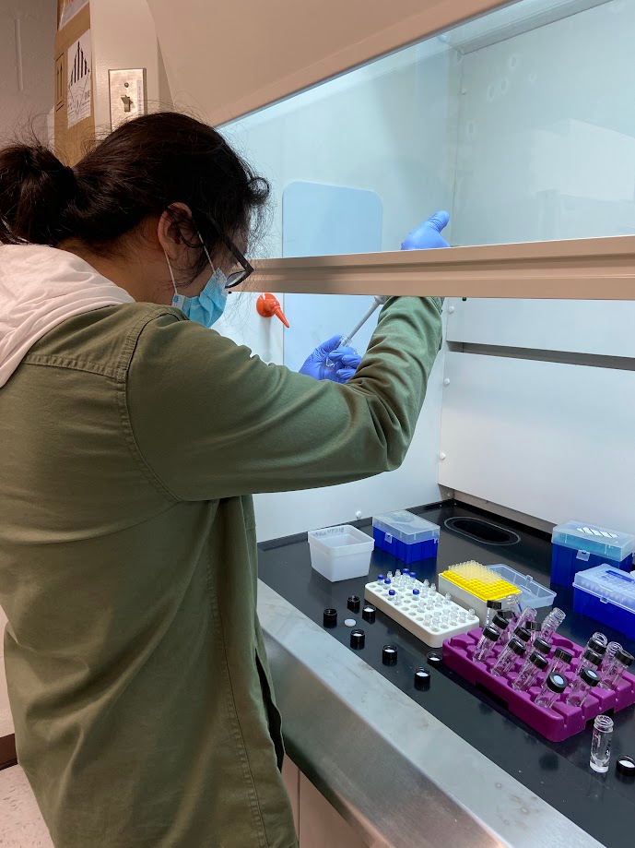
ABOUT ME
David Zhao (he/him)
Biochemistry Major and Statistics Minor looking to become a Chemistry Research Scientist
Current undergraduate researcher at the lab of Dr. Sergei Sukharev in IPST / Department of Biology
Former undergraduate researcher at the lab of Dr. Nishanth Sunny in the Department of Animal and Avian Sciences – Metabolism!
https://regiolantus.github.io/

Slide 4
Agenda
1
Amino Acids
2
Acid Base Chemistry of Amino Acids

Slide 5
1
Amino Acids

Slide 6
General Tips and Resources for Memorizing Amino Acids
Side Chain Simplicity
Sporcle
Generally, the simpler the side chain of the amino acid, the more straightforward it's one letter abbreviation.
Amino Acids by Structure - https://www.sporcle.com/games/sproutcm/amino-acids-from-structures
One Letter Abbreviations - https://www.sporcle.com/games/mitchellduffy/single_letter_amino_acids

Slide 7
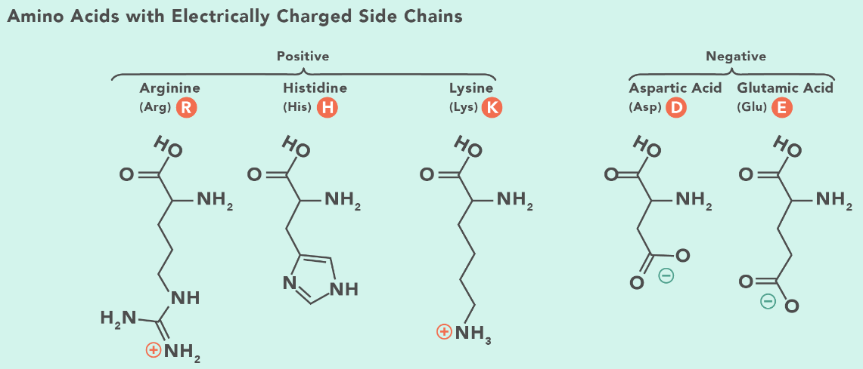
For Charged Amino Acids:
Dragons Eat Knights Riding Horses
Negatively Charged
D - Aspartate
E - Glutamate
Positively Charged
K - Lysine
R - Arginine
H - Histidine

Slide 8
Group Activity
Which of the following state names cannot be a 1-letter polypeptide sequence for a protein? For the ones that can be a sequence, give the peptide sequence in the three letter form.
N’ - MARYLAND - C’
N’ - CALIFORNIA - C’
N’ - HAWAII - C’
N’ - NEBRASKA - C’
N’ - UTAH - C’
N’ - MICHIGAN - C’

Slide 9
Group Activity
Which of the following state names cannot be a 1-letter polypeptide sequence for a protein? For the ones that can be a sequence, give the peptide sequence in the three letter form.
N’ - MARYLAND - C’
N’ - Met - Ala - Arg - Tyr - Leu - Ala - Asn - Asp - C’
N’ - CALIFORNIA - C’
N’ - HAWAII - C’
N’ - His - Ala - Trp - Ala - Ile - Ile - C’
N’ - NEBRASKA - C’
N’ - UTAH - C’
N’ - MICHIGAN - C’
N’ - Met - Ile - Cys - His - Ile - Gly - Ala - Asn - C’

Slide 10
2
Acid Base Chemistry of Amino Acids

Slide 11
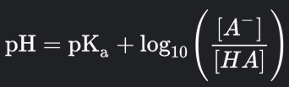
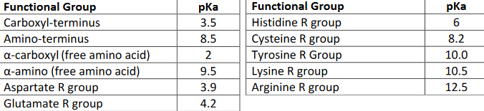
Henderson–Hasselbalch equation
When pKa > pH,
pH - pKa = (-)
[HA] > [A-]
When pKa < pH,
pH - pKa = (+)
[HA] < [A-]

Slide 12
pKa Scale
ɑ - carboxyl (free amino acid)
PHYSIOLOGICAL pH
carboxyl-terminus
aspartate R group
glutamate R group
histidine R group
cysteine R group
amino-terminus
ɑ - amino (free amino acid)
tyrosine R group
lysine R group
arginine R group
2
3.5
3.9
4.2
6
7.4
8.2
8.5
9.5
10
10.5
12.5
pKa - NOT TO SCALE

Slide 13
Group Activity
Of the three valid states, what is the net charge of each polypeptide sequence at physiological pH (i.e. a pH of 7.4)?
N’ - MARYLAND - C’
N’ - Met - Ala - Arg - Tyr - Leu - Ala - Asn - Asp - C’
N’ - HAWAII - C’
N’ - His - Ala - Trp - Ala - Ile - Ile - C’
N’ - MICHIGAN - C’
N’ - Met - Ile - Cys - His - Ile - Gly - Ala - Asn - C’

Slide 14
Group Activity
Of the three valid states, what is the net charge of each polypeptide sequence at physiological pH (i.e. a pH of 7.4)?
N’ - MARYLAND - C’
N’ - Met - Ala - Arg - Tyr - Leu - Ala - Asn - Asp - C’
(+1) + (0) + (0) + (+1) + (0) + (0) + (0) + (0) + (-1) + (-1) = 0
N’ - HAWAII - C’
N’ - His - Ala - Trp - Ala - Ile - Ile - C’
(+1) + (0) + (0) + (0) + (0) + (0) + (0) + (-1) = 0
N’ - MICHIGAN - C’
N’ - Met - Ile - Cys - His - Ile - Gly - Ala - Asn - C’
(+1) + (0) + (0) + (0) + (0) + (0) + (0) + (0) + (0) + (-1) = 0

Slide 15
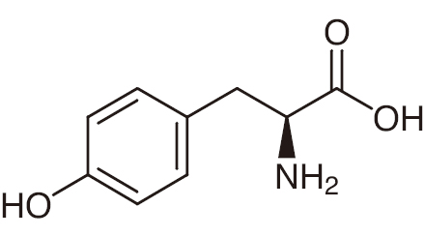
Group Activity
(On whiteboard) diagram the titration curve for Tyrosine (Tyr, Y). Determine the pI for Tyrosine.

Slide 16
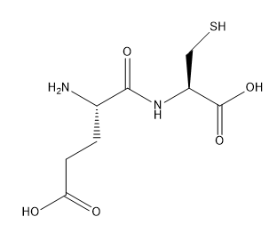
Group Activity
(On whiteboard) diagram the titration curve for the dipeptide Glu-Cys. Determine the pI of this dipeptide.

Slide 17
Concerns so Far
What topics (covered so far) would you like more practice for?
Helpful for me to decide what to focus on for the next sessions - I plan to make worksheets for in-person sessions.
Less practice | More practice
 | Titration Amino Acids in General Figuring out Charges on Amino Acids Buffers and how to react to additions / other conditions Protonation states How to solve problems for pKa given pH

