Slide 1
BCHM 463 – EXAM II Review
David Zhao | Dr. Tienson-Tseng | 10/19/2022

Slide 2

Please Sign In! https://umdsurvey.umd.edu/jfe/form/SV_8pESxFL6Ce4uYho

Slide 3
01
03
02
04
Practice Exam Review
Enzymes and Catalytic Mechanisms
Carbs and Lipids
Enzyme Kinetics

Slide 4
01
Practice Exam Review

Slide 5
Questions?

Slide 6
02
Carbs and Lipids

Slide 7
Comparison of Disaccharide Linkages
α (1→4)
β (1→4)
Specific Examples:
Function:
Specific Examples:
Function:

Slide 8
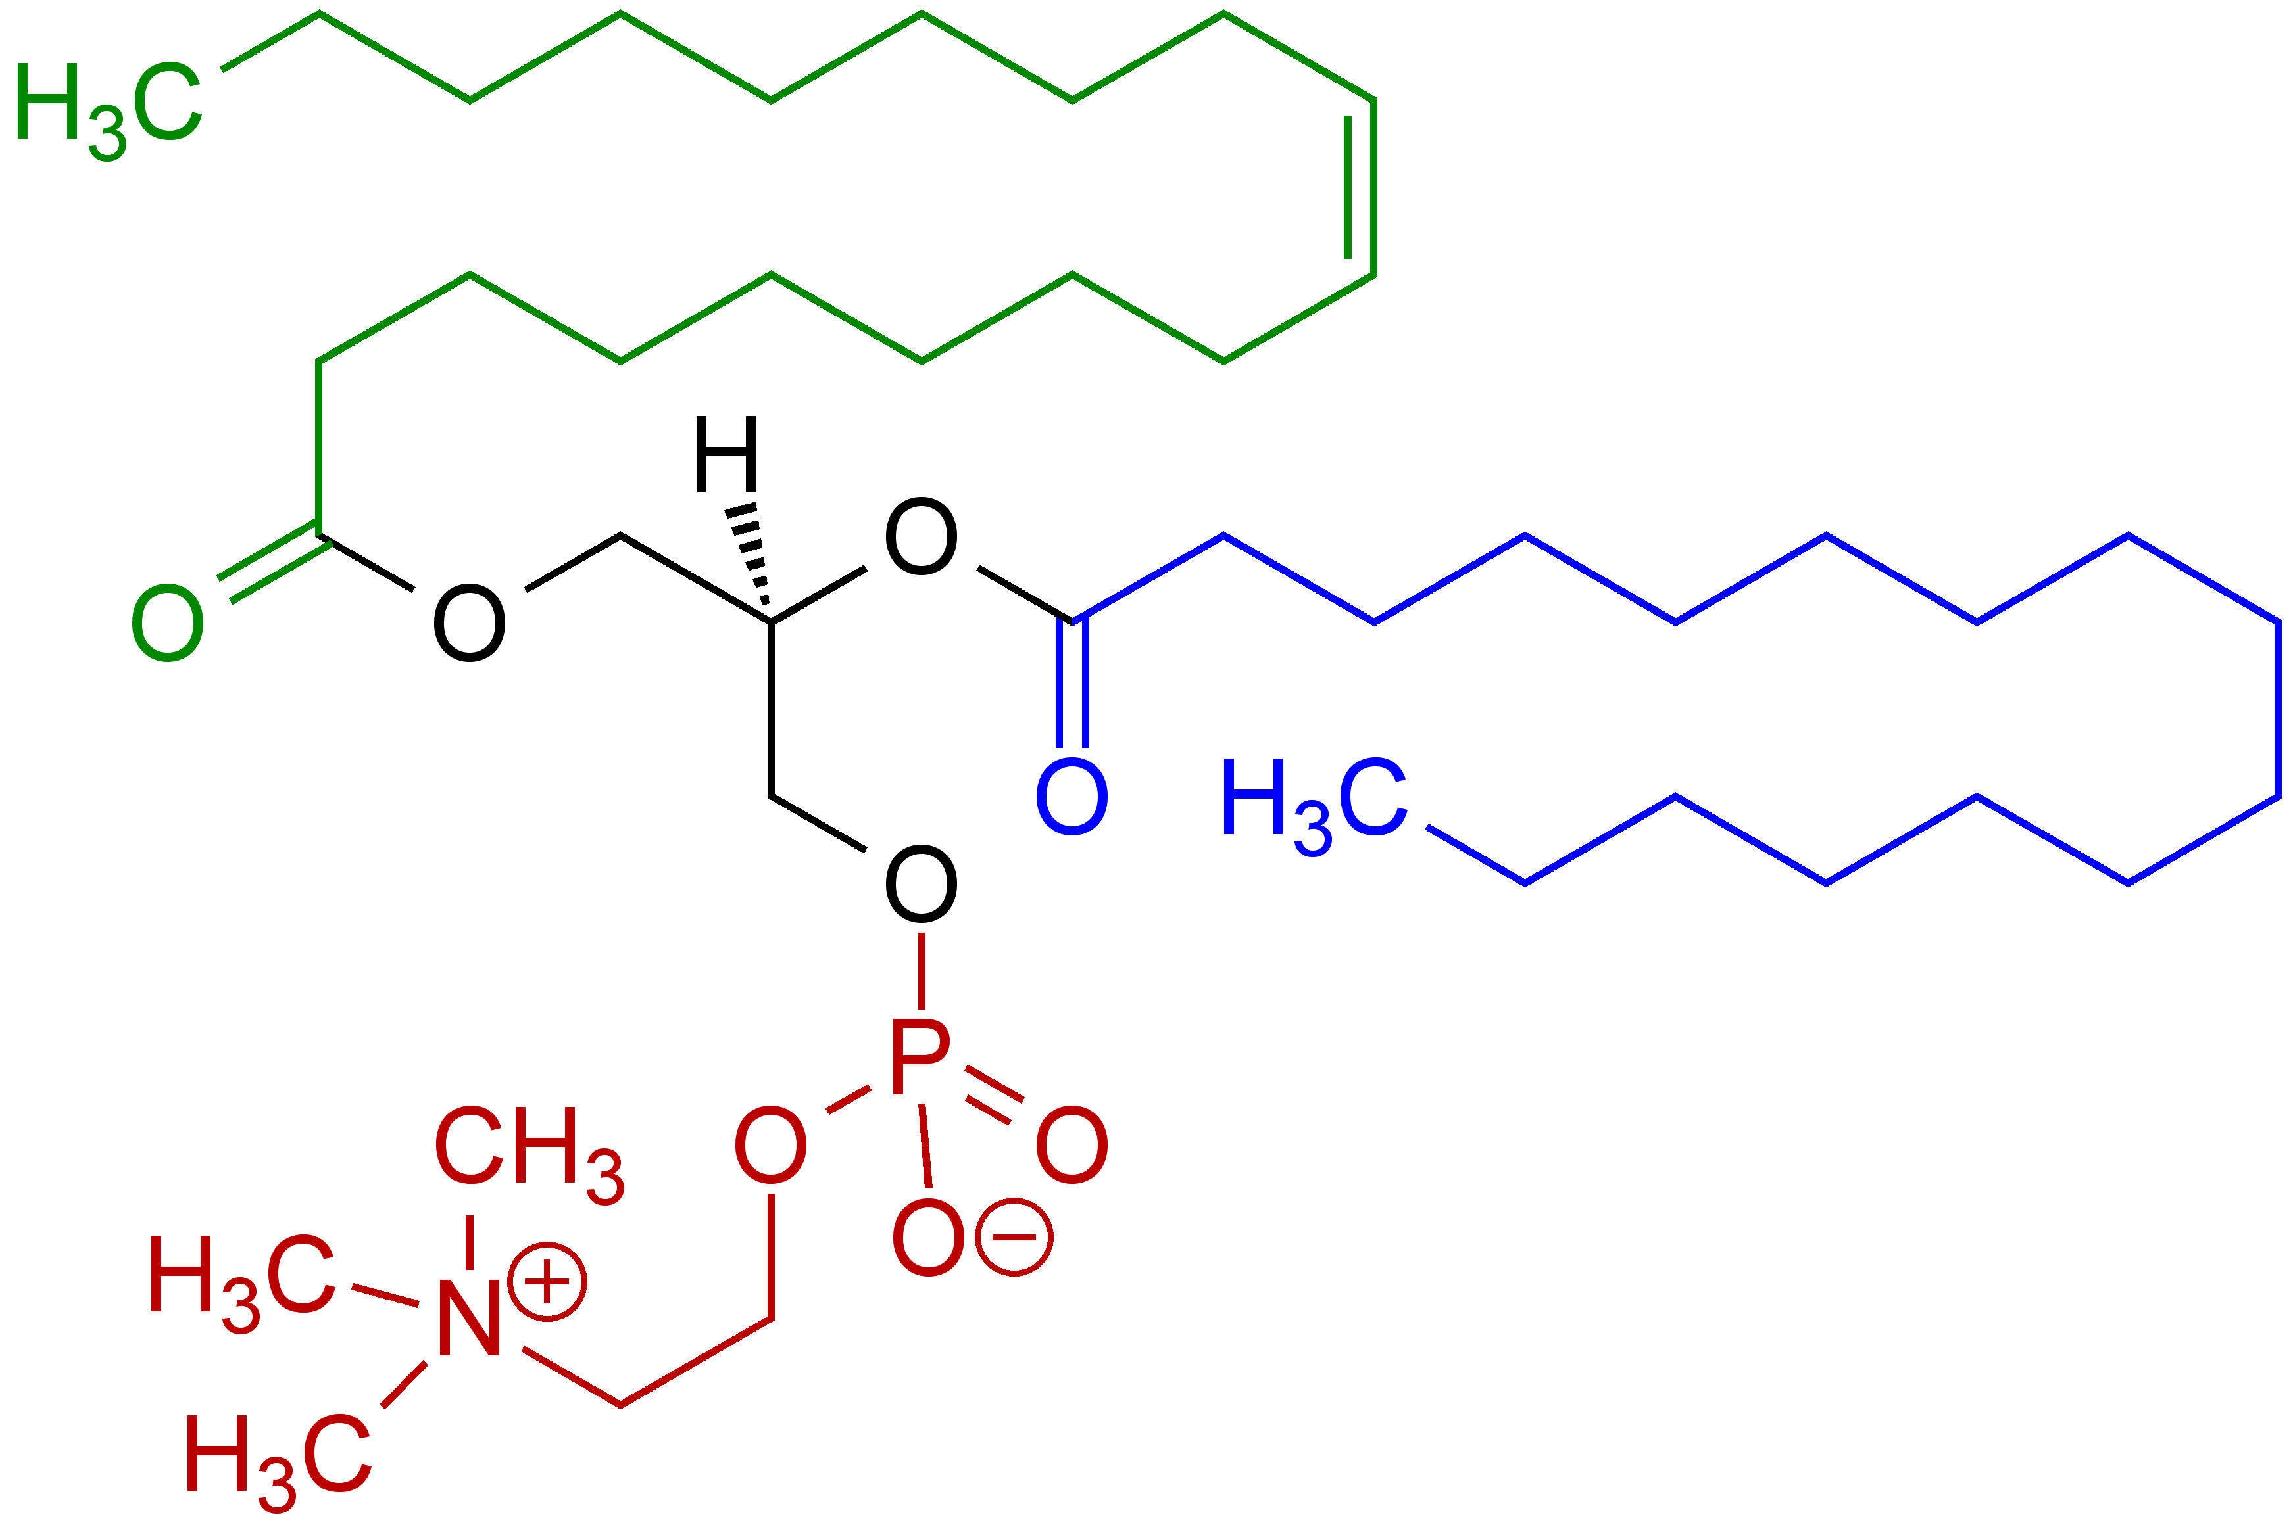
Identify the molecule above. Name a biochemical role this macromolecule plays, making sure to describe how its structural features allow for the molecule to carry out its function.

Slide 9
03
Enzymes and Catalytic Mechanisms

Slide 10
What Classes of Enzymes Exist?
Hint: There are 7 (6 of interest to us in this class)

Slide 11
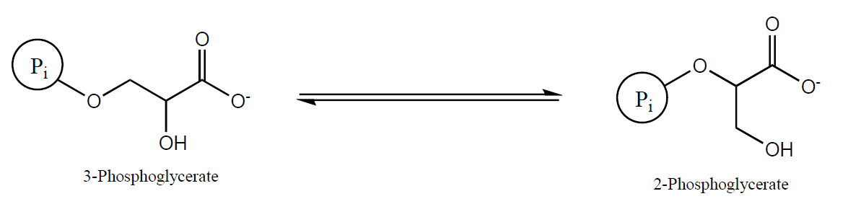
Enzyme Classification
For the following reactions, classify the type of enzyme which catalyzes the reaction

Slide 12
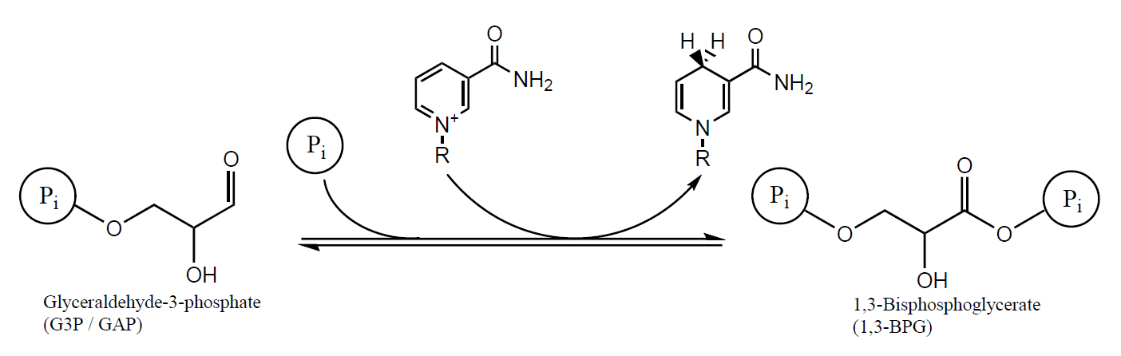
Enzyme Classification
For the following reactions, classify the type of enzyme which catalyzes the reaction

Slide 13
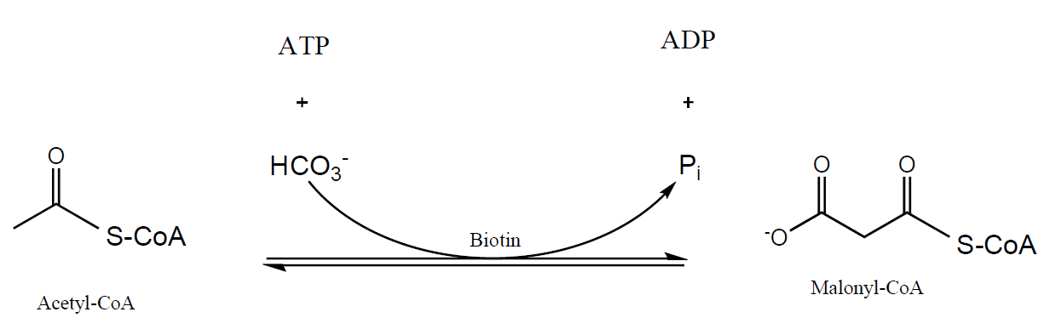
Enzyme Classification
For the following reactions, classify the type of enzyme which catalyzes the reaction

Slide 14
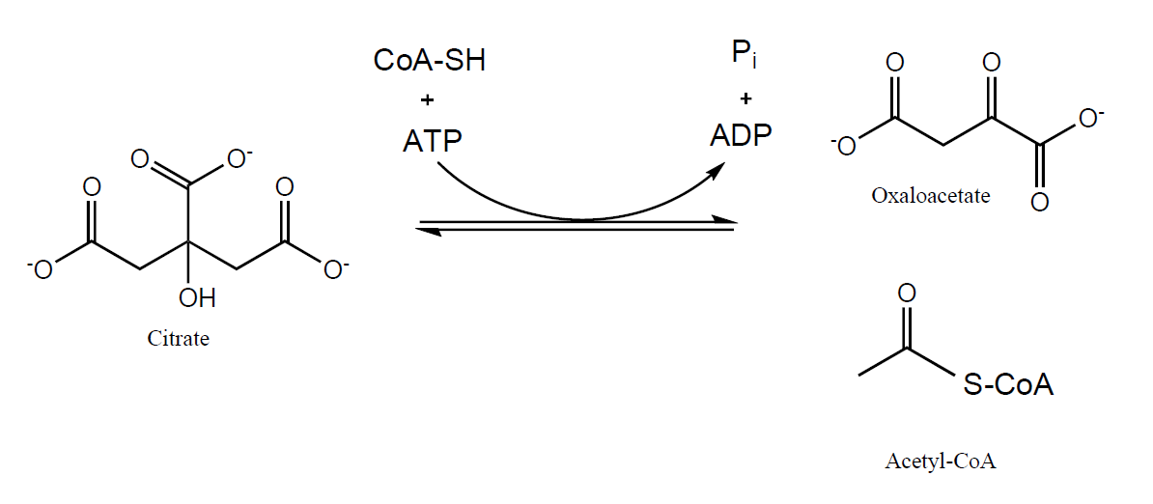
Enzyme Classification
For the following reactions, classify the type of enzyme which catalyzes the reaction

Slide 15
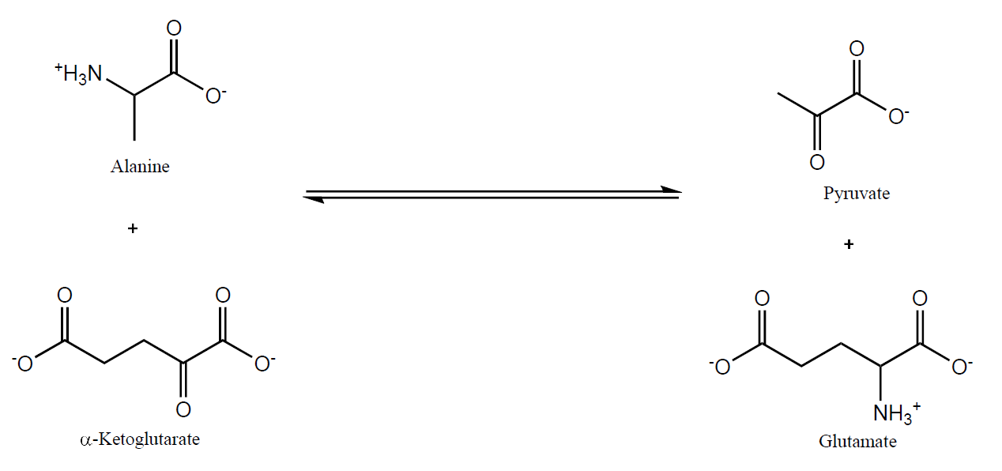
Enzyme Classification
For the following reactions, classify the type of enzyme which catalyzes the reaction

Slide 16
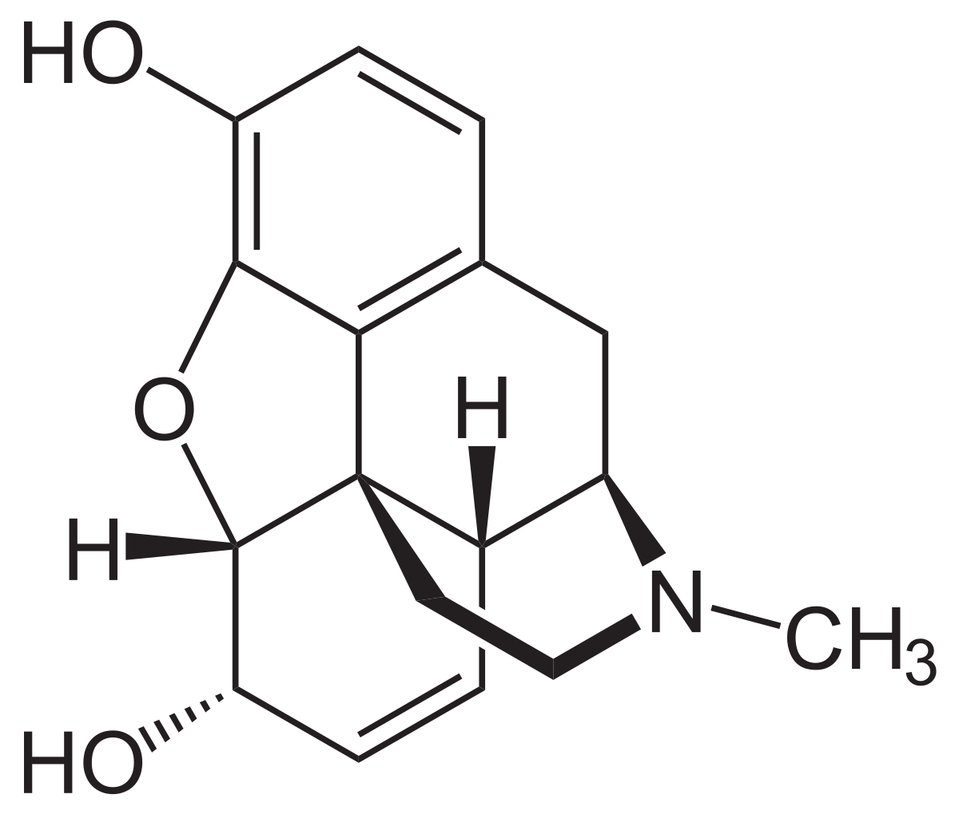
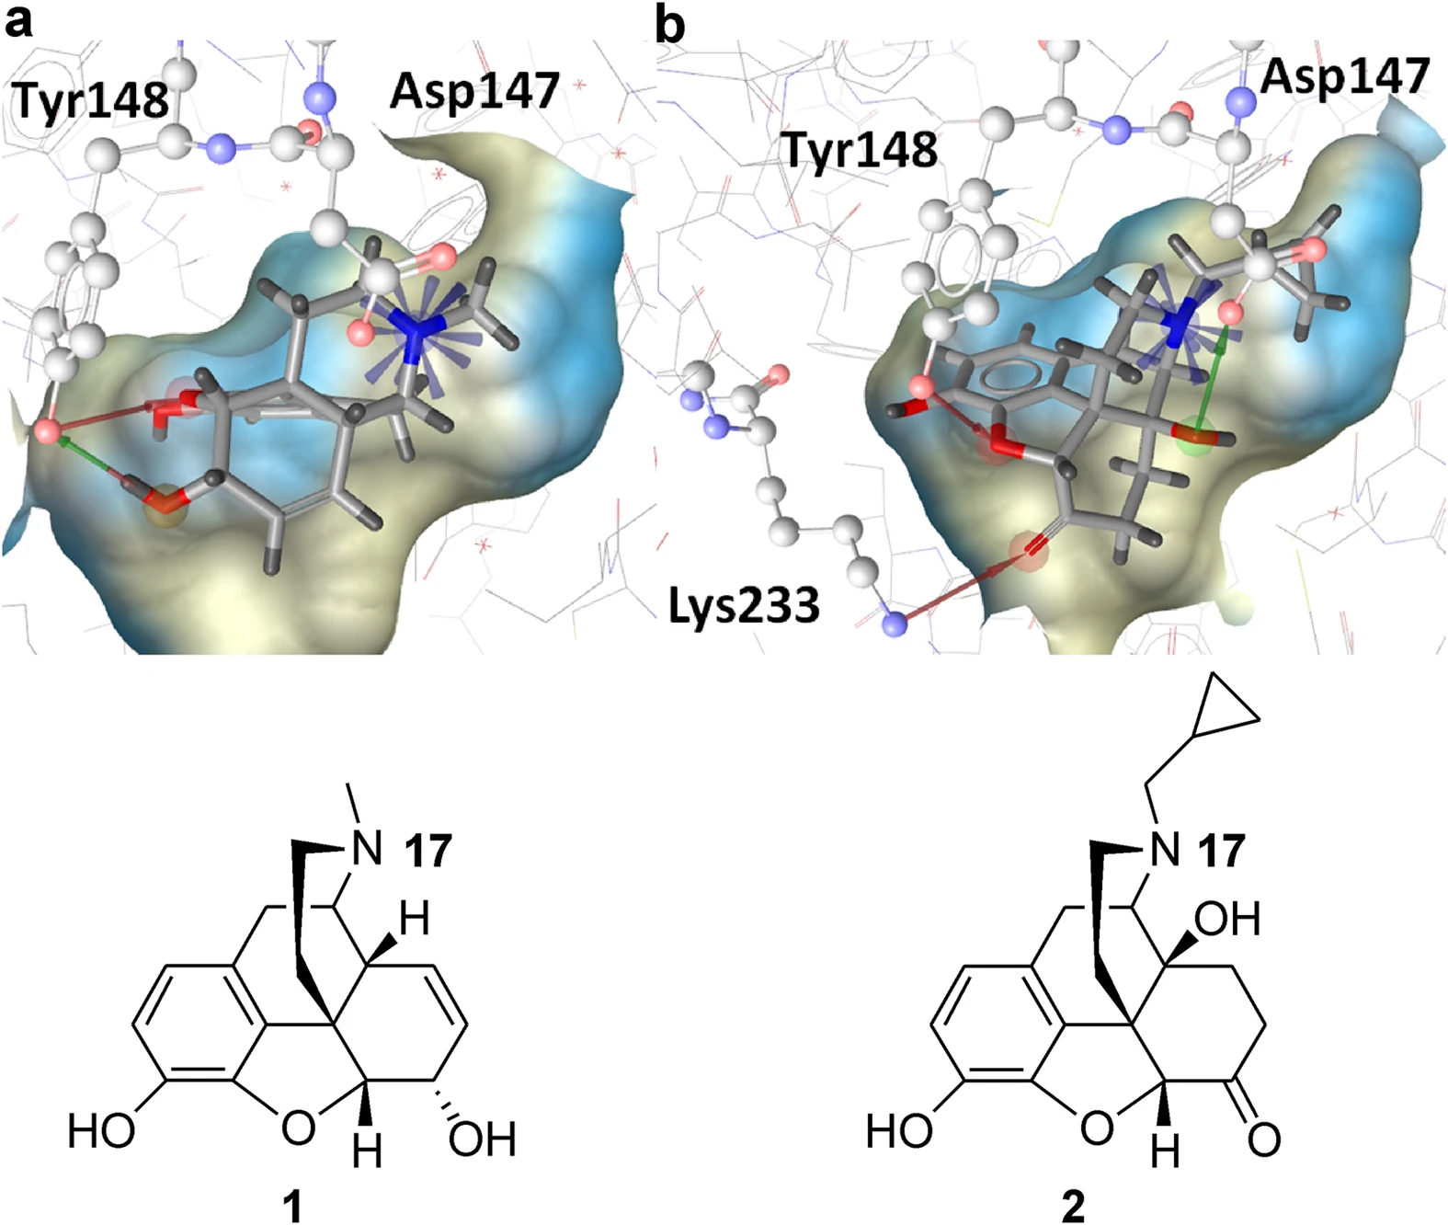
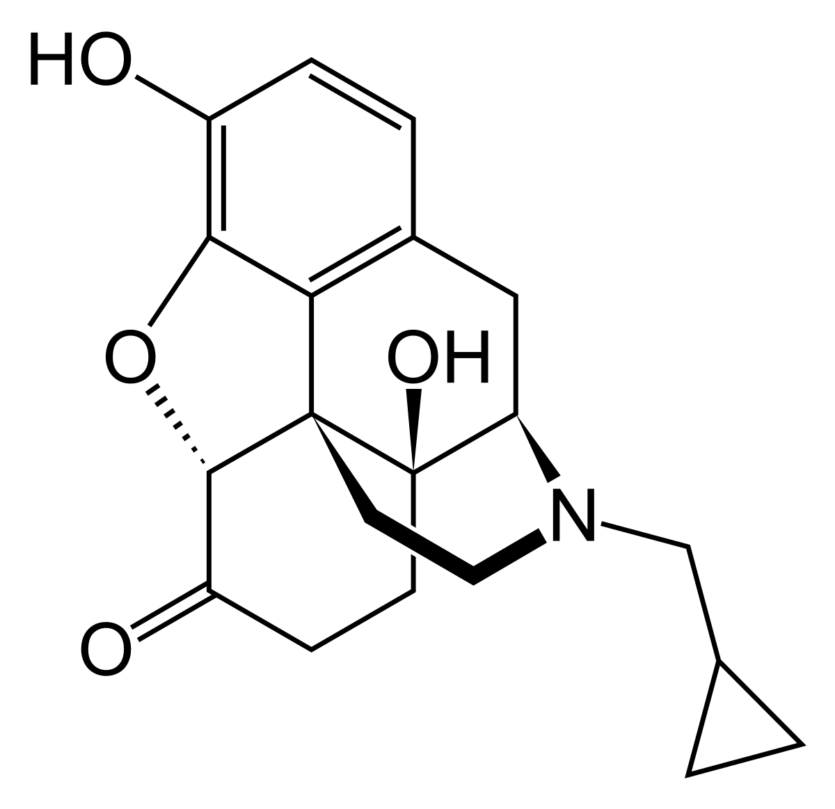
Active Site Interactions of Enzymes
Label some possible non-covalent interactions responsible for the ligand binding to the protein.
Interactions:
Morphine:
+
H
Naltrexone:
+
H
Kaserer, T.; Lantero, A.; Schmidhammer, H.; Spetea, M.; Schuster, D. Μ Opioid Receptor: Novel Antagonists and Structural Modeling. Scientific Reports 2016, 6 (1).

Slide 17
Active Site Interactions of Enzymes
How would the mutation Y148F impact the binding of either morphine or naltrexone?
Interactions:
Morphine:
+
H
Naltrexone:
+
H
Kaserer, T.; Lantero, A.; Schmidhammer, H.; Spetea, M.; Schuster, D. Μ Opioid Receptor: Novel Antagonists and Structural Modeling. Scientific Reports 2016, 6 (1).

Slide 18
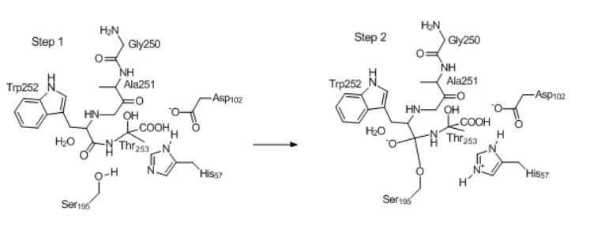
Types of Catalysis
For the following enzyme mechanism steps, describe the type of catalysis pictured in the circled part(s).

Slide 19
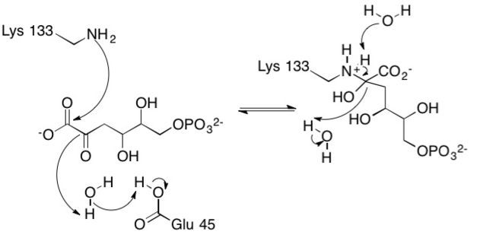
Types of Catalysis
For the following enzyme mechanism steps, describe the type of catalysis pictured in the circled part(s).

Slide 20
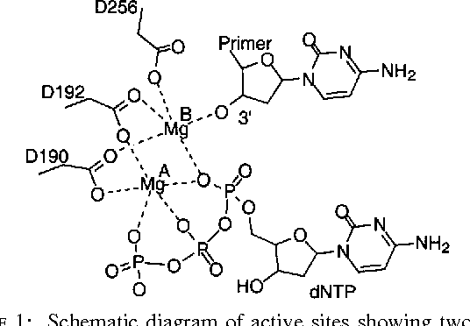
Types of Catalysis
For the following enzyme mechanism steps, describe the type of catalysis pictured in the circled part(s).

Slide 21
04
Enzyme Kinetics

Slide 22
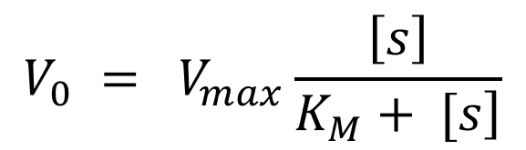
Enzyme Kinetics – Lineweaver-Burk Equation

Slide 23
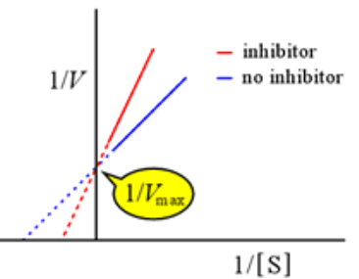
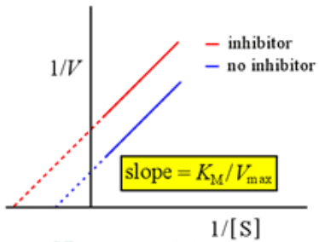
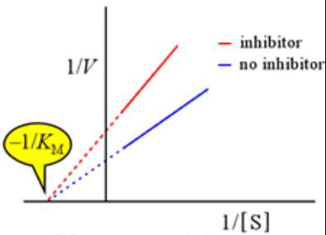
Enzyme Kinetics – Relating L-B to M-M
Competitive Inhibition
Uncompetitive Inhibition
Noncompetitive Inhibition
What would the Michaelis-Menten plot of each of these Lineweaver-Burke models look like?

Slide 24
Enzyme Kinetics – Relating L-B to M-M
Competitive Inhibition
Uncompetitive Inhibition
Noncompetitive Inhibition
For each of these inhibition models, where does the inhibitor bind on the enzyme?

Slide 25
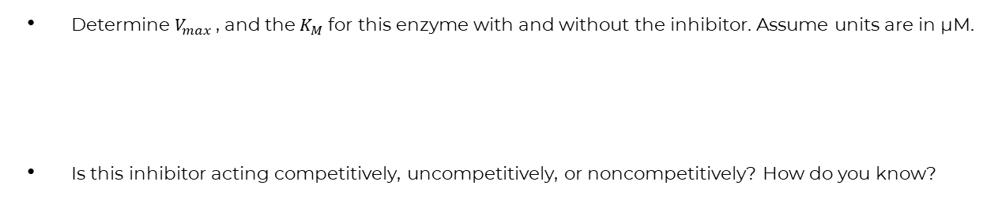
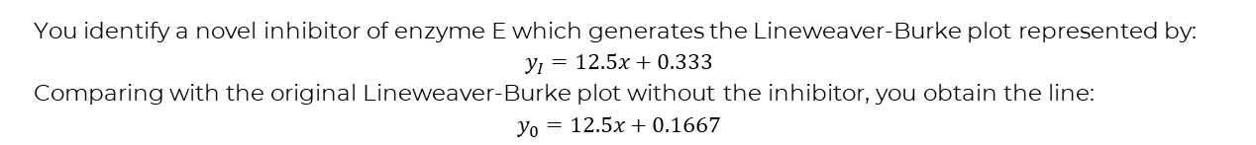
Enzyme Kinetics – Practice Question
You identify a novel inhibitor of enzyme E which generates the Lineweaver-Burke plot represented by:
$$y_{I}=12.5x+0.333$$
Comparing with the original Lineweaver-Burke plot without the inhibitor, you obtain the line:
$$y_{0}=12.5x+0.1667$$
Determine $V_{max}$ , and the $K_{M}$ for this enzyme with and without the inhibitor. Assume units are in µM.
Is this inhibitor acting competitively, uncompetitively, or noncompetitively? How do you know?

Slide 26
Enzyme Kinetics – Practice Question
[S], µM | V₀, No Inhibitor | V₀, Inhibitor 1 | V₀, Inhibitor 2 | V₀, Inhibitor 3
2 | 13.2 | 13.5 | 26.8 | 26.4
4 | 26 | 26.3 | 53.2 | 52
6 | 38.8 | 39.1 | 76.9 | 77.6
8 | 51.6 | 51.9 | 106 | 103.2
To the left is some data of three different inhibitors.
Find the Lineweaver-Burke equation for the original enzyme without inhibitors, and for each enzyme with inhibitors.
Determine the V_{max} and K_{M} of each enzyme and inhibitor mixture.
Which inhibitors are acting competitively / uncompetitively / noncompetitively?

Slide 27
Thanks for Coming and Good Luck!
Any general questions?

