Slide 1
BCHM 463 – EXAM II Review
David Zhao | Dr. Tienson-Tseng | 10/19/2022

Slide 2

Please Sign In! https://umdsurvey.umd.edu/jfe/form/SV_8pESxFL6Ce4uYho

Slide 3
01
03
02
04
Practice Exam Review
Enzymes and Catalytic Mechanisms
Carbs and Lipids
Enzyme Kinetics

Slide 4
01
Practice Exam Review

Slide 5
Questions?

Slide 6
02
Carbs and Lipids

Slide 7
Comparison of Disaccharide Linkages
α (1→4)
β (1→4)
Specific Examples:
Function:
Specific Examples:
Function:

Slide 8
Comparison of Disaccharide Linkages
α (1→4)
β (1→4)
Specific Examples:
Maltose
Glycogen
Function:
Energy storage for later use
Specific Examples:
Cellulose
Lactose
Function:
Mainly provides structure

Slide 9
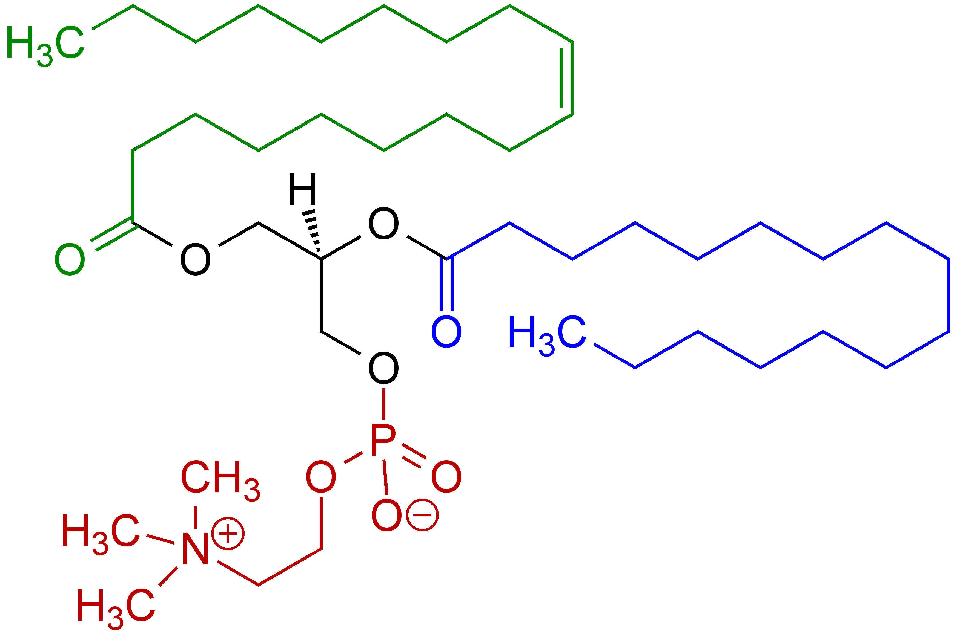
Identify the molecule above. Name a biochemical role this macromolecule plays, making sure to describe how its structural features allow for the molecule to carry out its function.

Slide 10
This is a phosphatidylcholine, which is a specific type of sphingolipid. The polar end is the end with the phosphatidylcholine, and the nonpolar end is the end containing the fatty acid chains. The amphipathic features of this molecule allow for the molecule to be able to aggregate or self-assemble to form ordered structures such as cell membranes.

Slide 11
03
Enzymes and Catalytic Mechanisms

Slide 12
What Classes of Enzymes Exist?
Hint: There are 7 (6 of interest to us in this class)

Slide 13
What Classes of Enzymes Exist?
Hint: There are 7 (6 of interest to us in this class)
Oxidoreductases – involve the transfer of electrons through oxidation reduction reactions – look for NAD+/NADH
Transferases – transfer of functional groups between molecules
Hydrolases – Use of H2O to cleave or form bonds (input of water breaks bonds, output of water results in formation of bonds.
Lyases – Removal of a group to form a double bond.
Ligases – Uses the energy of a coupled ATP reaction to form bonds.
Isomerase – Intermolecular rearrangements.
Translocases – Transport of molecule across membrane (relatively new enzyme class)

Slide 14
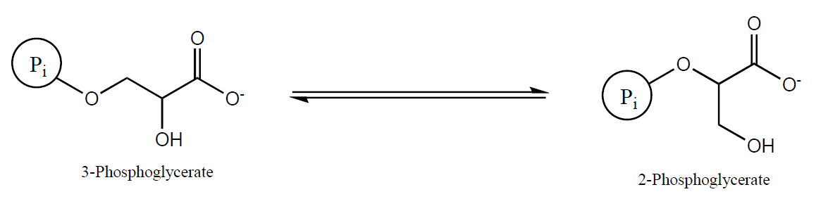
Enzyme Classification
For the following reactions, classify the type of enzyme which catalyzes the reaction

Slide 15
Enzyme Classification
For the following reactions, classify the type of enzyme which catalyzes the reaction
Isomerase
Enzyme name – Phosphoglycerate Mutase

Slide 16
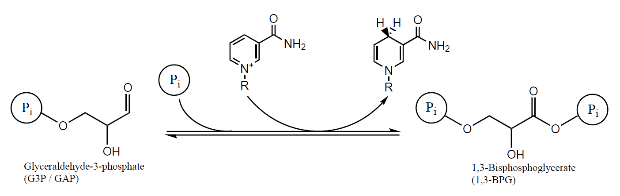
Enzyme Classification
For the following reactions, classify the type of enzyme which catalyzes the reaction

Slide 17
Enzyme Classification
For the following reactions, classify the type of enzyme which catalyzes the reaction
Oxidoreductase or Group Transfer
Enzyme Name: Glyceraldehyde-3-phosphate Dehydrogenase

Slide 18
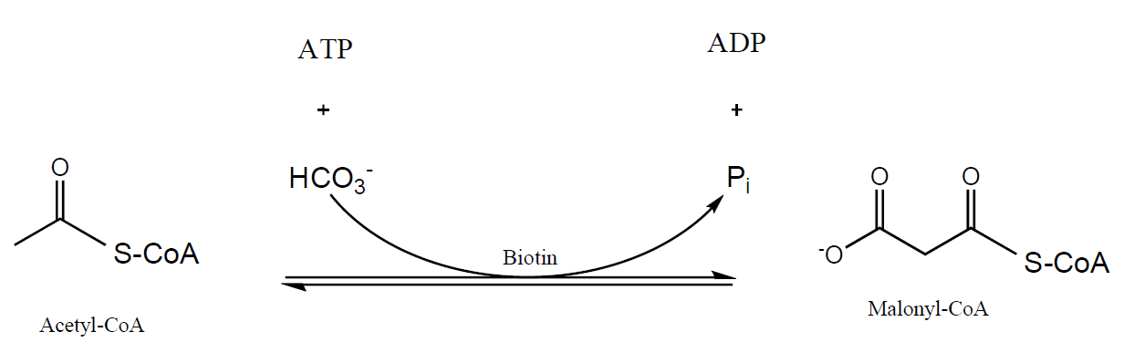
Enzyme Classification
For the following reactions, classify the type of enzyme which catalyzes the reaction

Slide 19
Enzyme Classification
For the following reactions, classify the type of enzyme which catalyzes the reaction
Ligase
Enzyme Name: Acetyl-CoA Carboxylase

Slide 20
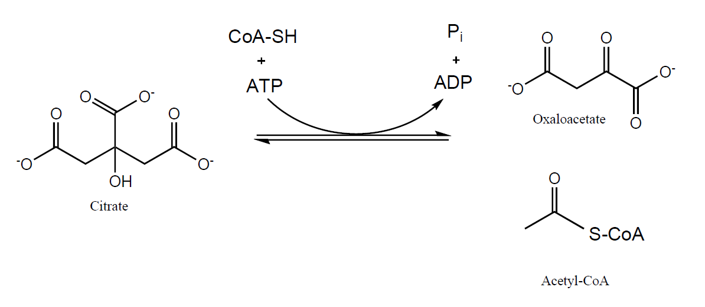
Enzyme Classification
For the following reactions, classify the type of enzyme which catalyzes the reaction

Slide 21
Enzyme Classification
For the following reactions, classify the type of enzyme which catalyzes the reaction
Lyase
Enzyme Name: ATP Citrate Lyase

Slide 22
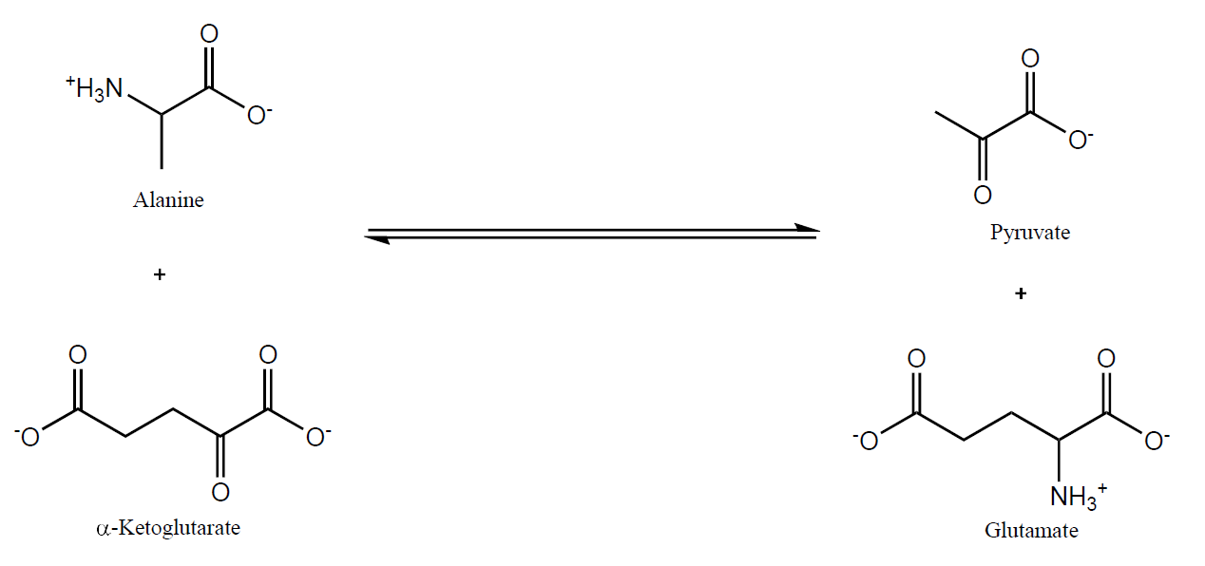
Enzyme Classification
For the following reactions, classify the type of enzyme which catalyzes the reaction

Slide 23
Enzyme Classification
For the following reactions, classify the type of enzyme which catalyzes the reaction
Transferase
Enzyme Name: Alanine Amino Transferase

Slide 24
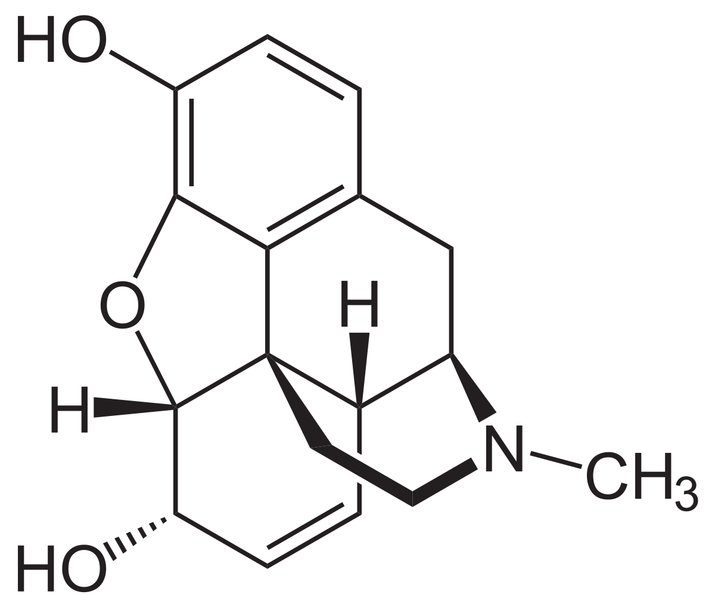
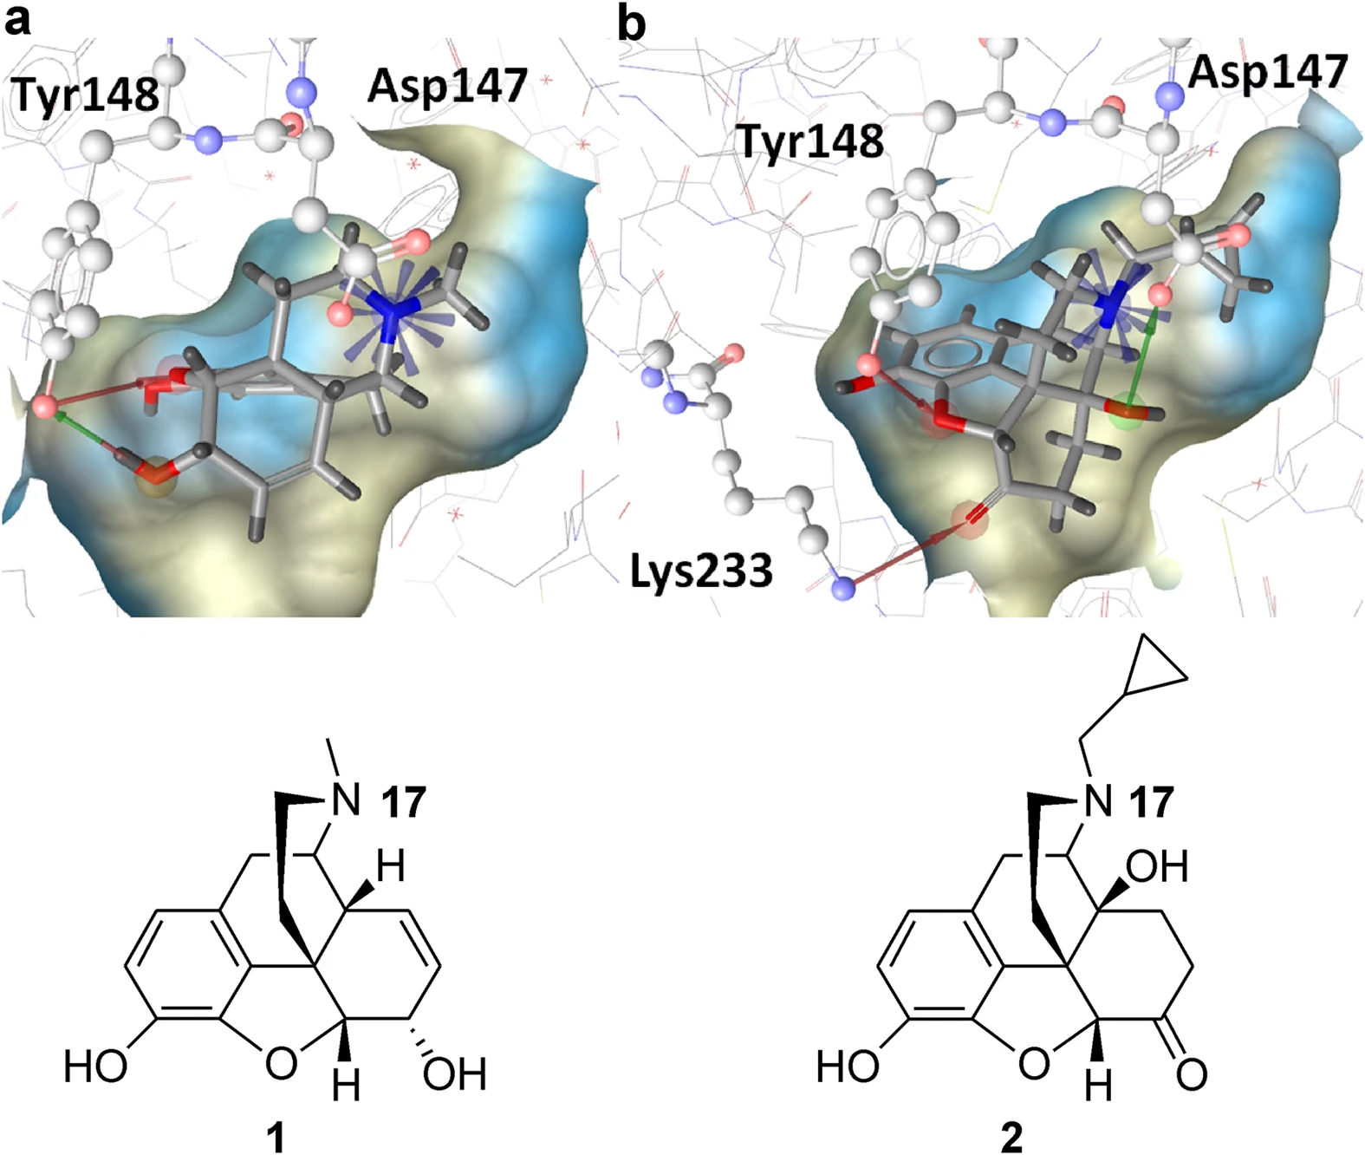
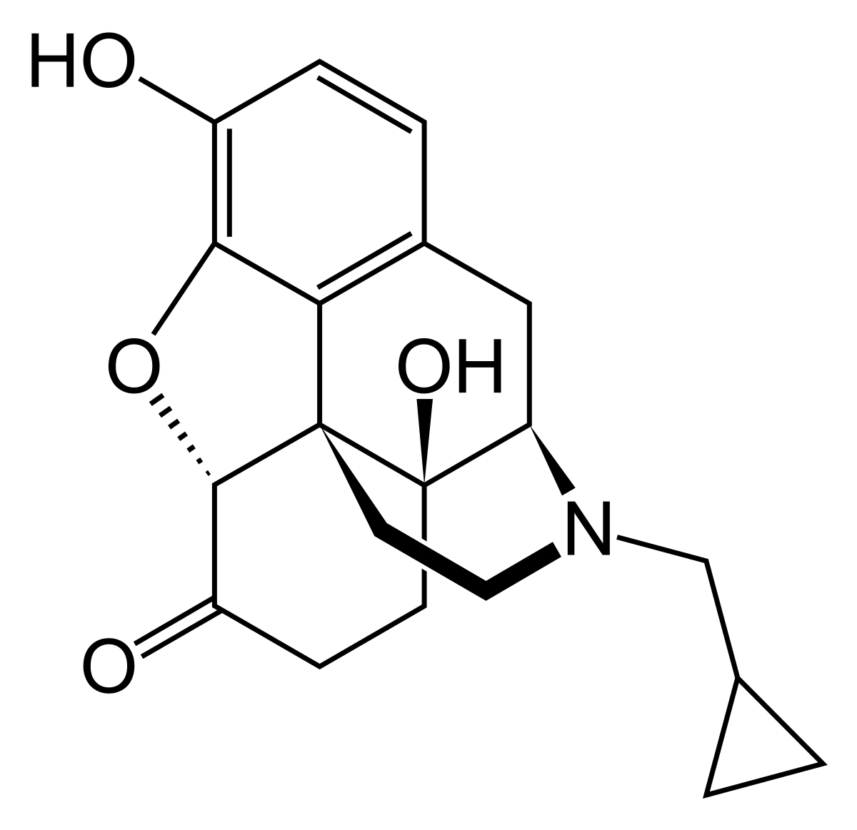
Active Site Interactions of Enzymes
Label some possible non-covalent interactions responsible for the ligand binding to the protein.
Interactions:
Morphine:
+
H
Naltrexone:
+
H
Kaserer, T.; Lantero, A.; Schmidhammer, H.; Spetea, M.; Schuster, D. Μ Opioid Receptor: Novel Antagonists and Structural Modeling. Scientific Reports 2016, 6 (1).

Slide 25
Active Site Interactions of Enzymes
Label some possible non-covalent interactions responsible for the ligand binding to the protein.
Interactions:
Morphine:
Ionic Interaction
H-Bonding
+
H
H-Bonding
Naltrexone:
H-Bonding
H-Bonding
Ionic Interaction
H-Bonding
+
H
H-Bonding
Kaserer, T.; Lantero, A.; Schmidhammer, H.; Spetea, M.; Schuster, D. Μ Opioid Receptor: Novel Antagonists and Structural Modeling. Scientific Reports 2016, 6 (1).
Please note:
= In theory these groups could interact, but the paper says otherwise. If I was grading the exam, I wouldn’t necessarily count these as incorrect since it’s hard to visualize ligand-enzyme interactions in 2-D space.

Slide 26
Active Site Interactions of Enzymes
How would the mutation Y148F impact the binding of either morphine or naltrexone?
Interactions:
Morphine:
+
H
Naltrexone:
+
H
Kaserer, T.; Lantero, A.; Schmidhammer, H.; Spetea, M.; Schuster, D. Μ Opioid Receptor: Novel Antagonists and Structural Modeling. Scientific Reports 2016, 6 (1).

Slide 27
Active Site Interactions of Enzymes
How would the mutation Y148F impact the binding of either morphine or naltrexone?
Interactions:
Morphine:
+
H
Naltrexone:
This mutation would decrease the binding affinity for both Morphine and Naltrexone at the active site of the enzyme (Kd would increase)
+
H
Kaserer, T.; Lantero, A.; Schmidhammer, H.; Spetea, M.; Schuster, D. Μ Opioid Receptor: Novel Antagonists and Structural Modeling. Scientific Reports 2016, 6 (1).

Slide 28
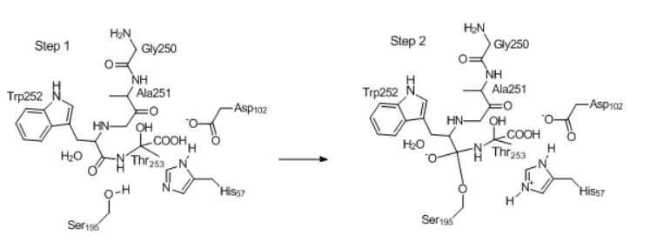
Types of Catalysis
For the following enzyme mechanism steps, describe the type of catalysis pictured in the circled part(s).

Slide 29
Types of Catalysis
For the following enzyme mechanism steps, describe the type of catalysis pictured in the circled part(s).
Aspartate 102 – Electrostatic catalysis – negatively charged carbonyl group pushes imidazole electron density on histidine toward serine residue, facilitating deprotonation of the serine (catalytic triad). Remember that the amino acid residue does not necessarily have to be interacting with the ligand to be considered a part of catalysis.
Histidine 57 – General base catalysis– Deprotonates serine to allow for serine’s oxyanion to attack the carbonyl of the peptide bond.
Serine 195 – Covalent catalysis. Could be acid catalysis if considering step between 1 and 2 (Step 1.5) where histidine deprotonates the serine, but between step 1 and 2 serine changes by covalently binding to ligand, and thus this is an example of covalent catalysis.

Slide 30
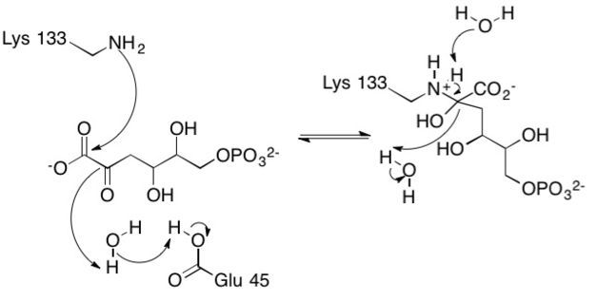
Types of Catalysis
For the following enzyme mechanism steps, describe the type of catalysis pictured in the circled part(s).
Lysine 133 – Covalent catalysis – between step one and two, lysine forms a covalent bond with the ligand.
Glutamate 45 – General acid catalysis – glutamate is deprotonated by water to allow for regeneration of water to act as a nucleophile for the second part of reaction.

Slide 31
Types of Catalysis
For the following enzyme mechanism steps, describe the type of catalysis pictured in the circled part(s).

Slide 32
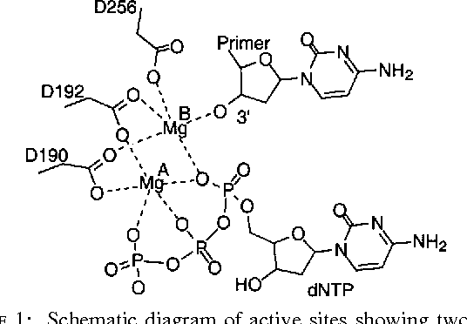
Types of Catalysis
For the following enzyme mechanism steps, describe the type of catalysis pictured in the circled part(s).

Slide 33
Types of Catalysis
For the following enzyme mechanism steps, describe the type of catalysis pictured in the circled part(s).
Aspartate 256, 192, 190 – Electrostatic catalysis, could also be positional / orientation – negatively charged carbonyl groups coordinate positively charged metals to allow for DNA polymerization to take place. The deprotonated O group on the 3’ Carbon of the nucleoside is not a “natural” occurrence.
Mg A and Mg B – Metal ion catalysis - DNA is inherently a negatively charged molecule due to its phosphate backbone, and in this reaction mechanism the positive charge of the magnesium can be seen to help coordinate and stabilize the polymerization reaction.

Slide 34
04
Enzyme Kinetics

Slide 35
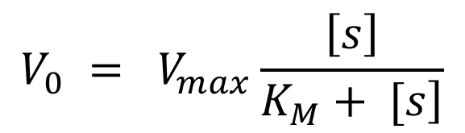
Enzyme Kinetics – Lineweaver-Burk Equation

Slide 36







Enzyme Kinetics – Lineweaver-Burk Equation

Slide 37
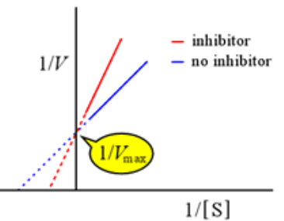
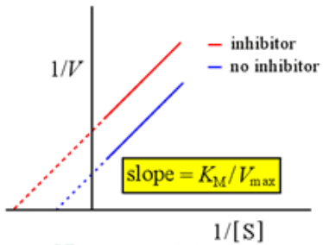
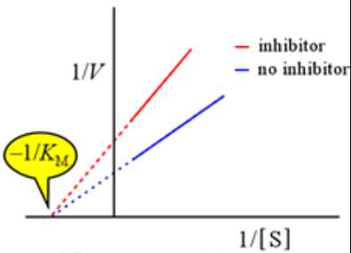
Enzyme Kinetics – Relating L-B to M-M
Competitive Inhibition
Uncompetitive Inhibition
Noncompetitive Inhibition
What would the Michaelis-Menten plot of each of these Lineweaver-Burke models look like?

Slide 38




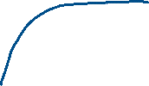

Enzyme Kinetics – Relating L-B to M-M
Competitive Inhibition
Uncompetitive Inhibition
Noncompetitive Inhibition
What would the Michaelis-Menten plot of each of these Lineweaver-Burke models look like?
V
V
V
Km increases with inhibitor, Vmax is constant
Km decreases with inhibitor, Vmax is constant
Km constant with inhibitor, Vmax decreases
[S]
[S]
[S]

Slide 39
Enzyme Kinetics – Relating L-B to M-M
Competitive Inhibition
Uncompetitive Inhibition
Noncompetitive Inhibition
For each of these inhibition models, where does the inhibitor bind on the enzyme?

Slide 40
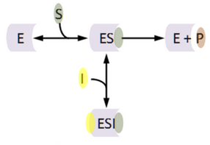
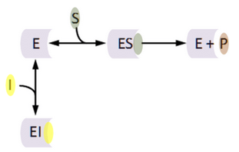
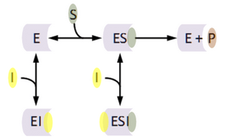
Enzyme Kinetics – Relating L-B to M-M
Competitive Inhibition
Uncompetitive Inhibition
Noncompetitive Inhibition
For each of these inhibition models, where does the inhibitor bind on the enzyme?
In noncompetitive inhibition, the inhibitor binds to the enzyme-substrate complex at a spot other than the active site or at the active site of the enzyme.
In competitive inhibition, the inhibitor binds to the active site only
In uncompetitive inhibition, the inhibitor binds to the enzyme-substrate complex at a spot other than the active site.

Slide 41
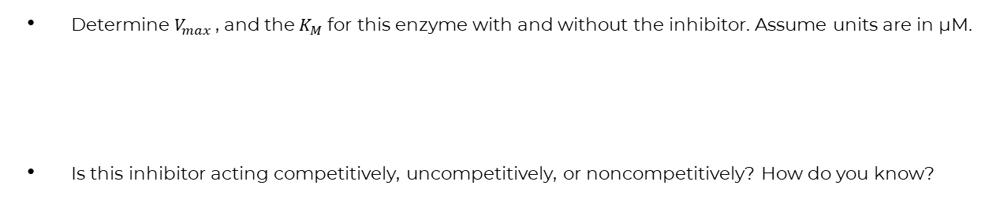
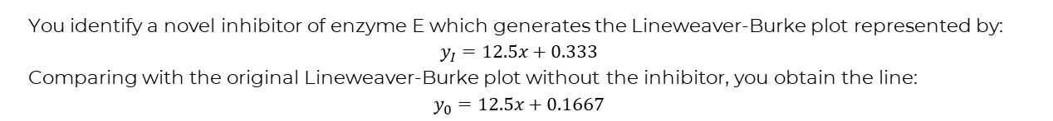
Enzyme Kinetics – Practice Question
You identify a novel inhibitor of enzyme E which generates the Lineweaver-Burke plot represented by:
$$y_{I}=12.5x+0.333$$
Comparing with the original Lineweaver-Burke plot without the inhibitor, you obtain the line:
$$y_{0}=12.5x+0.1667$$
Determine $V_{max}$ , and the $K_{M}$ for this enzyme with and without the inhibitor. Assume units are in µM.
Is this inhibitor acting competitively, uncompetitively, or noncompetitively? How do you know?

Slide 42
Enzyme Kinetics – Practice Question
You identify a novel inhibitor of enzyme E which generates the Lineweaver-Burke plot represented by:
$$y_{I}=12.5x+0.333$$
Comparing with the original Lineweaver-Burke plot without the inhibitor, you obtain the line:
$$y_{0}=12.5x+0.1667$$
Determine $V_{max}$ , and the $K_{M}$ for this enzyme with and without the inhibitor. Assume units are in µM.
Is this inhibitor acting competitively, uncompetitively, or noncompetitively? How do you know?
 | With Inhibitor | Without Inhibitor
Vmax | 3 µM / s | 6 µM / s
Km | 12.5 s⁻¹ (3 µM / s) = 37.5 µM | 12.5 s⁻¹ (6 µM / s) = 75 µM
This inhibitor is acting uncompetitively. The lines are parallel - the slope of these two lines are the same, yet the y-intercept is different (Vmax decreases with inhibitor but Km also decreases with inhibitor leading to no change in slope since m = Km/Vmax

Slide 43
Enzyme Kinetics – Practice Question
1/[S], µM⁻¹ | V₀, No Inhibitor | V₀, Inhibitor 1 | V₀, Inhibitor 2 | V₀, Inhibitor 3
2 | 13.2 | 13.5 | 26.8 | 26.4
4 | 26 | 26.3 | 53.2 | 52
6 | 38.8 | 39.1 | 76.9 | 77.6
8 | 51.6 | 51.9 | 106 | 103.2
To the left is some data of three different inhibitors.
Find the Lineweaver-Burke equation for the original enzyme without inhibitors, and for each enzyme with inhibitors.
Determine the V_{max} and K_{M} of each enzyme and inhibitor mixture.
Which inhibitors are acting competitively / uncompetitively / noncompetitively?

Slide 44
Enzyme Kinetics – Practice Question
1/[S], µM⁻¹ | V₀, No Inhibitor | V₀, Inhibitor 1 | V₀, Inhibitor 2 | V₀, Inhibitor 3
2 | 13.2 | 13.5 | 26.8 | 26.4
4 | 26 | 26.3 | 53.2 | 52
6 | 38.8 | 39.1 | 76.9 | 77.6
8 | 51.6 | 51.9 | 106 | 103.2
To the left is some data of three different inhibitors.
Find the Lineweaver-Burke equation for the original enzyme without inhibitors, and for each enzyme with inhibitors.
Original: y = 6.4x + 0.4
Inhibitor 1: 6.4x + 0.7
Inhibitor 2: 13.2x + 0.4
Inhibitor 3: 12.8x + 0.8
Determine the V_{max} and K_{M} of each enzyme and inhibitor mixture.
Which inhibitors are acting competitively / uncompetitively / noncompetitively?
Inhibitor 1 – Uncompetitive – Vmax decreases along with KM
Inhibitor 2 – Competitive – Vmax constant, KM increases
Inhibitor 3 – Noncompetitive – Vmax decreases, KM constant.
 | Original | Inhibitor 1 | Inhibitor 2 | Inhibitor 3
V_{max} | 2.5 | 1.42 | 2.5 | 1.25
K_{M} | 16 | 9.088 | 33 | 16

Slide 45
Thanks for Coming and Good Luck!
Any general questions?

