Slide 1
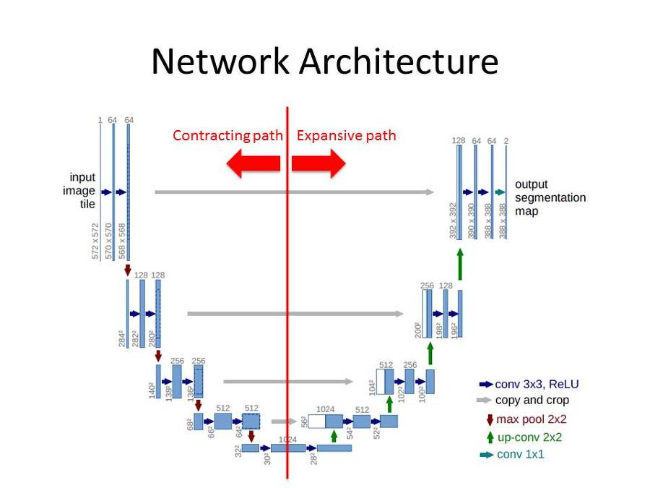
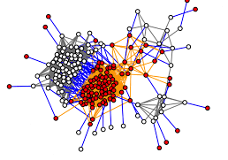
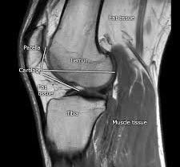
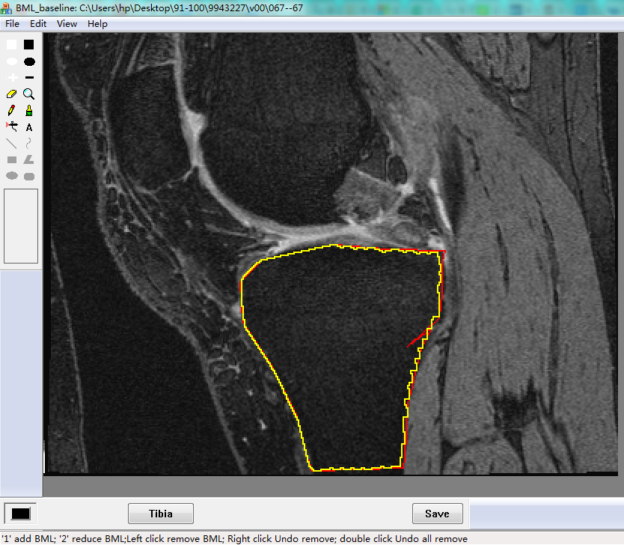
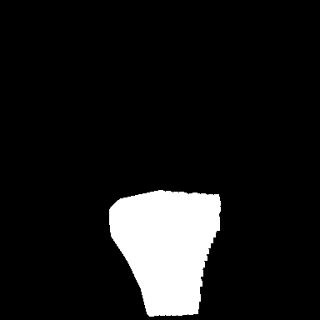
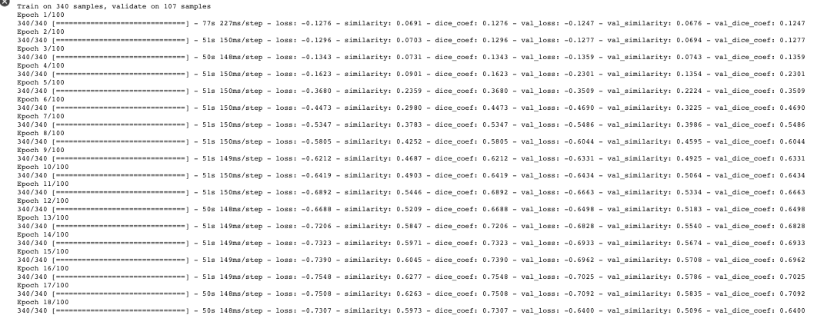
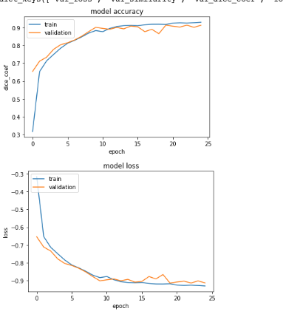
Machine Learning Model for MRI Segmentation
Erli Wang & David Nawee
CS 631T
Results
After analyzing the training and testing data, we discovered interesting and unexpected results. In experiment A we ran the program on five cases using 340 images to train the model and 100 images to test. The testing results produced a loss of 87%, dice_coeff of 87%, and similarity 78%. These results aligned with our predictions and even performed slightly better than expected. In experiment B, the same five cases were labeled differently using the same images for both training and testing. The results produced were astonishing. Keeping all variables constant and only differing in how the MRIs were labeled the results were as follows: loss of 69%, dice_coeff of 69%, and similarity of 55%. The results were much lower than what we predicted and showed us that labeling done by different people could indeed produce drastically different results. Lastly, the results generated from our large dataset with a training pool of 2849 images and a testing pool of 546 images had a loss of 87%, dice_coeff of 87%, and a similarity of 78%. Even more unexpected, experiment A is results for the testing phase almost identically matched the results produced in the testing phase of the large dataset.
Abstract
Materials
In recent years, with the development of newly-emerging techniques such as deep learning and data labeling, doctors and clinical practitioners no longer have to spend a lot of time reading medical images to diagnose diseases. Machine learning has reduced the time it takes to analyze thousands of data samples from weeks to mere hours. In machine learning, there are many different algorithms, each learning differently. One of the most successful programs is the convolutional neural network. The idea of CNN comes from biology, and the way organisms neurons interact and work with one another in harmonious relationships. CNN is used to learn, detect, and segment MRI images.
Google Collaboratory
Matlab
Dicom conversion code
Bone image creation code
Binary mask code
Machine learning algorithm
Data.py program
MRI images
Baseline data labeling application
Figure 1: An MRI describing the main regions composing a normal knee
Methodology
To begin, we each labeled five different cases of knee MRIs using the baseline image labeling application. The process took about three hours to mark five cases. After acquiring the data from each MRI, we used the provided binary mask code to generate a mask for each image of the tibia and then used a dicom code to convert the MRIs into file type tiff.
At this time, we began setting up the image conversion code for the masks and the MRI in Google Collaboratory. The data.py files used for the npy file generation varied from twenty minutes to an hour depending on the image pool.
After the files were appropriately generated, we proceeded to the primary step of our methodology, running the U-Net program to train & test. The U-Net program took the newly created data generated from the data.py file and began training. Running on GPU, this step took about an hour to complete for five cases and around five hours to complete for forty cases. After the program finished, the training and test reports were returned. Lastly, we analyzed the data provided by google collab and recorded our results.
Introduction
The concept of an artificial neural network is a primary component of deep learning and is widely popular in computer vision. Alan Turing first introduced the proposal of genetic algorithms in 1950 and has led to an emergence of new ideas and technology in a very young field.
In this project, we train a convolutional neural network called U-Net to identify the tibia bone, a major bone composing the knee from MRIs. A knee MRI consists of large bones like the femur and tibia, but also much smaller bones, muscles, tissue, and other crucial information surrounding the knee. The goal of the project is to learn more about how accurate and efficient the U-Net algorithm can be. We will be running multiple experiments with different amounts of knee MRIs and different labeling done on the same knee MRIs. We hypothesize that the U-Net algorithm will accurately return predicted images 90% similar to the test images for the large dataset and the experiments with a smaller image pool will return a similarity around 70%. In total, we are testing the U-Net program three different times.
Figure 2: On the left, labeled image using baseline application and extracted binary mask on right.
Conclusion
We learned the results from a training model could differ dramatically even if image pool, OS, algorithms are similar for training and testing of a U-Net machine learning algorithm. Also, we discovered different labeling could produce different results. The most exciting part of our findings was the discovery that using more images for training and testing doesn’t guarantee a model that can predict better. To conclude, although the accuracy of a machine learning algorithm can differ significantly based on many factors, and the predicted images might not be as descriptive as a medical professional might need. The amount of time deep learning algorithms can save is immeasurable and might be the next key to help to extend the human life span.
Figure 3: A quick glance at the training data while running the U-Net program
Figure 4: Large dataset test
results generated from U-Net
References
“Convolutional Neural Networks in Python.” DataCamp Community, www.datacamp.com/community/tutorials/convolutional-neural-networks-python
V-Net: Fully Convolutional Neural Networks for Volumetric Medical Image Segmentation - IEEE Conference Publication, ieeexplore.ieee.org/abstract/

