Slide 1
MM5021: Business Ethics
Lecture 1. Introduction and Stakeholder Theory
Class D (Business Analytics 2)
Time: 13:30-16:20 pm, Saturday (Weeks 2, 5, 8, 11)
Dr. Xueyong Zhan
Associate Professor
MM5021 Lecture 1

Slide 2
Introduction
About the Instructor
  Associate Professor, Department of Management and Marketing, The Hong Kong Polytechnic University
  Ph.D. in public administration and MPA, University of Southern California, Los Angeles, California, U.S.A.
  M.S. in management science, Chinese Academy of Sciences.
  B.S. in engineering, Tsinghua University, Beijing.
About You
  Tell us something about you
MM5021 Lecture 1

Slide 3
About the Course: Objectives
The purpose of this course is to provide students with an overview of business ethics, which has its foundations in a diverse range of business functions and sectors: accountancy, finance, information technology, logistics, marketing or management. It will help develop students’ abilities to appreciate the notions of social responsibility and ethical behaviors and to examine corporate interactions with stakeholders.
It will cover: 1) perspectives of business ethics and corporate social responsibility; 2) key aspects of ethical and responsibilities issues in business and management; and 3) management of business ethics and corporate social responsibilities.
Upon completion of the subject, students will be able to: 1) understand “business ethics” and “corporate social responsibility” from a global perspective; 2) identify and resolve ethical dilemmas and responsibility issues in business and management; and 3) analyze ethical and responsibility issues in individual business and management domains.
MM5021 Lecture 1

Slide 4
About the Course: Content
Session 1. Introduction and Stakeholder Theory (Week 2)
  Milton Friedman (1970), The Social Responsibility of Business Is to Increase Its Profits.
  Carroll, Archie B. (1999) "Corporate social responsibility: Evolution of a definitional construct." Business & society 38.3: 268-295.
  Crane and Matten, Chapter 1: Introducing Business Ethics
  Crane and Matten, Chapter 2: Framing Business Ethics: Corporate Responsibility, Stakeholders, and Citizenship.
Session 2. Conceptual Foundation of Business Ethics (Week 5)
  Crane and Matten, Chapter 3: Evaluating Business Ethics: Normative Ethical Theories
  Crane and Matten, Chapter 4: Making Decision in Business Ethics: Descriptive Ethical Theories.
  Bowie, Norman E. "A Kantian approach to business ethics." A companion to business ethics (2002): 3-16.
  Hicks, S. R. (2018). Ayn Rand and contemporary business ethics. Perspectives on Ayn Rand's Contributions to Economic and Business Thought, 239.
  Babson College, Introduction to the Babson Framework for Ethical Decision Making.
MM5021 Lecture 1

Slide 5
About the Course: Content
Session 3. Managing Business Ethics in the Era of Globalization (Week 8)
  ICAC seminar on business ethics and corporate governance
  Crane and Matten, Chapter 10, Civil Society and Business Ethics.
  Crane and Matten, Chapter 11: Government, Regulation, and Business Ethics.
  Crane and Matten, Chapter 12: Conclusions and Future Perspectives.
  Marquis, C., Zhang, J., & Zhou, Y. 2011. Regulatory uncertainty and corporate responses to environmental protection in China. California Management Review, 54(1), 39-63.
Session 4. Group Presentations (Week 11)
MM5021 Lecture 1

Slide 6
About the Course: Requirements
Textbook: Crane, A., Matten, D., Glozer, S., Spence, L. (2019). Business Ethics: Managing Corporate Citizenship and Sustainability in the Age of Globalization, International Edition, Oxford University Press.
You may purchase the textbook either at the PolyU bookstore or online via Amazon. Previous versions of the textbook may also be fine.
Other papers assigned as core readings are electronically available online or through the PolyU library system. All students are expected to finish the core reading materials for each week prior to class, and to participate in class discussions.
Additional materials may be distributed.
Class attendance and timely submission of individual assignments are required.
MM5021 Lecture 1

Slide 7
Important Policy
Continuous Assessment: 100%
  Attendance and class exercises: 20 %
  Case Study - Group presentation: 20 %
  Case Analysis – individual take-home assignment 60%
  NO Final Exam
Communications
  Please use email to communicate with the lecturer: xueyong.zhan@polyu.edu.hk. Add the course title MM5021 into the email title, and indicate which class (B/C/D) you are in.
  LEARN@PolyU is the primary website for this course. Please check it on a regular base. If you need assistance to use this website, please contact the IT technicians of PolyU.
  When communicating with the instructor about the group projects, please copy your email to all other group members.
MM5021 Lecture 1

Slide 8
Important Policy
Office Hours
  Students with learning difficulty or other questions are encouraged to contact me or meet with me during office hours (appointments required) or before/after the class.
Student Feedback
  We are committed to improving our teaching continuously. Please feel free to raise your comments, suggestions, and critiques on every aspect of the course to the instructor by email. We will consider your feedback and suggestion carefully and do our best to make this course a positive and practical learning experience for you.
Academic Integrity
  Academic dishonesty is not tolerated in this class. Cheating and plagiarism will be penalized in accordance with university rules/guidelines. All students are required to fully understand and comply with the principles of academic integrity. Finally, the individual paper must be submitted together with a Turnitin report.
MM5021 Lecture 1

Slide 9
Important Policy
Students are allowed to use Generative AI tools and resources in this class. To ensure academic integrity, however, students must openly disclose any AI-generated material they use. The instructor will provide updates on this matter in accordance with university rules and guidelines. In particular, students may use Generative AI in assessment unless they have been told otherwise before the assessment. Notwithstanding, PolyU upholds the principle that students should be accountable for their own work. While using Generative AI in assessment may be acceptable, claiming any piece of work, large or small, generated by AI as one’s own is not. Such behavior will be considered as an act that violates academic integrity. AI output used in assessment tasks should be properly referenced. For assessments in which reasonable use of Generative AI tools is deemed acceptable, students can be required to declare the use of Generative AI in their work, using a template such as this:
❑ I/We declare that Generative AI tools have not been used to produce the submitted work.
❑ I/We declare that Generative AI tools have been used to prepare the submitted work. The Generative AI tools used and the manner in which they were used are as follows:
MM5021 Lecture 1

Slide 10
Final Project: Presentation
Students will be divided into Five groups and each group will be responsible for making a presentation on a topic suggested by the instructor.
Group members (Six) are encouraged to conduct collaborative study and group meetings/discussions.
Please submit your group information form to the instructor by next Saturday. Results of grouping/topic selection will be announced as soon as possible. I will make more announcements later regarding the group project consultation session.
Please submit your ppt (15 pages maximum) to the instructor one day before the final presentation class.
Each group will have around 30 minutes, including final presentation (20 minutes), with Q&A session (5-10 minutes)
MM5021 Lecture 1

Slide 11
Suggested Topics
Intended Learning Outcomes:
  Apply appropriate approaches to handle ethics issues when involving one or more of the five technology elements (A – Artificial Intelligence (AI);B – Blockchain; C – Cloud Computing; D – Data Science; E – Entrepreneurship)
MM5021 Lecture 1

Slide 12
Suggested Topics
Theme 1: Corporate Responsibility to Investors/Shareholders
  Case 1-1: Amazon’s long-term growth strategy
  Case 1-2: Meituan’s long-term growth strategy
Theme 2: Corporate Responsibility to Employees
  Case 2-1: OT (working over time) in IT industries
  Case 2-2: Uber drivers: are they workers or self-employed?
Theme 3: Corporate Responsibility to Consumers
  Case 3-1: Facebook: Corporate compliance with EU General Data Protection Regulation
  Case 3-2: Didi: Corporate compliance with China's Personal Information Protection Law
MM5021 Lecture 1

Slide 13
Suggested Topics
Theme 4: Corporate Responsibility to Suppliers (& Competitors)
  Case 4-1: The Better Cotton Initiative
  Case 4-2: Starbucks‘s C.A.F.E (Coffee and Farmer Equity) practices
Theme 5: Corporate Responsibility to Community
  Case 5-1: Tencent’s philanthropic strategy
  Case 5-2: Pinduoduo’s activities in poverty alleviation
Theme 6: Corporate Responsibility to the Environment
  Case 6-1: Google
  Case 6-2: Tesla
MM5021 Lecture 1

Slide 14
Group Project Information
Case Outline In-class Discussion (5%)
  In the third class, each group will present a preliminary study of their case. The purpose of this discussion is to make sure that you are on the right track. Please submit a one-page WORD document to the instructor before the class.
  Each group will have around 5 minutes to introduce their case, followed by another 5 minutes of Q&A.
  The case outline presentation should cover the following areas:
    Formulate a statement of business dilemmas/challenges in ethics/CSR.
    Conduct an initial assessment of the company’s successes/failures in addressing such a dilemma/challenge.
  The case study presentation can be delivered by one student.
MM5021 Lecture 1

Slide 15
Group Project Information
Final Presentation (20%)
  Group final presentations will be the extension of their case study, and it should be delivered by the whole group. The presentation will be assessed by the following criteria: organization and structure; clarity of the presentation; quality of analysis (e.g. logical consistency, critical thinking); and responses to questions.
  The final presentation should cover the following areas:
    Refine the statement of corporate dilemmas/challenges in ethics or responsibility, clearly defined.
    Analyze and evaluate the company’s business strategies in addressing such dilemmas/challenges
    Conduct a full assessment of the company’s successes/failures in addressing such a dilemma/challenge
MM5021 Lecture 1

Slide 16
Final Project: Individual Essay
After the presentations of the case study group project, each student should write a paper. While you are given much flexibility in choosing what to write, your individual final paper needs to have a coherent theme relevant to the case/topic you studied and be written clearly and systematically.
The paper should reflect your ability in understanding, integrating, and evaluating ideas you learned from the readings, the lectures, and the projects. Each essay should be around 2 pages, 600-800 words (excluding references), Times New Roman style, 12 point font, single-spaced.
The due date of individual final paper will be announced later.
A turnitin report is required. The required benchmark of originality score is 10%, excluding references.
MM5021 Lecture 1

Slide 17
Performance / Grade Criteria
Excellent (A+ to A-)
  Demonstrate thorough mastery at an advanced level of extensive knowledge and skills required for attaining all the course learning outcomes. Show very strong analytical and critical abilities and logical thinking, with evidence of original thoughts, and ability to apply knowledge to a wide range of complex, familiar and unfamiliar situations. Apply highly effective organizational and presentational skills in both oral presentations and paper writing. Critical use of data and results to draw appropriate and insightful conclusions.
Good (B+ to B-)
  Demonstrate substantial command of a broad range of knowledge and skills required for attaining at least most of the course learning outcomes. Show strong evidence of analytical and critical abilities and logical thinking, and ability to apply knowledge to familiar and some unfamiliar situations. Apply very effective organizational and presentational skills in both oral presentations and paper writing.
MM5021 Lecture 1

Slide 18
Performance / Grade Criteria
Satisfactory (C+ to C-)
  Demonstrate general but incomplete to partial command of knowledge and skills required for attaining most of the course learning outcomes. Show evidence of some analytical and critical abilities and logical thinking to some coherent and logical thinking. Organization and presentational skills are minimally effective. Misuse of results and/or unable to draw appropriate conclusions, but with limited analytical and critical abilities. Show ability to apply knowledge to most familiar situation to solve problems. Apply moderately effective organizational and presentational skills in both oral presentations and paper writing.
Pass (D+ to D)
  Demonstrate limited command of knowledge and skills required for attaining most of the course learning outcomes. Show evidence of some analytical and critical abilities and logical thinking to some coherent and logical thinking. Organization and presentational skills are not effective, but with limited analytical and critical abilities. Show limited ability to apply knowledge to some situations and to solve problems.
MM5021 Lecture 1

Slide 19
Performance / Grade Criteria
Unsatisfactory
  (F) Failed to submit required individual assignments. Failed to attend the final exam. Demonstrate very little or no evidence of command of knowledge and skills required for attaining the course learning outcomes. Show no analytical and critical abilities, logical and coherent thinking. Show no ability to apply knowledge to solve problems. Organization and presentational skills are ineffective.
  (S) Absent from all assessment components
MM5021 Lecture 1

Slide 20
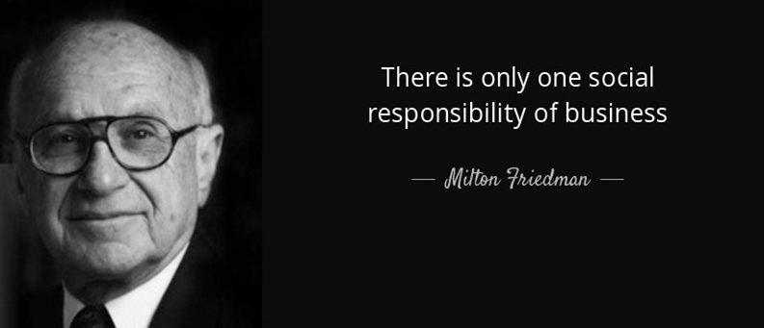
Corporate Social Responsibility
Milton Friedman, one of the greatest economists, introduced “A Friedman Doctrine”: The Social Responsibility of Business is to Increase Its Profits.
MM5021 Lecture 1

Slide 21
Corporate Social Responsibility
Corporate Social Responsibility
  The primary goal of modern firms is to produce profits, but they also need to meet legal responsibility and broader social obligations and ensure ethical behavior in producing those profits
Drivers of CSR
  Corporate values - a value shift has taken place within businesses where they not only feel responsibility for wealth creation but also for social and environmental goods.
  Operational strategy - being more socially and environmentally responsible is important for the strategic development of a company.
  Social and public pressure - pressure groups, consumers, media, the state and other public bodies are pressing companies to become more socially responsible.
MM5021 Lecture 1

Slide 22
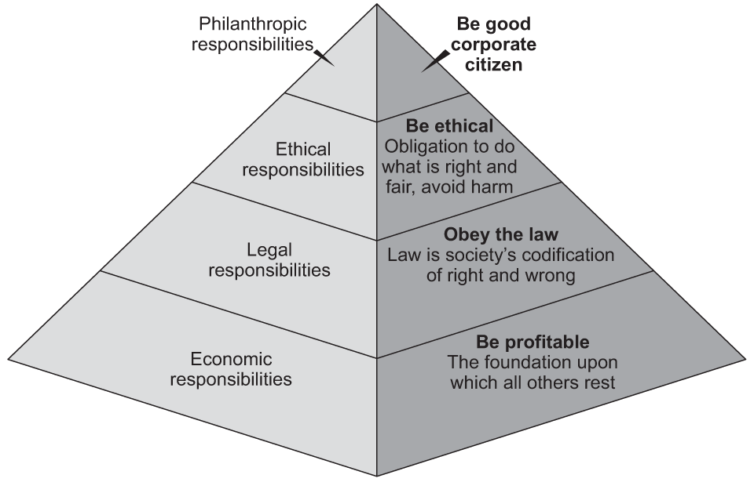
Pyramid of CSR (Carroll, 1991)
MM5021 Lecture 1

Slide 23
The Internal Governance of Firms
Economic View of Firms
  Profit-maximizing function, constrained by market competition and governmental regulations
  Legal model of corporate governance: stockholders have the ultimate authority; they exercise their control through their legal right to elect the board of directors, which is responsible for ensuring that the firm is well managed and stockholders receive a fair return on their investment
  Ownership and management separation: information asymmetry and the principal-agent problem
MM5021 Lecture 1

Slide 24
The Internal Governance of Firms
Principal-agent Problem
  Owners want managers to seek the long-run success of the firm. But managers may have other objectives: short-term performance (cash out their bonus and leave the company); personal career advancement; potential for goal conflict between owners and managers
  Managers are really in control because stockholders have limited ability to exercise their legal rights
  Top managers in fact nominate board members and can often remove them; board members often do not have the information necessary to oversee management.
MM5021 Lecture 1

Slide 25
Stakeholders and Corporate Governance
Theory developed by Edward Freeman (1984)
  A stakeholder of an organization is: …any group or individual who can affect, or is affected by, the achievement of the organization’s objectives (Freeman 1984:46)
More precise definition of ‘affects’ and ‘affected by’ (Evan and Freeman 1993)
  Principle of corporate rights - the corporation has the obligation not to violate the rights of others
  Principle of corporate effect – companies are responsible for the effects of their actions on others
Source: Crane et al (2019)
MM5021 Lecture 1

Slide 26
Stakeholders and Corporate Governance
External Stakeholders
  Stakeholders may include suppliers; labor unions; government regulatory agencies; professional associations; NGOs/civil society and policy advocacy groups; prospective employees; customers; local communities; competitors…
  Corporations and stakeholders: individuals rely on them for jobs; communities rely on them for job creation, tax base to support government services; countries rely on them for economic growth, international trade
Strengths of NGOs and Civil Society
  Well-connected with communities and consumers; may act as moderators and facilitators between corporations and individuals;
  May leverage the power of public policy actors, the media and the Internet to check the behavior of business
  Collective actions against unethical business practices
MM5021 Lecture 1

Slide 27
Stakeholders and Corporate Governance
Stakeholders and Governance
  Business managers need to consider public interests, including environmental protection; sustainable development; helping the poor; work safety standards…
According to Freeman, this broader view of responsibility towards multiple stakeholders assigns a new role to management.
Rather than simply being agents of shareholders, management has to take into account the rights and interests of all legitimate stakeholders:
  Stakeholder democracy
  Corporate governance
Source: Crane et al (2019)
MM5021 Lecture 1

Slide 28
Stakeholder Theory of the Firm
Traditional management model
Shareholders
Customers
Firm
Suppliers
Employees
Source: Crane et al (2019)
MM5021 Lecture 1

Slide 29
Stakeholder Theory of the Firm
A stakeholder model
Government
Competitors
Shareholders
Customers
Firm
Suppliers
Employees
Civil
society
Source: Crane et al (2019)
MM5021 Lecture 1

Slide 30
Stakeholder Theory of the Firm
A network model
Customer stakeholder 1
Government
Competitors
Customers
Customer stakeholder 3
Shareholders
Firm
Suppliers
Employee stakeholder 1
Employees
Civil society
Supplier stakeholder 1
Employee stakeholder 2
Civil society stakeholder 1
Civil society stakeholder 2
Source: Crane et al (2019)
MM5021 Lecture 1

Slide 31

Greta Thunberg
Climate activist Greta Thunberg rebukes world leaders:
https://www.youtube.com/watch?v=rYxt0BeTrT8
MM5021 Lecture 1

Slide 32
References
Carroll, A. B. (1999). Corporate Social Responsibility: Evolution of a Definitional Construct, Business & Society, Vol. 38, No. 3, pp. 268-295.
Carroll, A. B. (1991). The pyramid of corporate social responsibility: Toward the moral management of organizational stakeholders. Business Horizons, 34, 39-48.
Crane, A., Matten, D., Glozer, S., Spence, L. (2019). Business Ethics: Managing Corporate Citizenship and Sustainability in the Age of Globalization, International Edition, Oxford University Press.
Milton Friedman (1970), The Social Responsibility of Business Is to Increase Its Profits. The New York Times Magazine.
MM5021 Lecture 1

