Slide 1
Chap. 3
Arithmetic for computer (ALU)
臺大電機系
吳安宇教授
2015-03-27 v1
臺大電機吳安宇教授- 計算機結構

Slide 2
Outline
3.1 Introduction
3.2 Addition and Subtraction
3.3 Multiplication
3.4 Division
3.5 Floating Point
3.6 Parallelism and Computer Arithmetic: Associativity
臺大電機吳安宇教授- 計算機結構

Slide 3
Introduction
Arithmetic algorithms (ALU Operations)
  1. Addition/Subtraction
  2. Multiplication/Division
Representation of numbers
  1. What is the ”largest” and “smallest” number that can be represented by a computer word?
  2. How to represent floating-point numbers?
MIPS instructions for (A)&(B)
臺大電機吳安宇教授- 計算機結構

Slide 4
Outline
3.1 Introduction
3.2 Addition and Subtraction
3.3 Multiplication
3.4 Division
3.5 Floating Point
3.6 Parallelism and Computer Arithmetic: Associativity
臺大電機吳安宇教授- 計算機結構

Slide 5
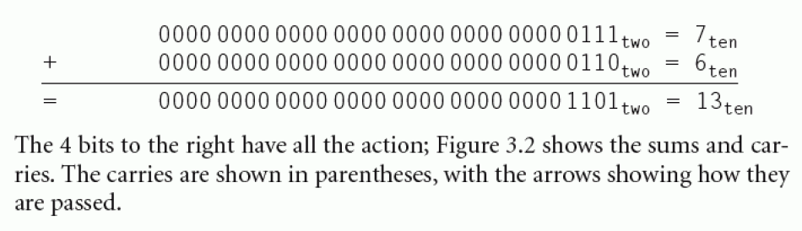

Addition and Subtraction
Example
  Adding 6 to 7
臺大電機吳安宇教授- 計算機結構

Slide 6
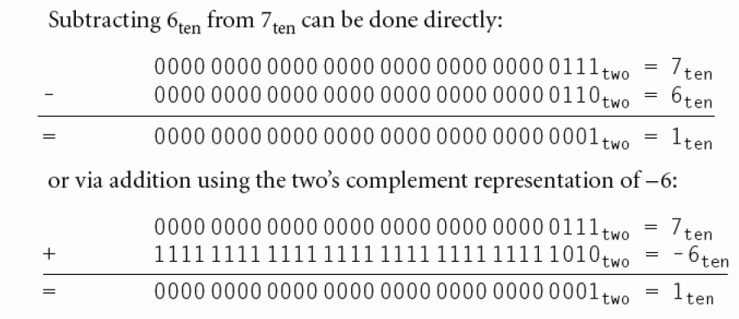
Addition and Subtraction
Example
  subtracting 6 from 7 (or add 2’s complement of 6)
臺大電機吳安宇教授- 計算機結構

Slide 7
Overflow
  Overflow: Sum/difference of two 32-bit numbers is too large to be represented in 32 bits.
  Example:
    Bit 31 30 3 2 1 0
    0111 1111……1111 = 2,147,483,647
    +) 0000 0000……0010 = 2
    10……………… 0001 = - 2,147,483,647
    check sign bit
臺大電機吳安宇教授- 計算機結構

Slide 8
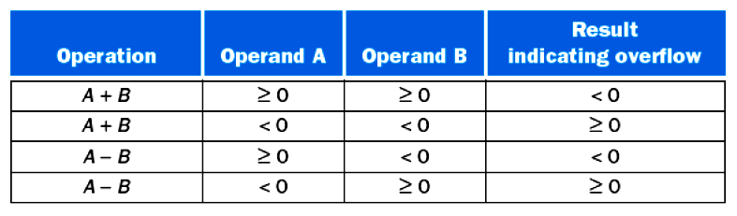
Overflow condition
  Exception Also called interrupt. An unscheduled event that disrupts program execution; used to detect overflow.
  Interrupt An exception that comes from outside of the processor. (Some architectures use the term interrupt for all exceptions)
  → Add (add), add immediate (addi), and subtract (sub) cause exceptions on overflow.
  → Add unsigned (addu), add immediate unsigned (addiu), and subtract unsigned (subu) do NOT cause exceptions on overflow.
  Adding operands of different signs → “no” overflow can occur
臺大電機吳安宇教授- 計算機結構

Slide 9
Arithmetic for Multimedia
By partitioning the carry chains within a 64-bit adder, a processor can perform simultaneous operations on short vectors of eight 8-bit operands, four 16-bit operands, or two 32-bit operands.
The extensions called vector or SIMD (Single Instruction Multiple Datapath), e.g.,, MMX extension in x86 CPU
Saturating Operations: When a calculation overflows, the result is set to the largest positive number or most negative number, rather than a modulo calculation as in conventional 2’s complement arithmetic.

Slide 10

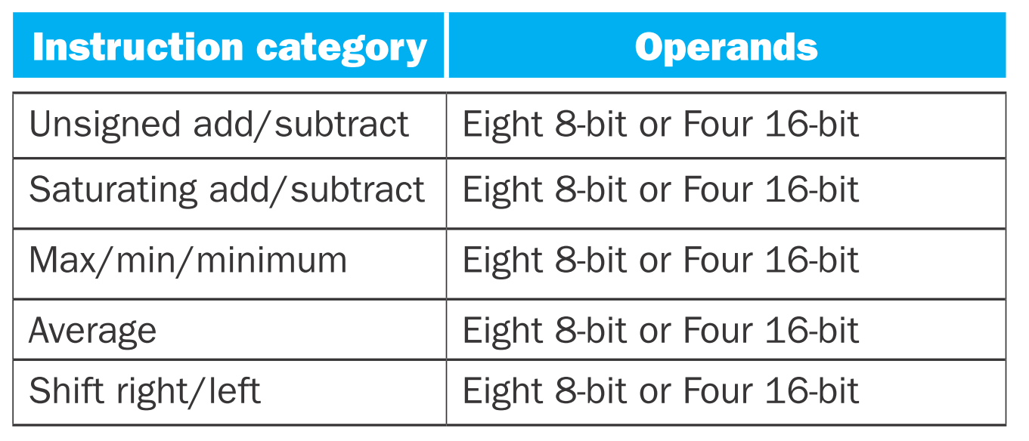
Arithmetic for Multimedia

Slide 11
How to handle overflow in HW?
  MIPS detects overflow with “exception” (interrupt) which is essentially an unplanned procedure call.
  Steps : (HW interrupt)
    The address of the instruction that caused overflow is saved in a register.
    Jump to the (interrupt) service routine (ISR) for that exception (Exception Vector Interrupt Address of Arithmetic Overview = 8000 0180_hex)
    Return to the program
  MIPS uses
    A register called “exception program counter” (EPC) to contain the address of the instruction that causes the exception.
    Instruction “move from system control (MFCO)” to copy EPC into a register so that MIPS software can return to the offending instruction via “jr” instruction.
臺大電機吳安宇教授- 計算機結構

Slide 12
Summary
Unsigned number is usually used for memory address and logic operations. In MIPS, the max address number is
2³² = 4,294,967,296₁₀
  Usually, we can ignore overflow
臺大電機吳安宇教授- 計算機結構

Slide 13
Outline
3.1 Introduction
3.2 Addition and Subtraction
3.3 Multiplication
3.4 Division
3.5 Floating Point
3.6 Parallelism and Computer Arithmetic: Associativity
臺大電機吳安宇教授- 計算機結構

Slide 14
Multiplication
Multiplying 1000₂x1001₂
  Multiplicand→ 1000 → 8
  Multiplier → x) 1001 → 9
  1000
  00000
  000000
  1000000
  product → 1001000 → 72
Steps:
  If multiplier bit =0, place 0
  =1, place multiplicand
  Do summation to get partial product
n-bit multiplicand × m-bit multiplier → (n+m)-bit product
臺大電機吳安宇教授- 計算機結構

Slide 15
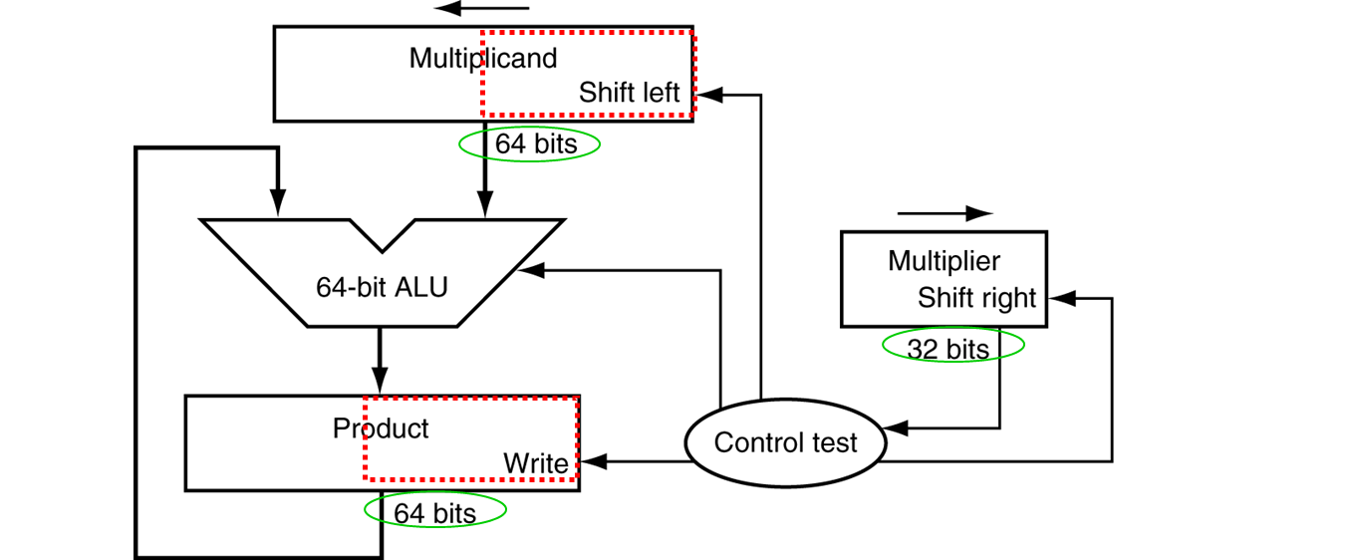

First version of multiplication HW
臺大電機吳安宇教授- 計算機結構

Slide 16

First version of multiplication algorithm

Slide 17
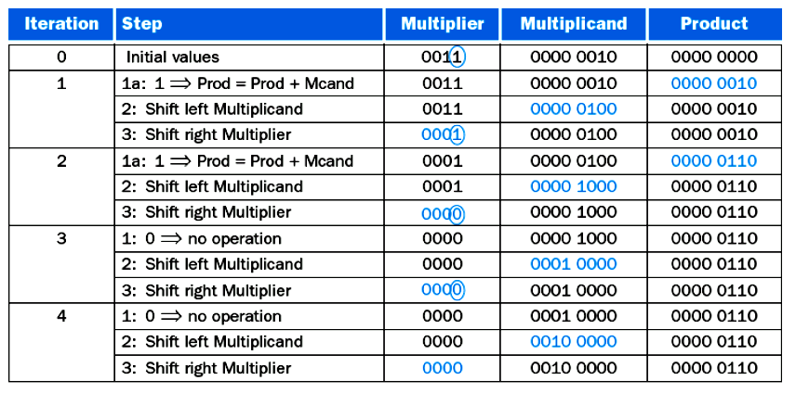
0010 (Multiplicand) x 0011 (Multiplier)
臺大電機吳安宇教授- 計算機結構

Slide 18

Second version of multiplication HW
FIGURE 3.5 Refined version of the multiplication hardware
臺大電機吳安宇教授- 計算機結構

Slide 19
Multiplication
Differences between 1st & 2nd version:
  64-bit multiplicand → 32 bit
  64-bit ALU → 32 bit
  Instead of shifting the multiplicand to the left (x2), we shift the “product” to the right (initial at upper half of Product, then div 2)
Multiply in MIPS
  MIPS provides a separate pair of 32-bit registers to contain the 64-bit product, called Hi and Lo.
  To produce a properly signed or unsigned product, MIPS has two instructions: multiply (mult) and multiply unsigned (multu).
  To fetch the integer 32-bit product, the programmer uses move from lo (mflo).
  The MIPS assembler generates a pseudo instruction for multiply that specifies three general purpose registers, generating mflo and mfhi instructions to place the product into registers.
臺大電機吳安宇教授- 計算機結構

Slide 20
Outline
3.1 Introduction
3.2 Addition and Subtraction
3.3 Multiplication
3.4 Division
3.5 Floating Point
3.6 Parallelism and Computer Arithmetic: Associativity
臺大電機吳安宇教授- 計算機結構

Slide 21
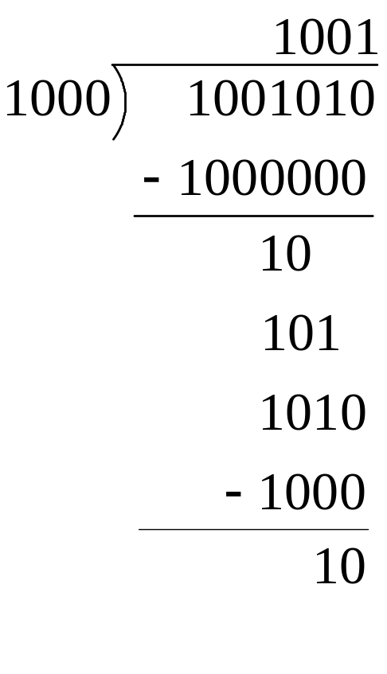
Division
Dividing 1,001,010 by 1000
Dividend = Quotient x Divisor + Remainder
where Remainder < Divisor
Quotient
Dividend
Divisor
Remainder
(from Dividend)
臺大電機吳安宇教授- 計算機結構

Slide 22

First version of Division HW
Initially divisor in left half
⁰⁰⁰
Set 1/Set 0
Dividend
Initially dividend
FIGURE 3.8 First version of the division hardware
臺大電機吳安宇教授- 計算機結構

Slide 23
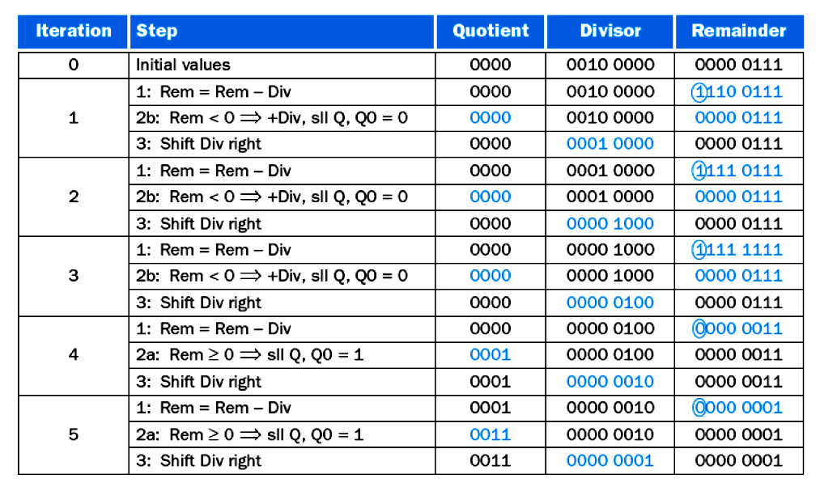
0000 0111 ÷ 0010
Negative
Restore/set0
Negative
Restore/set0
Negative
Restore/set0
Positive
set1
Positive
set1
臺大電機吳安宇教授- 計算機結構

Slide 24
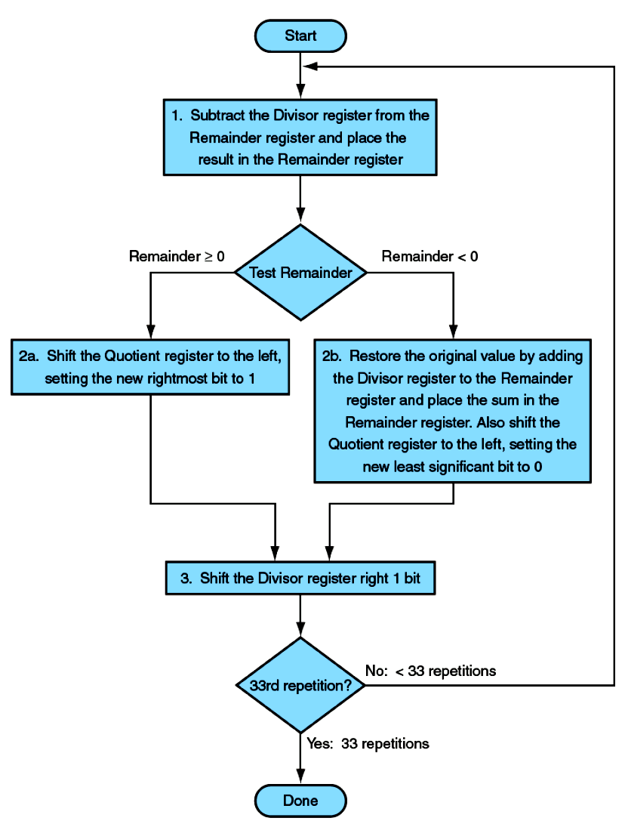
First version of Division algorithm

Slide 25
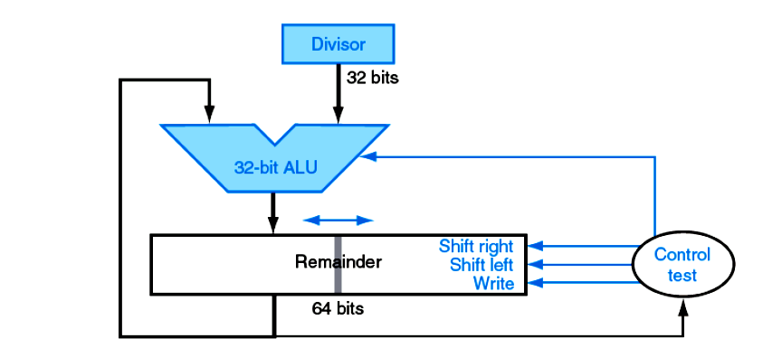
An improved version of division
Add/subtract
Remainder
Quotient
Set 0/1
Dividend
FIGURE 3.11 An improved version of the division hardware
Bidirection for both Multiply & Division
for Division only
臺大電機吳安宇教授- 計算機結構

Slide 26
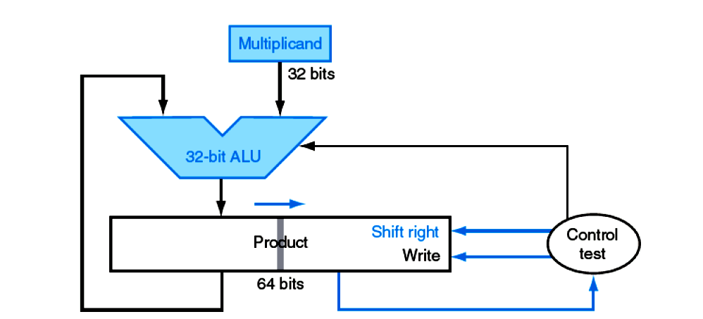
c. f. 2nd version of multiplication HW
Add
FIGURE 3.5 Refined version of the multiplication hardware
臺大電機吳安宇教授- 計算機結構

Slide 27
Division
The same sequential hardware can be used for both multiply and divide. The only requirement is a 64-bit register that can shift left or right and a 32-bit ALU that adds or subtracts.
MIPS uses the 32-bit Hi and Lo registers for both multiply and divide.
MIPS (Lo = quotient, Hi = Remainder)
  div $2, $3 # Lo=$2 / $3 , Hi=$2 mod $3 (signed)
  divu $2, $3 # Lo=$2 / $3 , Hi=$2 mod $3 (unsigned)
  mflo $4 # Move Quotient to $4
  mfhi $1 # Move Remainder to $1
臺大電機吳安宇教授- 計算機結構

Slide 28
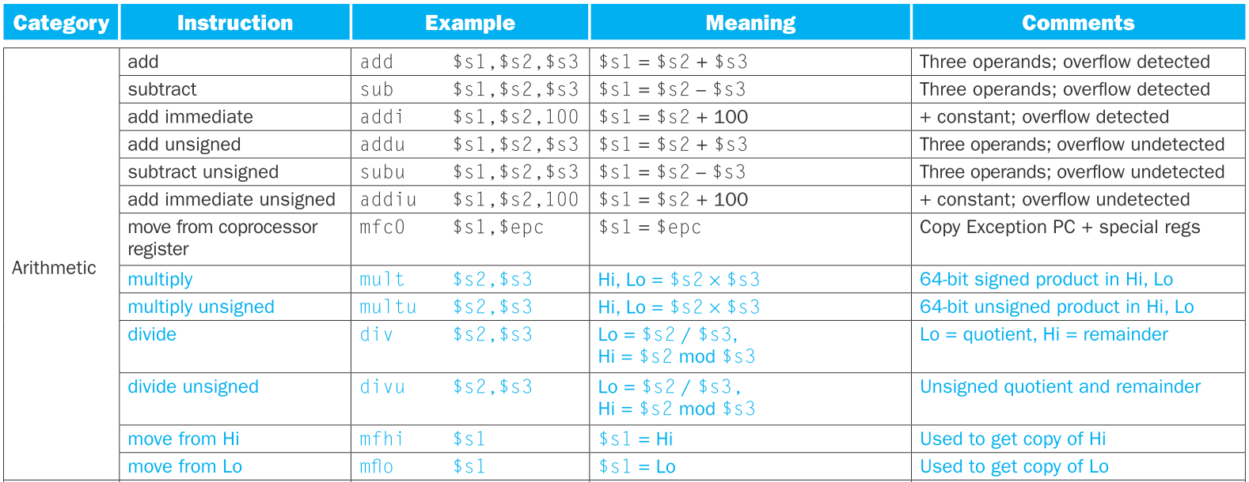
Summary of MIPS Arithmetic Instructions

Slide 29
Outline
3.1 Introduction
3.2 Addition and Subtraction
3.3 Multiplication (omit)
3.4 Division (omit)
3.5 Floating Point
3.6 Parallelism and Computer Arithmetic: Associativity
臺大電機吳安宇教授- 計算機結構

Slide 30
Normalized number
In addition to signed and unsigned integers, we have “Real numbers” in mathematics
  π=3.14159……
  e=2.71828……
  3,155,760,000 = 3.15576×10⁹
  0.000 000 001 = 1.0×10⁻⁹
A number in scientific notation that has no leading 0 is called a “normalized” number
  Ex.
1.0×10⁻⁹ (V) → Normalized scientific notation
0.1×10⁻¹⁰ ( X )
10.0x10⁻⁸ ( X )
臺大電機吳安宇教授- 計算機結構

Slide 31
Representation of Floating-point Number
In binary digits
± 1.xxxxxxx₂ × 2^{yyyy} (base 2)
Representation in MIPS
Single Precision
N=(-1)^{S}*F*2E
31 | 30~23 | 22~0
S | exponent | fraction
1 bit (S) | 8 bits (E) | 23 bits (F)
(2’s complement → biased by 127)
臺大電機吳安宇教授- 計算機結構

Slide 32
Double precision
Double precision floating-point number (two 32-bit words, by IEEE 754 floating-point standard)
31 | 30~20 | 19~0
S | exponent | fraction
1 bit (S) | 11bits (E) | 20 bits (F)
word0
word1
fraction (cont’d)
32bits
臺大電機吳安宇教授- 計算機結構

Slide 33
Accuracy & Range
Trade-off between “accuracy” and “range”
  Increasing the size of fraction enhances accuracy.
  Increasing the size of exponent increases the range.
Overflow: number is too large to be represented by the hardware.
Underflow: number is too small to be represented by the hardware.
  Exercise
-∞← | x |  |  | x | →∞
Min negative No. | Max negative No. | 0 | Min positive No. | Max positive No.
臺大電機吳安宇教授- 計算機結構

Slide 34
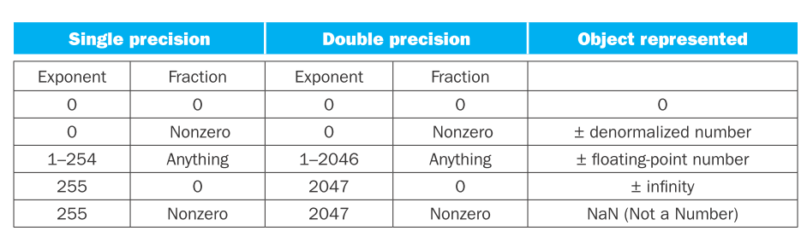
Representing floating-point numbers
(IEEE 754 floating-point standard)
0 → S=E=F=0
Hidden 1 is added (Recall N= ± 1.xxxxxxx₂ × 2^{yyyy} )
N=(-1)^{S} x [ 1 + Fraction ] x 2E
=(-1)^{S} x [ 1 + (S1x2⁻¹) + (S2x2⁻²)+…+…] x 2E
FIGURE 3.13 IEEE 754 encoding of floating-point numbers.
臺大電機吳安宇教授- 計算機結構

Slide 35
Representing floating-point numbers
Unbiased exponent: 2’s complement for Exponet
+1.0x2⁻¹ (not good) +1.0x2⁺¹ (not good)
31 30~23 22~0
→ Biased notation exponent:
∴N=(-1)^{S} x (1+significand) x 2^{(exponent-bias)}
where bias =127 (for single precision)
=1023 (for double precision)
0 | 11111111 | 000………000
0 | 00000001 | 000………000
0 | → | Reserved for 0 & denormalized
1 | → | -126
…… |  | ……
127 | → | 0
128 | → | +1
…… |  | ……
254 | → | +127
255 | +bias (127) | Real meaning
臺大電機吳安宇教授- 計算機結構

Slide 36
Floating Point
Ex. Represent -0.75₁₀ in IEEEE 754 standard
-0.7510 = -0.112
= -0.11x2⁰ (scientific notation)
= -1.1x2⁻¹ (normalized scientific notation)
add 127 to exponent
→ (-1)¹x(1+.1000…0)x2⁽¹²⁶⁾
→
31 | 30~23 (exp) | 22~0 (fraction)
1 | 01111110 | 1000………00
臺大電機吳安宇教授- 計算機結構

Slide 37
Floating Point
Ex. What’s the number in base 10 ?
Sign bit = 1
exponent = 129 →real exponent = 129-127 = 2
significand (fraction) =2^(-2) = 0.25_base2
N=(-1)^{S} x (1+fraction) x 2^{(exponent-bias)}
= -1¹ x (1+0.25) x 2²
= -1 x 1.25 x 4 = -510
31 | 30~23 | 22~0
1 | 10000001 | 010………00
臺大電機吳安宇教授- 計算機結構

Slide 38
Floating Point Addition
Ex. 9.999x10¹ + 1.610x10⁻¹ (with 4 significand digits)
  Step1. align the decimal point with the larger exponent (Note: large number is more important !)
  1.610x10⁻¹ → 0.016x10⁺¹
  Step2. Adding the significand
  9.999
  +)0.016
  10.015 sum=10.015x10⁺¹
  Step3. Write in “normalized form”
  sum=1.0015x10²
  Step4. Truncate significand to 4 digits
  sum=1.002x10²
臺大電機吳安宇教授- 計算機結構

Slide 39
FP Adder Hardware
Much more complex than integer adder
Doing it in one clock cycle would take too long
  Much longer than integer operations
  Slower clock would penalize all instructions
FP adder usually takes several cycles
  Can be pipelined
Overflow check: Exponent (E) (0, 255 are reserved)
  Single precision: -126 =< E =< 127
  Double precision: -1022 =< E =< 1023
Notes:
Morgan Kaufmann Publishers
Chapter 3 — Arithmetic for Computers

Slide 40
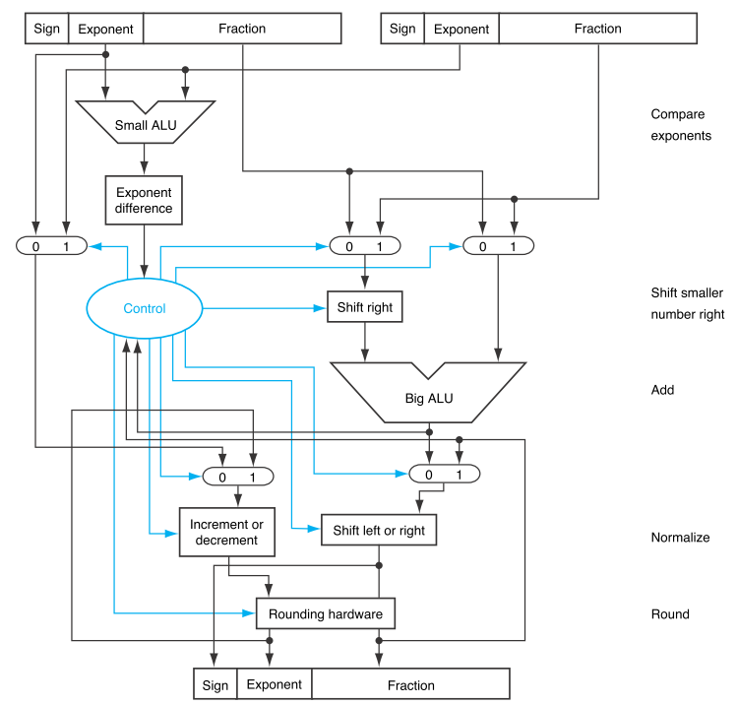
FP Adder Hardware
Step 1
Step 2
Step 3
Step 4
FIGURE 3.15 Block diagram of an arithmetic unit dedicated to floating-point addition
Notes:
Morgan Kaufmann Publishers
Chapter 3 — Arithmetic for Computers

Slide 41
Floating Point Multiplication (skip)
Ex: (1.110x10¹⁰ )x (9.200x10⁻⁵ )
(4 digits for significand, 2 digits for exponent)
  Step1. adding exponent
  10+(-5)=5 → new exponent
  Step2. Multiplying significands
  1.110
  x) 9.200 → product = 10.21200x10⁺⁵
  10.21200₁₀
  Step3. Normalize the result
  10.21200x10⁺⁵=1.0212x10⁺⁶
  check overflow: exponent is too large
  underflow: large negative exponent
  Step4. Rounding significant (to 4 digits): 1.021x10⁺⁶
  Step5. add sign: + 1.021x10⁺⁶
臺大電機吳安宇教授- 計算機結構

Slide 42
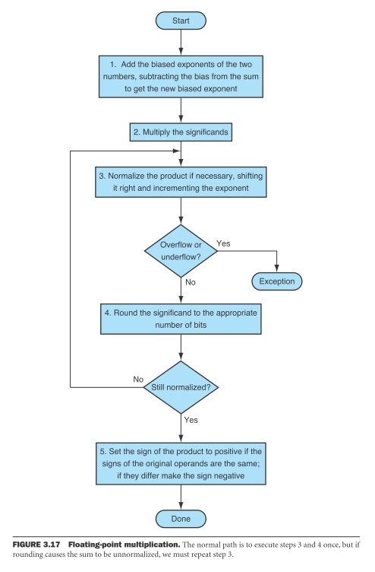
Floating Point Multiplication (skip)
臺大電機吳安宇教授- 計算機結構

Slide 43
FP Arithmetic Hardware
FP multiplier is of similar complexity to FP adder
  But uses a multiplier for significands instead of an adder
FP arithmetic hardware usually does
  Addition, subtraction, multiplication, division, reciprocal, square-root
  FP ↔ integer conversion
Operations usually takes several cycles
  Can be pipelined
Notes:
Morgan Kaufmann Publishers
Chapter 3 — Arithmetic for Computers

Slide 44
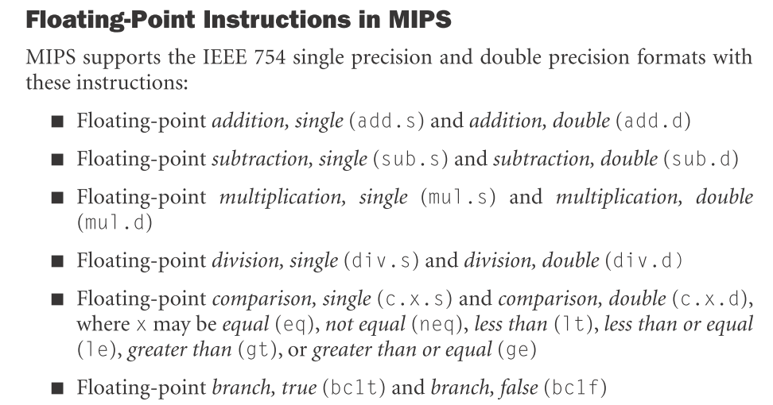
Floating-point Instructions in MIPS

Slide 45
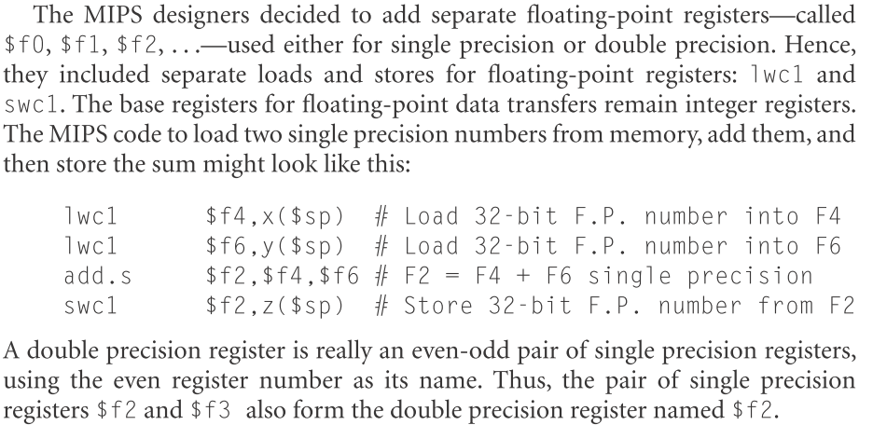
Floating-point Registers

Slide 46
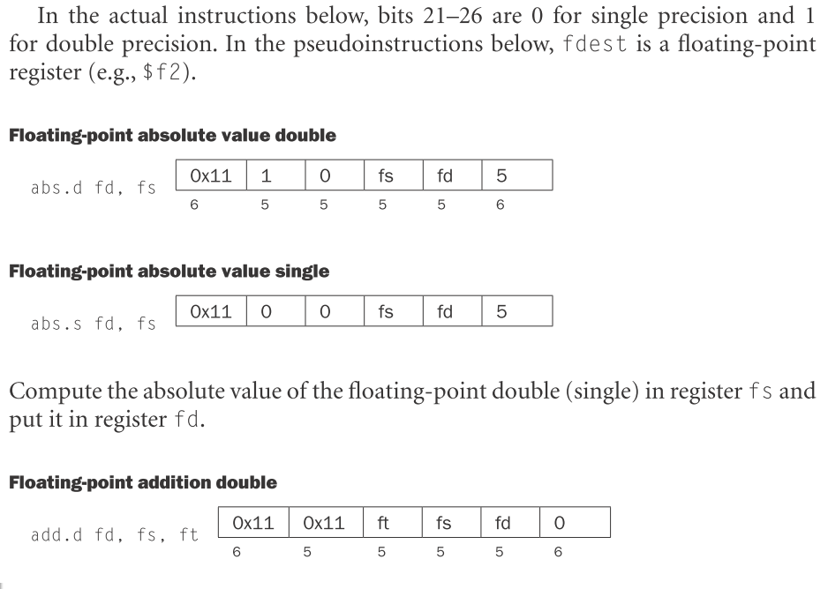
Floating-Point Instruction format (on Page B-73)

Slide 47
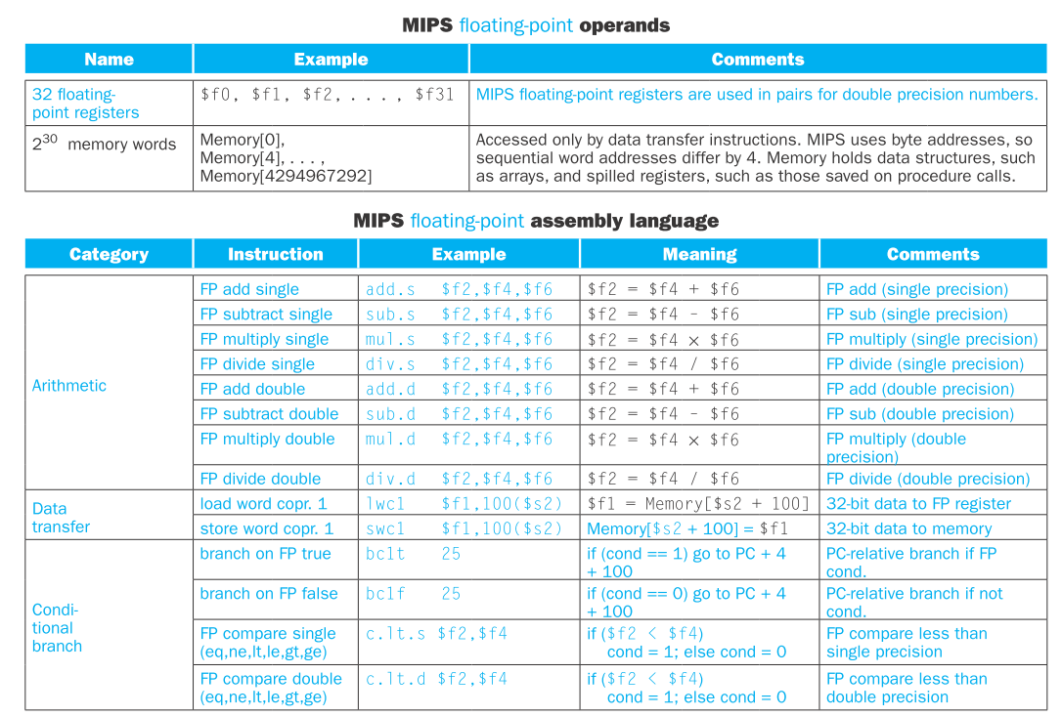
Summary of MIPS floating-pt Operands

Slide 48
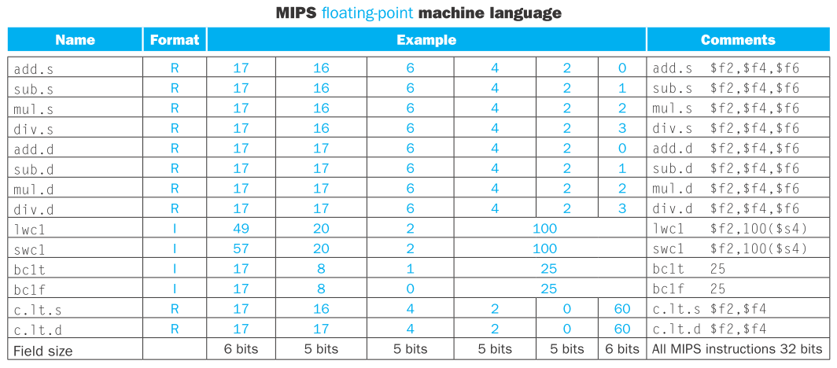
Summary of MIPS fp Machine Language
ft, fs, fd

Slide 49
FP Example: °F to °C
C code:
float f2c (float fahr) {
return ((5.0/9.0)*(fahr - 32.0));
}
  fahr in $f12, result in $f0, literals in global memory space
Compiled MIPS code:
f2c:
lwc1 $f16, const5($gp) # $f16 = 5.0
lwc1 $f18, const9($gp) # $f18 = 9.0
div.s $f16, $f16, $f18 # 5.0/9.0
lwc1 $f18, const32($gp) # $f18 = 32.0
sub.s $f18, $f12, $f18 # $f18 = fahr – 32.0 mul.s $f0, $f16, $f18 # $f0 = result
jr $ra # return
Notes:
Morgan Kaufmann Publishers
Chapter 3 — Arithmetic for Computers

Slide 50
FP Example: Array Multiplication
(skip: please check by yourself)
X = X + Y × Z
  All 32 × 32 matrices, 64-bit double-precision elements
C code:
void mm (double x[][],
double y[][], double z[][]) {
int i, j, k;
for (i = 0; i! = 32; i = i + 1)
for (j = 0; j! = 32; j = j + 1)
for (k = 0; k! = 32; k = k + 1)
x[i][j] = x[i][j]
+ y[i][k] * z[k][j];
}
  Addresses of x, y, z in $a0, $a1, $a2, and
  i, j, k in $s0, $s1, $s2

Slide 51
FP Example: Array Multiplication
MIPS code:
li $t1, 32 # $t1 = 32 (row size/loop end)
li $s0, 0 # i = 0; initialize 1st for loop
L1: li $s1, 0 # j = 0; restart 2nd for loop
L2: li $s2, 0 # k = 0; restart 3rd for loop
sll $t2, $s0, 5 # $t2 = i * 32 (size of row of x)
addu $t2, $t2, $s1 # $t2 = i * size(row) + j
sll $t2, $t2, 3 # $t2 = byte offset of [i][j]
addu $t2, $a0, $t2 # $t2 = byte address of x[i][j]
l.d $f4, 0($t2) # $f4 = 8 bytes of x[i][j]
L3: sll $t0, $s2, 5 # $t0 = k * 32 (size of row of z)
addu $t0, $t0, $s1 # $t0 = k * size(row) + j
sll $t0, $t0, 3 # $t0 = byte offset of [k][j]
addu $t0, $a2, $t0 # $t0 = byte address of z[k][j]
l.d $f16, 0($t0) # $f16 = 8 bytes of z[k][j]
…

Slide 52
FP Example: Array Multiplication
…
sll $t0, $s0, 5 # $t0 = i*32 (size of row of y)
addu $t0, $t0, $s2 # $t0 = i*size(row) + k
sll $t0, $t0, 3 # $t0 = byte offset of [i][k]
addu $t0, $a1, $t0 # $t0 = byte address of y[i][k]
l.d $f18, 0($t0) # $f18 = 8 bytes of y[i][k]
mul.d $f16, $f18, $f16 # $f16 = y[i][k] * z[k][j]
add.d $f4, $f4, $f16 # f4=x[i][j] + y[i][k]*z[k][j]
addiu $s2, $s2, 1 # $k k + 1
bne $s2, $t1, L3 # if (k != 32) go to L3
s.d $f4, 0($t2) # x[i][j] = $f4
addiu $s1, $s1, 1 # $j = j + 1
bne $s1, $t1, L2 # if (j != 32) go to L2
addiu $s0, $s0, 1 # $i = i + 1
bne $s0, $t1, L1 # if (i != 32) go to L1

Slide 53
Summary
Computer arithmetic are essential parts of ALU designs.
Most modern CPU has supported floating-point operations for high-performance computation
SIMD extension is also popular to enhance CPU’s capability for multimedia applications.
Note the computing power and speed efficiency among arithmetic operations. In general, Integer ADD/SUB < (Int) MUL << (Int) Div << Floating-point operations.

