Slide 1
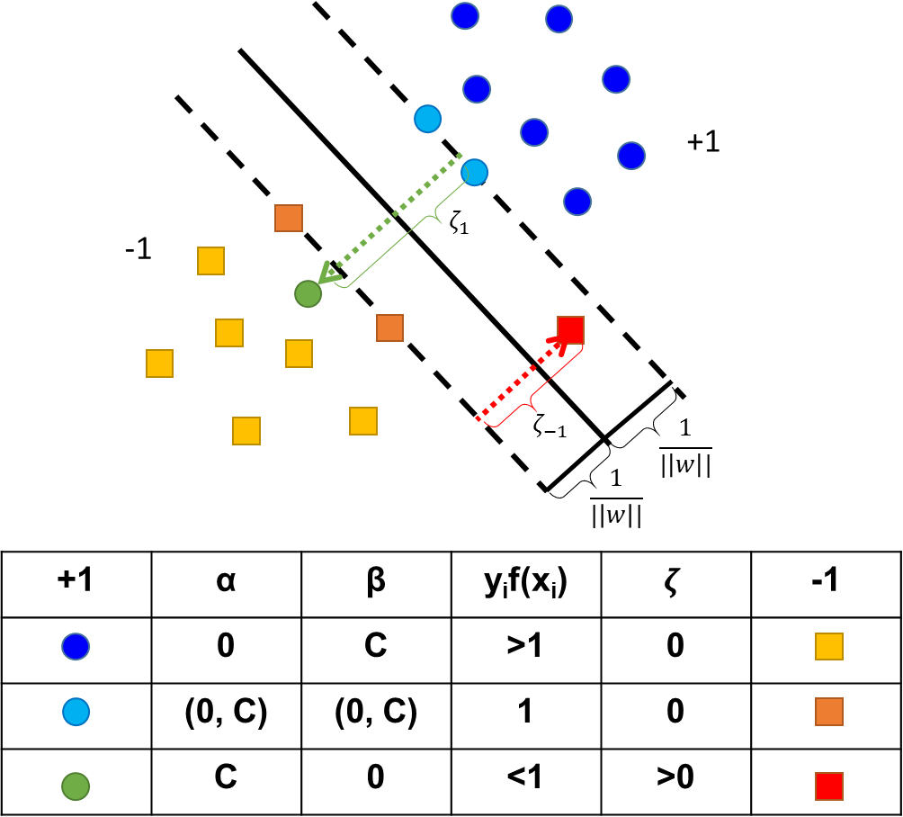

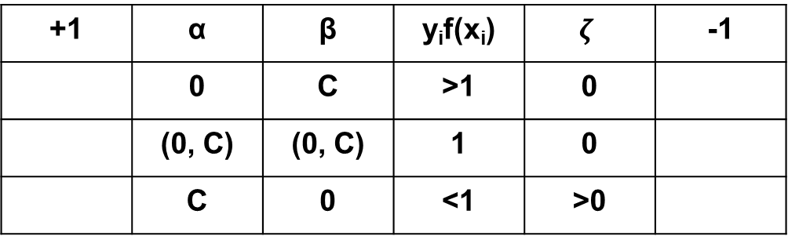



+1
$$ζ_{1}$$
-1
$$ζ_{−1}$$
$$\frac{1}{|\left|w\right||}$$
$$\frac{1}{|\left|w\right||}$$
+1 | α | β | y_{i}f(x_{i}) | $$ζ$$ | -1
 | 0 | C | >1 | 0
 | (0, C) | (0, C) | 1 | 0
 | C | 0 | <1 | >0

