Slide 1

jRun
Juan Alonso Cruz, Omar Baradei, Eric Dai, David Han, Felix Park
Carbon 2017
6/8/2017
Notes:
Template version: 11/20/2012, for PowerPoint 2007 & 2010

Slide 2

About Our Project
Let N = 1
P = NP
Q.E.D.
Travelling Salesman Problem in Polynomial Time

Slide 3
Questions?

Slide 4
“Problem”
Data for Banks [Capital One]
Better serve customers
“Real data is found when it is least expected"
Notes:
After we solved P=NP, we moved onto a different problem.
Banks [Capital One] need data in order to better serve customers.
Banks [Capital One] can use this to determine whether the product the customer needs from the bank is
suitable and if the return outweighs the risk.

Slide 5
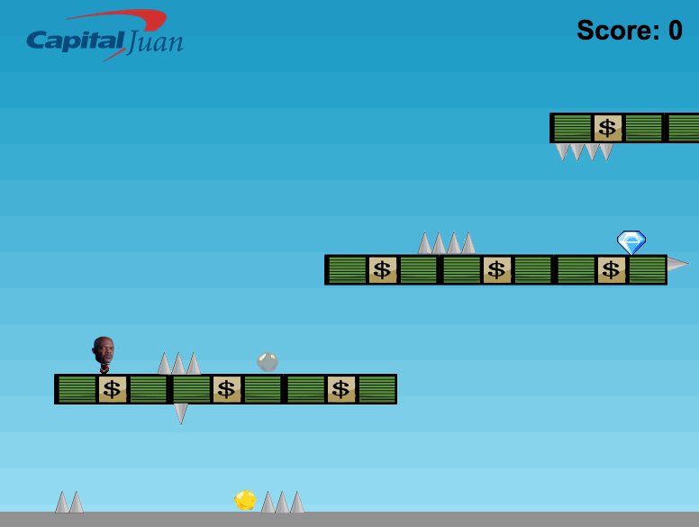


“Solution”
Simple, lightweight running-platform game
Capital One website is loading or reach 404 page.
One time play per acceptable page visit
Notes:
jRun is a simple, lightweight running-platform game that collect information about gameplay and
uses it to access a real life risk-index about the customer's behavior and spending habits. The game is easy to play and cross-platform.
We do this by giving the user different scenarios where they will have to choose between risky paths
in return for more valuable gems. Our vision is to give customers the option to play the game on
a loading screen or 404 page on Capital One's site. A nonchalant but fun way to easily collect data.

Slide 6



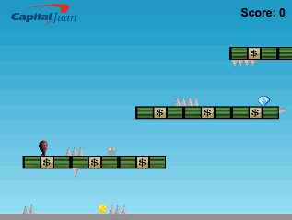
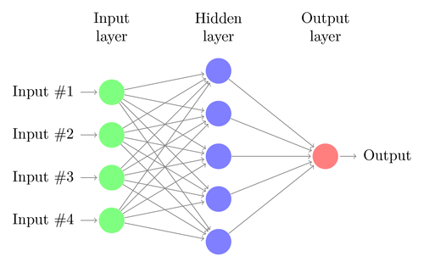
Our Data
jumps
silver
gold
Risk index
diamond
Notes:
Our algorithm has nothing to do with the success of the player. Instead, we keep track of which gems they
attempt to get, how many jumps they perform, and the speed where they chose these behaviors.
A neural network is trained using data from loyal, long-time customers that are previously labeled with our risk index.
New customers will then be given the option to play the game. Their data is then tested on the neural network in order to give banks the data they need.
Our neural network is implemented with TensorFlow and deployed on AWS.

Slide 7

Questions?

