Slide 1
Mesa — Restaurant Review Platform
IFQ636 Software Lifecycle Management · Assignment 2
Live demo & walkthrough
David (Anrio) Carver · n11473215 · solo submission
Live: http://3.27.208.40/ · github.com/david1carver/restaurant-review-platform

Slide 2
10-minute plan — where to spend your time
0:00 Intro (on camera) [talk]
0:40 Live app demo — browse, login, review, notification [LIVE]
2:20 Design — Figma wireframes + prototype [LIVE]
2:50 Design patterns & OOP — 8 patterns ★ biggest weight (28 pts) [talk + code]
4:30 Unit testing — 49 passing [LIVE]
6:00 API testing — Postman, error codes [LIVE]
7:15 CI/CD & deployment — runner, pm2, live IP [LIVE]
9:00 GitHub workflow — branches, PRs, conflicts [LIVE]
9:40 Wrap [talk]

Slide 3
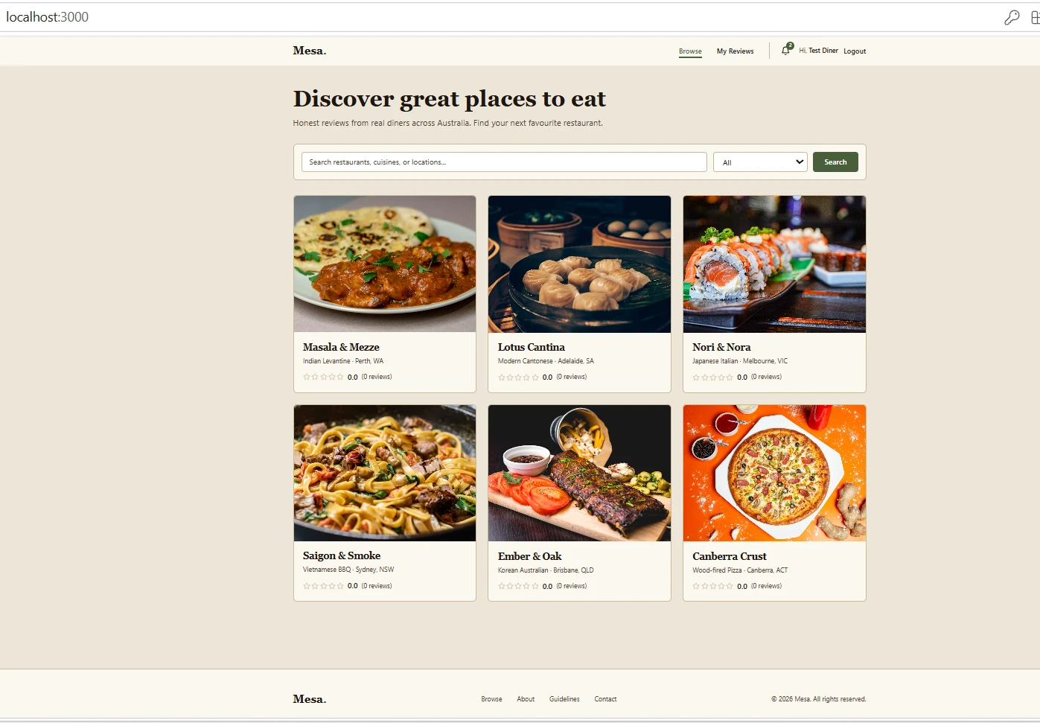
1 · Intro 0:00–0:40
SAY
• “I’m David Carver. This is my IFQ636 A2 — Mesa, a Restaurant Review Platform.”
• “I completed it solo — my allocated teammate withdrew from the unit, so all work shown is my own.”
• “For A2 I added 8 design patterns, a Notifications feature, 49 unit tests, full API testing, and a live CI/CD deployment.”
SHOW (live on screen)
▶ Your face on camera (required).
▶ The live app loading at the public URL.
⚠ Camera ON for the whole video — academic-integrity requirement.

Slide 4
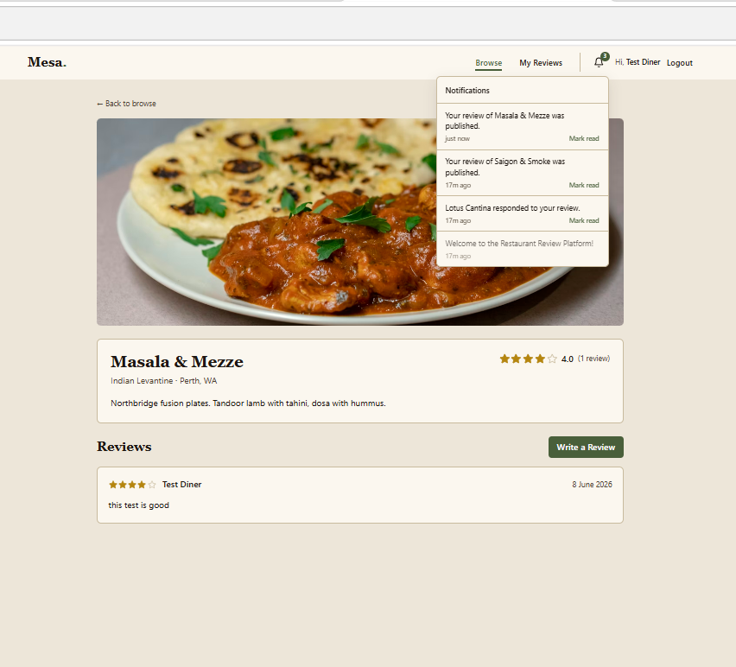
2 · Live application demo 0:40–2:20
SAY
• “Public catalogue — searchable, filterable by cuisine.”
• “I log in as a diner and post a 5-star review.”
• “One action, two effects: the rating updates (Observer) AND a notification appears in the bell.”
• “A second review of the same place is rejected — one per diner. As admin I can moderate and manage restaurants.”
SHOW (live on screen)
▶ Browse → login → post review → open notifications bell.
▶ Try the duplicate review (rejected). Admin panel + moderation.
⚠ Keep EC2 running. If a 502 flashes, wait ~10s and refresh.

Slide 5
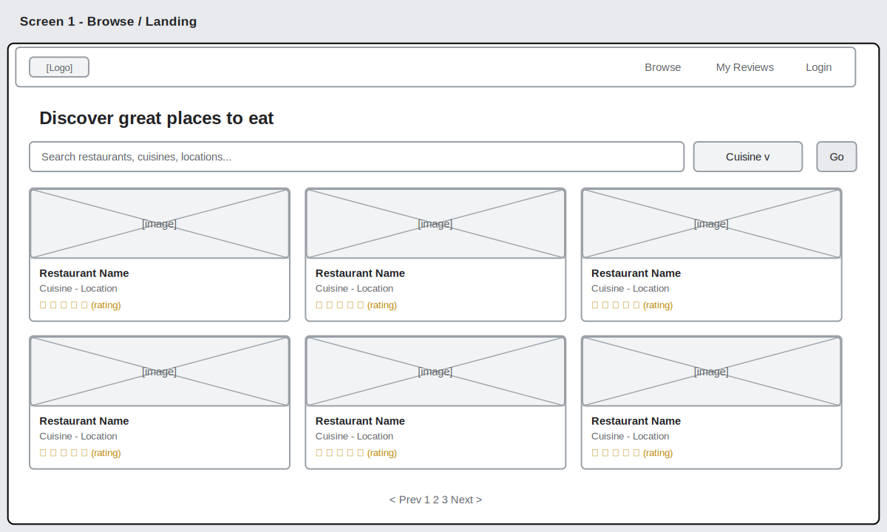
3 · Design (Figma) 2:20–2:50
SAY
• “Before building, the UI was designed in Figma — low-fidelity wireframes and a high-fidelity prototype.”
• “These cover the full diner and admin journeys.”
SHOW (live on screen)
▶ Open the Figma file (or docs/A2/wireframes/).
▶ Click through 2–3 screens to show the interactive prototype.
⚠ Part B requires the video to show your Figma design.

Slide 6
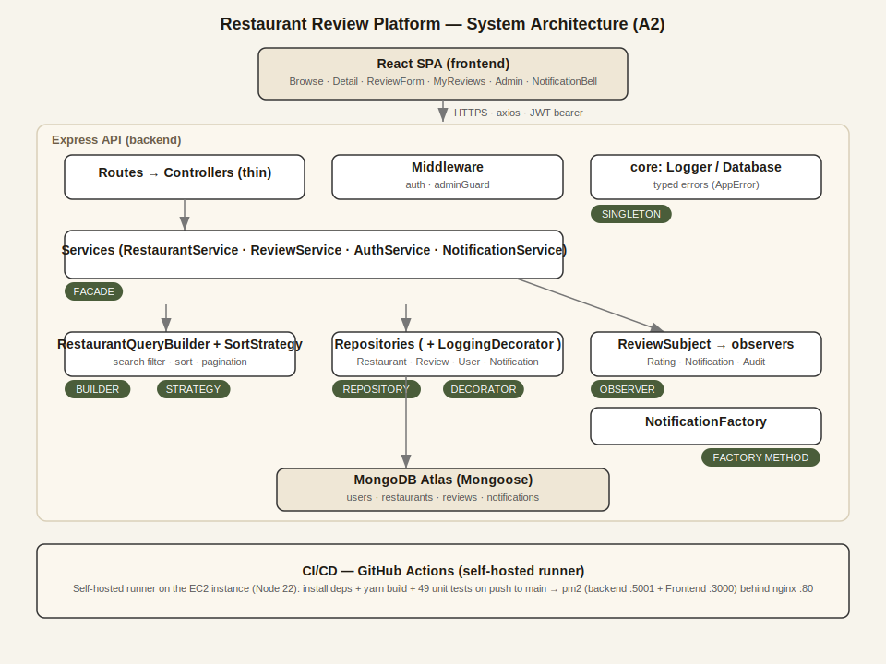
4 · Design patterns & OOP 2:50–4:30
★ Highest-weighted criterion — slow down here (28 / 100)
SAY
• “Eight patterns — the rubric needs seven.”
• “Singleton, Repository, Decorator (Proxy), Facade, Builder, Strategy, Factory, Observer.”
• “Create-review path: controller → Service (Facade) → Repository (+Logging Decorator) → ReviewSubject notifies observers.”
• “OOP: #private encapsulation; abstract SortStrategy throws if instantiated; polymorphic update()/toMongoSort().”
SHOW (live on screen)
▶ The architecture diagram (patterns + request flow).
▶ Open 2–3 files: ReviewSubject.js, ReviewService.js, SortStrategy.js — point at each pattern.

Slide 7
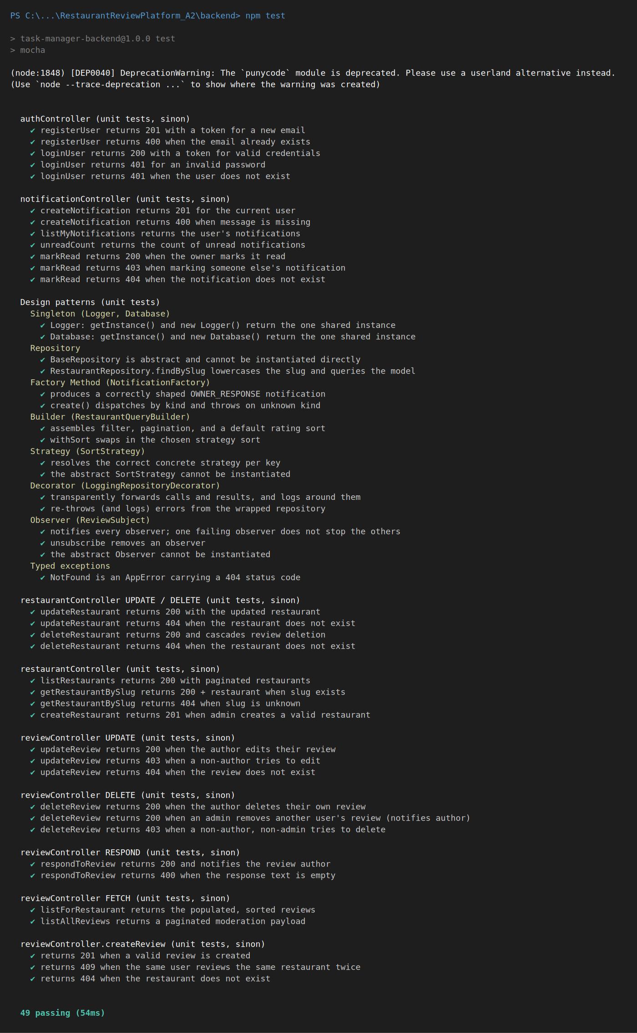
5 · Unit testing 4:30–6:00
SAY
• “Mocha, Chai and Sinon — pure unit tests, no DB; Mongoose calls are stubbed.”
• “npm test → 49 passing.”
• “e.g. createReview returns 201 on success, 409 on a duplicate; a pattern test checks the Observer fans out.”
SHOW (live on screen)
▶ Run npm test live (or show the 49-passing terminal).
▶ Scroll the test-case matrix (TC ID / Expected / Actual).
⚠ HD wants coverage of create/update/delete/fetch — call them out as they pass.

Slide 8
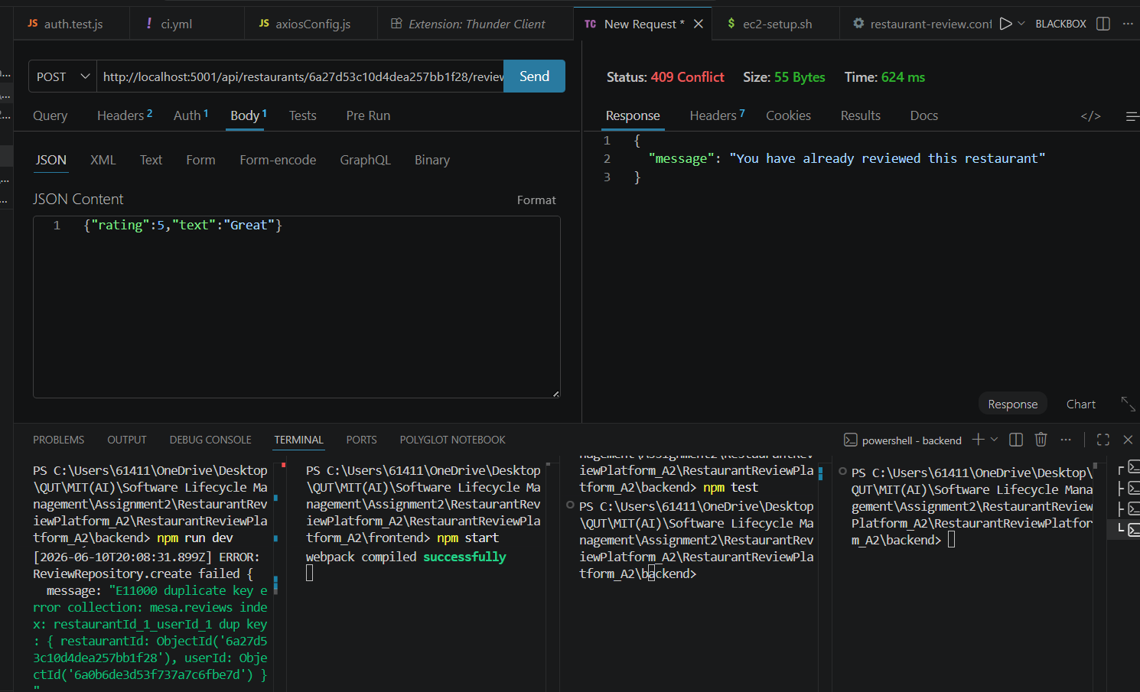
6 · API testing (Postman) 6:00–7:15
SAY
• “Every endpoint tested with its error handling.”
• “Login 200 + JWT; create review 201; duplicate 409.”
• “No token 401; missing fields 400; diner creating a restaurant 403 (role guard).”
SHOW (live on screen)
▶ Show the 409 duplicate, then the 403 role-guard response.
▶ Mention the exported collection in docs/A2.

Slide 9
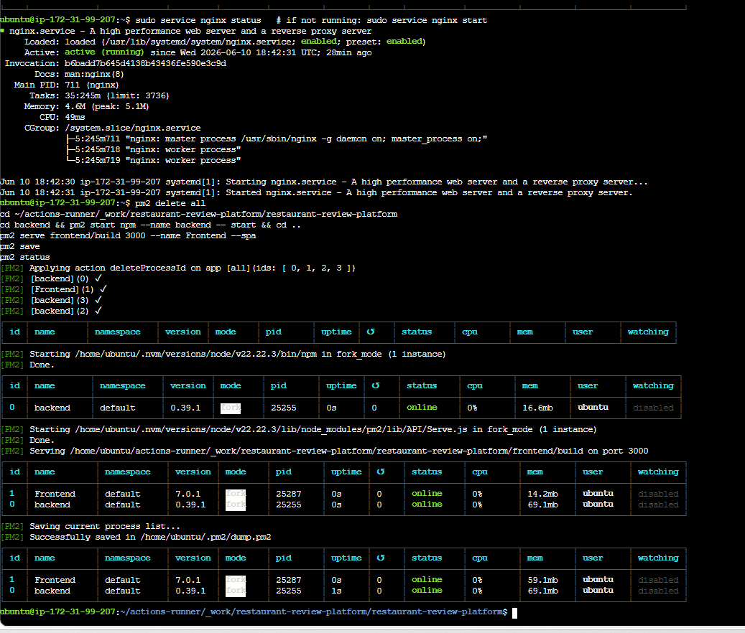
7 · CI/CD & deployment 7:15–9:00
SAY
• “Deployment is automated by a GitHub Actions self-hosted runner on the EC2 instance.”
• “Every push to main: install → build → test → write .env → restart under pm2.”
• “nginx serves the build on port 80 and proxies /api to the backend.”
SHOW (live on screen)
▶ ci.yml on GitHub (self-hosted), Actions tab green, Runner idle.
▶ pm2 status (backend + Frontend online). Optionally push a change → green → refresh live site.
⚠ Confirm the live IP is current before recording — dead link = lost marks.

Slide 10
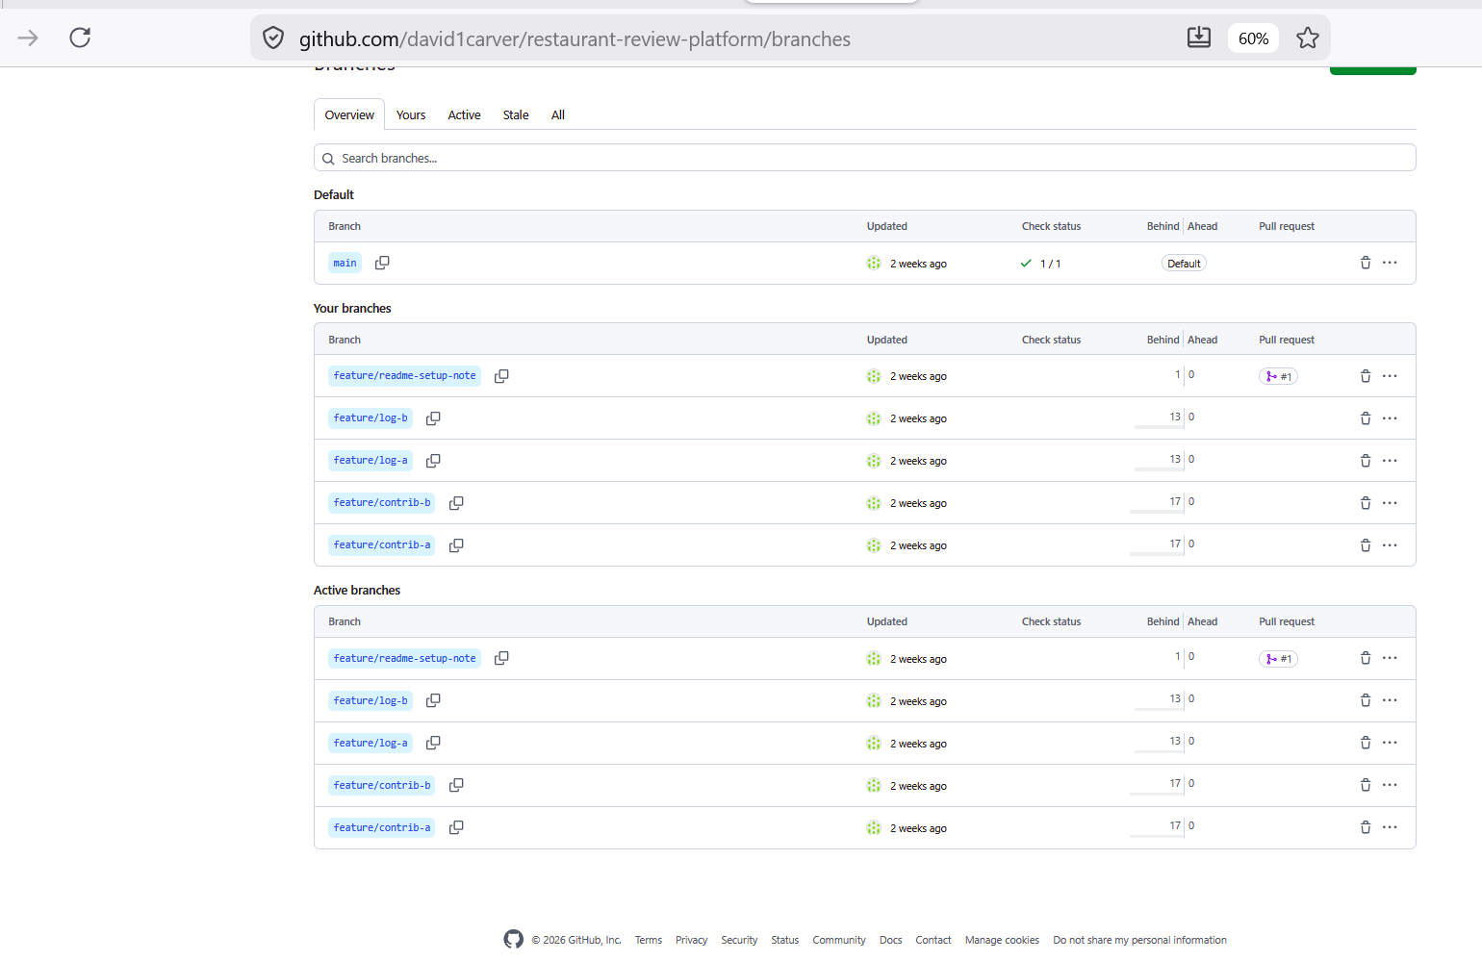
8 · GitHub workflow 9:00–9:40
SAY
• “Feature-branch workflow — branches, pull requests, and two merge conflicts I resolved.”
• “As my teammate withdrew, this is an individual demonstration of the workflow.”
SHOW (live on screen)
▶ Insights → Contributors / Network, the branch list, a merged PR, a resolved-conflict commit.
⚠ Be honest: present as “I practised the full Git workflow myself,” not team collaboration.

Slide 11
9 · Wrap 9:40–10:00
SAY
• “An OOP, pattern-based backend; a Notifications feature; 49 unit tests; full API testing; a live auto-deployed app.”
• “Thanks for watching.”
SHOW (live on screen)
▶ Back on camera. End on the live app or the architecture diagram.

Slide 12
Where the marks are — focus your energy
28 pts Design patterns & OOP — ★ Spend the most time. Show code live.
16 pts README / report / reflection — Video polish counts here.
12 pts API testing — Show error codes.
12 pts Unit testing — Call out create/update/delete/fetch.
12 pts CI/CD pipeline — Live URL + pm2 online.
10 pts SRS documentation — Covered in report; mention briefly.
10 pts Team collaboration — Solo-capped — be honest, keep it short.
Projected ≈ 88/100 (High Distinction). The video and a live IP protect this mark.

