Slide 1
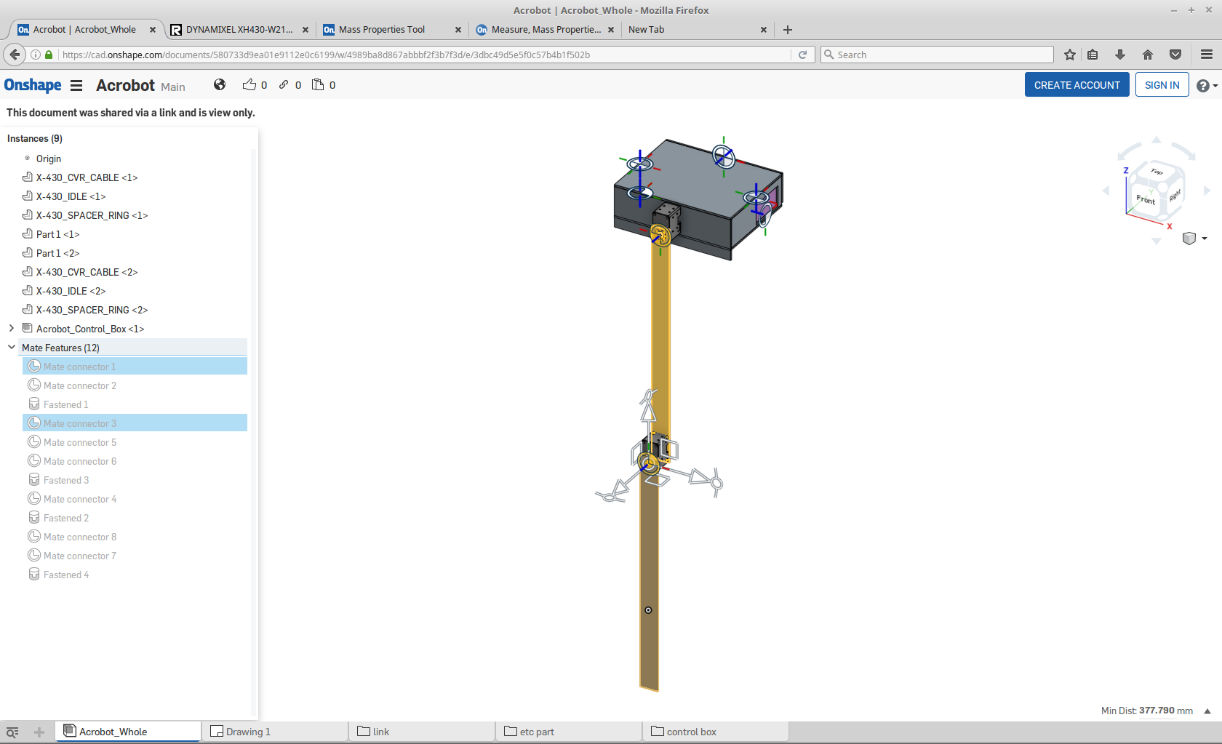
Acrobot Link 1: length

Slide 2
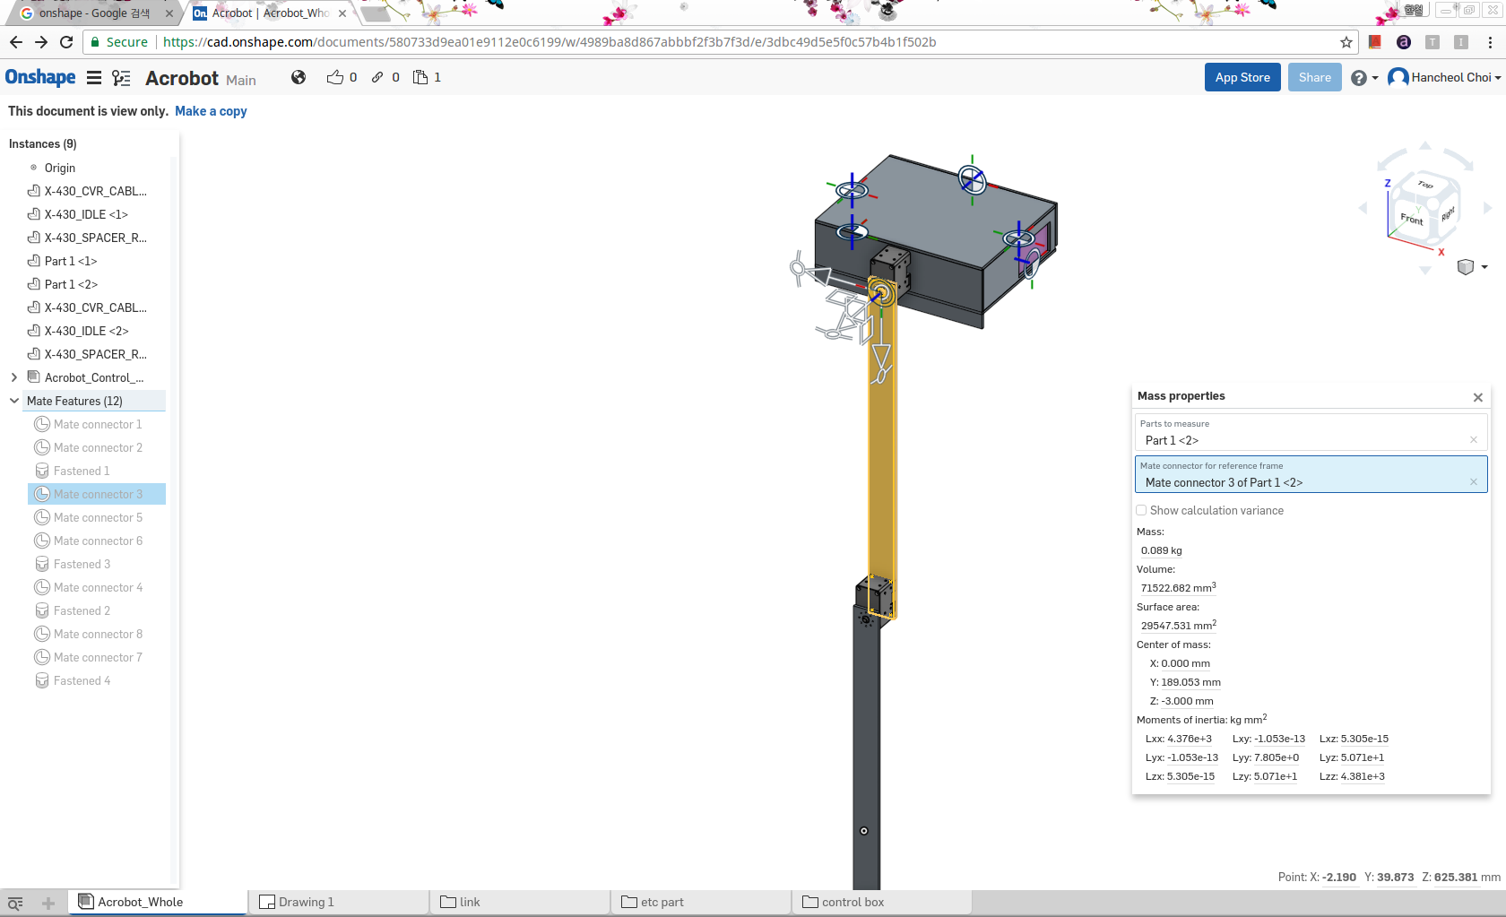
Acrobot Link 1: inertia(link)

Slide 3
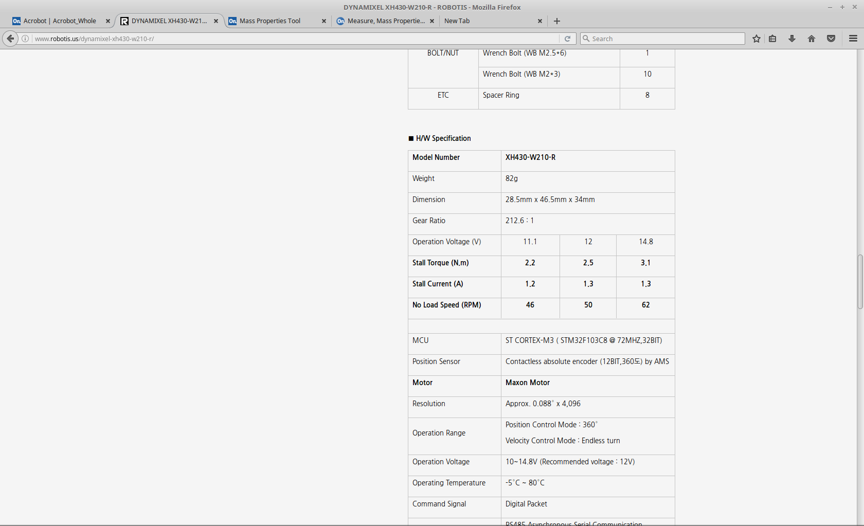
Acrobot Link 1: inertia (motor)

Slide 4
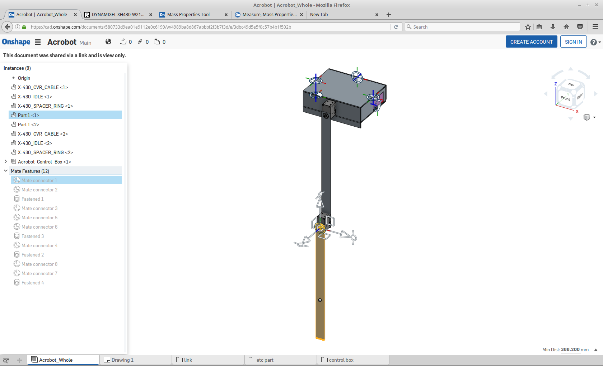
Acrobot Link 2: length

Slide 5
Acrobot Link 2: inertia

Slide 6
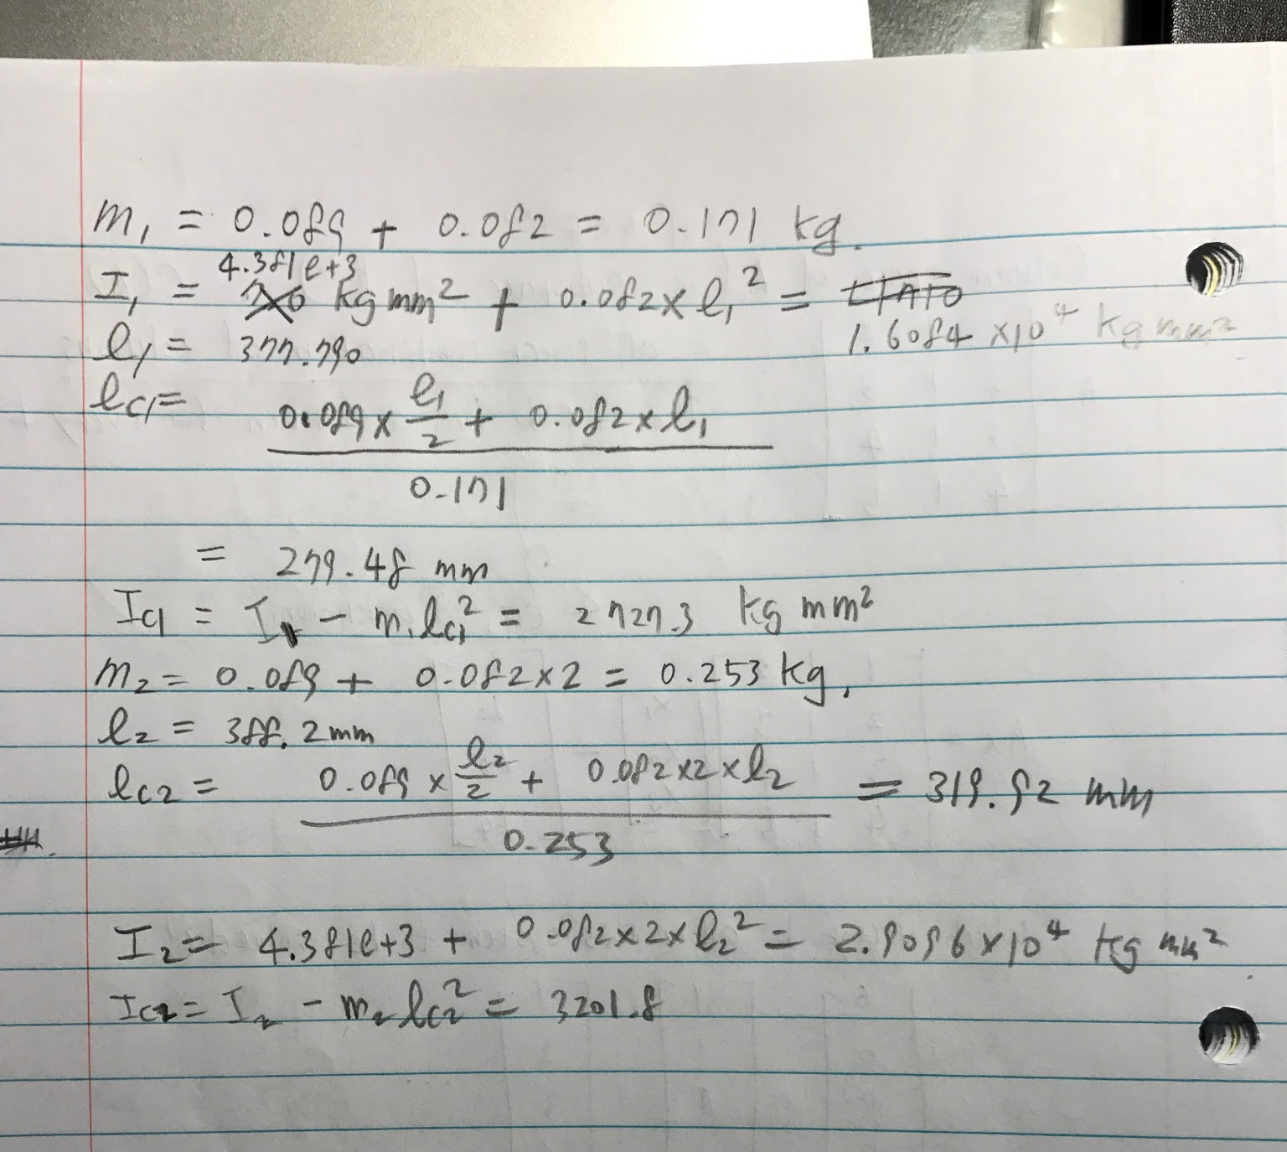
calculation

