Slide 1
Lecture 1
Introduction

Slide 2
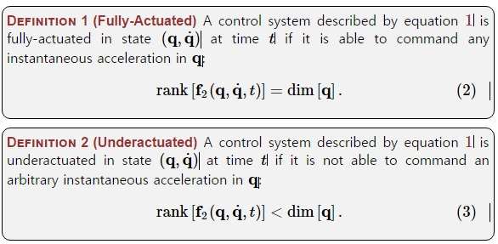
Definition: Underactuated
Fully-actuated vs Underactuated Systems
Fully-actuated : 모든 joint에 모터제어 어셈블리를 가지고 있어 모든 joint 를 제어 한다
Underactuated : momentum, 무게중심의 제어 등 결합하여 직접적으로 제어 하지 않은 joint 를 하나 이상 갖는다
Honda's ASIMO VS PDW by Steve Collins and Andy Ruina
underactuated

Slide 3



Feedback Linearization (1)
Nonlinear system dynamics
If we choose input u as
using system dynamics
Cancel nonlinear term
Trivial linear system(e.g. Bricks on ice)
But, (Big assumption) fully-actuated! exists!

Slide 4


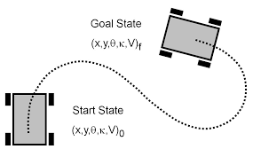
Feedback Linearization (2): other underactuated case
Input saturatoins
같은 시스템에서 가속도가 11이 필요한데, 다음과 같은 제약이 있다면?
State constraints
Ex. nonholonimic constraints
Model uncertainty
Impossible!

Slide 5
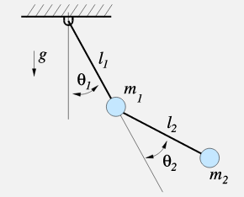


Manipulator Equations (1)
전형적인 Manipulator 동역학식
Lagrangian mechanics (Appendix A 참조)
Newton-Euler mechanics
Mass-spring-damper system 의 matrix 버전!
Inertia
Coriolis
Gravity
Input map

Slide 6



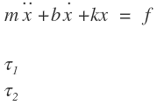
Manipulator Equations (2)
fully-actuated vs. underactuated 예제
H : (no negative energy) → Invertable
B :
: fully-actuated
: underactuated

Slide 7
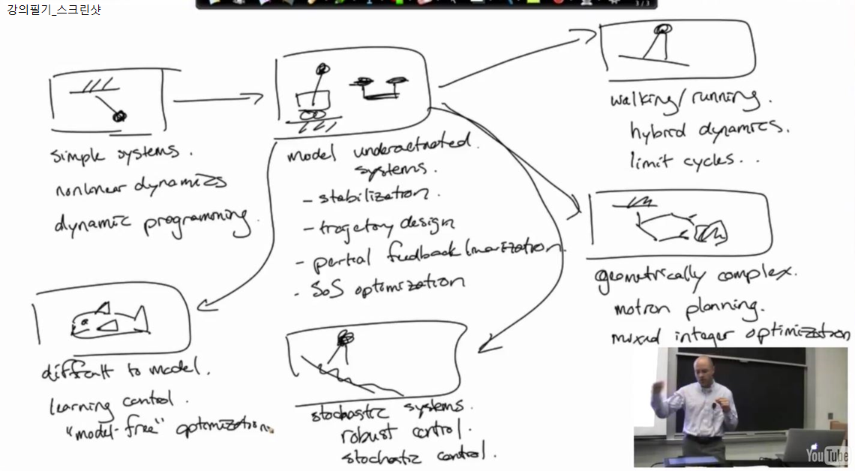
Plan for the course (1)

Slide 8
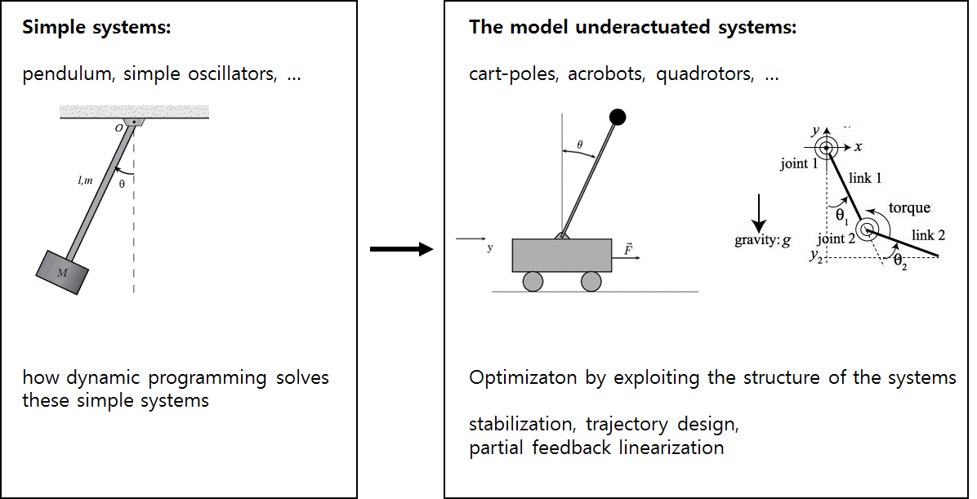
Plan for the course (2)

Slide 9
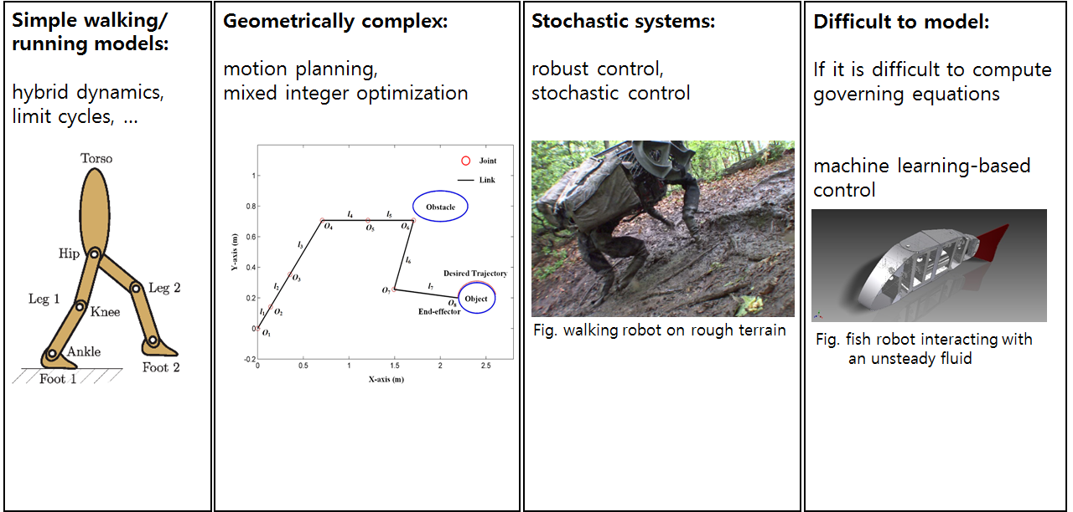
Plan for the course (3)

Slide 10
Appendix A. Lagrangian mechanics
노트 참조

Slide 11
Appendix B. drake(MATLAB)
A planning, control and analysis toolbox for nonlinear dynamical systems
(Github: https://github.com/RobotLocomotion/drake , Wiki: http://drake.mit.edu/)
install : http://drake.mit.edu/installation.html

Slide 12
Reference
[1] Russ Tedrake, Underactuated Robotics

