Slide 1
Work2Play
Final Presentation

Slide 2
Inhalt
Idea
Vision
Project Management
Use case
Youtrack
Risk Mgmt.
RUP
Cost estimation (funktion points)
Time spent

Slide 3
Inhalt
Development
Architecture
Technologies
Automation(Pipelining)
Testing
Patterns
Metrics

Slide 4
Inhalt
Technical ability
Class diagram
Demo

Slide 5
Vision

Slide 6
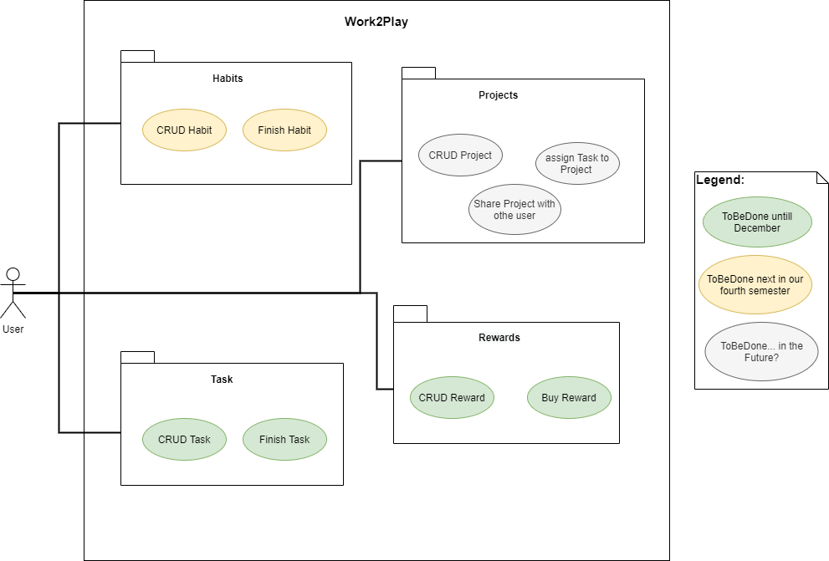
Use Cases

Slide 7
Scrum with Youtrack

Slide 8
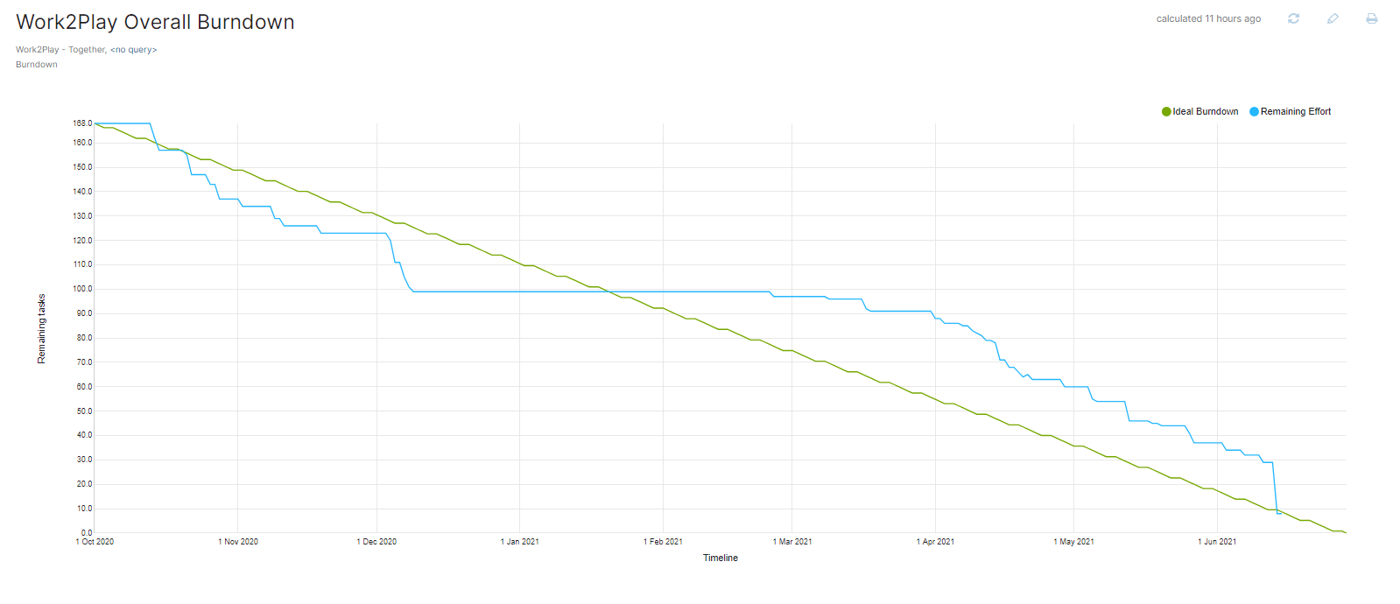
Burndown chart

Slide 9
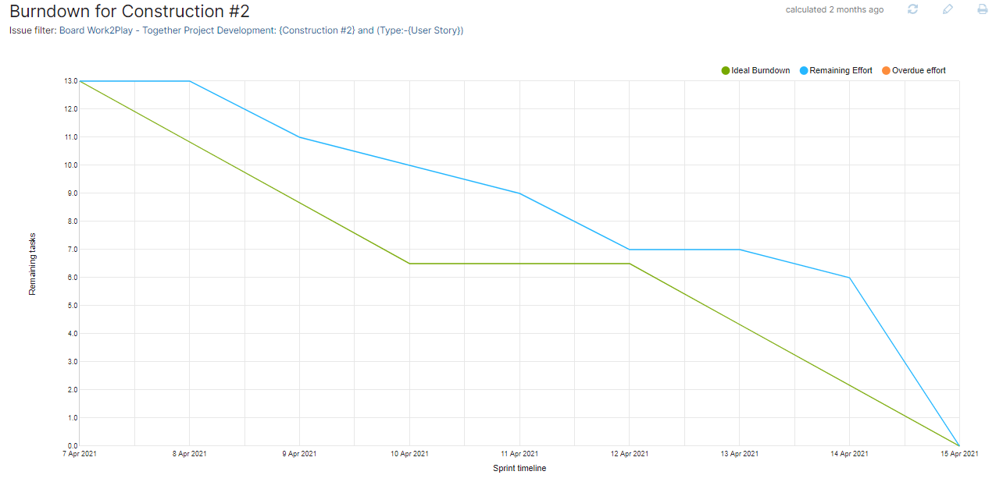
Burndown Chart

Slide 10
RUP Roles
Bereich | Verantwortlicher
Projekt Management | Robin Schmidt
Auslieferung (Deployment) | David Eymann
Anforderungsanalyse | Tom Wagner
Design | Tom Wagner
Implemetantion | Robin Schmidt/ Tom Wagner
Test | David Eymann/ Robin Schmidt

Slide 11
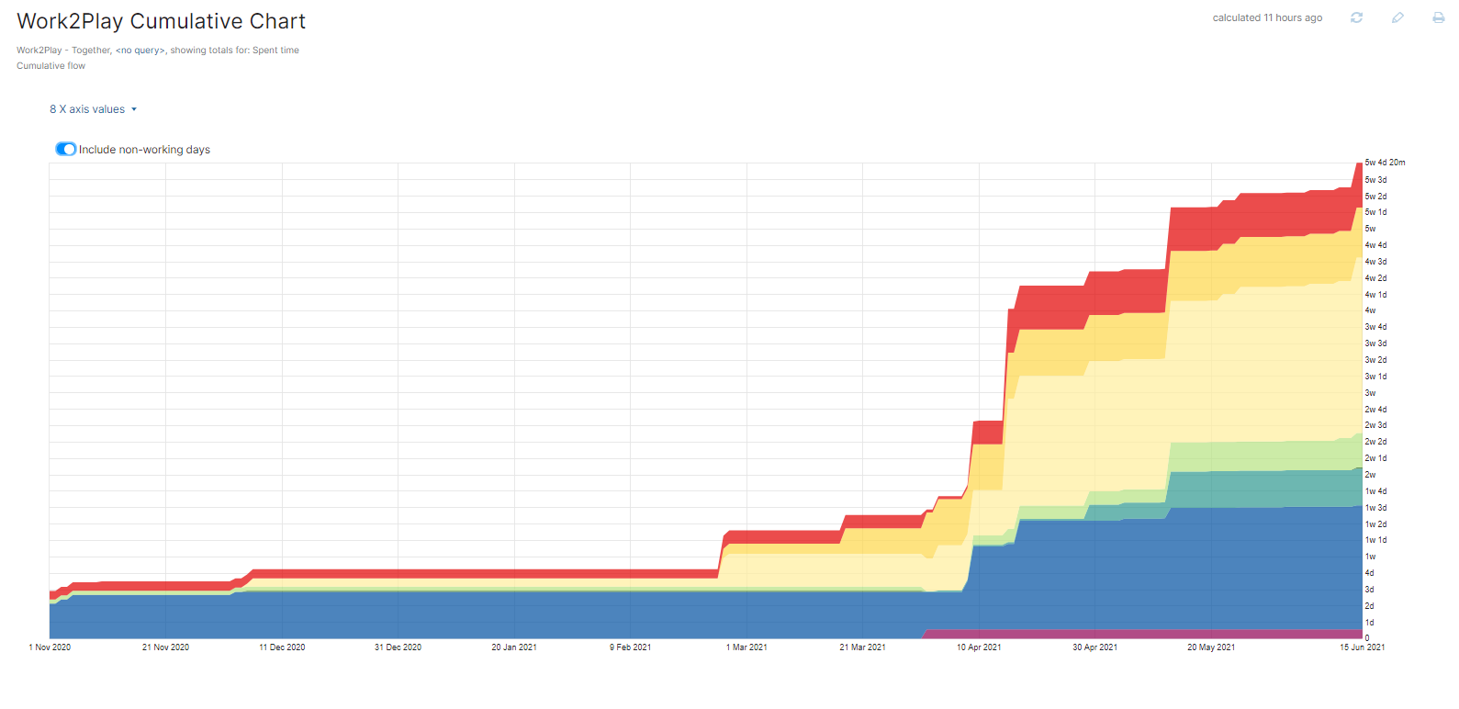
RUP Workflow

Slide 12
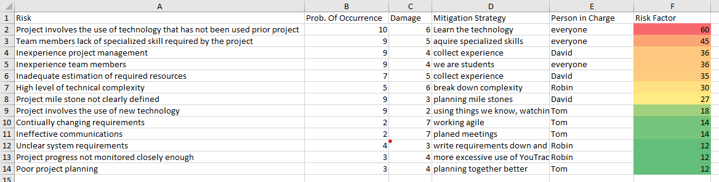
Risk Management

Slide 13
Cost estimation

Slide 14
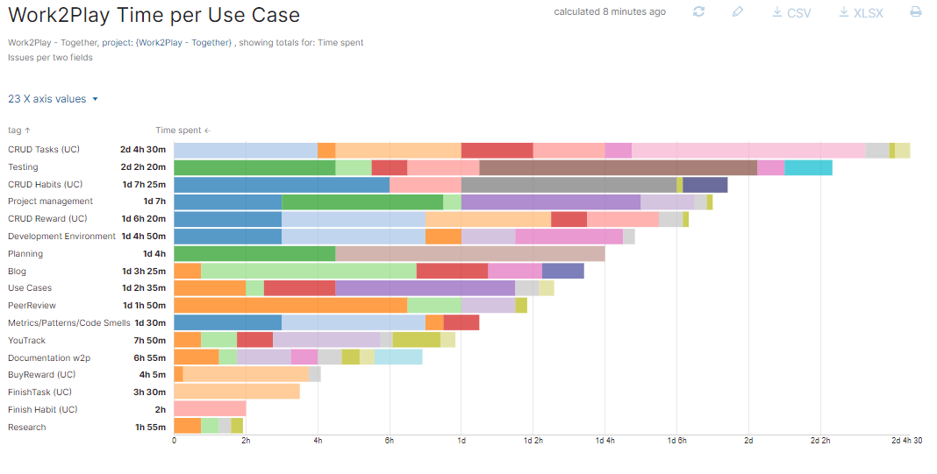
Time Spent

Slide 15
Architecture

Slide 16







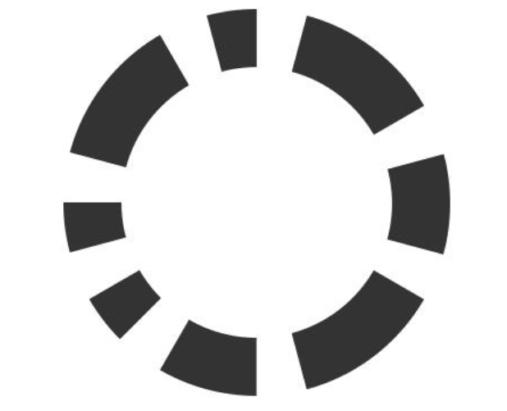




Tech stack
Development
Organisation
Modellierung/Skizzen
Testen
Code Qualität

Slide 17
Pipelining/ CI

Slide 18
Testing

Slide 19
Patterns

Slide 20
Metrics

Slide 21
Class diagramm

Slide 22
Demo

Slide 23
Bildquellen
https://source.android.com/setup/start/brands
https://encrypted-tbn0.gstatic.com/images?q=tbn:ANd9GcS9eFshkMUXF_Y_Uxe6mS82ldtZjlzqrcAA2GhVrF-eY_Dze0_t-E-Vi1X-EgQzJRpwjMc&usqp=CAU
https://plugins.jetbrains.com/plugin/7973-sonarlint
https://plugins.jetbrains.com/plugin/10811-codemr
https://i.pinimg.com/originals/f2/05/d0/f205d0e793dcfb335732a92ea82b3b5e.jpg

