Slide 1

HomeCD
Finding the music

Slide 2

David Johnson
Former Embedded Systems/Network Software Engineer
Bachelor Degrees : Computer/Electrical Engineering
Management Information Systems
Oracle Certified Professional DBA 10, 11g
Personal Interests: Bicycling, Music, Cooking

Slide 3
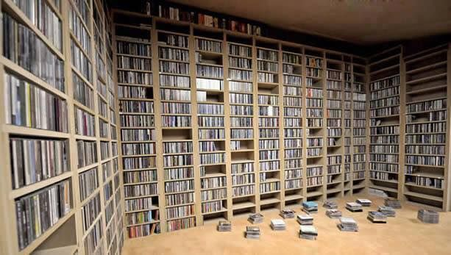
PROBLEM
There are no streaming services for Classical Music Therefore I have hundreds of Compact Discs
Use Cases:
Where are all my Tangerine Dream disks?
What works by Beethoven do I have?
It’s July 4th how many copies of Tchaikovsky’s 1812 do I have?
Is it time to listen to “Clean up your stuff !”

Slide 4
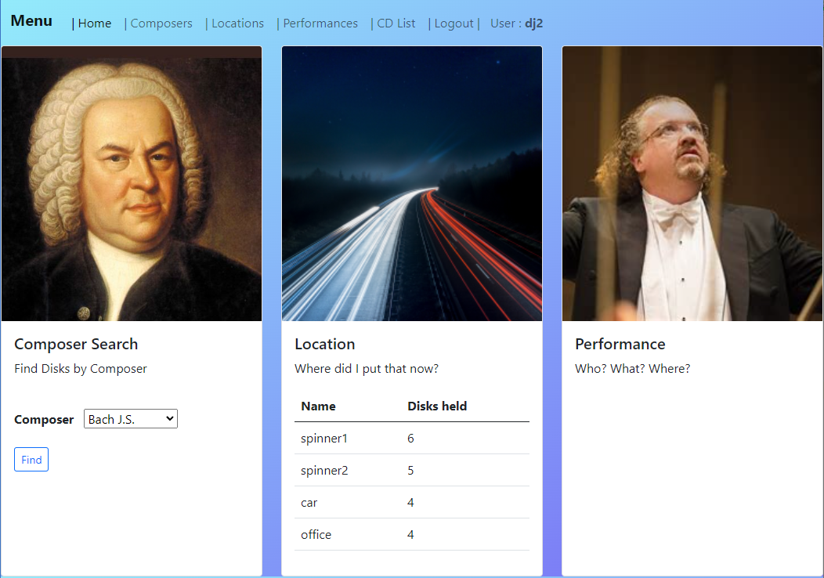
OPERATION
Navigation
Composer (Who)
Performance (What)
Location (Where)
CD Movement
Administration
CD addition
User changes

Slide 5
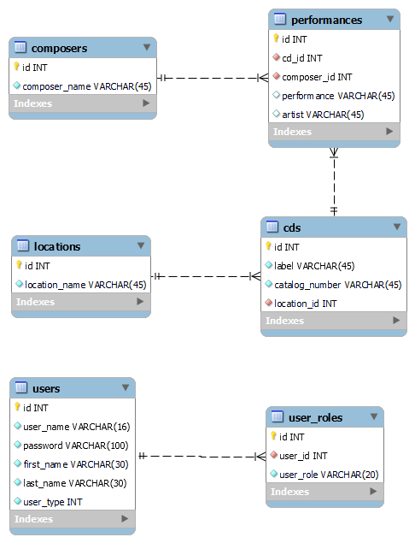
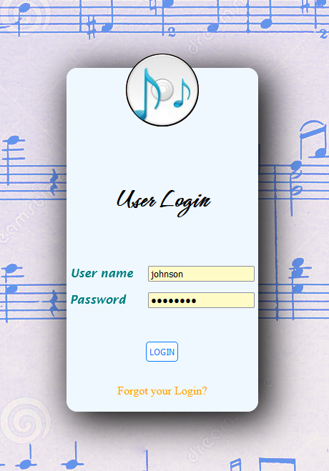
DB Entity Relationships
Login

Slide 6

Future Goals
Streamline CD addition for multiple performance and symphonic movements
Expand testing to full coverage
Convert from MVC to React/Rest paradigm

