Slide 1
Steganography
David Hernandez

Slide 2
Schedule
About me
Requirements
What is Steganography
Boring stuff (Stuff you will probably forget and such) and how it was used before
How to show people something that only you can see.
How to do that using images, audio, and video.
How to tell if other people are using Steganography.

Slide 3
This is me!

Slide 4
Requirements
Age: I don’t care
Skills: I don’t care
Organization: I don’t care
Terrorist: I don’t care (The people around you will take care of you afterwards)
Operating system: As long as it doesn’t have an apple you are good. We will be using Windows and Linux for this demonstration so have a Windows VM handy.
Tools: Will be provided via an ftp server (don’t worry I’ll show you how)

Slide 5
What is Steganography
Concealing secret(s) within a non-secret
Paper, People, Images, Video, Audio
Secrets that attract no attention
Not Crypto
Hiding the fact that the message even exits

Slide 6
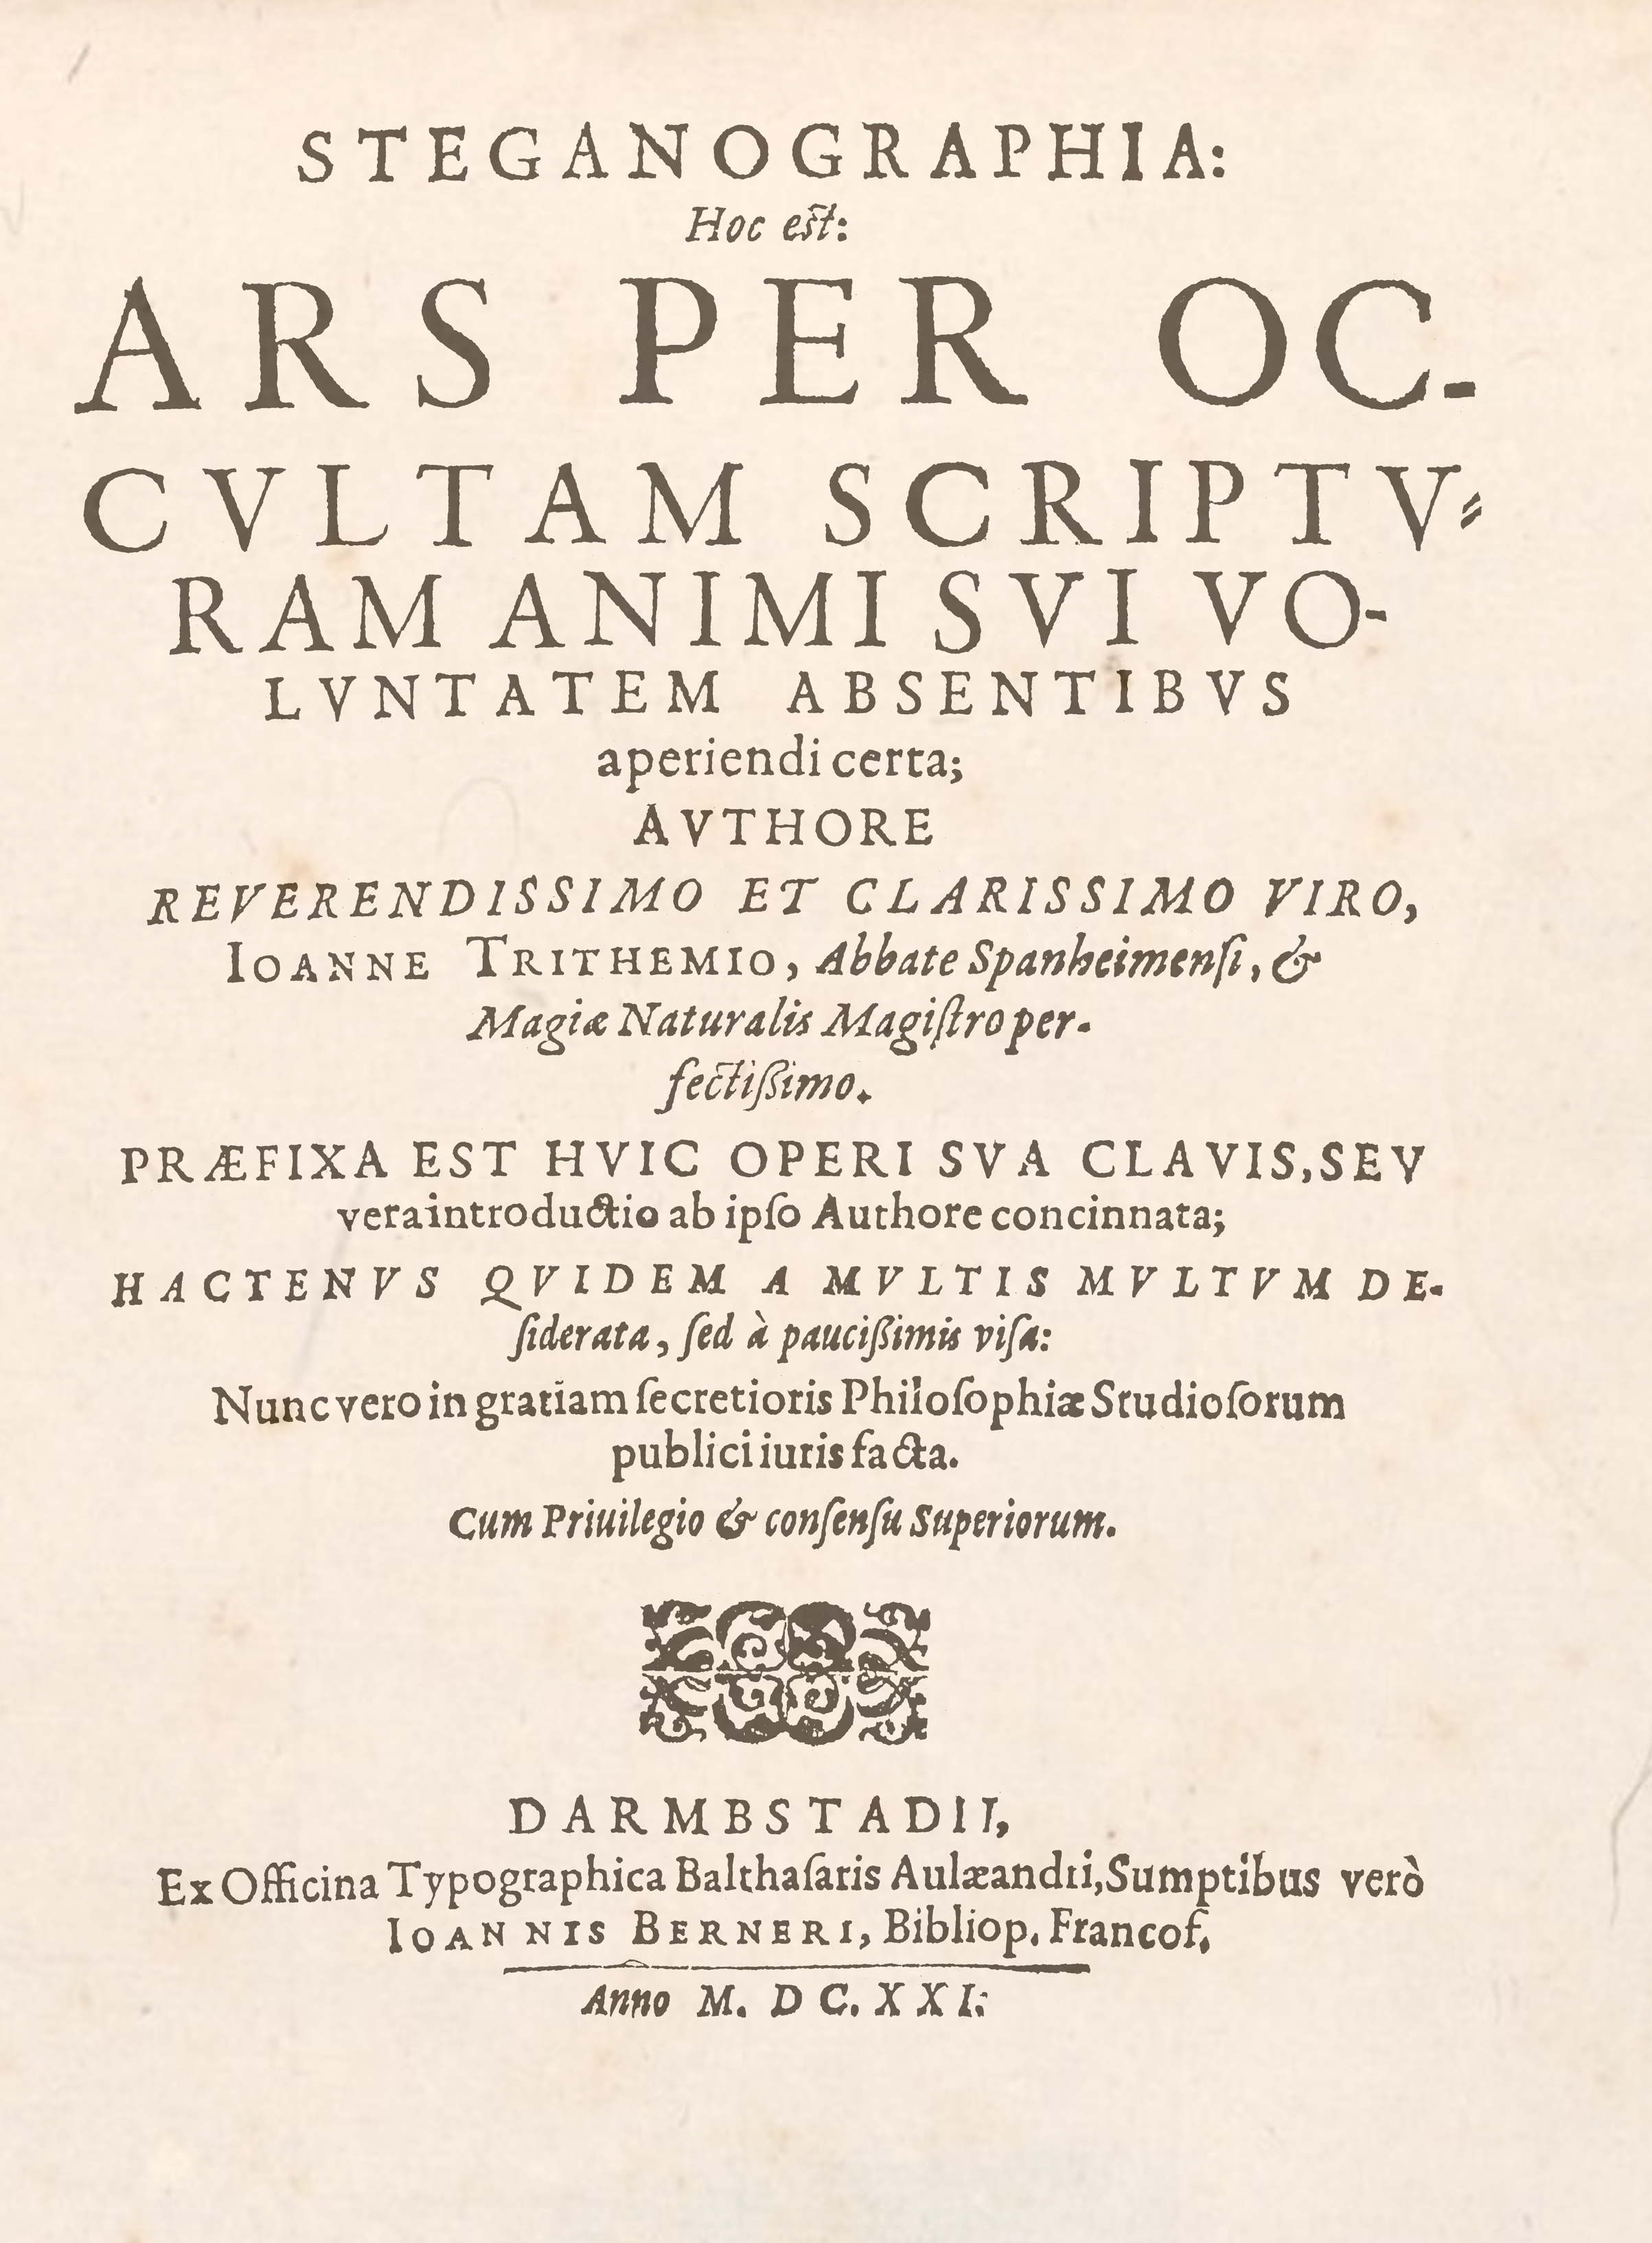
First Written Form
Steganographia written 1499 published 1606
Book about magic, but more about crypto and stego
Tried to purge the book
3 books that have more techniques

Slide 7
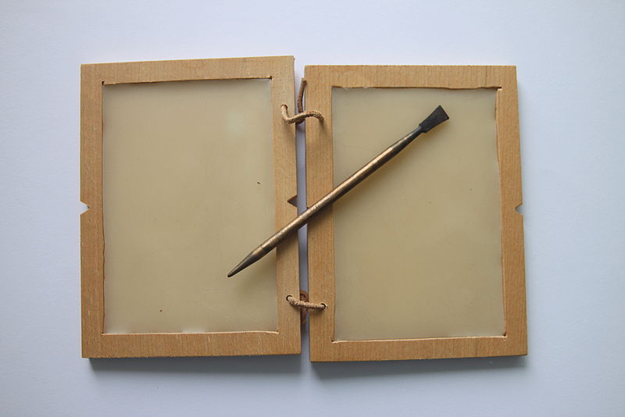
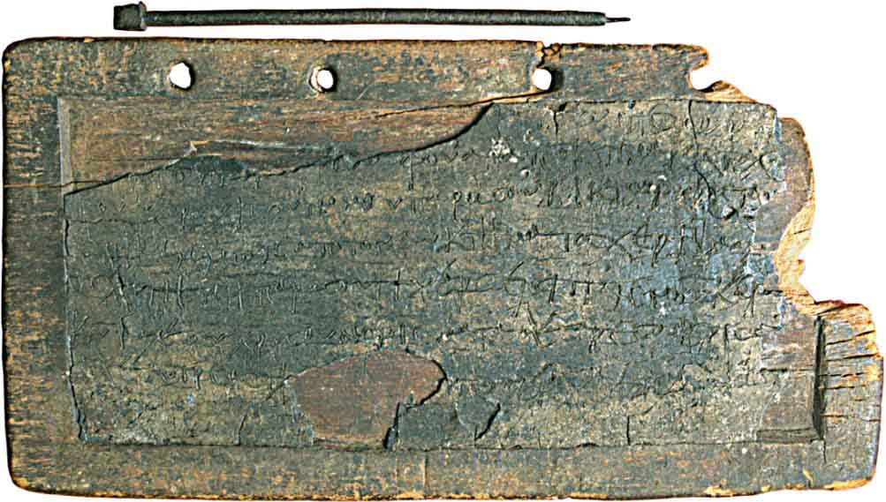
Herodotus Stories (Greek Historian)
480 BC Greek named Demaratus sent warning for an invasion by Xerxes to Lacedemonians using a folding tablet, plot for 300

Slide 8
The Shave Head
Histaieus wanted to to revolt against the Medes and the Persians without others knowing.
Shaved the most faithful slave’s head, let grow and sent him to his destination.
Message arrived to his correspondents in Persia and the revolt succeeded

Slide 9
Cutting the Bunny
Harpagus wanted to warn Cyrus that the Medians would revolt if he attack his grandfather. Couldn’t because of blocked watched roads.
Cut open a hare’s belly with out trimming the fur and embedded a message with in.
Had a servant dressed as a hunter to deliver the hare.

Slide 10
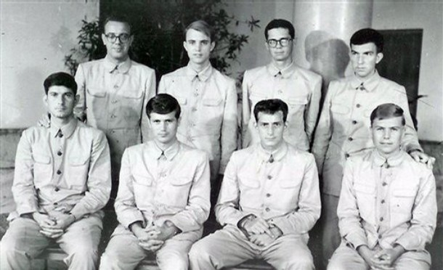
Additional History
World War II German microdots and American Letters
Doll Woman
USS Pueblo

Slide 11
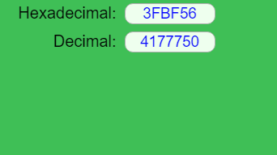
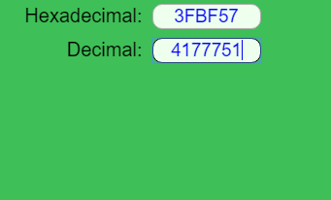
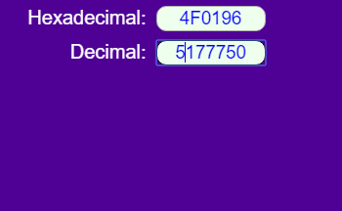
How it works with Images
Adding bits after end of file
Changing LSB

Slide 12
How it works Audio/Video

Slide 13
Who used/uses Steganography
Copyrights (watermarks) and counterfeits
Relationship gifts
Printers
Russians
Malware
Terrorists

Slide 14
Why Use Steganography
Network steganography

Slide 15
Demos
openstego
Touch

Slide 16
Refrences
http://www.networkworld.com/article/2870165/lan-wan/the-history-of-steganography.html
http://www.machinae.com/crypto/herodotus.html
https://en.wikipedia.org/wiki/File:Table_with_was_and_stylus_Roman_times.jpg
http://historyofinformation.com/images/wax_tablet_egypt_600.jpg
https://en.wikipedia.org/wiki/Harpagus

