Slide 1

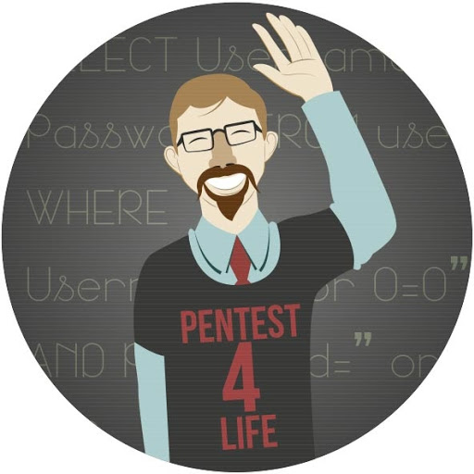
How to get into Cyber Security?

Slide 2
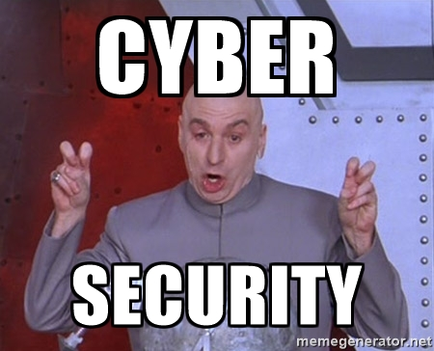
What is Cyber Security
Who knows anymore...
Defending IT resources
Attacking IT resources
Managing IT resources

Slide 3


Slide 4


Slide 5


Slide 6


Slide 7


Slide 8


Slide 9

Going to School
Don’t waste your time
Schools will never catch up with Cyber Security
Cyber Security Industry
Changes Daily
It will get better, It’s just
not there yet
Schools need to teach
“real” basics

Slide 10
Training & Certs
Expensive, some free...
Degree replacement (Piece of Paper)
Degrees most asked for: Security +, CIPP, CISSP, CISM, CISA
Base personal success upon Cert

Slide 11
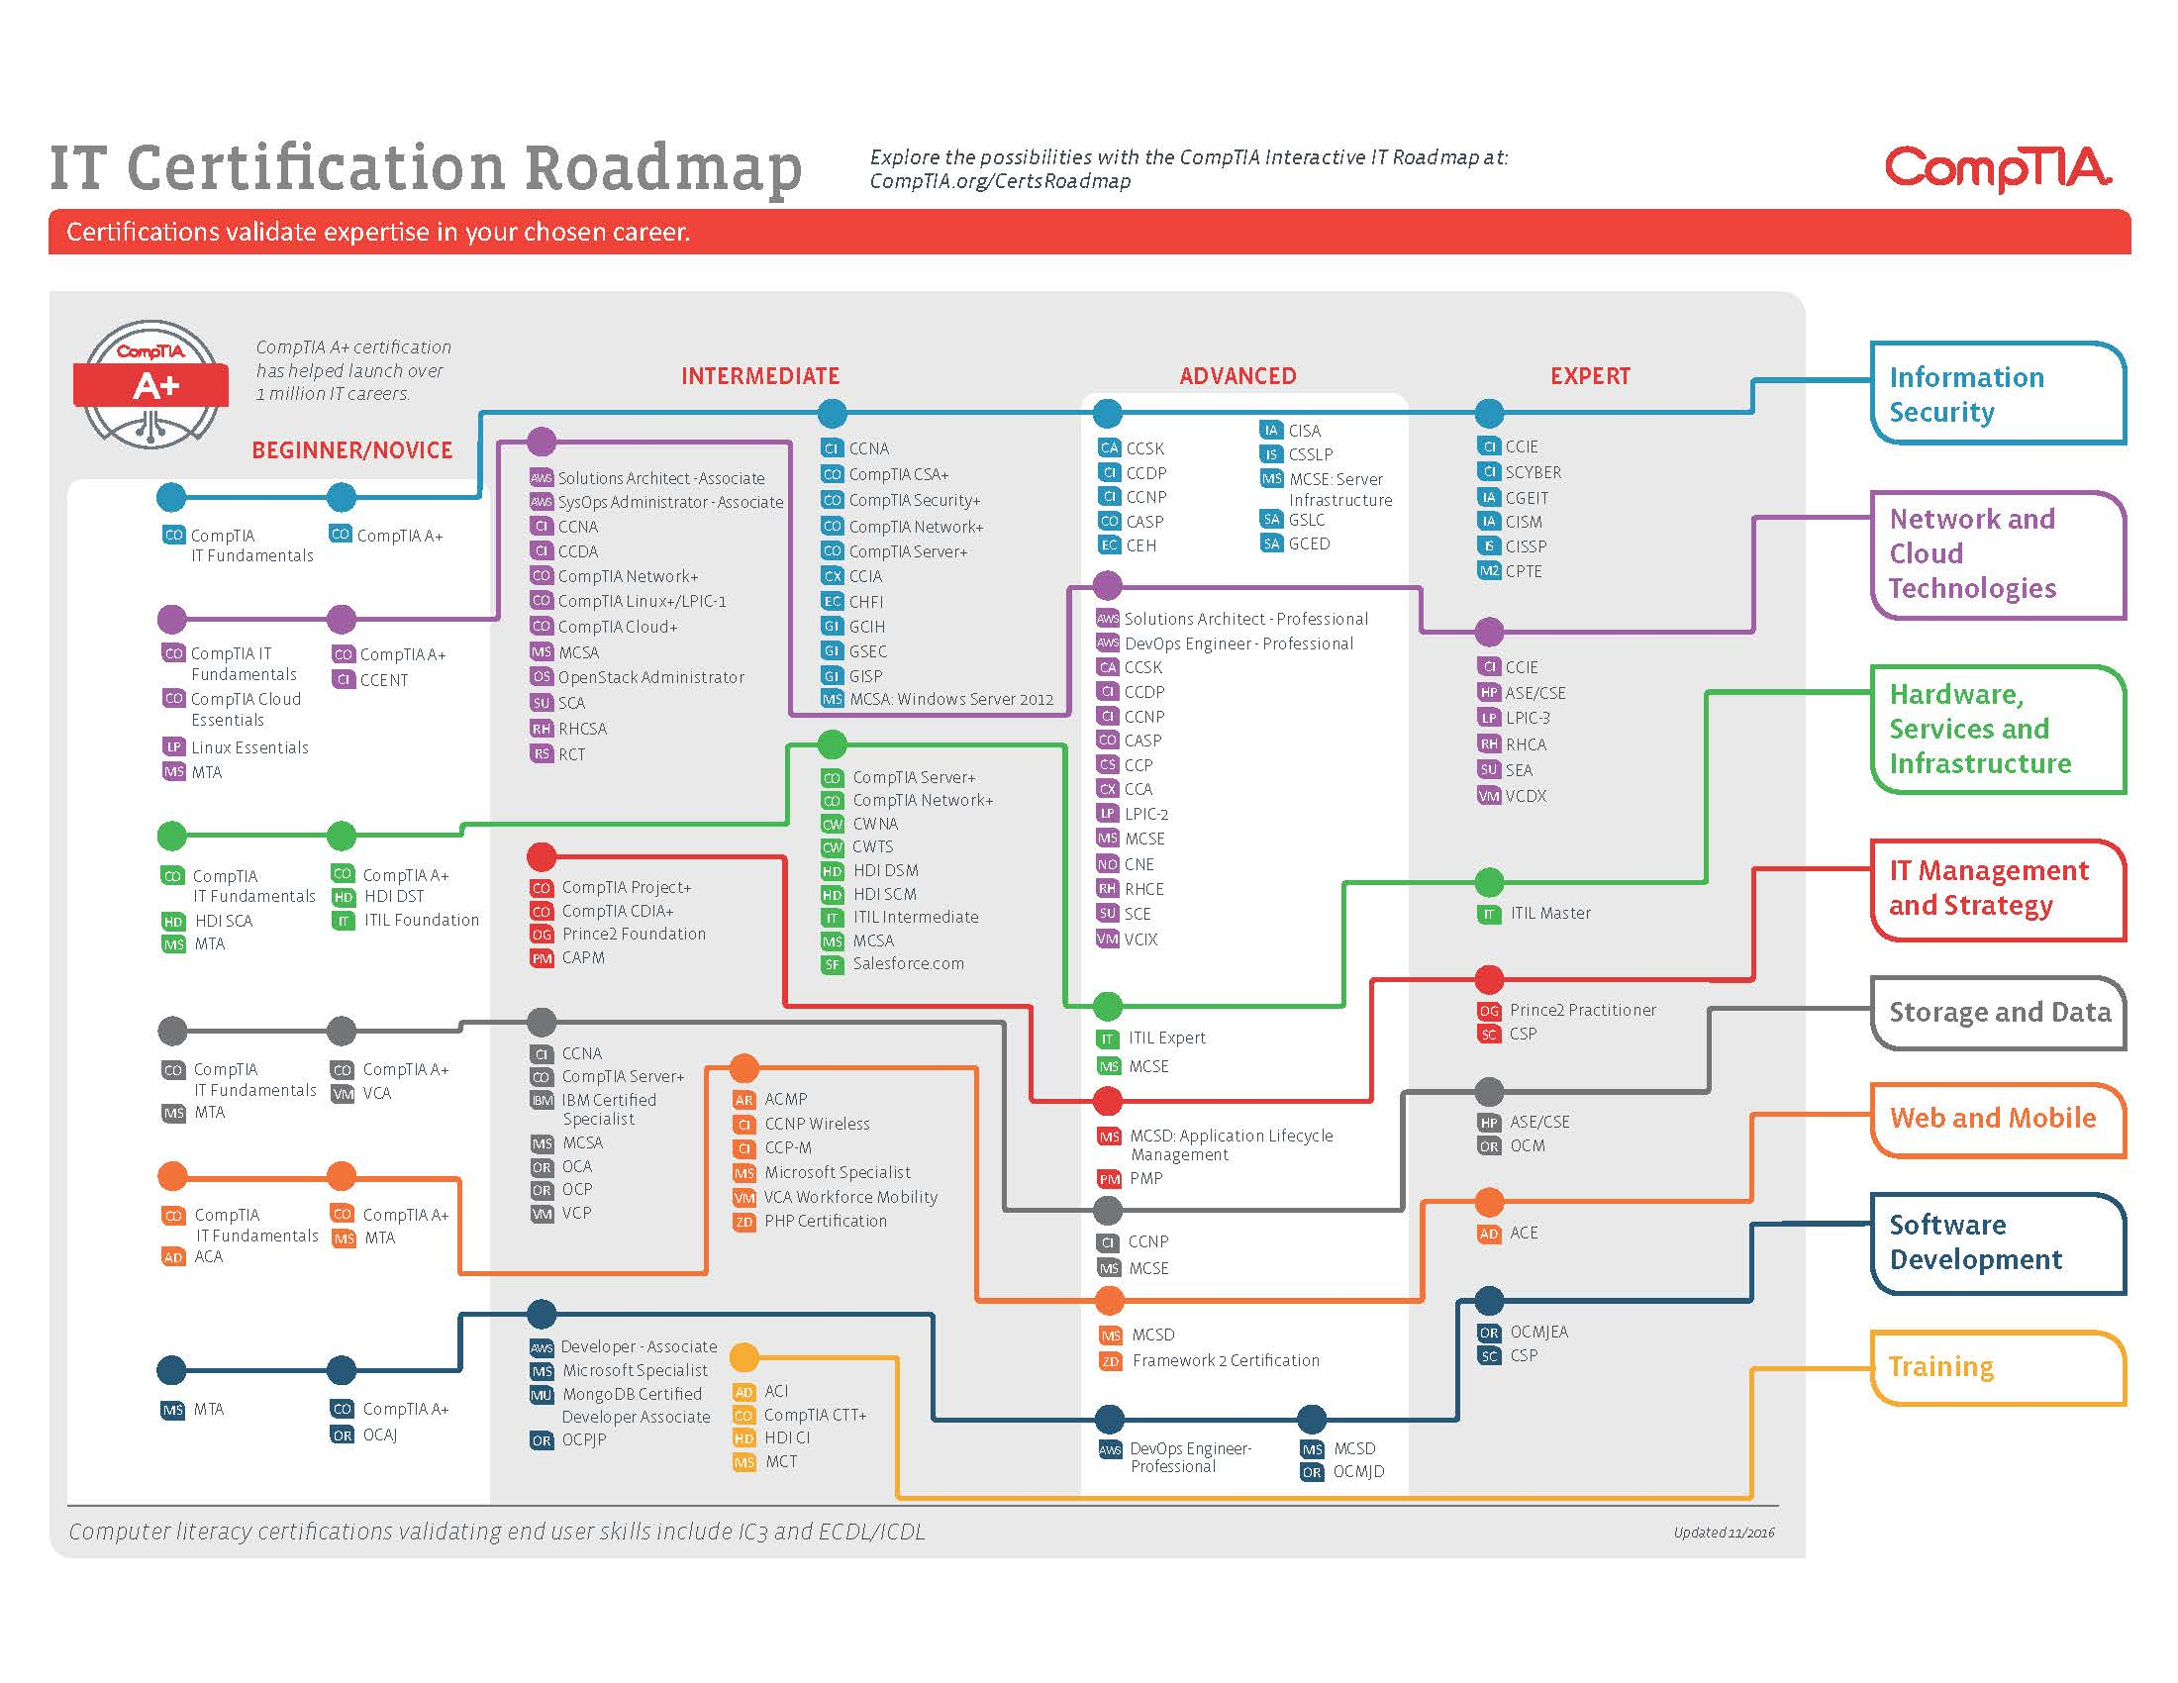

Slide 12
Internships/Externships/Apprenticeships
Better way
Real world experience
Meet industry people
Understand how industry works
Broader picture of interconnected systems
Yet, can be slow, but definitely worth it

Slide 13
How to really get into Cyber Security
All applicable Cyber Security knowledge will come from personal experience

Slide 14
What you should do
Get involved!!!
Meetup.com
Eventbrite.com
SWCSE.com
Chaper Meetups: OWASP, SWSPF, ISSA, ISACA, CSA, ISC2, PHX2600, etc
Hacker Spaces: AZCWR, HackerSync, Galvanize, GangPlank, etc

Slide 15
Know Terminology and Tools
IP Address vs Home Address
LOIC vs HOIC vs HPing3
ELK Stack vs Splunk
Linux vs Windows
TCP vs UDP
Nessus vs ZAP
Metasploit vs Maltego

Slide 16
Hacker OS
DEFT OS
Kali Linux
Parrot-Security OS
Live Hacking OS
BlackBox
BlackArch Linux
Pentoo Linux
Security Onion
Download and Learn Something

Slide 17
Make Some Use of the Internet
Google!!!!
Youtube
Blogs: schneier.com, thehackernews.com, Google Hangouts
StackOverFlow
IRC Channels
GitHub

Slide 18
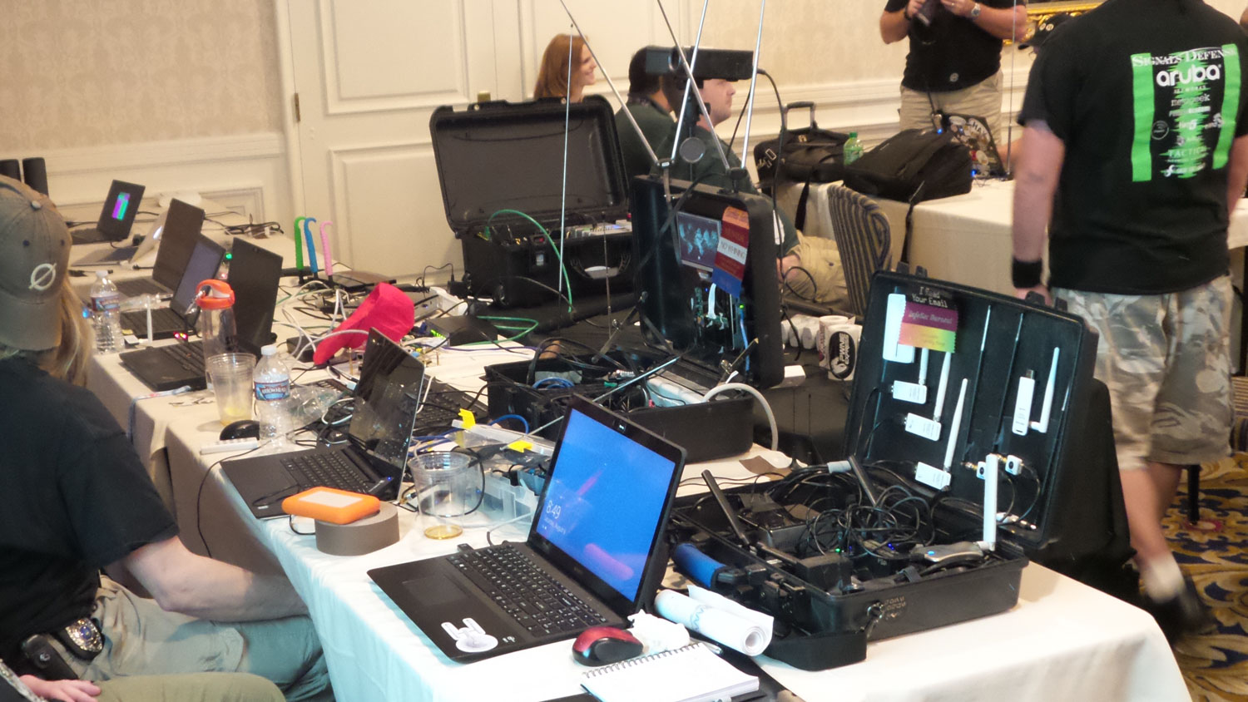
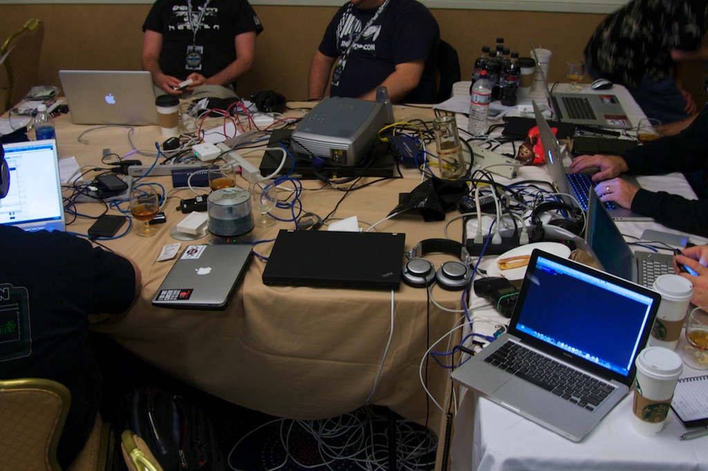

Conferences
Defcon
DerbyCon
Blackhat
CactusCon
ShmooCon

Slide 19
Competitions
Compete in them!!!!
ICTF, CCDC, CyberPatriot, CSAW, CPTC, DFCQ, ISTS, NCL, PCACQ, Panoply, CyberLympics, NetWars, AventGames, ASU CSC, etc..
ctftime.org
reddit.com/r/securityCTF/
github.com/ctfs
github.com/apsdehal/awesome-ctf
http://captf.com/

Slide 20

Question Authority
Critical thinking
Troubleshooting
Question
Everything

Slide 21

#1 Collaborate with Everyone Around You
Hackers are strong because, they share all their data.
Tools and Knowledge are shared all the time
Don’t be an AO and share your
OpenSource if you are cool
Create reputation
This is also your avenue into the workforce

Slide 22
Additional Resources
http://www.amanhardikar.com/mindmaps/Practice.png
http://cyberseek.org/
https://github.com/Hack-with-Github/Awesome-Hacking/blob/master/README.md
cyberawareaz.com

Slide 24
References
https://certification.comptia.org/docs/default-source/downloadablefiles/it-certification-roadmap.pdf?sfvrsn=2
http://csrc.nist.gov/nice/framework/national_cybersecurity_workforce_framework_03_2013_version1_0_interactive.pdf
https://digitalguardian.com/blog/top-50-must-attend-information-security-conferences
https://www.youtube.com/watch?v=dcjViYTDk-A

