Slide 1
Scheme & Functional Programming
Week 6: WORKSHEET 5
Author: David xu

Slide 2
Discussion

Slide 3
(a) Compare and contrast functional programming languages (FPLs) to other programming languages you’ve worked with.
Notes:
Functional programming languages (FPLs) differ significantly from imperative and object-oriented languages in several key aspects: Core Concepts
Immutability: FPLs like Haskell and F# emphasize immutable data structures, contrasting with the mutable state common in imperative languages like C++ and Java.First-class functions: In FPLs such as Scheme and ML, functions are treated as first-class citizens. While some modern imperative languages like JavaScript and Python support this to an extent, it's a fundamental concept in FPLs.Declarative style: FPLs focus on describing what should be computed, rather than how to compute it step-by-step as in imperative languages like C or BASIC.Language Features
Pure functions: FPLs encourage the use of pure functions without side effects. This differs from methods in object-oriented languages like Java or C# that often modify object state.Recursion: Recursion is heavily used in FPLs like Scheme for control flow, as opposed to loops which are more common in imperative languages like Fortran or COBOL.Pattern matching: Many FPLs provide powerful pattern matching capabilities. For example, ML and F# offer sophisticated pattern matching, which is less common in languages like C++ or Java.Lazy evaluation: Some FPLs like Haskell use lazy evaluation, where expressions are only evaluated when needed. This contrasts with the eager evaluation typical in imperative languages.Data Structures
Lists and tuples: FPLs often have built-in support for immutable lists and tuples. For instance, F# provides native support for these data structures.Algebraic data types: Many FPLs support algebraic data types for creating complex data structures, which differs from the class-based approach in object-oriented languages like Java or C#.Paradigm Shift
Learning FPLs often requires a significant mental shift for programmers accustomed to imperative or object-oriented languages. The focus on immutability, higher-order functions, and declarative problem-solving in languages like Haskell or F# can be challenging but also leads to new ways of approaching programming problems.While some modern multi-paradigm languages like C# and Java have incorporated functional programming concepts, pure functional languages like Haskell or F# provide a more complete and focused functional programming experience.

Slide 4
(b) What is referential transparency? Provide an example.
Notes:
Referential transparency is a key concept in functional programming languages:
Definition
Referential transparency means that an expression can be replaced by its value without changing the program's behavior. In other words, a function call will always produce the same result for the same input, regardless of when or where it is evaluated.Characteristics
Pure functions: Referentially transparent functions are pure - they have no side effects and their output depends only on their inputs.
Immutability: Data is immutable in languages that enforce referential transparency, preventing state changes that could affect function outputs.
Predictability: Programs with referential transparency are more predictable and easier to reason about.

Slide 5
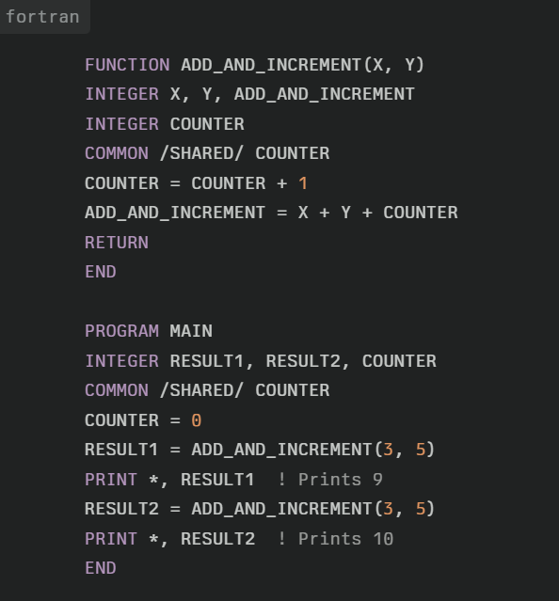
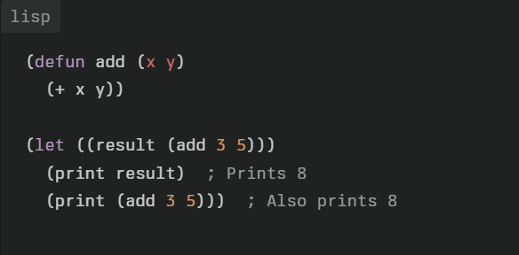
(b) What is referential transparency? Provide an example.
Notes:
In this LISP example:The add function is referentially transparent.
We can replace any call to (add 3 5) with the value 8 without changing the program's behavior.
The function will always return the same result for the same inputs.
In this Fortran 77 example:The ADD_AND_INCREMENT function is not referentially transparent.
It uses a common block variable COUNTER that changes with each call.
Calling the function with the same arguments (3 and 5) produces different results each time.

Slide 6
(c) What is a side effect? Do these exist in FPLs?
Notes:
Key Differences
Side Effects: LISP functions typically avoid side effects, while Fortran 77 functions often modify program state through common blocks or global variables.
Predictability: LISP's referential transparency makes code more predictable and easier to reason about.
Testing: Referentially transparent functions in LISP are easier to test, as their behavior depends solely on inputs.
Optimization: LISP's referential transparency allows for easier compiler optimizations, such as memoization.
Parallelism: LISP's approach facilitates parallel execution, as functions don't depend on shared mutable state.
Referential transparency, as demonstrated in the LISP example, is a hallmark of functional programming. It leads to more predictable and maintainable code, though it can require a significant shift in thinking for programmers accustomed to imperative styles like Fortran 77.

Slide 7
(d) Can functions in FPLs be viewed as values?
Notes:
functions in functional programming languages (FPLs) can indeed be viewed as values. This is one of the key characteristics that distinguishes FPLs from many imperative languages. Here are some key points about functions as values in FPLs:First-class functions: In FPLs like LISP, Scheme, ML, and Haskell, functions are first-class citizens, meaning they can be:Assigned to variables
Passed as arguments to other functions
Returned as results from functions
Higher-order functions: FPLs support higher-order functions, which are functions that can take other functions as parameters or return functions as results.
Function literals: Many FPLs allow you to create anonymous functions (lambda expressions) on the fly, treating them as literal values.
Closures: FPLs often support closures, which are functions packaged together with their lexical environment.

Slide 8
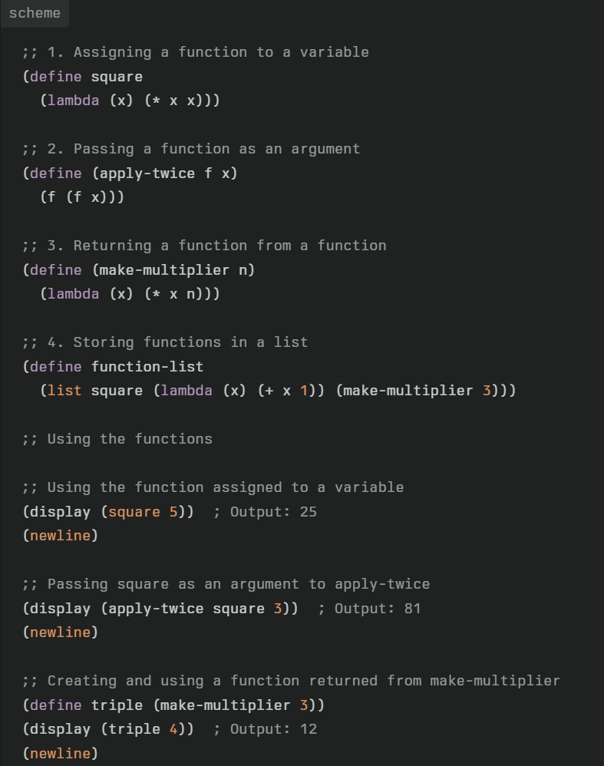
(d) Can functions in FPLs be viewed as values?
Notes:
Assigned to variables
Passed as arguments to other functions
Returned as results from functions
Stored in data structures
Here's a Scheme example demonstrating these concepts:

Slide 9
(e) Are FPLs suitable for concurrent systems? Why or why not?
Notes:
Concurrent systems are computer systems that can execute multiple computations simultaneously. In programming, this refers to programs that can have multiple threads of execution running in parallel.FPLs have several characteristics that make them well-suited for developing concurrent systems:Immutability: FPLs emphasize immutable data structures, which eliminates many concurrency issues related to shared mutable state. This makes it easier to reason about concurrent code.
Pure functions: Functions in FPLs are often pure, meaning they have no side effects and always produce the same output for given inputs. This makes them inherently thread-safe.
Referential transparency: This property allows expressions to be replaced by their values without changing program behavior, which facilitates parallelization of code.
Higher-order functions: FPLs support higher-order functions, which can be used to abstract concurrency patterns and create reusable concurrent structures.
Lazy evaluation: Some FPLs use lazy evaluation, which can help in managing computational resources in concurrent systems.
The book mentions that a section on concurrency in functional programming languages was added to Chapter 13, indicating that FPLs do have specific support for concurrent programming. This likely includes:Parallel evaluation of expressions
Concurrent data structures
Message-passing concurrency models
Software transactional memory
While FPLs have advantages for concurrent programming, there are also some potential challenges:
Performance: Some concurrent algorithms may be less efficient when implemented in a purely functional style.
State management: While immutability is beneficial, managing state changes in a purely functional way can sometimes be complex.
Learning curve: Developers accustomed to imperative concurrent programming may need time to adapt to functional concurrency patterns.
Overall, FPLs are generally considered highly suitable for concurrent systems due to their inherent properties that align well with concurrent programming principles. Their emphasis on immutability and pure functions can lead to more robust and easier-to-reason-about concurrent code.

Slide 10
(f) What is Tail Recursion Optimisation?
Notes:
Tail recursion optimization is an important concept in functional programming languages. Here are the key points about tail recursion optimization:
Definition: Tail recursion optimization (also called tail call optimization) is a compiler optimization technique that transforms certain types of recursive function calls into iterative loops.
Purpose: It allows recursive algorithms to execute using constant stack space, avoiding stack overflow errors for deep recursions.
Applicability: It applies to recursive calls that are in tail position - meaning the recursive call is the last operation performed before the function returns its result.
How it works: The compiler replaces the recursive call with a jump back to the beginning of the function, reusing the current stack frame instead of creating a new one.
Benefits:Improves performance by eliminating the overhead of multiple function calls
Allows writing recursive algorithms that can handle arbitrarily large inputs without risk of stack overflow
Language support: Many functional programming languages like Scheme, ML, and Haskell guarantee tail call optimization. Some imperative languages like C and C++ may optionally support it.

Slide 11
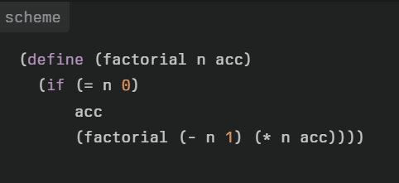
(f) What is Tail Recursion Optimisation?
Notes:
This factorial implementation can be optimized into an iterative loop, using constant stack space regardless of input size.Limitations: Not all recursive functions can be optimized this way - only those where the recursive call is in tail position.
Tail recursion optimization allows functional languages to efficiently implement algorithms that would typically use loops in imperative languages, while maintaining a recursive and often more intuitive structure.

Slide 12
(g) Discuss the use of a lambda function.
Notes:
Lambda functions are an important concept in functional programming languages like Scheme. Here are the key points about lambda functions, along with a Scheme example:Definition: Lambda functions are anonymous functions that can be created on-the-fly without being bound to an identifier.
First-class citizens: In Scheme, lambda functions are treated as first-class values, meaning they can be:Assigned to variables
Passed as arguments to other functions
Returned as results from functions
Syntax: In Scheme, lambda functions are created using the lambda keyword followed by a parameter list and function body.
Use cases: Lambda functions are particularly useful for:Creating small, one-off functions
Passing functions as arguments to higher-order functions
Implementing closures
Flexibility: They allow for more flexible and concise code, especially when used with higher-order functions.

Slide 13
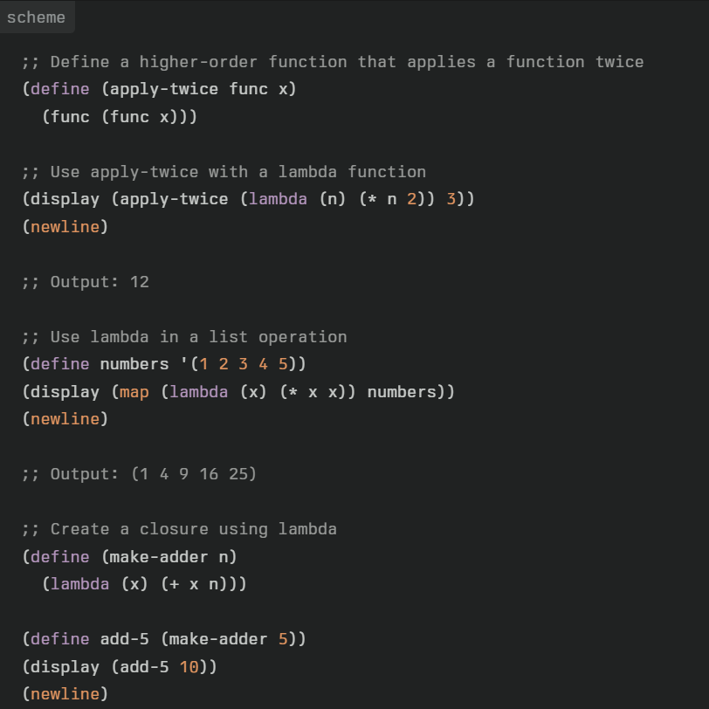
(g) Discuss the use of a lambda function.
Notes:
This example demonstrates:Using a lambda function as an argument to a higher-order function (apply-twice)
Using lambda with the map function to square a list of numbers
Creating a closure with lambda to make a function that adds a specific number
Lambda functions in Scheme provide a powerful and flexible way to work with functions as first-class values, enabling concise and expressive functional programming patterns.

Slide 14
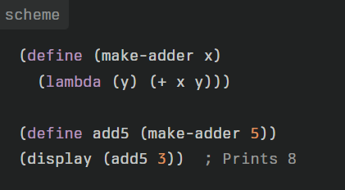
(h) What is a closure?
Notes:
A closure is an important concept in functional programming languages. Here are the key points about closures:
Definition: A closure is a function together with its referencing environment.
Referencing environment: This includes all the variables that were in scope when the closure was created.
Function as a first-class object: Closures treat functions as first-class objects, allowing them to be assigned to variables, passed as arguments, and returned from other functions.
Lexical scoping: Closures rely on lexical scoping, where the scope of a variable is determined by its position in the source code.
State preservation: Closures can "capture" and preserve the state of variables from their enclosing scope, even after that scope has finished executing.
The make-adder function returns a lambda expression with x instead of 5. When we call (make-adder 5), it returns (lambda (y) (+ 5 y)), which is then bound to add5. So when we call (add5 3), it behaves exactly like ((lambda (y) (+ 5 y)) 3).

Slide 15

(i) With reference to programming language characteristics, compare Scheme and Elixir.
Notes:
Paradigm:
Scheme is a functional programming language, emphasizing immutability and recursion.
Elixir is also functional, but incorporates some imperative features and is built for concurrency.
Syntax:
Scheme uses a minimalist syntax with heavy use of parentheses (Lisp-like).
Elixir has a more Ruby-like syntax, which is generally considered more readable.
Type System:
Scheme is dynamically typed.
Elixir is also dynamically typed, but offers more robust pattern matching.
Concurrency:
Scheme doesn't have built-in concurrency features.
Elixir is designed for concurrency, using the actor model via Erlang's BEAM VM.
Immutability:
In Scheme, data structures are typically immutable.
Elixir enforces immutability for all data.
Metaprogramming:
Scheme offers powerful macros for metaprogramming.
Elixir provides metaprogramming capabilities through macros, but they're generally considered easier to use than Scheme's.
Ecosystem:
Scheme has a long history and academic focus, with various implementations.
Elixir has a growing ecosystem, particularly strong in web development and distributed systems.
Use Cases:
Scheme is often used in education and language research.
Elixir is commonly used for building scalable and fault-tolerant applications, especially web services.
Both languages emphasize functional programming concepts, but Elixir is more oriented towards practical, industry applications, especially those requiring concurrency and fault tolerance. Scheme, on the other hand, is valued for its simplicity and is often used in academic settings to teach programming concepts.

Slide 16
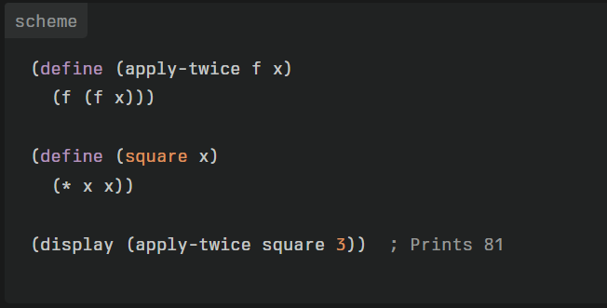
(j) Is Scheme orthogonal? Provide an example.
Notes:
orthogonality in programming languages refers to the property where "a relatively small set of primitive constructs can be combined in a relatively small number of ways to build the control and data structures of the language."
This definition implies several key aspects of orthogonality:
Small set of primitives: The language has a limited number of basic building blocks or fundamental constructs.
Combinatorial power: These basic constructs can be combined in various ways.
Expressiveness: Despite the limited number of primitives and combinations, the language can express a wide range of control and data structures.
Consistency: The primitives work uniformly across different contexts in the language.
This example showcases Scheme's orthogonality in several ways:
Functions as first-class objects: The square function is passed as an argument to apply-twice, demonstrating that functions can be treated like any other data type.
Uniform syntax: The syntax for function definition (define) and function application is consistent, whether it's a user-defined function or a built-in operator like *.
Consistency of data types: Numbers, functions, and even complex expressions are all treated uniformly as expressions that can be evaluated.
Composability: The apply-twice function can be used with any function that takes one argument and returns a value of the same type, not just square.
This example illustrates how a small set of primitive constructs (function definition, function application, arithmetic operations) can be combined in flexible ways to create more complex behaviors, which is a key aspect of orthogonality in programming languages.

Slide 17
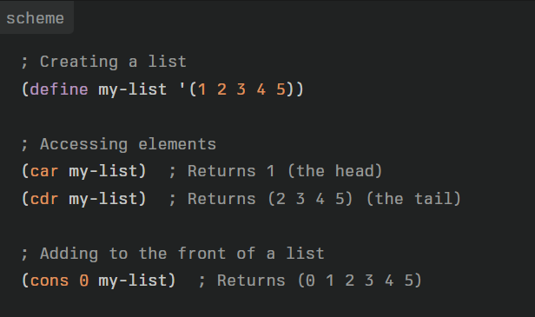
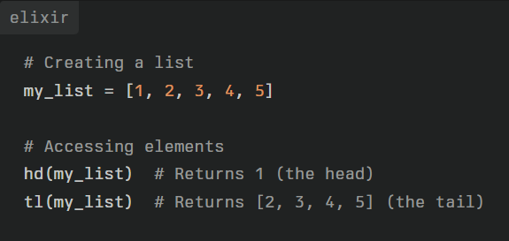
(k) Both Elixir and Scheme use similar list structures. Describe, with an example, how lists are structured.
Notes:
Linked Structure:
In both languages, lists are implemented as linked structures, specifically as singly-linked lists.
Cons Cells:
Lists are built from "cons cells" (short for "construct"). Each cons cell contains two parts: the first element (or "head") and a pointer to the rest of the list (or "tail").
Empty List:
Both languages have a concept of an empty list, which serves as the terminator for all lists.
Immutability:
Lists in both languages are immutable. Operations that seem to modify a list actually create a new list.
Key similarities:
Both use a head/tail structure.
Both allow easy prepending of elements.
Both treat lists as immutable.
Key differences:
Syntax: Scheme uses parentheses, while Elixir uses square brackets.
Function names: Scheme uses car and cdr, while Elixir uses hd and tl.
Cons operation: Scheme uses cons, while Elixir uses the | operator.
In both languages, these list structures are optimized for operations that work from the front of the list, such as prepending elements or processing lists recursively. This design aligns well with functional programming patterns and recursion-based algorithms.

Slide 18
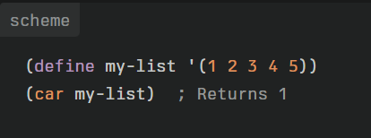
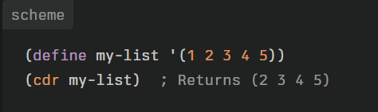
(l) In Scheme, what are the car and cdr functions used for? Use examples.
Notes:
In Scheme, the car and cdr functions are fundamental operations used to access elements of lists. They are derived from the original implementation of lists in Lisp using "cons cells". Here's an explanation of each with examples:
car (Contents of Address Register):
car returns the first element of a list.
It's used to access the "head" of the list.
cdr (Contents of Decrement Register):
cdr returns a new list containing all elements except the first one.
It's used to access the "tail" of the list.

Slide 19
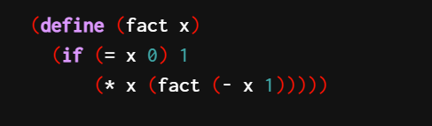
(m) Consider the following code snippet. Transform it into a tail-recursive function:

Slide 20
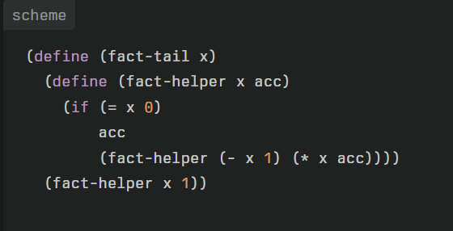
(m) Consider the following code snippet. Transform it into a tail-recursive function:
Notes:
Let's break down this transformation:
We define a new outer function fact-tail that takes the original argument x.
Inside fact-tail, we define an inner helper function fact-helper that takes two parameters:
x: the current number we're processing
acc: the accumulator that stores the intermediate result
The base case of the recursion is when x reaches 0. At this point, we return the accumulator acc, which contains the final result.
In the recursive case, instead of waiting for the recursive call to complete and then multiplying, we:
Decrease x by 1
Multiply the current x with the accumulator
Pass these new values to the next recursive call
The initial call to fact-helper is made with the original x and an accumulator value of 1.
This version is tail-recursive because the recursive call to fact-helper is the last operation in the function. The multiplication happens before the recursive call, not after it returns.
To use this function, you would call (fact-tail 5) instead of (fact 5). The result will be the same, but the tail-recursive version can handle larger inputs without risking stack overflow, assuming the Scheme implementation supports proper tail-call optimization.

Slide 21
2. S-expressions
The Lisp family of languages use what are known as S-expressions for both code and data. (1) Describe what an S-expression is, (2) devise a means of visually representing these expressions, and (3) detail the process needed to evaluate such an expression.
Notes:
expression
The syntactic elements of the Lisp programming language are symbolic
expressions, also known as s-expressions. Both programs and data are
represented as s-expressions: an s-expression may be either an atom or a list.
Lisp atoms are the basic syntactic units of the language and include both
numbers and symbols. Symbolic atoms are composed of letters, numbers,
and the non-alphanumeric characters.
Examples of Lisp atoms include:
3.1416
100
hyphenated-name
*some-global*
nil
A list is a sequence of either atoms or other lists separated by blanks and
enclosed in parentheses. Examples of lists include:
(1 2 3 4)
(george kate james joyce)
(a (b c) (d (e f)))
()
Note that lists may be elements of lists. This nesting may be arbitrarily deep and allows us to create symbol structures of any desired form and
complexity. The empty list, “()”, plays a special role in the construction
and manipulation of Lisp data structures and is given the special name
nil. nil is the only s-expression that is considered to be both an atom
and a list. Lists are extremely flexible tools for constructing
representational structures

Slide 22
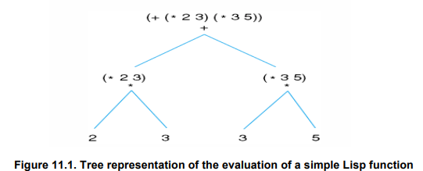
2. S-expressions
The Lisp family of languages use what are known as S-expressions for both code and data. (1) Describe what an S-expression is, (2) devise a means of visually representing these expressions, and (3) detail the process needed to evaluate such an expression.
Notes:
Process to evaluate an S-expression:
a) If the S-expression is an atom:
If it's a number or string, return its value
If it's a symbol, return the value bound to that symbol
b) If the S-expression is a list:
Evaluate the first element (usually a function or special form)
If it's a function:
Evaluate all the arguments (recursively applying these rules)
Apply the function to the evaluated arguments
If it's a special form (like if, define, quote):
Follow the specific evaluation rules for that special form
c) Return the result
Evaluate the outermost expression (+):
It's the addition function
Evaluate the first argument (* 2 3):
a. Evaluate (*): it's the multiplication function
b. Evaluate 2: it's 2
c. Evaluate 3: it's 3
d. Apply *: 2 * 3 = 6
Evaluate the second argument (* 3 5):
a. Evaluate (*): it's the multiplication function
b. Evaluate 3: it's 3
c. Evaluate 5: it's 5
d. Apply *: 3 * 5 = 15
Now we have (+ 6 15)
Apply + to the results: 6 + 15 = 21
Return 21
So, the final result of evaluating (+ (* 2 3) (* 3 5)) is 21.
This example demonstrates how S-expressions are evaluated recursively, with inner expressions being evaluated before outer ones, and how the results are passed up the expression tree until the final result is computed.

Slide 23
3. Programming Tasks
Notes:
Link :
https://github.com/david3xu/progLang/tree/main/prac05

