Slide 1

Scripting Languages
WORKSHEET 8
Author: David xu
Notes:
https://github.com/david3xu/progLang

Slide 2

Discussion
Notes:
https://github.com/david3xu/progLang

Slide 3
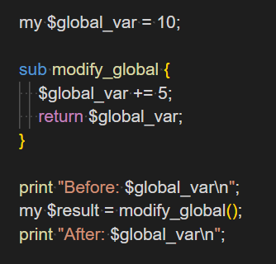
(a) What are the advantages and disadvantages of the way Perl passes parameters?
Notes:
Advantages:
* **Contextual information**: Perl uses contextual information to drive decisions made at run time. Each operator determines the context of its arguments, allowing them to exhibit different behavior.
* **Flexibility**: The ability for each argument to tell which kind of context it occupies allows for flexible behavior in operators.
Disadvantages:
* **Complexity**: The use of contextual information can make Perl code more complex and harder to understand.
* **Potential issues with side effects**: In this example, the modify_global function has a side effect of changing the value of $global_var. When the function is called, it not only returns a value but also modifies the global state of the program.

Slide 4
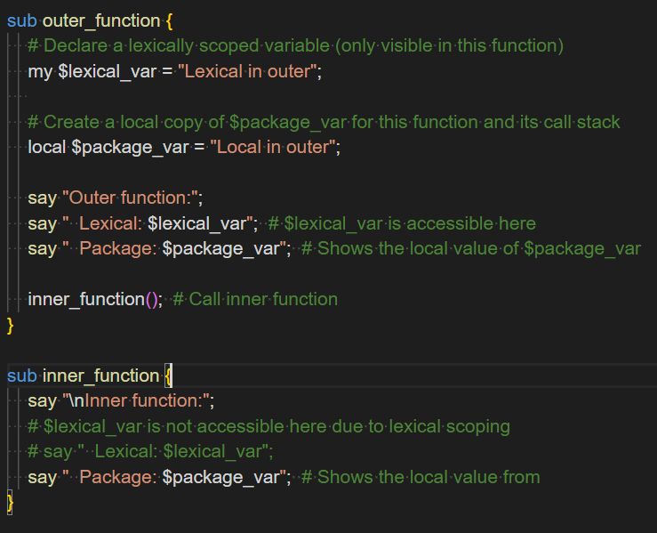
(b) What are the differences between ‘my‘ and ‘local‘ variables in Perl?
Notes:
### my Variables
- **Lexical scope**: `my` variables are lexically scoped, meaning their visibility is limited to the block where they're declared.
- **No inheritance**: `my` variables do not inherit values from outer scopes.
- **Garbage collection**: When a `my` variable goes out of scope, it's automatically garbage collected.
### local Variables
- **Dynamic scoping**: `local` variables are dynamically scoped, meaning their visibility is determined by the call stack.
- **Inheritance**: `local` variables inherit values from outer scopes.
- **No garbage collection**: When a `local` variable goes out of scope, it's not automatically garbage collected.

Slide 5
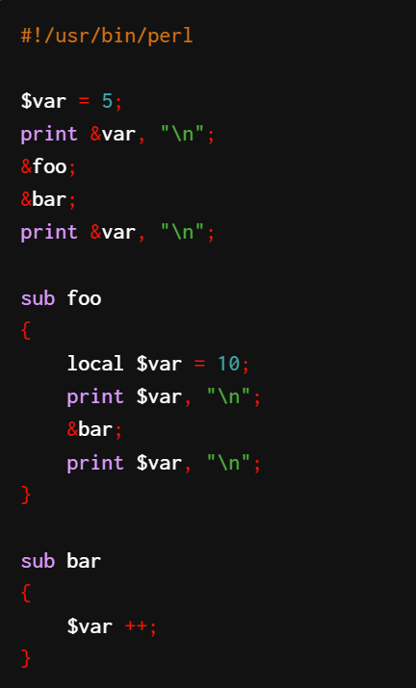
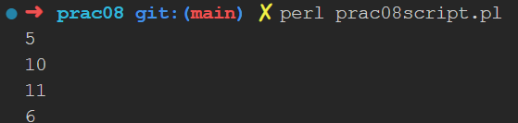
(c) What will be printed by the following Perl script?

Slide 6

(d) Perl tends to be a divisive topic; some people love it and what it is capable of. Others strongly dislike it. Why would this be?
Notes:
The divisiveness surrounding Perl can be attributed to several factors. One reason is its unique syntax and approach to programming, which may not appeal to everyone. For instance, the use of sigils (`$`, `@`, `%`) to denote variable types can be confusing for those accustomed to other languages.
Another factor contributing to the divide is Perl's reputation for being a "quick hack" language, often used for rapid prototyping or scripting tasks rather than large-scale development. This perception may lead some developers to view Perl as inferior to more traditional programming languages like C++ or Java.
Additionally, Perl's community and ecosystem have been subject to controversy over the years. The language's creator, Larry Wall, has been known for his strong opinions and sometimes abrasive personality, which can be off-putting to those who prefer a more collaborative approach.
Lastly, the rise of newer languages like Python, Ruby, and JavaScript has shifted focus away from Perl, leading some developers to view it as outdated or obsolete. However, Perl still maintains a dedicated user base and is widely used in certain niches, such as system administration and text processing.
In summary, the divisiveness surrounding Perl can be attributed to its unique syntax, reputation for quick hacks, community dynamics, and being overshadowed by newer languages.

Slide 7
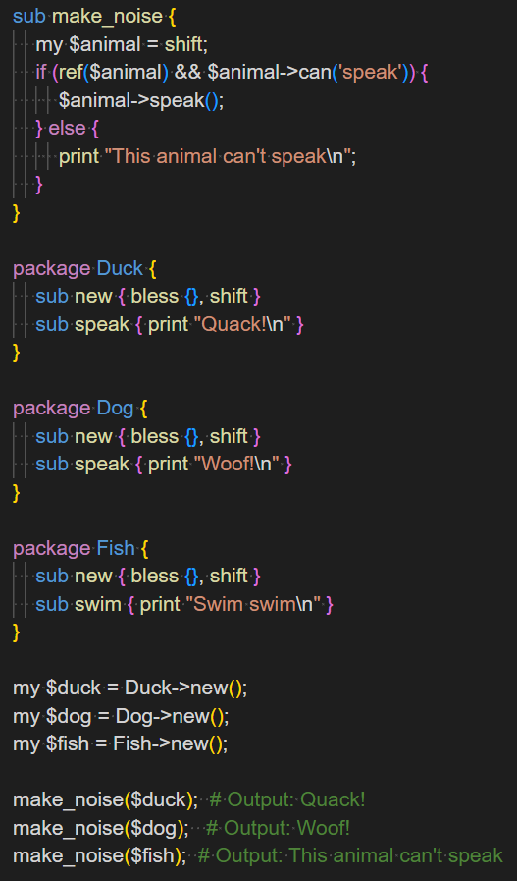
(e) What is ‘Duck typing’?
Notes:
## Duck Typing
Duck typing is a concept in programming that refers to the ability of an object or variable to be used in a particular context based on its behavior or properties, rather than its explicit type. This approach is often contrasted with static typing, where the type of a variable must be explicitly declared.
In duck typing, if an object "quacks like a duck" (i.e., it has the expected methods and properties), it can be used in place of a variable that would normally require a specific type. This allows for more flexibility and dynamic behavior in programming, as objects can adapt to different contexts without needing explicit type conversions.
We define a make_noise function that attempts to call a speak method on any object passed to it.
We create three different classes: Duck, Dog, and Fish. Duck and Dog have a speak method, while Fish does not.
The make_noise function uses the can method to check if the object has a speak method, regardless of its actual class.
When we call make_noise with different objects, it successfully calls speak on the Duck and Dog objects, but recognizes that the Fish object cannot "speak".
This demonstrates duck typing because the make_noise function doesn't care about the specific type of the object it receives. It only cares whether the object can perform the speak action. If it can, it's treated as a "speaking animal", regardless of its actual class.
Duck typing in Perl allows for more flexible and reusable code, as it focuses on an object's capabilities rather than its type. This can lead to more modular and extensible designs, especially when working with diverse object types that share common behaviors.
### Summary
Duck typing is a programming concept that emphasizes behavior over explicit types, allowing objects to adapt to different contexts without needing type conversions. This approach can lead to more flexible and dynamic code, but may also introduce complexity if not managed carefully.

Slide 8
(f) Ruby is used in several places, including for web development. In fact, Twitter was implemented in part with Ruby (although parts of since been rewritten to Scala). What about Ruby makes it suitable for these purposes? In what circumstances might it not be suitable?
Notes:
Ruby is a versatile language suitable for web development due to its simplicity, flexibility, and extensive libraries. Its suitability can be attributed to several factors:
* **Dynamic typing**: Ruby's dynamic typing allows developers to focus on the logic of their code without worrying about explicit type definitions.
* **Object-oriented programming (OOP) capabilities**: Ruby supports OOP principles, making it easy to organize and structure large-scale applications.
* **Extensive libraries**: Ruby has a vast collection of libraries and frameworks, such as Ruby on Rails, that simplify web development tasks like database interactions, routing, and templating.
However, Ruby might not be the best choice in certain circumstances:
* **Performance-critical applications**: While Ruby is suitable for most web development tasks, it may not be the best fit for high-performance applications or those requiring low-level memory management.
* **Large-scale enterprise environments**: Although Ruby can handle large-scale applications, its performance and scalability might be outmatched by languages like Java or C# in extremely demanding environments.
In the context of Twitter's implementation, Ruby was chosen for its simplicity and flexibility. However, parts of the system have since been rewritten to Scala, likely due to performance concerns.

Slide 9
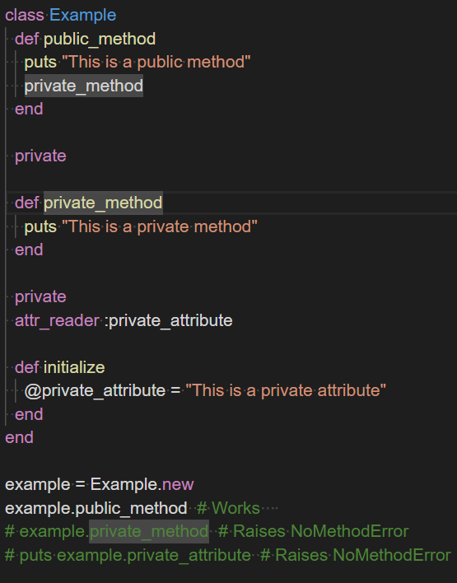
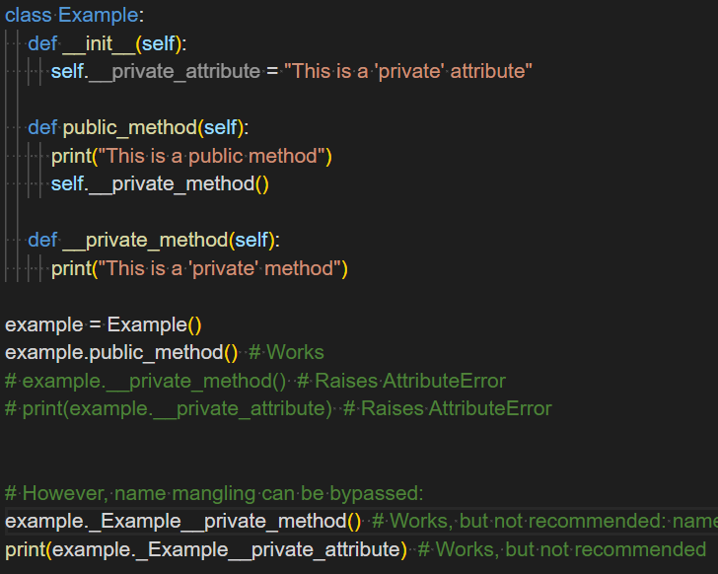
(g) Compare private access for methods and attributes in Ruby and Python.
Notes:
Ruby
Private Methods:
Defined using the private keyword before method definitions
Can only be called with an implicit receiver (self)
Accessible within the class and its subclasses
Cannot be called with an explicit receiver from outside the class
Private Attributes:
Ruby doesn't have true private attributes
Instance variables are always private by default
Access is controlled through getter/setter methods
Python
Private Methods:
Use name mangling with double underscores (__) prefix
Not truly private, but makes access more difficult
Can still be accessed from outside using _ClassName__method_name
Private Attributes:
Also use name mangling with double underscores
Similar to methods, not truly private
Key Differences:
Implementation: Ruby uses keywords, while Python uses naming conventions.
Strictness: Ruby's private methods are more strictly enforced than Python's.
Inheritance: Ruby's private methods are accessible in subclasses, while Python's name-mangled methods are not directly inherited.
True Privacy: Neither language offers true privacy, but Python's approach makes accidental access less likely.
Philosophy: Ruby trusts developers more, while Python's "we're all consenting adults" philosophy still provides a mechanism to discourage improper access.
In both languages, private methods and attributes are primarily used for encapsulation and to prevent unintended external access to internal implementation details.

Slide 10
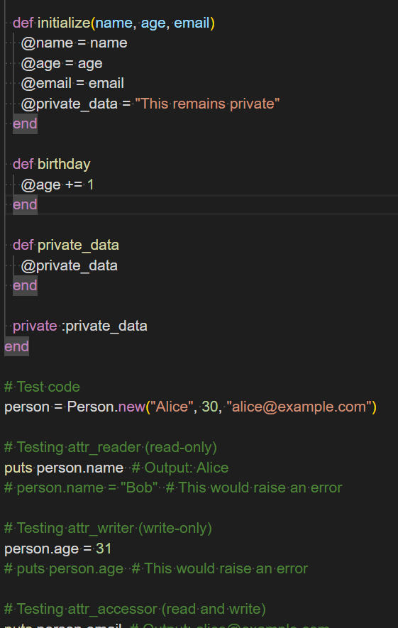
(h) How do you declare a public instance variable in Ruby?
Notes:
In Ruby, you cannot directly declare a public instance variable. Here's a clarification:
Instance variables in Ruby are always private by default.
Instance variables are always prefixed with the @ symbol.
There is no way to make an instance variable directly public.
To achieve public access to an instance variable, you need to use getter and/or setter methods. Here are the common ways to do this:
Define explicit getter/setter methods
Use Ruby's attr_accessor, attr_reader, or attr_writer:
If you only need read access, use attr_reader:
If you only need write access, use attr_writer:

Slide 11
(i) Some shell languages support arithmetic and some do not. Discuss why this might be.
Notes:
Arithmetic operations refer to mathematical calculations performed on numbers or expressions.
### 1. **Design Philosophy**
Shell languages like Bash and Zsh were designed with a focus on scripting and automation tasks. They inherited features from their Unix shell ancestors, which often included basic arithmetic capabilities for simple calculations. In contrast, shells like Fish or PowerShell might have prioritized other aspects, such as user experience or integration with specific platforms.
### 2. **Use Cases**
The need for arithmetic operations varies across different use cases:
* **Scripting and Automation**: Shells used for scripting and automation often require basic arithmetic capabilities to perform tasks like file size calculations, data processing, or simple mathematical transformations.
* **Interactive Use**: In interactive shells, users might not frequently need arithmetic operations. However, when they do, it's usually for more complex tasks that could be handled by a dedicated programming language.
### 3. **Implementation Complexity**
Implementing arithmetic support in shell languages can add complexity:
* **Parsing and Evaluation**: Introducing arithmetic capabilities requires parsing and evaluating expressions, which can complicate the shell's syntax and error handling.
* **Performance**: Arithmetic operations might introduce performance overhead, especially if they involve complex calculations or large data sets.
### 4. **Language Evolution**
As shell languages evolve, their design priorities change:
* **Modernization**: Newer shells like Fish focus on improving user experience, which might lead to a shift away from basic arithmetic capabilities.
* **Integration with Other Tools**: Shells that integrate well with other tools or programming languages might prioritize features that enhance this integration over native arithmetic support.
### 5. **Community and Ecosystem**
The community and ecosystem surrounding a shell language influence its development:
* **User Demand**: If users frequently request or rely on arithmetic capabilities, the shell's developers are more likely to include them.
* **Competition**: In a competitive market, shells that offer unique features might gain an advantage over those without.
### Summary
The decision to support arithmetic operations in shell languages depends on factors like design philosophy, use cases, implementation complexity, language evolution, and community demand. While some shells prioritize basic arithmetic capabilities for scripting and automation tasks, others focus on user experience or integration with other tools.

Slide 12
(j) Shell languages provide many features that general-purpose languages have, but are not typically used for large programs themselves. Why?
Notes:
This is because shell languages were designed with a focus on scripting and automation tasks, rather than complex program development.
### Key Points:
- **Design Philosophy**: Shell languages like Bash and Zsh were designed to be simple, lightweight, and easy to use for scripting and automation tasks. They inherited features from their Unix shell ancestors, which often included basic arithmetic capabilities for simple calculations.
- **Use Cases**: Shells are used for tasks like file management, process control, and data processing. However, they are not typically used for large-scale program development or complex algorithms.
- **Implementation Complexity**: Implementing complex programs in a shell language can be cumbersome due to the lack of built-in support for features like object-oriented programming, memory management, and advanced data structures.
### Example Use Cases
1. **Scripting and Automation**: Shells are ideal for scripting and automation tasks, such as:
* Automating file backups
* Running system maintenance tasks
* Processing log files
2. **Interactive Use**: In interactive shells, users can perform simple calculations or execute shell scripts.
### Programming Languages
Most programming languages support basic arithmetic operations. Some examples include:
* **Python**: Supports addition, subtraction, multiplication, and division using operators like `+`, `-`, `*`, and `/`.
* **Java**: Also supports these basic arithmetic operations using similar operators.
* **C++**: Includes arithmetic operations as part of its core syntax.
### Summary
Shell languages are not typically used for large programs themselves due to their design philosophy, use cases, and implementation complexity. They are ideal for scripting and automation tasks, interactive use, or simple calculations. For complex program development, general-purpose programming languages like Python, Java, or C++ are more suitable.

Slide 13
Programming Exercises
Notes:
https://github.com/david3xu/progLang

