Slide 1
Logical Programming
ProLog
Week 9: WORKSHEET 7
Author: David xu
Notes:
https://github.com/david3xu/progLang

Slide 2
(1) Why is traditional logic insufficient to model the real world?
Notes:
Traditional logic is insufficient to model the real world because it relies on a binary system of true or false, which cannot capture the complexity and nuances of real-world situations. This limitation is highlighted in the context of discrete event simulation, where continuous processes like crystal growth or water flow are better represented by capturing individual particles rather than relying solely on traditional logic.
"Discrete event simulation is one in which the model is naturally expressed in terms of events (typically interactions among various interesting objects) that happen at specific times." This suggests that traditional logic may not be sufficient to capture the dynamic and often non-binary nature of real-world phenomena.
Furthermore, the text notes that discrete event simulation is usually not appropriate for continuous processes unless they are captured at the level of individual particles. This implies that traditional logic may struggle to model complex systems where multiple factors interact in a non-linear fashion.
Therefore, while traditional logic has its strengths, it is insufficient on its own to model the real world due to its binary nature and inability to capture the complexity of continuous processes.
what is is traditional logic insufficient ?
Traditional logic is insufficient to model the real world because it relies solely on a true/false system, assuming that if a goal cannot be proved true, it must be false. This approach has several limitations:
It does not account for incomplete or uncertain information.
It assumes that all knowledge can be represented as a set of propositions in a database.
It is unable to reason about the world outside its database.
In contrast, logic programming languages like Prolog use a more nuanced approach, where goals are assumed to be false if they cannot be proved true. This allows for more flexible and efficient reasoning, but also introduces limitations, such as:
Inability to prove that a goal is false.
Limited ability to reason about the world outside its database.
These limitations make traditional logic insufficient for modeling the real world, where incomplete or uncertain information is common.

Slide 3
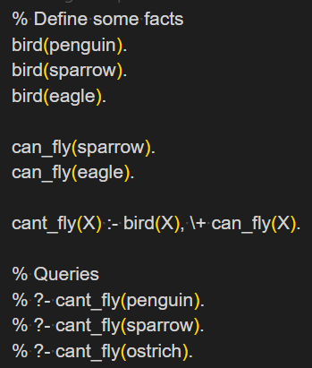
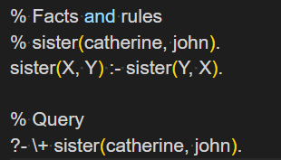
(2) What is the problem with negation in Prolog?
Notes:
Closed World Assumption: Prolog assumes that anything not explicitly stated or provable is false. This can lead to incorrect conclusions when dealing with incomplete information.
Negation as Failure: Prolog implements negation using the concept of "negation as failure." This means that if Prolog fails to prove a goal, it assumes the negation of that goal is true. This approach can lead to logical inconsistencies in certain scenarios.
Negation as Failure Example
To illustrate negation as failure in Prolog, let's consider a simple example:
Suppose we have the following facts and rules:
sister(catherine, john).
sister(X, Y) :- sister(Y, X).
?- \+ sister(catherine, john).
In this example, the \+ operator is used to indicate negation as failure. The query ?- \+ sister(catherine, john). asks Prolog to prove that it's not true that Catherine is John's sister.
Prolog will attempt to prove this by trying to find a proof for sister(catherine, john). Since the fact sister(catherine, john) is explicitly stated, Prolog will fail to find a proof and conclude that the negation of sister(catherine, john) is true.
However, if we remove the fact sister(catherine, john). from the database, Prolog will no longer be able to prove or disprove the statement.
The Prolog interpreter will indeed continue running without terminating. This is a case of infinite recursion.
Explanation
The negation \+ attempts to prove sister(catherine, john) in order to negate it.
To prove sister(catherine, john), Prolog uses the rule:
prolog
sister(X, Y) :- sister(Y, X).
This leads to trying to prove sister(john, catherine).
The rule is applied again, leading back to trying to prove sister(catherine, john).
This process continues indefinitely, creating an infinite loop.
The Core Problem
This example illustrates a fundamental issue with negation in Prolog:
Infinite Recursion: The combination of negation and recursive rules can easily lead to non-terminating computations.
Lack of Termination Check: Prolog doesn't have a built-in mechanism to detect this kind of infinite recursion when dealing with negation.
Violation of Occur Check: In more complex scenarios, this can also relate to Prolog's lack of occur check in unification, which can lead to similar infinite loops.

Slide 4
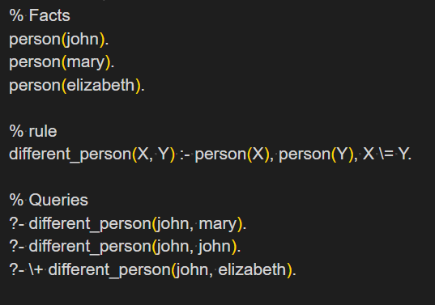
(3) How is inequality implemented in Prolog?
Notes:
You are correct that the example I provided earlier was about equality, not inequality. To provide an example of inequality implemented in Prolog, let's consider a simple scenario:
Suppose we want to check if two numbers are not equal. We can define a predicate not_equal/2 as follows:
not_equal(X, Y) :- X \= Y.
This predicate uses the \= operator (read as "not equal") to check if X and Y are not equal.
To demonstrate how this works, let's consider an example query:
?- not_equal(2, 3).
true.
In this case, the query is true because 2 and 3 are indeed not equal.
However, if we try to use this predicate with numbers that are equal, it will fail:
?- not_equal(2, 2).
false.
This makes sense, since the predicate is designed to check for inequality.
To illustrate how this can be used in a more complex scenario, let's consider an example where we want to find all pairs of numbers that are not equal. We can use the findall/3 predicate to achieve this:
findall(Pair, (X = 1..5, Y = X + 1..6, not_equal(X, Y)), Pairs).
This query will find all pairs of numbers (X, Y) where X and Y are consecutive integers from 1 to 5, and X is not equal to Y. The resulting pairs will be stored in the Pairs variable.
I hope this example helps illustrate how inequality can be implemented in Prolog!

Slide 5
(4) What are the three types of statements used in Prolog?
Notes:
1. Facts
A fact is a statement that asserts the truth of some proposition. It has no arguments and is used to state a simple fact.
mother(mary, shelley).
This statement asserts that Mary is the mother of Shelley.
2. Rules (Headed Horn Clauses)
A rule is a statement that specifies a relationship between propositions. It has a head and a body, where the head is a single proposition and the body is one or more propositions.
mother(X, Y) :- parent(X, Y).
This statement asserts that if X is a parent of Y, then X is also the mother of Y.
3. Goals
A goal is a query to the Prolog system, asking it to find a solution that satisfies the conditions specified in the goal.
?- mother(mary, shelley).
This statement asks the Prolog system to find a solution for which Mary is the mother of Shelley.
These three types of statements are fundamental to the Prolog programming language and are used to express facts, rules, and queries.

Slide 6
(5) Is Prolog well-suited for dealing with complex mathematical problems involving infinite datasets? Justify your answer.
Notes:
Prolog is not particularly well-suited for dealing with complex mathematical problems involving infinite datasets. The reason lies in its resolution process, which may have to find every element in the database before it finds the one shown (as mentioned in the document).
In the context of Prolog's resolution process, this means that if we're trying to solve a problem that requires checking an infinite number of elements (e.g., all integers), the system might not be able to terminate. This is because Prolog's resolution process involves recursively instantiating variables and checking subgoals until it finds a solution or exhausts all possibilities.
For example, consider the program for integer division mentioned in the document. While this program illustrates a simple generate-and-test approach using Prolog, it's not well-suited for dealing with infinite datasets because it would require an infinite number of iterations to check every possible value.
In contrast, other programming paradigms like functional programming (e.g., Scheme) or logic-based semantic networks might be more suitable for handling complex mathematical problems involving infinite datasets.

Slide 7
(6) Can Prolog handle non-monotonic problems?
Notes:
A non-monotonic problem is one that can be solved by a program that revises or retracts previously established facts. In other words, the solution to a non-monotonic problem may involve "forgetting" or "unlearning" previously known information.
In Prolog, non-monotonic problems are typically handled using negation as failure (NAF), which allows a program to infer that something is not true if it cannot be proven true. This can lead to situations where previously established facts are retracted or revised based on new information.
For example, consider the following Prolog rule:
parent(X, Y) :- mother(X, Y).
If we have a fact mother(mary, shelley)., then we can infer that parent(mary, shelley).. However, if we later discover that Mary is not actually the mother of Shelley (e.g., through additional facts or rules), then our inference about Mary being a parent of Shelley may be retracted.
Prolog's ability to handle non-monotonic problems makes it well-suited for applications where knowledge can change over time or where previously established facts need to be revised based on new information.

Slide 8
(7) What is the difference between forward and backward chaining?
Notes:
parent(X, Y) :- mother(X, Y).
mother(mary, shelley).
?- parent(mary, shelley).
is an example of forward chaining. You start with the fact mother(mary, shelley) and use it to deduce that mary is a parent of shelley.
However, if you change the query to ?- parent(X, mary)., then it becomes an example of backward chaining:
parent(X, Y) :- mother(X, Y).
mother(mary, shelley).
?- parent(X, mary).
In this case, you start with a query (parent(X, mary)) and use the rule parent(X, Y) :- mother(X, Y) to find that mary is a parent of someone.

Slide 9
(8) What is meant by backtracking?
Notes:
In Prolog, backtracking refers to the process of exploring alternative solutions when a previous attempt fails. It's like trying different paths to reach a goal.
When a query is made, Prolog tries to find a solution by matching the query with the rules and facts in the database. If it finds a match, it uses that information to deduce new facts. However, if it can't find a match or if the match leads to an inconsistency (e.g., a contradiction), Prolog backtracks to explore alternative solutions.
Example
Let's consider the example from the previous conversation:
parent(X, Y) :- mother(X, Y).
mother(mary, shelley).
?- parent(mary, shelley).
In this case, Prolog tries to find a solution by matching the query parent(mary, shelley) with the rule parent(X, Y) :- mother(X, Y). Since it finds a match (i.e., mother(mary, shelley)), it uses that information to deduce that mary is a parent of shelley.
However, if we ask Prolog:
?- parent(john, mary).
It will try to find a solution by matching the query with the rules and facts in the database. If it can't find a match or if the match leads to an inconsistency, it will backtrack to explore alternative solutions.
Key Takeaway
Backtracking is an essential feature of Prolog that allows it to explore different paths to reach a goal when a previous attempt fails. It's a powerful tool for solving complex problems and finding alternative solutions.

Slide 10
(9) What is the ‘cut’ operator useful for?
Notes:
The 'cut' operator (!) is useful for preventing backtracking in Prolog. When a cut is encountered during a query, it ensures that the current branch of execution is abandoned, and the search space is pruned to exclude any further exploration of that branch.
In other words, the cut operator helps to prevent the system from exploring alternative solutions or branches that have already been explored, which can improve efficiency in certain cases. However, it's worth noting that overuse of the cut operator can lead to incomplete or incorrect results, as it can mask errors and make it harder to understand the execution flow.
Here's an example:
parent(john, mary).
parent(mary, ann).
grandparent(X, Z) :- parent(X, Y), parent(Y, Z).
?- grandparent(john, ann).
Without the cut operator, this query would backtrack and explore all possible combinations of parents to find a solution. With the cut operator, the search space is pruned, and only the most direct path is explored.
grandparent(X, Z) :- parent(X, Y), !, parent(Y, Z).
?- grandparent(john, ann).
In this example, the cut operator (!) ensures that once a parent of john (i.e., mary) is found, the search space is pruned to exclude any further exploration of alternative parents.

Slide 11
Prolog Programming

