Slide 1


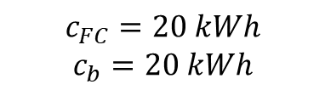
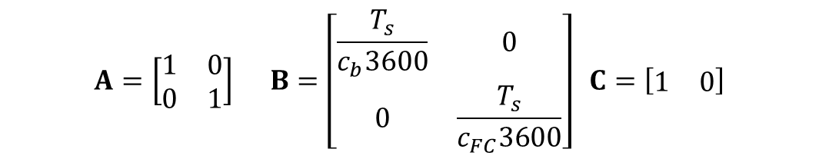
Prediction model
Discrete model
Parameters
$$x_{k+1}=Ax_{k}+Bu_{k}$$
$$y_{k}=Cx_{k}$$
x$={\left[{SoC}_{b} {SoC}_{FC}\right]}^{T}$
$$u_{k}={\left[P_{b} P_{FC}\right]}^{T}$$
$$A=\left[\begin{matrix}1 & 0 \\ 0 & 1\end{matrix}\right] B=\left[\begin{matrix}\frac{T_{s}}{c_{b}3600} & 0 \\ 0 & \frac{T_{s}}{c_{FC}3600}\end{matrix}\right] C=\left[\begin{matrix}1 & 0\end{matrix}\right]$$
$$c_{FC}=20 kWh$$
$$c_{b}=20 kWh$$

Slide 2
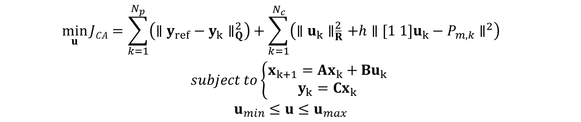




Model Predictive Control
Problem formulation – minimize the cost function
Global optimal solution (design $Q/\overline{R}$)
$N_{p}$ = 7, $N_{c}$ = 3, $T_{s}=0.1$ ,$h=500,P_{m}=−10$^{(kW)}
$$\min_{u}{JCA=\sum_{k=1}^{N_{p}}{\left({∥y_{ref}−y_{k}∥}_{Q}^{2}\right)}}+\sum_{k=1}^{N_{c}}{\left({∥u_{k}∥}_{\overline{R}}^{2}+h{∥[1 1]u_{k}−P_{m,k}∥}^{2}\right)}$$
$$subject to\left\{\begin{aligned}x_{k+1}=Ax_{k}+Bu_{k} \\ y_{k}=Cx_{k}\end{aligned}\right.$$
$$u_{min}≤u≤u_{max}$$
$$u={\left(K^{T}QK+\overline{R}+hB_{CA}^{T}B_{CA}\right)}^{−1}\left\{K^{T}Q\left(Y_{ref}−Fx_{k}\right)+hB_{CA}^{T}P_{m}\right\}$$
$$B_{CA}=\left[\begin{matrix}\begin{matrix}1 & 1 & 0 \\ 0 & 0 & 1 \\ 0 & 0 & 0\end{matrix} & \begin{matrix}0 & 0 & 0 \\ 1 & 0 & 0 \\ 0 & 1 & 1\end{matrix}\end{matrix}\right]$$
$$P_{m}=P_{m}∗ones(Nc,1)$$
$$y_{ref}=0.5∗ones(Np,1)$$

Slide 3
筆記
問題描述
Base line的alphaFC沒有考慮到負載變化(意謂著電池會被FC回充)
電池的熱效應沒有考慮熱量散逸(影響Jtemp)
過大的電池電流會導致溫度斜率上升
整體電流積分越大，溫度影響越大
FC很容量不大，很容易在尚未完成路程時用完
電池或FC任一個先用完後Jsoc就會有懲罰
設計想法
盡可能減少電池電流
操控方面:減少無效力的產生
能源方面:分配以FC為主並設法最大化效率
盡可能讓FC與電池同時用完
盡可能減少燃料電池的能量做”搬移”:負載追隨

Slide 4
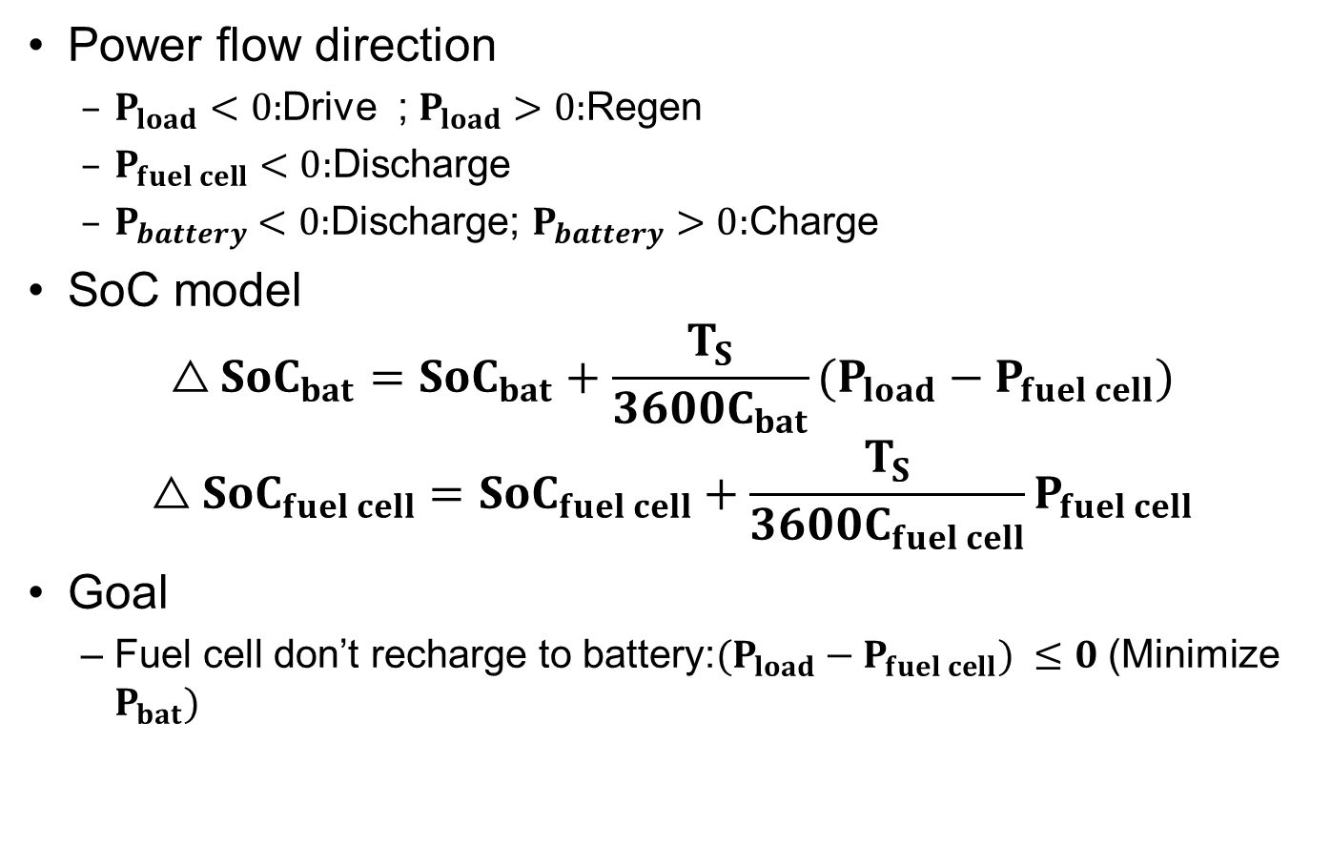
Power system model
Power flow direction
$P_{load}<0:$Drive ; $P_{load}>0:$Regen
$P_{fuel cell}$ $<0:$Discharge
$P_{battery}$ $<0:$Discharge; $P_{battery}$ $>0:$Charge
SoC model
$$△{SoC}_{bat}={SoC}_{bat}+\frac{T_{S}}{3600C_{bat}}(P_{load}−P_{fuel cell})$$
$$△{SoC}_{fuel cell}={SoC}_{fuel cell}+\frac{T_{S}}{3600C_{fuel cell}}P_{fuel cell}$$
Goal
Fuel cell don’t recharge to battery:$(P_{load}−P_{fuel cell}) ≤0$ (Minimize $P_{bat})$

Slide 5
Prediction model
Discrete model
Prediction model
Parameters
$x_{k+1}=Ax_{k}+Bu_{k}$+ D$w_{k}$
$$y_{k}=Cx_{k}$$
x$={\left[{SoC}_{b} {SoC}_{FC}\right]}^{T}$
$$u_{k}=P_{FC}$$
$$A=\left[\begin{matrix}1 & 0 \\ 0 & 1\end{matrix}\right] B=\left[\begin{matrix}\frac{{−T}_{s}}{c_{b}3600} \\ \frac{T_{s}}{c_{FC}3600}\end{matrix}\right] C=\left[\begin{matrix}1 & 0\end{matrix}\right] D=\left[\begin{matrix}\frac{T_{s}}{c_{b}3600} \\ 0\end{matrix}\right]$$
Y$=Fx_{k}+KU$+ GW F=HA K=HB G=HD $H=\left[\begin{matrix}1 & 0\end{matrix}\right]$
$$c_{FC}=20 kWh$$
$$c_{b}=20 kWh$$

Slide 6
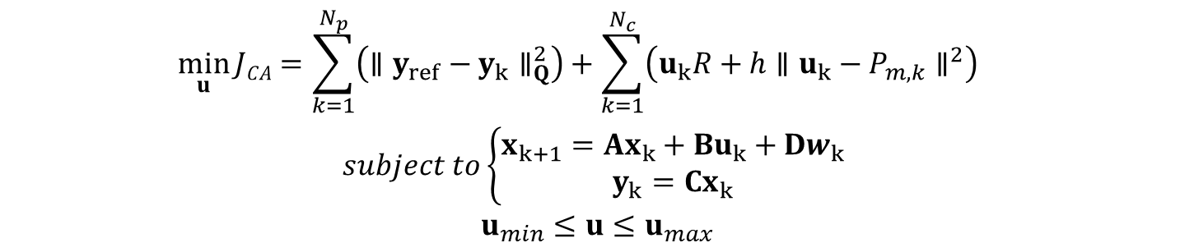
Model Predictive Control
Problem formulation – minimize the cost function
Global optimal solution (design $Q/\overline{R}$)
$N_{p}$ = 7, $N_{c}$ = 3, $T_{s}=0.1$ ,$h=500,P_{m}=−10$^{(kW)}
$$\min_{u}{JCA=\sum_{k=1}^{N_{p}}{\left({∥y_{ref}−y_{k}∥}_{Q}^{2}\right)}}+\sum_{k=1}^{N_{c}}{\left(u_{k}R+h{∥u_{k}−P_{m,k}∥}^{2}\right)}$$
$$subject to\left\{\begin{aligned}x_{k+1}=Ax_{k}+Bu_{k}+Dw_{k} \\ y_{k}=Cx_{k}\end{aligned}\right.$$
$$u_{min}≤u≤u_{max}$$
$$u={\left(K^{T}QK+\overline{R}+hB_{CA}^{T}B_{CA}\right)}^{−1}\left\{K^{T}QGP_{m}+K^{T}Q\left(y_{ref}−Fx_{k}\right)+hB_{CA}^{T}P_{m}\right\}$$
$$B_{CA}=\left[\begin{matrix}1 & 0 & 0 \\ 0 & 1 & 0 \\ 0 & 0 & 1\end{matrix}\right]$$
$$P_{m}=P_{m}∗ones(Nc,1)$$
$$y_{ref}=socref∗ones(Np,1)$$

