Slide 1
MVT 2023 Energy Management Algorithm
National Taipei University of Technology
Vehicle Engineering
Advanced Vehicle Control Lab Advisor：Professor Bo-Chiuan Chen
Student：林暐鈞, 吳祈陞, 陳乃維
2/9/2023

Slide 2
Outline
Introduction
Recent Literature
Integrated Control Strategy
Torque Allocation
Energy Storage System Power Control
Simulation Result
Conclusion

Slide 3
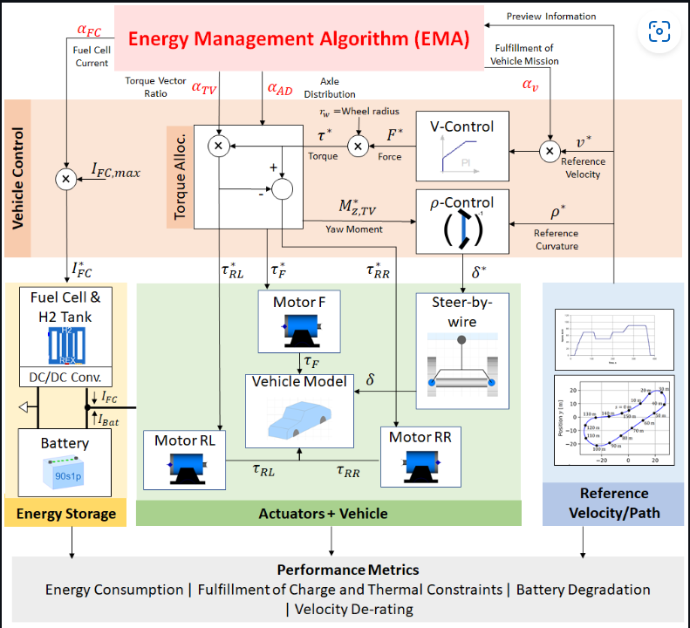
Introduction
Hybrid energy storage system: Fuel cell/ Li-ion battery
Multi-actuators: Three motors
Goal: design EMA that controls motor torques, fuel cell current to minimize energy consumption, battery degradation while not violating some constraints

Slide 4
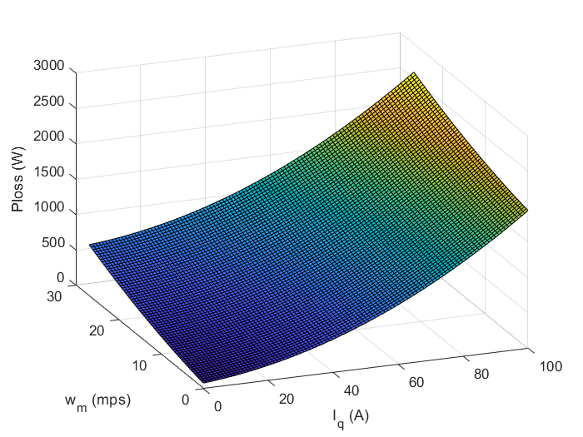
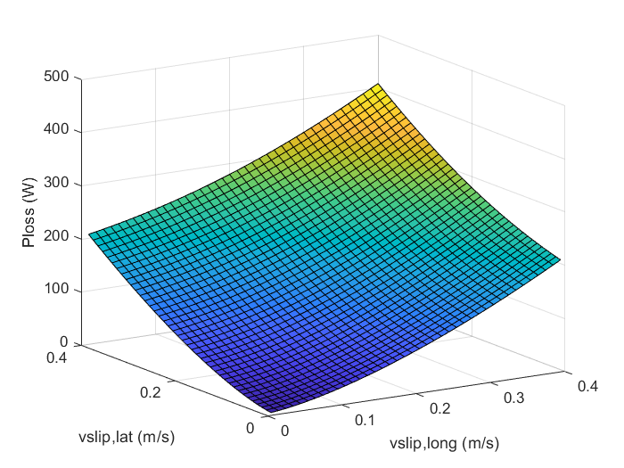
Motor Torque Control Purpose
Axle distribution/Torque vectoring
Trade-off between tire loss and motor loss
The battery temperature and degradation should also be taken into consideration

Slide 5
Motor Power Loss
Four types of motor power loss
Inverter and copper loss depend on q axis current
Iron and friction loss depend on motor speed
Overall power loss

Slide 6
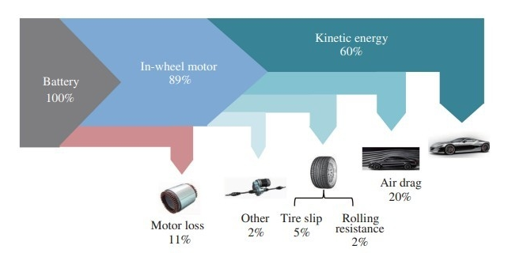


Tire Power Loss
Tire energy dissipation
Up to 7% of total energy
Tire power loss model
Load transfer is neglected

Slide 7
Outline
Introduction
Recent Literature
Integrated Control Strategy
Torque Allocation
Energy Storage System Power Control
Simulation Result
Conclusion

Slide 8
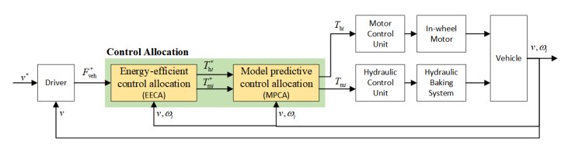
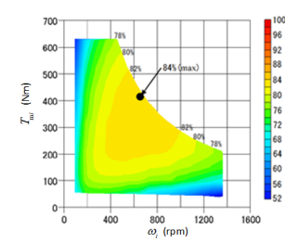
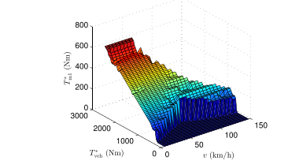
Recent literature - 1
MPC allocation is a popular method in recent literatures
Two step optimization method
H. Jing, F. Jia and Z. Liu, "Multi-Objective Optimal Control Allocation for an Over-Actuated Electric Vehicle," in IEEE Access, vol. 6, pp. 4824-4833, 2018, doi: 10.1109/ACCESS.2017.2788941.

Slide 9
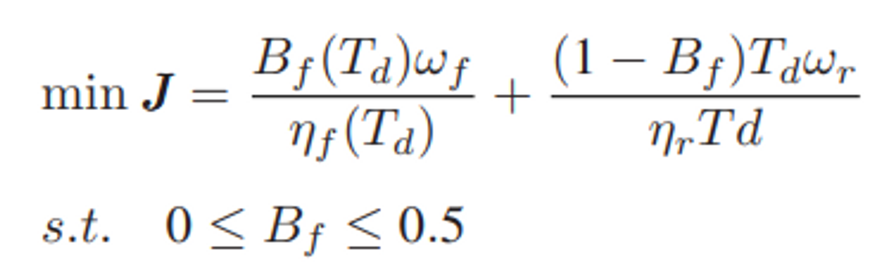
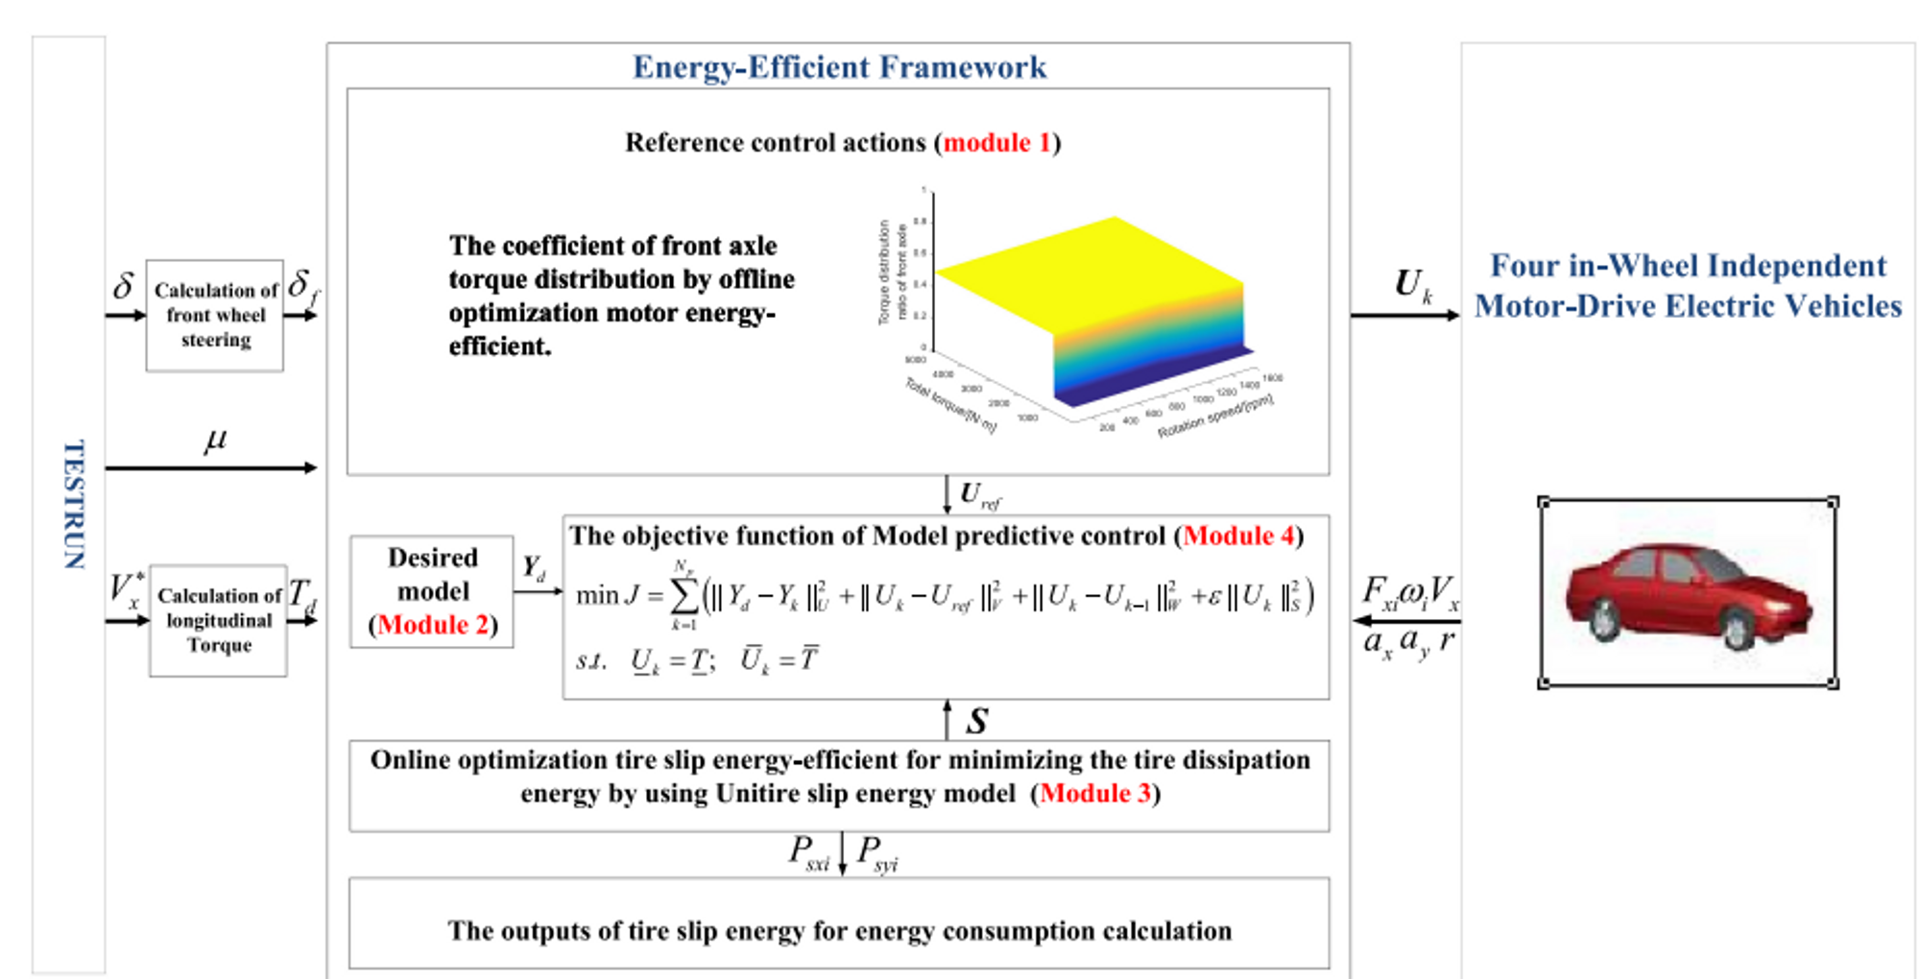
Recent literature - 2
Power optimization/ Tire power loss…are considered
Multi-purpose integrated control strategy are main focus

Slide 10
Outline
Introduction
Recent Literature
Integrated Control Strategy
Torque Allocation
Energy Storage System Power Control
Simulation Result
Conclusion

Slide 11
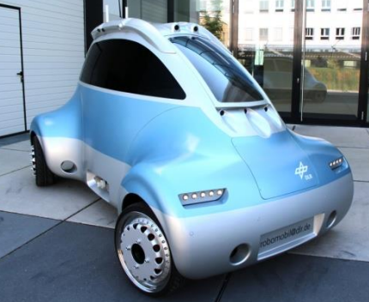
















AVCL Integrated Control Strategy
Control input
$$u_{T}={\left[T_{FM}^{∗},T_{RL}^{∗},T_{RR}^{∗}\right]}^{T}$$
$$u_{i}={\left[i_{b}^{∗},i_{FC}^{∗}\right]}^{T}$$
Energy storage
Model Predictive Power Management
$$u_{i}$$
Battery
Fuel Cell&H2 Tank
$$κ$$
$$i_{b}$$
$$i_{FC}$$
Road information
$$P_{d}$$
$$T_{d}$$
DC BUS
Speed controller
$$T_{d}$$
Actuators
$$T_{FM}$$
Axle Distribution
Motor Power loss Minimization
$$uref$$
Model Predictive Control
Allocation
$$u_{T}$$
Motor F
$$T_{RL}$$
Motor RL
$$T_{RR}$$
Tire Energy Dissipation
Minimization
$$R_{1}$$
Motor RR
$${\hat{F}}_{zi},{\hat{F}}_{yi},{\hat{F}}_{xi},\hat{β}$$
$${{\hat{F}}_{yi},{\hat{F}}_{xi},\hat{v}}_{slip,i}$$
Estimators
$vx ,δ,r,$ $a_{x},a_{y},ωi{, SoC}_{b} {SoC}_{FC}$

Slide 12
Outline
Introduction
Recent Literature
Integrated Control Strategy
Torque Allocation
Energy Storage System Power Control
Simulation Result
Conclusion

Slide 13
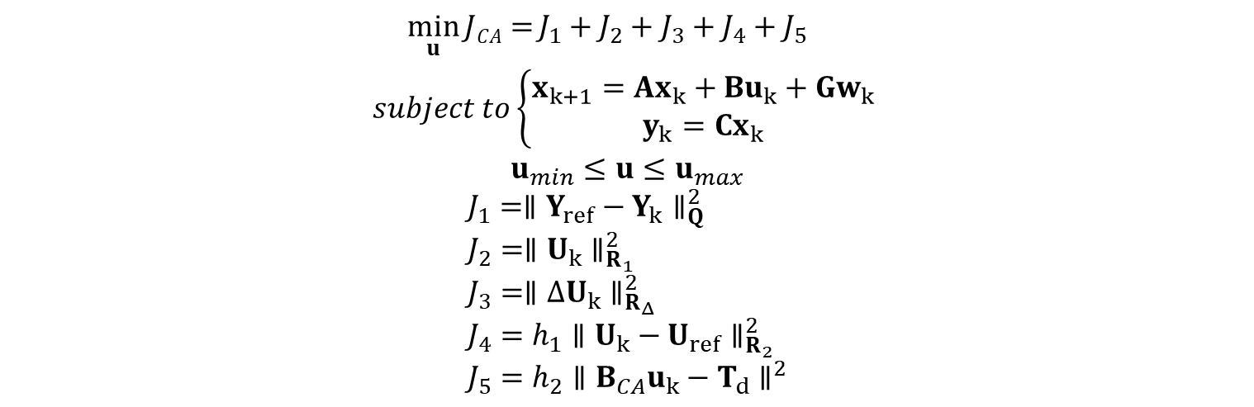
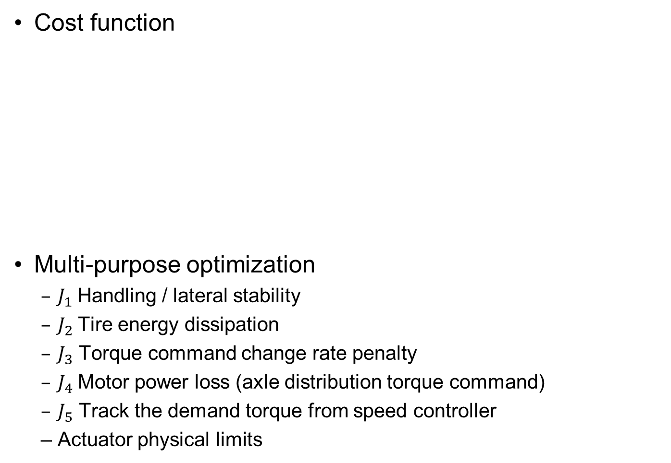
Model Predictive Control Allocation
Cost function
Multi-purpose optimization
$J_{1}$Handling / lateral stability
$J_{2}$Tire energy dissipation
$J_{3}$ Torque command change rate penalty
$J_{4}$Motor power loss (axle distribution torque command)
$J_{5}$ Track the demand torque from speed controller
Actuator physical limits
$$\min_{u}{JCA=}J_{1}+J_{2}+J_{3}+J_{4}+J_{5}$$
$$subject to\left\{\begin{aligned}x_{k+1}=Ax_{k}+Bu_{k}+Gw_{k} \\ y_{k}=Cx_{k}\end{aligned}\right.$$
$$u_{min}≤u≤u_{max}$$
$$J_{1}={∥Y_{ref}−Y_{k}∥}_{Q}^{2} \\ J_{2}={∥U_{k}∥}_{R_{1}}^{2} \\ J_{3}={∥ΔU_{k}∥}_{R_{Δ}}^{2} \\ J_{4}=h_{1}{∥U_{k}−U_{ref}∥}_{R_{2}}^{2} \\ J_{5}=h_{2}{∥B_{CA}u_{k}−T_{d}∥}^{2}$$

Slide 14

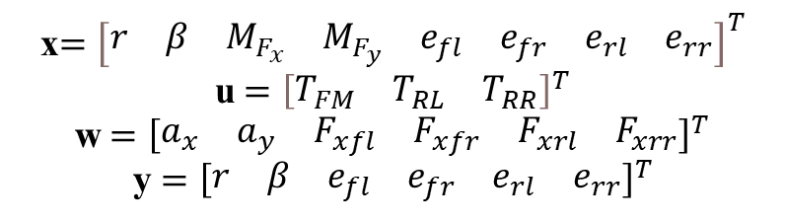



Prediction Model - 1
State space model
$$\dot{\text{x}}=A\text{x}+B\text{u}+G\text{w}$$
$$\text{y}=C\text{x}$$
x$={\left[\begin{matrix}r & β & M_{F_{x}} & M_{F_{y}} & e_{fl} & e_{fr} & e_{rl} & e_{rr}\end{matrix}\right]}^{T}$
u$={\left[\begin{matrix}T_{FM} & T_{RL} & T_{RR}\end{matrix}\right]}^{T}$
w$={\left[\begin{matrix}a_{x} & a_{y} & F_{xfl} & F_{xfr} & F_{xrl} & F_{xrr}\end{matrix}\right]}^{T}$
y $={\left[\begin{matrix}r & β & e_{fl} & e_{fr} & e_{rl} & e_{rr}\end{matrix}\right]}^{T}$
$$A=\left[\begin{matrix}0 & 0 & \frac{1}{I_{z}} & \frac{1}{I_{z}} & 0 & 0 & 0 & 0 \\ −1 & 0 & 0 & 0 & 0 & 0 & 0 & 0 \\ 0 & 0 & −\frac{1}{τ} & 0 & 0 & 0 & 0 & 0 \\ 0 & 0 & \frac{k_{m}}{I_{z}} & \frac{k_{m}}{I_{z}} & 0 & 0 & 0 & 0 \\ 0 & 0 & −\frac{d}{2I_{z}r_{w}} & −\frac{d}{2I_{z}r_{w}} & 0 & 0 & 0 & 0 \\ 0 & 0 & −\frac{d}{2I_{z}r_{w}} & −\frac{d}{2I_{z}r_{w}} & 0 & 0 & 0 & 0 \\ 0 & 0 & \frac{d}{2I_{z}r_{w}} & \frac{d}{2I_{z}r_{w}} & 0 & 0 & 0 & 0 \\ 0 & 0 & \frac{d}{2I_{z}r_{w}} & \frac{d}{2I_{z}r_{w}} & 0 & 0 & 0 & 0\end{matrix}\right]$$
$$B=\left[\begin{matrix}0 & \frac{−t_{wr}}{2I_{z}r_{e}} & \frac{t_{wr}}{2I_{z}r_{e}} \\ 0 & 0 & 0 \\ 0 & 0 & 0 \\ 0 & −\frac{k_{m}d}{2I_{z}r_{w}} & \frac{k_{m}d}{2I_{z}r_{w}} \\ \frac{−1}{I_{w}} & \frac{d^{2}}{4I_{z}r_{w}^{2}} & −\frac{d^{2}}{4I_{z}r_{w}^{2}} \\ 0 & \frac{−1}{I_{w}}+\frac{d^{2}}{4I_{z}r_{w}^{2}} & −\frac{d^{2}}{4I_{z}r_{w}^{2}} \\ \frac{−1}{I_{w}} & −\frac{d^{2}}{4I_{z}r_{w}^{2}} & \frac{d^{2}}{4I_{z}r_{w}^{2}} \\ 0 & \frac{d^{2}}{4I_{z}r_{w}^{2}} & \frac{−1}{I_{w}}+\frac{d^{2}}{4I_{z}r_{w}^{2}}\end{matrix}\right]$$
$$E=\left[\begin{matrix}0 & 0 & 0 & 0 & 0 & 0 \\ 0 & \frac{1}{V_{x}} & 0 & 0 & 0 & 0 \\ 0 & 0 & \frac{A_{xi}}{τ} & \frac{A_{xi}}{τ} & \frac{A_{xi}}{τ} & \frac{A_{xi}}{τ} \\ 0 & 0 & 0 & 0 & 0 & 0 \\ \frac{1}{r_{w}} & 0 & \frac{r_{w}}{I_{w}} & 0 & 0 & 0 \\ \frac{1}{r_{w}} & 0 & 0 & \frac{r_{w}}{I_{w}} & 0 & 0 \\ \frac{1}{r_{w}} & 0 & 0 & 0 & \frac{r_{w}}{I_{w}} & 0 \\ \frac{1}{r_{w}} & 0 & 0 & 0 & 0 & \frac{r_{w}}{I_{w}}\end{matrix}\right]$$

Slide 15


Prediction model - 2
Discretization
Online optimization using quadratic programming
This model are also tested in 4WID control
For certain parameter pair, it is better than hierarchy control strategy
$$x_{k+1}=A_{d}x_{k}+B_{d}u_{k}+G_{d}w_{k}$$
$$y_{k}=Cx_{k}$$
$$A_{d}=I+T_{s}A$$
$$B_{d}=T_{s}B$$
$$G_{d}=T_{s}G$$

Slide 16
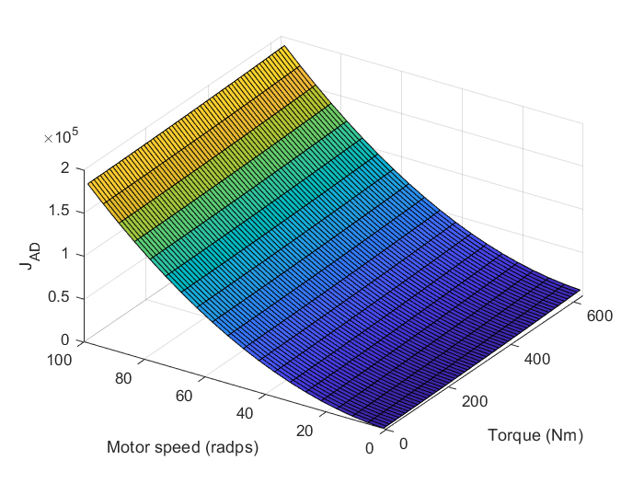
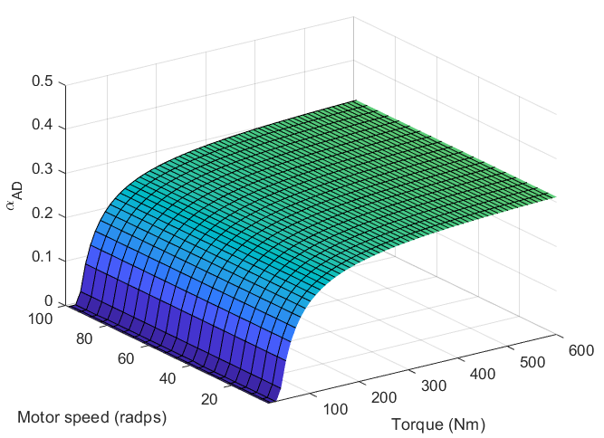
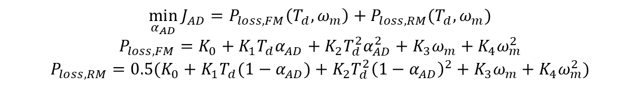
Motor Power Loss Minimization
Cost function
Formulated based on the model of their power loss model
Off-line nonlinear optimization
3D look-up table
$$\min_{α_{AD}}{J_{AD}}=P_{loss,FM}\left(T_{d},ω_{m}\right)+P_{loss,RM}(T_{d},ω_{m})$$
$$P_{loss,FM}=K_{0}+K_{1}T_{d}α_{AD}+K_{2}T_{d}^{2}α_{AD}^{2}+K_{3}ω_{m}+K_{4}ω_{m}^{2}$$
$$P_{loss,RM}=0.5(K_{0}+K_{1}T_{d}(1−α_{AD})+K_{2}T_{d}^{2}{\left(1−α_{AD}\right)}^{2}+K_{3}ω_{m}+K_{4}ω_{m}^{2})$$
Axle Distribution
Motor Power loss Minimization

Slide 17
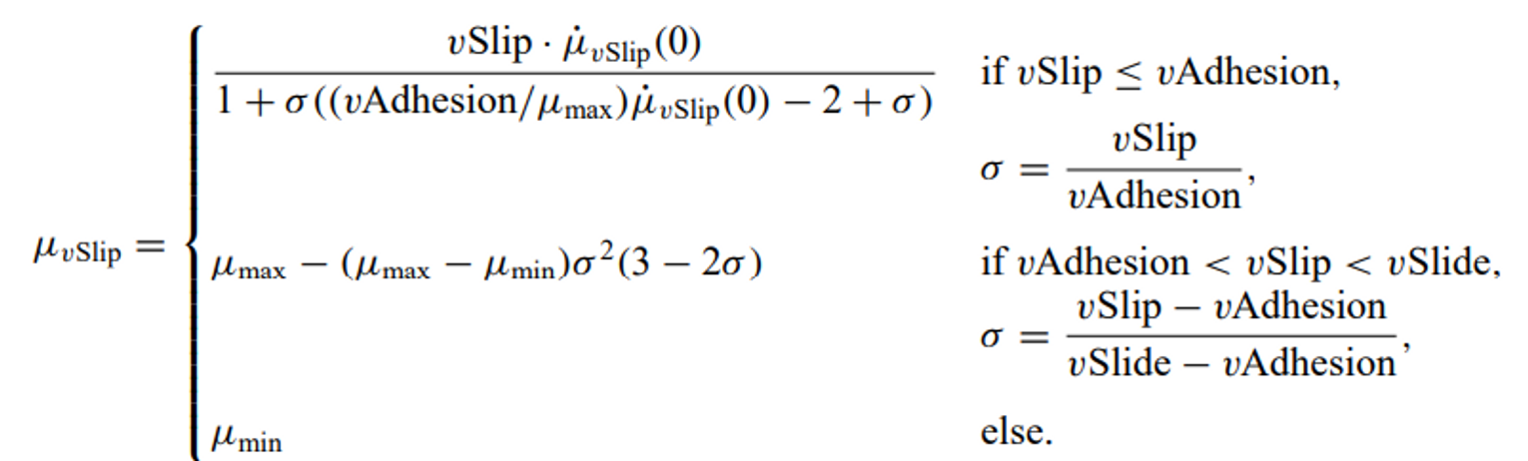
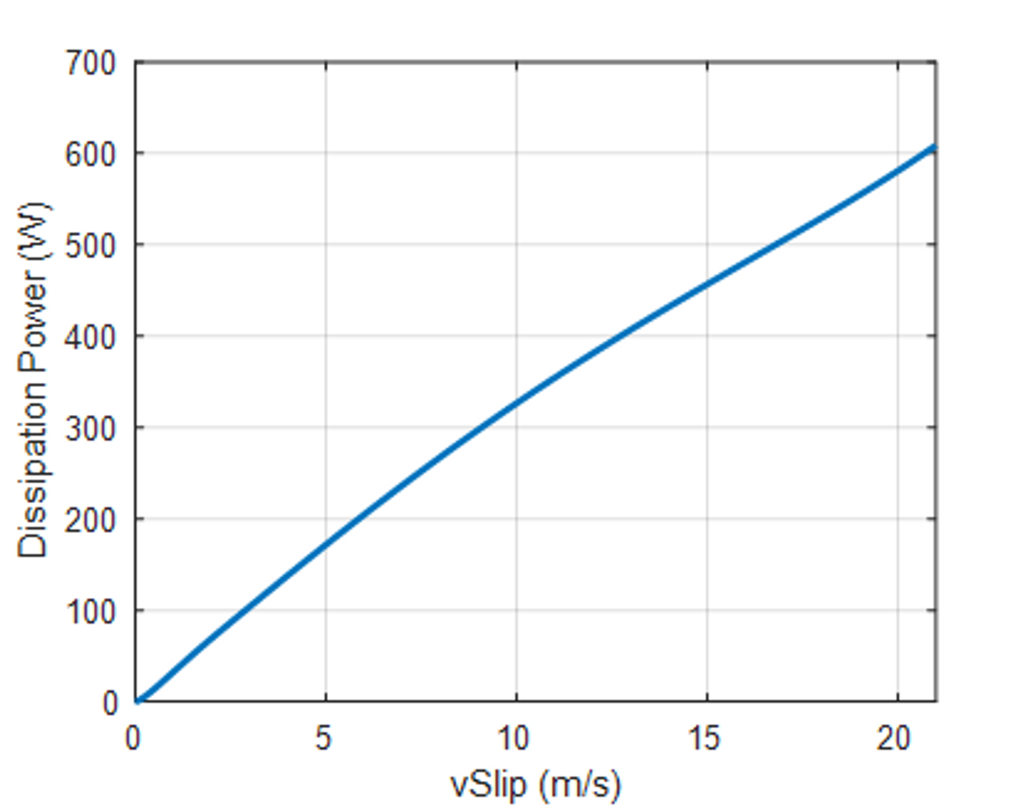
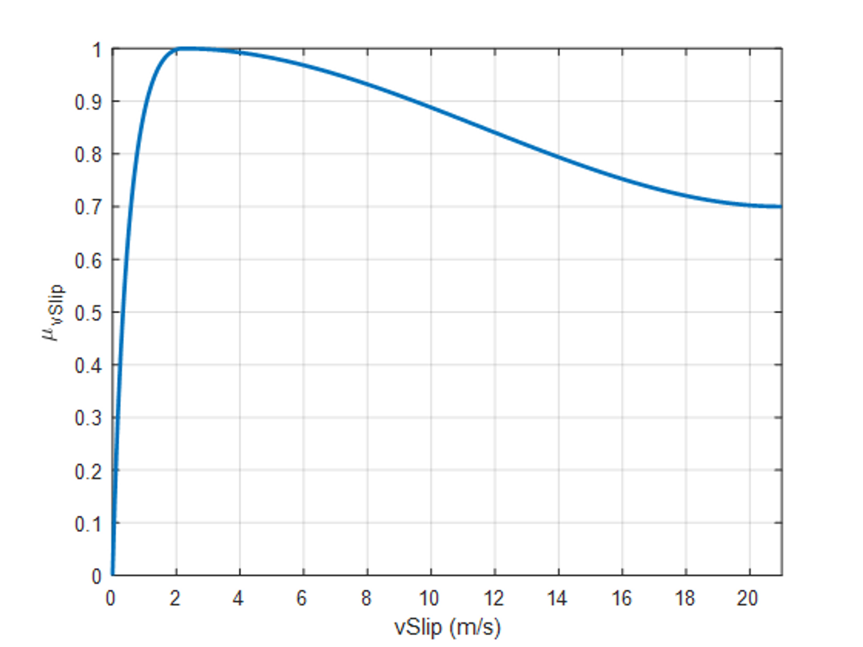
Tire Energy Dissipation Minimization
Tire model by their paper
Weighting design: use the estimated tire power loss at k-1 to adjust $R_{1}$ dynamically

Slide 18
Outline
Introduction
Recent Literature
Integrated Control Strategy
Torque Allocation
Energy Storage System Power Control
Simulation Result
Conclusion

Slide 19
Battery EMA Version log
Version | Description
V0 | Initialization MPC model
V0.1 | Changed the R_delta weighting
V0.2 | Pmax is modified to be based on the product of Ifc_max and true voltage
V0.3 | Added the low-efficiency zone strategy
V0.4 | Changed Yref to gap tracking between SoCfc and SoCbat
V1.0 | Added variable weight strategy

Slide 20
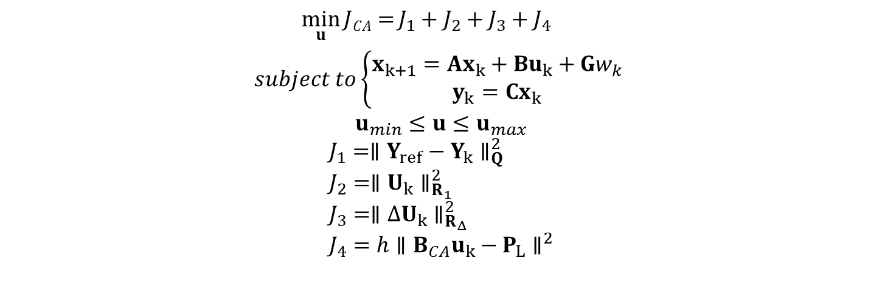

Energy Storage System Power Control
Problem formulation – minimize the cost function
$J_{1}$Battery SoC tracking when FC SoC is enough
$J_{2},J_{3}$FC power penalty/ power change rate penalty
$J_{4}$Track the demand load power
$$\min_{u}{JCA=}J_{1}+J_{2}+J_{3}+J_{4}$$
$$subject to\left\{\begin{aligned}x_{k+1}=Ax_{k}+Bu_{k}+Gw_{k} \\ y_{k}=Cx_{k}\end{aligned}\right.$$
$$u_{min}≤u≤u_{max}$$
$$J_{1}={∥Y_{ref}−Y_{k}∥}_{Q}^{2} \\ J_{2}={∥U_{k}∥}_{R_{1}}^{2} \\ J_{3}={∥ΔU_{k}∥}_{R_{Δ}}^{2} \\ J_{4}=h{∥B_{CA}u_{k}−P_{L}∥}^{2}$$

Slide 21

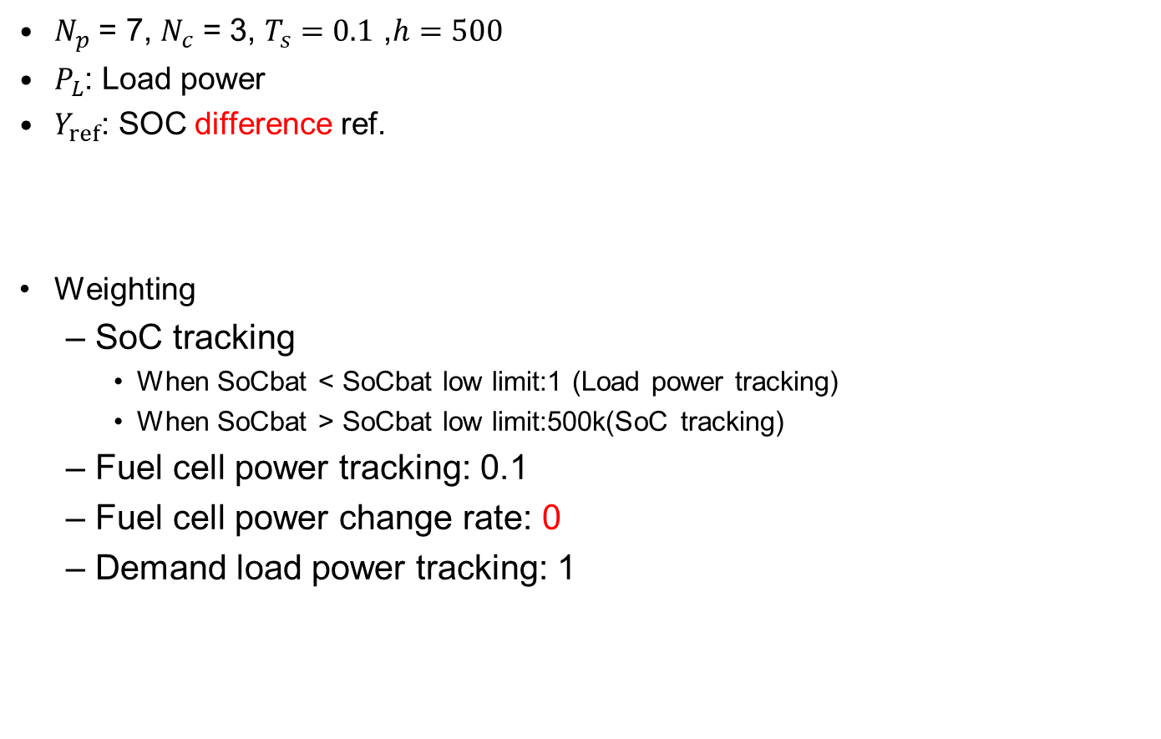


Energy Storage System Power Control
$N_{p}$ = 7, $N_{c}$ = 3, $T_{s}=0.1$ ,$h=500$
$P_{L}$: Load power
$Y_{ref}$: SOC difference ref.
Weighting
SoC tracking
When SoCbat < SoCbat low limit:1 (Load power tracking)
When SoCbat > SoCbat low limit:500k(SoC tracking)
Fuel cell power tracking: 0.1
Fuel cell power change rate: 0
Demand load power tracking: 1
$$B_{CA}=\left[\begin{matrix}1 & 0 & 0 \\ 0 & 1 & 0 \\ 0 & 0 & 1\end{matrix}\right]$$
$$P_{L}=P_{L}∗ones(Nc,1)$$
$$Y_{ref}=Y_{ref}∗ones(Np,1)$$

Slide 22


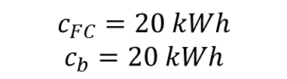
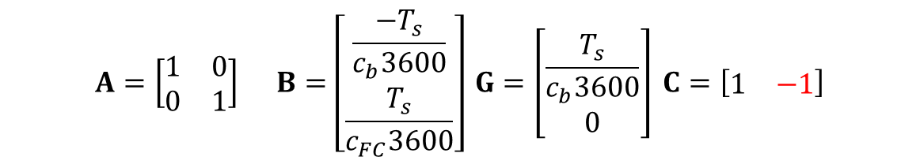
Power control-oriented model
Discrete model
Parameters
$$x_{k+1}=Ax_{k}+Bu_{k}+Gw_{k}$$
$$y_{k}=Cx_{k}$$
x$={\left[{SoC}_{b} {SoC}_{FC}\right]}^{T}$
$$u_{k}=P_{FC}$$
$$w_{k}=P_{L}$$
$$A=\left[\begin{matrix}1 & 0 \\ 0 & 1\end{matrix}\right] B=\left[\begin{matrix}\frac{−T_{s}}{c_{b}3600} \\ \frac{T_{s}}{c_{FC}3600}\end{matrix}\right] G=\left[\begin{matrix}\frac{T_{s}}{c_{b}3600} \\ 0\end{matrix}\right] C=\left[\begin{matrix}1 & −1\end{matrix}\right]$$
$$c_{FC}=20 kWh$$
$$c_{b}=20 kWh$$

Slide 23
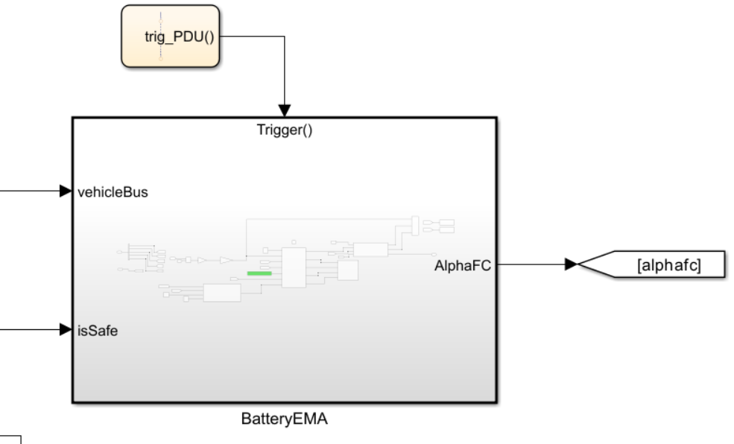
Battery EMA
Model Predictive Power Management
Predictive model
QP solver
Weighting Control Strategy
Weighting change strategy
Hysteresis window
Eff. Power Control Strategy
Low eff. limit
AlphaFC convert

Slide 24
Outline
Introduction
Recent Literature
Integrated Control Strategy
Torque Allocation
Energy Storage System Power Control
Simulation Result
Conclusion

Slide 25
Only Battery EMA
J average below the baseline 23%
J_energy average below the baseline 0.32 kWh
J_SoC average below the baseline 5298.7 sec
J_Temp average below the baseline 3.98 deg
J_deg average below the baseline 0.005 mAh/cycle
J_v average above the baseline 57 s
J_tire average below the baseline 2.56 Wh
Better
Worse
Track | JE | JS | JT | JD | JV | JT | J
1 | 9.9213 | 10208.26 | 0 | 0.0004 | 6762.7668 | 76.822 | 0.7693
2 | 9.6703 | 0 | 0 | 0.0004 | 0 | 94.169 | 0.9329
3 | 11.0545 | 7985.49 | 0.8013 | 0.0005 | 809.8524 | 223.4199 | 0.8095
4 | 2.3406 | 0 | 0 | 0.0009 | 0 | 12.4427 | 0.6687
5 | 8.9133 | 632.25 | 19.3363 | 0.0506 | 109.2686 | 161.1183 | 0.9111
6 | 6.881 | 292.49 | 0 | 0.0009 | 0 | 233.8156 | 0.7377
7 | 3.5689 | 0 | 0 | 0.0011 | 0 | 186.823 | 0.7167
8 | 10.1949 | 1676.76 | 0 | 0.0006 | 967.8447 | 447.165 | 0.671
9 | 1.4706 | 0 | 0 | 0.0007 | 0 | 66.1595 | 0.6815
10 | 10.7609 | 1190.94 | 3.3007 | 0.0009 | 567.0538 | 573.3547 | 0.7592

Slide 26
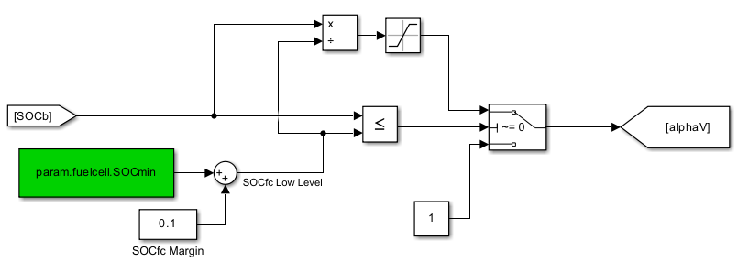
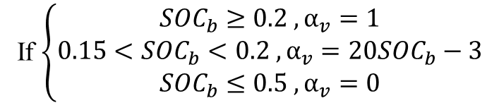
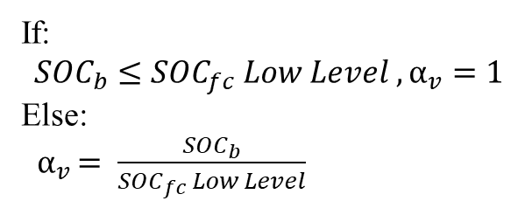
Speed Profile Strategy
Baseline:
If $\left\{\begin{aligned}{SOC}_{b}≥0.2 ,α_{v}=1 \\ 0.15<{SOC}_{b}<0.2 ,α_{v}=20{SOC}_{b}−3 \\ {SOC}_{b}≤0.5 ,α_{v}=0\end{aligned}\right.$
First version EMA:
If:
$${SOC}_{b}≤{SOC}_{fc} Low Level ,α_{v}=1$$
Else:
${ α}_{v }= \frac{{SOC}_{b}}{{SOC}_{fc} Low Level}$

Slide 27
Battery EMA with Speed Strategy
Compare with battery only EMA
J_energy average above the battery EMA 0.1864kwh
J_SoC average below the battery EMA 105.27 sec
J_Temp average above the bettery EMA 0.65 deg
J_deg average above the bettery EMA 0.00194 mAh/cycle
J_v average below the bettery EMA 443.95 s
J_tire average above the bettery EMA 7.37 Wh
Better
Worse
Track | JE | JS | JT | JD | JV | JT | J | Improvement
1 | 10.3449 | 9155.55 | 0 | 0.0004 | 3800.2211 | 84.1352 | 0.7074 | 8.05%
2 | 9.6703 | 0 | 0 | 0.0004 | 0 | 94.169 | 0.8329 | 10.72%
3 | 11.324 | 7985.49 | 1.7981 | 0.0006 | 286.5594 | 232.2375 | 0.7227 | 10.72%
4 | 2.3404 | 0 | 0 | 0.0009 | 0 | 12.4427 | 0.6687 | 0.00%
5 | 9.305 | 632.25 | 22.8112 | 0.0698 | 53.5693 | 168.3439 | 0.8556 | 6.09%
6 | 6.881 | 292.49 | 0 | 0.0009 | 0 | 233.8156 | 0.7377 | 0.00%
7 | 3.5689 | 0 | 0 | 0.0011 | 0 | 186.823 | 0.7167 | 0.00%
8 | 10.5893 | 1676.76 | 0 | 0.0007 | 406.442 | 470.5503 | 0.6104 | 9.03%
9 | 1.4706 | 0 | 0 | 0.0007 | 0 | 66.1595 | 0.6815 | 0.00%
10 | 11.1459 | 1190.94 | 5.3535 | 0.0009 | 230.483 | 600.2707 | 0.6449 | 15.06%
Overall improvement |  |  |  |  |  |  |  | 5.97%

Slide 28
Only Motor EMA
Fuel cell is baseline control
Hard to improve Jtire by torque allocation
For longitudinal-driving cases
CG almost in the center of the vehicle, no load transfer effect
Tire loss is always the best if axle 1:1 distribution is used
Better
Worse
Track | JE
1 | 10.0591
2 | 9.6982
3 | 11.2399
4 | 2.8125
5 | 9.2831
6 | 6.958
7 | 4.3416
8 | 10.3652
9 | 2.041
10 | 11.1979
Track | JE | JS | JT | JD | JV | JT | J | Improvement
1 | 10.0261 | 16300.65 | 1.5173 | 0.0005 | 6636.4906 | 82.9603 | 1.0567 | -5.67%
2 | 9.6192 | 18508.15 | 0 | 0.0004 | 0 | 102.9065 | 1.0141 | -1.41%
3 | 11.1587 | 15864.05 | 6.0848 | 0.0006 | 360.8056 | 244.9704 | 0.954 | 4.60%
4 | 2.7999 | 189.73 | 0 | 0.005 | 0 | 13.0507 | 1.0091 | -0.91%
5 | 9.2771 | 736.86 | 30.558 | 0.0989 | 67.7088 | 175.6008 | 1.0145 | -1.45%
6 | 6.9906 | 1992.11 | 0 | 0.0031 | 0 | 262.0099 | 1.0209 | -2.09%
7 | 4.0045 | 1803.67 | 0 | 0.0021 | 0 | 173.1167 | 0.9654 | 3.46%
8 | 10.1349 | 10522.36 | 7.923 | 0.0007 | 499.677 | 437.168 | 0.9168 | 8.32%
9 | 1.9424 | 878.59 | 0 | 0.0018 | 0 | 61.4279 | 0.9742 | 2.58%
10 | 10.7605 | 8257.3 | 20.1192 | 0.0011 | 7.435 | 581.4874 | 0.8436 | 15.64%
Overall improvement |  |  |  |  |  |  |  | 2.31%
J average |  |  |  |  |  |  |  | 0.97693

Slide 29
Integrated EMA Comparison - 1
Compare with Battery EMA with Speed Strategy
Better
Worse
Track | JE | JS | JT | JD | JV | JT | J | Improvement
1 | 10.3252 | 9242.08 | 0 | 0.0004 | 3815.1435 | 90.4562 | 0.7219 | -2.05%
2 | 9.5813 | 248.09 | 0 | 0.0004 | 0 | 102.9066 | 0.849 | -1.93%
3 | 11.1924 | 7985.8 | 1.9128 | 0.0006 | 191.8071 | 248.4432 | 0.7081 | 2.02%
4 | 2.3298 | 0 | 0 | 0.0009 | 0 | 13.0508 | 0.6762 | -1.12%
5 | 9.2838 | 633.09 | 23.5681 | 0.0773 | 49.9551 | 178.5958 | 0.8757 | -2.35%
6 | 6.9132 | 337.31 | 0 | 0.0009 | 0 | 262.0098 | 0.7623 | -3.33%
7 | 3.2641 | 0 | 0 | 0.0011 | 0 | 173.1169 | 0.6928 | 3.33%
8 | 10.199 | 1246.35 | 0 | 0.0006 | 209.8987 | 451.4761 | 0.5316 | 12.91%
9 | 1.3897 | 0 | 0 | 0.0007 | 0 | 61.4281 | 0.663 | 2.71%
10 | 10.5268 | 1108.36 | 6.3714 | 0.001 | 21.5529 | 579.9002 | 0.5618 | 12.89%
Overall improvement |  |  |  |  |  |  |  | 2.31%
J average |  |  |  |  |  |  |  | 0.70424

Slide 30
Integrated EMA Comparison - 2
Compare with Baseline
Overall improvement is 29.58%
Tire loss is still hard to improve
Better
Worse
Track | JE | JS | JT | JD | JV | JT | J | Improvement
1 | 10.3252 | 9242.08 | 0 | 0.0004 | 3815.1435 | 90.4562 | 0.7219 | 27.81%
2 | 9.5813 | 248.09 | 0 | 0.0004 | 0 | 102.9066 | 0.849 | 15.10%
3 | 11.1924 | 7985.8 | 1.9128 | 0.0006 | 191.8071 | 248.4432 | 0.7081 | 29.19%
4 | 2.3298 | 0 | 0 | 0.0009 | 0 | 13.0508 | 0.6762 | 32.38%
5 | 9.2838 | 633.09 | 23.5681 | 0.0773 | 49.9551 | 178.5958 | 0.8757 | 12.43%
6 | 6.9132 | 337.31 | 0 | 0.0009 | 0 | 262.0098 | 0.7623 | 23.77%
7 | 3.2641 | 0 | 0 | 0.0011 | 0 | 173.1169 | 0.6928 | 30.72%
8 | 10.199 | 1246.35 | 0 | 0.0006 | 209.8987 | 451.4761 | 0.5316 | 46.84%
9 | 1.3897 | 0 | 0 | 0.0007 | 0 | 61.4281 | 0.663 | 33.70%
10 | 10.5268 | 1108.36 | 6.3714 | 0.001 | 21.5529 | 579.9002 | 0.5618 | 43.82%
Overall improvement |  |  |  |  |  |  |  | 29.58%
J average |  |  |  |  |  |  |  | 0.70424

Slide 31
Outline
Introduction
Recent Literature
Integrated Control Strategy
Torque Allocation
Energy Storage System Power Control
Conclusion

Slide 32
Conclusion
The first version of torque allocation is done.
The first version of power distribution for hybrid energy storage is done, and the results are better than the baseline.
First EMA can improver overall performance up to 29.58%
The final version will be released on 2/15
Preview info is extended to 25 sec
…

