Slide 1
After popcorn
Study of movies and shows public reception in various platforms.

Slide 2
Overview & Introduction?
•Aim /introduction (E)
•Data gathering – Twitter API (E*)
•Topic modelling (E+)
•Sentiment analysis: Wanda – ex. Wordcloud, VADER, mean variance (D)
•Data gathering - , collection.. API/Scraping, crawling…, youtube, reddit, imdb(D*)
•Sentiment analysis: films –movie list , polarity… (D+)
•Data gathering – wiki pageviews (E)
•Correlations (E)
•Summary & conclusions (E)

Slide 3
INTRODUCTION

Slide 4
DATA GATHERING - Twitter API
Twitter API
python tweepy StreamListener
Tweets about a specific topic:
Wandavision
keywords = ["wandavision","WandaVision"]
Premiere
keywords = ['movie premiere','new movie','new episode', 'new film']
Twitter API
python tweepy Cursor
Search old tweets in case we missed on a specific topic.

Slide 5
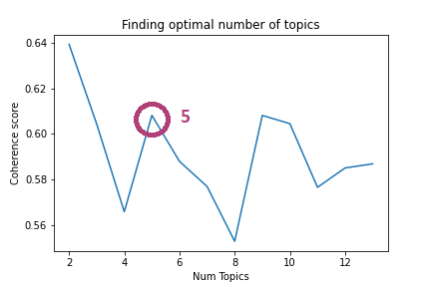
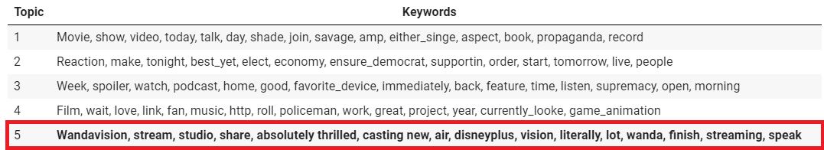
TOPIC MODELLING
5 February

Slide 6
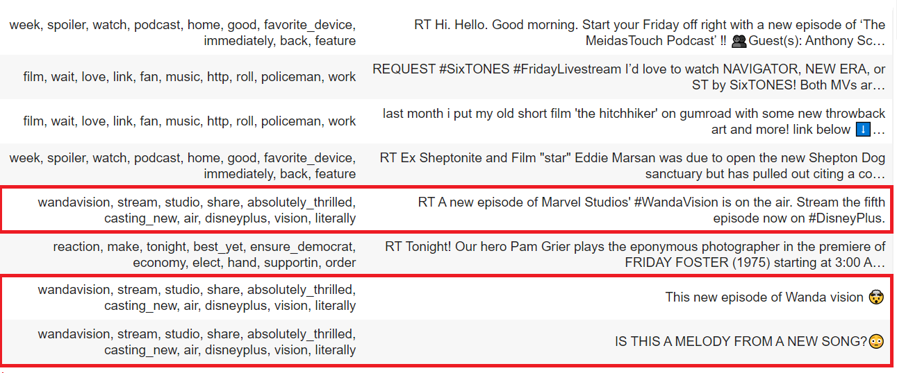
Example tweets

Slide 7
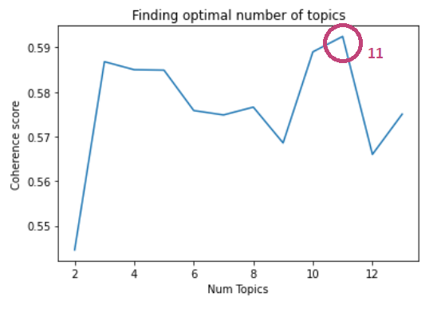
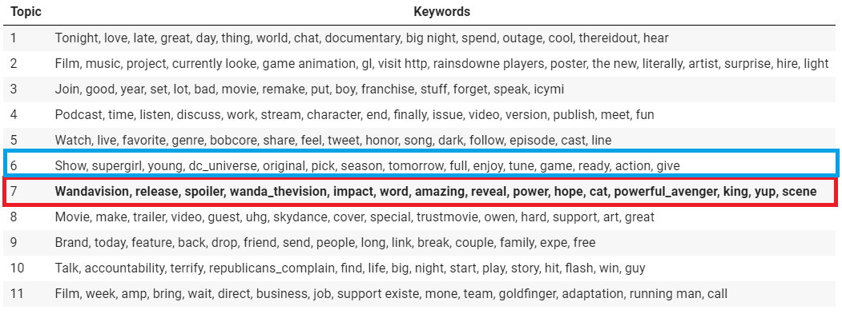
19 February

Slide 8
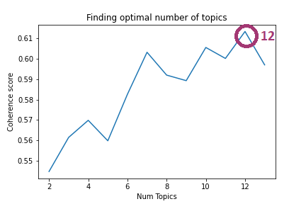
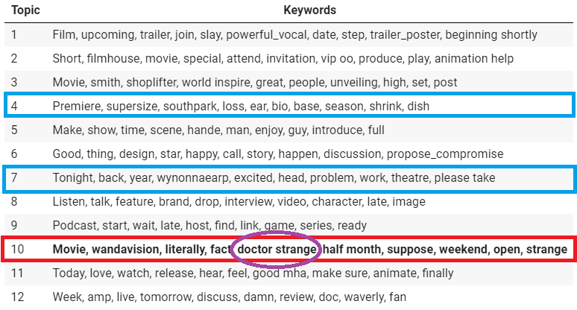
5 March

Slide 9
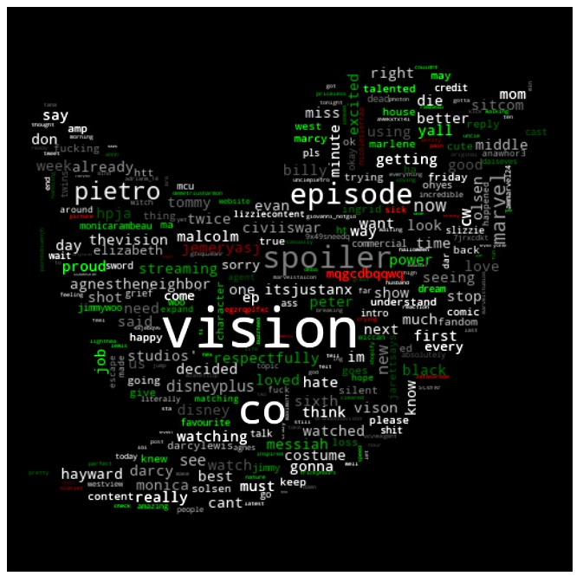
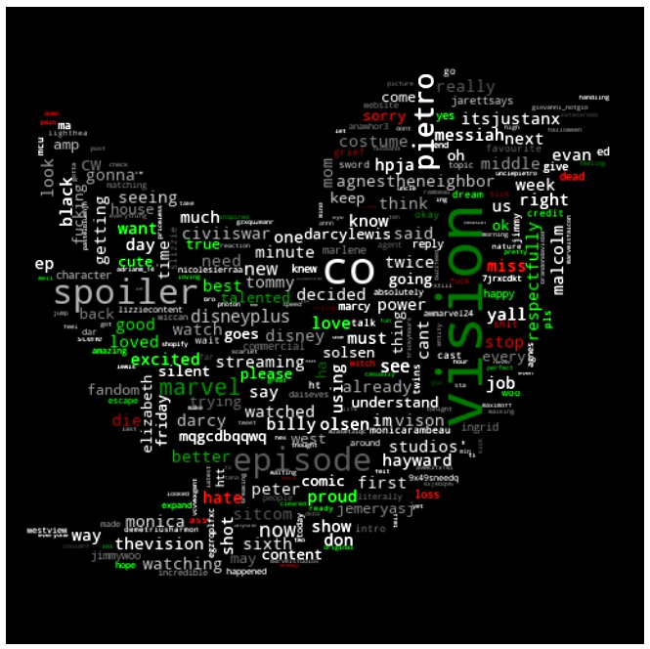
Sentiment analysis: Wanda

Slide 10
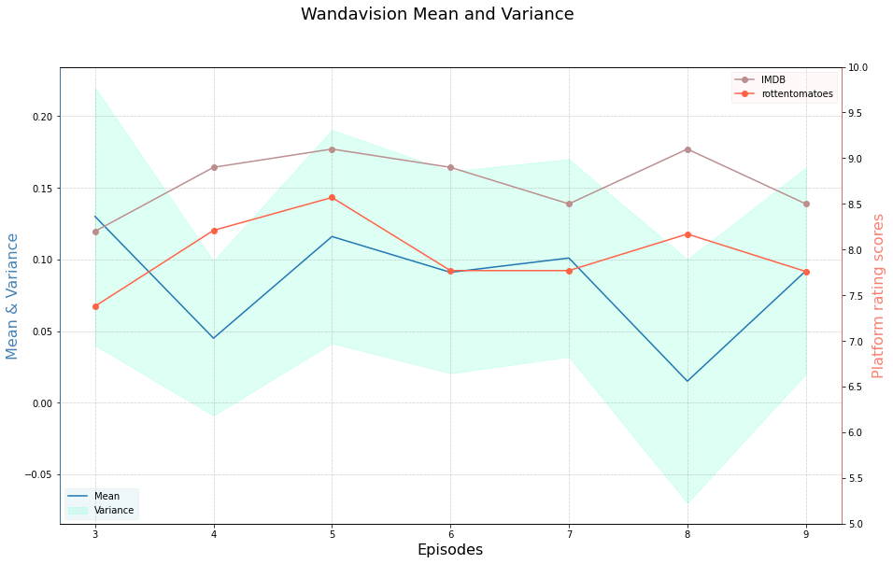
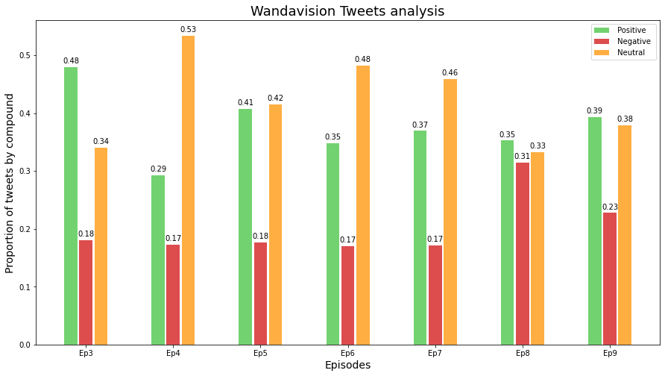
Sentiment analysis: Wanda

Slide 11
Data gathering - YouTube, Reddit, IMDB
Youtube API
python youtube-data-api
Comments of particular film videos from well known reviewers of the platform
Reddit API
python praw
Comments from official post regarding the film review
IMDB
python beautifulsoup
Scraping and crawling the IMDB webpage

Slide 12
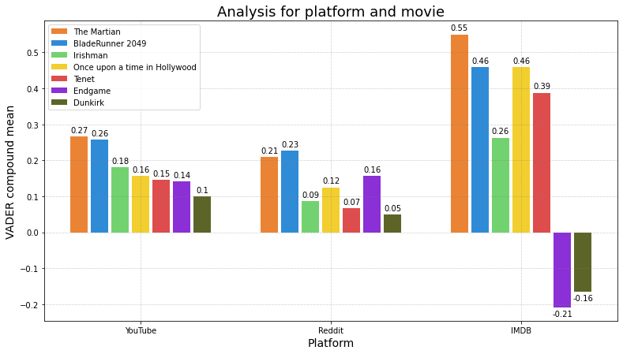
Sentiment analysis: films –movie list , polarity…
Youtube and Reddit similar
IMDB more polarized
Endgame and Dunkirk films contain negative words intrinsically

Slide 13
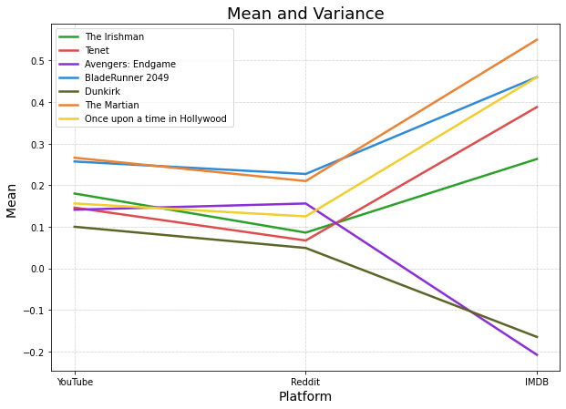
Sentiment analysis: films –movie list , polarity…

Slide 14
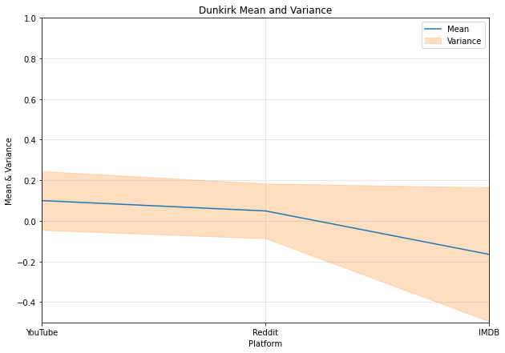
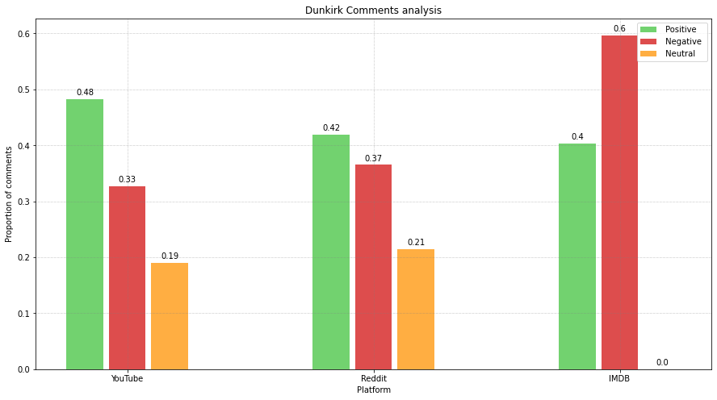
Sentiment analysis: films –movie list , polarity…

Slide 15
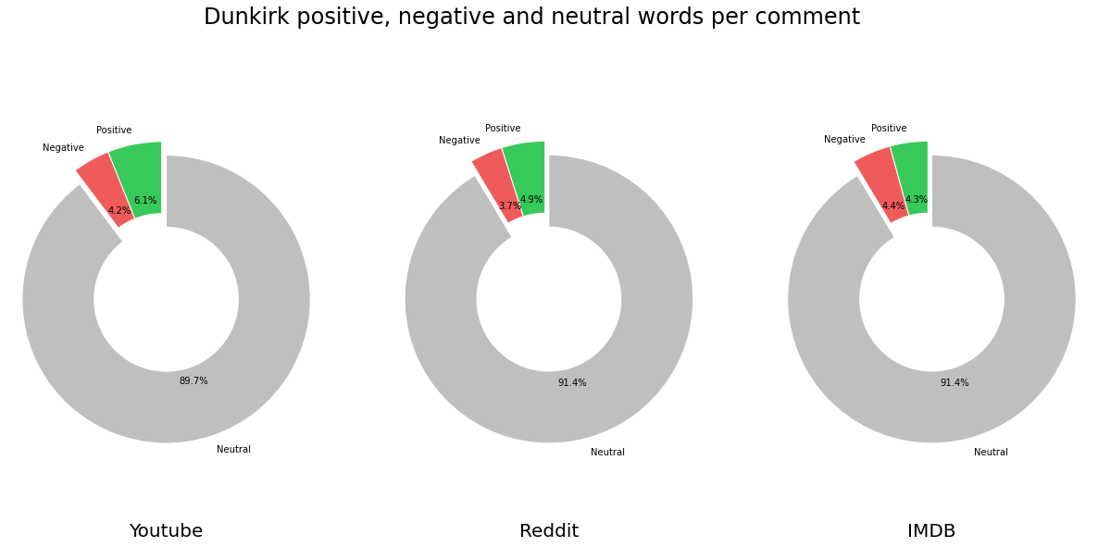
Sentiment analysis: films –movie list , polarity…

Slide 16
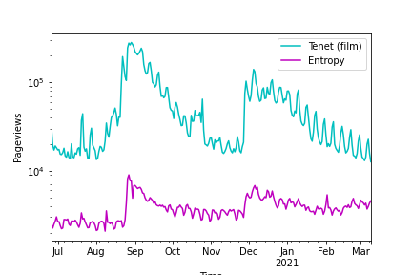
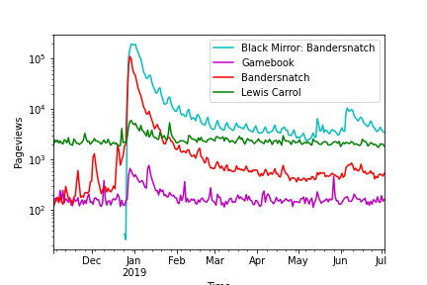
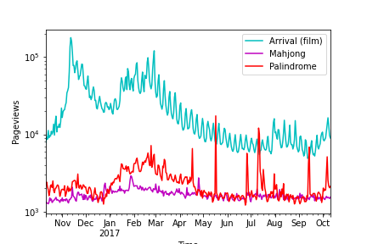
Correlation

Slide 17
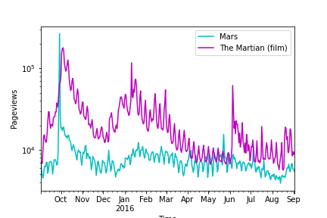
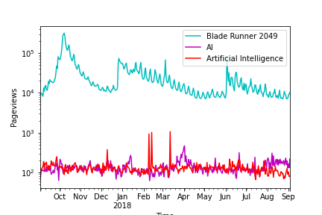

Slide 18
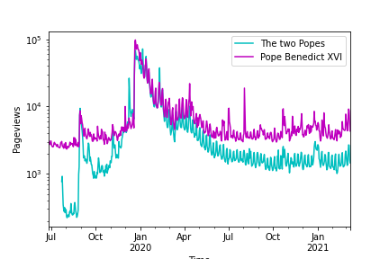
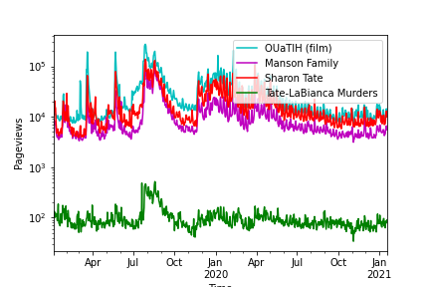
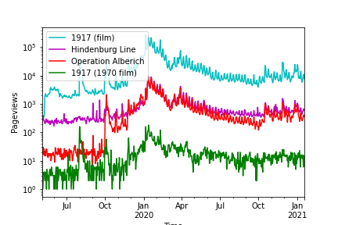
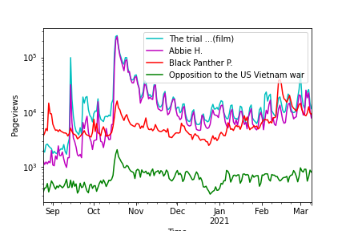

Slide 19
SUMMARY AND CONCLUSIONS

