Slide 1

The eye that watches five years ahead.
10Alytics Global Hackathon 2026 | Track B: Data Science | Pod Nova
An early-warning intelligence layer for ASEAN public health | A Dedication towards SDG 3, 10, 17

Slide 2
THE PROBLEM
Southeast Asia's health systems react after the crisis.
By then, people have already died.
16 yrs
56x
~45%
gap in life expectancy between the best and worst ASEAN member state
higher risk of dying in childbirth in Lao PDR than in Singapore
of the global tuberculosis burden sits in the ASEAN region
The data to prevent these outcomes exists, but it is fragmented, dirty, and backward-looking. SIAGA turns it into foresight.
SIAGA NOVA
02

Slide 3
THE SOLUTION
Three decision tools in one intelligence layer
Predict
Explain
Forecast
Lifespan model
Driver isolation
Disease early-warning
Predicts a country's life expectancy from the levers a health ministry controls: staffing, immunization, spend, disease burden, nutrition, sanitation, agriculture, and climate.
SHAP ranks every driver in years of life expectancy, so officials see where the next investment buys the most benefit.
Backtested time-series models forecast TB and malaria five years ahead, with honest uncertainty bands.
Siaga is Malay for "alert, ready, on standby", the word ASEAN governments use for emergency preparedness.
SIAGA NOVA
03

Slide 4
DATA & METHOD
Rigour first: we cleaned, then we proved the cleaning
20
0.93
7
0
datasets harmonized (18 ASEAN + 2 external)
agreement with World Bank
errors adjudicated
datasets discarded
into one clean country-year panel: names reconciled, headers fixed, text-numbers parsed.
life-expectancy correlation with an independent source confirms the harmonization.
suspected entry errors confirmed against World Bank before repair, not dropped on a hunch.
every file has a role: features, forecast targets, or the equity layer.
SIAGA NOVA
04

Slide 5
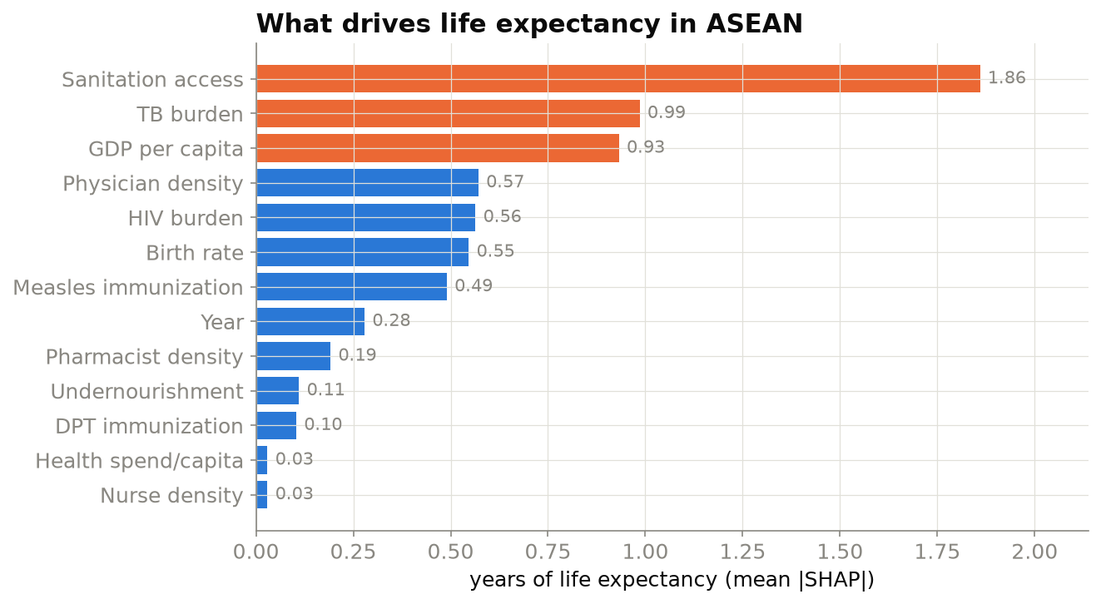
INSIGHT 1 - DRIVER ISOLATION
Sanitation, disease burden, income, and climate drive life expectancy most
Reading it
Basic sanitation access is the largest lever (~1.9 yrs), ahead of TB, HIV, income, and agriculture share. Climate factors add 0.5 years of signal. This ranking is the policy priority list.
SIAGA NOVA
05

Slide 6
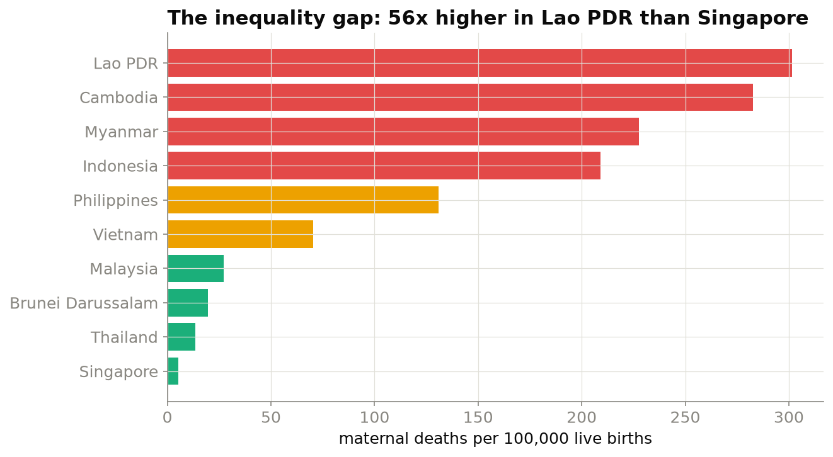
INSIGHT 2 - REDUCED INEQUALITIES (SDG 10)
The regional average hides a 56x gap
Reading it
Maternal mortality ranges from ~5 per 100,000 in Singapore to ~300 in Lao PDR. Equity, not just averages, must guide resources.
SIAGA NOVA
06

Slide 7
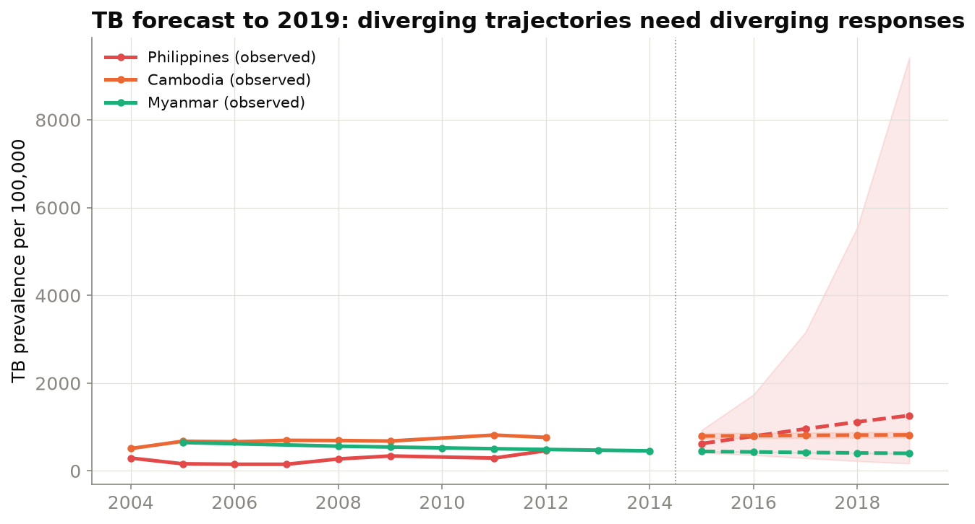
INSIGHT 3 - EPIDEMIOLOGICAL FORECAST
Diverging TB trajectories demand diverging responses
Reading it
Myanmar's TB is falling, but the Philippines is rising. A single regional policy would fail both. SIAGA forecasts each country.
SIAGA NOVA
07

Slide 8
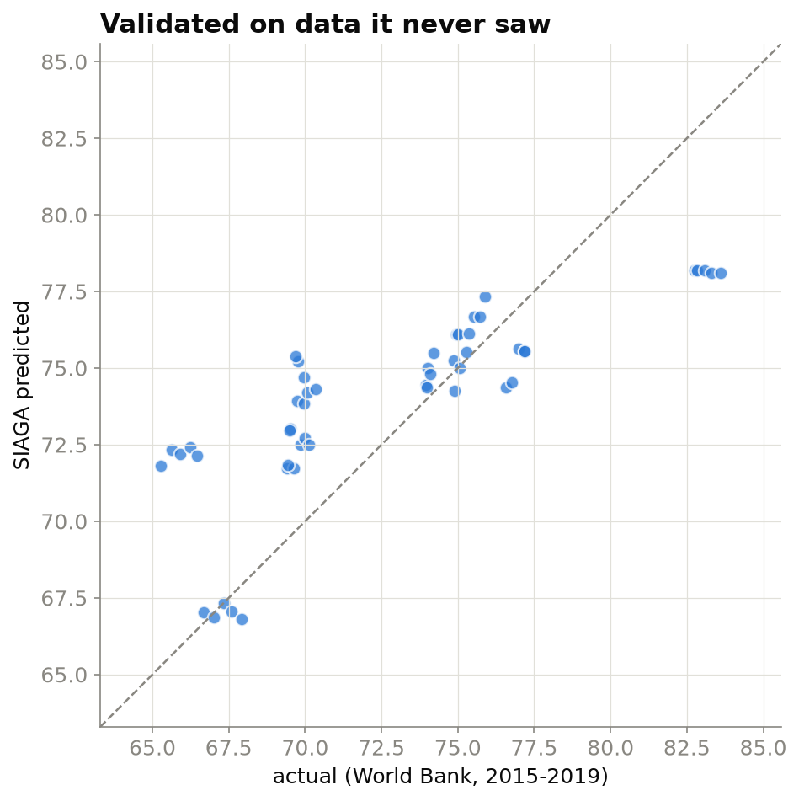
THE MODEL & ITS PROOF
Honest by design, validated on data it never saw
Predict the near future of a known country
1.08 years average error | R² 0.93 (2012-2014 held out)
Hold up on independent World Bank data
1.96 years average error | R² 0.76 (2015-2019, unseen source)
Safe by construction
Medical priors are hard-coded, so more staffing or vaccines can never lower the prediction.
SIAGA NOVA
08

Slide 9
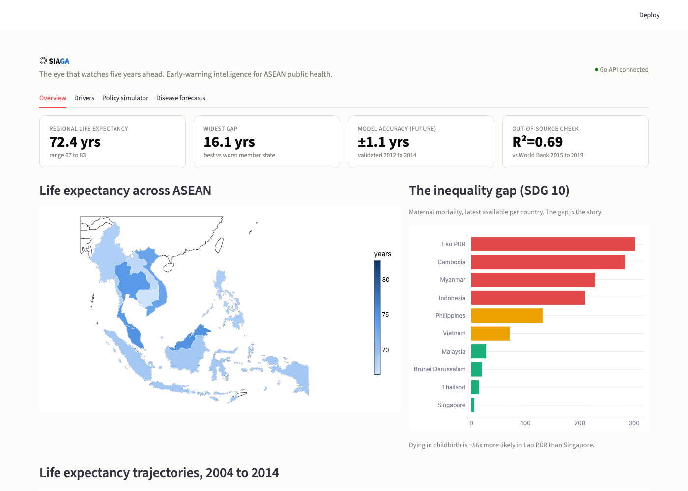
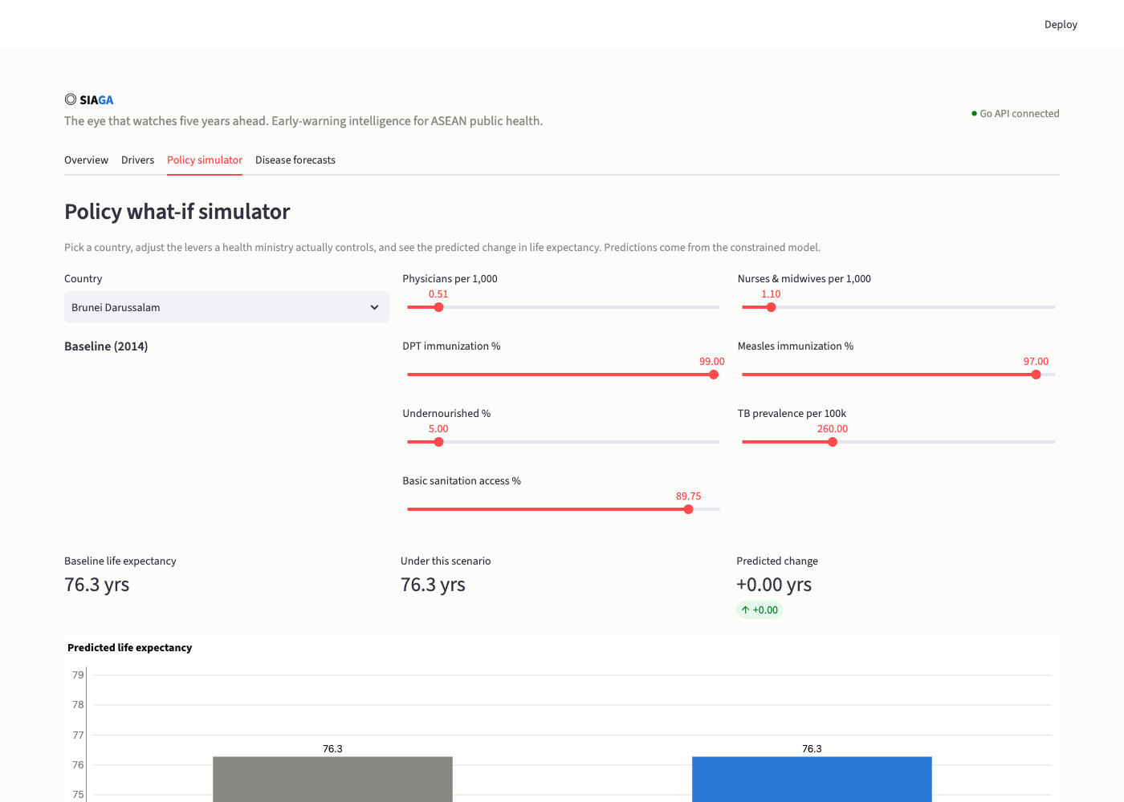
THE PRODUCT
A dashboard a minister could use on Monday
Interactive policy simulator
Move a lever, see the predicted change in life expectancy, live.
Go interoperability API
A dependency-free binary with API-key auth and rate limiting, serving one harmonized schema across borders (SDG 17).
Versioned model + pipeline
Retrain and redeploy from one command: python -m pipeline.train.
SIAGA NOVA
09

Slide 10
WHAT TO DO NOW
Five actions, deployable today, grounded in the data
1
Invest in water and sanitation where coverage lags
The model's #1 driver (~1.9 yrs) and the historical record agree. Prioritise WASH in Cambodia, Lao PDR, Myanmar.
2
Surge TB case-finding in the Philippines and Cambodia
Forecasts show TB high or rising. Active case-finding, GeneXpert diagnostics, WHO DOTS adherence support.
3
Fund maternal and child nutrition in high-burden states
Undernourishment stays a top driver. Micronutrients and school feeding, plus rural midwives for the 56x maternal gap.
4
Protect immunization coverage above 95%
Measles and DPT are strong, cheap drivers. Sustain coverage and run catch-up campaigns where it dipped.
5
Adopt one shared cross-border data schema (SDG 17)
Fragmentation delays outbreak detection. The SIAGA API lets member states share indicators for earlier warning.
Recommendations reflect the data and established WHO/UN practice, independent of the model.
SIAGA NOVA
10

Slide 11
IMPACT, FEASIBILITY & ROADMAP
Built to ship, designed to scale
Feasible now
Real impact
Phase 2 roadmap
Turns 'report the past' into 'act before the outbreak.' Every recommendation ties to a measurable driver of life expectancy.
Blockchain consent and audit layer for cross-border data. Flutter offline-first field app. Mobility and soil data for nowcasting. Climate (NASA POWER) already integrated.
Runs on free, open data and a static binary. No cloud lock-in. Designed for the unreliable power and connectivity in the brief.
SIAGA NOVA
11

Slide 12


WHY SIAGA WINS
Rigorous, explainable, and honest, and it works before the outbreak, not after. Team Members
David O. Agyakwa
Leader
Christian Oamhen
Pod Nova | Vote SIAGA.
SIAGA NOVA
12

