Slide 1
Self-introduction
June/9/2015
Daiwei Wang
Financial Services Department, Rakuten Inc.
http://www.rakuten.co.jp/

Slide 2
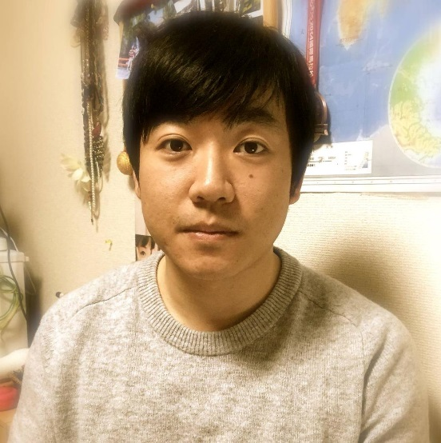
Self-introduction (1/3)
Name: Wang Daiwei
Nickname: David
Location: Harbin, Heilongjiang Province, China
25++

Slide 3
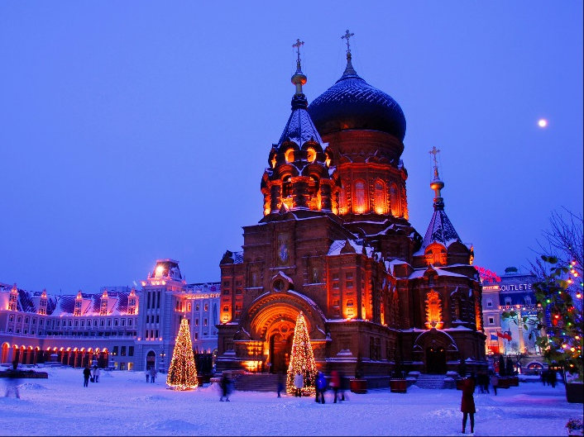
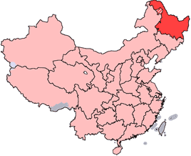
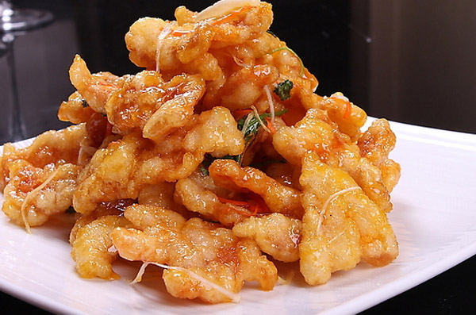

Self-introduction (2/3)
Guo bao Rou
Smoked sausage
Harbin Beer
Chicken braised mushrroms
…
Northeast capital city in China of Heilong Jiang Province
8th most populous Chinese city

Slide 4
Self-introduction (3/3)
Bachelor Degree
Ph.D. Degree
Tele-communication
Signal processing
2011
2015 Apr.
2009
2014
Master Degree
New grad
Signal processing
Backend programming
JAPAN
CHINA

Slide 5
Programming Skills
MATLAB
R
C
Objective-C
Swift
HTML / CSS
JavaScript
PAST
Capybara
RSpec
New Grads TRAINING
PHP
Java
NOW

Slide 6



Hobbies
Road Bicycling
UI/UX Design
Delicious Food

Slide 7

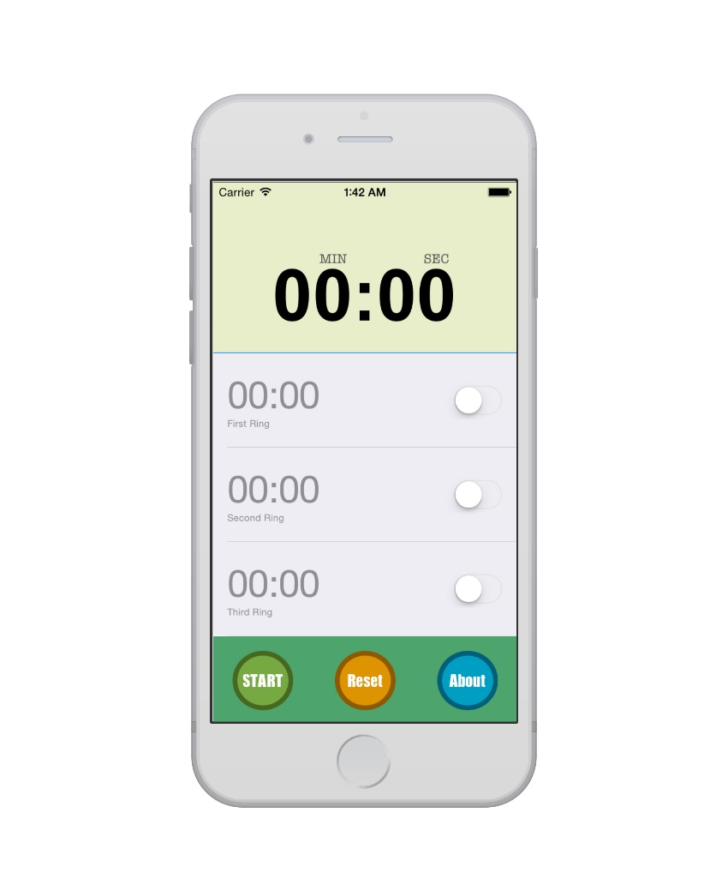
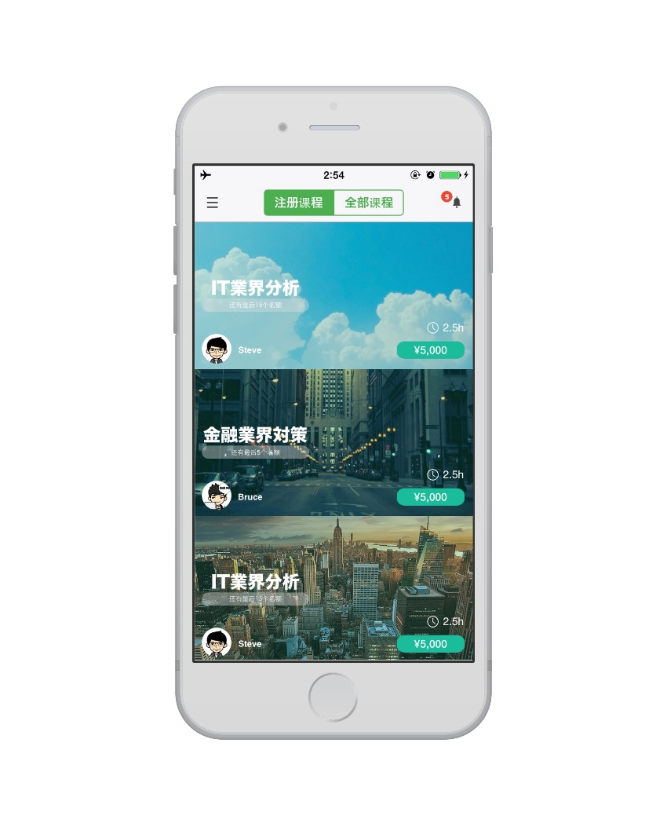
iPhone App Developing
Timers
Reminder
Course Reservation

Slide 8
Thank you ☺

