Slide 1
Software Design:The design phase of software development deals with transforming the customer requirements as described in the SRS documents into a form implementable using a programming language. The software design process can be divided into the following three levels or phases of design:
1. Interface Design
2.Architectural Design
3.Detailed Design
Elements of a System
Architecture: This is the conceptual model that defines the structure, behavior, and views of a system. We can use flowcharts to represent and illustrate the architecture.

Slide 2
Modules: These are components that handle one specific task in a
system. A combination of the modules makes up the system.
Components: This provides a particular function or group of related functions.
They are made up of modules.
Interfaces: This is the shared boundary across which the components of a
System exchange information and relate.
Data: This is the management of the information and data flow.

Slide 3
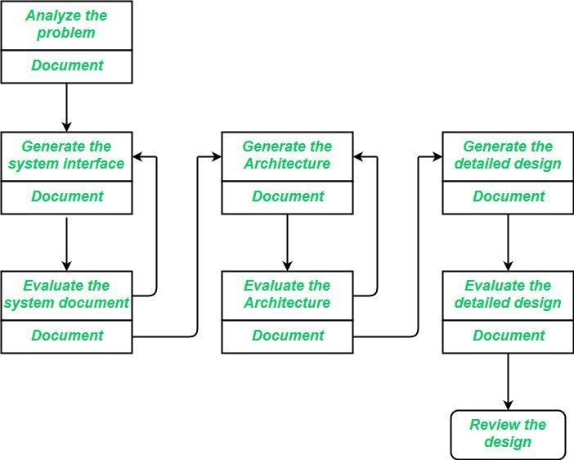

Slide 4
Interface Design
Interface design should include the following details:
Precise description of events in the environment, or messages from agents
to which the system must respond
Precise description of the events or messages that the system must produce. Specification of the data, and the formats of the data coming into and going out of the system.
Specification of the ordering and timing relationships between incoming events or messages, and outgoing events or outputs.

Slide 5
Architectural Design
Architectural design is the specification of the major components of a system, their responsibilities, properties, interfaces, and the relationships and interactions between them.
Gross decomposition of the systems into major components.
Allocation of functional responsibilities to components.
Component Interfaces.
Component scaling and performance properties, resource consumption properties, reliability properties, and so forth.
Communication and interaction between components.
The architectural design adds important details ignored during the interface design. Design of the internals of the major components is ignored until the last phase of the design.

Slide 6
Detailed Design:
Design is the specification of the internal elements of all major system components their properties, relationships, processing, and often their algorithms and the data structures.
Decomposition of major system components into program units.
Allocation of functional responsibilities to units.
User interfaces.
Unit states and state changes.
Data and control interaction between units.
Data packaging and implementation, including issues of scope and visibility of program elements.
Algorithms and data structures.

Slide 7
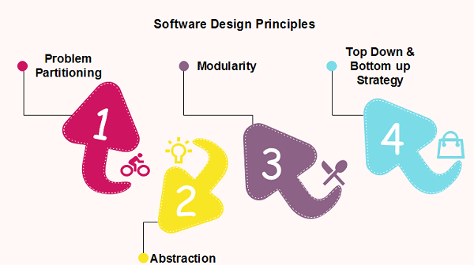
Software Design Principles:
Software design principles are concerned with providing means to handle the complexity of the design process effectively.

Slide 8
Problem Partitioning
For small problem, we can handle the entire problem at once but for the significant problem, divide the problems and conquer the problem it means to divide the problem into smaller pieces so that each piece can be captured separately.
Benefits of Problem Partitioning
Software is easy to understand
Software becomes simple
Software is easy to test
Software is easy to modify
Software is easy to maintain
Software is easy to expand

Slide 9
Abstraction:
An abstraction is a tool that enables a designer to consider a component at an abstract level without bothering about the internal details of the implementation. Abstraction can be used for existing element as well as the component being designed
Here, there are two common abstraction mechanisms
Functional Abstraction
Data Abstraction
Functional Abstraction
A module is specified by the method it performs.
The details of the algorithm to accomplish the functions are not visible to the user of the function.
Data Abstraction
Details of the data elements are not visible to the users of data. Data Abstraction
forms the basis for Object Oriented design approaches.

Slide 10
Modularity:
Modularity specifies to the division of software into separate modules which are differently named and addressed and are integrated later on in to obtain the completely functional software.
Each module has single specified objectives.
Modules can be separately compiled and saved in the library.
Modules should be easier to use than to build.
Modules are simpler from outside than inside.

Slide 11
Design concepts:
The set of fundamental software design concepts are as follows:
1.Abstraction:
A solution is stated in large terms using the language of the
problem environment at the highest level abstraction.
The lower level of abstraction provides a more detail
description of the solution.
A sequence of instruction that contain a specific and limited
function refers in a procedural abstraction.
A collection of data that describes a data object is a data abstraction.

Slide 12
2.Architecture:
The complete structure of the software is known as software architecture.
Structure provides conceptual integrity for a system in a number of ways.
The architecture is the structure of program modules where
they interact with each other in a specialized way.
The components use the structure of data.
The aim of the software design is to obtain an architectural framework of a system.

Slide 13
3.Patterns:
A design pattern describes a design structure and that structure solves a particular design problem in a specified content
Modularity
A software is separately divided into name and addressable components. Sometime they are called as modules which integrate to satisfy the problem requirements.
5.Information hiding
Modules must be specified and designed so that the information like algorithm
and data presented in a module is not accessible for other modules not requiring that information.
Functional independence
The functional independence is the concept of separation and related to the concept of modularity, abstraction and information hiding.
The functional independence is accessed using two criteria i.e Cohesion and coupling.

Slide 14
Cohesion
Cohesion is an extension of the information hiding concept.
A cohesive module performs a single task and it requires a small interaction with the other components in other parts of the program.
Coupling
Coupling is an indication of interconnection between modules in a structure of software.
Refinement
Refinement is a top-down design approach. It is a process of elaboration.
A program is established for refining levels of procedural details.
A hierarchy is established by decomposing a statement of function in a stepwise manner till the programming language statement are reached

Slide 15
Refactoring
It is a reorganization technique which simplifies the design of components without changing its function behaviour.
Refactoring is the process of changing the software system in a way that it does not change the external behaviour of the code still improves its internal structure
Coupling and Cohesion
Module Coupling
In software engineering, the coupling is the degree of interdependence between software modules. Two modules that are tightly coupled are strongly dependent on each other. However, two modules that are loosely coupled are not dependent on each other. Uncoupled modules have no interdependence at all within them.

Slide 16
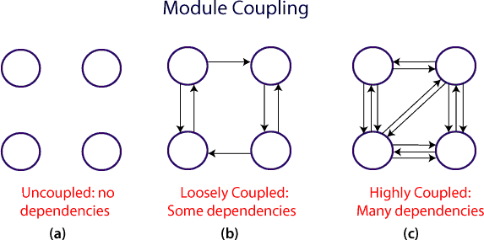

Slide 17
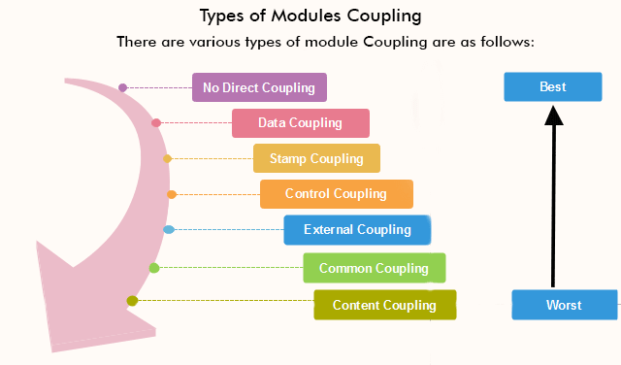

Slide 18
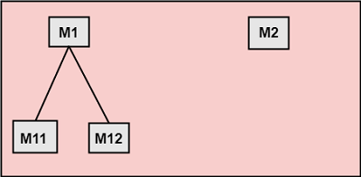
No Direct Coupling: There is no direct coupling between M1 and M2
In this case, modules are subordinates to different modules. Therefore, no direct coupling.

Slide 19
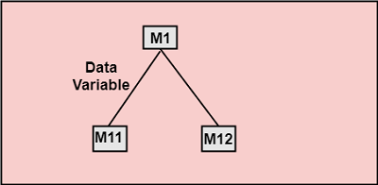
Data Coupling: When data of one module is passed to another module, this is called data coupling.
Stamp Coupling: Two modules are stamp coupled if they communicate using composite data items such as structure, objects, etc. When the module passes non-global data structure or entire structure to another module, they are said to be stamp coupled. For example, passing structure variable in C or object in C++ language to a module.

Slide 20
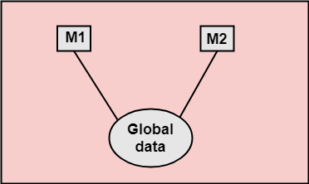
Control Coupling: Control Coupling exists among two modules if data from one module is used to direct the structure of instruction execution in another.
External Coupling: External Coupling arises when two modules share an externally imposed data format, communication protocols, or device interface. This is related to communication to external tools and devices.
Common Coupling: Two modules are common coupled if they share information through some global data items.

Slide 21
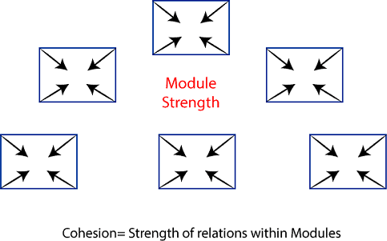
Content Coupling: Content Coupling exists among two modules if they share code, e.g., a branch from one module into another module.
Module Cohesion
In computer programming, cohesion defines to the degree to which the elements of a module belong together. Thus, cohesion measures the strength of relationships between pieces of functionality within a given module. For example, in highly cohesive systems, functionality is strongly related.

Slide 22
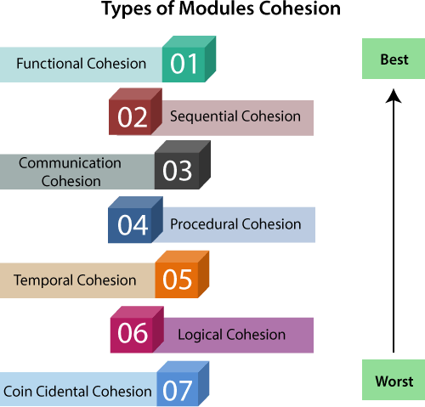
Types of Modules Cohesion

Slide 23
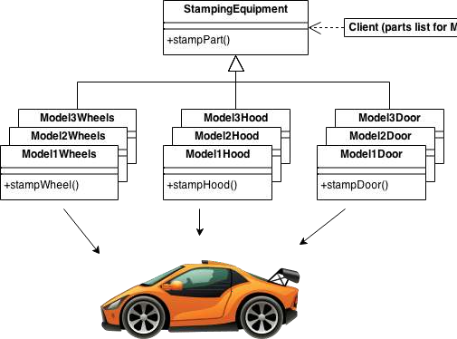
Design Patterns
In software engineering, a design pattern is a general repeatable solution to a commonly occurring problem in software design. A design pattern isn't a finished design that can be transformed directly into code. It is a description or template for how to solve a problem that can be used in many different situations.

Slide 24
AbstractFactory
Creates an instance of several families of classes
Builder
Separates object construction from its representation
FactoryMethod
Creates an instance of several derived classes
ObjectPool
Avoid expensive acquisition and release of resources by recycling objectsthat are no longer in use
Prototype
A fully initialized instance to be copied or cloned
Singleton
A class of which only a single instance can exist

Slide 25
Types of Design Patterns
There are three types of Design Patterns,
Creational Design Pattern
Structural Design Pattern
Behavioral Design Pattern
Creational Design Pattern
Creational Design Pattern abstract the instantiation process. They help in making a systemindependent of how its objects are created, composed and represented.
Importance of Creational Design Patterns:
A class creational Pattern uses inheritance to vary the class that’s instantiated, whereas anobject creational pattern will delegate instantiation to another object.

Slide 26
Creational patterns become important as systems evolve to depend more on object composition than class inheritance. As that happens, emphasis shifts away from hardcoding a fixed set of behaviors toward defining a smaller set of fundamental behaviors that can be composed into any number of more complex ones.
Advantages of Creational Design Patterns
Flexibility and Adaptability: Creational patterns make it easier to introduce new types of objects or change the way objects are created without modifying existing client code. This enhances the system’s flexibility and adaptability to change.
Reusability: By providing a standardized way to create objects, creational patterns promote code reuse across different parts of the application or even in different projects. This leads tomore maintainable and scalable software.
Centralized Control: Creational patterns, such as Singleton and Factory patterns,

Slide 27
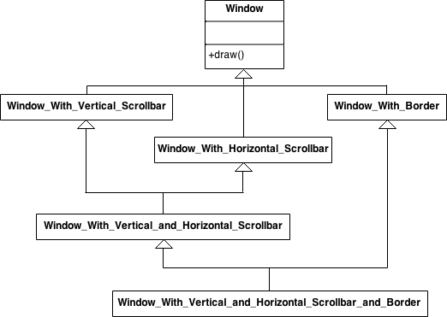
Structural design patterns
These design patterns are all about Class and Object composition. S class-creation patterns use inheritance to compose interfaces. Structura patterns define ways to compose objects to obtain new functionality

Slide 28
Behavioral Design Pattern
Behavioral patterns are concerned with algorithms and the assignment of responsibilities between objects. Behavioral patterns describe not just patterns of objects or classes but also thepatterns of communication between them.
Importance of Behavioral Design Pattern
These patterns characterize complex control flow that’s difficult to follow at run-TIME
They shift focus away from flow of control to let you concentratejust on the way objects are interconnected.
Behavioral class patterns use inheritance to distribute behavior between classes.
When to use Behavioral Design Patterns
Communication Between Objects: Use behavioral patterns when you want to define how objects communicate, collaborate, and interact with each other in a flexible and reusable way.
Encapsulation of Behavior: Apply behavioral patterns to encapsulate algorithms,
strategies,or behaviors, allowing them to vary independently from the objects that use them. This promotes code reusability and maintainability

Slide 29
Advantages of Behavioral Design Patterns:
Flexibility and Adaptability.
Code Reusability
Separation of Concerns
Encapsulation of Algorithms
Ease of Maintenance
Disadvantages of Behavioral Design Patterns
Increased Complexity
Over-Engineering
Limited Applicability
Code Readability
Scalability Concerns

Slide 30
Model-view-controller(MVC)
Definition:
The MVC pattern in Software Engineering Architecture is defined as an applicationbeing separated into three logical components: Model, View and Controller .
Model
This component in the architecture will represent all data-related logic. This includes defining how the data is formed. In other words, this holds the definition for many ofthe types that we use in the application. In many cases, the model here refers to the type of data that we are dealing with in the application. This component also notifiesits dependents about data changes.
View
Contains all User interface (UI) logic in the application. This component of the application encapsulates mainly the UI related logic which includes things that the enduser will manipulate like dropdown buttons and web pages etc.

Slide 31
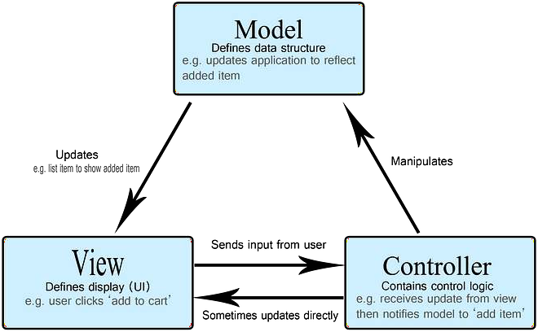
Controller
Controllers exist as a layer between Model and View components to process all the business logic arising from user input. It is responsible to handle inputs from the View.
components, manipulate data using the models from the Model component and thenfinally interact with the view components again to render the final output to the enduser. Responsible for manipulating the data.

Slide 32
1.4. Adapter:
What is an Adapter?
An adapter is a class that transforms (adapts) an interface into another.
For example, an adapter implements an interface A and gets injected an interface B. When the adapter is instantiated it gets injected in its constructor an object that implements interface
B. This adapter is then injected wherever interface A is neededand receives method requests that it transforms and proxies to the inner object thatimplements interface B.

Slide 33
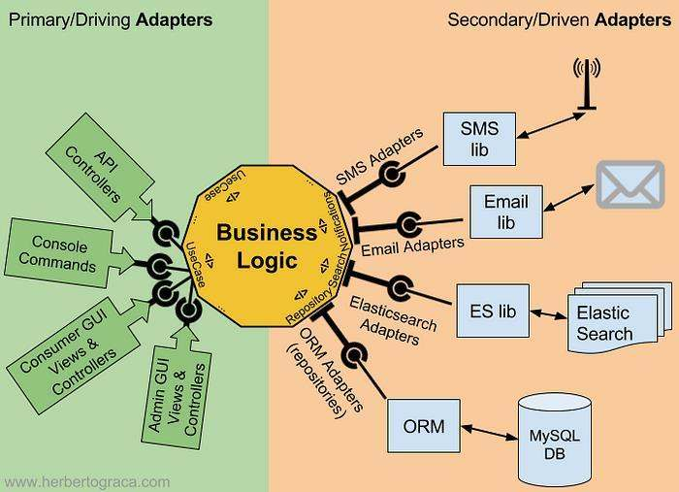

Slide 34
System Design Strategy – Software Engineering:
System Design Strategy refers to the approach that is taken to design a software system.
There are several strategies that can be used to design software systems, including the following:
Top-Down Design: This strategy starts with a high-level view of the system and graduallybreaks it down into smaller, more manageable components.
Bottom-Up Design: This strategy starts with individual components and builds the system up,piece by piece.
Iterative Design: This strategy involves designing and implementing the system in stages, witheach stage building on the results of the previous stage.

Slide 35
4.Incremental Design: This strategy involves designing and implementing a small part of the system at a time, adding more functionality with each iteration.
5.Agile Design: This strategy involves a flexible, iterative approach to design, where requirements and design evolve through collaboration between self-organizing and cross- functional teams.

Slide 36
Bottom-up approach:
The design starts with the lowest level components and subsystems. By using these components,the next immediate higher-level components and subsystems are created or composed. The process is continued till all the components and subsystems are composed into a single component, which is considered as the complete system. The amount of abstraction grows high as the design moves to more high levels.
By using the basic information existing system, when a new system needs to be created, the bottom-up strategy suits the purpose.

Slide 37
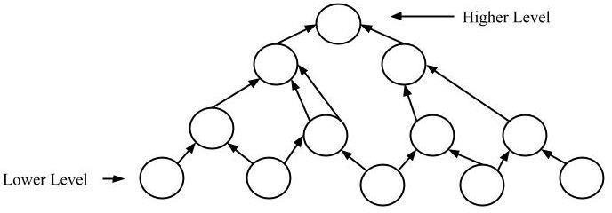

Slide 38
Top-down approach:
Each system is divided into several subsystems and components. Each of the subsystems is further divided into a set of subsystems and components. This process of division facilitates forming a system hierarchy structure. The complete software system is considered a single entityand in relation to the characteristics, the system is split into sub-systems and components. The same is done with each of the sub-systems.
This process is continued until the lowest level of the system is reached. The design is started initially by defining the system as a whole and then keeps on adding definitions of the subsystemsand components. When all the definitions are combined, it turns out to be a complete system.

Slide 39
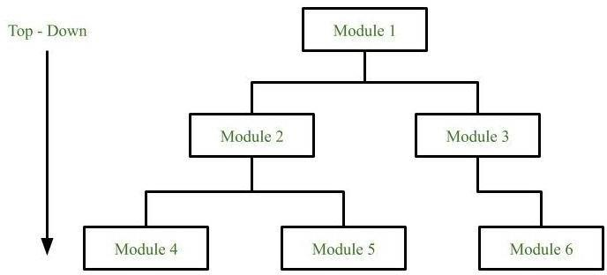

Slide 40
Hybrid Design:
It is a combination of both top-down and bottom-up design strategies. In this, we can reuse the modules.
Advantages of using a System Design Strategy
Improved quality
Ease of maintenance
Improved efficiency
Better communication
Faster development
Disadvantages of using a System Design Strategy
Time-consuming
Inflexibility

Slide 41
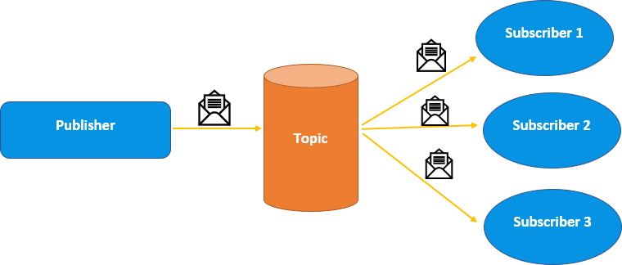
publish –subscribe pattern:
The pub-sub model involves publishers and subscribers, making it a messaging pattern.Specifically, the publishers are responsible for sending messages to the system, while subscribers are responsible for receiving those messages

Slide 42
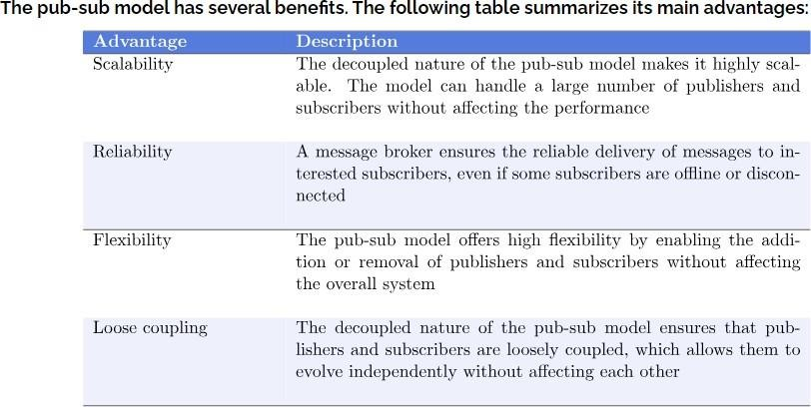

Slide 43
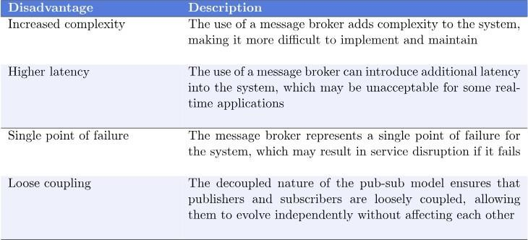

Slide 44
OBSERVER
Observer design pattern falls under the category of behavioral design pattern Observer Pattern maintains a one-to-many relationship among objects, ensuring that whe state of one object is changed, all of its dependent objects are simultaneously inf and updated. This design pattern is also referred to as Dependents.
A subject and observer (many) exist in a one-to-many relationship. Here the observ not have any access to data, so they are dependent on the subject to feed them with inform

Slide 45
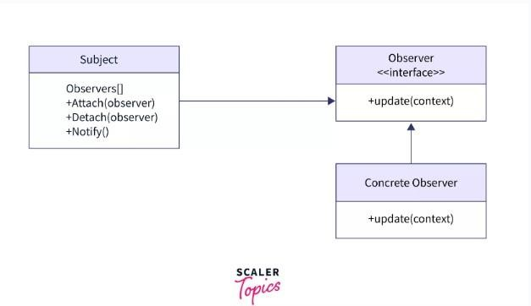

Slide 46
PROXY DESIGN PATTERN
Proxy means ‘in place of’, representing’ or ‘in place of’ or ‘on behalf of’ are literal meanings of proxy and that directly explains Proxy Design Pattern. Proxies are also called surrogates, handles, and wrappers. They are closely related in structure, but not purpose, to Adapters and Decorators.
A real world example can be a cheque or credit card is a proxy for what is in our bank account. It can be used in place of cash, and provides a means of accessing that cash when required. And that’s exactly what the Proxy pattern does – “Controls and manage access to the object they are protecting“.
BEHAVIOR
As in the decorator pattern, proxies can be chained together. The client, and each proxy,

Slide 47
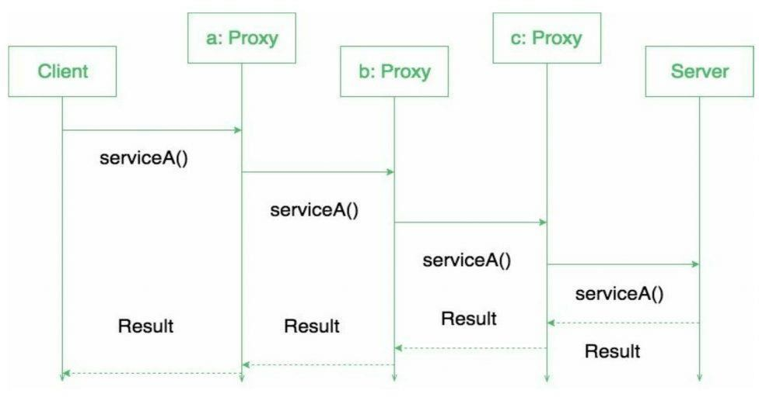

Slide 48
When to use this pattern?
Proxy pattern is used when we need to create a wrapper to cover the main object’s complexity from the client.
FACADE DESIGN PATTERN:
Now Let’s try and understand the facade pattern better using a simple example. Let’s consider a hotel. This hotel has a hotel keeper.
There are a lot of restaurants inside the hotel e.g. Veg restaurants, Non-Veg restaurants, and Veg/Non Both restaurants. You, as a client want access to different menus of different restaurants.
You do not know what are the different menus they have. You just have access to a hotel keeper who knows his hotel well. Whichever menu you want, you tell the hotel keeper and he takes it out of the respective restaurants and hands it over to you. Here, the hotel keeper acts as the facade, as he hides the complexities of the system hotel. Let’s see how it works:

Slide 49
Facade is a structural design pattern with the intent to provide a simplified (but limited) interface to a complex system of classes, library or framework.
A Facade class can often be transformed into a Singleton since a single facade object is sufficient in most cases.
Facade routinely wraps multiple objects.
The Facade class will not encapsulate subclasses but will provide a simple interface to their functions.
Classes in the subsystem will still be available to the client. However, Facade will decouple client and subsystems so that they can change independently.

Slide 50
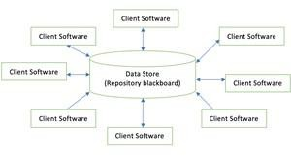
ARCHITECTURAL STYLES:
The software needs the architectural design to represents the design of software. IEEE defines architectural design as “the process of defining a collection of hardware and software
components and their interfaces to establish the framework for the development of a computersystem.” The software that is built for computer-based systems can exhibit one of these many architectural styles.

Slide 51
Data centered architecture

Slide 52
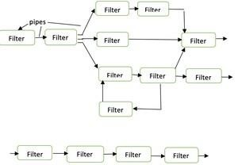

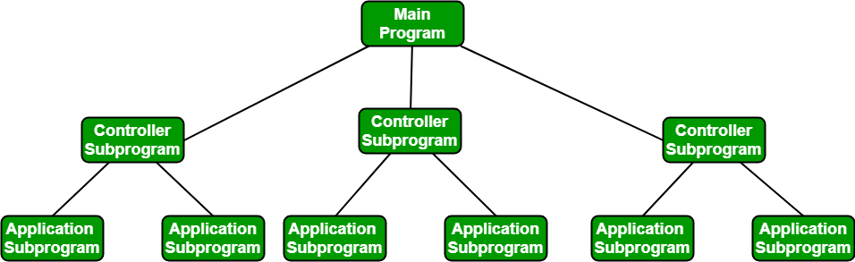
Data Flow architecture

Slide 53
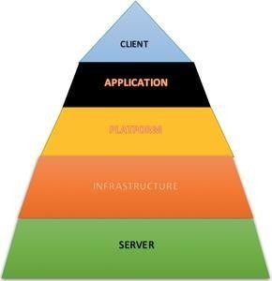
Layered architecture:

Slide 54
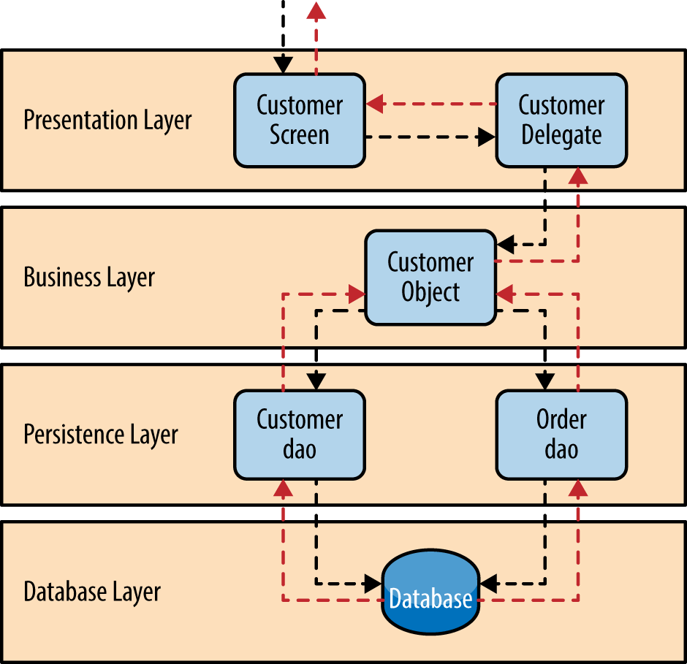

Slide 55
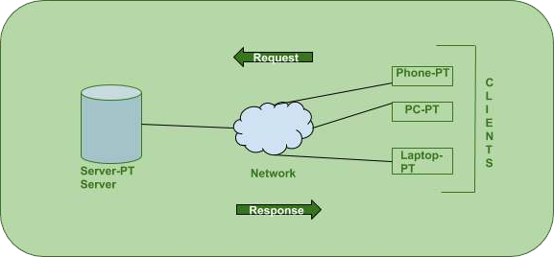
CLIENT-SERVER MODEL
The Client-server model is a distributed application structure that partitions task or workload between the providers of a resource or service, called servers, and service requesters called clients. In the client-server architecture, when the client computer sends a request for data tothe server through the internet, the server accepts the requested process and deliver the data packets requested back to the client.

Slide 56
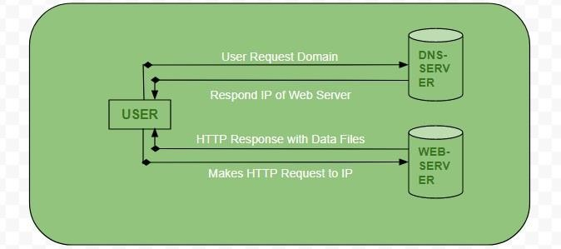

Slide 57
CCS356−OBVJECT ORIENTED SOFTWARE ENGINEERING
PIPE AND FILTER ARCHITECTURES
Pipe and Filter is a simple architectural style that connects a number of components that process a stream of data, each connected to the next component in the processing pipeline via a Pipe.
The Pipe and Filter architecture is inspired by the Unix technique of connecting the output of an application to the input of another via pipes on the shell.
The pipe and filter architecture consists of one or more data sources. The data source is connected to data filters via pipes. Filters process the data they receive, passing them to other filters in the pipeline. The final data is received at a Data Sink:

Slide 58
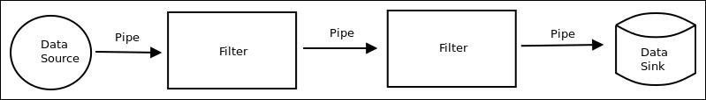
Pipe and Filter is another architectural pattern, which has independent entities called filters (components) which perform transformations on data and process the input they receive, and pipes, which serve as connectors for the stream of data being transformed, each connected to the next component in the pipeline.

Slide 59
USER INTERFACE DESIGN:
The user interface is the front-end application view to which the user interacts touse the software. The software becomes more popular if its user interface is:
Attractive
Simple to use
Responsive in a short time
Clear to understand
Consistent on all interface screensTypes of User Interface
Command Line Interface: The Command Line Interface provides a command prompt, where the user types the command and feeds it to the system. The user needs to remember the syntax of the command and its use.
Graphical User Interface: Graphical User Interface provides a simple interactive interface to interact with the system. GUI can be a combination of both hardware and software. Using GUI, the user interprets the software.

Slide 60
