Slide 1

Recording Architectural Decisions
David Ayers, Principal Architect, Credera
david.ayers@credera.com
@iamagiantnerd

Slide 2
Who am I, and why should you listen to me?
Technologist with 20+ years of experience building solutions to complex problems
Former VP of Technology for The Container Store
Principal Architect with Credera in the
Technology Architecture & Strategy Practice
Advocate for technology-as-craft
All around nerdy guy

Slide 3
The Problem
“Why did we do it this way?”
— Every developer in history, at some point in their career
Notes:
Have you ever looked at something and said, why did we do that?
I know every developer has faced this at some point. You're looking at something that was done (maybe you did it!), and you're not sure why it was done that way.

Slide 4
We make decisions
every day!
Notes:
As technologists, we make important architectural decisions every day
These decisions can range from far reaching (Angular vs. React) to mundane (Infinite scroll vs. pagination for search results)
These decisions can be made by one person, or made by the team

Slide 5
Most of us take these
decisions seriously!
Notes:
Most of us do a great job and carefully thinking through these decisions:
Taking into account all of the pros and cons of the many different options
Discussing these options with the team
Perhaps doing a spike or a "pepsi challenge" to determine a "best fit" for a particular decision

Slide 6
Then we implement it…
Notes:
And then we go about implementing it
Maybe we update a user story with some of the information that led to the decision (usually not though)

Slide 7
And all of that context is lost
😪
Notes:
And all of that context is lost

Slide 8
Why does context
matter?
Notes:
Why does that context matter?

Slide 9
I’d like to make a change!
🙋‍♀️
Notes:
Let's say someone wants to make a change, and there is no context about why the original decision was made. They can either:

Slide 10
Oh well, I guess they knew better
🤷‍♀️
Notes:
Blindly accept the original decision. Which might be ok, if it was a good decision to begin with. But maybe the context has changed, and without any record of that context, doing nothing may be a mistake.

Slide 11
I’ll just go ahead and change things!
💁‍♀️
Notes:
Blindly change the decision. Which also might be ok, but maybe there is a crucial fact about the new decision (some non-functional requirement, for example) that was considered and ultimately discarded for reasons which are still valid.

Slide 12
The Solution
“Large documents are never kept up to date. Small, modular documents have at least a chance at being updated.”
— Michael Nygard, Documenting Architectural Decisions Blog Post

Slide 13
Architectural Decision Records
(ADRs)
Notes:
First proposed by Michael Nygard (consultant, author, speaker), Architectural Decision Records provide a way to capture these decisions as part of the codebase that's being working on; where the rubber meets the road.
There’s a special case for decisions that span projects or the entire enterprise, I’ll get to that in a few minutes.

Slide 14
ADRs are:
Lightweight, text based, markdown
Notes:
- Lightweight, text based solution, usually written in Markdown
Markdown allows "pretty" rendering when used with Github, Gitlab & others, still human readable

Slide 15
ADRs are:
Saved in a file with an
incrementing sequence:
0001-git-for-version-control.md
Notes:
Each decision is stored in a separate file, with an incrementing sequence; so the first decision on a project is 0001, the second is 0002, etc.

Slide 16
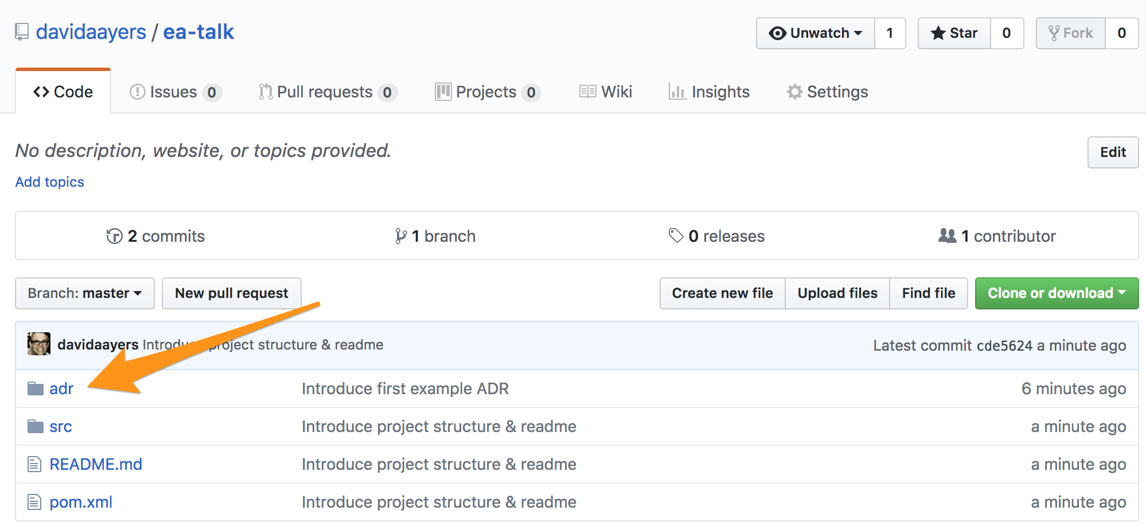
ADRs are: Saved with the project

Slide 17
Anatomy of an ADR

Slide 18
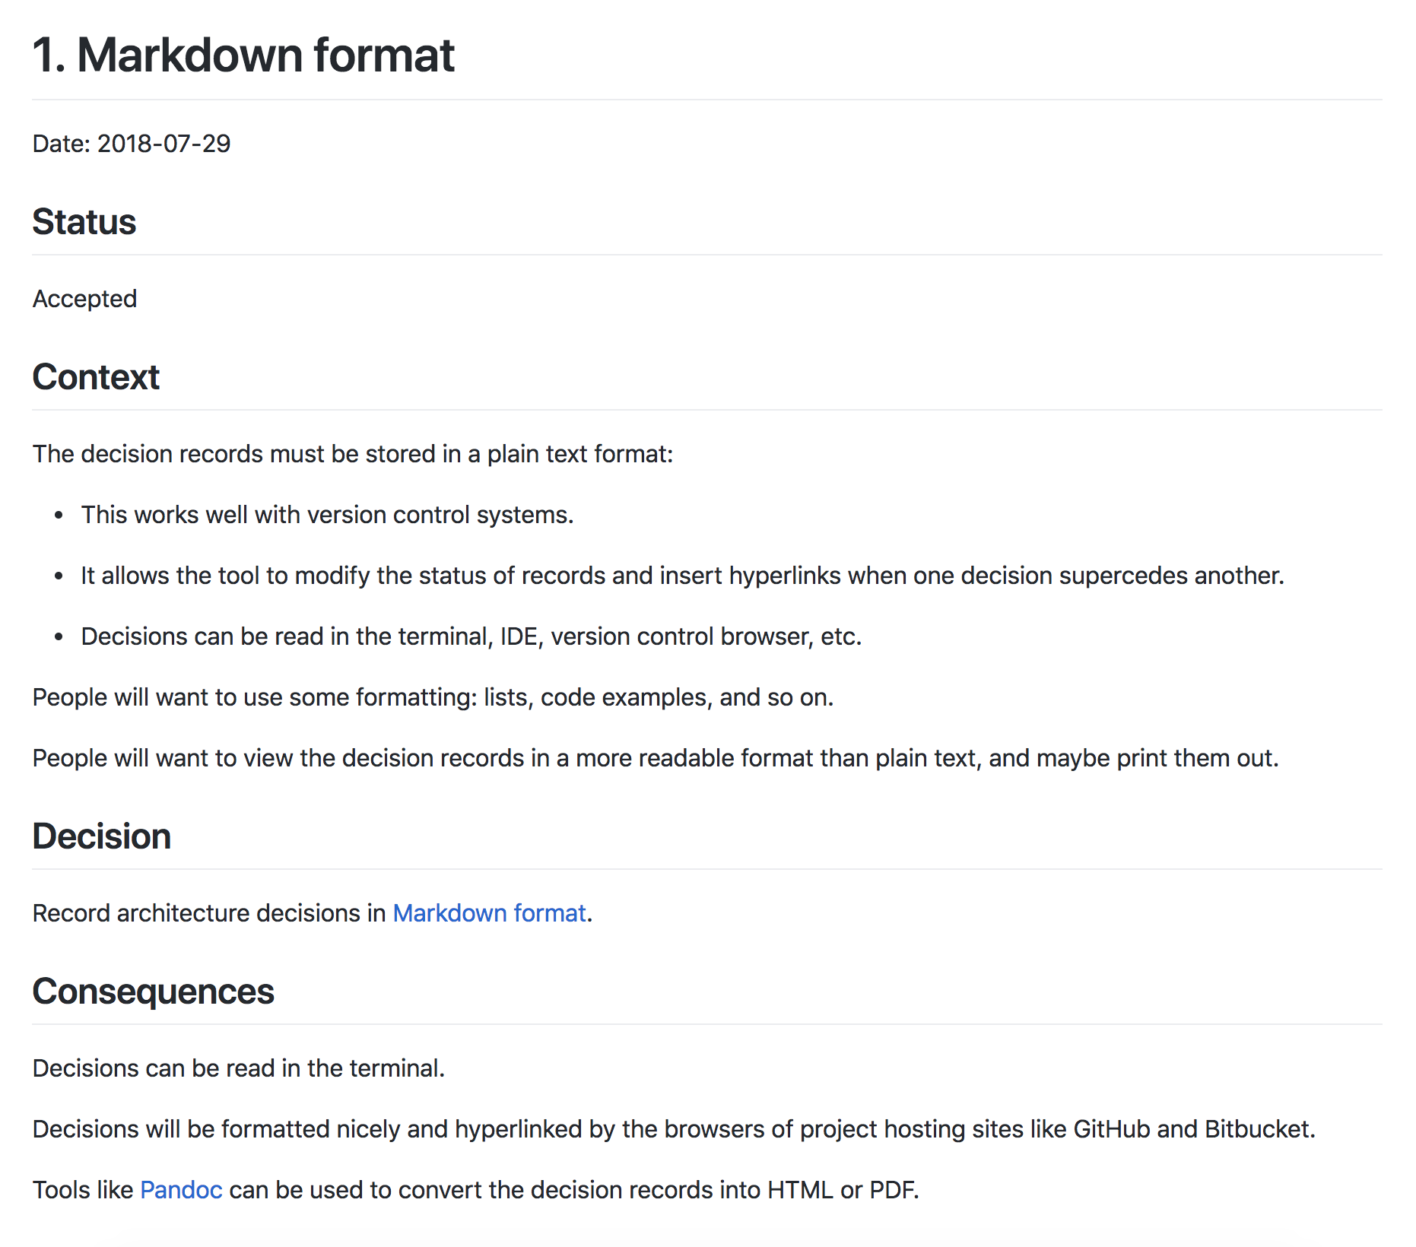
Notes:
Here’s an example ADR, which records our decision to use Markdown when creating ADRs. Meta enough?

Slide 19
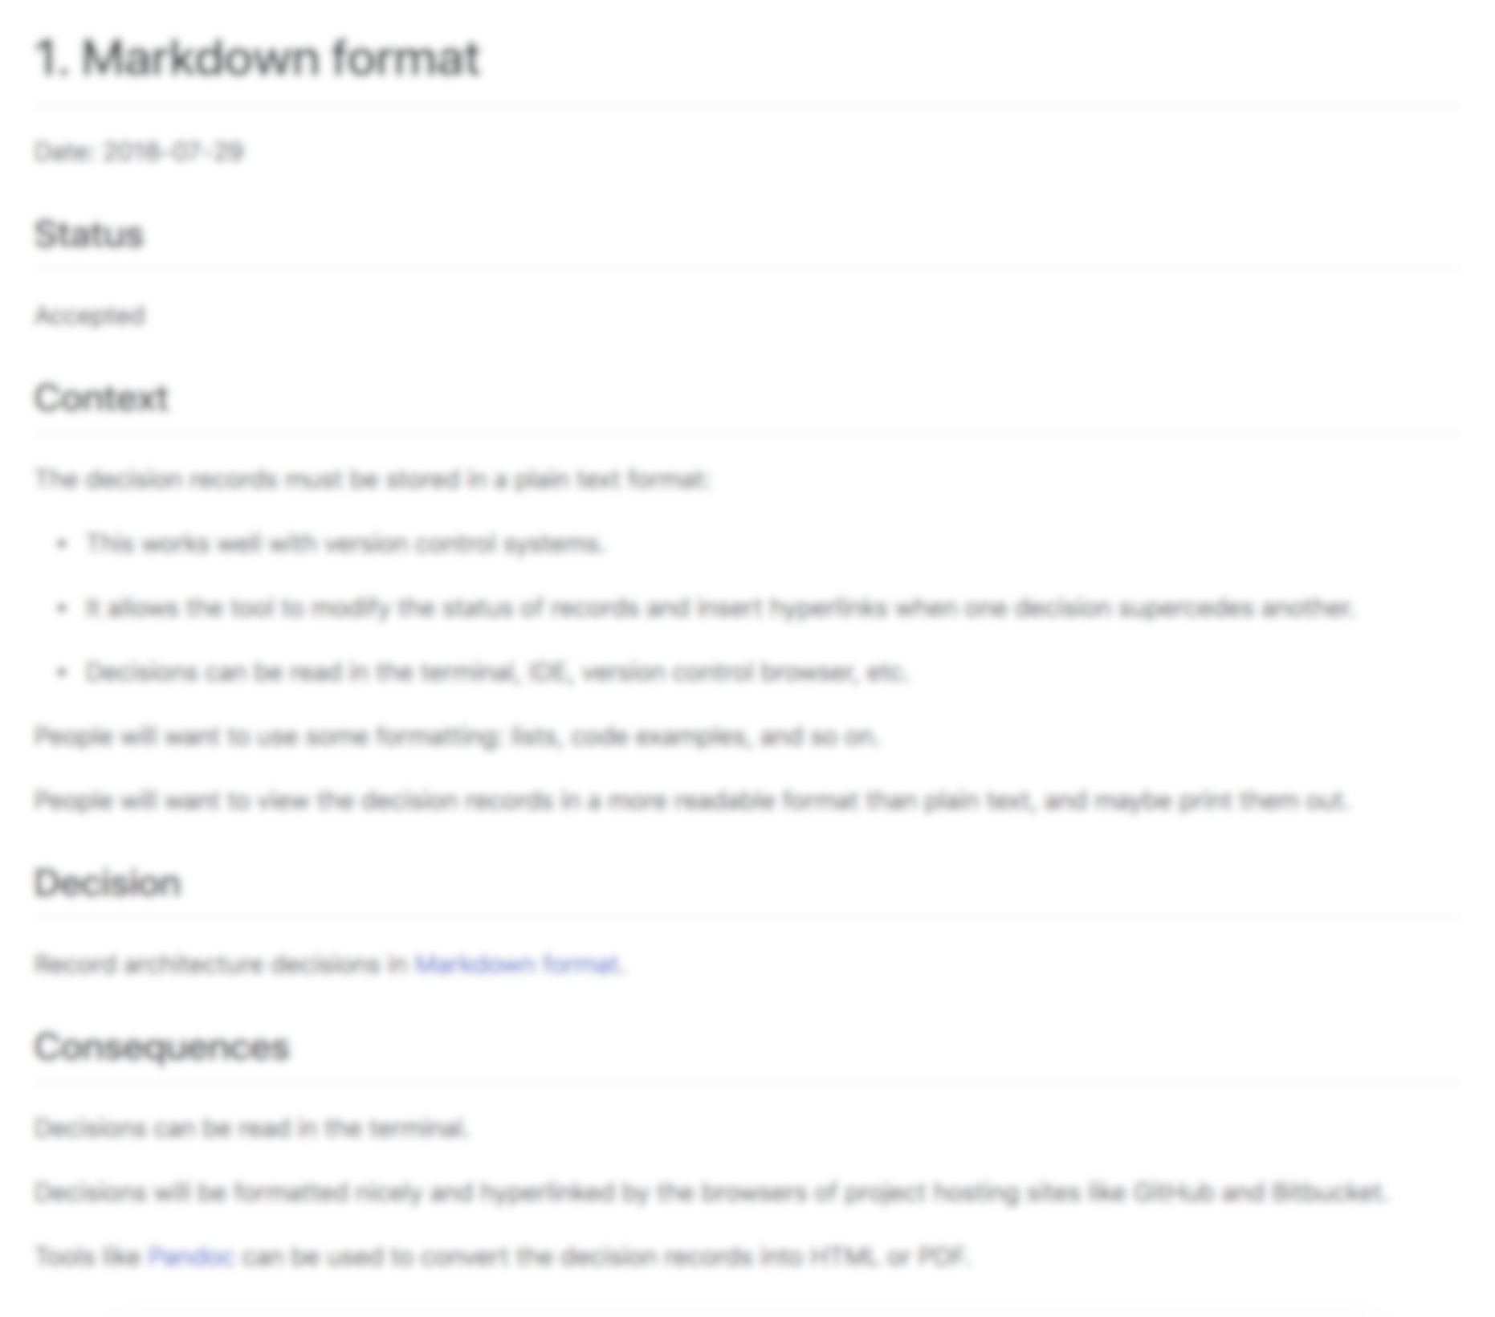
Title
Notes:
Titles are usually best expressed as simple noun phrases:
"Git for version control"
"LDAP for authentication"
"Spring MVC for web development"

Slide 20
Status
Notes:
One of
Proposed
Accepted
Superseded
Deprecated
Side note: The original idea around ADRs was that they were immutable.
This is one area where, in the past, we have deviated from the original ideas around ADRs. For superseded & deprecated ADRs, we either just changed the ADR itself, or moved it to an "archive" directory, to reduce the signal-to-noise ratio. Changing ADRs is fine, if you're storing them in source control.

Slide 21
Context
Notes:
Describes the forces at play, in a factual way. These forces can be technology-based, politically-based, culturally-based, project-based, etc. There is likely tension, and if so, the context should reflect that tension in a non-biased way.

Slide 22
Decision
Notes:
Most commonly stated as "We will..." and then the decision, or just a statement of the decision itself.

Slide 23
Consequences
Notes:
Every decision has consequences, for good or ill. Record them here. Again, pay attention to the language used; these aren't value judgements, they are statements of fact, or as close as you can get.

Slide 24
SHORT AND TO THE POINT
Notes:
The entire ADR document should be no more than a page or two; after all, we're trying to keep these lightweight!

Slide 25
Leverage your existing
workflow!
Notes:
If you are using a PR/MR workflow for the project, you can leverage that for ADRs too!
Architectural decisions can be proposed via a Pull Request, and any discussion related to what goes into the ADR itself is captured as part of the repo in Github/Gitlab/etc.

Slide 26
What should require
an ADR?
Notes:
Don't sweat the details — if you’re not sure if you should create an ADR, create one. You’ll learn to start to know it when you see it. Until then, if you even think you might need one, make one!
* Can be as simple as choice of IDE (eclipse vs. IntelliJ)
* Or as complex as documenting a spike done to validate an architectural approach
* Can also document feature decisions: Infinite scroll vs. pagination

Slide 27
But what about overarching concerns that apply to more than one project?
Notes:
We also used ADRs to document and socialize Technical Architecture decisions. Sure, there are lots of ways that companies can do this, lots of systems to capture these kinds of things. But using the tools that most of the technology team was *already* using (i.e. text editors, source control, github), we exposed the decisions in a way that we hadn’t seen before. In this context, the ADRs were things like:
"Git for version control"
"Code commit formatting"
"Docker for deployments"
"Ansible for orchestration"
"Vault for secret management"
These were kept in a special repo on github that existed just for Technical Architecture ADRs. Other stuff, like architectural diagrams were also stored there [PlantUML](http://plantuml.com/) is a good tool for text-based architecture diagrams.

Slide 28
Wait, but what about
Wikis?
Notes:
What about wikis?
Lots of people use wikis to try to document these types of decisions, which is better than nothing
But, there is a disconnect (usually) between the code and the wiki, and in most places, wikis are where documents go to die
That being said, well maintained wikis can be great, and ADRs can exist on wikis (but I wouldn’t recommend it)

Slide 29
The Benefits
“Incorrect documentation is often worse than no documentation.”
— Bertrand Meyer

Slide 30
New team member
onboarding
Notes:
- New people joining the team can better understand the thought processes that lead to current state

Slide 31
Save people from
themselves
Notes:
- Stops people from repeating the sins of the past
How many times have we said "I swear we looked at that, but I don’t really remember"

Slide 32
Informs decision making
process
Notes:
- Informs current decision making processes - by looking at all of the decisions that were made in a project, one can get a sense for the types of decisions that are made, which in itself is informative and provides context

Slide 33
ADRs = Goodness 👍🏽
Notes:
ADRs proved to be a powerful tool that helped codify our decisions, and record them, which allowed them to be socialized much easier, and capturing the context behind the decisions helped us avoid problems that would have had us repeat mistakes of the past.

Slide 34
More praise for ADRs: ThoughtWorks Technology Radar
Notes:
Has anyone heard of this? Thoughworks puts this together every six months based on what they are seeing in the marketplace.

Slide 35
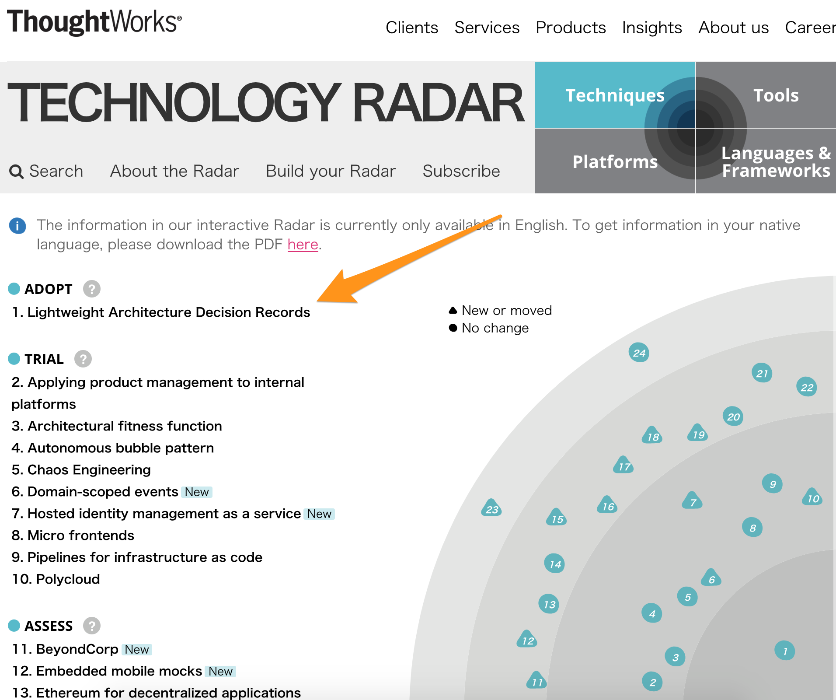
https://www.thoughtworks.com/radar/techniques
Notes:
Thoughtworks has also moved ADRs into “Adopt” in their technology radar, so the idea of using ADRs is gaining momentum in the world.

Slide 36
Real world examples: https://github.com/npryce/adr-tools/tree/master/doc/adr https://github.com/arachne-framework/architecture https://github.com/marc-bouvier/trello2eisenhower/tree/master/adr https://github.com/hilton/scripting-docs/tree/master/ADR
Notes:
Has anyone heard of this? Thoughworks puts this together every six months based on what they are seeing in the marketplace.

Slide 37
Tools: Command line ADR tool: https://github.com/npryce/adr-tools Compendium of ADR information: https://adr.github.io
Notes:
Has anyone heard of this? Thoughworks puts this together every six months based on what they are seeing in the marketplace.

Slide 38
Thanks for your time!
Slides & Information available at:
https://github.com/davidaayers/adr-talk
David Ayers, Principal Architect, Credera
david.ayers@credera.com
@iamagiantnerd

