Slide 1

Communicating and Documenting Architectural Decisions
https://github.com/davidaayers/comm-and-doc-arch-decisions
David Ayers, Group VP of Technology, Leslie’s Poolmart
iamagiantnerd@gmail.com
@iamagiantnerd

Slide 2
Who am I, and why should you listen to me?
Technology leader with 20+ years of experience building solutions to complex problems
Group VP of Technology for Leslie’s Poolmart
Former VP of Technology for The Container Store
Believer & advocate for technology-as-craft
Giant Nerd

Slide 3
“May you live in interesting times”
-- Not an ancient Chinese curse, according to Wikipedia
Notes:
We do live in interesting times. Technology is changing at an ever increasing pace, and we’re all learning new ways of doing things.
A lot of us work in “agile” workplaces; agile practitioners advocate deferring decisions until the least responsible moment and using evolutionary architectures, and delegating these responsibilities to the teams – i.e. “the people doing the work”

Slide 4
The Problem
Notes:
As technology practitioners, we work with teams that are responsible for maintaining the health, welfare, and safety of the systems we work with, as well as having either an interest or responsibility for how these systems connect and work together.
With decentralized decision making happing all around us, how to we provide some guard rails and a safety net to protect our teams (and our systems) from the dangers that are lurking out there. Because, make no mistake, they are lurking.

Slide 5

The Curious Case of MongoDB
Notes:
A quick example to illustrate the problem:
We had a team that decided that the best database to use was MongoDB. They talked to a guy on the ops side, who was super accommodating and set up something. They proceeded to build an application (with a tight deadline and large financial impact if we didn’t hit the deadline), and it worked great.
But when it was time to go into production, they hadn’t worked out all of the details with the ops team. They hadn’t socialized their decision properly, nor had they had any sort of “oversight” on their decision to use Mongo.
None of what they did was objectively wrong, but it surfaced a problem: How should we go about avoid stuff like this in the future? What techniques can we use to mitigate issues like this, while at the same time providing flexibility to the teams that are building things?

Slide 6
Lightweight Architectural Decision Records
Enterprise Architecture Guilds
Build Reference Implementations
Notes:
Over time, we settled on several techniques to help make, document, and socialize our architectural decisions, and today, I’m going to talk about 3 of them

Slide 7
Lightweight Architectural Decision Records
Enterprise Architecture Guilds
Build Reference Implementations

Slide 8
“Why did we decide to do it this way?”
-- Every developer in history, twelve months after making a decision
Notes:
As technologists, we make architectural decisions all of the time.

Slide 9
We aren’t good at:
Notes:
But what we're not good at doing is:

Slide 10
Socializing Decisions
Notes:
We're not good at socializing these decisions though the team/department (whoever participated in the discussion has the context, everyone else is out of luck!)

Slide 11

Recording Decisions
Notes:
And we're not good at recording the decisions, and more importantly, the *context* behind the decisions, in a way that our future selves (or anyone -- someone just joining the team, for example) can look back and understand *why* the decision was made and what the factors that went into the decision were. Most of these decisions are well thought out and carefully considered, taking in all the pros and cons of a given situation, but usually that context is lost forever.

Slide 12

ADRs (Architectural Decision Records)
Michael Nygard
@mtnygard
Notes:
Enter Architectural Decision Records (ADRs). First proposed by Michael Nygard, Architectural Decision Records provide a way to capture these decisions as part of the codebase that's being working on; where the rubber meets the road.
There’s a special case for decisions that span projects or the entire enterprise, I’ll get to that in a few minutes.

Slide 13
Aren’t well documented
Notes:
All too often, decisions that are made aren't well documented, and if they are, it's usually in some written document on a shared drive somewhere,

Slide 14

Wiki pages, where documents go to die
Notes:
or in a poorly organized wiki page.
The idea of putting a record of these types of decisions *SLIDE*

Slide 15
Right in the codebase! Brilliant!
Notes:
*right in the codebase* really resonated with me, and starts to nibble away at one of the problems I talked about earlier -- socializing best practices and decisions. Putting them right in the codebase where people are working every day can make it very relevant for a particular project.

Slide 16
But why?
Notes:
Why should we document decisions like this?
As I said earlier; one of the most important reasons is to capture the *context* behind decisions. Which is incredibly worthwhile when someone on the team wants (or needs) to make a change. As Michael Nygard explained in his article introducing ADRs:

Slide 17

I’d like to make a change!
Notes:
Let's say someone wants to make a change, and there is no context about why the original decision was made. They can either:

Slide 18

Oh well, I guess they knew better
Notes:
Blindly accept the original decision. Which might be ok, if it was a good decision to begin with. But maybe the context has changed, and without any record of that context, doing nothing may be a mistake.

Slide 19

I’ll just go ahead and change things!
Notes:
Blindly change the decision. Which also might be ok, but maybe there is a crucial fact about the new decision (some non-functional requirement, for example) that was considered and ultimately discarded for reasons which are still valid.

Slide 20
Anatomy of an ADR

Slide 21
Text Document, usually Markdown
https://daringfireball.net/projects/markdown/
Notes:
Markdown is a lightweight markup language that creates human readable text documents, but can be rendered by many different engines as HTML pages.

Slide 22
One ADR per file
Notes:
An ADR is saved in a file that contains an incrementing sequence, one for each ADR, for example:

Slide 23
0001-git-for-version-control.md

Slide 24
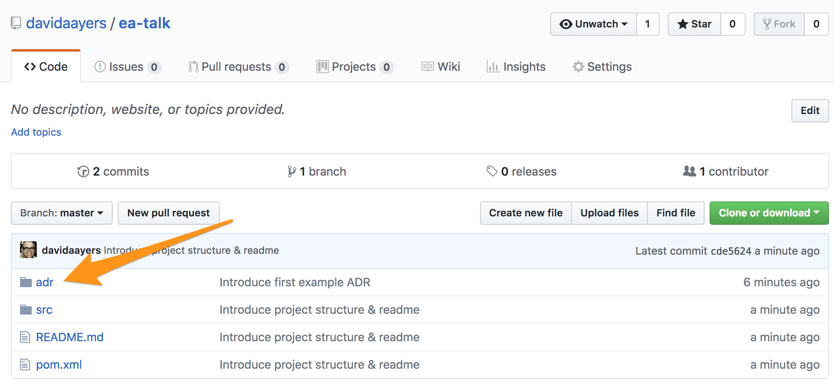
Saved in an “adr” folder with the project

Slide 25
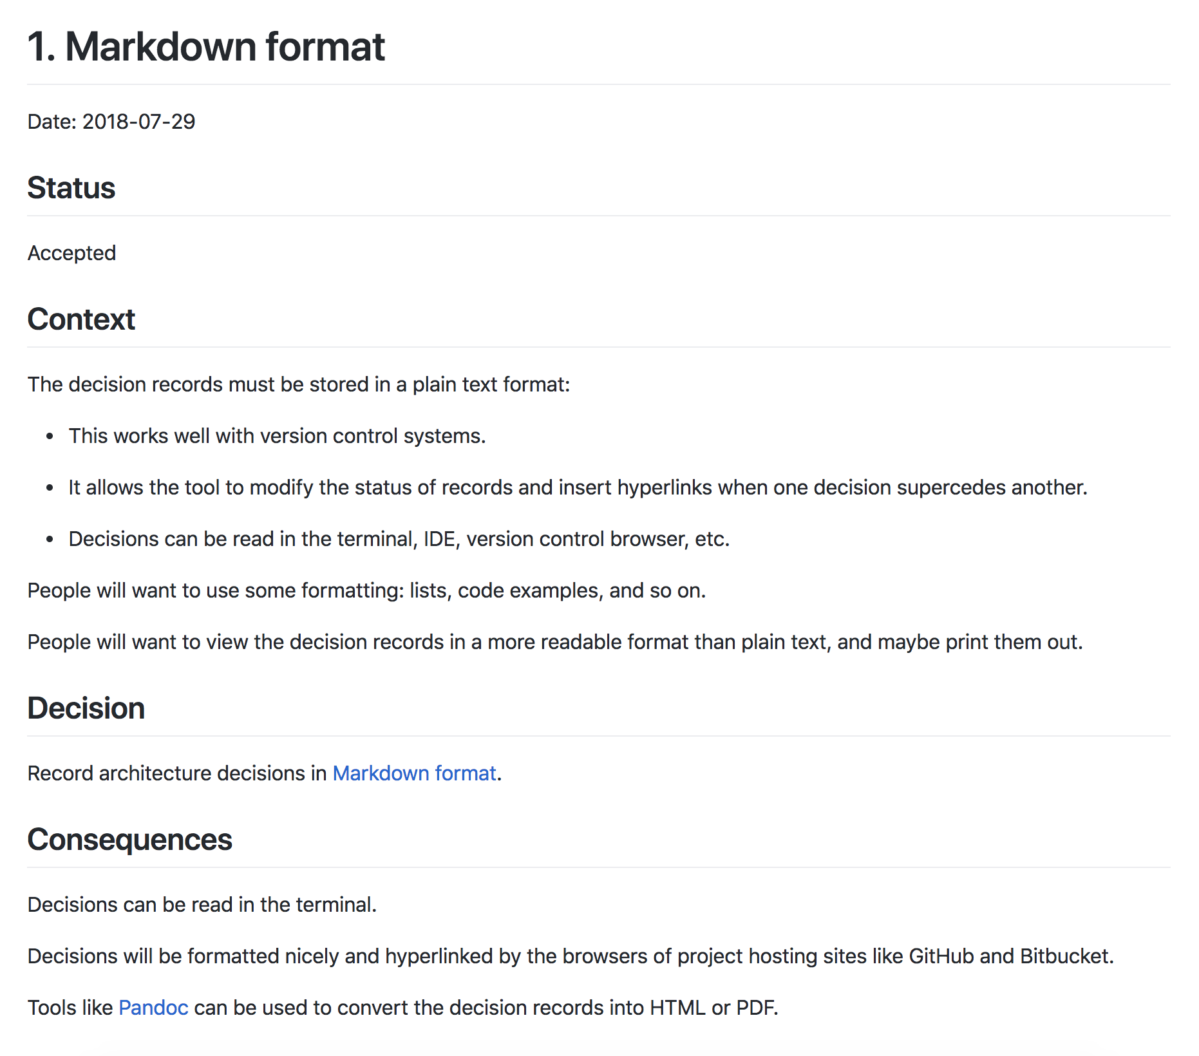
Notes:
Here’s an example ADR, which records our decision to use Markdown when creating ADRs. Meta enough?

Slide 26
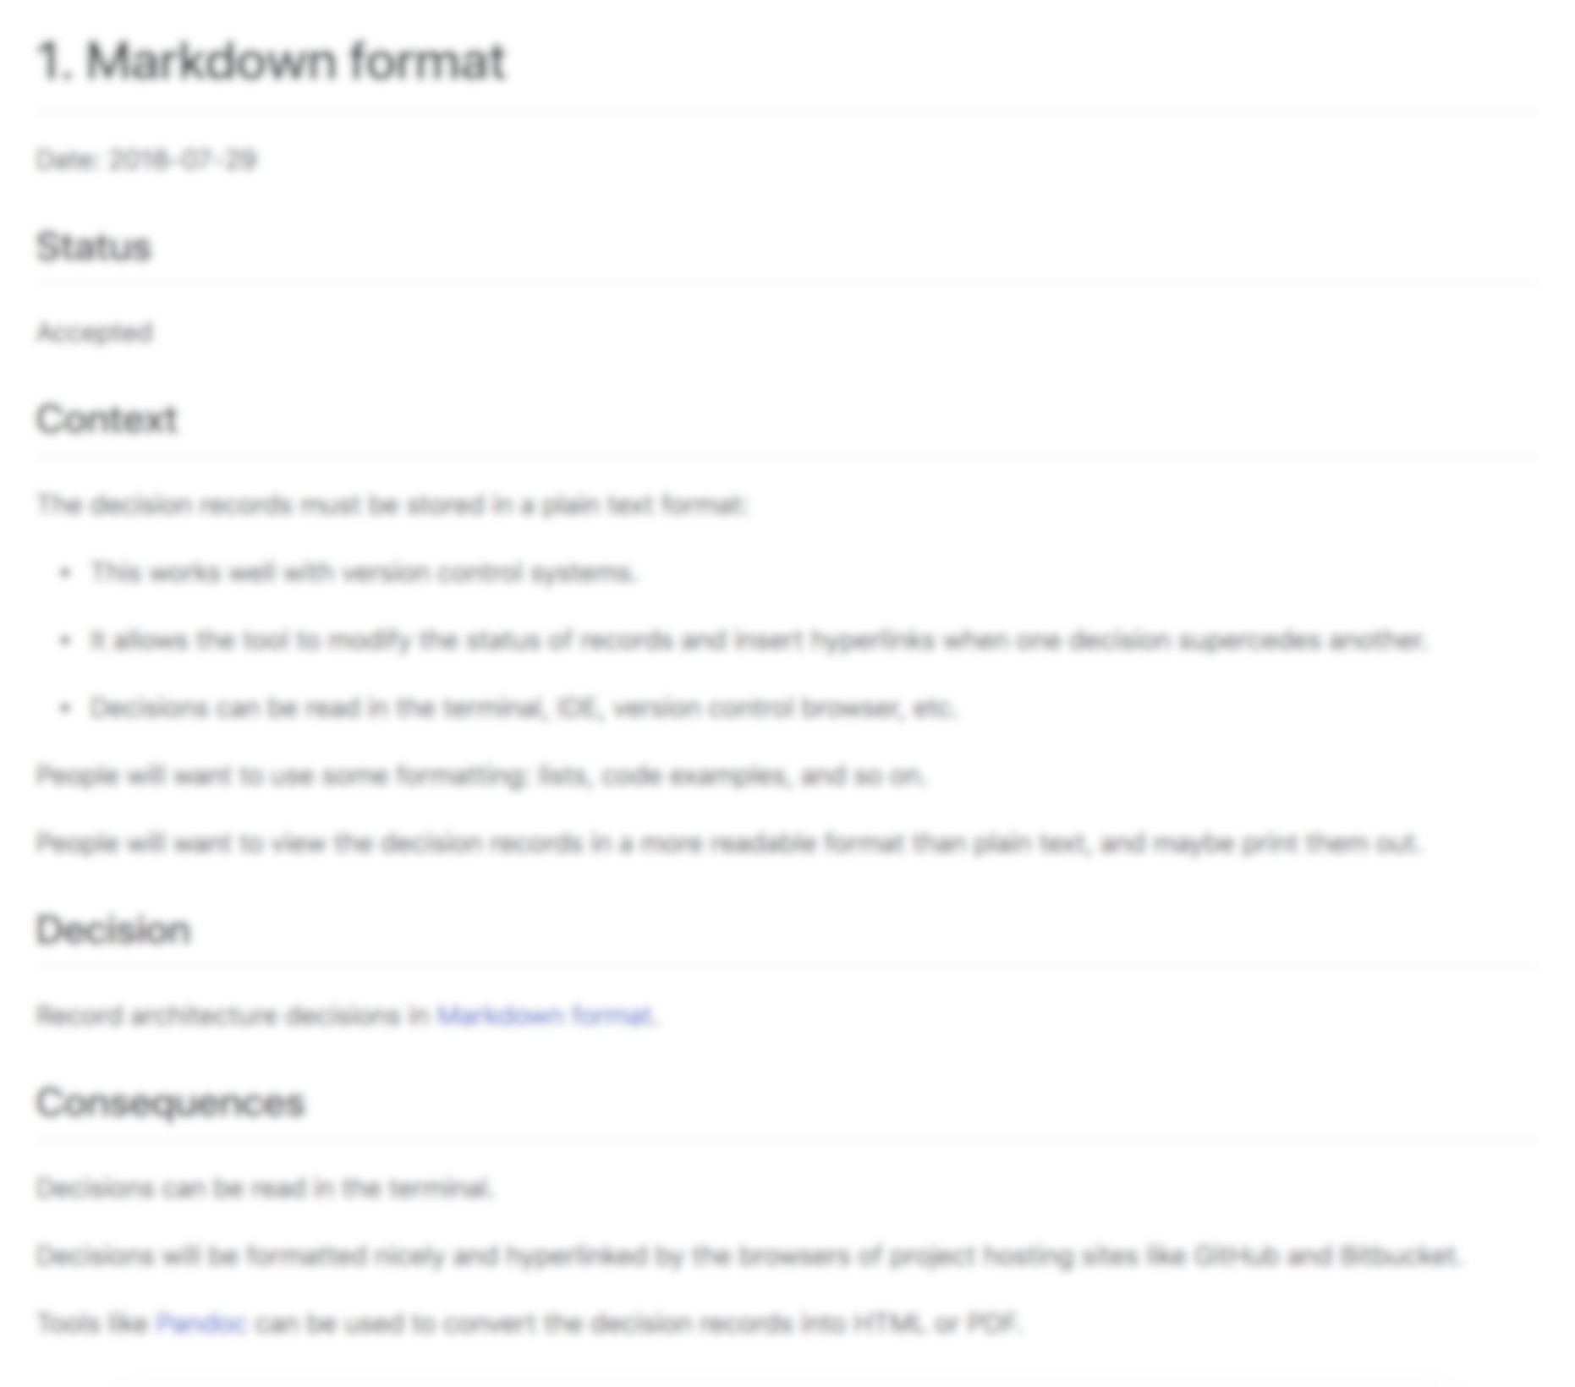
Title
Notes:
Titles are usually best expressed as simple noun phrases:
"Git for version control"
"LDAP for authentication"
"Spring MVC for web development"

Slide 27
Status
Notes:
One of
Proposed
Accepted
Superseded
Deprecated
Side note: The original idea around ADRs was that they were immutable.
This is one area where, in the past, we have deviated from the original ideas around ADRs. For superseded & deprecated ADRs, we either just changed the ADR itself, or moved it to an "archive" directory, to reduce the signal-to-noise ratio. Changing ADRs is fine, if you're storing them in source control.

Slide 28
Context
Notes:
Describes the forces at play, in a factual way. These forces can be technology-based, politically-based, culturally-based, project-based, etc. There is likely tension, and if so, the context should reflect that tension in a non-biased way.

Slide 29
Decision
Notes:
Most commonly stated as "We will..." and then the decision, or just a statement of the decision itself.

Slide 30
Consequences
Notes:
Every decision has consequences, for good or ill. Record them here.

Slide 31
SHORT AND TO THE POINT
Notes:
The entire ADR document should be no more than a page or two; after all, we're trying to keep these lightweight!

Slide 32
But what about overarching concerns that apply to more than one project?
Notes:
We also used ADRs to document and socialize Enterprise Architecture decisions. Sure, there are lots of ways that companies can do this, lots of systems to capture these kinds of things. But using the tools that most of the technology team was *already* using (i.e. text editors, source control, github), we exposed the decisions in a way that really wasn't seen before. In this context, the ADRs were things like:
"Git for version control"
"Code commit formatting"
"Docker for deployments"
"Ansible for orchestration"
"Vault for secret management"
These were kept in a special repo on github that existed just for EA ADRs.

Slide 33
Let’s look at some examples
Notes:
*Pull up some example Tech Arch ADRs*

Slide 34
Re-use existing code review processes
Notes:
For all types of ADRs, we used the Pull Request workflow, same as any regular code.
If you're not familiar with workflows like this, it's a common open source technique to review code that's "proposed" to be added to a codebase. Many enterprises have adopted this to add a layer of peer code review into their processes.
A new ADR was proposed by opening a pull request, and conversation and comments added to the ADR. It was then "adopted' when it was discussed in the Architecture Guild (which we'll discuss later).
If you aren’t using something like a pull request workflow for development, I highly recommend it. Maybe that can be your first ADR!

Slide 35

ADRs = Goodness
Notes:
ADRs proved to be a powerful tool that helped codify our decisions, and record them, which allowed them to be socialized much easier, and capturing the context behind the decisions helped us avoid problems that would have had us repeat mistakes of the past.

Slide 36

Socializing ADRs
Notes:
With large development organizations that have multiple teams, socializing the decisions that are documented can be a challenge. You have all of these great ADRs, but how do you get people to read them. I’ll talk in a minute about Architecture Guilds, which is one way, but socializing anything requires a multi-pronged approach.
At The Container Store, one of the things we did is create a regular newsletter to everyone in the department talking about the new or updated ADRs recently created, with links to the Github repo where the ADR was stored.

Slide 37
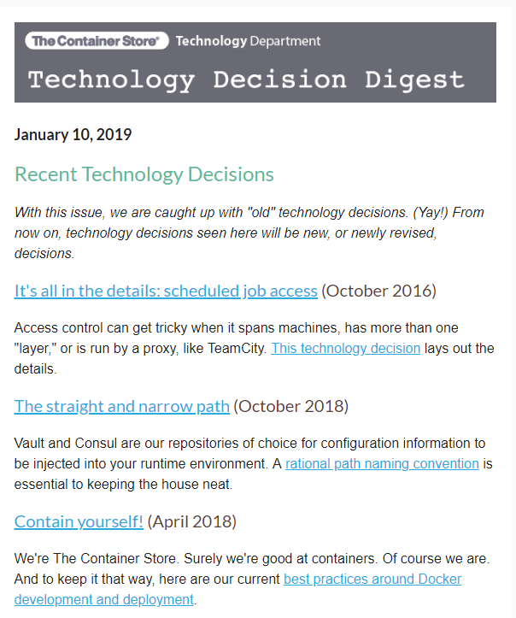

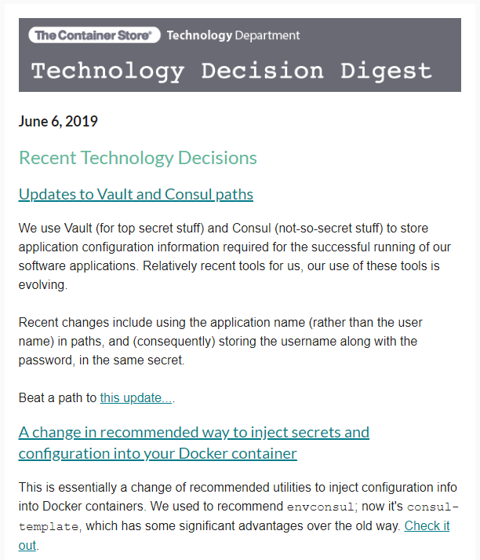

Slide 38
More praise for ADRs: ThoughtWorks Technology Radar
Notes:
Has anyone heard of this? Thoughworks puts this together every six months based on what they are seeing in the marketplace. Technically, they are a competitor to my company, so maybe I shouldn’t be talking about this, but…

Slide 39
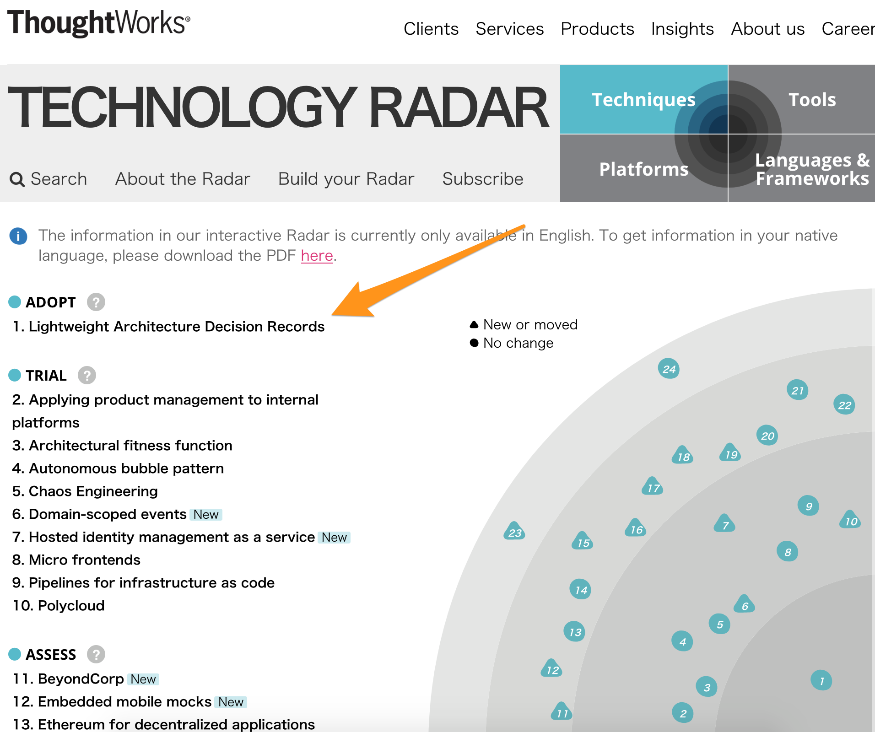
https://www.thoughtworks.com/radar/techniques
Notes:
Thoughtworks has also moved ADRs into “Adopt” in their technology radar, so the idea of using ADRs is gaining momentum in the world.

Slide 40
Lightweight Architectural Decision Records
Enterprise Architecture Guilds
Build Reference Implementations

Slide 41
New Approaches!
Notes:
So, many have adopted new approaches for teams,

Slide 42
Cross Functional!
Notes:
bringing together cross functional resources together on

Slide 43

Two Pizzas!
Notes:
two-pizza teams, and empowering them to solve real business problems,

Slide 44
Free Reign!
Notes:
and given them free reign to choose the best technologies to get the job done.

Slide 45




Notes:
And the Enterprise Architects are sad; all of that time trying to build standardized approaches and processes with the appropriate governance around them.
Obviously, every enterprise is different, and while this may not be the exact path you are on, there are likely similar challenges.
How do we make sure this doesn't just devolve into chaos?

Slide 46

Power to the People
https://labs.spotify.com/2014/03/27/spotify-engineering-culture-part-1
Notes:
One approach that worked very well for me in the past was to co-opt these agile teams, and give them a hand in helping craft the overall Enterprise Architecture for the company. We did this by forming a "Guild", a concept inspired by the work that Spotify has done and publicized around how they build their org structure.

Slide 47




Open To All
Notes:
The guild was open to anyone that wanted to attend, which sometimes made for big meetings, but it tended to self-regulate. People that were really interested stuck around, those that had a passing interest or were just curious about what's going on tended to stop coming.

Slide 48

Decision Making
Notes:
Obviously, such a large group is an inefficient way to make decisions. But, it's a great group for lively discussions around topics where lots of people have passions.
When it comes to actually making decisions, there were generally three paths:

Slide 49
#1 Write ADRs
Notes:
A short term, tactical decision needs to be made. Identify 3-4 people who are passionate and task them with drafting an ADR to be presented back to the guild. If there is an obvious champion for this decision, appoint them to lead the group.

Slide 50
#2 Form Short-Term SIGs
Notes:
For longer term, strategic or structural decisions, identify a group of people (no more than 8-10) and create a short-term Special Interest Group. This SIG is tasked with researching, prototyping, spiking for whatever the topic is. These short-term SIGs will usually produce one or two deliverables. One, for sure, will be at least on ADR proposing a decisions (sometimes there are multiple ADRs that come out of one of these short-term SIGs). The other deliverable can be something like a reference implementation of a particular technology, something I'll discuss in more depth later.

Slide 51
#3 Long Running SIGs
Notes:
Long running SIGs around areas of interest; these usually ended up being around languages or practices, like a Java SIG, a Ruby SIG, a Database Development SIG, etc. If there was some decision that related to something where a SIG already existed, the decision was delegated to them. For example, how to handle Java upgrades with the recent changes Oracle has made to their long-term support model. Just like short-term SIGs, the deliverables would be ADRs or reference implementations. A special deliverable of these kinds of SIGs are things like code standards & shared libraries. Yes, I believe you should argue tabs vs. spaces, and agree on standards that can be codified in linting tools that enforce those standards. And that's what these SIGs did, among other things.

Slide 52
What about the “Architecture Review Board”?
Notes:
Instead of an "Architecture Review Board", architectural decisions were brought before the guild for discussion and adoption. The Guild had "high ranking" technology folks, so if it was ever necessary for someone to serve as a tiebreaker, they were there to do that. But it almost never came down to it. As I said earlier, people generally make good decisions, and when it comes down to it, people want the best for the company and the environment that they work in day-to-day.

Slide 53
The Guild helped with one of the hardest problems: Socializing Decisions
Notes:
The guild also served another important purpose. The participants really felt like they were helping form the Architecture for the Enterprise, and they became evangelists, spreading the word to their peers about the decisions that were being made. It wasn't a silver bullet to socialize decisions, but it helped a lot. The guild would also present on a regular basis at our "all-hands" meetings, covering important topics, new decisions, reminders of best practices, etc.

Slide 54
What did these meetings look like?
Notes:
Each guild meeting started with a set agenda

Slide 55
Reports from each SIG on the work they have done
Discussion on short-term SIGs and should they continue or not
Review and discuss open ADRs, either 1) voting to adopt, or 2) sending back for more work & discussion
Open discussion
Notes:
This open discussion time often proved to be the most interesting. Someone would bring up a topic that applied to the Guild, and there would be lively discussion and debate, often ending with action items delegated to an existing SIG, or the formation of a new, short-term SIG.
All in all, the Enterprise Architecture guild proved to be a powerful tool to help bring some order to a potentially chaotic world.

Slide 56
Architecture Guilds in the wild

Slide 57
Comcast
800 People across Comcast participate
Modeled on IETF hierarchy with steering group and working groups
Each working group has a charter as a markdown doc in Github, and a
dedicated chat channel in Slack
Working groups responsible for building ADRs to express their findings
https://www.infoq.com/articles/architecture-guild-800-friends/

Slide 58
Comcast
Benefits Comcast found:
The emergence of an architecture and design community
Acceleration of decision making
Crowd sourcing of Working Group charters
https://www.infoq.com/articles/architecture-guild-800-friends/

Slide 59
Lightweight Architectural Decision Records
Enterprise Architecture Guilds
Build Reference Implementations
Notes:
As noted above, one of the jobs of the SIGs is to "create reference implementations". What does this mean?
Here's an example, based on my experience.

Slide 60
Docker
Vault
Consul
Java
Spring Boot
Notes:
A company I worked for had established Docker as our deployment platform (everything deployed is a container) with Vault for secret management, and Consul for service discovery and key/value store. There were a large number of Java developers, and their SIG had settled on Spring Boot as their preferred microservice platform.

Slide 61
Complex Environment? You betcha
Notes:
This is a complex environment, with many moving pieces, so that SIG worked together to create a "base" reference implementation that took care of wiring all of the proper pieces together. A greenfield project could "copy" the reference implementation, and get a bunch of stuff for "free",

Slide 62
Reference Application Baked In Best Practices
Notes:
with all of the right things set up to take advantage of Vault & Consul, as well as anything else defined as part of our approach to application development (linting rules, static code analysis, security, etc).

Slide 63
Linting Rules

Slide 64
Static Code Analysis

Slide 65
Security
Notes:
with all of the right things set up to take advantage of Vault & Consul, as well as anything else defined as part of our approach to application development (linting rules, static code analysis, security, etc).

Slide 66
Everything you need to get started just writing code

Slide 67
Did It Work?
Notes:
In the real world, this reference implementation really did help accelerate our progress. Just like the best frameworks are opinionated, our reference implementation was opinionated -- it baked in the best opinions of the Enterprise Architecture Guild & the Java SIG into a consumable unit, rather than those opinions only being expressed in ADRs or other documentation. Seeing the opinions expressed as a reference implementation is very powerful, and helps show how abstract ideas are made into concrete implementations.

Slide 68
Other Reference Implementations
Notes:
At that company, we were also developing Node.js applications and Ruby/Rails applications, and reference implementations were created for those as well that expressed the same Docker-based concepts, but specific to those other languages.

Slide 69
Implicit Commitment to Maintain
Notes:
If you begin building reference applications, there is an implicit commitment to maintaining them. As new standards emerge -- and they will -- these reference implementations need to be kept up to date so the opinions they express stay in line with the standards that evolving for the Enterprise.

Slide 70
Well Worth the Effort
Notes:
But the benefits are well worth the cost of maintenance. Beyond serving as a kick start for new projects, and giving examples of standards in the form of actual code, these reference implementations serve as a way to guide people to follow the well-worn paths of those that have gone in front of them. In our environment, teams were allowed (pretty much) to choose to use the technology they wanted (with discussion & agreement in the Guild first), but if someone wanted to build an application in Grails or Go, they would have to "invent" all of the solutions that were already baked into the reference applications to interact with the rest of the Enterprise. It wasn't an explicit deterrent, per-se, but it did tend to focus people's efforts in making the existing tech stacks more robust, rather than introducing new tech stacks.

Slide 71
Bonus Technique: Tracer Bullet/Steel Thread
Notes:
A great technique for this is a "tracer bullet"; minimal functionality that exercises all of the seams between teams in a project. It doesn't have to be fully functional, but it does actually have to interact with each system that will be present in the final solution. Doing this early, as part of the project inception, gives the team a strong foundation to build on for the rest of the project, and it usually exposes things that weren't properly thought out (that can lead to ADRs for the project!).

Slide 72
Thanks for your time!
Notes:
As I said at the beginning, Enterprise Architecture is at a crossroads, especially in organizations which do a lot of custom software development. This may sounds like hyperbole, but I think the tensions between these new ways of doing things and the "traditional" approach to Enterprise Architecture are very real.
I think that Enterprise Architecture professionals need to look at techniques like the ones I have presented here, and look to add them to their professional "toolbox". This doesn't mean abandoning "traditional" approaches. I'm suggesting an evolution, not a revolution. But change is going to be necessary, because the rest of technology is changing, whether we like it or not.
Hopefully I've given you some idea to think about and maybe adopt. Thank you for your time!

Slide 73
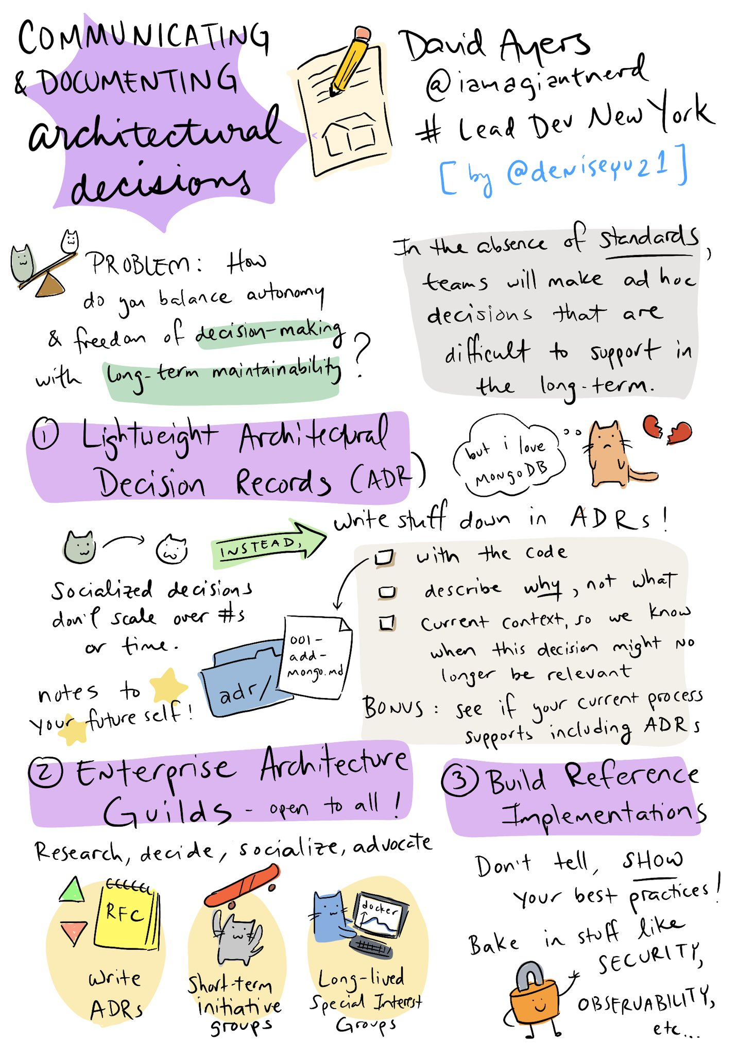
Shout out! Special thanks to @deniseyu21 for this awesome sketchnote of this talk!

Slide 74
Communicating and Documenting Architectural Decisions
https://github.com/davidaayers/comm-and-doc-arch-decisions
David Ayers, Group VP of Technology, Leslie’s Poolmart
iamagiantnerd@gmail.com
@iamagiantnerd
Icons by Adioma (https://adioma.com) and Joypixels (https://joypixels.com)

