Slide 1
Enterprise Architecture in a DevOps Time
https://github.com/davidaayers/ea-talk
David Ayers, Group VP of Technology, Leslie’s Poolmart
iamagiantnerd@gmail.com
@iamagiantnerd

Slide 2
Who am I, and why should you listen to me?
Technology leader with 20+ years of experience building solutions to complex problems
Group VP of Technology for Leslie’s Poolmart
Former VP of Technology for The Container Store
Believer & advocate for technology-as-craft
Giant Nerd

Slide 3
“May you live in interesting times”
-- Not an ancient Chinese curse, according to Wikipedia
Notes:
We do live in interesting times. Technology is changing at an ever increasing pace, and Enterprise Architecture is not immune.
Enterprise Architecture is at a crossroads, especially in organizations which do a lot of custom software development. The DevOps movement, combined with design thinking and agile organizational design has left a lot of Enterprise Architecture professionals scratching their head on how they can add value and continue to provide governance and guidance to the technology teams. At the same time, many companies are just now starting to create EA practices, to start to put their arms around technology sprawl.
But before we dig into how Enterprise Architecture needs to change, let's try to come to a common understanding.

Slide 4
What is Enterprise Architecture?
Notes:
What I have found is that Enterprise Architecture is defined very differently for many different companies.
For two years I was part of a group of people in "Chief Architect" roles in companies across many different industries. Each meeting, someone would be responsible for coming up with a topic, and we had great, lively discussions.
After meeting for about a year, someone “wait a minute, what do YOU think Enterprise Architecture is??”. Everyone had a different idea.
If you google "what is enterprise architecture", you get over
**SLIDE**

Slide 5
72 Million Results
Notes:
72 million results.
To be fair, most of these are links to Gartner or Forester reports.
In preparing for this talk, I read through all 72 million results to try to find the answer. Ok not really, but I did read through a bunch of them for a definition, found one that I think fit well, and cut-and-pasted it into this presentation:

Slide 6
“The goal of enterprise architecture is to create a unified IT environment (standardized hardware and software systems) across the firm or all of the firm's business units, with tight symbiotic links to the business side of the organization and its strategy”
http://www.ittoday.info/Articles/What_Is_Enterprise_Architecture.htm

Slide 7
Two Problems
Notes:
In my opinion, there are two problems with this view

Slide 8
Enterprises are messy things
Notes:
First, every enterprise is a mess.
If you have managed to create a "unified IT environment" with "standardized hardware and software systems", you are in the minority of enterprises (and you are probably leaving new, important capabilities by the wayside)
Most companies have to deal with a mishmash of disparate systems, with varying degrees of integration (if any), often with lots of custom developed code gluing everything together. Given this
***amorphous pool of technology***,
the lofty goal of a "unified IT environment" is very difficult to achieve, and the road to unification is filled with compromises -- some of which are practical and pragmatic, others, not so much.

Slide 9
We have learned new ways of doing things
Notes:
Second, as I said in the introduction, we have learned new ways of doing things. In today's world, teams are building using customer feedback, apply design thinking to guide product & feature development, and using agile methodologies, and wrapping them all in a brand new DevOps delivery methodology, and many advocates say that teams should be able to freely choose their technology stacks.
These new ways of doing things also fall along a continuum – some organizations are more open and able to allow a more homogenous environment, others are not. No matter where you are along this continuum, the one thing that’s constant is change. You will use technologies a year from now that you’re not using today. Teams will want to try things that make their delivery more efficient. Your approach to EA will need to be able to evolve along with technology.

Slide 10

The Curious Case of MongoDB
Notes:
A quick example to illustrate the problem:
We had a team that decided that the best database to use was MongoDB. They talked to a guy on the ops side, who was super accommodating and set up something. They proceeded to build an application (with a tight deadline and large financial impact if we didn’t hit the deadline), and it worked great.
But when it was time to go into production, they hadn’t worked out all of the details with the ops team. They hadn’t socialized their decision properly, nor had they had any sort of “oversight” on their decision to use Mongo.
None of what they did was objectively wrong, but it surfaced a problem: How should we go about avoid stuff like this in the future? What techniques can we use to mitigate issues like this, while at the same time providing flexibility to the teams that are building things?

Slide 11
Fundamental Dilemma
Notes:
So, there is a fundamental dilemma and tension between these new ways of doing things and traditional thinking about Enterprise Architecture

Slide 12

Agile methods are architecturally weak, disconnected from the realities of delivering large systems in complex enterprise environments!
Enterprise Architect
Notes:
On the one hand, many Enterprise Architects are trying to "hold the line" and are skeptical of change, scared of technology sprawl.

Slide 13

Architecture processes are slow, clumsy and bureaucratic. They would benefit from a more agile approach!
Agile Developer
Notes:
On the other hand, Agile/Devops people thing traditional Enterprise Architecture just shackles their ability to move forward.

Slide 14
EVOLUTION
We need to evolve our thinking together!
Notes:
For all of these reasons, Enterprise Architecture is at a crossroads, and must evolve. We need a new definition for these dangerous times.
So I went back through those 72 million results, and found a different one that I thing better describes where we need to go.

Slide 15
“In an agile world, where architectures evolve through the work of empowered teams, EA should play a hands-on role, facilitating reuse and guiding the enterprise to a flexible, agile architecture.”
--Mark Schwartz, author and former CIO of US Citizenship and Immigration Services
https://enterprisersproject.com/article/2017/7/devops-requires-dumping-old-it-leadership-ideas
Notes:
Author of several books, currently works at AWS:
“A seat at the table”
“The art of business value”
Obviously, Mark has a lot of experience in complex environments.

Slide 16
What does this mean?
Notes:
More specifically, what does this mean about our roles as architects?

Slide 17
4 Areas
Notes:
I think there are four main areas about how Enterprise Architects approach their work that need to evolve for this new world:

Slide 18
#1 Facilitate & socialize best practices & common understandings
Notes:
Instead of constraining teams by rigorous “standards", Enterprise Architecture needs to facilitate and socialize common understanding and help build best practices. Socialization is usually the hard part.

Slide 19
#2 Lifeguards & Swimming Coaches
Notes:
The "amorphous pool of technology" that are most enterprises also presents an opportunity for Enterprise Architects to serve as a lifeguards & swimming coaches. With the right techniques, Enterprise Architecture can become a powerful voice that can have great influence in a technology organization, without becoming the “standards enforcers”.

Slide 20
#3 Trust
Notes:
Only by building trust between EA & the rest of the technology group will you help really achieve your goals. If EA as seen as the “standards enforcers”, there isn’t going to be a strong relationship there.
People want to make the enterprise better. They want to be craftspeople. We need to find ways to embrace that, not tamp it down.

Slide 21
#4 Enterprise Architecture: The Team Sport
Notes:
I also think that Enterprise Architects can help build a culture of caring about technology as a craft,
leverage the group of smart people around you to help build a strong Enterprise Architecture mindset that spreads out beyond just the people in Enterprise Architecture.
Enterprise Architecture unfairly gets a bad rap of "Ivory Tower" architecture (and I know that doesn't really apply much anymore), and even though most Enterprise Architecture folks aren't really like this (anymore), that's still the unfortunate view many people have of Enterprise Architecture. By making everyone care about Enterprise Architecture, we can begin to change this view.

Slide 22
5 Techniques
Notes:
We’ve talked about things that need to change, now I’m going to talk through give techniques and approaches that I have seen be successful.
Think of these as recipes – they can be adjusted as necessary, and you can pick and choose which might work best in your environment – although several of them are self-reinforcing and work well together.

Slide 23
Lightweight Architectural Decision Records
Enterprise Architecture Guilds
Build Reference Implementations
Get in the pool and swim around
Focus on Teams & Seams
Notes:
These are the five techniques I'm going to cover in the rest of the presentation.

Slide 24
Lightweight Architectural Decision Records
Enterprise Architecture Guilds
Build Reference Implementations
Get in the pool and swim around
Focus on Teams & Seams

Slide 25
“Why did we decide to do it this way?”
-- Every developer in history, twelve months after making a decision
Notes:
As technologists, we make architectural decisions all of the time.

Slide 26
We aren’t good at:
Notes:
But what we're not good at doing is:

Slide 27
Socializing Decisions
Notes:
We're not good at socializing these decisions though the team/department (whoever participated in the discussion has the context, everyone else is out of luck!)

Slide 28

Recording Decisions
Notes:
We're not good at recording the decisions, and more importantly, the *context* behind the decisions, in a way that our future selves (or anyone -- someone just joining the team, for example) can look back and understand *why* the decision was made and what the factors that went into the decision were. Most of these decisions are well thought out and carefully considered, taking in all the pros and cons of a given situation, but usually that context is lost forever.

Slide 29
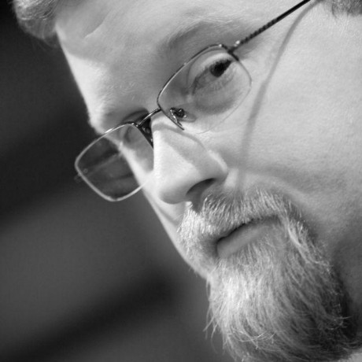
ADRs (Architectural Decision Records)
Michael Nygard
@mtnygard
Notes:
Enter Architectural Decision Records (ADRs). First proposed by Michael Nygard, Architectural Decision Records provide a way to capture these decisions as part of the codebase that's being working on; where the rubber meets the road.
There’s a special case for decisions that span projects or the entire enterprise, I’ll get to that in a few minutes.

Slide 30
Aren’t well documented
Notes:
All too often, decisions that are made aren't well documented, and if they are, it's usually in some written document on a shared drive somewhere,

Slide 31

Wiki pages, where documents go to die
Notes:
or in a poorly organized wiki page.
The idea of putting a record of these types of decisions *SLIDE*

Slide 32
Right in the codebase! Brilliant!
Notes:
*right in the codebase* really resonated with me, and starts to nibble away at one of the problems I talked about earlier -- socializing best practices and decisions. Putting them right in the codebase where people are working every day can make it very relevant for a particular project.

Slide 33
But why?
Notes:
Why should we document decisions like this?
As I said earlier; one of the most important reasons is to capture the *context* behind decisions. Which is incredibly worthwhile when someone on the team wants (or needs) to make a change. As Michael Nygard explained in his article introducing ADRs:

Slide 34

I’d like to make a change!
Notes:
Let's say someone wants to make a change, and there is no context about why the original decision was made. They can either:

Slide 35
Oh well, I guess they knew better
Notes:
Blindly accept the original decision. Which might be ok, if it was a good decision to begin with. But maybe the context has changed, and without any record of that context, doing nothing may be a mistake.

Slide 36

I’ll just go ahead and change things!
Notes:
Blindly change the decision. Which also might be ok, but maybe there is a crucial fact about the new decision (some non-functional requirement, for example) that was considered and ultimately discarded for reasons which are still valid.

Slide 37
Anatomy of an ADR

Slide 38
Text Document, usually Markdown
https://daringfireball.net/projects/markdown/
Notes:
Markdown is a lightweight markup language that creates human readable text documents, but can be rendered by many different engines as HTML pages.

Slide 39
One ADR per file
Notes:
An ADR is saved in a file that contains an incrementing sequence, one for each ADR, for example:

Slide 40
0001-git-for-version-control.md

Slide 41
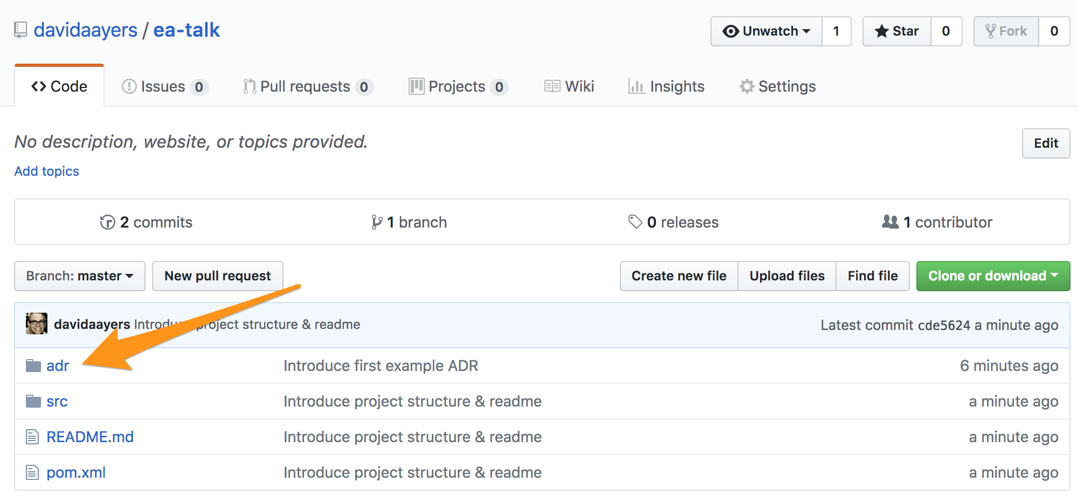
Saved in an “adr” folder with the project

Slide 42
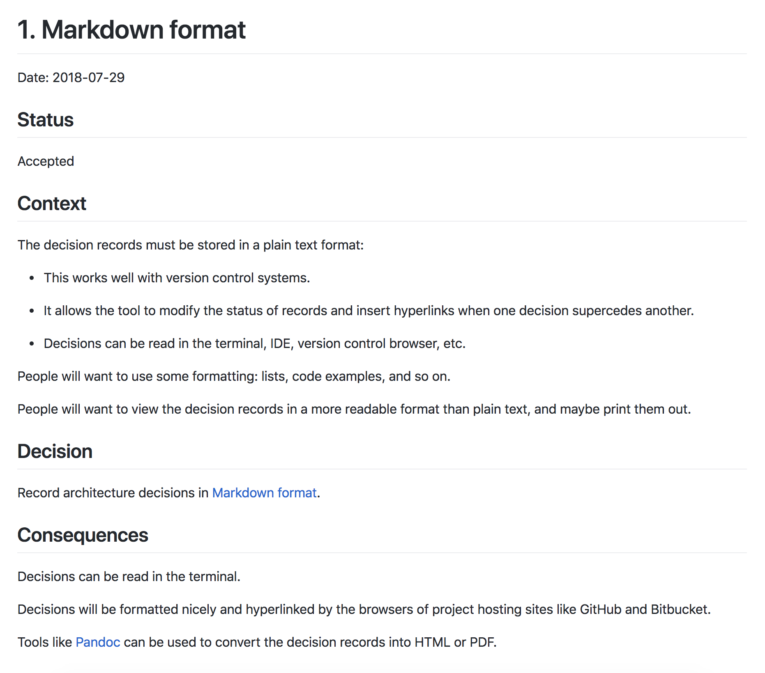
Notes:
Here’s an example ADR, which records our decision to use Markdown when creating ADRs. Meta enough?

Slide 43
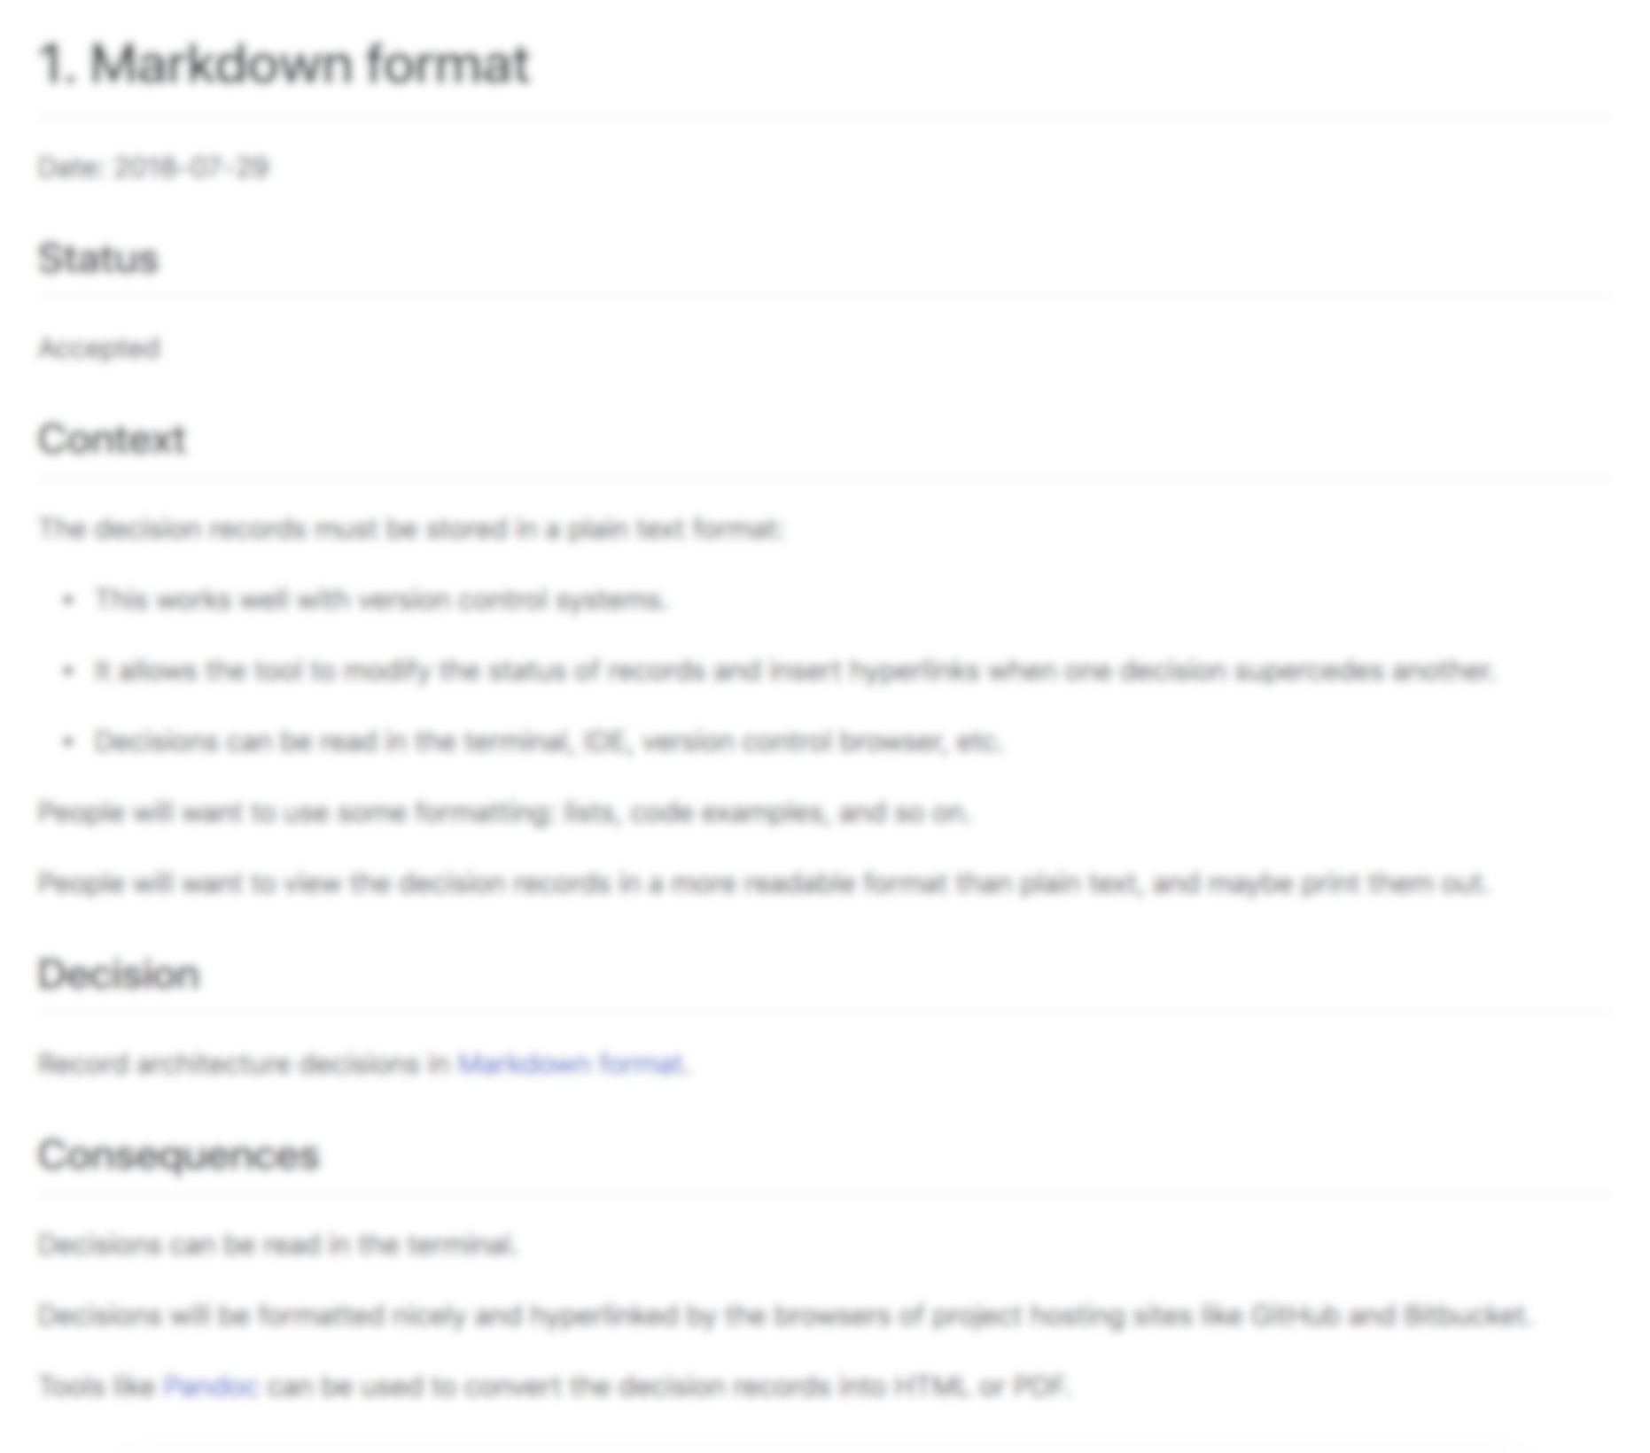
Title
Notes:
Titles are usually best expressed as simple noun phrases:
"Git for version control"
"LDAP for authentication"
"Spring MVC for web development"

Slide 44
Status
Notes:
One of
Proposed
Accepted
Superseded
Deprecated
Side note: The original idea around ADRs was that they were immutable.
This is one area where, in the past, we have deviated from the original ideas around ADRs. For superseded & deprecated ADRs, we either just changed the ADR itself, or moved it to an "archive" directory, to reduce the signal-to-noise ratio. Changing ADRs is fine, if you're storing them in source control.

Slide 45
Context
Notes:
Describes the forces at play, in a factual way. These forces can be technology-based, politically-based, culturally-based, project-based, etc. There is likely tension, and if so, the context should reflect that tension in a non-biased way.

Slide 46
Decision
Notes:
Most commonly stated as "We will..." and then the decision, or just a statement of the decision itself.

Slide 47
Consequences
Notes:
Every decision has consequences, for good or ill. Record them here.

Slide 48
SHORT AND TO THE POINT
Notes:
The entire ADR document should be no more than a page or two; after all, we're trying to keep these lightweight!

Slide 49
But what about overarching concerns that apply to more than one project?
Notes:
We also used ADRs to document and socialize Enterprise Architecture decisions. Sure, there are lots of ways that companies can do this, lots of systems to capture these kinds of things. But using the tools that most of the technology team was *already* using (i.e. text editors, source control, github), we exposed the decisions in a way that really wasn't seen before. In this context, the ADRs were things like:
"Git for version control"
"Code commit formatting"
"Docker for deployments"
"Ansible for orchestration"
"Vault for secret management"
These were kept in a special repo on github that existed just for EA ADRs.

Slide 50
Let’s look at some examples!
Notes:
*Pull up Examples*

Slide 51
Re-use existing code review processes
Notes:
For all types of ADRs, we used the Pull Request workflow, same as any regular code.
If you're not familiar with workflows like this, it's a common open source technique to review code that's "proposed" to be added to a codebase. Many enterprises have adopted this to add a layer of peer code review into their processes.
A new ADR was proposed by opening a pull request, and conversation and comments added to the ADR. It was then "adopted' when it was discussed in the Architecture Guild (which we'll discuss later).
If you aren’t using something like a pull request workflow for development, I highly recommend it. Maybe that can be your first ADR!

Slide 52

ADRs = Goodness
Notes:
ADRs proved to be a powerful tool that helped codify our decisions, and record them, which allowed them to be socialized much easier, and capturing the context behind the decisions helped us avoid problems that would have had us repeat mistakes of the past.

Slide 53

Socializing ADRs
Notes:
ADRs proved to be a powerful tool that helped codify our decisions, and record them, which allowed them to be socialized much easier, and capturing the context behind the decisions helped us avoid problems that would have had us repeat mistakes of the past.

Slide 54
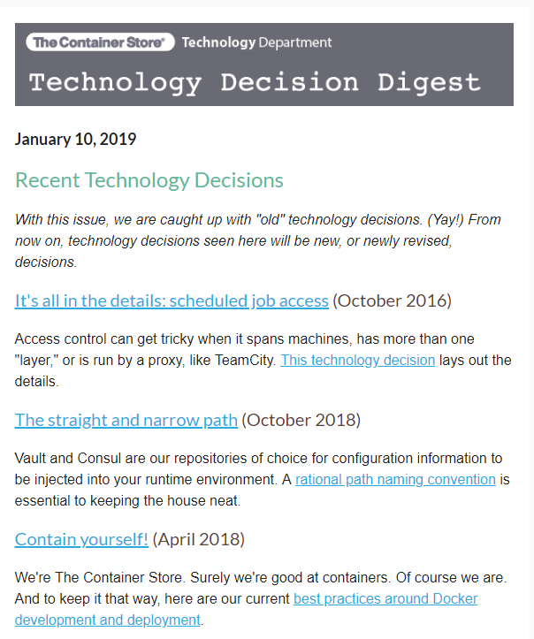
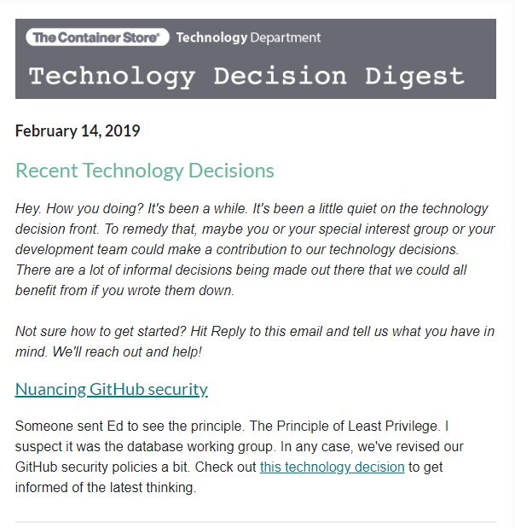
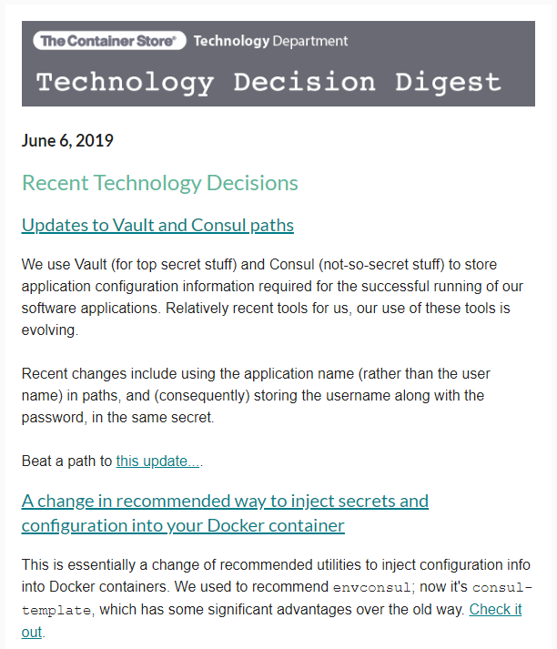

Slide 55
More praise for ADRs: ThoughtWorks Technology Radar
Notes:
Has anyone heard of this? Thoughworks puts this together every six months based on what they are seeing in the marketplace. Technically, they are a competitor to my company, so maybe I shouldn’t be talking about this, but…

Slide 56
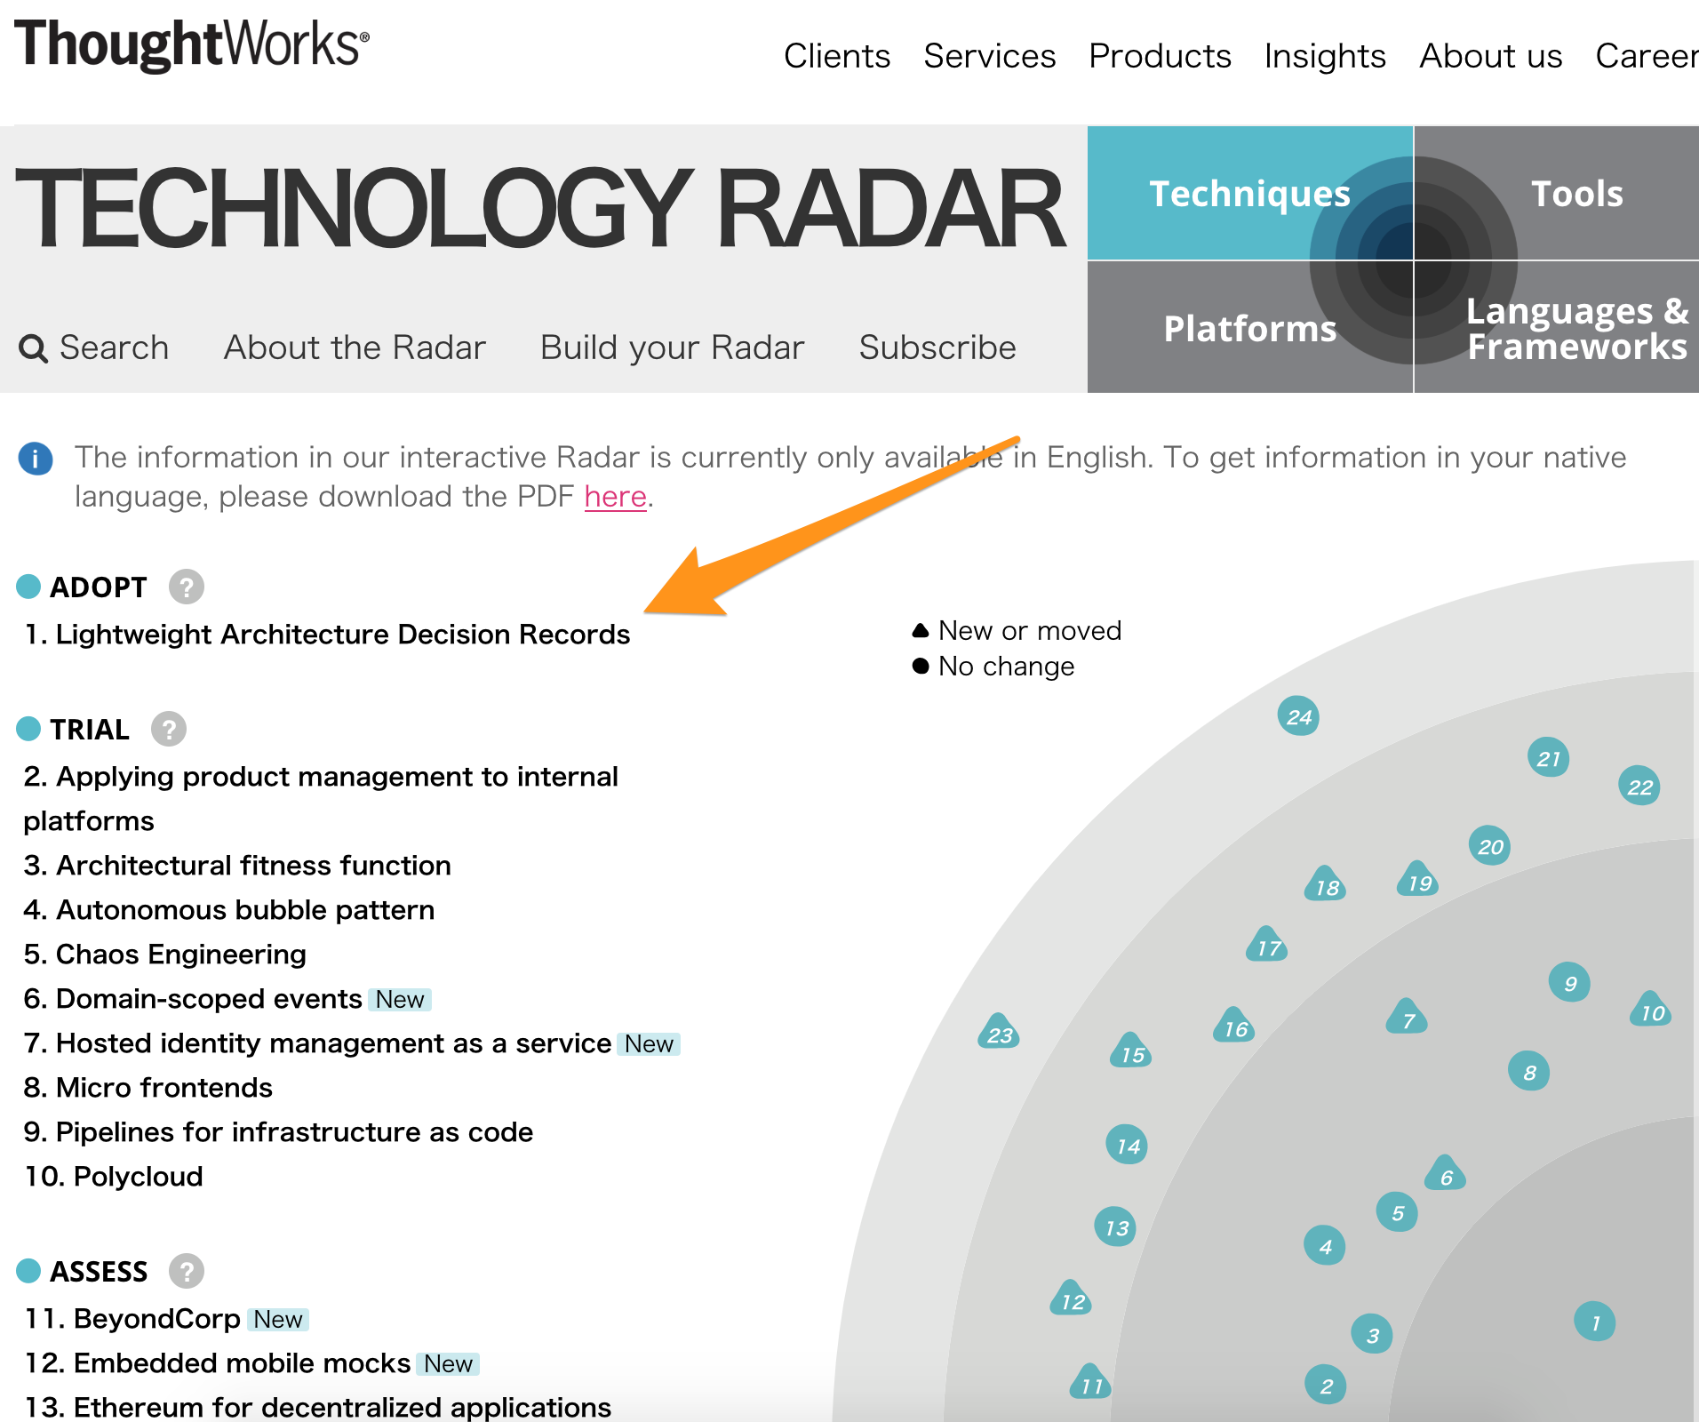
https://www.thoughtworks.com/radar/techniques
Notes:
Thoughtworks has also moved ADRs into “Adopt” in their technology radar, so the idea of using ADRs is gaining momentum in the world.

Slide 57
Lightweight Architectural Decision Records
Enterprise Architecture Guilds
Build Reference Implementations
Get in the pool and swim around
Focus on Teams & Seams

Slide 58
New Approaches!
Notes:
So, many have adopted new approaches for teams,

Slide 59
Cross Functional!
Notes:
bringing together cross functional resources together on

Slide 60

Two Pizzas!
Notes:
two-pizza teams, and empowering them to solve real business problems,

Slide 61
Free Reign!
Notes:
and given them free reign to choose the best technologies to get the job done.

Slide 62




Notes:
And the Enterprise Architects are sad; all of that time trying to build standardized approaches and processes with the appropriate governance around them.
Obviously, every enterprise is different, and while this may not be the exact path you are on, there are likely similar challenges.
How do we make sure this doesn't just devolve into chaos?

Slide 63

Power to the People
https://labs.spotify.com/2014/03/27/spotify-engineering-culture-part-1
Notes:
One approach that worked very well for me in the past was to co-opt these agile teams, and give them a hand in helping craft the overall Enterprise Architecture for the company. We did this by forming a "Guild", a concept inspired by the work that Spotify has done and publicized around how they build their org structure.

Slide 64




Open To All
Notes:
The guild was open to anyone that wanted to attend, which sometimes made for big meetings, but it tended to self-regulate. People that were really interested stuck around, those that had a passing interest or were just curious about what's going on tended to stop coming.

Slide 65

Decision Making
Notes:
Obviously, such a large group is an inefficient way to make decisions. But, it's a great group for lively discussions around topics where lots of people have passions.
When it comes to actually making decisions, there were generally three paths:

Slide 66
#1 Write ADRs
Notes:
A short term, tactical decision needs to be made. Identify 3-4 people who are passionate and task them with drafting an ADR to be presented back to the guild. If there is an obvious champion for this decision, appoint them to lead the group.

Slide 67
#2 Form Short-Term SIGs
Notes:
For longer term, strategic or structural decisions, identify a group of people (no more than 8-10) and create a short-term Special Interest Group. This SIG is tasked with researching, prototyping, spiking for whatever the topic is. These short-term SIGs will usually produce one or two deliverables. One, for sure, will be at least on ADR proposing a decisions (sometimes there are multiple ADRs that come out of one of these short-term SIGs). The other deliverable can be something like a reference implementation of a particular technology, something I'll discuss in more depth later.

Slide 68
#3 Long Running SIGs
Notes:
Long running SIGs around areas of interest; these usually ended up being around languages or practices, like a Java SIG, a Ruby SIG, a Database Development SIG, etc. If there was some decision that related to something where a SIG already existed, the decision was delegated to them. For example, how to handle Java upgrades with the recent changes Oracle has made to their long-term support model. Just like short-term SIGs, the deliverables would be ADRs or reference implementations. A special deliverable of these kinds of SIGs are things like code standards & shared libraries. Yes, I believe you should argue tabs vs. spaces, and agree on standards that can be codified in linting tools that enforce those standards. And that's what these SIGs did, among other things.

Slide 69
SIGs = Great Places to embed Enterprise Architects
Notes:
These SIGs are great places to embed Enterprise Architecture folks, especially as it related to reference implementations. I'll talk about this more later, but this is a great opportunity for Enterprise Architects to jump back into the pool and swim around a bit, flexing those practitioner muscles.

Slide 70
What about the “Architecture Review Board”?
Notes:
Instead of an "Architecture Review Board", architectural decisions were brought before the guild for discussion and adoption. The Guild had "high ranking" technology folks, so if it was ever necessary for someone to serve as a tiebreaker, they were there to do that. But it almost never came down to it. As I said earlier, people generally make good decisions, and when it comes down to it, people want the best for the company and the environment that they work in day-to-day.

Slide 71
The Guild helped with one of the hardest problems: Socializing Decisions
Notes:
The guild also served another important purpose. The participants really felt like they were helping form the Architecture for the Enterprise, and they became evangelists, spreading the word to their peers about the decisions that were being made. It wasn't a silver bullet to socialize decisions, but it helped a lot. The guild would also present on a regular basis at our "all-hands" meetings, covering important topics, new decisions, reminders of best practices, etc.

Slide 72
What did these meetings look like?
Notes:
Each guild meeting started with a set agenda

Slide 73
Reports from each SIG on the work they have done
Discussion on short-term SIGs and should they continue or not
Review and discuss open ADRs, either 1) voting to adopt, or 2) sending back for more work & discussion
Open discussion
Notes:
This open discussion time often proved to be the most interesting. Someone would bring up a topic that applied to the Guild, and there would be lively discussion and debate, often ending with action items delegated to an existing SIG, or the formation of a new, short-term SIG.
All in all, the Enterprise Architecture guild proved to be a powerful tool to help bring some order to a potentially chaotic world.

Slide 74
Architecture Guilds in the wild
Notes:
Each guild meeting started with a set agenda

Slide 75
Comcast
800 People across Comcast participate
Modeled on IETF hierarchy with steering group and working groups
Each working group has a charter as a markdown doc in Github, and a
dedicated chat channel in Slack
Working groups responsible for building ADRs to express their findings
https://www.infoq.com/articles/architecture-guild-800-friends/
Notes:
Each guild meeting started with a set agenda

Slide 76
Comcast
Benefits Comcast found:
The emergence of an architecture and design community
Acceleration of decision making
Crowd sourcing of Working Group charters
https://www.infoq.com/articles/architecture-guild-800-friends/
Notes:
Each guild meeting started with a set agenda

Slide 77
Lightweight Architectural Decision Records
Enterprise Architecture Guilds
Build Reference Implementations
Get in the pool and swim around
Focus on Teams & Seams
Notes:
As noted above, one of the jobs of the SIGs is to "create reference implementations". What does this mean?
Here's an example, based on my experience.

Slide 78
Docker
Vault
Consul
Java
Spring Boot
Notes:
A company I worked for had established Docker as our deployment platform (everything deployed is a container) with Vault for secret management, and Consul for service discovery and key/value store. There were a large number of Java developers, and their SIG had settled on Spring Boot as their preferred microservice platform.

Slide 79

Complex Environment? You betcha
Notes:
This is a complex environment, with many moving pieces, so that SIG worked together to create a "base" reference implementation that took care of wiring all of the proper pieces together. A greenfield project could "copy" the reference implementation, and get a bunch of stuff for "free",

Slide 80
Reference Application Baked In Best Practices
Notes:
with all of the right things set up to take advantage of Vault & Consul, as well as anything else defined as part of our approach to application development (linting rules, static code analysis, security, etc).

Slide 81
Linting Rules

Slide 82
Static Code Analysis

Slide 83
Security
Notes:
with all of the right things set up to take advantage of Vault & Consul, as well as anything else defined as part of our approach to application development (linting rules, static code analysis, security, etc).

Slide 84
Everything you need to get started just writing code

Slide 85

Did It Work?
Notes:
In the real world, this reference implementation really did help accelerate our progress. Just like the best frameworks are opinionated, our reference implementation was opinionated -- it baked in the best opinions of the Enterprise Architecture Guild & the Java SIG into a consumable unit, rather than those opinions only being expressed in ADRs or other documentation. Seeing the opinions expressed as a reference implementation is very powerful, and helps show how abstract ideas are made into concrete implementations.

Slide 86
Other Reference Implementations
Notes:
At that company, we were also developing Node.js applications and Ruby/Rails applications, and reference implementations were created for those as well that expressed the same Docker-based concepts, but specific to those other languages.

Slide 87
Implicit Commitment to Maintain
Notes:
If you begin building reference applications, there is an implicit commitment to maintaining them. As new standards emerge -- and they will -- these reference implementations need to be kept up to date so the opinions they express stay in line with the standards that evolving for the Enterprise.

Slide 88
Well Worth the Effort
Notes:
But the benefits are well worth the cost of maintenance. Beyond serving as a kick start for new projects, and giving examples of standards in the form of actual code, these reference implementations serve as a way to guide people to follow the well-worn paths of those that have gone in front of them. In our environment, teams were allowed (pretty much) to choose to use the technology they wanted (with discussion & agreement in the Guild first), but if someone wanted to build an application in Grails or Go, they would have to "invent" all of the solutions that were already baked into the reference applications to interact with the rest of the Enterprise. It wasn't an explicit deterrent, per-se, but it did tend to focus people's efforts in making the existing tech stacks more robust, rather than introducing new tech stacks.

Slide 89
Lightweight Architectural Decision Records
Enterprise Architecture Guilds
Build Reference Implementations
Get in the pool and swim around
Focus on Teams & Seams

Slide 90

Controversy
Notes:
This may be the most controversial (to some) topic in the presentation.

Slide 91
“In an agile world, where architectures evolve through the work of empowered teams, EA should play a hands-on role, facilitating reuse and guiding the enterprise to a flexible, agile architecture.”
--Mark Schwartz, author and former CIO of US Citizenship and Immigration Services
https://enterprisersproject.com/article/2017/7/devops-requires-dumping-old-it-leadership-ideas
Notes:
Let's recall what Mark Schwartz has to say

Slide 92
It Doesn’t Mean
Notes:
Being hand-on doesn't mean working day in and day out coding (or building infrastructure, or configuring routers) -- necessarily. It does mean that on occasion, as appropriate, that EA folks should roll up their sleeves and bust out an IDE or command line.

Slide 93
It Could Mean
Notes:
In my view there are three areas where jumping in the pool make a lot of sense:

Slide 94

#1 Help Develop Reference Architectures
Notes:
Development of reference architectures. As a member of a SIG around a language or technology, Enterprise Architects are well positioned to help in the production of reference implementations. Enterprise Architects have a good sense of the enterprise, the tooling, the teams & steams (more on this later), and they can help guide the creation of these reference architectures, and also help make sure they evolve as the world evolves. And they can also help craft the ADRs that go along with these reference architectures, helping to frame the context behind the decisions that went into the crafting of the reference implementation.

Slide 95

#2 Work with Teams at Project Inception
Notes:
The second thing swimming around in the pool means:
Working with project teams at the inception of projects. The beginning of any project is an important time. For greenfield projects, it's an opportunity to make sure things are being set up to best follow the standards decided by the Guild & SIGs, or even better, a way to establish new standards. For brownfield projects, the knowledge that Enterprise Architects have about "where the bodies are buried" can only help set up a team for success. Actually helping the teams develop the architecture for their project by working on them side-by-side in the code will give those teams a strong foundation at the beginning, when many teams need it most. And, it gives the Enterprise Architects a change to exercise muscles that may not have been used for a while, ensuring they don't atrophy.

Slide 96

#3 Develop Spikes/Prototypes
Notes:
Finally, the last thing swimming around in the pool means:
Developing spikes/prototypes around new technologies. This could be new encryption appliance or piece of networking equipment on loan from a potential vendor. It could be new javascript front end framework that several people are interested but aren't sure how it would work in your company's infrastructure. The learnings from a spike can inform the creation of ADRs, helping to inform the decisions about new technology adoption.

Slide 97
The Value Proposition
Notes:
In all of these cases, the learning that an Enterprise Architect brings back from these sessions can help inform and enrich the organizations understand of its own ecosystem, through first hand observation and participating. After completing one of these "swims", it's a great time to look at existing documentation with a fresh view; maybe new connections between systems that weren't previously known or documented can now be updated. Inventories & catalogs of enterprise systems can updated; score cards that show the health of various systems can be updated with a better understanding of the actual underlying health, instead of a superficial understanding gleaned through interviews and discussions. The idea is to use this "swims" not only to provide the three benefits we talked about, but to also harvest useful (and perhaps previously unknown or not well understood) areas of important enterprise systems.

Slide 98
Lightweight Architectural Decision Records
Enterprise Architecture Guilds
Build Reference Implementations
Get in the pool and swim around
Focus on Teams & Seams

Slide 99
Teams Still Need to Interact with Other Teams
Notes:
Depending on where you are in an agile adoption/DevOps transformation, you might have more “traditional” project teams, or cross-functional, self-sufficient agile team.
No matter what, these teams will still need to interact. The ecommerce team needs to get orders to the fulfillment team. The fulfillment team needs to get information to accounting. Accounting needs to get data to Finance.

Slide 100
Enterprises are messy things
Notes:
And in most enterprises, the actual systems in place in each of these areas is a hodge-podge of "off the shelf" solutions and custom built software. Even if you have a big ERP implementation, it's likely been surrounded over the years with lots of barnacles; bolted on components that fill a specific niche need, or connect to another system. As I said earlier, Enterprises are messy things.

Slide 101
Teams & Seams
Notes:
So, Enterprise Architects can often be most beneficial to the enterprise by focusing their efforts on the seams between systems, and the teams behind those systems, and how they interact with each other and the rest of the enterprise.

Slide 102

Wait, weren’t ADRs supposed to fix this?
Notes:
Even if you have a robust set of ADRs that describe the decisions that were made around different systems, there still needs to be a good understand of how data and information flows between these systems, and what techniques are in place to ensure that these seams are robust and well understood.
Let's talk about the two main ways that systems interact:

Slide 103
Synchronously & Asynchronously

Slide 104


Synchronous
Notes:
Synchronous interactions in today's enterprises *usually* take the form of direct calls from one system to another via an exposed API layer.

Slide 105




REST
SOAP
EJB
Shared DB
???
Notes:
The most modern approach is REST, but it's also common for older, legacy approaches to APIs to be active as well, things like SOAP, EJB, Direct Database Access, and who knows what else?

Slide 106
Changing APIs is Hard
Notes:
One of the most common problems that happens in complex enterprises with many teams is that changes to APIs have a ripple effect; especially if they are not done with care. This is a great place for Enterprise Architects -- work with teams to develop a robust API versioning approach, and work to socialize it across the enterprise (sounds like a good topic for a SIG, which an Enterprise Architect could lead). When developing an API versioning approach, there are a couple of key things to make sure *all teams* understand:

Slide 107
#1 Semantic Versioning major.minor.patch
Notes:
Think in terms of semantic versioning -- major.minor.patch
patches & minor releases are *guaranteed* to be backward compatible, major releases are not. And it’s up to you and the teams to fulfill this guarantee.

Slide 108
#2 API Contract Tests
Notes:
Ensure that there are methods in place to actually make this guarantee a reality. There are lots of tools and techniques out there for testing API contracts; figure out which ones make sense for you and your teams

Slide 109
#3 Multiple Concurrent Versions Running Simultaneously
Notes:
Accept that there will need to be multiple versions of APIs running concurrently, but have a plan to sunset old versions as quickly as possible. You might need to change your API in a way that breaks backward compatibility, but you also need to make sure you give other teams a chance to catch up. After all, their priorities may be very different than yours. Make sure that your DevOps tooling supports multiple concurrent versions, you'll need it!

Slide 110

Expose & Socialize API Contracts
Notes:
Another problem with having lots of teams with lots of APIs is exposing them to other teams, with the appropriate documentation on how to consume them. Tools like Swagger, which expose your public APIs in a way that makes them easy to understand can really help in this area; do some investigation and spiking and bake things like this into reference implementations.

Slide 111
Asynchronous

Slide 112

Easy to do!
Notes:
Asynchronous communication patterns have been around for a long time, and have been gaining in popularity as parts of IOT ingestion patterns, data warehousing ETL patterns, and general service-to-service communications. These asynchronous patterns go a long way towards decoupling systems, and building more robust solutions that don't rely on another service being up *right now*.

Slide 113

Easy to do WRONG!
Notes:
But, they are also very very easy to do poorly. One of the most common things I have seen is a great asynchronous queuing architecture with almost no thought given to error handling or robustness. I have seen places where thousands of messages are "discovered" sitting in some queue not being processed, and no one has notices.
Additionally, most of these technologies, while easy to stand up, are complex to run.

Slide 114

EA to the Rescue!
Notes:
Enterprise Architects are particularly well suited to play a large role in helping to architect these asynchronous seams between systems & teams, working with the EA Guild and the appropriate SIGs.
It’s probably worth creating a SIG around asynchronous messaging, with EA leading the charge, especially as these methods are established. Having wider participating in how these solutions are architecture, and the underlying technology that’s being used (Kafka, ActiveMQ, RabbitMQ, etc) will help make them more successful, as well as helping to socialize the best practices.

Slide 115
Error Handling Approach
Notes:
There needs to be a defined error handling approach (codified as a reference implementation)

Slide 116
Error Notification Approach
Notes:
There needs to be standards on notification of error (which ensure that action actually takes place).
The best error handling routines are programmatic, but often that's particularly hard to do, and many situations will still require human intervention to untangle.

Slide 117
Project Inception
Notes:
Finally, as Enterprise Architects work with teams at the inception of projects, they can apply their understanding of the seams between systems to help the team build the right interactions.

Slide 118
Bonus Team & SeamTechnique: Tracer Bullet
Notes:
A great technique for this is a "tracer bullet"; minimal functionality that exercises all of the seams between teams in a project. It doesn't have to be fully functional, but it does actually have to interact with each system that will be present in the final solution. Doing this early, as part of the project inception, gives the team a strong foundation to build on for the rest of the project, and it usually exposes things that weren't properly thought out (that can lead to ADRs for the project!).

Slide 119
Thanks for your time!
Notes:
As I said at the beginning, Enterprise Architecture is at a crossroads, especially in organizations which do a lot of custom software development. This may sounds like hyperbole, but I think the tensions between these new ways of doing things and the "traditional" approach to Enterprise Architecture are very real.
I think that Enterprise Architecture professionals need to look at techniques like the ones I have presented here, and look to add them to their professional "toolbox". This doesn't mean abandoning "traditional" approaches. I'm suggesting an evolution, not a revolution. But change is going to be necessary, because the rest of technology is changing, whether we like it or not.
Hopefully I've given you some idea to think about and maybe adopt. Thank you for your time!

Slide 120
Enterprise Architecture in a DevOps Time
https://github.com/davidaayers/ea-talk
David Ayers, Group VP of Technology, Leslie’s Poolmart
iamagiantnerd@gmail.com
@iamagiantnerd

