Slide 1

Alex, Avery, David, Esteban, Zami

Slide 2
What does cheapskates do?

Slide 3
cheapskates is essentially a budgeting app that asks its users to enter a budget, and then uses the user's current location to filter out nearby dining establishments that won’t break the bank.

Slide 4
How does cheapskates work?

Slide 5
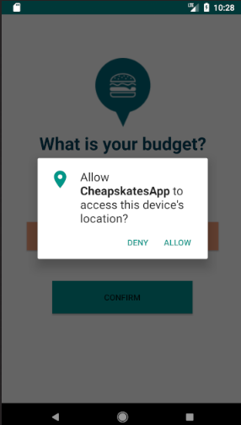
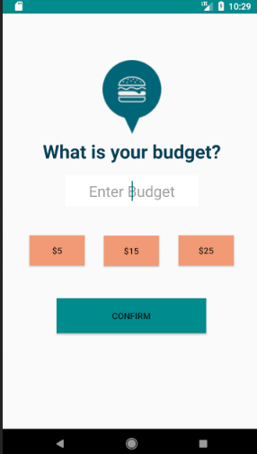
Once access is granted the homepage is shown and prompts the user to enter a budget or press one of the hardcoded budget options.
The App begins by asking the user to allowing access to the device’s location.

Slide 6
What is happening in the background?
Once the user enters a budget or clicks one of the budget buttons, budget will be saved in SharePrefrences--a useful tool in android studios that allows stores data--so it can be accessed in another java activity. At this time, the longitude and latitude of the phone’s location is also saved in SharedPrefrences. These values will become crucial in using out API provided by Zomato.

Slide 7
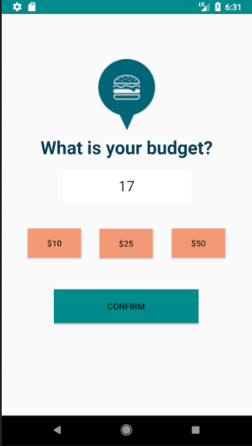
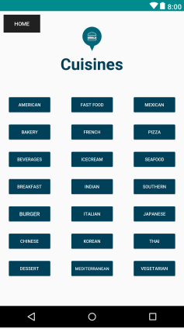
All of the cuisine options are shown in the form of buttons
Once you’ve enter the budget...

Slide 8
What is happening in the background?
After the user puts in their budget, they are directed to a page that has a page that contains three columns of button. Each button has a type of food cuisine. This allows our users to narrow down their search by cuisine. How this is done is with our Zomato API, you can specify the cuisine within the request URL by adding the correct cusine id onto the end of the link. When the user clicks a button, a variable named cuisine is assigned an integer value and stored in sharedpreferences. This integer will be later retrieved and concatenated into the request url during the API call.

Slide 9
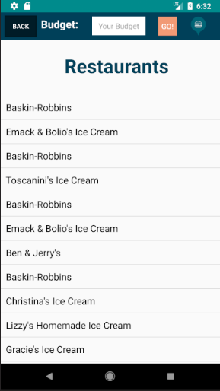
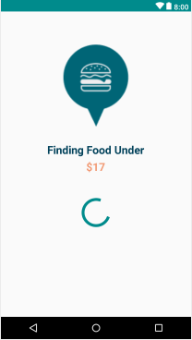
After selecting a cuisine, the user information is then used to...
Generate a list of restaurants.

Slide 10
What is happening in the background?
While the user is viewing the loading page, this is when cheapskates makes the call to the Zomato API. The request url needs to have a set longitude, latitude, radius, and cuisine in order to give the user the correct list. We easily add these values to the request URL string by concatenating the string. After the connection is made, we obtain the information using a type of JSON parsing called Volley. The API gives cheapskates the information in the form of JSON. We then organize the data, cutting out restaurants that are out of the users price range and to the specificity of the selected cuisine, by iterating through the Zomato array and filing all of the result into another list which we will later display.

Slide 11
What is happening in the background?
To display the resulting restaurants after the user has narrowed down the search, we use the android feature Listview. The list that was created while the Zomato’s API result was being sorted, is now being displayed as a scrollable list with the help of the list adapter. Each item of the list is clickable so the user can gain further information about the restaurant they selected. When clicked, the JSON object retrieved from the response body would be stored along with the intent, allowing the response to be utilized in a different java class.
The user also has access to a back button, located in the toolbar, which gives them the option to go back to the cuisine page and select another option. The button has an intent that, when pressed, takes them back to the cuisines page so they can look through other budget friendly food options. However, if the user would like to change their budget, there is also a textbox located in the toolbar that allows them to change their budget with the press of go.

Slide 12
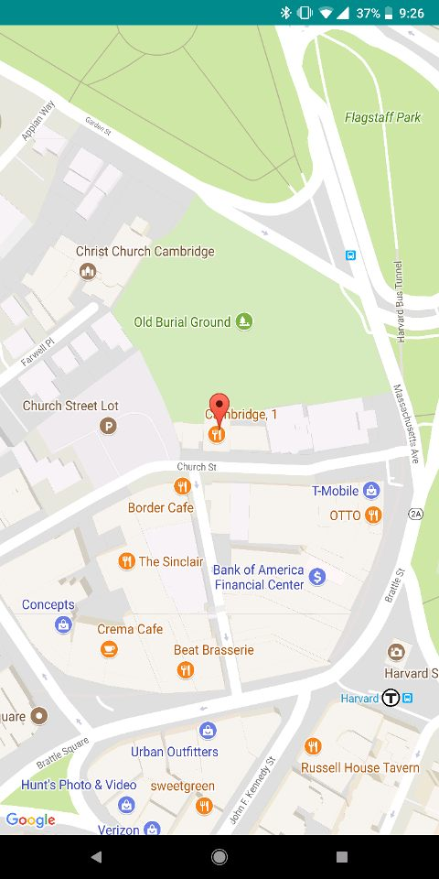
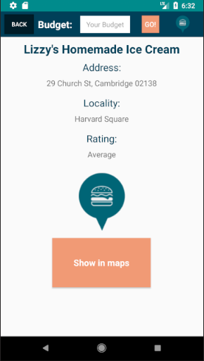
A map view!
After selecting a restaurant, basic information about the establishment is shown and...

Slide 13
What is happening in the background?
In this page, we are simply giving the user the information. The list created when sorting the API not only stores the names of the restaurants, but also the location, address, rating and locality of each restaurant. This information is displayed to the user as well as a map view when the “Show in Maps” button is pressed. The maps button is linked to another page that displays the restaurant's location using the longitude and latitude retrieved from the JSON object with the Google Maps API. Like in the previous page, the user also has the option to go back to the previous page using the back button and change their inputted budget.

Slide 14
Types of error handling for user inputs:
If the user enters a budget of zero they are prompted to a page that asks if them if they would like to change their budget. When they press the button to change their budget, the new valid input will then be saved in SharedPrefrences and the app will continue as planned!
If the user enters a budget that is over three digits...well that simply is not allowed! This app is for cheapskates and a small pop dialog makes sure they know!

Slide 15
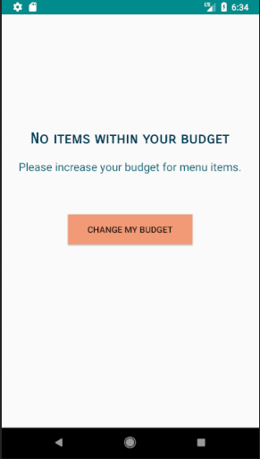
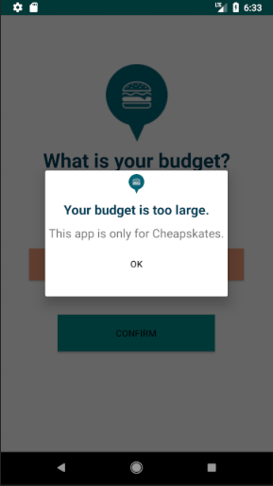
Can’t do that!
Or that!

Slide 16
Bon Appetit!

