Slide 1





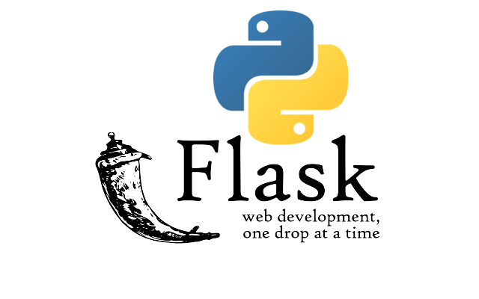


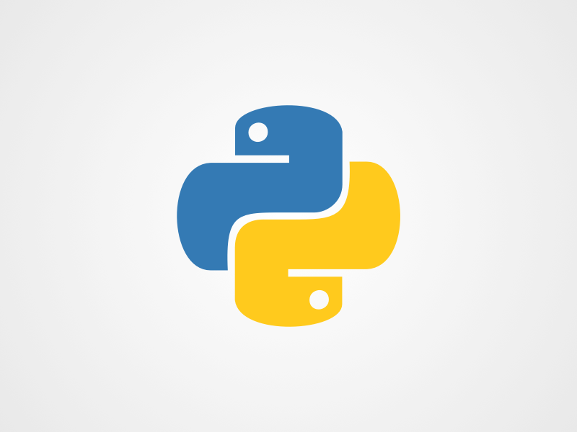

DATABASE
FRONTEND
DEPLOYMENT
REACT
TAILWIND CSS
AI INTEGRATION
BACKEND
PYTHON

