Slide 1
OpenCAD
Ara Knaian, David Darylmple, Forrest Green, Smari McCarthy,
Neil Gershenfeld

Slide 2
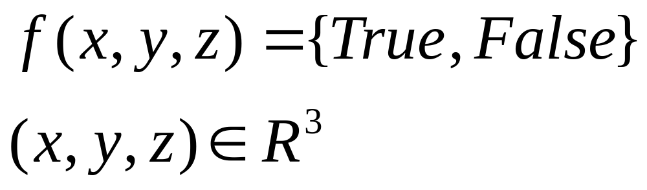
Boolean F-Rep Geometry

Slide 3
Boolean F-Rep Geometry
Simple --- Easy to Document
Simple --- Easy to Work With, Create Primitives and Transformations
Unambiguous (e.g. no DXF inside vs. outside problem)
Precise
Expressive --- Can easily a wide variety of geometries
Can convert vector drawings (e.g. DXF), B-splines (e.g NURBS), F-rep (HyperFUN), constraint lists, CSG, etc. to this format
Efficient rendering to triangle meshes, bitmaps, and vector toolpaths
Vs. B-Splines and CSG : Simpler and More General
Vs. Voxel Grid / Point Cloud: More Efficient and Precise
Vs. F-Rep: Boolean representation allows efficient rendering

Slide 4
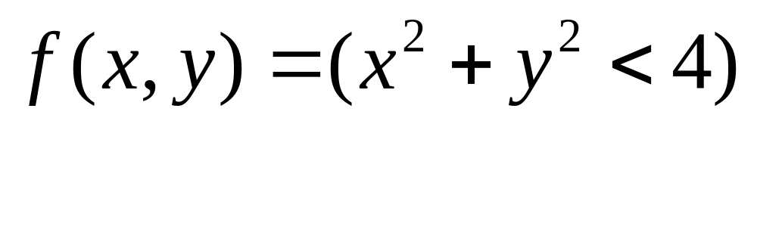
Boolean F-Rep Geometry
2

