Slide 1

TECNOTITAN
EN / 01
TECNOTITAN CORPORATE
TECNOTITAN
Applied technology for companies that need to build the future
01
US$500K pre-seed
02
18 months runway
Software, artificial intelligence, video games, robotics and technology transformation consulting from Colombia for global markets.
03
6 product lines
David Arias Giraldo, CEO
Investor Deck / 2026
www.tecnotitan.com

Slide 2

TECNOTITAN
EN / 02
WHY NOW
Companies need AI implementation, not more slideware
AI adoption pressure is reaching companies that still run on manual workflows, scattered data and teams without internal capacity to build.
01
02
03
Clear operating pain
Rising AI demand
Need for technical execution
www.tecnotitan.com

Slide 3
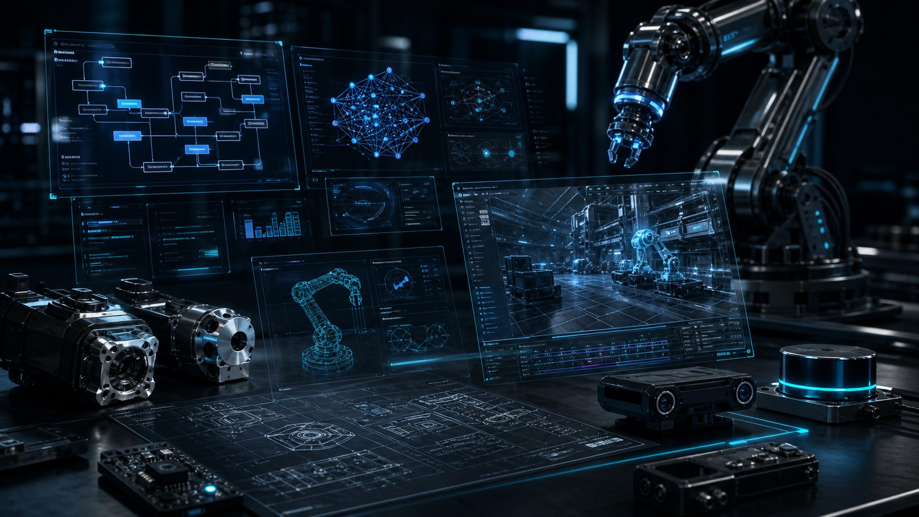
TECNOTITAN
EN / 03
PROBLEM
Technology transformation stalls when it lives in silos
01
Repetitive work
02
Data without action
Many companies have manual workflows, underused data, pressure to implement AI and teams without a clear path from ideas to products.
03
AI without adoption
04
Talent without playbooks
Manual workflows
Data activation
AI adoption gap
www.tecnotitan.com

Slide 4
TECNOTITAN
EN / 04
PLATFORM
Tecnotitan turns consulting into product, and product into platform
Every project feeds reusable modules, industry knowledge and capabilities that accelerate new solutions.
01
02
03
04
Diagnose
Build
Productize
Scale
Reusable IP, sector knowledge and operating playbooks compound across every project.
www.tecnotitan.com

Slide 5

TECNOTITAN
EN / 05
PORTFOLIO
A product system for companies, talent and digital experiences
The portfolio is designed to enter through urgent needs and expand into operations, learning and applied intelligence.
Copiloto Pyme
Tecnotitan OS
Life Copilot mobile app
Tecnotitan Engine
Tecnotitan Academy
Tecnotitan AI Call Center
www.tecnotitan.com

Slide 6
TECNOTITAN
EN / 06
SERVICES
Consulting accelerates revenue and market learning
Services create trust, reveal real problems and convert implementations into repeatable assets.
01
02
03
04
AI diagnosis
Technology roadmap
Implementation
Adoption and training
Services are the market-sensing engine that turns demand into product decisions.
www.tecnotitan.com

Slide 7
TECNOTITAN
EN / 07
DIVISIONS
Five divisions share IP, data and talent
Software, AI, video games, robotics and technology transformation operate as one architecture, not isolated businesses.
TECNOTITAN
CORE
Shared IP, data and reusable playbooks
Software
Artificial intelligence
Video games
Robotics
Technology consulting
www.tecnotitan.com

Slide 8

TECNOTITAN
EN / 08
MODEL
Service revenue today, scalable products tomorrow
The model combines consulting, implementation, subscriptions, licensing, academy programs and future technology spin-offs.
01
02
03
04
Services
SaaS and licensing
Academy
Ventures
Each layer can monetize independently while feeding data, references and reusable modules back into the platform.
www.tecnotitan.com

Slide 9
TECNOTITAN
EN / 09
GO-TO-MARKET
Enter through operational pain, expand through platform
01
LatAm as base
02
Mid-market and enterprise
Tecnotitan can start with AI and software projects for companies, then expand with products that solve recurring use cases.
03
Global partners
04
Strategic investors
01
02
03
04
Pilot
Implementation
Product expansion
Strategic partner
www.tecnotitan.com

Slide 10
TECNOTITAN
EN / 10
TEAM
A lean founding team focused on execution
David Arias Giraldo leads the vision as CEO. The company currently has one full-time consultant and two programmers.
Founder CEO
Consulting
Engineering
Next hires
Hiring priorities: product engineering, AI delivery, sales development and investor relations.
www.tecnotitan.com

Slide 11
TECNOTITAN
EN / 11
ROADMAP
From validation to a regional technology platform
The path prioritizes real cases, proprietary products, internal automation and commercial expansion with an investor-ready focus.
01
02
03
2026: cases and MVPs
2027: product and IP
2028: regional scale
www.tecnotitan.com

Slide 12
TECNOTITAN
EN / 12
INVESTMENT
Raising US$500K pre-seed to reach paid pilots and repeatable product
01
40% product and engineering
02
25% sales and pilots
The round funds 18 months to turn AI and software services into proprietary products with initial customers, measurable use cases and a global commercial base.
03
20% AI delivery
04
15% ops and data room
info@tecnotitan.com | www.tecnotitan.com
www.tecnotitan.com

