Slide 1
Shannon Diversity Index for 4 National Park Samples
Notes:
Direction and audience (source: https://www.nps.gov/articles/biodiversitynp.htm)
Seems romanticism drives non-technical and non-expert crowds and there seems to be friction in the expert audience for relevance. In the spectrum, it seems the desired audience is the technical and some of the expert crowd. Use moderate and briefly explained jargon with a focus on practical application
Based on the writing (more than a fair share of pathos employed), leveraging the romanticism of the populous with a focus on future implications may be a solid venue? More accurately, perhaps, leveraging the populous in this way to initiate and solidify change for a given end. Expansion of lands and complexity of efforts. That said the majority of references are to non-profits or state entities. Not sexy, but part-and-parcel to the debate is survival. A vital argument may prove necessary albeit overdone.
Likely emphasize biodiversity and population to enforce security and stability in terms of a foundation and introduce/explain ecological interconnections to show the importance of having these reserves in diverse areas to protect for more environments thus more organisms.
Ecological network: a model that shows the interactions between species in an ecosystem. Each node is made up of species, nutrient pools or habitat patches and the edges are the relationships between these nodes
Interactions can be trophic (predation) or symbiotic

Slide 2
Data analyzed
For this presentation two datasets were used each with a focus on:
Species observed
Contains information on each species observed including category of organism, scientific name, a list of common names and conservation status (Species of Concern, Endangered, Threatened, In Recovery or N/A)
Observations in the National Parks
Contains information on observations of given species in each of the national parks observed (Yellowstone, Yosemite, Bryce and Great Smoky Mountains)

Slide 3
Considerations in Data Cleaning
Duplicated entries in both the Species and Observation datasets were dropped
Each entry in both datasets should have at least one facet of the datum that would separate it from the remainder (e.g., observation count of a given species for a given park should be in condensed into one entry, not multiple)
Common names for Species dataset dropped (following duplicates being dropped)
Each common name entry was a list of commonly used names and individual species (beyond number of unique ones) were not used in the analysis

Slide 4

Dataset
For this presentation, the tables were merged and summarized into one table organized by category of organism:
Count of unique species per category
Total observations per category
Count of species with a conservation status
From this temporary table, the Shannon Diversity Index was calculated with the following:

Slide 5
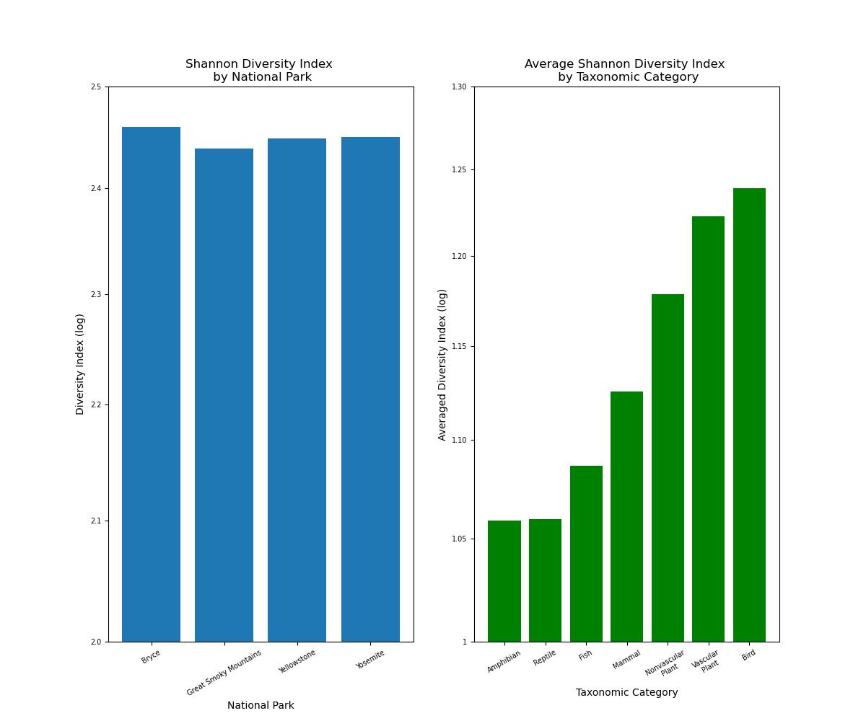
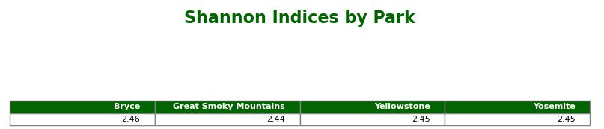
Taking the initial indices by park, there is not much difference
The bar chart (right) shows a that the indices are fairly close (note the scale starting at an index of 2)

Slide 6
Biodiversity – Foundation
A higher index shows greater diversity (the objective, more or less).
An index of around 2.4 shows a good amount of diversity
However, Biodiversity has multiple facets that play into the index as a whole and any individual part could tell a different story
Species diversity –

Slide 7
Biodiversity – the number of different kinds of organisms in a studied location or the relationship between species evenness and species richness
Species richness – the number of unique species in the area
In the dataset, there are 5,541 unique species.
Safe to say the areas are species rich
Species evenness – the relative number of organisms of each species in the area
If the areas are species rich, are they also even?

Slide 8
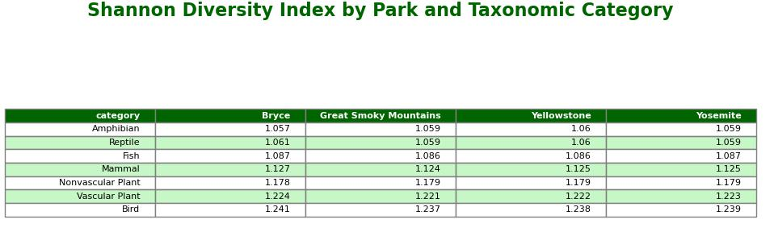
Species Evenness
To determine evenness, the Shannon Index Calculation was applied to the dataset again after the dataset was grouped by both National Park and Category
Indices across National Parks and Categories were very close, so the entries were averaged for summary
The bar chart to the left shows the index per taxonomic category as averaged across National Parks

Slide 9
Take-away
The parks are fairly diverse as a whole, but the parks are not evenly diverse
Foci
The data shows that Amphibian and Reptile species are the least diverse amongst the species represented in the sample
Additional
When deciding resource allocation or expansion, keeping these species in mind could buttress an argument for expanding areas with compatible habitats
With campaigning or public outreach, the Species dataset could provide insight as to which species in these taxonomic categories could be used in a visual piece

Slide 10
Questions and Answers

Slide 11
Appendix
Species Dataset and Description
Observations Dataset and Description
Areas of additional study

Slide 12
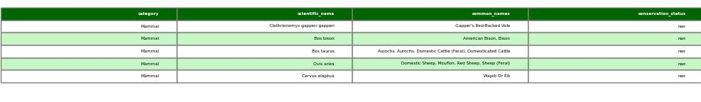
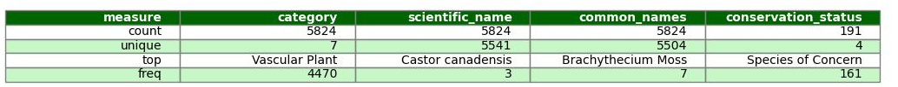
Species Dataframe
First 5 rows of Data frame
Description of Data frame

Slide 13
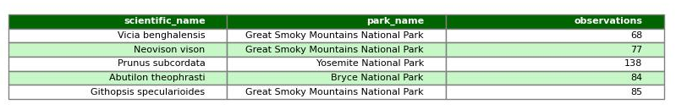
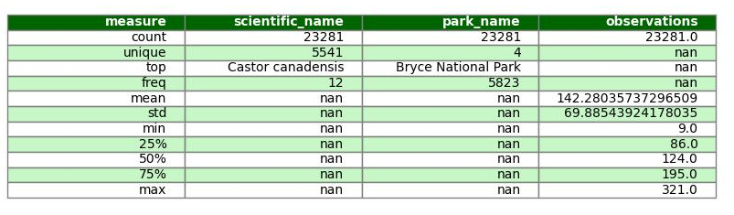
Observations Dataframe
First 5 rows of Data frame
Description of Data frame

Slide 14
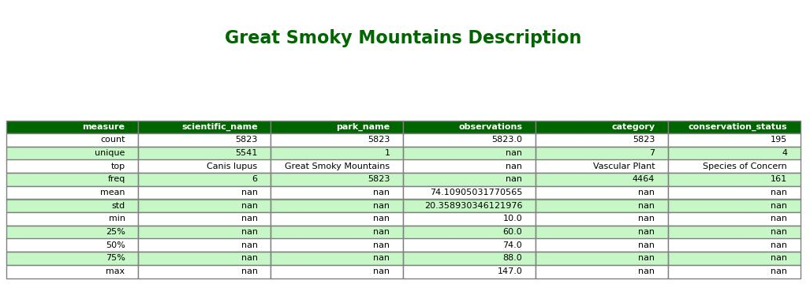
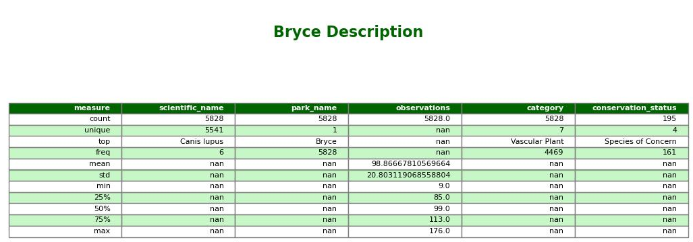
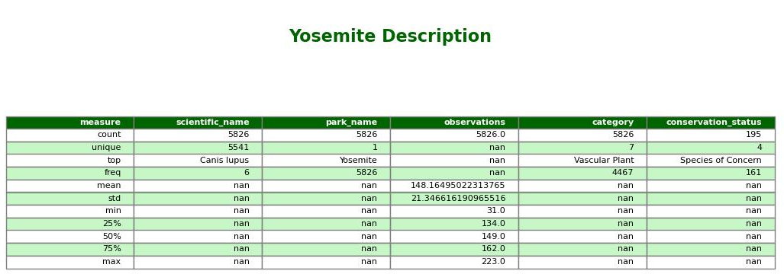
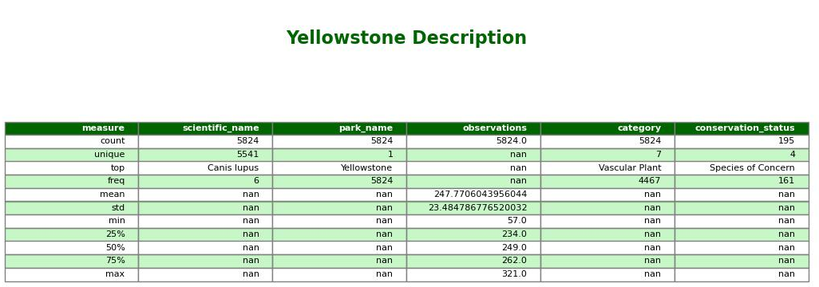
It may be important to note how close the count of scientific names are and how conservation status count is the same across all 4 parks. The methodology of this study was not discussed in the exercise but could impact how applicable the data is.

Slide 15
Areas of Additional Study
The proportions of conservation status between taxonomic categories and/or national parks
If there is one category that has a greater proportion of severe conservation statuses, then this may be a potential investment; or, conversely, if one category has less then resources may be reallocated.
Total observations across taxonomic categories or national parks and how these sums relate to proportion of conservation status or Shannon index
If species richness can have a significant impact on species diversity, then the procurement of a given species or the safeguard of a given species in each taxonomic category may prove more cost-effective.
Additional data: perhaps looking into maintenance costs over time could help determine a pattern and a point at which investment or outreach would be most efficient.

