Slide 1
Sales Summary: Jan-Aug

Slide 2
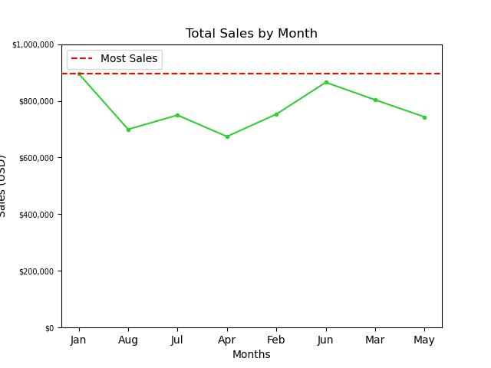
Monthly Sales
Sales peaked at the beginning of the year with nearly $850,000 in sales

Slide 3
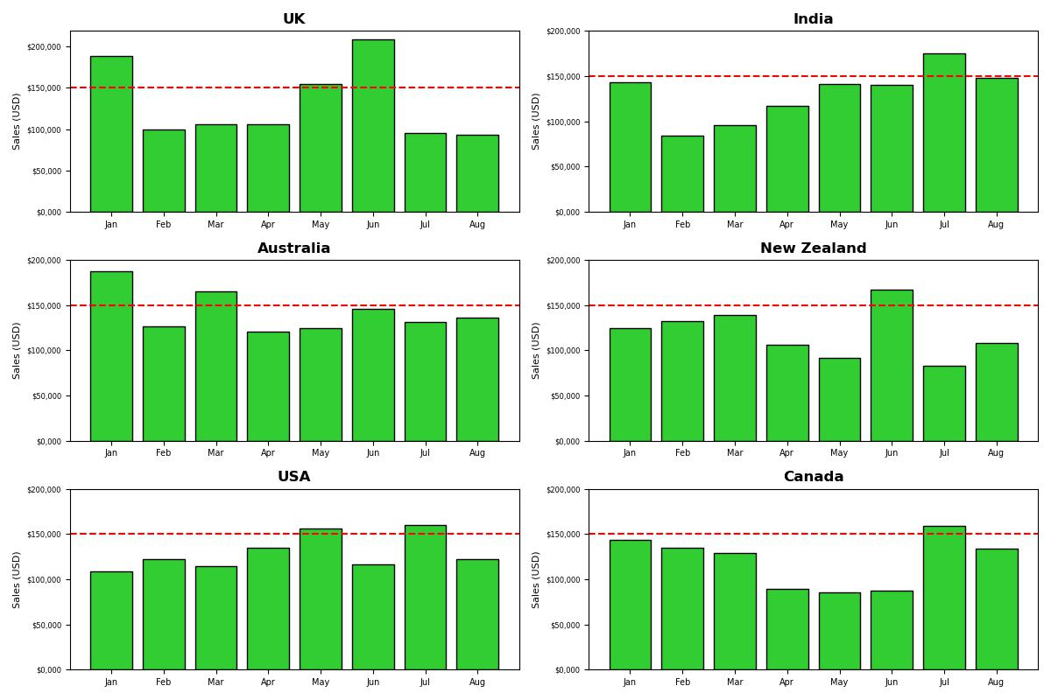
Country Sales
Total sales within each country tend to vary thoughout the year but two ranges are evident:
1) The beginning of the year
2) April-May
At one point during the year for each country, total sales exceed $150,000.

Slide 4
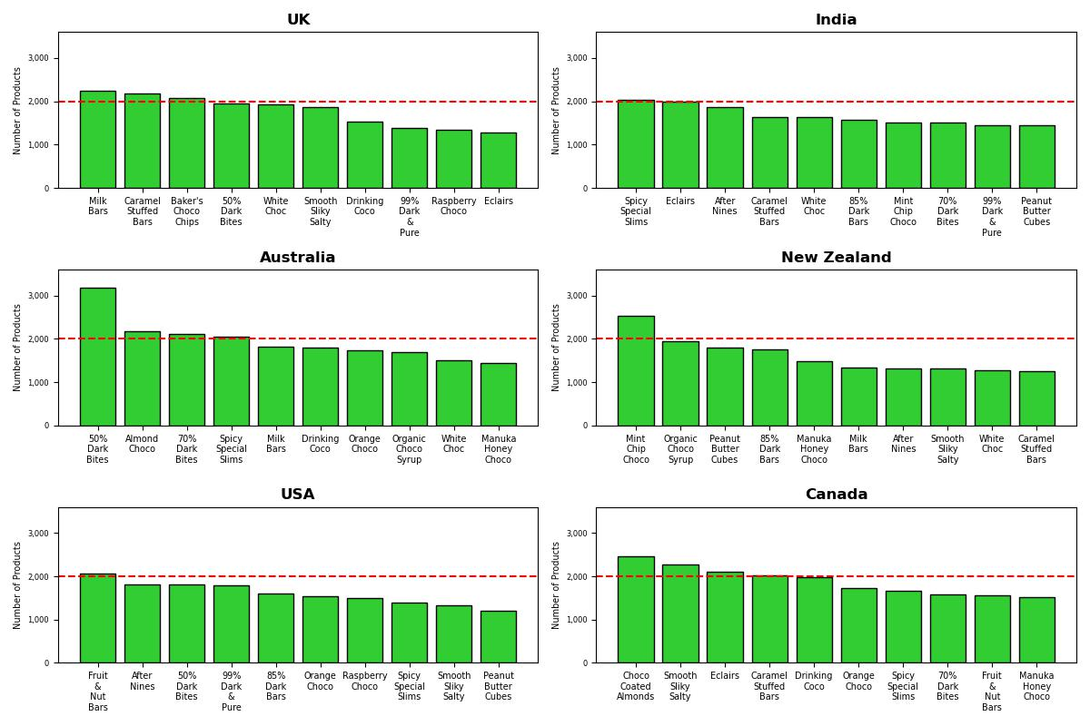
Product Distribution – Most Distributed
With the sales in mind, now to look at what make up these sales
Each country has a high seller, some have a larger margin than others

Slide 5
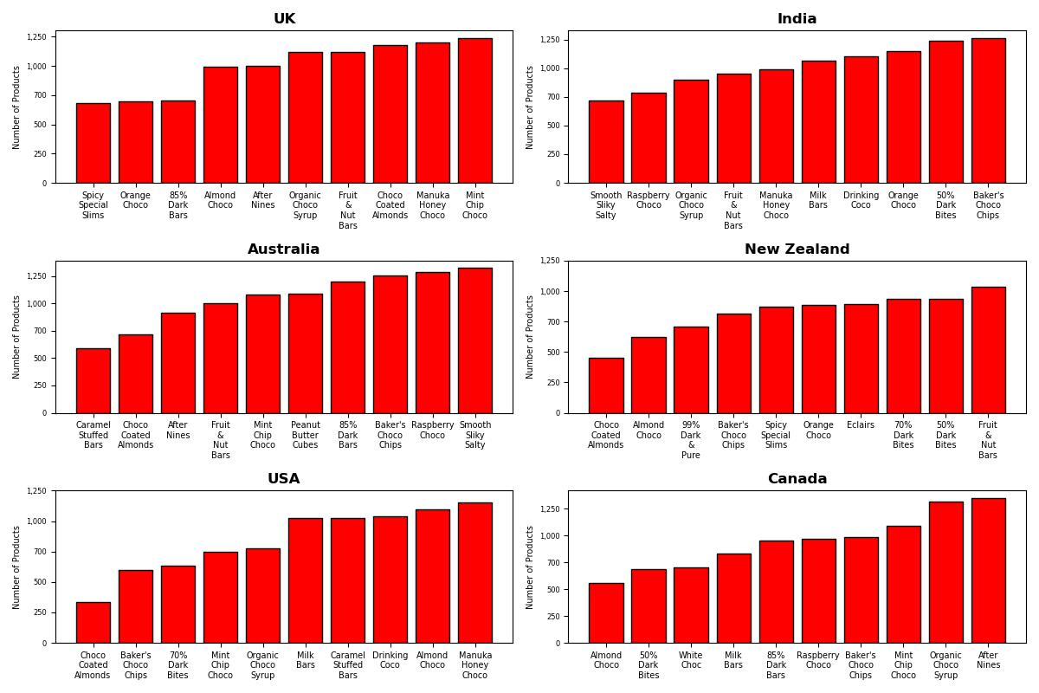

Slide 6
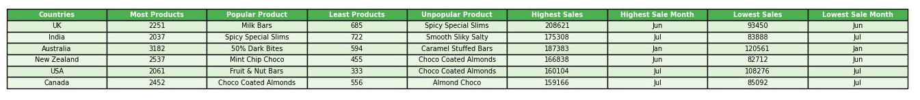
Notes:
Need excel table with max product distribution and sales then can get back into highest grossing months

Slide 8
Take-away
The question is not about production, but timely distribution of products. Since there are a variety of best-selling items, overall lower-selling items should see decreased/halted production; however, the production and destination of various products should be tailored to both the timeline of sales and the countries who favor each given product the most
Notes:
Create table of suggestions with product destination and month

