Slide 1
Sales Summary: Jan-Aug

Slide 2
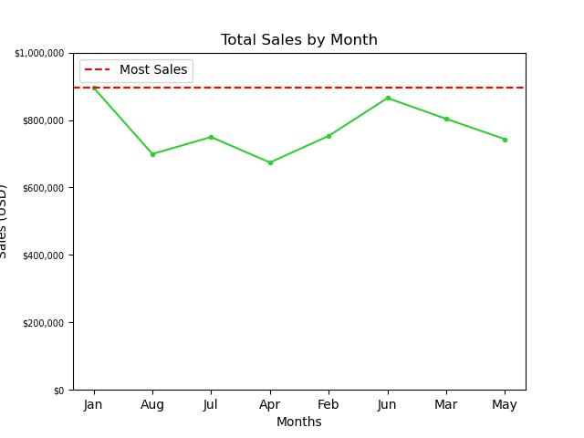
Monthly Sales
Sales peaked at the beginning of the year with nearly $850,000 in sales

Slide 3
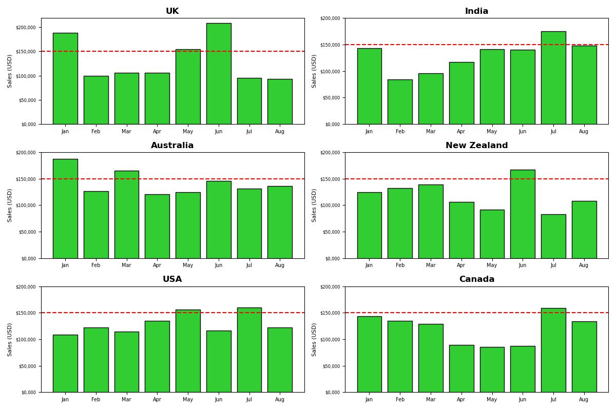
Country Sales
Total sales within each country tend to vary thoughout the year but two ranges seem to be generally higher:
1) The beginning of the year
2) May-July
At one point during the year for each country, total sales exceed $150,000.

Slide 4
In June we have the highest sales in the UK, while in the next month, we have the lowest in New Zealand

Slide 5
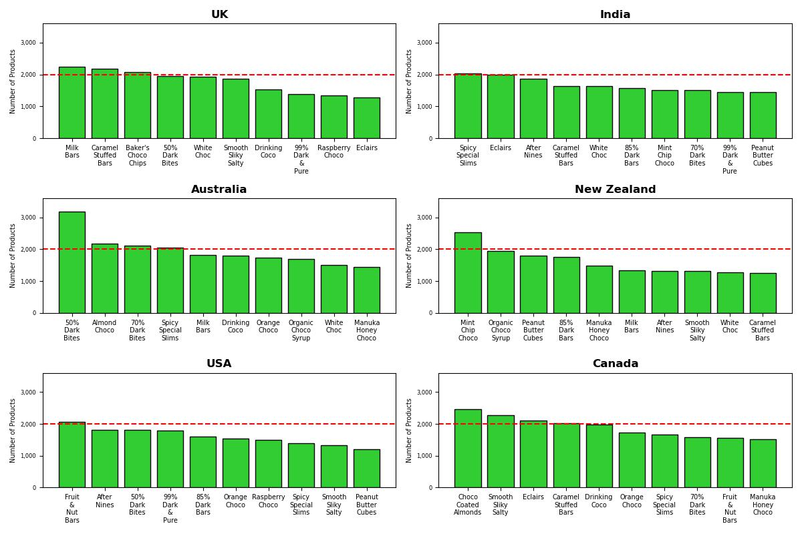
Most-Distributed Product

Slide 6
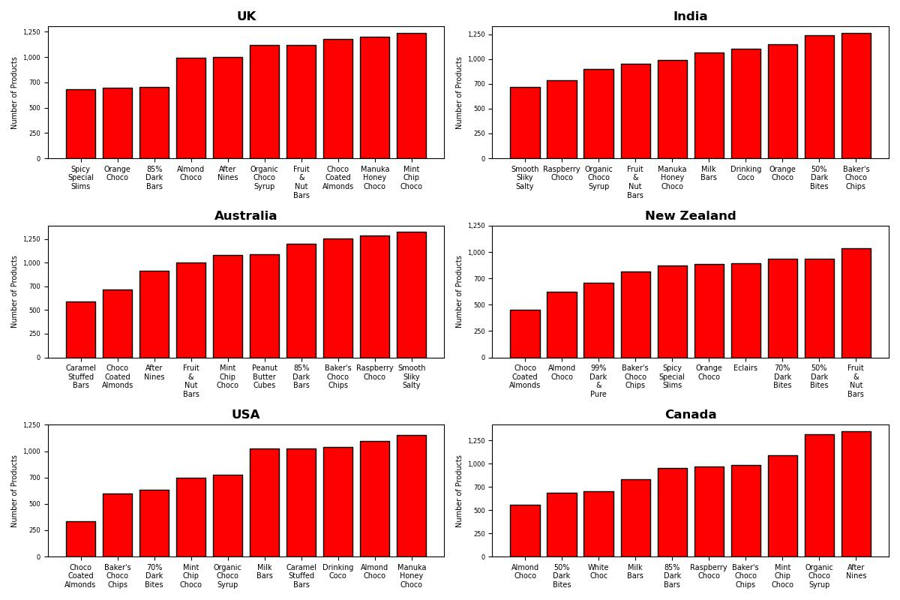
Least-Distributed Product

Slide 7
Summary – Sales and Distribution

Slide 8
Take-away
Sales generally peak around January (though there is not any data on sales through September – December, so sales may either be comparably high or contrastingly low) and May through July.
There are a products such as “Orange Choco” which does not show in any of the countries’ top 5 most-ordered and does show in some bottom 5 ordered.
Altering production of these items may be an effective way of cutting costs
Sales peak at different times for each country, and each country orders a different volume of each product
It may be cost-effective to examine product allocation and storage since what could be surplus for one country could be profit from another

Slide 9
Questions?

