Slide 1
Census Participation
General Assembly DATR 406
Jesse Zlotoff
June 2020

Slide 2
Predict Census participation by county
Although responding to the Census is required by law, not everyone participates.
The goal is to determine which demographic and geographic factors influence responsiveness.
2009 American Community Survey (ACS) 5-Year Estimates
+
2006 National Center for Health Statistics Urban/Rural Classification
2010 Census Participation Rate by County
Rules for prediction,
the model

Slide 3
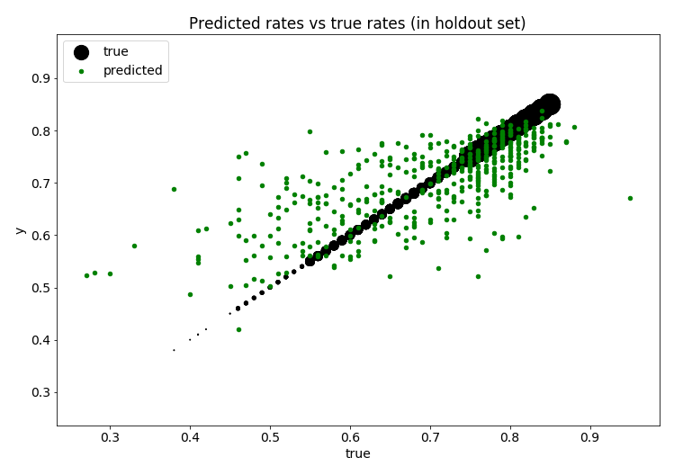
Model predicts participation rate within a few points
Model Performance
Holdout RMSE = 8.2%
Holdout R2 = 0.70
Baseline RMSE = 11.2%

Slide 4
Population, income and other socio-economic features best predict response rates
Top Features (Disaggregated)
Total Population
Income to Poverty Ratio 2 Plus
Structure Year Built Median
Urbanity Non-Core Flag
Income in multiple bins
Employed
Drive to Work Alone
Living Area in multiple bins
Speak Only English
Work in Government
Top Features, cont.
Less than High School Diploma
Work in Non-Profit, For Profit
Commute Time (multiple bins)
Household Type Married
Total Number of Households

Slide 5
Process overview
1. Download raw data
2. Prep ACS Data
Over 20,000 raw variables
Data is split into multiple files for each state
Data is keyed on “logrecno” (log record number) and needs to be joined with another file to get geoid
Multiple fields were combined, then divided by totals to get percentages by county features
3. Exploratory Data Analysis
Deal with missing data
Variable relationships
4. Build/test models

Slide 6
Modeling Strategy
Create a representative holdout set
Do a train/test split on remaining data
Build interactions of all input variables
Prep the data
Build Baseline Model from Mean of Target Value
Lasso
Train
Train, test, cross-validate models
Random Forest
Predict Test
Store Results
Gradient Boost
Cross-Validate
Compare models and tune features
Compare Model Performance
Select Best Model by CV RMSE
Rank Features by Importance
Tune Number of Features in Model
Freeze model and test on holdout set
Select Best Number of Features
Save Model Objects
Predict, Evaluate Holdout Set

Slide 7
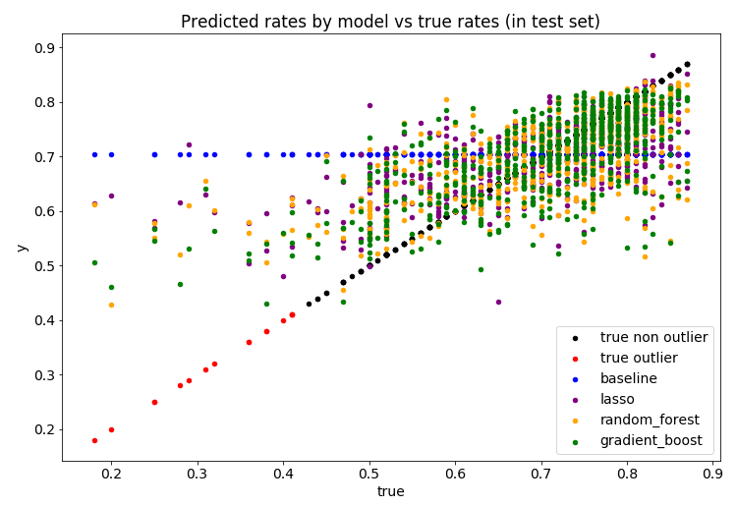
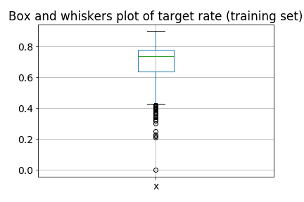
Outliers
None of the models tested predict the lowest values in the test set. The rates below 0.4 are outliers that make up a small percentage (~1%) of the train and test sets.

Slide 8
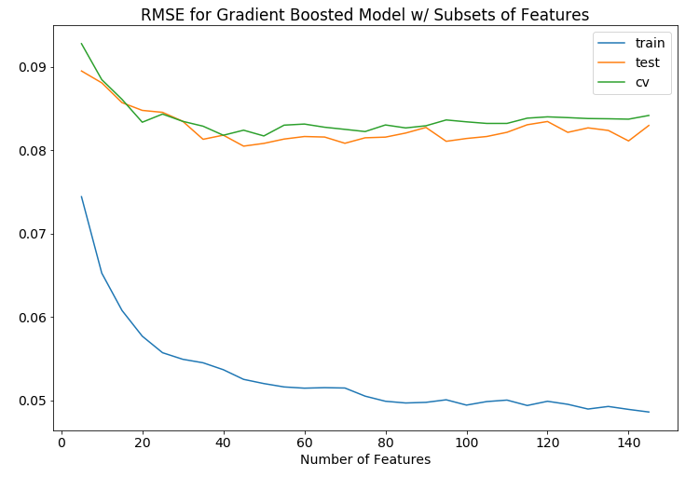
Feature Tuning
Num Features | CV RMSE | Test RMSE
50 | 0.0817 | 0.0808
40 | 0.0818 | 0.0818
75 | 0.0823 | 0.0815
45 | 0.0824 | 0.0805
I tested the best model with different sized subsets of features to improve efficiency and help avoid over-fitting.

Slide 9
Looking forward
Use newer versions of the same data to predict 2020 response rates
2018 American Community Survey (ACS) 5-Year Estimates
+
2013 National Center for Health Statistics Urban/Rural Classification
The model
Caveats:
The 2020 Census introduced the ability to respond online
The impact of the novel coronavirus on responsiveness is unknown
So the predicted values should be viewed as a baseline only
Predicted 2020 Census Participation Rate by County

