Slide 1
FMN Operations
Supply chain and plant decision support
Two business apps with measured models and runtime AI explanations
28 SKUs
17 machines
Which items need replenishment attention?
Which machines need inspection in the next 24 hours?
FMN AI Engineer Internship technical assessment
Notes:
Source: FMN_AI_Internship_Technical_Assessment.docx and both supplied CSVs. This is an assessment prototype, not a deployed FMN production system. Opening: the sponsors need actionable warning with plain-language evidence. All dates in the demo are historical.

Slide 2
Supply forecasts support a clear stock policy
Held-out sales error, WAPE (%)
Model choice
Weekly patterns with shrinkage fit six months of data. Test WAPE: 17.6%.
Action logic
Compare lead-time sales plus a reserve with stock. Show shortages, reorder pressure or excess cover.
New-SKU simulation WAPE: 31.2%. No future receipts are assumed. Reserve is a policy heuristic.
Notes:
Source: artifacts/dashboard.json evaluation.supply, src/supply.py. Three tuning origins in April and three test origins in May/June, each 14 days. Selected model test WAPE 17.576%, MAE 52.868. Forecasts estimate sales, not latent unconstrained demand. The 30-day UI view extends beyond the evaluated 14-day horizon.

Slide 3
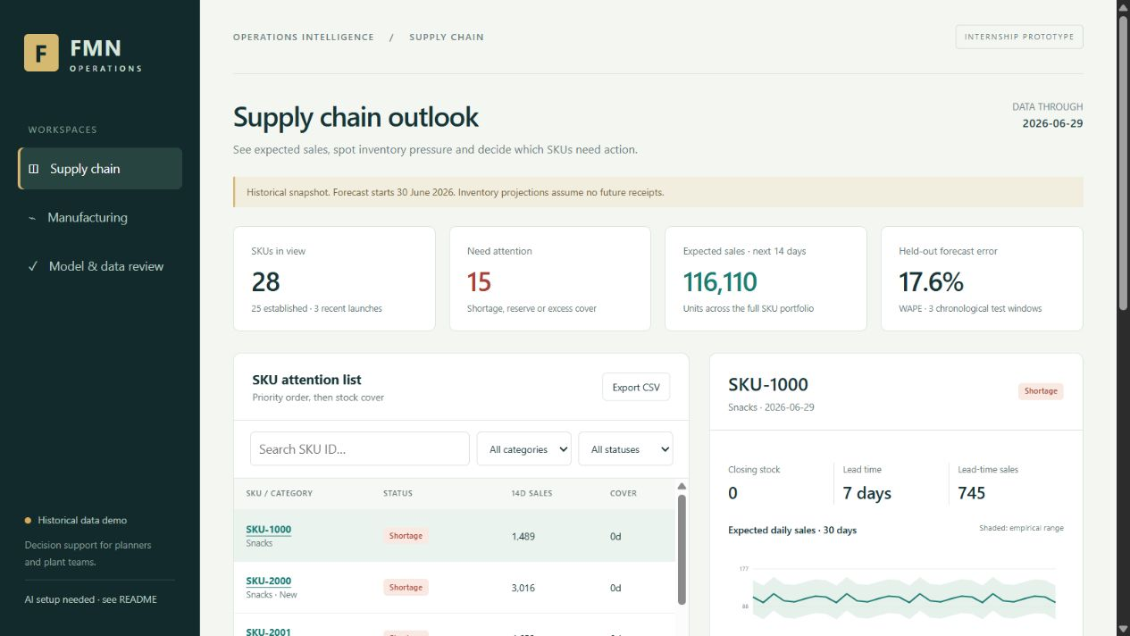
Supply chain demo
One attention list
Filter by category or status and open a SKU for its forecast and stock evidence.
Visible assumptions
New launches carry a limited-history warning. Explanations cite the selected item.
Actual interface. Snapshot: 29 June 2026. The app shows 13 shortages and 2 reserve-driven reorders.
Notes:
Source: presentation/supply-demo.png, captured from the implemented app. Demo: select SKU-1000, inspect lead-time demand and stock, then show new SKU-2000. Ask why SKU-1004 is flagged: it is actually Healthy in this snapshot. Explain that live AI requires a configured API key.

Slide 4
Machine ranking has signal, with material misses
0.309
4 of 7
Test average precision
Test failures warned in advance
Maintenance-only baseline: 0.169
Positive-hour prevalence: 1.79%
316 false alert hours
21.4% precision, 45.7% hourly recall
Regularized logistic regression uses causal sensor features and a frozen 0.47 threshold.
Only 17 failures in the full dataset. Brier score is worse than an always-zero baseline. Scores are uncalibrated.
Notes:
Source: artifacts/dashboard.json evaluation.manufacturing. Train Jan-Feb with 24h purge, validate March, test April. Selected L2=100 by March AP; threshold 0.47 maximizes March F2. Sensor test AP .30945, baseline .16949, prevalence .017855. Complete-window event recall 4/7. MCH-203 April 30 event excluded from event denominator due to incomplete evaluable pre-event window after censoring.

Slide 5
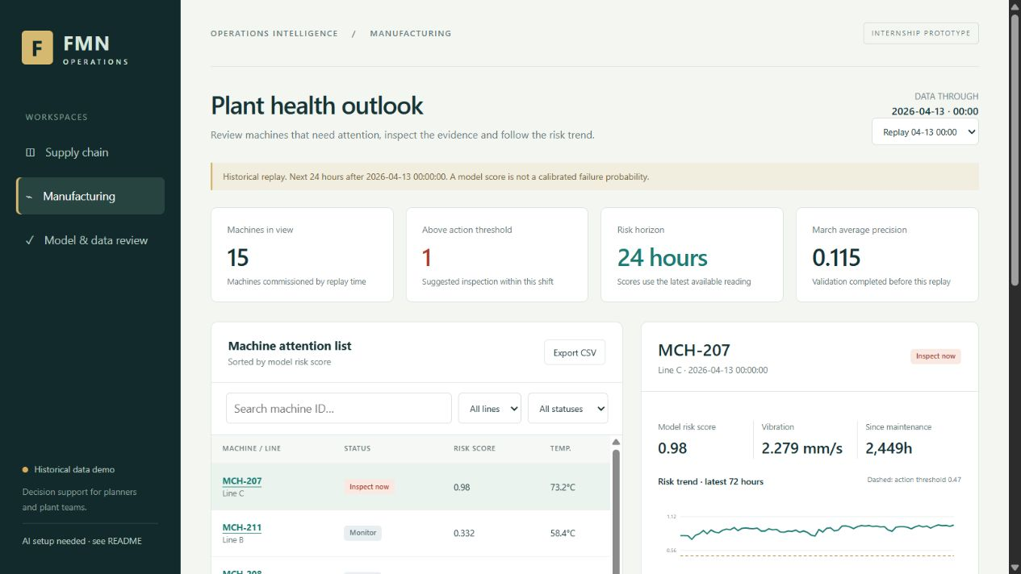
Plant demo with historical replay
A real warning state
Replay 13 April. Inspect MCH-207 and its rising or sustained score history.
Model evidence
Sensor contributions explain the score. They do not establish a mechanical cause.
Actual interface. Replay uses readings available at that timestamp. No later test outcomes enter AI context.
Notes:
Source: presentation/manufacturing-replay.png and artifacts/dashboard.json manufacturing_replays[2026-04-13 00:00:00]. At replay MCH-207 score is approximately .980, vibration 2.279 mm/s, maintenance age 2449h. Only earlier validation summaries reach replay AI, not later test outcomes. The latest April 30 snapshot has no above-threshold machines, so replay demonstrates a real earlier warning.

Slide 6
Runtime AI explains retrieved evidence
1. Retrieve
3. Check and display
Exact ID: full item evidence. Fleet question: every current item summary.
Validate cited IDs and render plain text. Show unavailable states on provider errors.
2. Generate
Grounding limits
A real LLM call receives measured values, model output and operating assumptions.
The LLM cannot act on stock or machinery. Review its numbers before making decisions.
Live API key setup is still required. No canned explanation is presented as AI output.
Notes:
Source: src/llm.py and server.py. Integration uses OpenAI Responses API: https://developers.openai.com/api/reference/resources/responses/methods/create. Structured output is checked for source-ID validity. These checks do not verify all numeric semantics. No live call was verified during development because no key was configured; mocked request tests pass.

Slide 7
Readiness and next steps
Available for local review
Model improvements
Two apps, source code, reproducible models, prediction-level backtests and this deck.
Collect more failures and calibrate risk. Add purchase orders and stockout-adjusted demand.
Before presenting
Operational rollout
Configure the API key and verify live answers. Rehearse the code and model tradeoffs.
Agree alert costs and stock policy. Add live ingestion, authentication and secured hosting.
Local run: python server.py. Public deployment and a remote repository URL remain to be set up.
Notes:
Source: README.md. Local run: python server.py after installing NumPy/pandas. Models, backtests, tests, source CSVs, frontend and deck included. Public app deployment and remote repository not created. Before submission: configure API key, run smoke_llm.py, review actual explanations, create repository URL and rehearse walkthrough. Production work: more failure data, calibrated and cost-based alerts, ERP purchase orders, authentication and live ingestion.

