Slide 1
Creating Content: Finding it Around Every Corner
By David A. Kennedy
davidakennedy.com
@davidakennedy

Slide 2
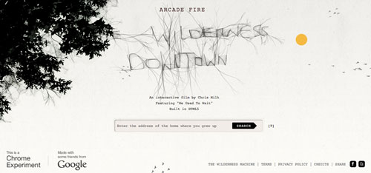
Content First!
We can’t do innovative without it.

Slide 3
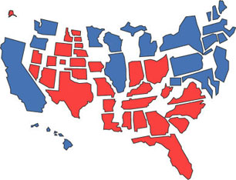
Which Way to the Content?
You need a plan.
Photo by Kaioshin
http://www.flickr.com/photos/kaioshin/1328338/

Slide 4
That Plan May Include
Editorial Calendar
Summon the troops
What do they really “like?”

Slide 5
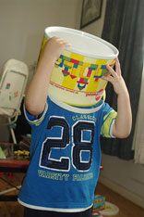
Get Out Your Buckets
Think of it like a WordPress site…
Give me 8-12 categories and maybe 20-50 tags.
Photo by Vanessa Pike-Russell http://www.flickr.com/photos/lilcrabbygal/4334877068/

Slide 6
Umm… You Haven’t…
I know, I know…
*Good content can be:
Polls
Questions
Photos
Videos (Short Clips)
Props (Links to Other’s Work)
UGC (Open Source, Anyone?)
Stories, Always Stories
Interviews
Lists (OMG, People Like Lists)
The Review
Guest Contributors (Experts)
Stats
Visualizations
Behind the Scenes
*a process – trust it

