Slide 1
STREAM learns developmental vector fields from cell state and regulatory sequence
Multi-timepoint CFM + CRE sequence conditioning + UCE cell-state embeddings
Time-resolved single-cell atlas
Regulatory DNA cCRE tokens
UCE or expression cell state
Gene velocity field
11.44M
1.23M
10k
UCE + cross-attn
mouse atlas cells
zebrafish control cells
modeled genes
best mouse model

Slide 2
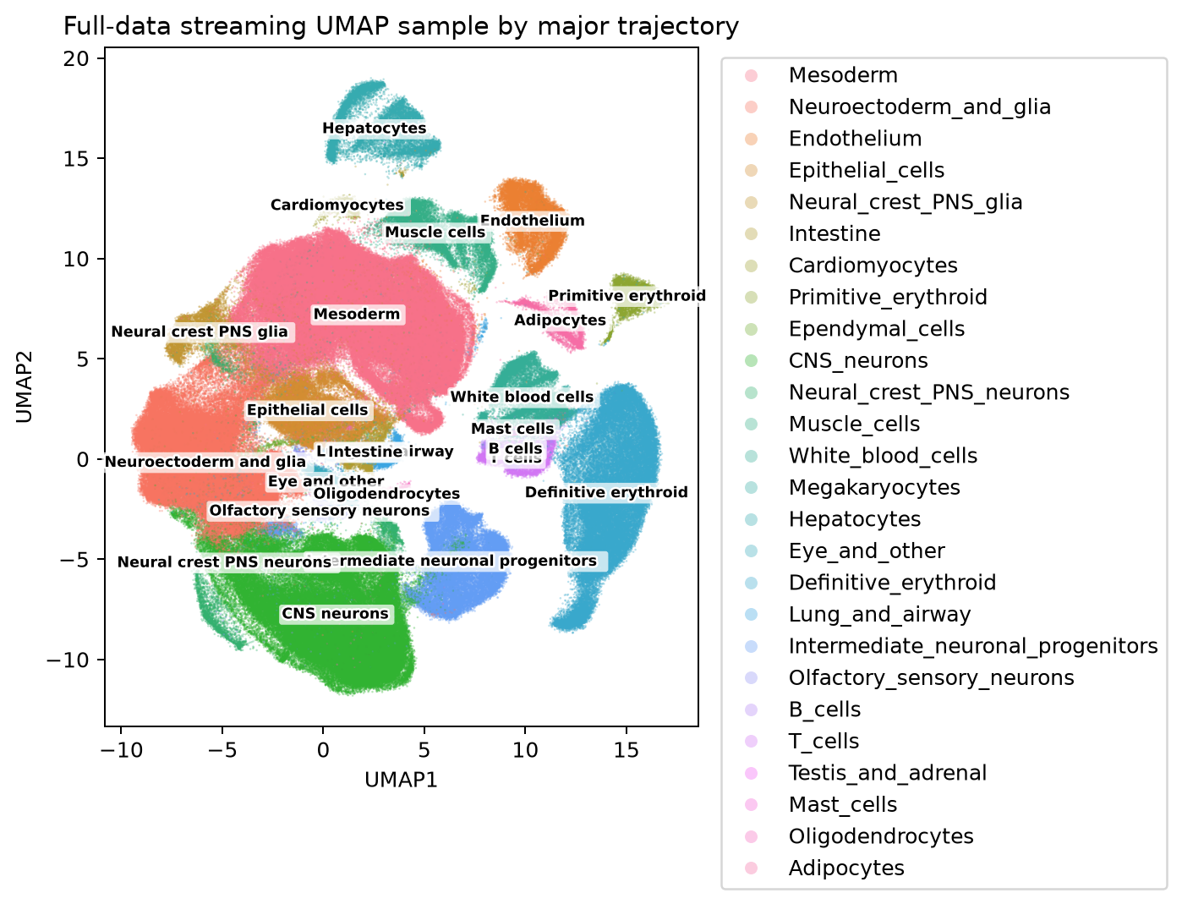
Development is observed as snapshots, but the target is a continuous vector field
Species | Cells | Timepoints | Held out | Genes | CRE tokens
Mouse | 11.44M | 43 | E9.5, E10.5 | 5k / 10k | 318k
Zebrafish | 1.23M | 18 | 36, 72 hpf | 10k | 318k
Causal rollout predicts held-out stages from observed source cells
The same output space is used for CFM and STREAM, so sequence conditioning is the isolated change
Cross-species tests swap regulatory sequence and UCE gene tokens while retaining expression-valued targets

Slide 3
Multi-timepoint CFM fits paths; causal evaluation rolls only into held-out stages
E8.5
E8.75
E9.0
E9.25
E9.5
E9.75
E10.0
E10.25
E10.5
E10.75
green = training intervals red = excluded intervals; causal scoring uses observed-to-held-out direction
1. sample cells at t_k
2. minibatch OT pairs cells
3. interpolate x_t at random tau
4. regress velocity (x_1 - x_0) / dt
One vector field is fit across all training intervals; no ODE rollout is needed during fitting.

Slide 4
STREAM predicts each gene velocity from global cell state and local regulatory tokens
cCRE + promoter tokens for gene g
AlphaGenome sequence embeddings
shared CRE transformer layers
promoter token readout
velocity f_g(s_t, Z_g)
cell state x_t or u_t
FiLM or cross-attention
Gene specificity comes from linked sequence tokens; weights are shared across genes.

Slide 5
Online UCE closes the expression-space vector field without endpoint leakage
expression endpoints x_k, x_k+1
OT pairs and linear paths
target expression velocity
STREAM / CFM vector field
predicted expression velocity
interpolated expression x_t
frozen UCE E(x_t) in R^1280
Run | Input to f | Output / loss
Expression state | x_t in R^G | G-gene velocity
Online UCE | E(x_t) in R^1280 | G-gene velocity

Slide 6
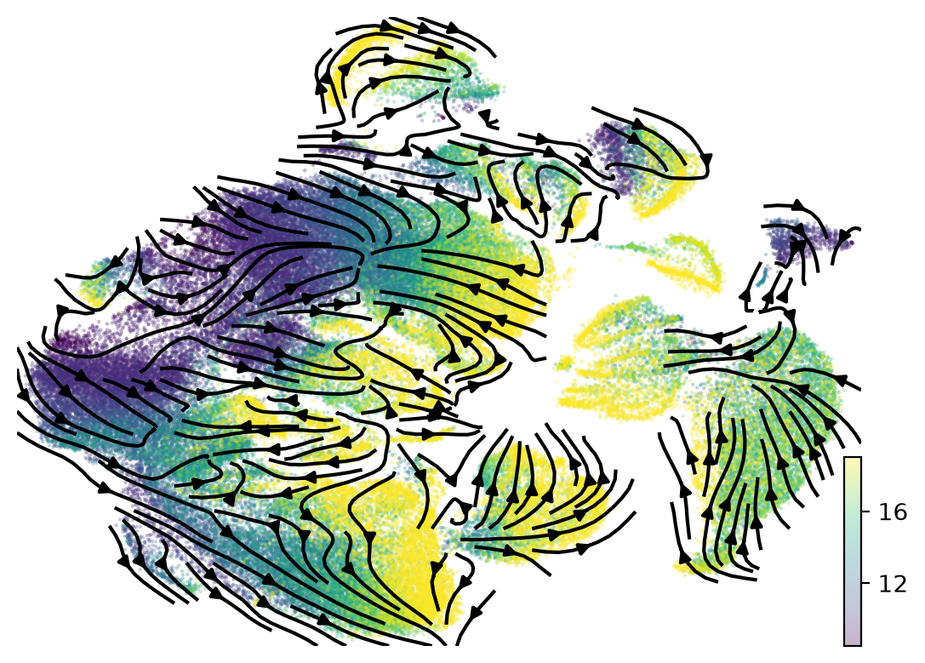
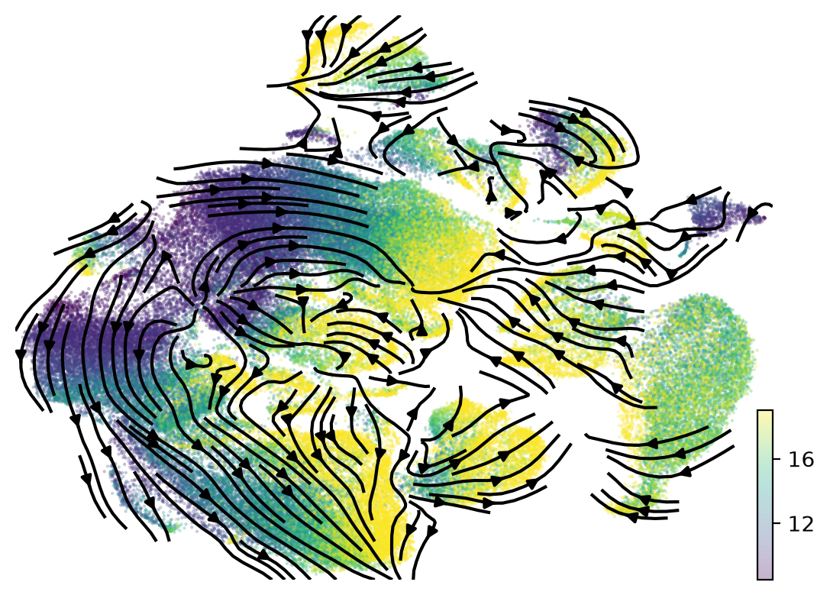
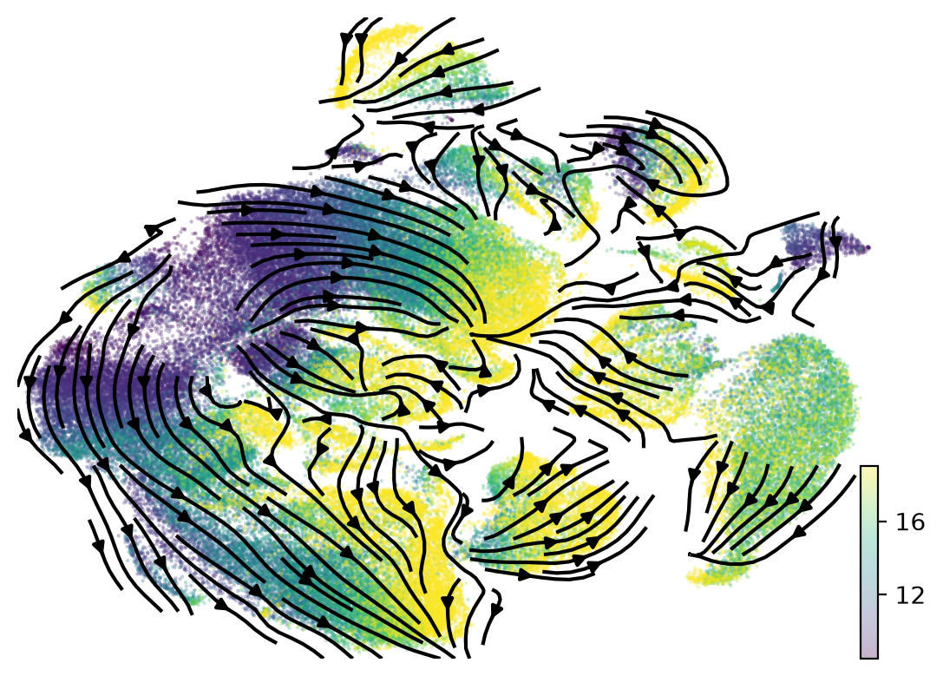
Learned vector fields can be visualized as velocity streams on the cell atlas
CFM
FiLM STREAM
Cross-attn STREAM
Illustrative stream plots show how model-predicted velocities align with the atlas manifold.

Slide 7
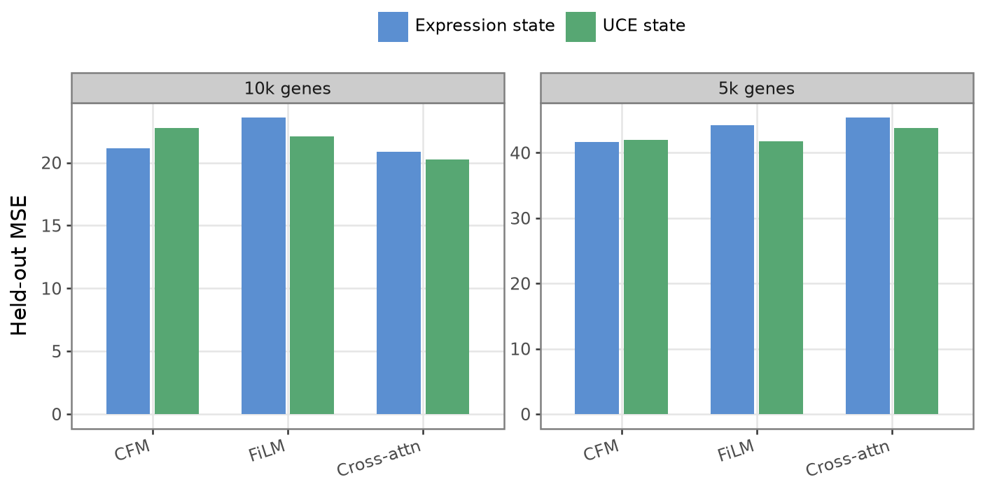
Mouse conditional-fit diagnostic: 10k genes lowers full-panel velocity loss
20.28
best 10k MSE
Cross-attn + UCE
1.594
best 10k MAE
Cross-attn + UCE
These OT-path losses use both endpoints and diagnose vector-field fit; they are not causal forecasts.

Slide 8
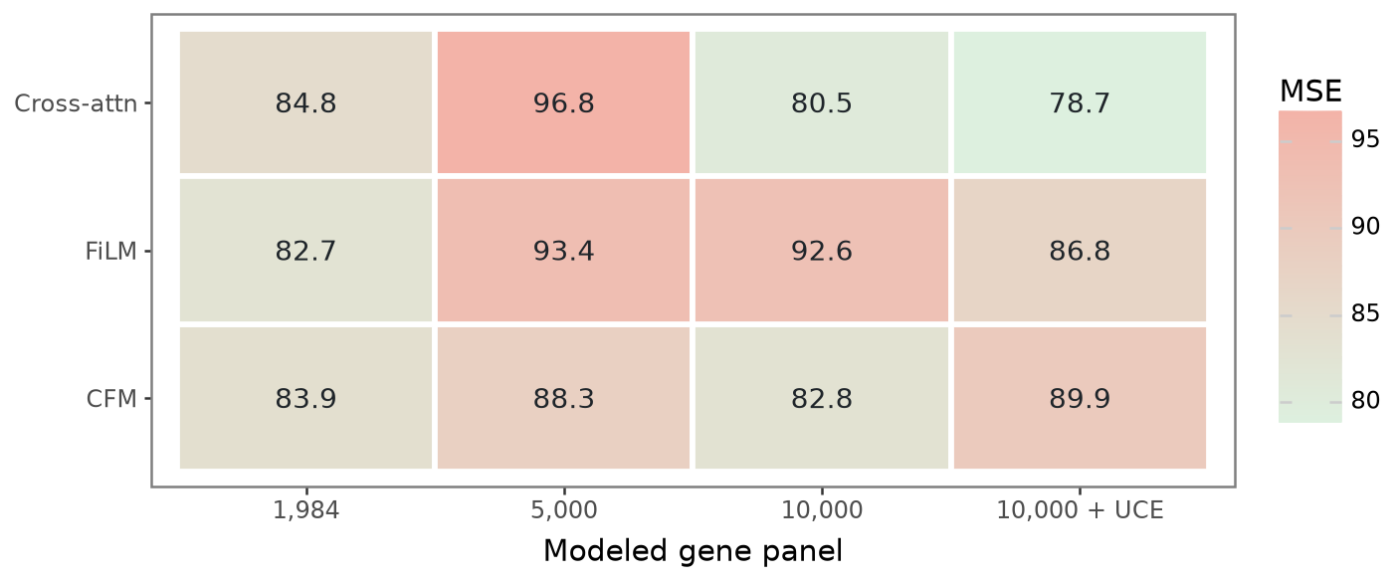
Conditional fit on a fixed legacy panel improves for 10k cross-attention
5k models do not improve the 1,984-gene metric
10k cross-attention improves loss from 84.8 to 80.5
10k UCE cross-attention improves further to 78.7
Numbers are OT-path velocity MSE on the same original gene panel; lower is better.

Slide 9
Legacy UCE improves conditional fit but does not establish forecasting
Model | MSE | MAE
Cross-attn + UCE | 20.28 | 1.594
Cross-attn | 20.86 | 1.742
CFM | 21.16 | 1.602
FiLM | 23.60 | 1.669
Legacy UCE interpolated both endpoint embeddings
Cross-attention can query UCE context differently for each gene's CRE tokens
Expression-state CFM remains a strong baseline, so sequence conditioning must beat a high bar
20.28
1.594
best full-panel MSE
best full-panel MAE

Slide 10
Cross-species transfer swaps the genome and cell-state vocabulary, not the training objective
zero-shot
mouse 10k UCE cross-attn
source checkpoint
fine-tuned
held-out 36 and 72 hpf expression displacement
zebrafish UCE cell states
zebrafish cCRE sequence tokens
zebrafish only
Two time conventions are evaluated: physical days and organism-relative [0,1] time.

Slide 11
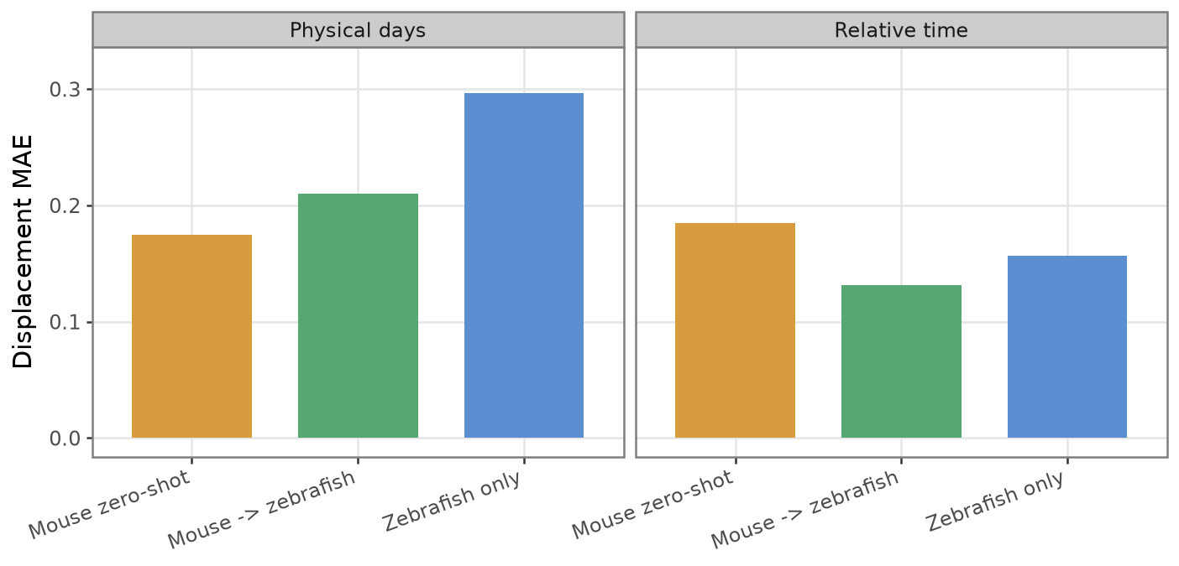
Zebrafish transfer results are conditional-fit diagnostics pending causal rollout
0.131
relative fine-tuned
0.157
relative zebrafish only
0.175
physical zero-shot
Lower displacement MAE is better. Bars compare learned transfer and target-only regimes.

Slide 12
Legacy cross-species conditional fit depends on time coordinate and training regime
Time | Regime | MAE | MSE
Relative time | Mouse zero-shot | 0.184 | 3.348
Relative time | Mouse -> zebrafish | 0.131 | 3.325
Relative time | Zebrafish only | 0.157 | 3.331
Physical days | Mouse zero-shot | 0.175 | 3.337
Physical days | Mouse -> zebrafish | 0.210 | 3.351
Physical days | Zebrafish only | 0.297 | 3.414
Relative time: fine-tuning beats zero-shot and zebrafish-only among learned models
Physical days: zero-shot is the strongest learned model, suggesting transferred timing is useful
Zebrafish-only training is weaker than transfer-started models in both time coordinates

Slide 13
Current picture: 10k improves conditional fit; causal UCE rollout is the required test
Question | Result | Evidence
Mouse panel size | 10k > 5k | Cross-attn improves legacy-panel loss at 10k
State representation | Legacy UCE fit improves | Forecasting claim requires online UCE rollout
Sequence conditioning | Useful but not automatic | CFM remains a strong baseline
Cross-species | Transfer signal appears | Fine-tuning helps in relative time
Next experiments
sequence embedding calibrated for zebrafish
stage-aware or time-conditioned transfer
rollout metrics beyond short displacement
Main result: 10k genes improve conditional fit; endpoint transport is now evaluated without destination leakage.

Slide 14
References anchor the flow-matching, cell-embedding, sequence, and zebrafish components
Component | Reference
Conditional Flow Matching | Lipman et al., Flow Matching for Generative Modeling, ICLR 2023 / arXiv:2210.02747
UCE cell state | Rosen et al., Universal cell embeddings provide a foundation model for cell biology, Nature 2026
Sequence embeddings | Avsec et al., Advancing regulatory variant effect prediction with AlphaGenome, Nature, doi:10.1038/s41586-025-10014-0
ZSCAPE atlas | Saunders et al., Embryo-scale reverse genetics at single-cell resolution, Nature 2023
STREAM figures | Generated from project outputs: atlas UMAP, held-out CFM metrics, UCE ablations, and transfer evaluations
Displayed plots and diagrams are generated from this repository's analysis outputs or drawn schematically in the deck builder.
The deck is reproducible from the slide builder script and current result CSV/PNG artifacts.

