Slide 1
XAI for classification of multivariate timeseries
Model XCM on ‘NATOPS’ with global and local XAI approaches
Visual Analytics
Dozent: Dominik Raab

Slide 2
Agenda
Definition of multivariate timeseries
Dataset ‘NATOPS‘
Model XCM
Architecture
Grad-CAM
Classification result
Approach
Live Demo

Slide 3
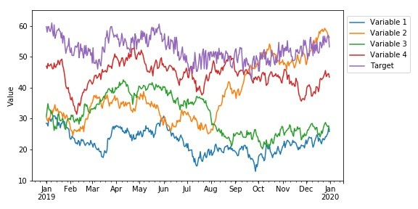
Multivariate timeseries
Eine multivariate Zeitreihe M ist eine t x l Matrix, wobei die j-te Zeile und die i-te Spalte von M jeweils m_{j} und m_{i} darstellt. Bei einer multivariaten Zeitreihe M ist jedes Element mi eine univariate Zeitreihe. Bei einem bestimmten Zeitpunkt t ist m_{t} = m₁t, m₂t, ..., m_{l}t, wobei l die Anzahl der univariaten Zeitreihen in M ist [1].
[2]

Slide 4
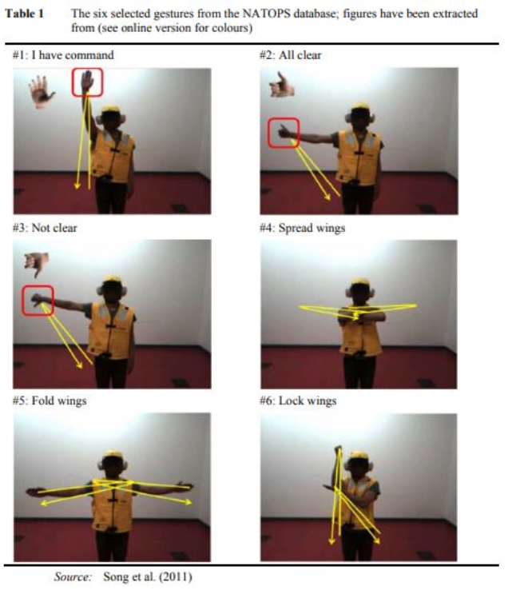
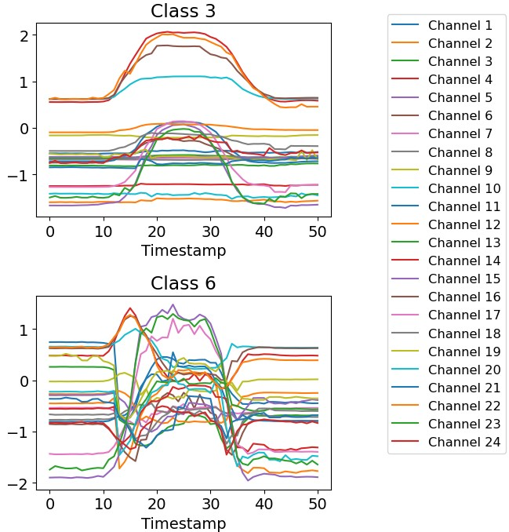
Dataset NATOPS
[3]

Slide 5
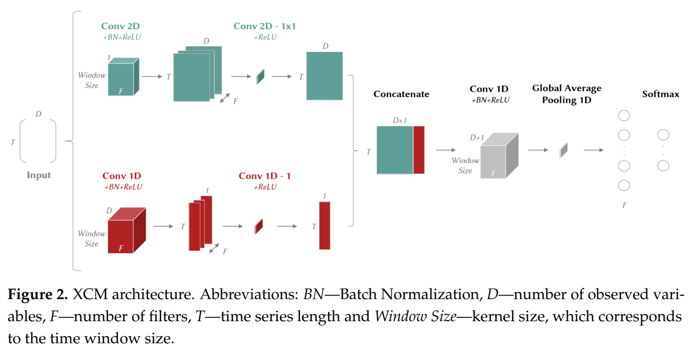
Model XCM
Extracts features directly from the observed values from the 2D convolutional filter and from time (1D convolutional filter) [4].
Feature maps are generated, which XCM processes into a 1D global average pooling and classifies with a SoftMax layer [4].

Slide 6
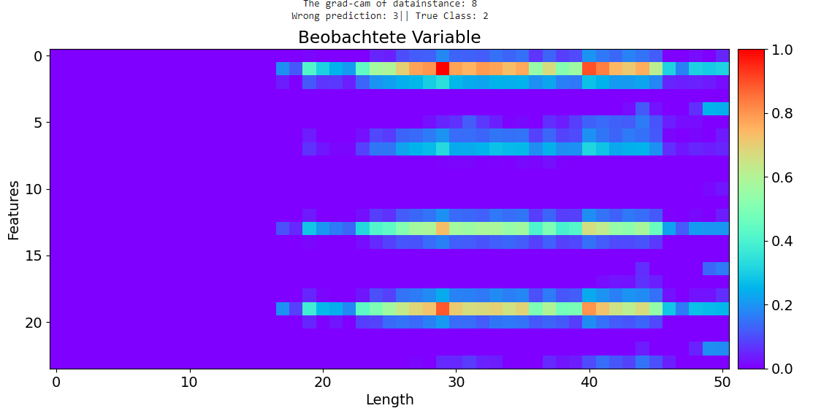
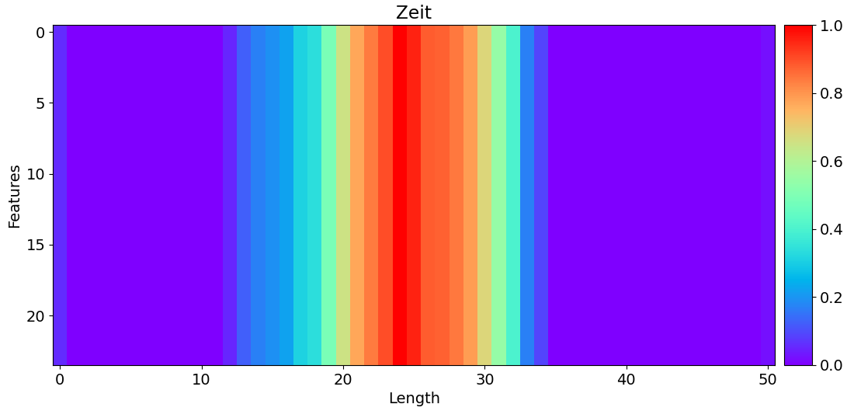
Model XCM – Grad-CAM
Grad-CAM first uses the attribution map of observed variables generated from the 2D convolutional layer feature maps [4, 7].
And second the attribution map of the time from the 1D convolutional layer [4].

Slide 7
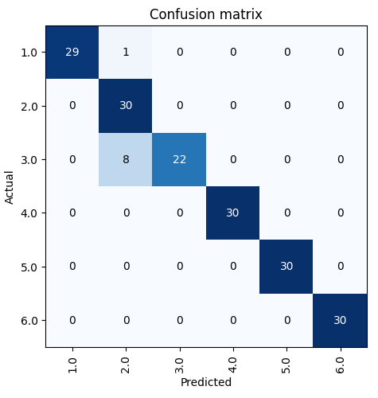
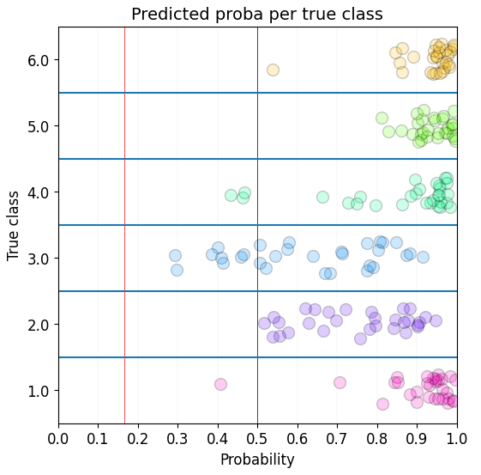
Classification Results

Slide 8
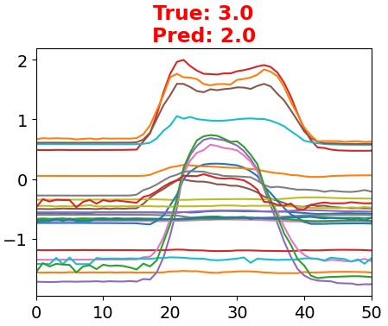
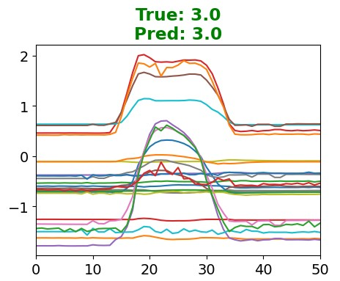
Approach
Global Explaination
(Permutation) [5,6,8]
?
Lokal Explaination
(Grad-CAM) [4]

Slide 9
Live Demo

Slide 10
Referenzen
[1] H. Ismail Fawaz, G. Forestier, J. Weber, L. Idoumghar, and P.-A. Muller, “Deep learning for time series classification: a review,” Data Mining and Knowledge Discovery, vol. 33, no. 4, pp. 917–963, 2019.
[2] https://media.licdn.com/dms/image/C4D12AQEcogkLzyEYNQ/article-inline_image-shrink_400_744/0/1576516447396?e=1692230400&v=beta&t=iERYcUJCz6g0EHO4OtKzwf9_WzmNwmonX7mBR9AF8PU
[3] http://www.timeseriesclassification.com/description.php?Dataset=NATOPS
[4] K. Fauvel, T. Lin, V. Masson, É. Fromont, and A. Termier, “Xcm: An explainable convolutional neural network for multivariate time series classification,” Mathematics, vol. 9, no. 23, p. 3137, 2021.
[5] https://github.com/timeseriesAI/tsai
[6] https://github.com/fastai/fastai
[7] R. R. Selvaraju, M. Cogswell, A. Das, R. Vedantam, D. Parikh and D. Batra, "Grad-CAM: Visual Explanations from Deep Networks via Gradient-Based Localization," 2017 IEEE International Conference on Computer Vision (ICCV), Venice, Italy, 2017, pp. 618-626, doi: 10.1109/ICCV.2017.74.
[8] Fisher, Aaron, Cynthia Rudin, and Francesca Dominici. “All models are wrong, but many are useful: Learning a variable’s importance by studying an entire class of prediction models simultaneously.” http://arxiv.org/abs/1801.01489 (2018)

