Slide 1
Java Full Stack Development Workshop
David Alex
IT Engineer Trainee
IPCS Global
Anna Nagar

Slide 2

Agenda
01
Full stack -Intro
What is full stack?
How it works?
02
Front-end
What is front end?
Languages used front end
How it works?
03
Back-end
What is back-end?
How it works?
Languages used and why java
04
Database
What is data base?
How it works?
What are data bases commonly used in industries?

Slide 3

Introduction
Developing
Testing
Documentation
Designing
Bug fixing

Slide 4
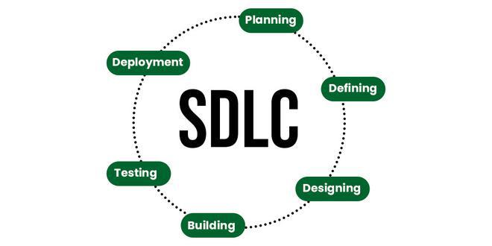
SDLC

Slide 5
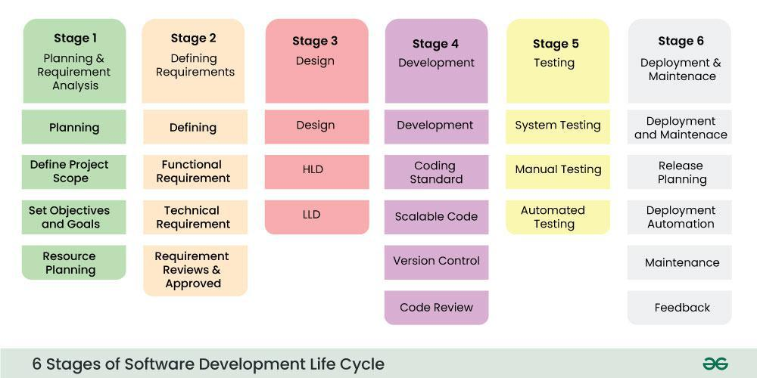

Slide 6
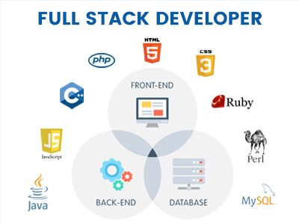
Full stack- intro

Slide 7
How it works?
Full stack development refers to the comprehensive development of both the user-facing side (frontend) and the server-side (backend) of an application.
The backend, also known as the server-side, is responsible for managing data, performing server-side logic, and storing and retrieving data from a database. Backend developers use programming languages like Python, Ruby, PHP, and JavaScript to create the server-side logic.
The database is responsible for storing and retrieving data. Databases can be relational (e.g., MySQL, PostgreSQL) or NoSQL (e.g., MongoDB).

Slide 8
Front-end
The front-end of a website or application refers to the user interface and user experience (UI/UX) aspects that users interact with directly. It is the client-side of the application, meaning it runs on the user's web browser or mobile device.
The front-end is responsible for:
User Interface (UI): The visual elements that users interact with, such as buttons, forms, images, and text.
User Experience (UX): The way users interact with the application, including the layout, navigation, and overall usability.

Slide 9
Client-side logic: The code that runs on the user's browser or device, handling tasks such as:
Rendering HTML, CSS, and JavaScript
Handling user input and events (e.g., clicks, keyboard input)
Updating the UI in response to user interactions
Validating user input and handling errors
Data visualization: Displaying data in a meaningful and visually appealing way, such as charts, graphs, and tables.
Languages used: HTML, CSS, JavaScript, Frameworks(Angular, React, Vue)
UI Libraries: Angular Material, Bootstrap, Tailwind css

Slide 10
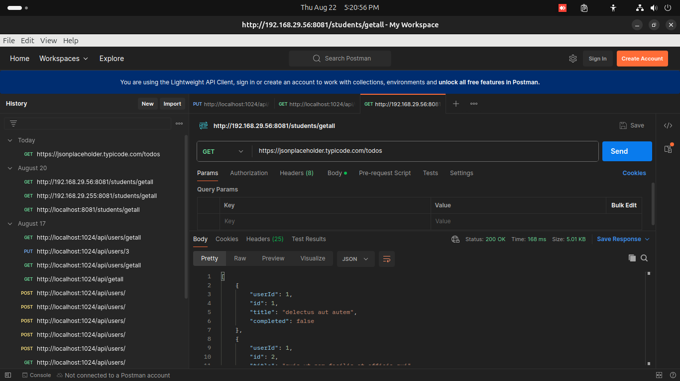

Slide 11
Back-end
The back-end of a website or application refers to the server-side of the application, which is responsible for managing data, handling requests, and providing APIs for the front-end to consume. It is the behind-the-scenes part of the application that users do not directly interact with.
The back-end is responsible for:
Data storage and management: Storing, retrieving, and manipulating data in databases, file systems, or other storage solutions.
Server-side logic: Running server-side code to handle requests, perform calculations, and make decisions.

Slide 12
APIs and integrations: Providing APIs (Application Programming Interfaces) for the front-end to consume, as well as integrating with third-party services and systems.
Request handling: Receiving and processing requests from the front-end, including HTTP requests, API calls, and other types of requests.
Security and authentication: Implementing security measures to protect data and ensure authorized access, including authentication, authorization, and encryption.
Business logic: Implementing the core business rules and processes of the application, such as payment processing, order fulfillment, and inventory management.

Slide 13
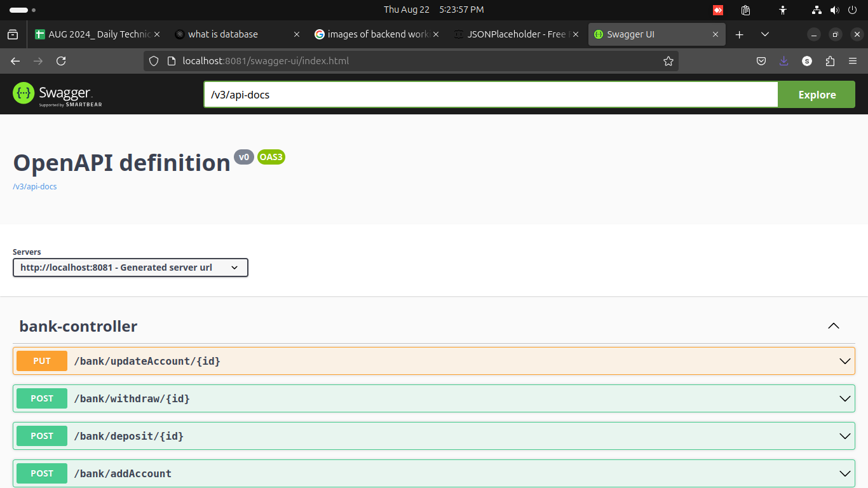

Slide 14
Database
A database is a collection of organized data that is stored in a way that allows for efficient retrieval and manipulation. It is a system that allows you to store, update, and retrieve data as needed. A database can be thought of as an electronic filing system that allows you to store, update, and retrieve data in a structured and controlled way.
A database typically consists of several key components:
Data: The actual information stored in the database, such as text, numbers, images, or other types of data.
Schema: The structure or organization of the data, including the relationships between different data elements.

Slide 15
Database management system (DBMS): The software that manages the database, providing features such as data storage, retrieval, and manipulation.
Storage: The physical location where the data is stored, such as a hard drive or solid-state drive.

Slide 16
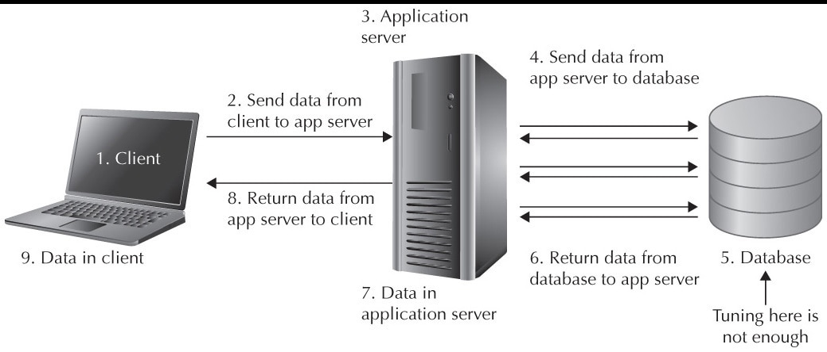

Slide 17
Thank you!

