Slide 1
Java Full Stack Development Workshop
David Alex
IT Engineer Trainee
IPCS Global
Anna Nagar

Slide 2

Agenda
01
Full stack -Intro
What is full stack?
How it works?
02
Front-end
What is front end?
Languages used front end
How it works?
03
Back-end
What is back-end?
How it works?
Languages used and why java
04
Database
What is data base?
How it works?
What are data bases commonly used in industries?

Slide 3

Introduction
Developing
Testing
Documentation
Designing
Bug fixing

Slide 4
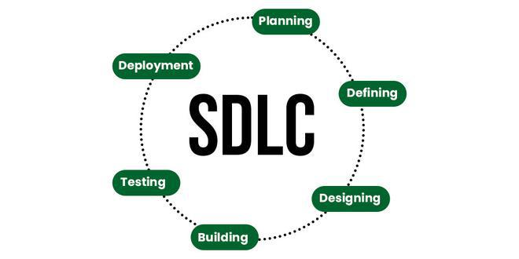
SDLC

Slide 5
Planning:
In the Software Development Life Cycle (SDLC), planning is the first phase of the software development process. It is a critical phase that sets the foundation for the entire project. During this phase, the project's objectives, scope, timelines, budget, and resources are defined.
The primary goals of the planning phase are to:
Define the project's objectives and scope
Identify the stakeholders and their roles
Determine the project's feasibility and viability
Develop a detailed project schedule and timeline
Establish a budget and resource allocation plan

Slide 6
The planning phase typically involves the following activities:
Project Initiation: Define the project's objectives, scope, and stakeholders.
Feasibility Study: Determine whether the project is feasible and viable.
Project Charter: Create a document that outlines the project's objectives, scope, and stakeholders.
Stakeholder Analysis: Identify and analyze the stakeholders and their roles.
Project Schedule: Develop a detailed project schedule and timeline.
Budgeting: Establish a budget and resource allocation plan.
Risk Management: Identify and assess potential risks and develop mitigation strategies.
Quality Planning: Define the project's quality and acceptance criteria.

Slide 7
Planning Phase:
The planning phase is the first stage of the Software Development Life Cycle (SDLC). It is a critical phase that sets the foundation for the entire project. During this phase, the project's objectives, scope, timelines, budget, and resources are defined.
Activities:
The following activities are typically performed during the planning phase:
Project Initiation:
Define the project's objectives and scope
Identify the stakeholders and their roles
Determine the project's feasibility and viability
Feasibility Study:
Conduct a feasibility study to determine whether the project is viable

Slide 8
Project Charter:
Create a project charter that outlines the project's objectives, scope, and stakeholders
Obtain approval from the project sponsor or stakeholders
Stakeholder Analysis:
Identify and analyze the stakeholders and their roles
Determine their expectations and requirements
Project Schedule:
Develop a detailed project schedule and timeline
Identify the milestones and deadlines
Budgeting:
Establish a budget and resource allocation plan
Identify the costs and resources required for the project

Slide 9
Risk Management:
Identify and assess potential risks and develop mitigation strategies
Develop a risk management plan
Quality Planning:
Define the project's quality and acceptance criteria
Develop a quality plan
Communication Plan:
Develop a communication plan that outlines how stakeholders will be informed and engaged throughout the project
Stakeholder Management Plan:
Develop a stakeholder management plan that outlines how stakeholders will be managed and engaged throughout the project

Slide 10
Benefits:
The planning phase provides several benefits, including:
Clear project objectives and scope:
Ensures that everyone involved in the project has a clear understanding of the project's objectives and scope
Realistic project schedule and budget:
Ensures that the project schedule and budget are realistic and achievable
Identified risks and mitigation strategies:
Ensures that potential risks are identified and mitigation strategies are developed

Slide 11
Improved communication and stakeholder engagement:
Ensures that stakeholders are informed and engaged throughout the project
Better quality and acceptance criteria:
Ensures that the project's quality and acceptance criteria are defined and met.

Slide 12
Defining Phase:
The defining phase is the second stage of the Software Development Life Cycle (SDLC). During this phase, the project's requirements are gathered, analyzed, and documented. The goal of this phase is to define the project's functional and non-functional requirements, and to create a clear understanding of what the project will deliver.
Activities:
The following activities are typically performed during the defining phase:
Requirements Gathering:
Identify and gather requirements from stakeholders, users, and customers
Use techniques such as interviews, surveys, and focus groups to gather requirements

Slide 13
Use Cases:
Create use cases to describe the interactions between the system and its users
Identify the actors, use cases, and scenarios within the system
User Stories:
Create user stories to describe the system's functionality from the user's perspective
Identify the user's goals, tasks, and acceptance criteria
Deliverables:
Requirements Document:
A document that outlines the project's functional and non-functional requirements

Slide 14
Data Flow Diagrams:
Diagrams that visualize the flow of data within the system
Entity-Relationship Diagrams:
Diagrams that visualize the relationships between entities within the system
Use Cases:
Documents that describe the interactions between the system and its users
User Stories:
Documents that describe the system's functionality from the user's perspective

Slide 15
Benefits:
The defining phase provides several benefits, including:
Clear requirements:
Ensures that the project's requirements are clear, concise, and well-defined
Improved communication:
Ensures that stakeholders, users, and developers have a common understanding of the project's requirements
Reduced scope creep:
Helps to prevent scope creep by defining the project's requirements upfront
Better design:
Provides a solid foundation for the design phase by defining the project's functional and non-functional requirements

Slide 16
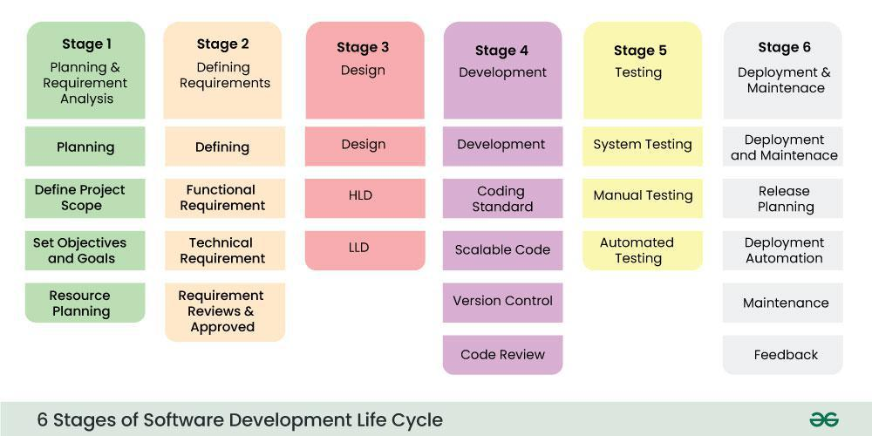

Slide 17
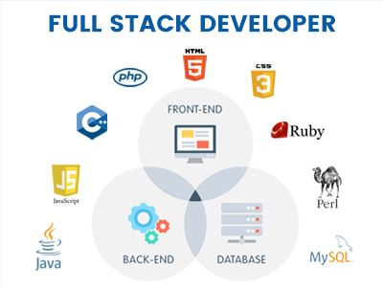
Full stack- intro

Slide 18
How it works?
Full stack development refers to the comprehensive development of both the user-facing side (frontend) and the server-side (backend) of an application.
The backend, also known as the server-side, is responsible for managing data, performing server-side logic, and storing and retrieving data from a database. Backend developers use programming languages like Python, Ruby, PHP, and JavaScript to create the server-side logic.
The database is responsible for storing and retrieving data. Databases can be relational (e.g., MySQL, PostgreSQL) or NoSQL (e.g., MongoDB).

Slide 19
Front-end
The front-end of a website or application refers to the user interface and user experience (UI/UX) aspects that users interact with directly. It is the client-side of the application, meaning it runs on the user's web browser or mobile device.
The front-end is responsible for:
User Interface (UI): The visual elements that users interact with, such as buttons, forms, images, and text.
User Experience (UX): The way users interact with the application, including the layout, navigation, and overall usability.

Slide 20
Client-side logic: The code that runs on the user's browser or device, handling tasks such as:
Rendering HTML, CSS, and JavaScript
Handling user input and events (e.g., clicks, keyboard input)
Updating the UI in response to user interactions
Validating user input and handling errors
Data visualization: Displaying data in a meaningful and visually appealing way, such as charts, graphs, and tables.
Languages used: HTML, CSS, JavaScript, Frameworks(Angular, React, Vue)
UI Libraries: Angular Material, Bootstrap, Tailwind css

Slide 21
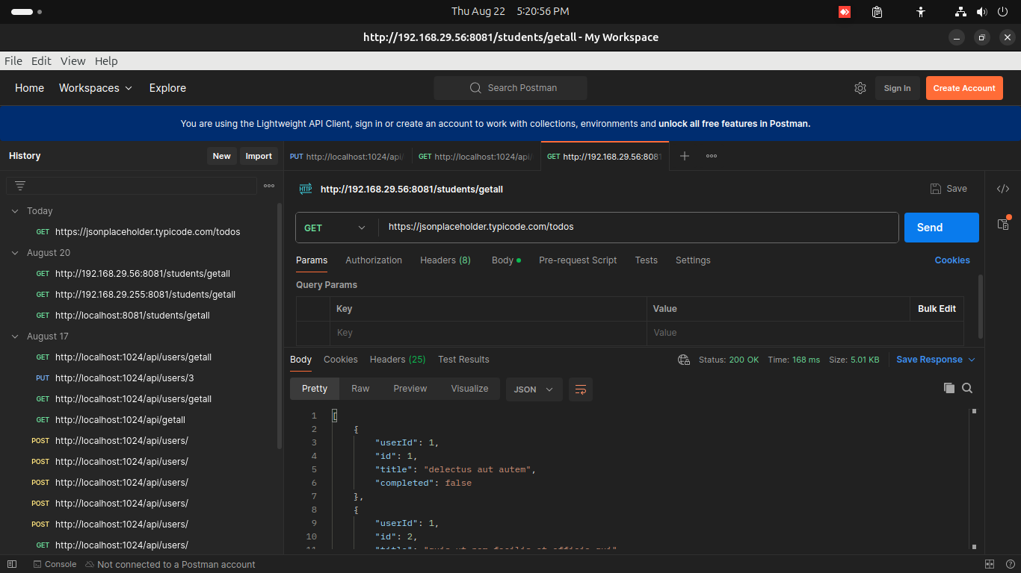

Slide 22
Back-end
The back-end of a website or application refers to the server-side of the application, which is responsible for managing data, handling requests, and providing APIs for the front-end to consume. It is the behind-the-scenes part of the application that users do not directly interact with.
The back-end is responsible for:
Data storage and management: Storing, retrieving, and manipulating data in databases, file systems, or other storage solutions.
Server-side logic: Running server-side code to handle requests, perform calculations, and make decisions.

Slide 23
APIs and integrations: Providing APIs (Application Programming Interfaces) for the front-end to consume, as well as integrating with third-party services and systems.
Request handling: Receiving and processing requests from the front-end, including HTTP requests, API calls, and other types of requests.
Security and authentication: Implementing security measures to protect data and ensure authorized access, including authentication, authorization, and encryption.
Business logic: Implementing the core business rules and processes of the application, such as payment processing, order fulfillment, and inventory management.

Slide 24
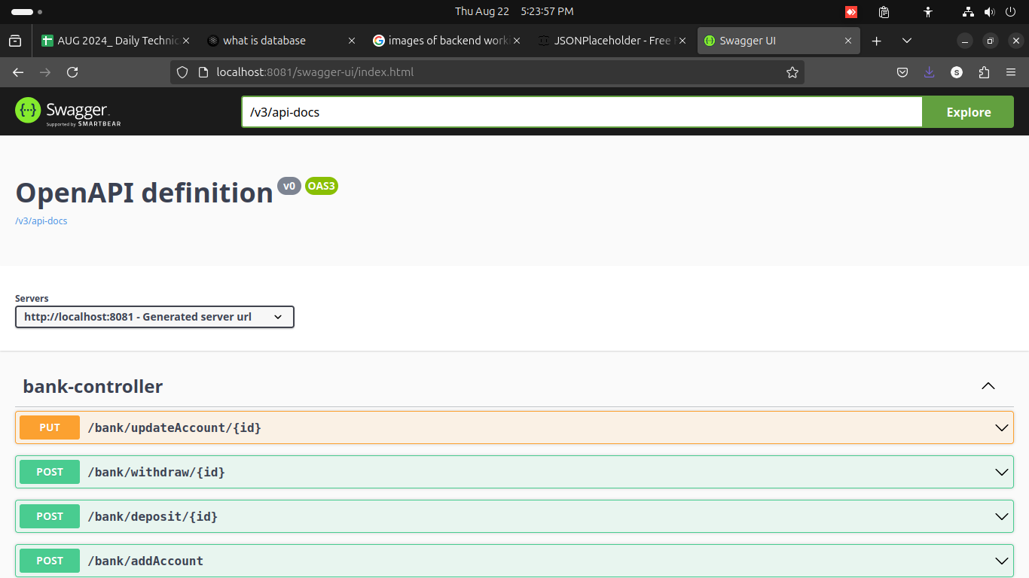

Slide 25
Database
A database is a collection of organized data that is stored in a way that allows for efficient retrieval and manipulation. It is a system that allows you to store, update, and retrieve data as needed. A database can be thought of as an electronic filing system that allows you to store, update, and retrieve data in a structured and controlled way.
A database typically consists of several key components:
Data: The actual information stored in the database, such as text, numbers, images, or other types of data.
Schema: The structure or organization of the data, including the relationships between different data elements.

Slide 26
Database management system (DBMS): The software that manages the database, providing features such as data storage, retrieval, and manipulation.
Storage: The physical location where the data is stored, such as a hard drive or solid-state drive.

Slide 27
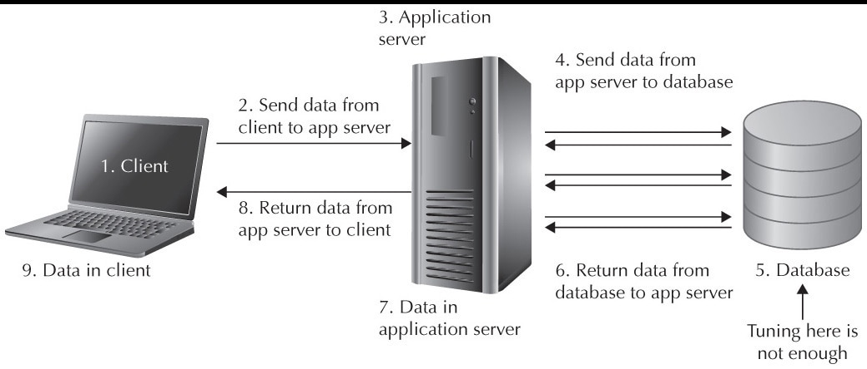

Slide 28

Thank you!

