Slide 1
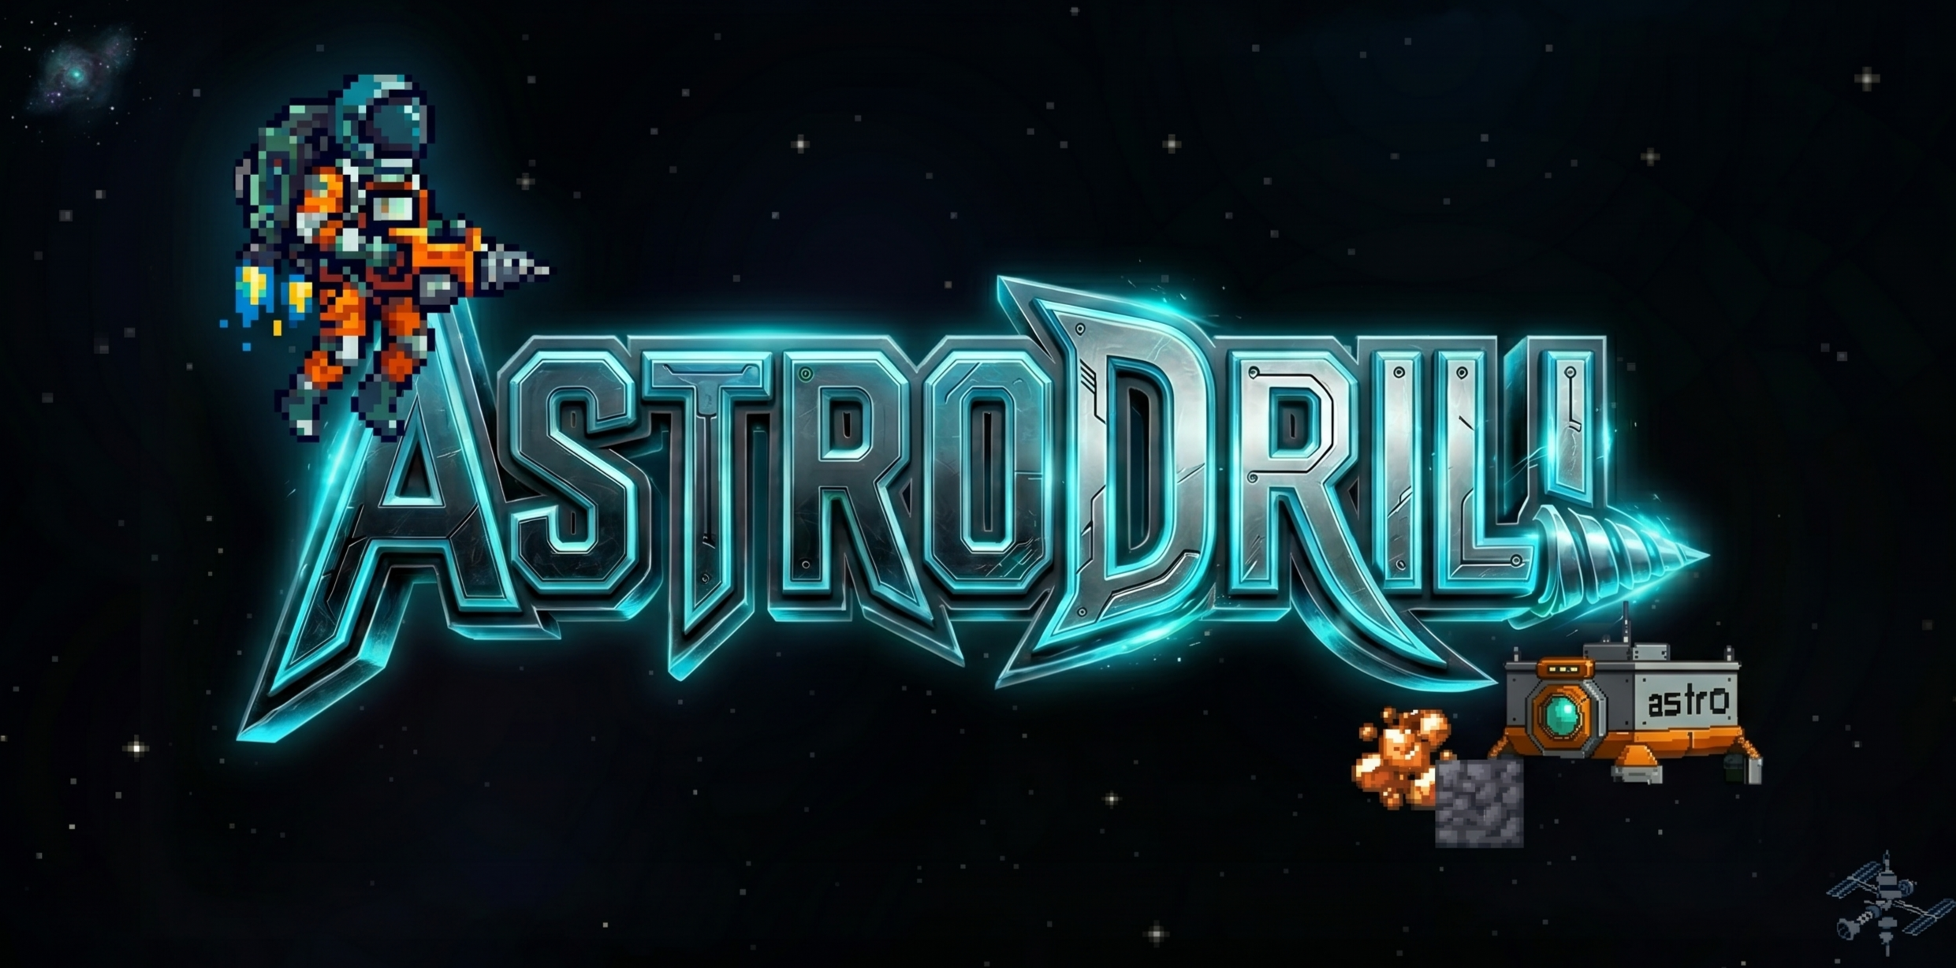
SECTOR // GAME OOP JAVA
2026
// PROYEK AKHIR OOP
AstroDrill
Proyek Akhir OOP, Open Recruitment NetLab 2026
Presenter: David Alexander
NETLAB // OPEN RECRUITMENT
01 // 15

Slide 2
ASTRODRILL // DAFTAR ISI
OOP FINAL PROJECT
AGENDA
Daftar Isi
01
Gambaran Proyek
03
02
Tech Stack dan Arsitektur
04 — 06
03
Database dan REST API
07 — 10
04
Enam Design Pattern
11 — 14
05
Demo, Bonus
15
02/15

Slide 3
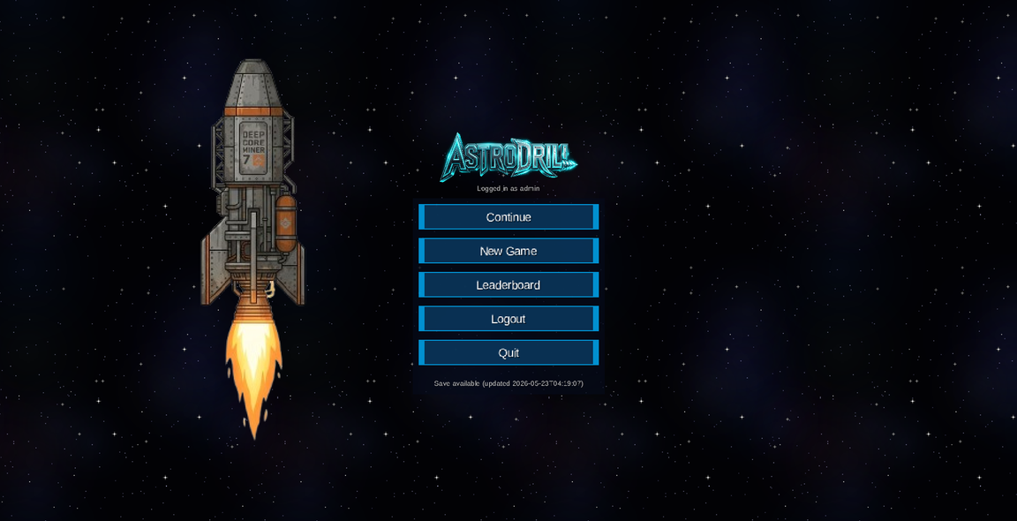
01 // GAMBARAN
ASTRODRILL
OVERVIEW
Gambaran Proyek
KONSEP INTI
▸ Genre: 2D mining dan spaceflight
▸ Bertahan & Gali: Kelola baterai jetpack dan
menjelajahi lapisan geologi
▸ Otomatisasi: Beralih dari penambangan manual
ke jaringan mesin yang saling terhubung
▸ Menang: Olah material endgame dan luncurkan
roket untuk menang.
03/15

Slide 4
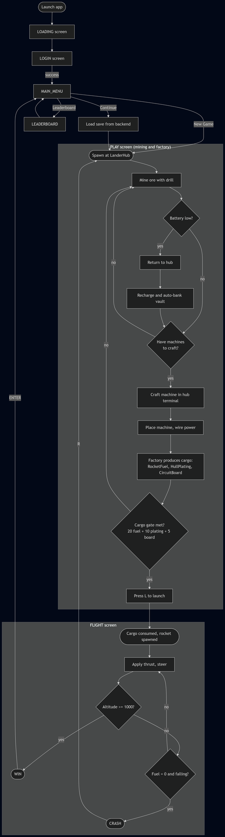
01 // GAMEPLAY
FLOWCHART
FLOW
Alur Gameplay
Mining, auto-bank di hub, crafting, otomatisasi, peluncuran.
▸ Cargo/material gate menjembatani fase mining dan flight.
MINING
AUTO-BANK
CRAFTING
CARGO GATE
FLIGHT
04/15

Slide 5

02 // TECH STACK
FRONTEND + BACKEND
STACK
Tech Stack
FRONTEND (GAME)
BACKEND (REST API) DAN DATABASE
▸ LibGDX 1.13, Java 17, Gradle
▸ Box2D untuk physics flight
▸ Custom AABB untuk mining
▸ Scene2D HUD
▸ Spring Boot 4, Java 17, Maven
▸ JPA, BCrypt, Jakarta Validation
▸ PostgreSQL dengan skema ternormalisasi
▸ Gson untuk serialisasi JSON
▸ Self-hosted: Docker + Tailscale Funnel (HTTPS)
05/15

Slide 6
02 // ARSITEKTUR
MONOREPO
REPO
Arsitektur Repository
▸ Kedua aplikasi independen menggunakan satu script launcher.
AstroDrill/
├── Game/ . LibGDX client (core, lwjgl3, html)
│ └── core/.../astrodrill/
│ ├── screen/ 6 layar (Login, Play, Flight, ...)
│ ├── entity/ Player, Block, Rocket, LanderHub
│ ├── machine/ Machine + 11 subclass + MachineFactory
│ ├── strategy/ EngineStrategy (Chemical, Ion)
│ ├── observer/ VaultObserver, InventoryObserver
│ ├── crafting/ MachineRecipe, UpgradeDefinition
│ ├── network/ BackendClient + DTO
│ └── GameManager Singleton, transisi layar
├── Backend/ Spring Boot REST API
│ ├── Dockerfile multi-stage build (Maven → JRE Alpine)
│ ├── docker-compose.yml backend + PostgreSQL container
│ └── src/main/java/.../backend/
│ ├── controller/ GameController, exception handler
│ ├── service/ AuthService, GameService
│ ├── entity/ Player, SaveState, Leaderboard
│ ├── repository/ JPA repository (3 entity)
│ └── dto/ Request/Response DTO
├── docs/ Dokumentasi, diagram, slides
└── package.json npm run dev menjalankan keduanya
06/15

Slide 7
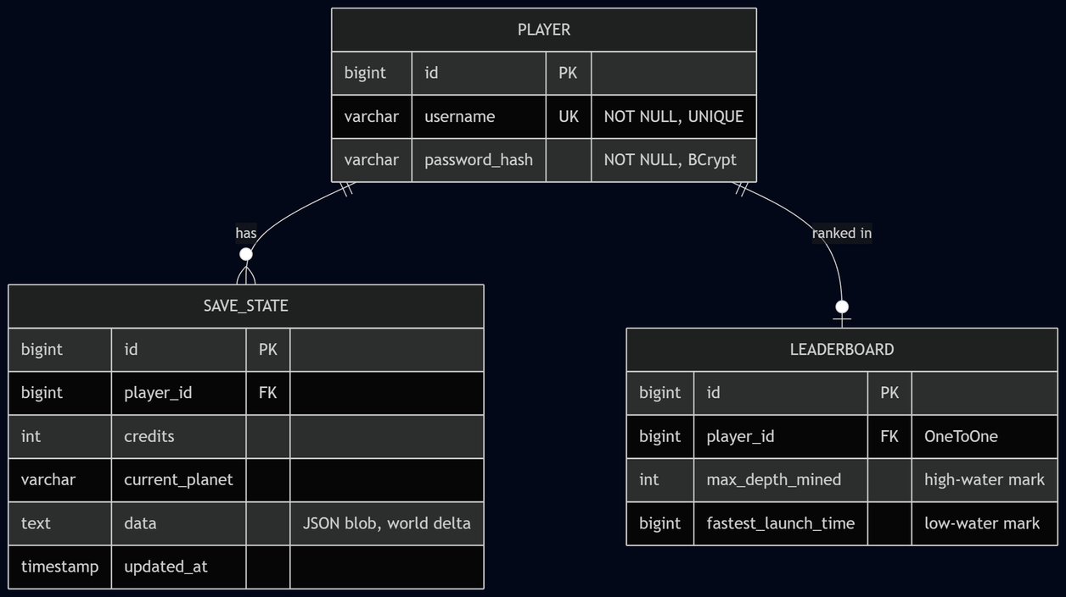
03 // DATABASE
ERD
SCHEMA
Desain Database
RELASI
▸ Tiga tabel ternormalisasi, hanya PostgreSQL
▸ Player memiliki banyak SaveState
▸ Player memiliki satu baris Leaderboard
▸ SaveState menyimpan world delta sebagai JSON
07/15

Slide 8
03 // REST API
5 ENDPOINTS
API
REST API
METHOD
PATH
STATUS CODES
POST
/register
201, 409
POST
/login
200, 401
POST
/save
200, 404
GET
/load/{playerId}
200, 404
GET
/leaderboard
200
▸ Base path: /api/game
▸ Error melewati GlobalExceptionHandler
▸ Auth: hanya BCrypt, tanpa JWT (single-player)
08/15

Slide 9
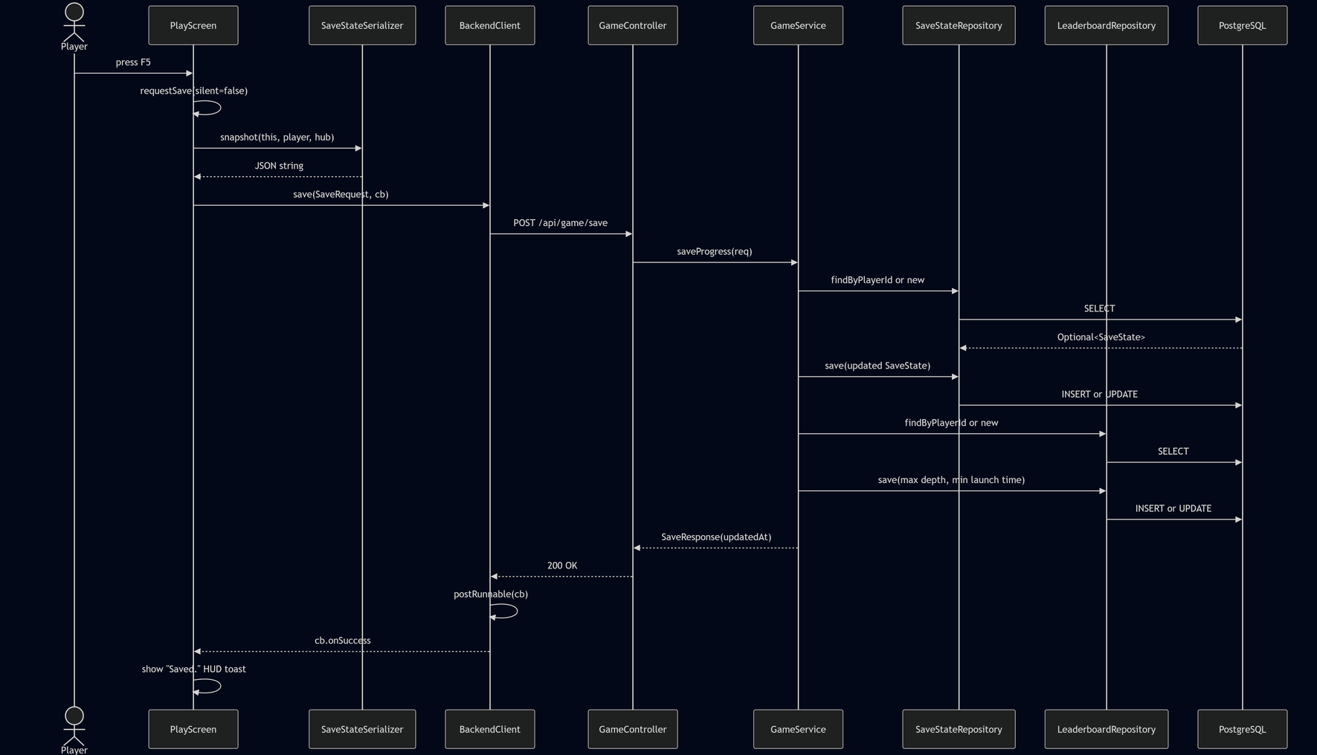
03 // SEQUENCE
F5 // SAVE
SEQUENCE DIAGRAM
Sequence: Save
▸ F5 / Main menu → Save & Exit di PlayScreen
serialisasi world delta
▸ POST ke /api/game/save
▸ GameService update SaveState dan Leaderboard
09/15

Slide 10
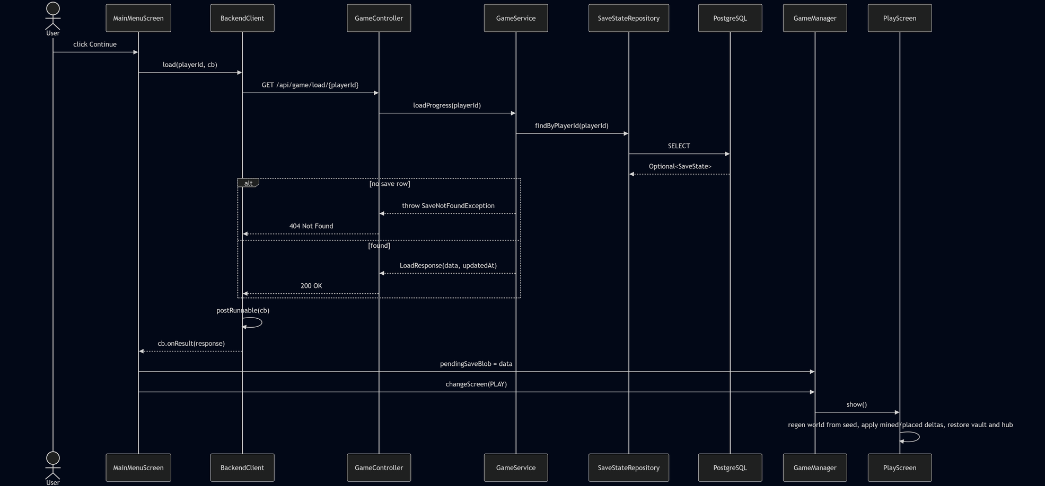
03 // SEQUENCE
CONTINUE // LOAD
SEQUENCE DIAGRAM
Sequence: Load (Continue)
▸ Continue memanggil GET /load/{playerId}
▸ World di-regenerate dari seed
▸ Saved delta diaplikasikan di atasnya
10/15

Slide 11
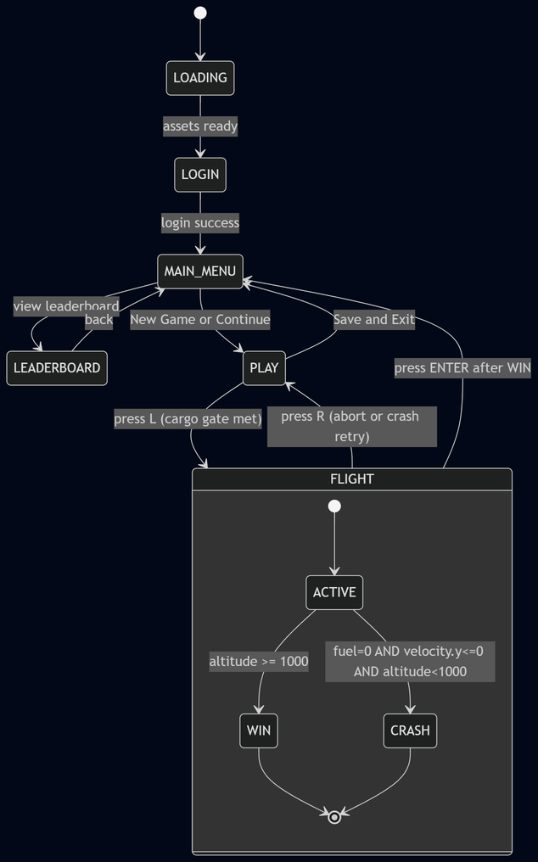
04 // STATE
SCREEN STATE
STATE DIAGRAM
State Machine Layar
▸ Satu entry point: changeScreen(ScreenType)
▸ Enam layar, nested FlightState
▸ Pattern State di dua level
11/15

Slide 12
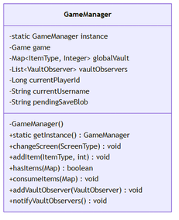
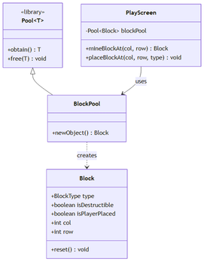
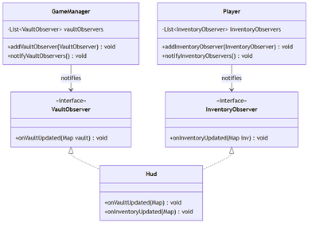
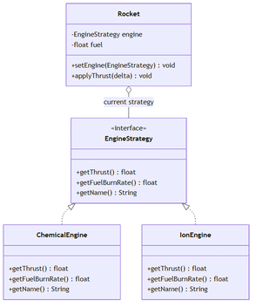
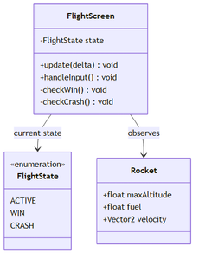
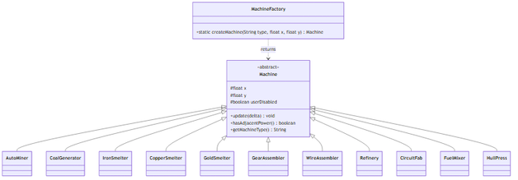
04 // PATTERNS
6 OF 6
DESIGN PATTERNS
Enam Design Pattern
Enam pattern GoF (tanpa Game Loop), semuanya load-bearing.
01
02
03
Singleton
Object Pool
Observer
GameManager
Pool<Block>
VaultObserver, InventoryObserver
04
05
06
Factory Method
Strategy
State
MachineFactory
EngineStrategy
FlightState
12/15

Slide 13
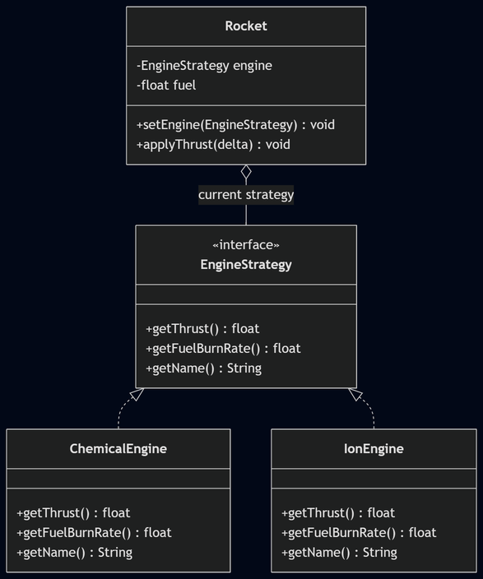
04 // PATTERN HIGHLIGHT
STRATEGY
PATTERN HIGHLIGHT
Sorotan Pattern: Strategy
▸ Rocket menyimpan field EngineStrategy
▸ ChemicalEngine: thrust 500, burn 10 per detik
▸ IonEngine: thrust 50, burn 0.5 per detik
▸ Tekan E untuk swap engine mid-flight
13/15

Slide 14
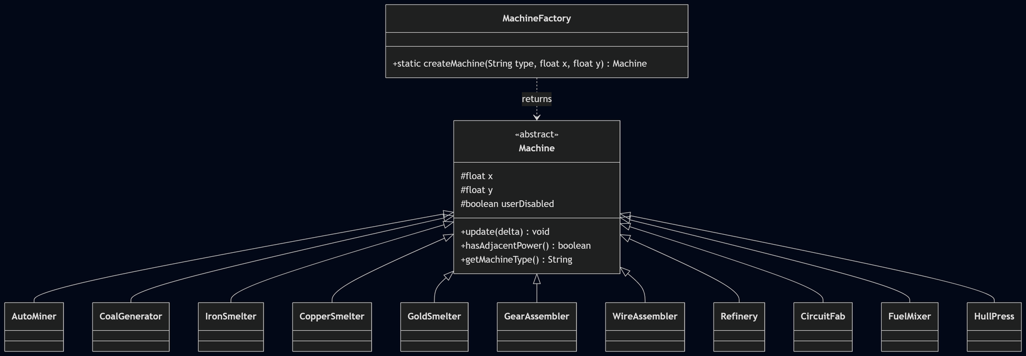
04 // PATTERN HIGHLIGHT
FACTORY METHOD
PATTERN HIGHLIGHT
Sorotan Pattern: Factory Method
▸ createMachine(String type) return Machine
▸ 11 subclass concrete menggunakan satu switch
▸ Dipakai oleh placement dan save restore
public static Machine createMachine(String type, float x, float y) {
switch (type) {
case "IronSmelter": return new IronSmelter(x, y, 1f, 1f);
case "AutoMiner": return new AutoMiner(x, y, 1f, 1f);
// ... 9 case lainnya
default: return null;
}
}
14/15

Slide 15
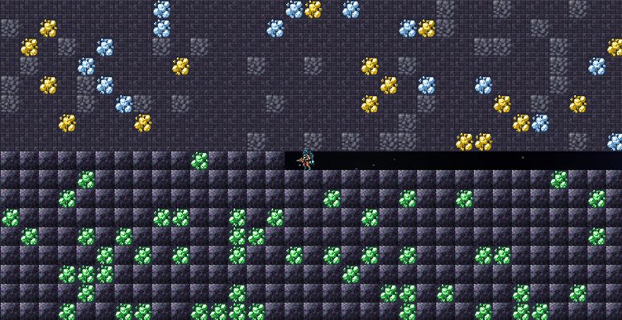
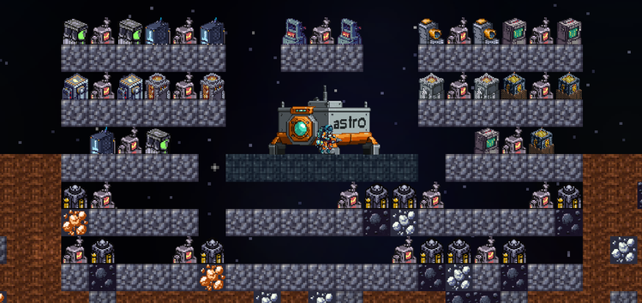
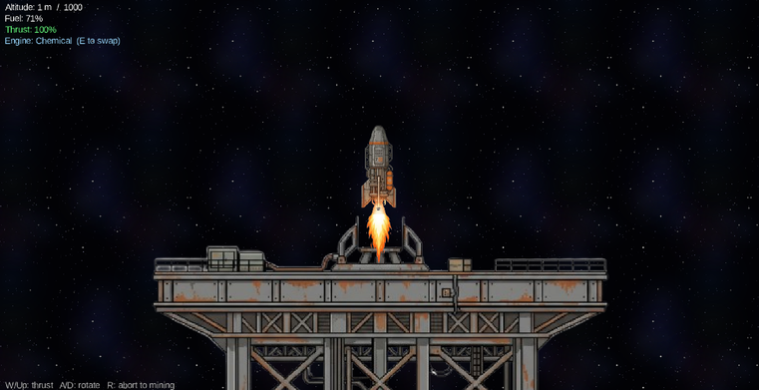
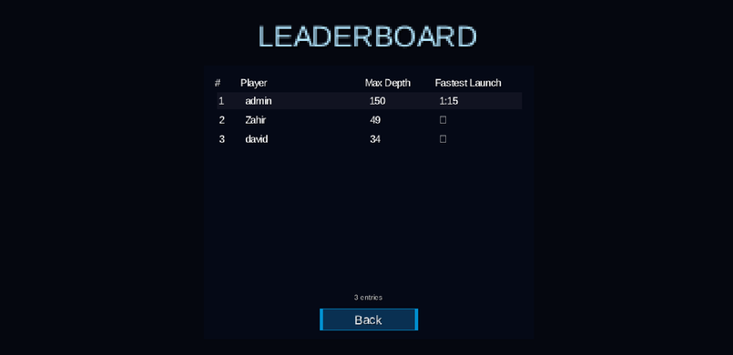
05 // DEMO
CLOSING
DEMO & BONUS
Demo & Bonus
BONUS
▸ itch.io: davidalexanderr.itch.io/astrodrill
▸ Backend self-hosted: Docker + Tailscale Funnel
▸ Sistem cloud save dan load
▸ Global leaderboard
▸ 11 machine yang dapat di-craft
Mining
01
Factory
02
Terima kasih!
Flight
03
Leaderboard
04
15/15

