Slide 1
Apollo Client Example chapter four pp115

Slide 2
npm install --save @apollo/client graphql
mkdir src/client/apollo
mkdir src/client/apollo/index.js

Slide 3
Contents of mkdir src/client/apollo/index.js
import { ApolloClient, InMemoryCache, from, HttpLink } from '@apollo/client';
import { onError } from "@apollo/client/link/error";
const client = new ApolloClient({
link: from([
onError(({ graphQLErrors, networkError }) => {
if (graphQLErrors) {
graphQLErrors.map(({ message, locations, path }) =>
console.log(`[GraphQL error]: Message: ${message}, Location:
${locations}, Path: ${path}`));
if (networkError) {
console.log(`[Network error]: ${networkError}`); } } }),
new HttpLink({
uri: 'http://localhost:8000/graphql’, }), ]),
cache: new InMemoryCache(),});
export default client;
Change it to ….the related DNS such as….
ec2-34-219-12-88.us-west-2.compute.amazonaws.com

Slide 4
Add enhancements to index.js NOTE: pay attention to the forward quotes `` for the gql query ( wrong in book )
import { ApolloClient, InMemoryCache, from, HttpLink } from '@apollo/client';
import { onError } from "@apollo/client/link/error";
import { gql } from '@apollo/client';
const client = new ApolloClient({
link: from([
onError(({ graphQLErrors, networkError }) => {
if (graphQLErrors) {
graphQLErrors.map(({ message, locations, path }) =>
console.log(`[GraphQL error]: Message: ${message}, Location:
${locations}, Path: ${path}`));
if (networkError) {
console.log(`[Network error]: ${networkError}`);

Slide 5
Add enhancements to index.js cont.
} }}),
new HttpLink({
uri: 'http://ec2-34-219-12-88.us-west-2.compute.amazonaws.com:8000/graphql',}),]),
cache: new InMemoryCache(),});
client.query({
query: gql`
{ posts {
id
text }}`
}).then(result => console.log(result));
export default client;

Slide 6
Final change is to update index.js in src/client (not the src/client/apollo)
ubuntu@ip-172-31-4-219:~/graphbook/src/client$ cat index.js
import React from 'react';
import ReactDOM from 'react-dom';
import App from './App';
import client from './apollo';
ReactDOM.render(<App/>, document.getElementById('root'));

Slide 7
Testing
Start the server in one terminal
Start client in another terminal
ubuntu@ip-172-31-4-219:~/graphbook/src/client/apollo$ npm run server
ubuntu@ip-172-31-4-219:~/graphbook/src/client$ npm run client

Slide 8
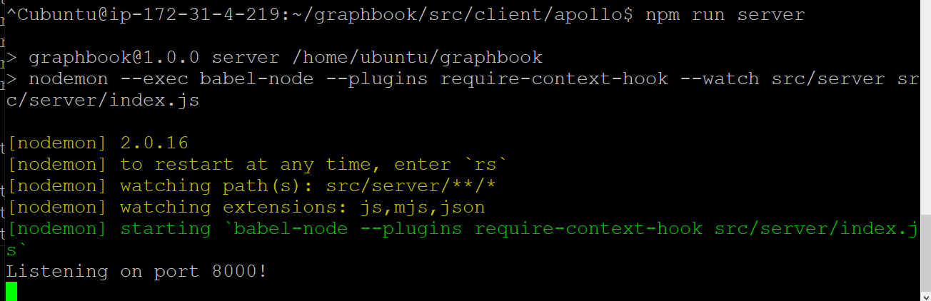

Slide 9
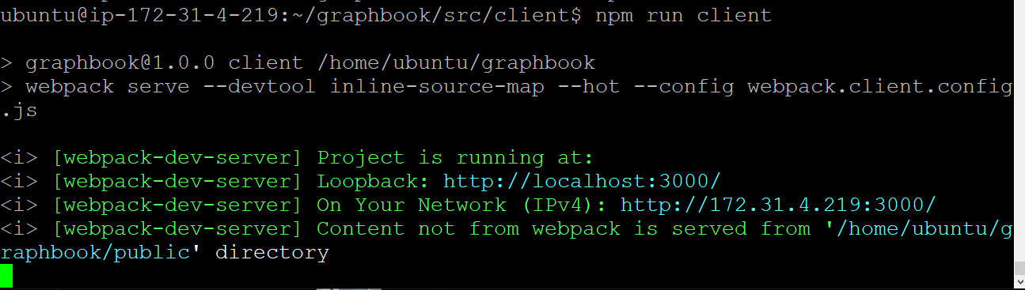

Slide 10
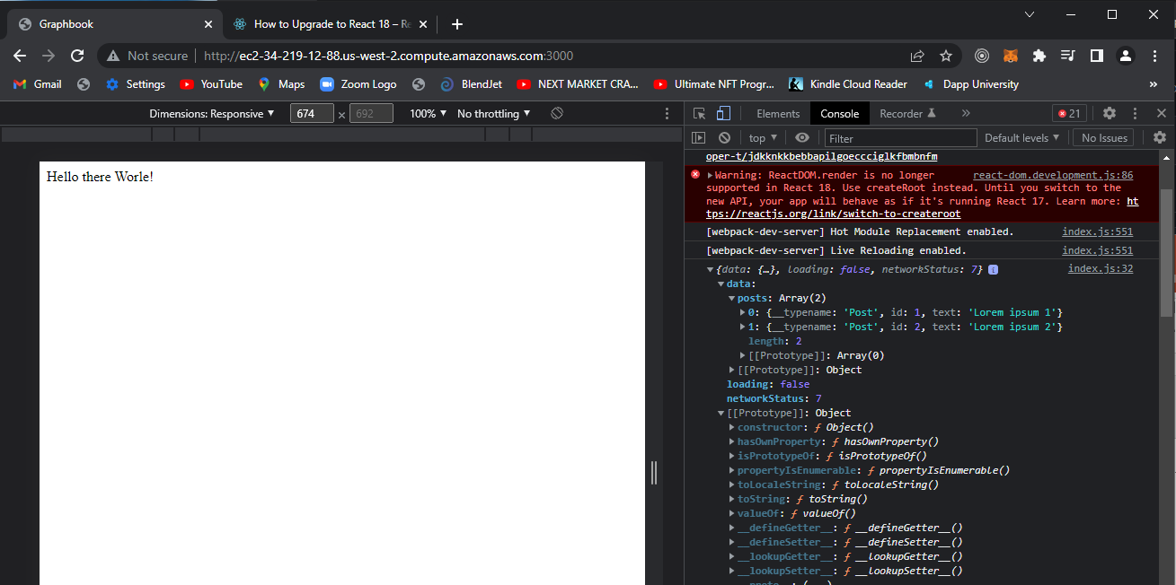
Run port 3000 just like the hello world
Output is in console from developer tools

Slide 11
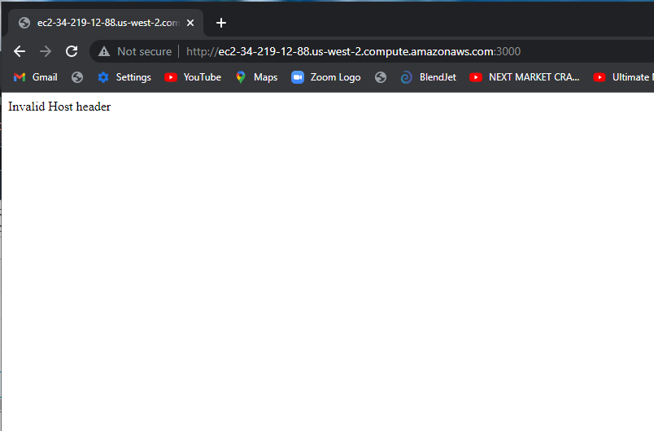
Problem: invalid host header

Slide 12
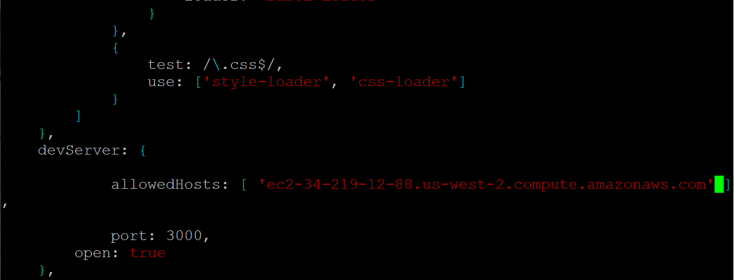
Solution : update the webpack.client.config.js with the appropriate DNS from your EC2 installation

