Slide 1
Apollo Client Example chapter four pp115

Slide 2
npm install --save @apollo/client graphql
mkdir src/client/apollo
mkdir src/client/apollo/index.js

Slide 3
Contents of mkdir src/client/apollo/index.js
import { ApolloClient, InMemoryCache, from, HttpLink } from '@apollo/client';
import { onError } from "@apollo/client/link/error";
const client = new ApolloClient({
link: from([
onError(({ graphQLErrors, networkError }) => {
if (graphQLErrors) {
graphQLErrors.map(({ message, locations, path }) =>
console.log(`[GraphQL error]: Message: ${message}, Location:
${locations}, Path: ${path}`));
if (networkError) {
console.log(`[Network error]: ${networkError}`); } } }),
new HttpLink({
uri: 'http://localhost:8000/graphql’, }), ]),
cache: new InMemoryCache(),});
export default client;
Change it to ….the related DNS such as….
ec2-34-219-12-88.us-west-2.compute.amazonaws.com

Slide 4
Add enhancements to index.js NOTE: pay attention to the forward quotes `` for the gql query ( wrong in book )
import { ApolloClient, InMemoryCache, from, HttpLink } from '@apollo/client';
import { onError } from "@apollo/client/link/error";
import { gql } from '@apollo/client';
const client = new ApolloClient({
link: from([
onError(({ graphQLErrors, networkError }) => {
if (graphQLErrors) {
graphQLErrors.map(({ message, locations, path }) =>
console.log(`[GraphQL error]: Message: ${message}, Location:
${locations}, Path: ${path}`));
if (networkError) {
console.log(`[Network error]: ${networkError}`);

Slide 5
Add enhancements to index.js cont.
} }}),
new HttpLink({
uri: 'http://ec2-34-219-12-88.us-west-2.compute.amazonaws.com:8000/graphql',}),]),
cache: new InMemoryCache(),});
client.query({
query: gql`
{ posts {
id
text }}`
}).then(result => console.log(result));
export default client;

Slide 6
Final change is to update index.js in src/client (not the src/client/apollo)
ubuntu@ip-172-31-4-219:~/graphbook/src/client$ cat index.js
import React from 'react';
import ReactDOM from 'react-dom';
import App from './App';
import client from './apollo';
ReactDOM.render(<App/>, document.getElementById('root'));

Slide 7
Testing
Start the server in one terminal
Start client in another terminal
ubuntu@ip-172-31-4-219:~/graphbook/src/client/apollo$ npm run server
ubuntu@ip-172-31-4-219:~/graphbook/src/client$ npm run client

Slide 8
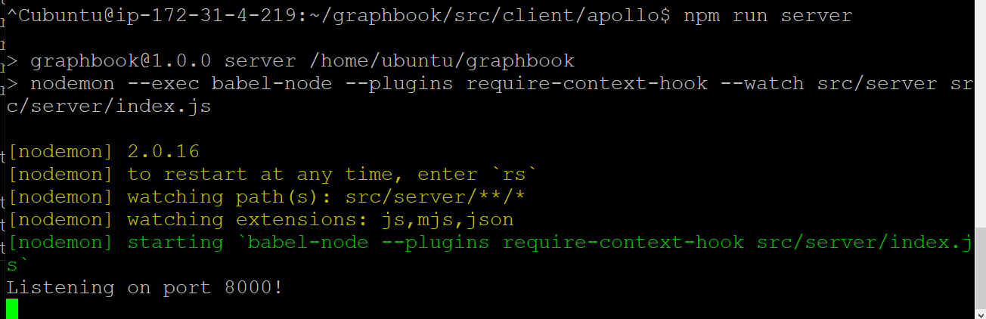

Slide 9
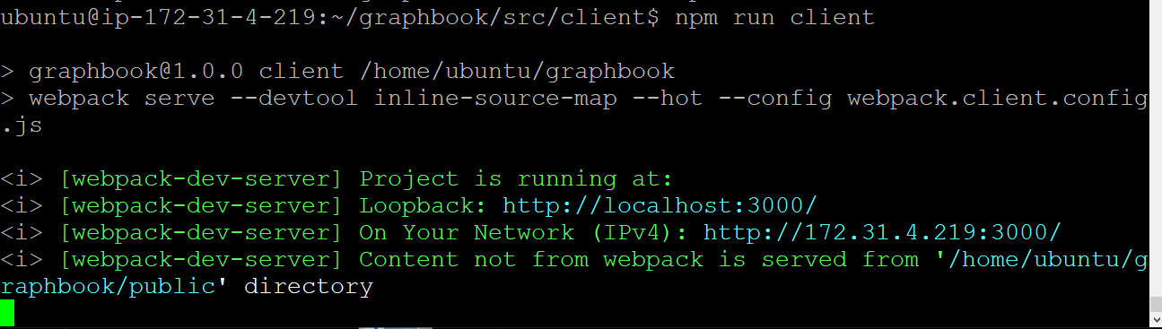

Slide 10
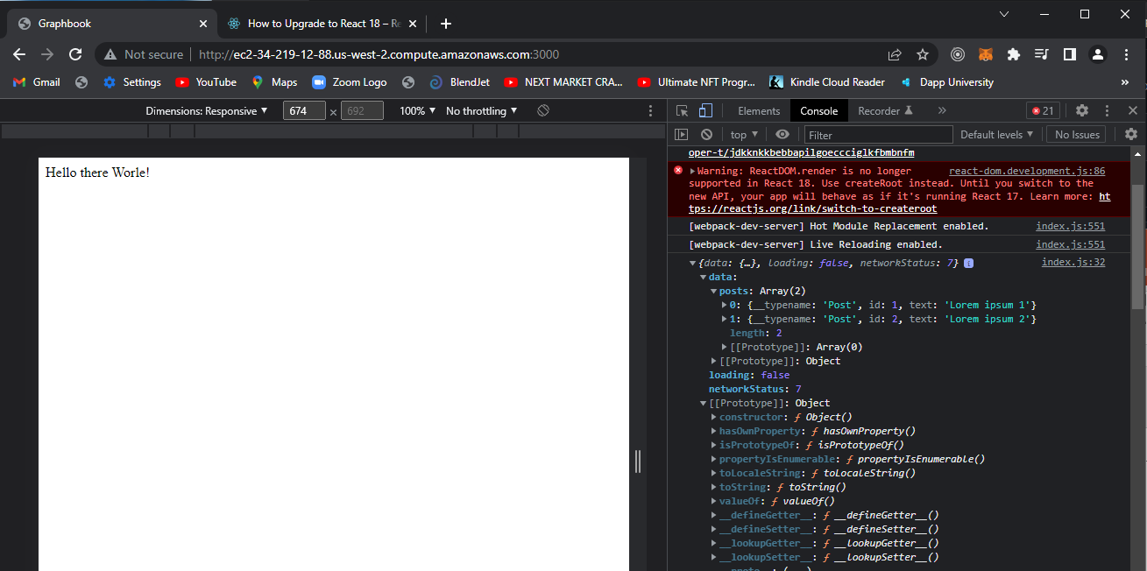
Run port 3000 just like the hello world
Output is in console from developer tools

Slide 11
Modification #2 pp 120 - 123
Enhancement for the means of integrating the graphQL read from our database directly to the React.js client interface (vs only making it available from the developers console.)
Files involved:
src/client/index.js
src/client/App.js
src/client/Feed.js

Slide 12
Updated contents of index.js found under src/client/index.js
import React from 'react';
import ReactDOM from 'react-dom';
import { ApolloProvider } from '@apollo/client/react';
import App from './App';
import client from './apollo';
ReactDOM.render(
<ApolloProvider client={client}>
<App/>
</ApolloProvider>, document.getElementById('root')
);

Slide 13
Updated App.js src/client/App.js
import React from 'react';
import { Helmet } from 'react-helmet';
import Feed from './Feed';
import Chats from './Chats';
import '../../assets/css/style.css';
const App = () => {
return (
<div className="container">
<Helmet>
<title>Graphbook - Feed</title>
<meta name="description" content="Newsfeed of all your friends on Graphbook" />
</Helmet>
<Feed />
<Chats />
</div> )
export default App

Slide 14
New file Feed.js src/client/Feed.js (part i)
import React, { useState } from 'react';
import { gql, useQuery, useMutation } from '@apollo/client';
const GET_POSTS = gql`
{
posts {
id
text
}
}
`;

Slide 15
Feed.js (part ii)
const Feed = () => {
const [postContent, setPostContent] = useState('');
const { loading, error, data, fetchMore } = useQuery(GET_POSTS);
const handleSubmit = (event) => {
event.preventDefault();
const newPost = {
id: posts.length + 1,
text: postContent,
user: {
avatar: '/uploads/avatar1.png',
username: 'Fake User' } };
setPosts([newPost, ...posts]);
setPostContent(''); };
if (loading) return 'Loading...';
if (error) return `Error! ${error.message}`;

Slide 16
Feed.js (part III)
const { posts } = data;
return (
<div className="container">
<div className="postForm">
<form onSubmit={handleSubmit}>
<textarea value={postContent} onChange={(e) => setPostContent(e.target.value)} placeholder="Write your custom post!"/>
<input type="submit" value="Submit" />
</form>
</div>
<div className="feed">
{posts.map((post, i) =>
<div key={post.id} className="post">
<div className="header">
</div>
<p className="content">
{post.text} </p> </div> )} </div> </div>)}
export default Feed

Slide 17
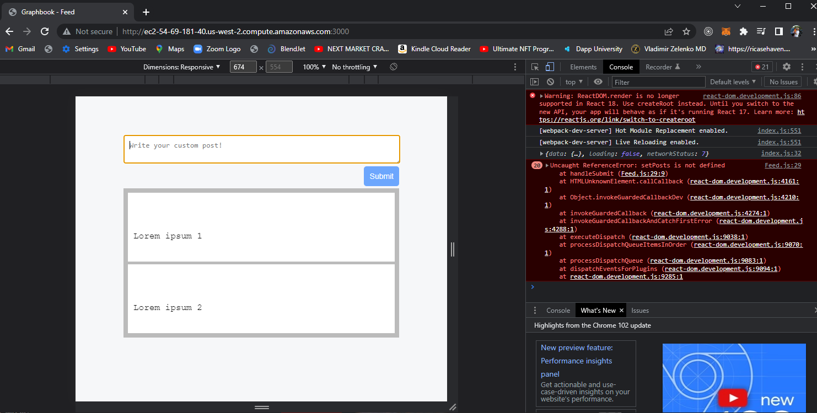
Expected results for the implementation up to page
Pp 123

Slide 19
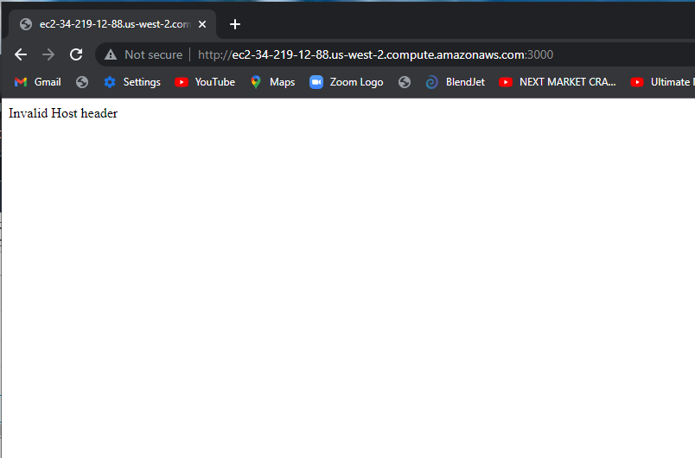
Problem: invalid host header

Slide 20
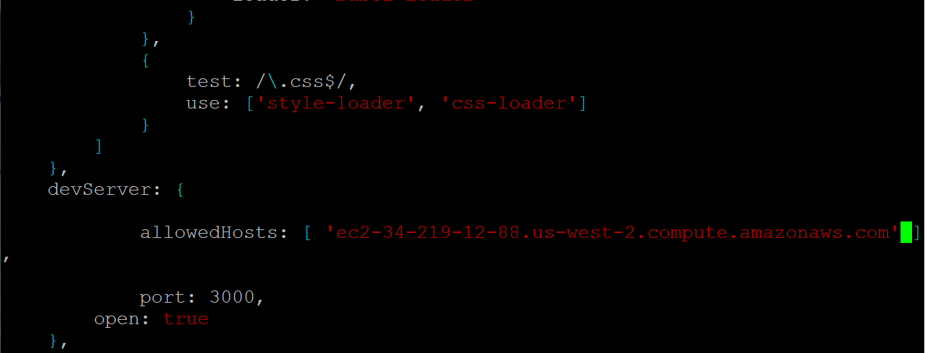
Solution : update the webpack.client.config.js with the appropriate DNS from your EC2 installation

Slide 21
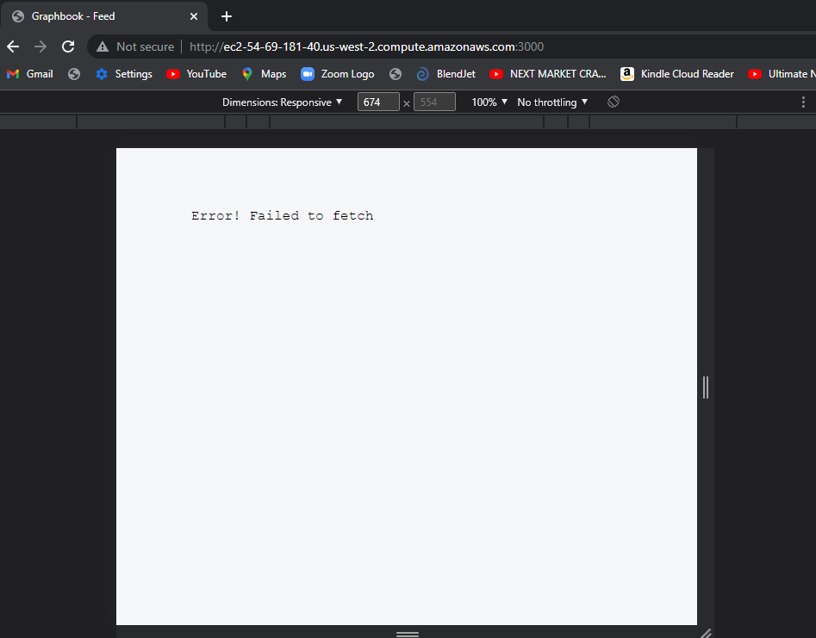

Slide 22
Solution : did not start apollo server
Npm run server ( in a separate terminal)
NOTE: remember to update DNS if your dns has changed

