Slide 1
Chapter 3

Slide 2
3 git clone https://github.com/palomasoftware/CIS419_ChapterTwo.git
4 cd CIS419_ChapterTwo/
5 sudo apt install npm
6 curl -sL https://deb.nodesource.com/setup_14.x -o nodesource_setup.sh
7 sudo bash nodesource_setup.sh
8 sudo apt-get update
9 sudo apt install nodejs build-essential
10 sudo apt-get update && sudo apt-get update -y
11 sudo apt-get install apache2 mysql-server php-pear php php-mysql
12 sudo mysql

Slide 3
skip mysql_secure_installation
mysql> CREATE USER 'root'@'%' IDENTIFIED BY 'Password123#@!';
Query OK, 0 rows affected (0.02 sec)
mysql> GRANT ALL PRIVILEGES ON *.* TO 'root'@'%' with GRANT OPTION;
Query OK, 0 rows affected (0.00 sec)
mysql> FLUSH PRIVILEGES;
Query OK, 0 rows affected (0.00 sec)
mysql> alter user 'root'@'localhost' IDENTIFIED WITH mysql_native_password by 'Password123#@!';
Query OK, 0 rows affected (0.01 sec)
mysql>

Slide 4
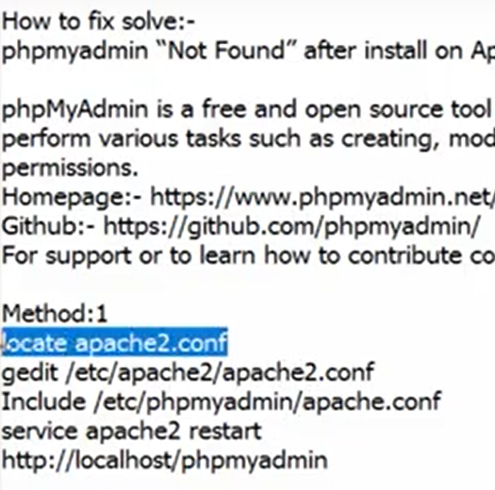
13 sudo apt-get install phpmyadmin
14 cd /etc/apache2
15 ls
16 sudo vi apache2.conf
17 sudo service apache2 restart
18 history

Slide 5
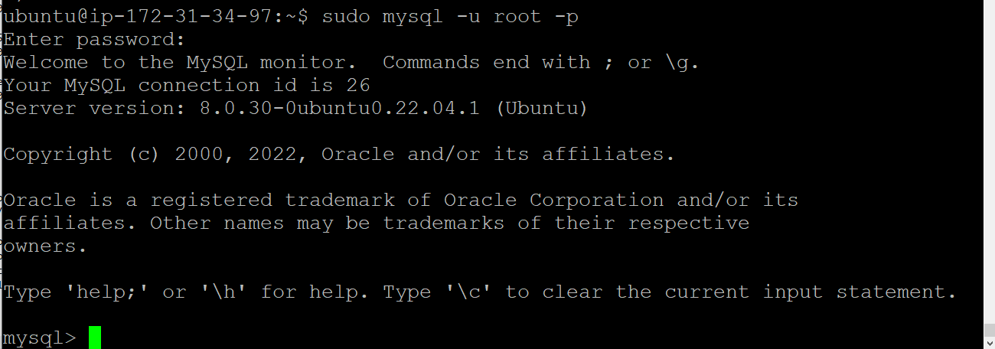
Can’t gain access for msql ?

Slide 6
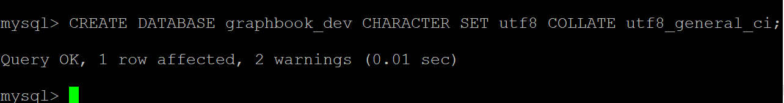

Slide 7
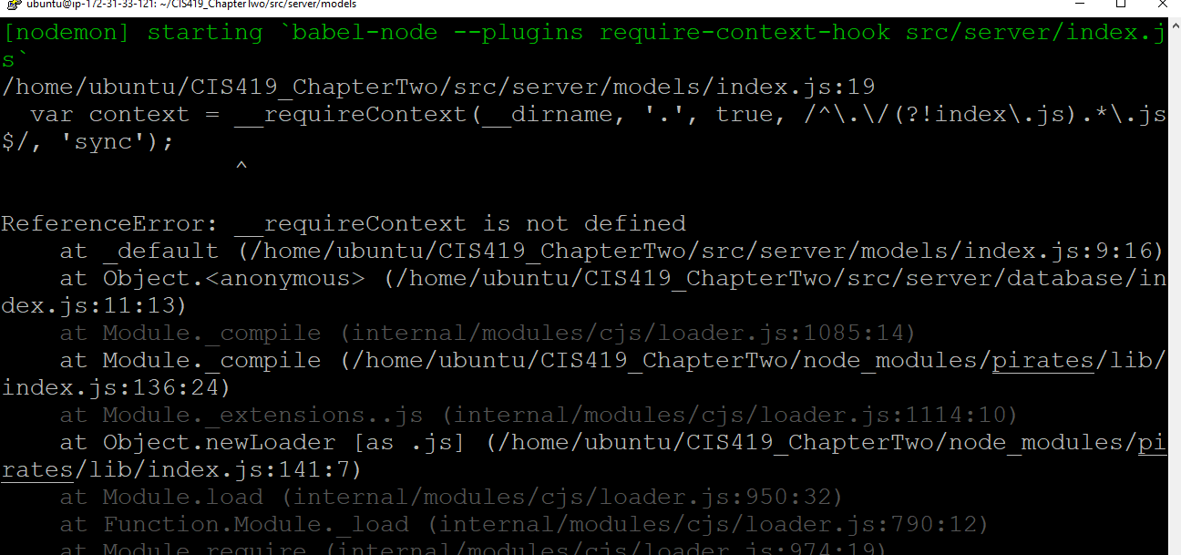

Slide 8
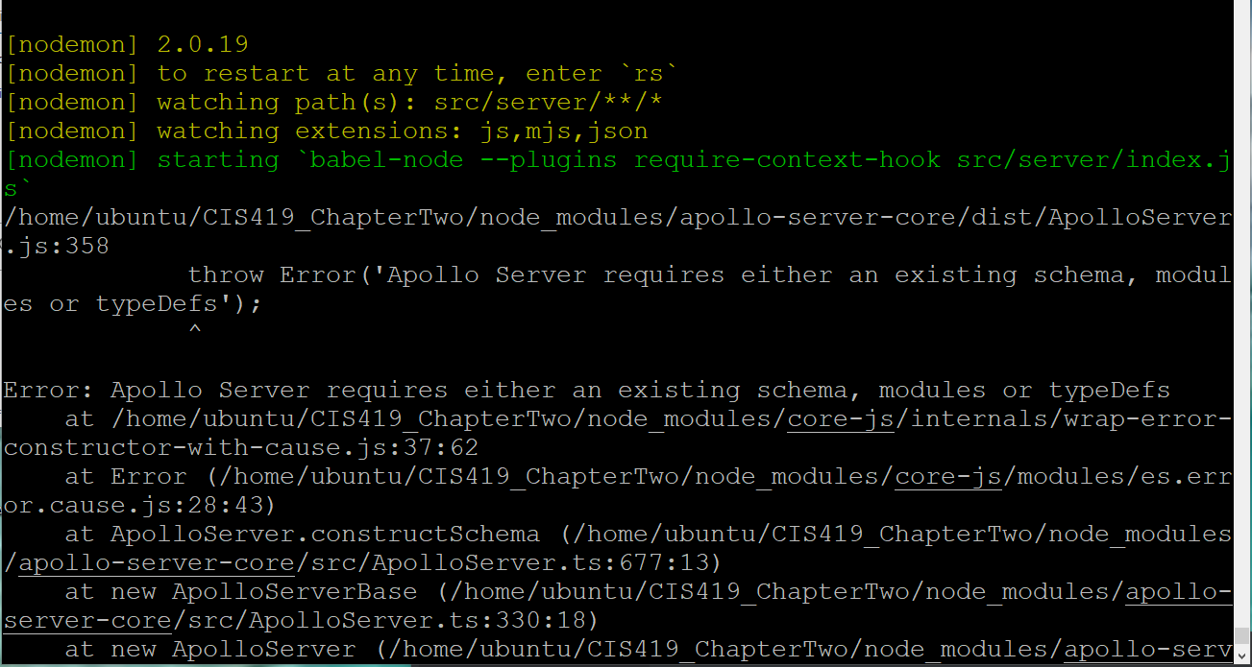

Slide 9
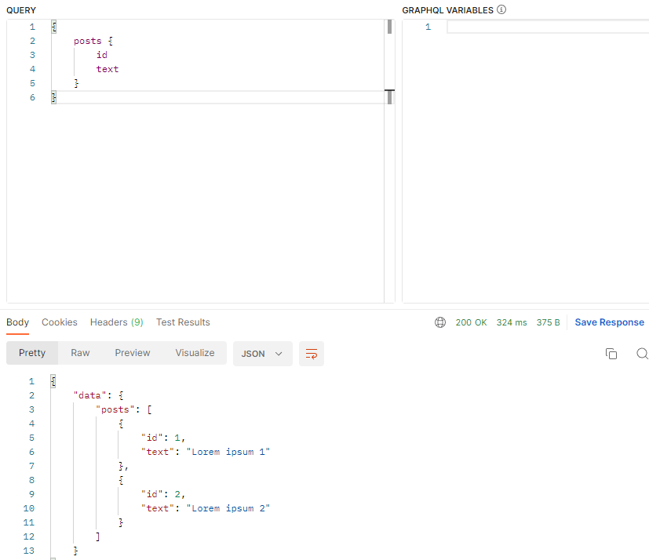

Slide 10
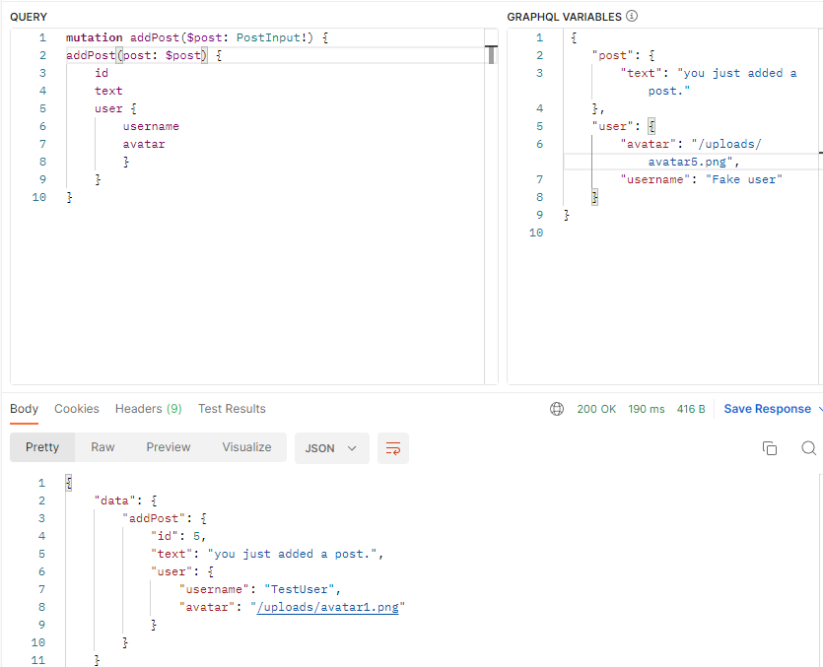

Slide 11
Challenges:
1.) make sure ‘babel-plugin-require-context-hook/register’ executes
In (src/server/models/index.js)!!!!!
If the “development” env variable is not showing you can remove the conditional from the index.js or put in optional require as I have put in the script ( see next page for stack ref).
https://github.com/apollographql/apollo-server/issues/1998
2.) make sure you install babel-plugin-register-context-hook
3.) make sure you install
Src/server/services/graphql/index.js from GITHUB (BOOK) COPY
DO NOT USE COPY FROM BOOK (pp 79)
4.) resolver /schema can be directly taken from github ok.

Slide 12
Challenges:
Only query the id and text
Use:
{
Posts {
Id
Text
}
}
Not
{
Posts {
Id
Text
User
}
}
(the user partis premature)

Slide 13
Challenges – remember extra install
npm install graphql-tools
Also , I had to re-order my post / users to make it work appropriately.

Slide 14
sudo apt-get update && sudo apt-get update -y
sudo apt-get install apache2 mysql-server php-pear php-mysql
mysql_secure_installation
sudo mysql_secure_installation

Slide 15
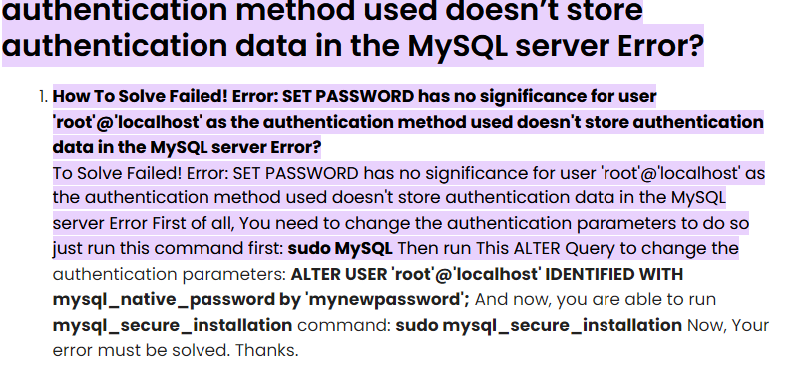

Slide 16
Fetched 7247 kB in 2s (3970 kB/s)
Reading package lists... Done
E: Could not open lock file /var/lib/dpkg/lock-frontend - open (13: Permission denied)
E: Unable to acquire the dpkg frontend lock (/var/lib/dpkg/lock-frontend), are you root?

Slide 17
mysql> CREATE USER 'root'@'%' IDENTIFIED BY 'junkcrunk22';
Query OK, 0 rows affected (0.01 sec)
mysql> GRANT ALL PRIVILEGES ON *.* TO 'root'@'%' WITH GRANT OPTION;
Query OK, 0 rows affected (0.00 sec)
mysql> FLUSH PRIVILEGES;
Query OK, 0 rows affected (0.01 sec)
ubuntu@ip-172-31-33-160:~$ sudo apt-get install phpmyadmin
when you get the password does not meet policy - rerun it but this time use the 'ignore' option

Slide 18
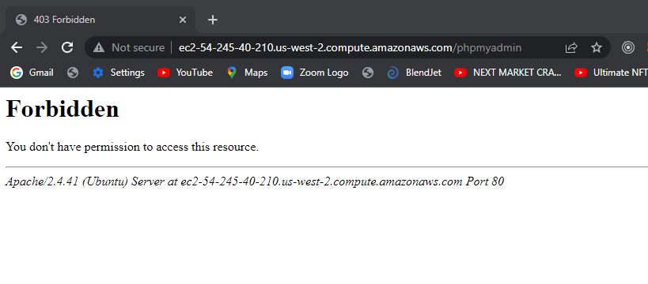

Slide 19
https://www.youtube.com/watch?v=qJjEeIFdoxg

Slide 20
Follow the instructions directly from the phpadmin youtube page

Slide 21
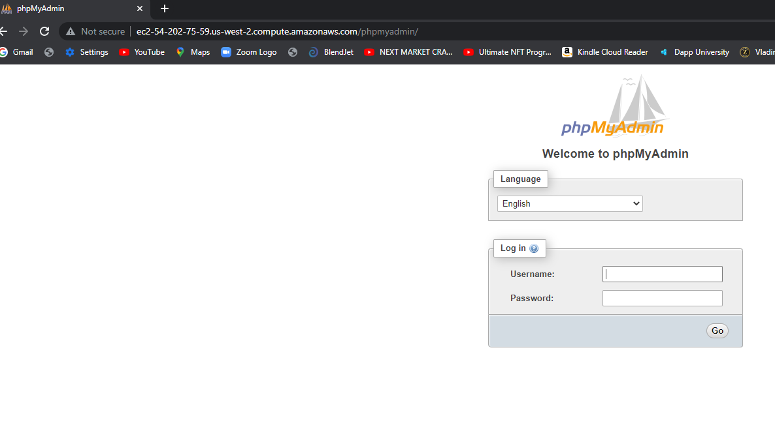

Slide 23
root@ip-172-31-33-160:/etc/phpmyadmin# vi config.inc.php
root@ip-172-31-33-160:/etc/phpmyadmin#

Slide 24
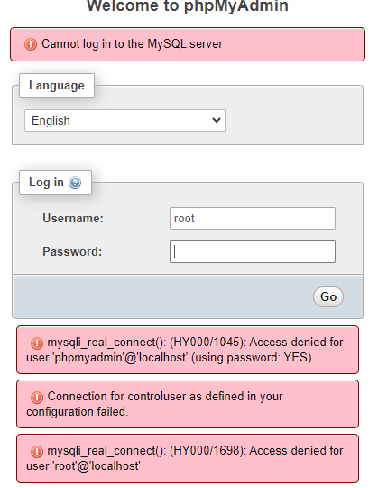

Slide 25
DID not work!
if (empty($dbserver)) $dbserver = 'ec2-54-202-75-59.us-west-2.compute.am
azonaws.com';
/* if (empty($dbserver)) $dbserver = 'localhost';
i*/
$cfg['Servers'][$i]['host'] = $dbserver;
if (!empty($dbport) || $dbserver != 'ec2-54-202-75-59.us-west-2.compute.amaz
onaws.com') {
/* if (!empty($dbport) || $dbserver != 'localhost') {*/
$cfg['Servers'][$i]['connect_type'] = 'tcp';
$cfg['Servers'][$i]['port'] = $dbport;

Slide 26
I can log in with my credentials!
root@ip-172-31-33-160:/usr/share# mysql -u root -p
Enter password:
Welcome to the MySQL monitor. Commands end with ; or \g.
Your MySQL connection id is 25
Server version: 8.0.28-0ubuntu0.20.04.3 (Ubuntu)
Copyright (c) 2000, 2022, Oracle and/or its affiliates.
Oracle is a registered trademark of Oracle Corporation and/or its
affiliates. Other names may be trademarks of their respective
owners.
Type 'help;' or '\h' for help. Type '\c' to clear the current input statement.
mysql>

Slide 27
sudo mysql -p -u root
Enter password:
Welcome to the MySQL monitor. Commands end with ; or \g.
Your MySQL connection id is 8
Server version: 8.0.28-0ubuntu0.20.04.3 (Ubuntu)
Type 'help;' or '\h' for help. Type '\c' to clear the current input statement.
mysql>
mysql> CREATE USER 'pmauser'@'%' IDENTIFIED BY 'junkcrunk22$$';
ERROR 1819 (HY000): Your password does not satisfy the current policy requirements
mysql>
mysql> CREATE USER 'pmauser'@'%' IDENTIFIED BY 'JunkcrunkJunkcrunk22$$';
Query OK, 0 rows affected (0.01 sec)
mysql>
mysql> GRANT ALL PRIVILEGES ON *.* TO 'pmauser'@'%' WITH GRANT OPTION;
Query OK, 0 rows affected (0.00 sec)

Slide 28
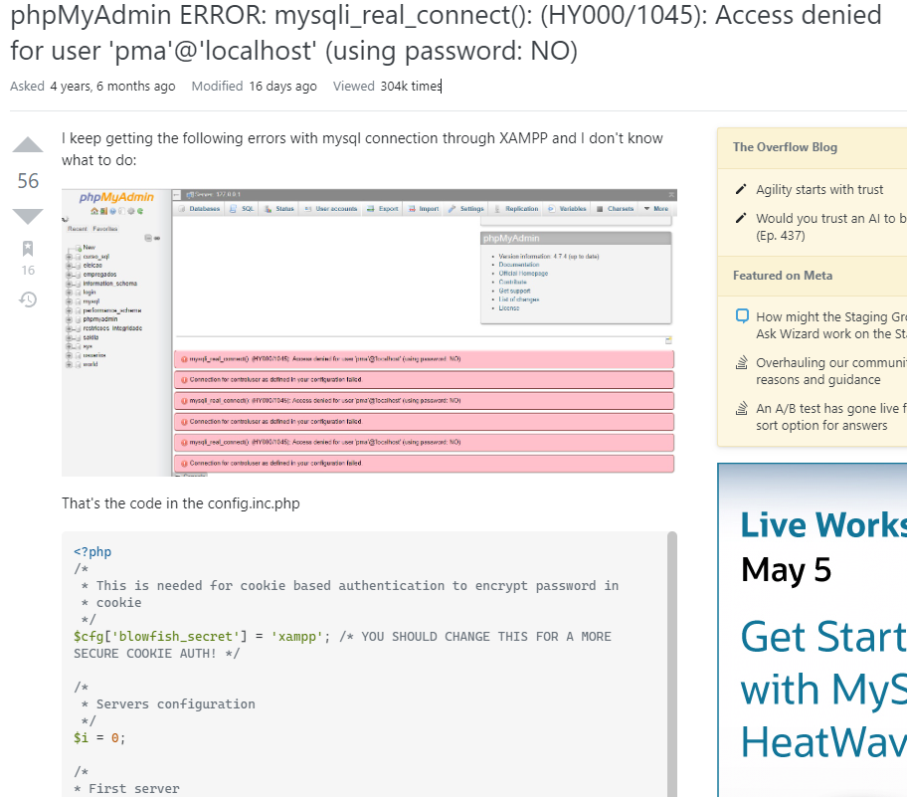

Slide 29
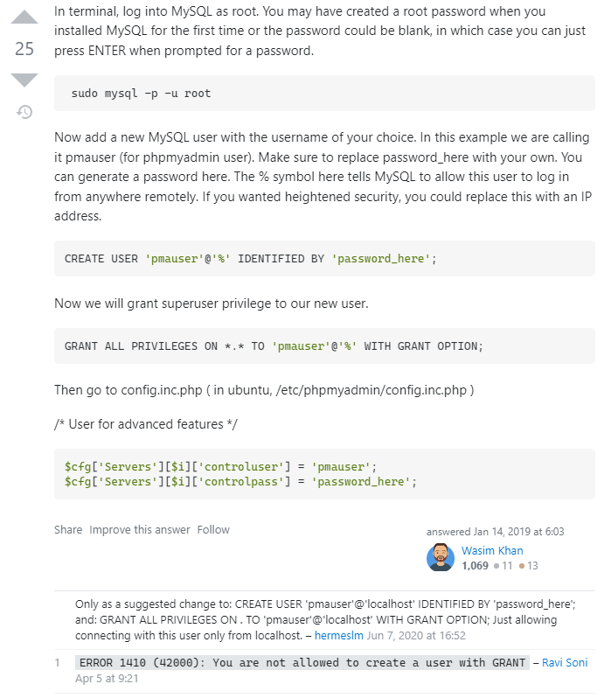

Slide 30
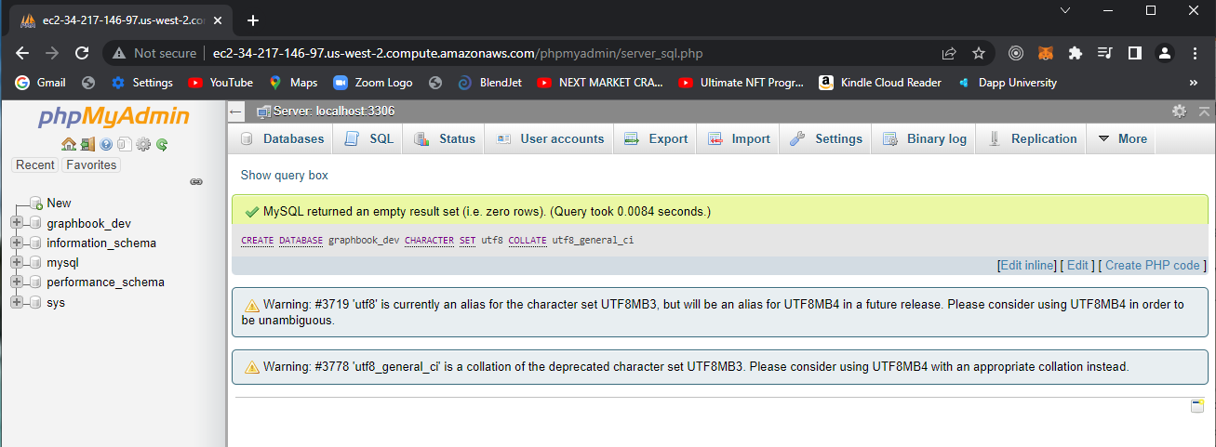

Slide 31
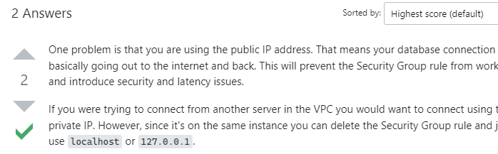
https://stackoverflow.com/questions/38837030/unable-to-connect-to-postgres-on-ec2-econnrefused

Slide 32
const Sequelize = require('sequelize')
const sequelize = new Sequelize('graphbook_dev','pmauser', 'JunkcrunkJunkcrunk22$$', {
host: 'localhost',
port: 3306,
dialect: 'mysql'
});
sequelize.authenticate().then(() => {
console.log("Connection sucessful!");
}).catch((err) => {
console.log(err);
console.log("Error connecting to database!");
});
console.log("Another task");

Slide 33
x.js
ubuntu@ip-172-31-33-160:~/sequelizeStuff$ node index.js
Another task
Executing (default): SELECT 1+1 AS result
Connection sucessful!
ubuntu@ip-172-31-33-160:~/sequelizeStuff$

Slide 34
cat index.js
const Sequelize = require('sequelize')
const sequelize = new Sequelize('graphbook_dev','pmauser', 'JunkcrunkJunkcrunk22$$', {
host: 'localhost',
port: 3306,
dialect: 'mysql'
});
const User = sequelize.define('user', {
username: {
type: Sequelize.DataTypes.STRING
},
password: {
type: Sequelize.DataTypes.STRING
},
age: {
type: Sequelize.DataTypes.STRING,
defaultValue: 21
}

Slide 35
});
User.sync().then((data) =>{
console.log("Table and model synced successfully!");
}).catch((err) => {
console.log("Error syncing the table and model!");});
ubuntu@ip-172-31-33-160:~/sequelizeStuff$ node index.js
Executing (default): CREATE TABLE IF NOT EXISTS `users` (`id` INTEGER NOT NULL auto_increment , `username` VARCHAR(255), `password` VARCHAR(255), `age` VARCHAR(255) DEFAULT 21, `createdAt` DATETIME NOT NULL, `updatedAt` DATETIME NOT NULL, PRIMARY KEY (`id`)) ENGINE=InnoDB;
Executing (default): SHOW INDEX FROM `users`
Table and model synced successfully!
ubuntu@ip-172-31-33-160:~/sequelizeStuff$

Slide 36
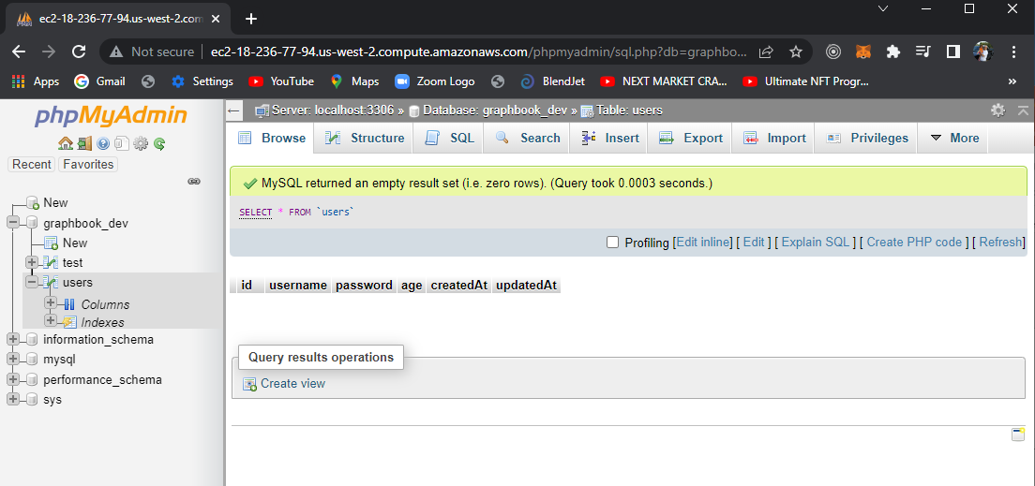

Slide 37
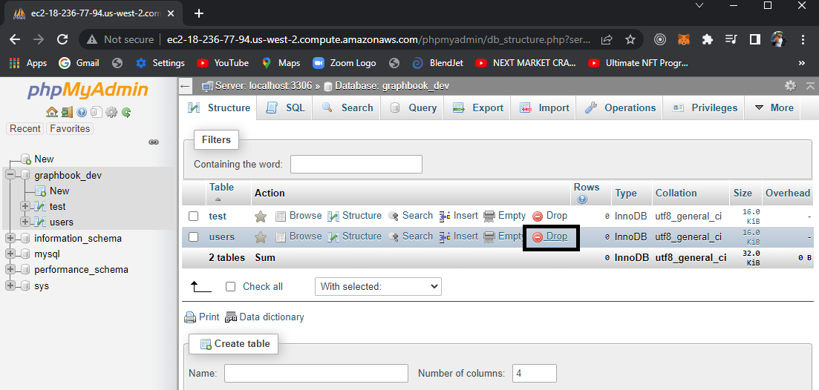

Slide 38
ubuntu@ip-172-31-33-160:~/sequelizeStuff$ cat indexWrite.js
const Sequelize = require('sequelize')
const { DataTypes } = Sequelize;
const sequelize = new Sequelize('graphbook_dev','pmauser', 'JunkcrunkJunkcrunk22$$', {
host: 'localhost',
port: 3306,
dialect: 'mysql'
});
const User = sequelize.define('user', {
user_id: {
type: DataTypes.INTEGER,
primaryKey: true,
autoIncrement: true
}
,
username: {
type: DataTypes.STRING
},

Slide 39
password: {
type: DataTypes.STRING
},
age: {
type: DataTypes.STRING,
defaultValue: 21
},
WittCodeRocks: {
type: DataTypes.BOOLEAN,
defaultValue: true
}
}, {
freezeTableName: true,
timestamps: false
});
User.sync({ alter: true} ).then(() =>{
const user = User.build({username: 'WittCode', password: '123', age: 25, WittCodeRocks: true});
return user.save();
ubuntu@ip-172-31-33-160:~/sequelizeStuff$

Slide 40
}).then((data) => {
console.log("User added to database!");
}).catch((err) => {
console.log("Error syncing the table and model!");
}
);
//sequelize.authenticate().then(() => {
// console.log("Connection sucessful!");
//}).catch((err) => {
//console.log(err);
// console.log("Error connecting to database!");
//});
//console.log("Another task");

Slide 41
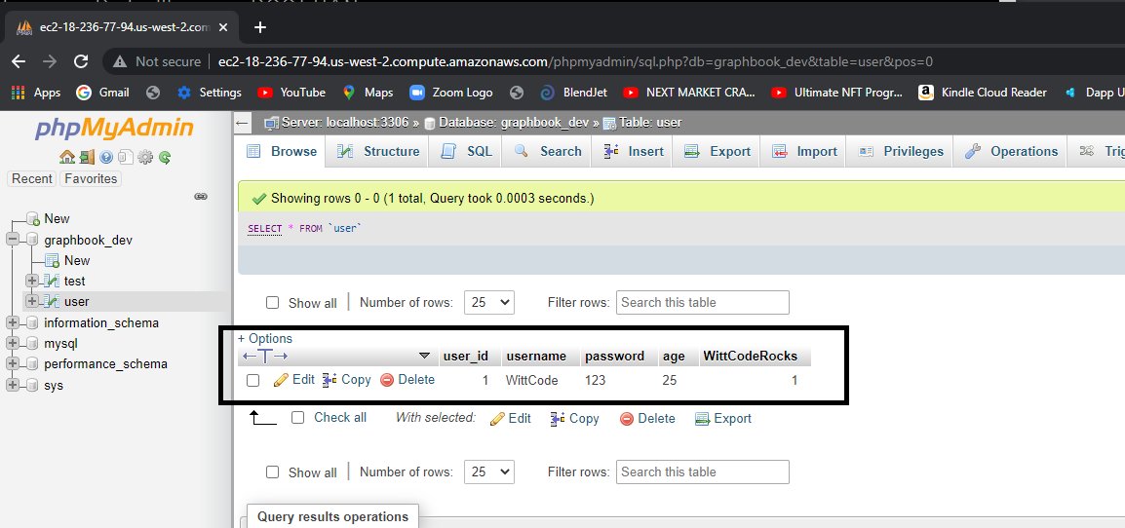

Slide 42
Sequelize: WittCode example
Graphql-> Sequelize -> mysql
https://nisar1406.medium.com/crud-operations-with-graphql-apollo-server-sequelize-auto-f6c334c41506

Slide 43
https://nisar1406.medium.com/crud-operations-with-graphql-apollo-server-sequelize-auto-f6c334c41506
ubuntu@ip-172-31-33-160:~/graphbook/config$ cat config.json
{
"development": {
"username": "pmauser",
"password": "JunkcrunkJunkcrunk22$$",
"database": "graphbook_dev",
"host": "localhost",
"dialect": "mysql"
}
}
ubuntu@ip-172-31-33-160:~/graphbook/config$

Slide 44
ubuntu@ip-172-31-33-160:~/graphbook/graphql$ cat resolvers.js
const {
user
} = require('../models');
const Query = {
getUsers: async (root) => {
try {
const users = await user.findAll();
return users;
} catch (err) {
console.log(err);
}
}
}

Slide 45
ubuntu@ip-172-31-33-160:~/graphbook/graphql$ cat typeDefs.graphql
type Query {
getUsers: [user]
}
type user {
user_id: Int
username: String
password: String
age: String
WittCodeRocks : Boolean
}

Slide 46
ubuntu@ip-172-31-33-160:~/graphbook$ cat server.js
const { ApolloServer, gql } = require('apollo-server');
const fs = require('fs');
const resolvers = require('./graphql/resolvers');
const typeDefs = gql(fs.readFileSync('./graphql/typeDefs.graphql', {encoding: 'utf-8'}));
const server = new ApolloServer({typeDefs, resolvers});
server.listen(5000).then(({
url
}) => {
console.log(`🚀 Server ready at ${url}`);
});

Slide 47
407 sequelize-auto -o "./models" -d graphbook_dev -h localhost -u pmauser -p 3306 -x 'JunkcrunkJunkcrunk22$$' -e mysql
408 cat config.json
409 cd config
410 cat config.json
411 cd ..
412 cd models
413 ls
414 cat test.js

Slide 48
415 ls
416 cat user.js
417 ls
418 cd ..
419 ls
420 mkdir graphql
421 cd models
422 ls
423 cat user.js
424 cd ..
425 cd graphql/`

Slide 49
ls
426 cd graphql
427 ls
428 vi typeDefs.graphql
429 vi resolvers.js
430 cd ..
431 ls
432 vi server.js
433 npm start

Slide 50
434 ls
435 cat server.js
436 node server.js
437 ls
438 cd graphql
439 ls
440 cd
441 ls
442 cd graphbook
443 ls
444 node server.js

Slide 51
445 npm start
446 cd graphql
447 ls
448 cat resolvers.js
449 cd ..
450 ls
451 cat server.js
452 ls
453 vi server.js
454 npm start
455 ls
$

Slide 52
456 cat server.js
457 npm start
458 vi server.js
459 npm install -g sequelize-cli
460 sudo npm install -g sequelize-cli
461 sudo npm install -g sequelize
462 npm start
463 sudo npm install -save sequelize-cli
464 sudo npm install --save sequelize
465 npm start
466 history
ubuntu@ip-172-31-33-160:~/graphbook

Slide 53
August 7, 2022
ubuntu@ip-172-31-33-160:~/graphbook$ sequelize-auto -o "./models" -d graphbook_dev -h localhost -u pmauser -p 3306 -x 'JunkcrunkJunkcrunk22$$' -e mysql
No mysql secure installation
Do “create user”
Do the alter

Slide 54
