Slide 1
Application Deployment Notes
0:35 / 24:17
How to Deploy a Docker App to AWS ECS
https://github.com/harblaith7/Docker-AWS-Crash-Course
https://www.youtube.com/watch?v=YDNSItBN15w

Slide 2
outline
Setup Test environment
Test Express application
Build docker file
Test docker file
Obtain IAM account w/ Amazon
Define repository
Logon and ‘push’ docker image to repository
Create cluster on ECS
Create Task on ECS
Run task
Test deployed application

Slide 3
Overview
Build on one EC2 instance
Build into a docker image
Register it on Amazon host
Instantiate an Amazon ECS cluster using EC2 ( it will show up as EC2 cluster – be aware of other regions )
Create a task to run in the cluster
Test deployed image

Slide 4
NOTE:
This is to support the exact instructions for both development on EC2 ubuntu instance as well as using an EC2 instance for the deployment

Slide 5
Harlaith7/Docker-AWS-Crash-Course

Slide 6
We will be working with a simple express server and building it into a docker image that can be employed to an ECS container
You need five files to get started – they are at
https://github.com/harblaith7/Docker-AWS-Crash-Course
You can manually copy them over or perform a git clone to bring these files to your local ubuntu instance
For now we will copy over the files directly from the github

Slide 7
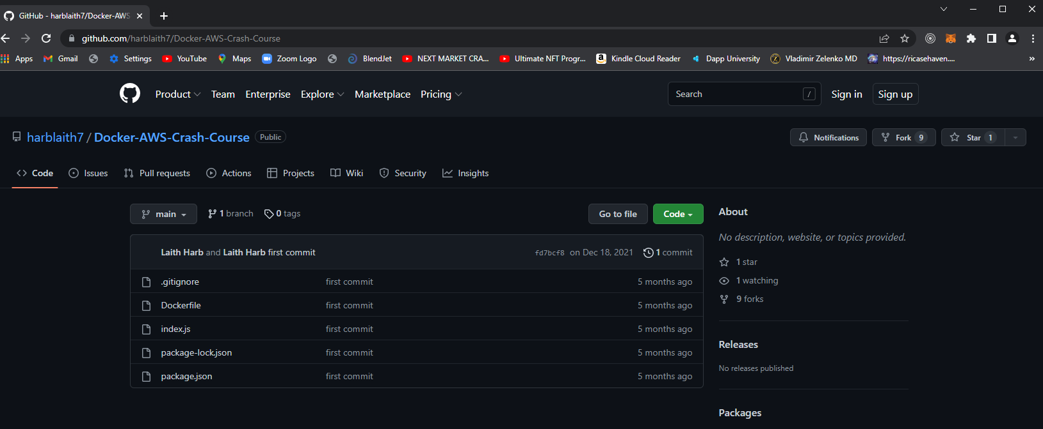

Slide 8
Now you should have the exact same files from the github noted:
Now install docker
ubuntu@ip-172-31-20-141:~/app$ sudo apt-get install docker
ubuntu@ip-172-31-20-141:~/app$ sudo snap install docker

Slide 9
ubuntu@ip-172-31-20-141:~/app$ sudo docker build -t express-app2 .

Slide 10
Sending build context to Docker daemon 37.38kB
Step 1/7 : FROM node:alpine
---> d94913fe64df
Step 2/7 : WORKDIR /app
---> Using cache
---> 701569067e54
Step 3/7 : COPY package.json .
---> Using cache
---> f3e70b060ed8
Step 4/7 : RUN npm install
---> Running in e7d2c03c7e87
added 57 packages, and audited 58 packages in 3s
7 packages are looking for funding
run `npm fund` for details
found 0 vulnerabilities
npm notice
npm notice New minor version of npm available! 8.8.0 -> 8.10.0
npm notice Changelog: <https://github.com/npm/cli/releases/tag/v8.10.0>
npm notice Run `npm install -g npm@8.10.0` to update!
npm notice
Removing intermediate container e7d2c03c7e87
---> 2e4bd16d23eb
Step 5/7 : COPY . .
---> c41743b1066f
Step 6/7 : EXPOSE 5000
---> Running in 31a33b112784
Removing intermediate container 31a33b112784
---> 0bedce446f34
Step 7/7 : CMD [ "node", "index.js" ]
---> Running in 07adc94900ef
Removing intermediate container 07adc94900ef
---> 59ac25c6bfba
Successfully built 59ac25c6bfba
Successfully tagged express-app2:latest

Slide 11
ubuntu@ip-172-31-20-141:~/app$ sudo docker images
REPOSITORY TAG IMAGE ID CREATED SIZE
express-app2 latest 59ac25c6bfba 4 seconds ago 177MB
node alpine d94913fe64df 2 weeks ago 171MB

Slide 12
Now run / test the docker image
ubuntu@ip-172-31-20-141:~/app$ sudo docker images
REPOSITORY TAG IMAGE ID CREATED SIZE
express-app2 latest 59ac25c6bfba 4 hours ago 177MB
node alpine d94913fe64df 2 weeks ago 171M
ubuntu@ip-172-31-20-141:~/app$ sudo docker run -p 6565:5000 59ac25c6bfba

Slide 14
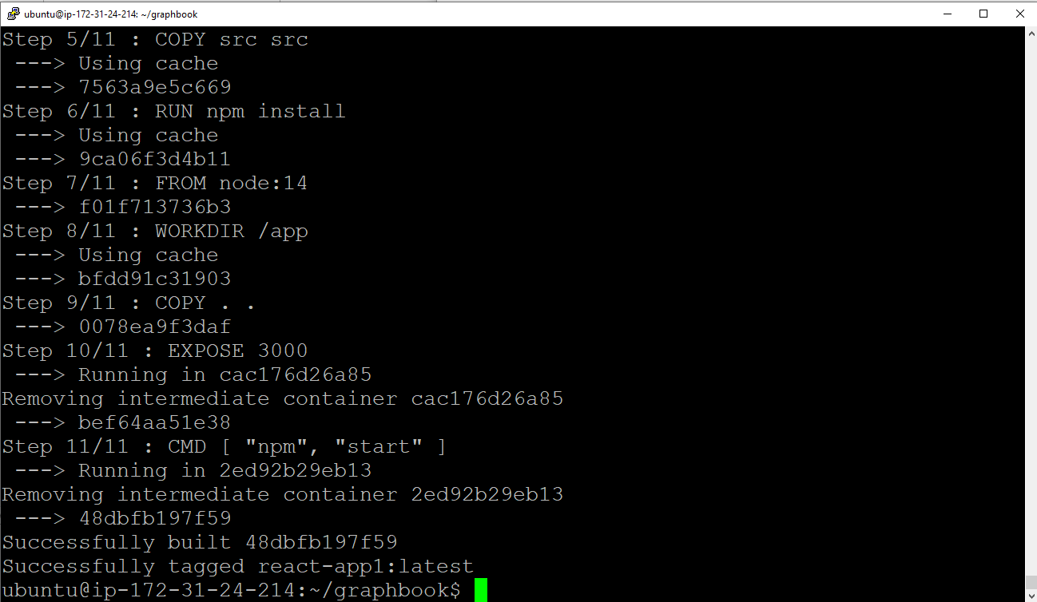

Slide 15
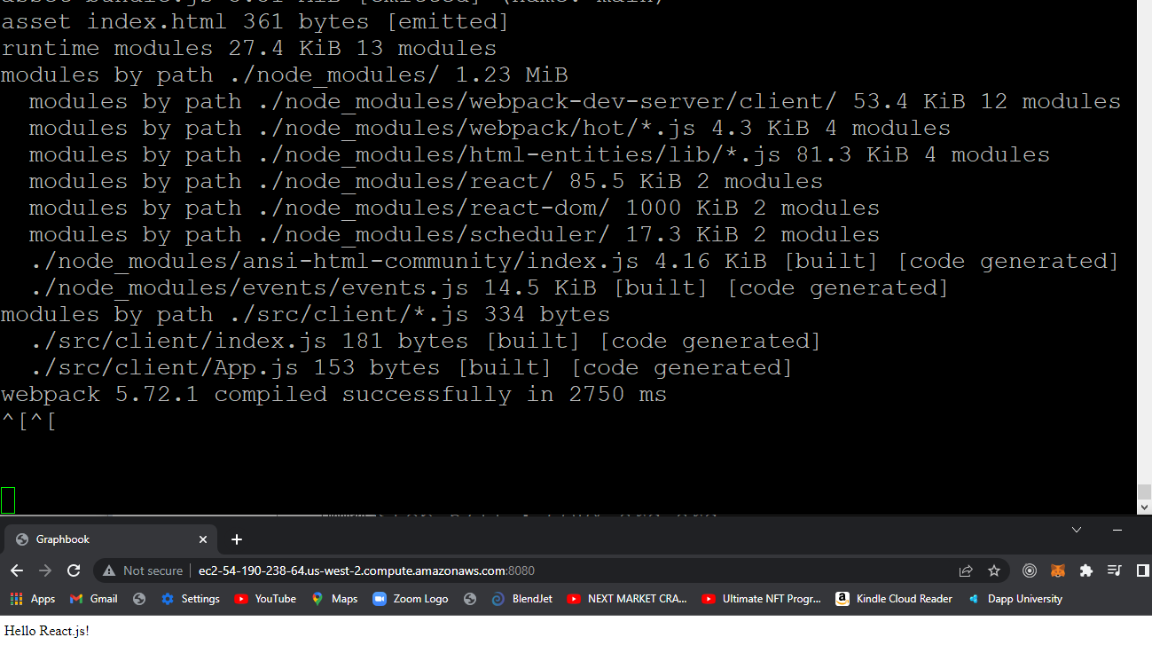

Slide 16
Dockerized hello world react.js

Slide 17
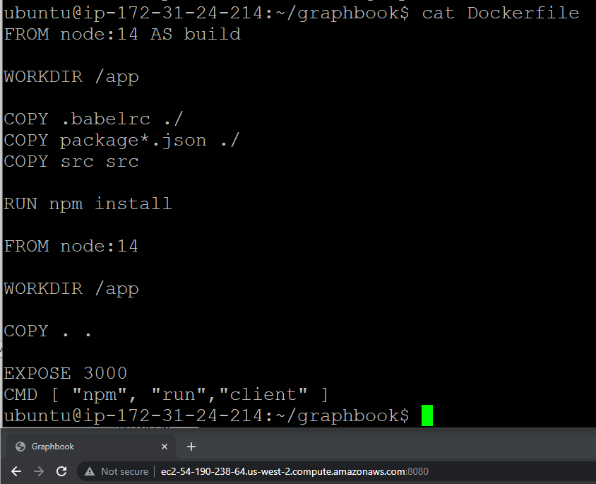

Slide 18
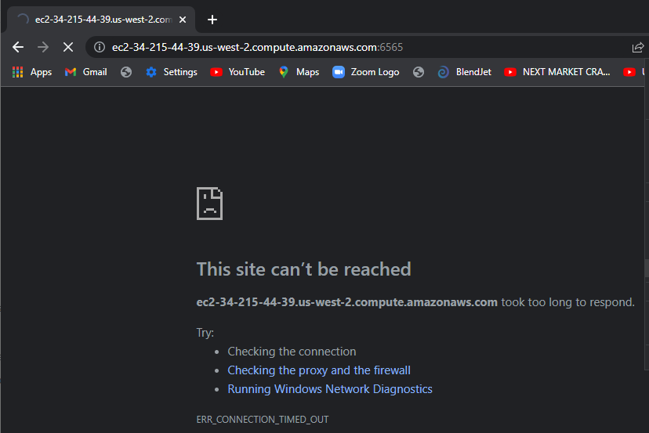

Slide 19
Check the inbound rules on the security group

Slide 20
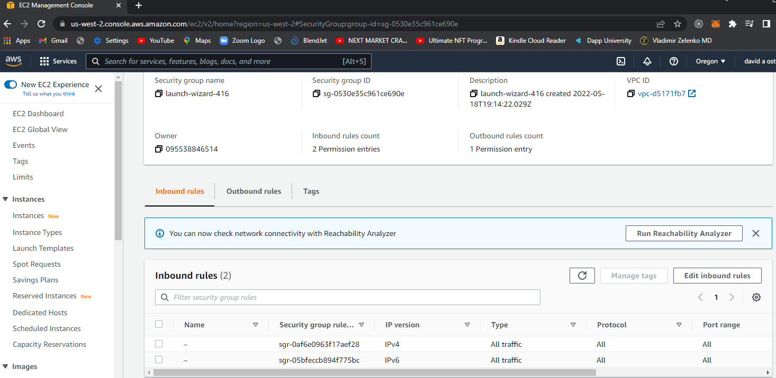

Slide 21
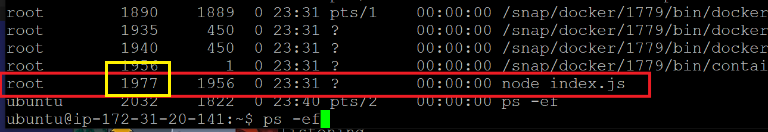
Comands to stop the server after starting

Slide 22
Now register the docker file
Create a repository with ECS
Select Amazon Elastic Container Registry from smilely prompt

Slide 23
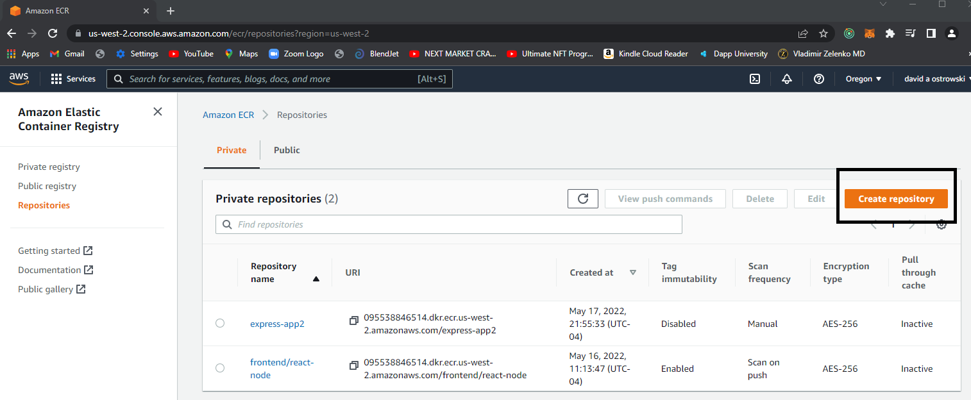

Slide 24
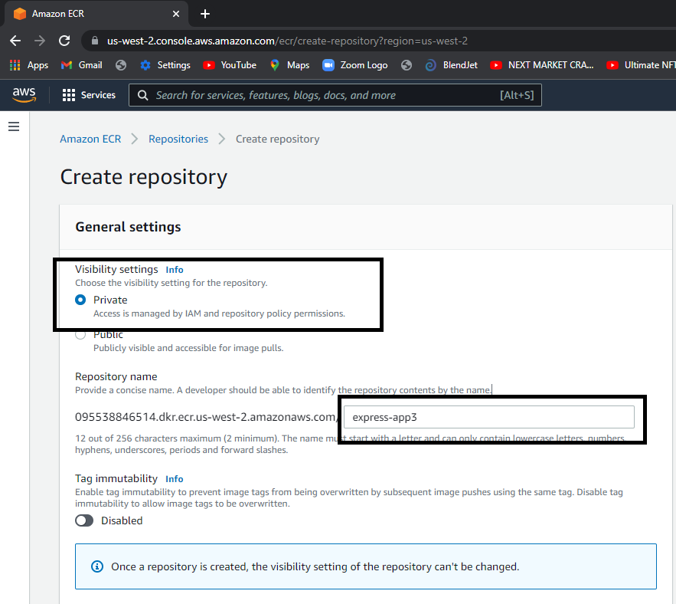

Slide 25
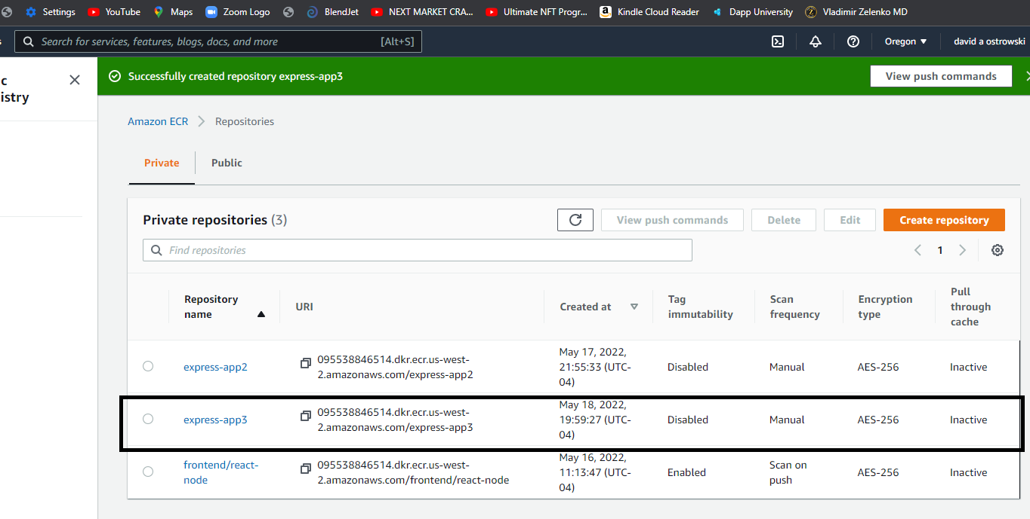

Slide 26
Now go to IAM dashboard

Slide 27
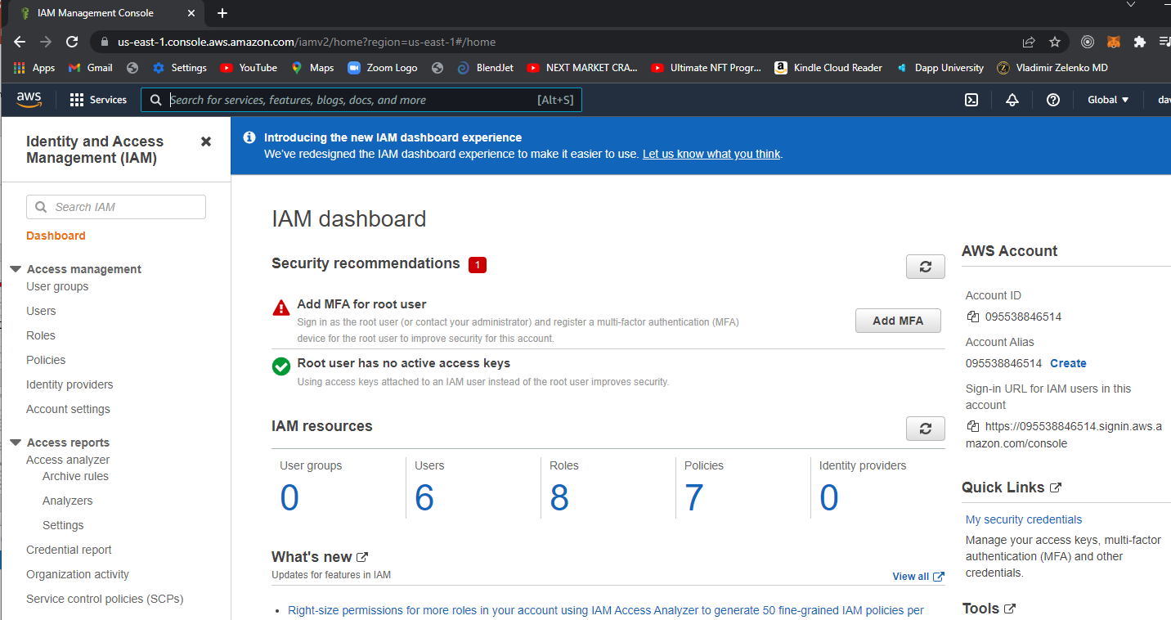

Slide 28
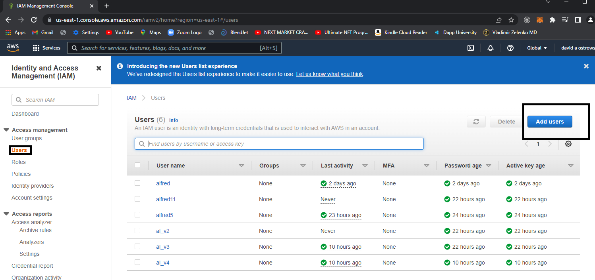

Slide 29
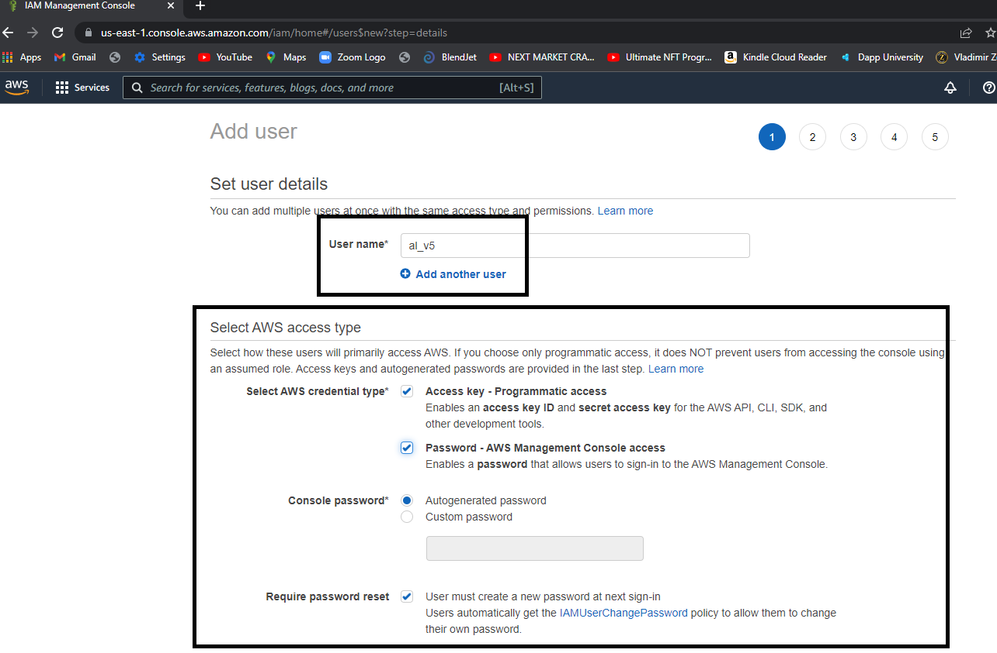

Slide 30
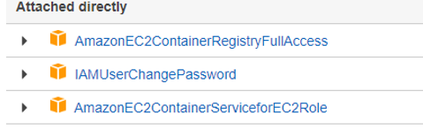
Do not hit “create policy”
Check off the three policies from the bottom list and process by just going to ‘next tags’

Slide 31
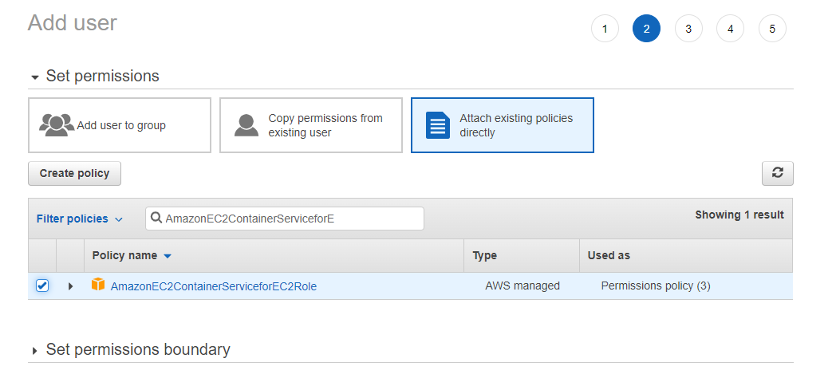

Slide 32
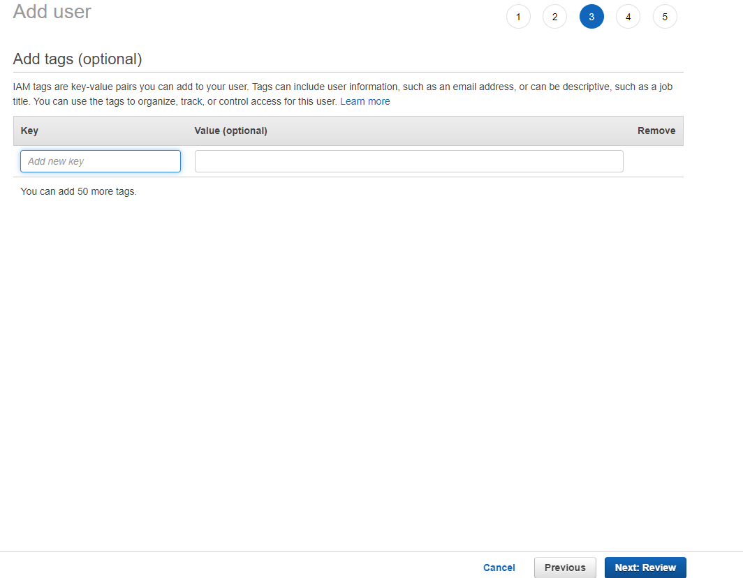
Just default and choose “next: review”

Slide 33
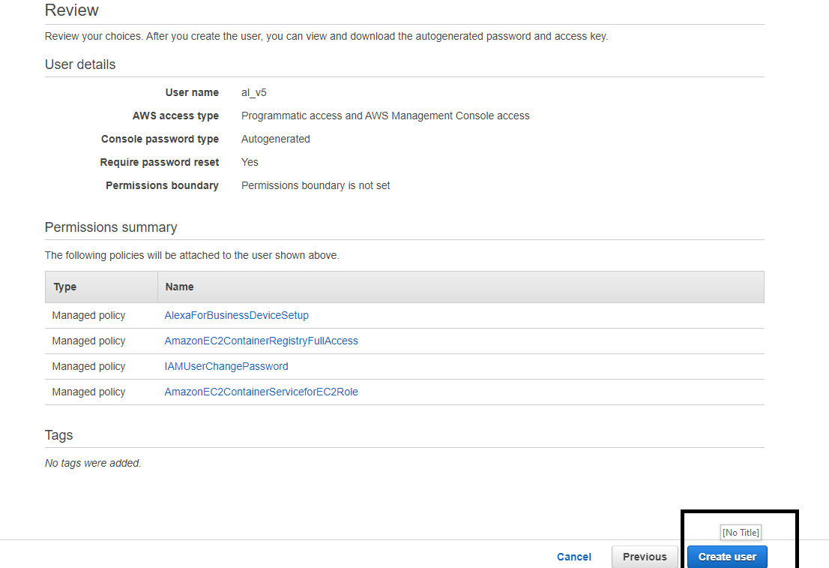

Slide 34
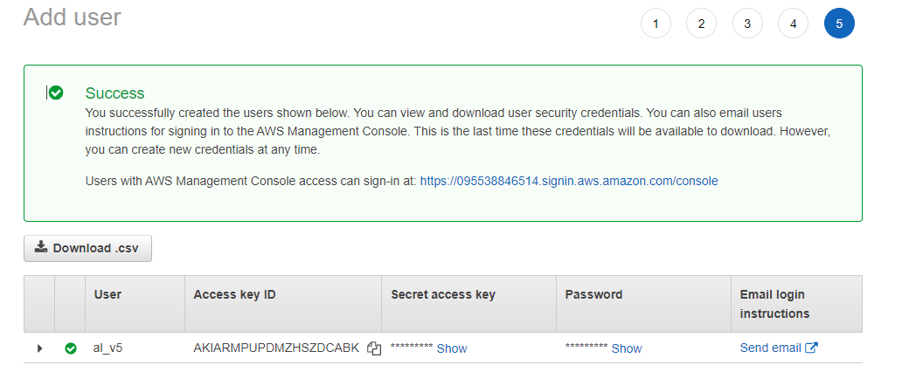

Slide 35
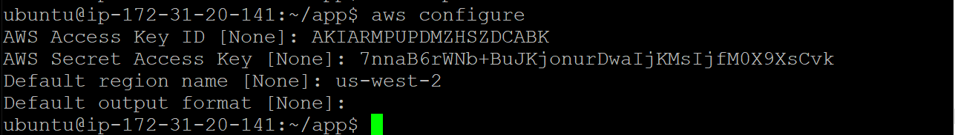
host.
ubuntu@ip-172-31-20-141:~/app$ sudo apt install awscli

Slide 36
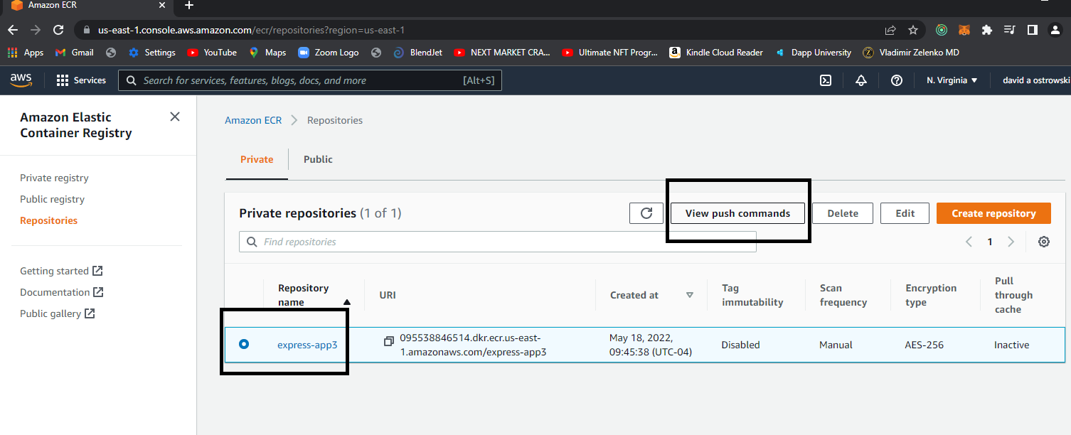

Slide 37
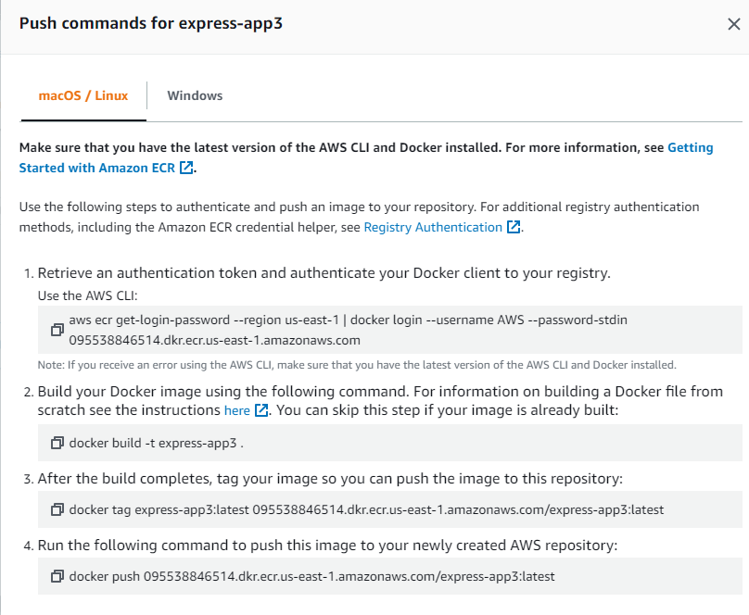
Didn’t work had
To use format
on next page

Slide 38
sudo docker login -u AWS -p $(aws ecr get-login-password --region us-east-1) 095538846514.dkr.ecr.us-east-1.amazonaws.com

Slide 39
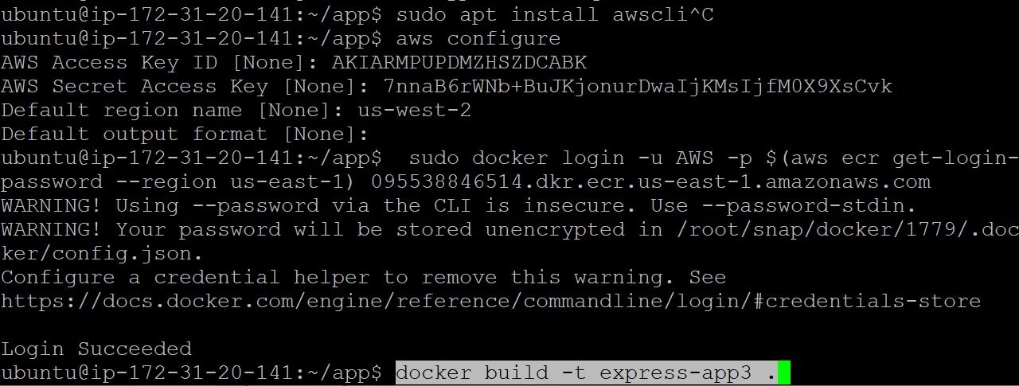

Slide 40
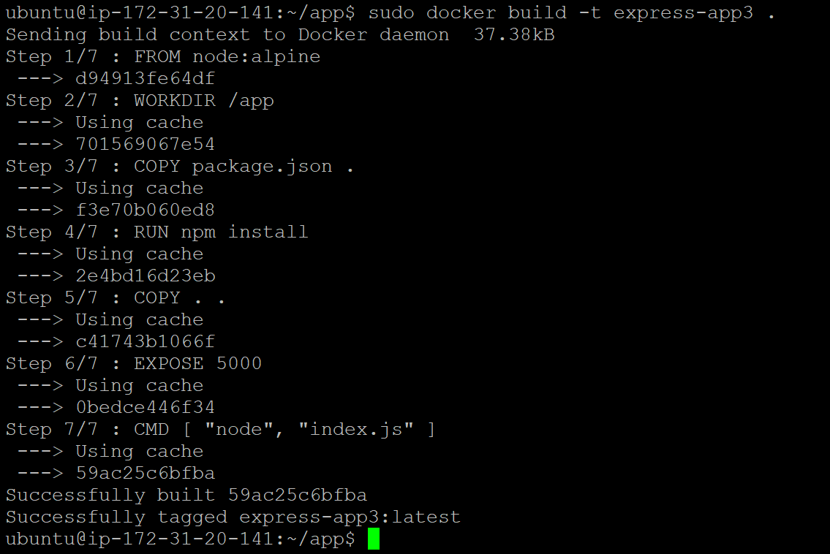

Slide 41
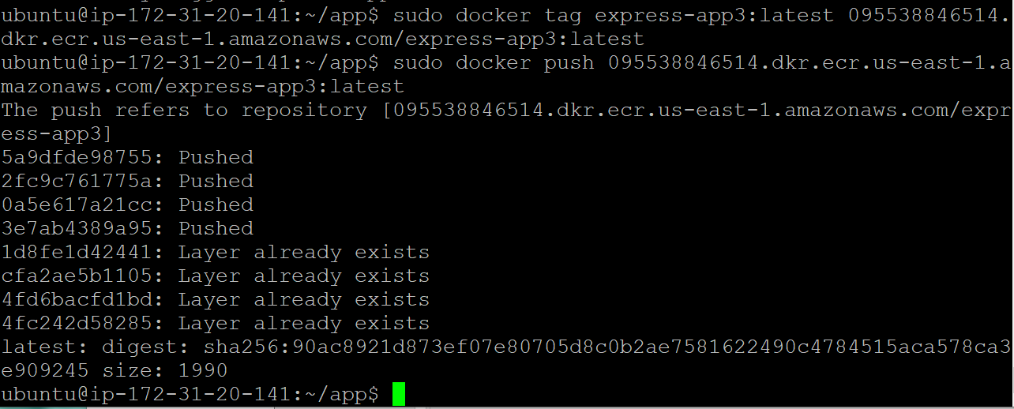

Slide 42
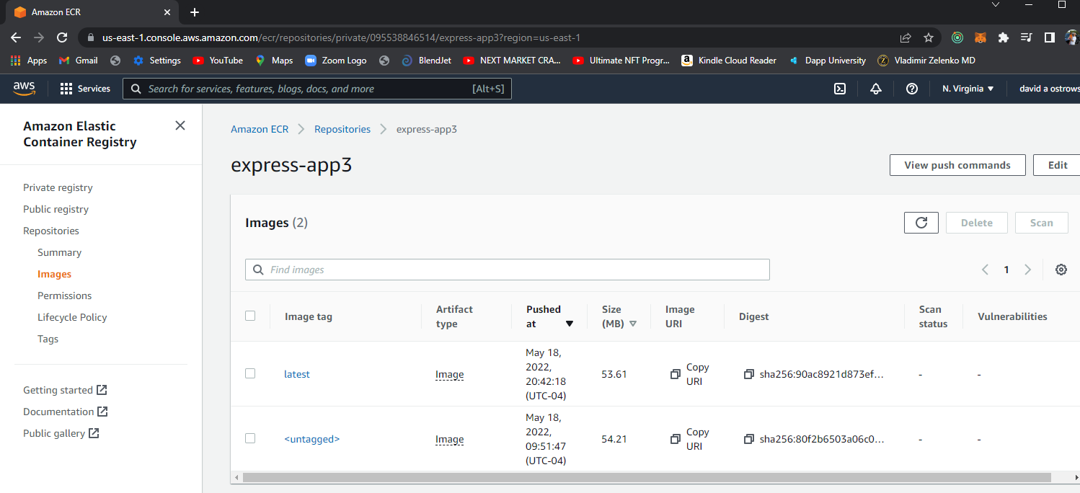

Slide 43
Now set the cluster
Set task
Run task
And you can test (make sure you have access…)

Slide 44
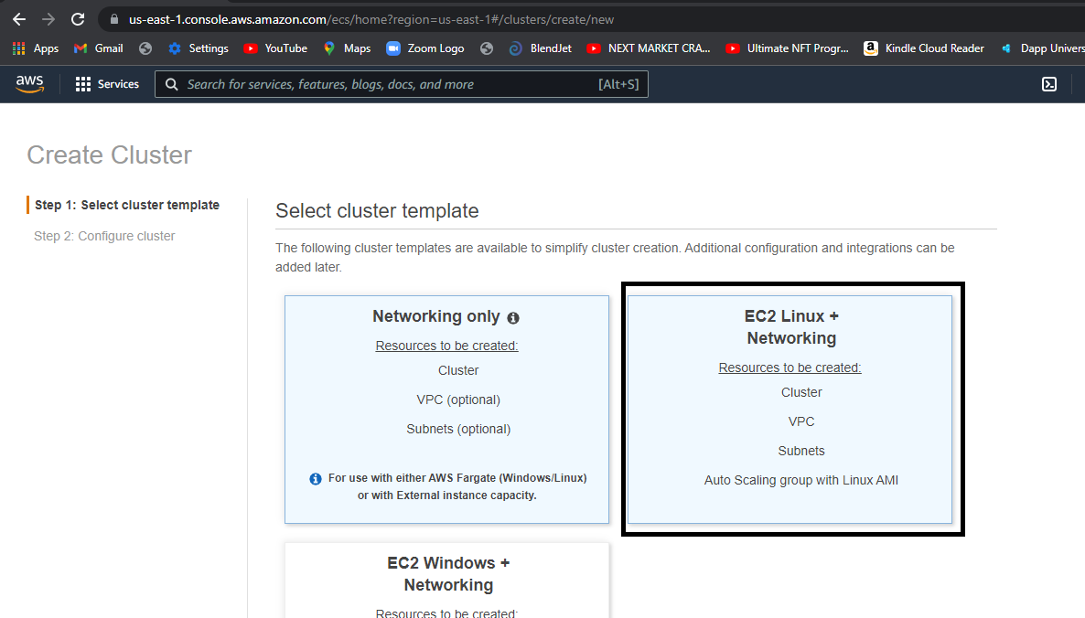

Slide 45
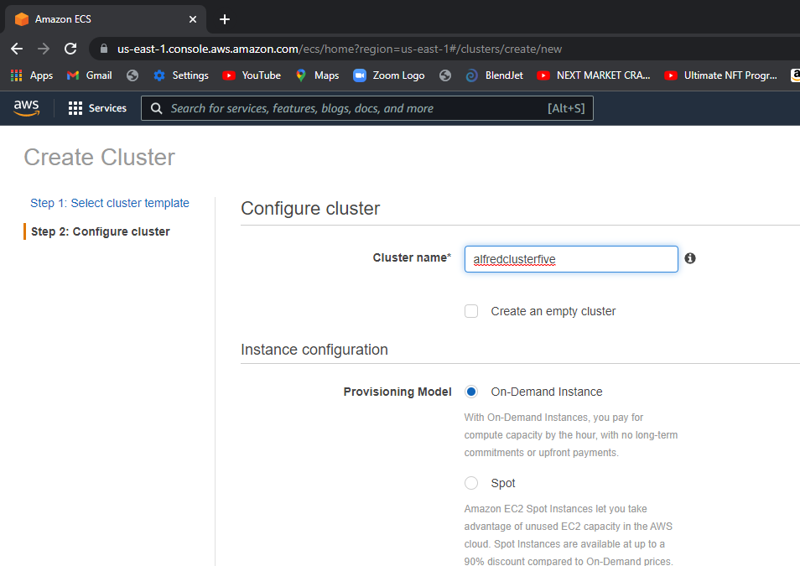
Default this !!!

Slide 46
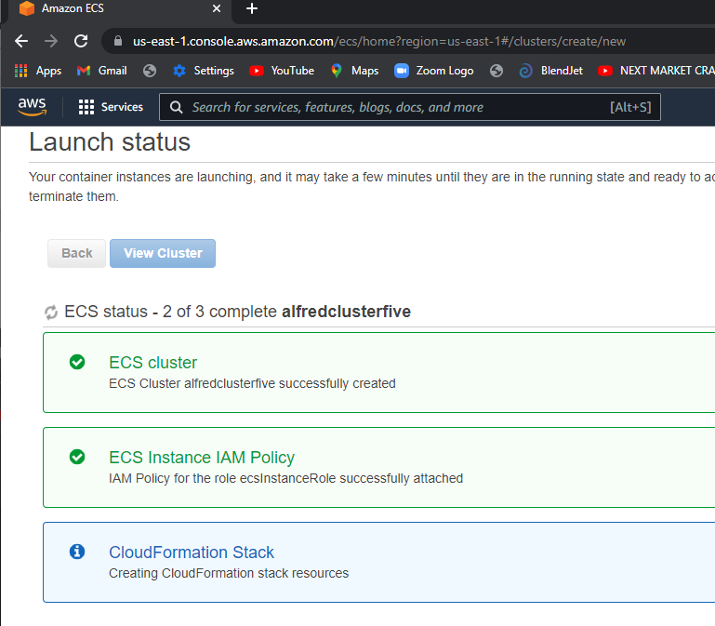

Slide 47
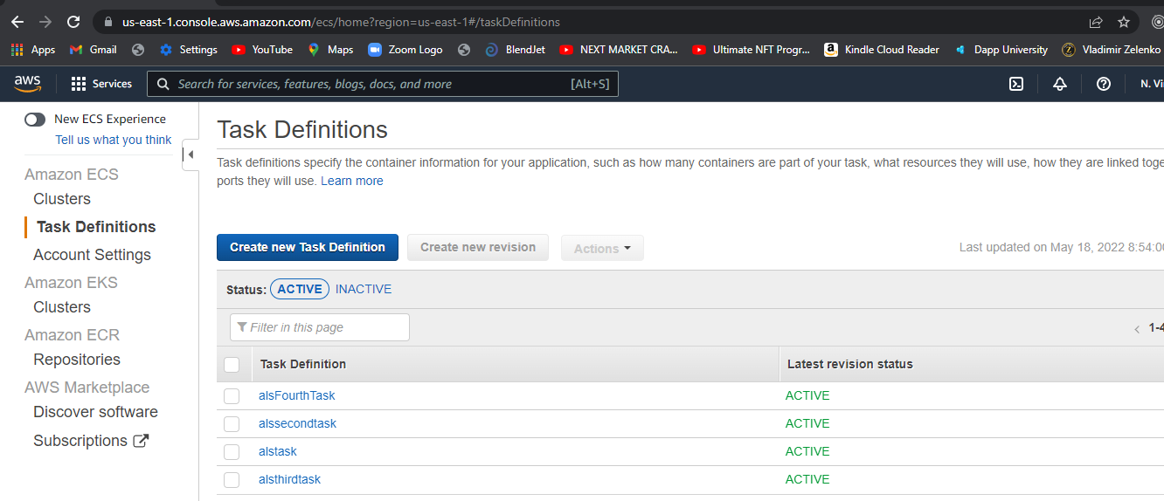
When that is up – create a task

Slide 48
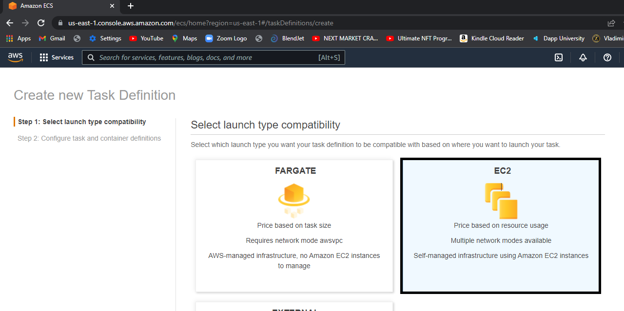
Create a task definition

Slide 49
Give it (your task) an arbitrary name
But most importantly make sure that you give it enough memory
100
1 vCPU

Slide 50
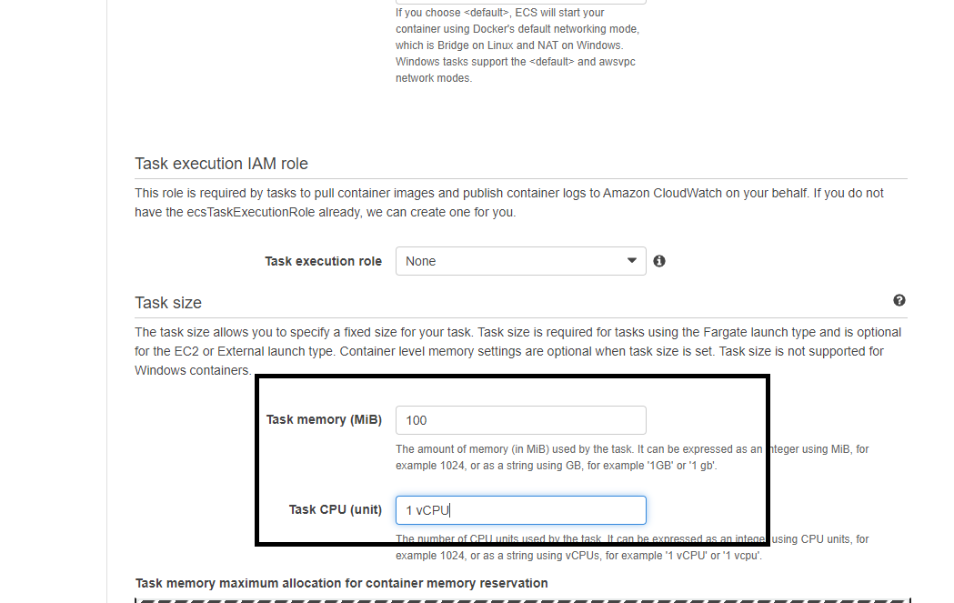

Slide 51
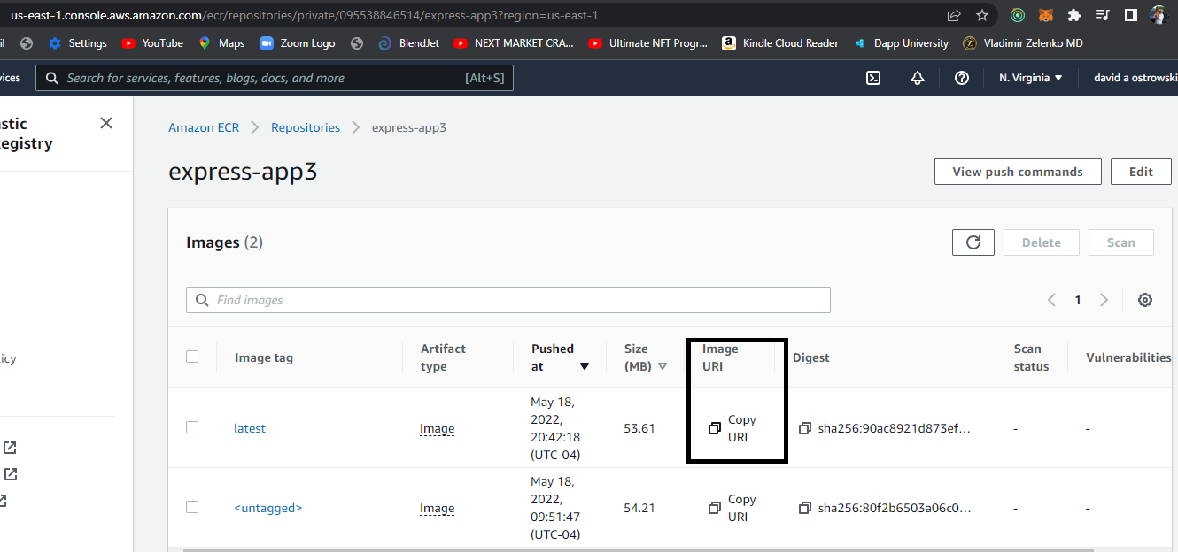

Slide 52
Build the task
Add the container
Add the image to your container

Slide 53
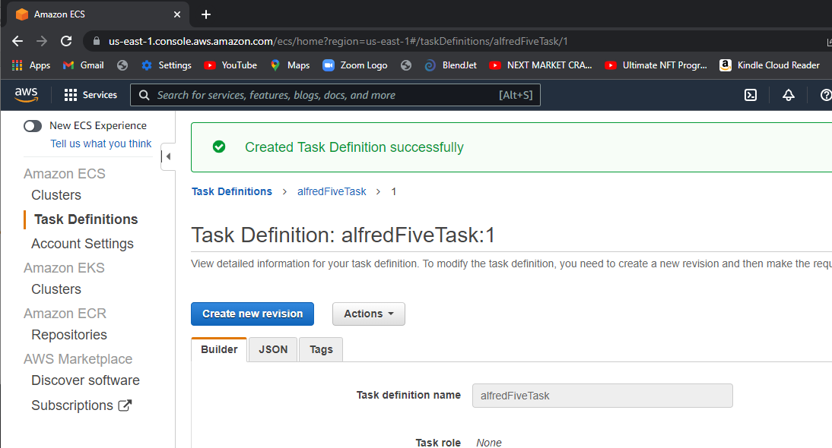

Slide 54
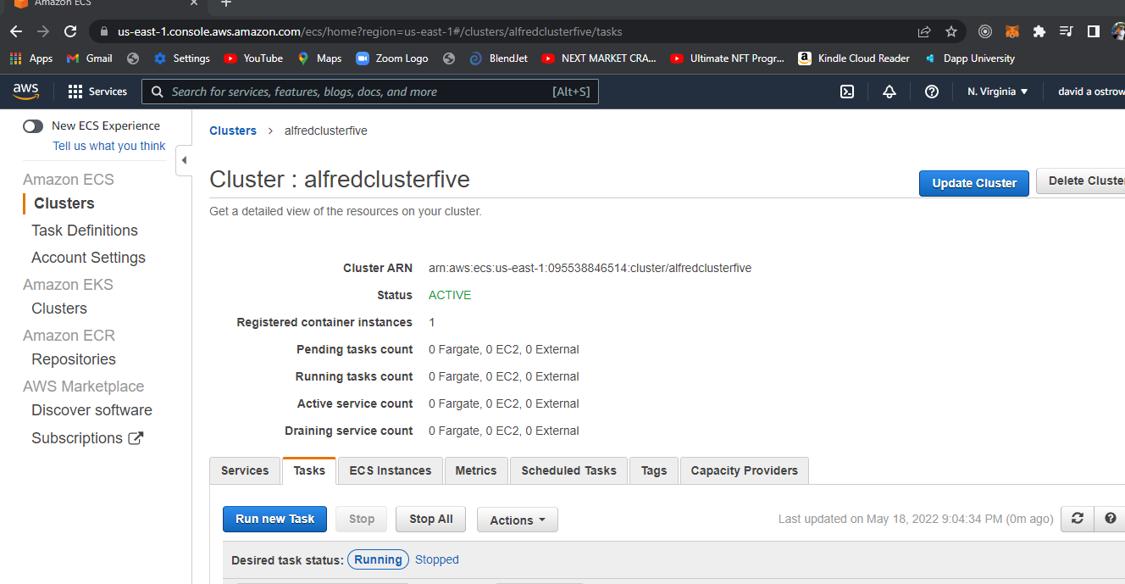

Slide 55
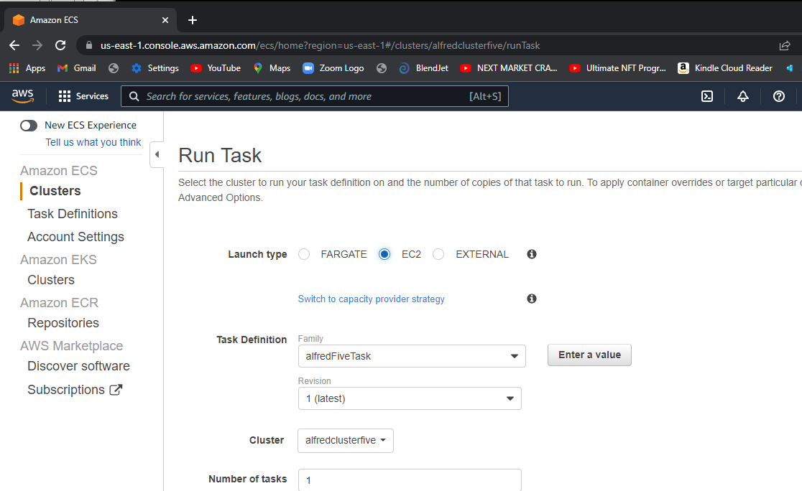
You created a task - now run it from the
Cluster it should show in the drop down
To be picked – run it on ec2

Slide 56
NOTE:
In the container you need to pick ec2
T2.micro for you instance
Also for the task – you need to pick the outside ,inside IP statement

Slide 57
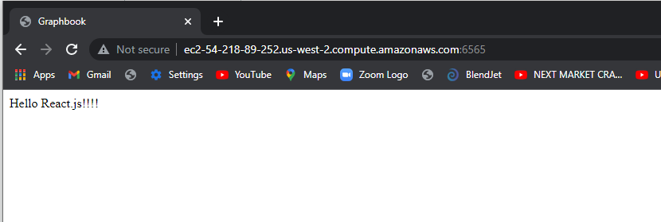
I got the docker -> repository-> cluster-> task def-> task run
BUT: I had to embed the public domain in my webpack.client.config file –so it is not transferrable among clusters and will have to be changed. (this had to be transferred to include the

